Slide 1
GOMOKU

Slide 2
Hello!
We are Team 4
LiKaiXin
Abduvosit
Shou hangtao

Slide 3
What is Gomoku?
1
Gomoku - Five in a Row

Slide 4
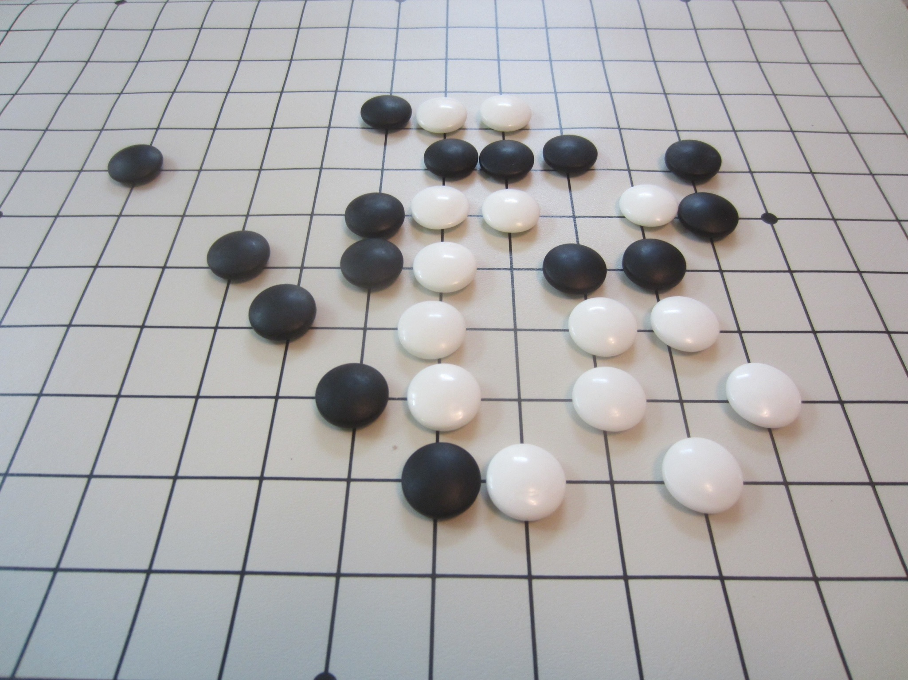

Slide 5
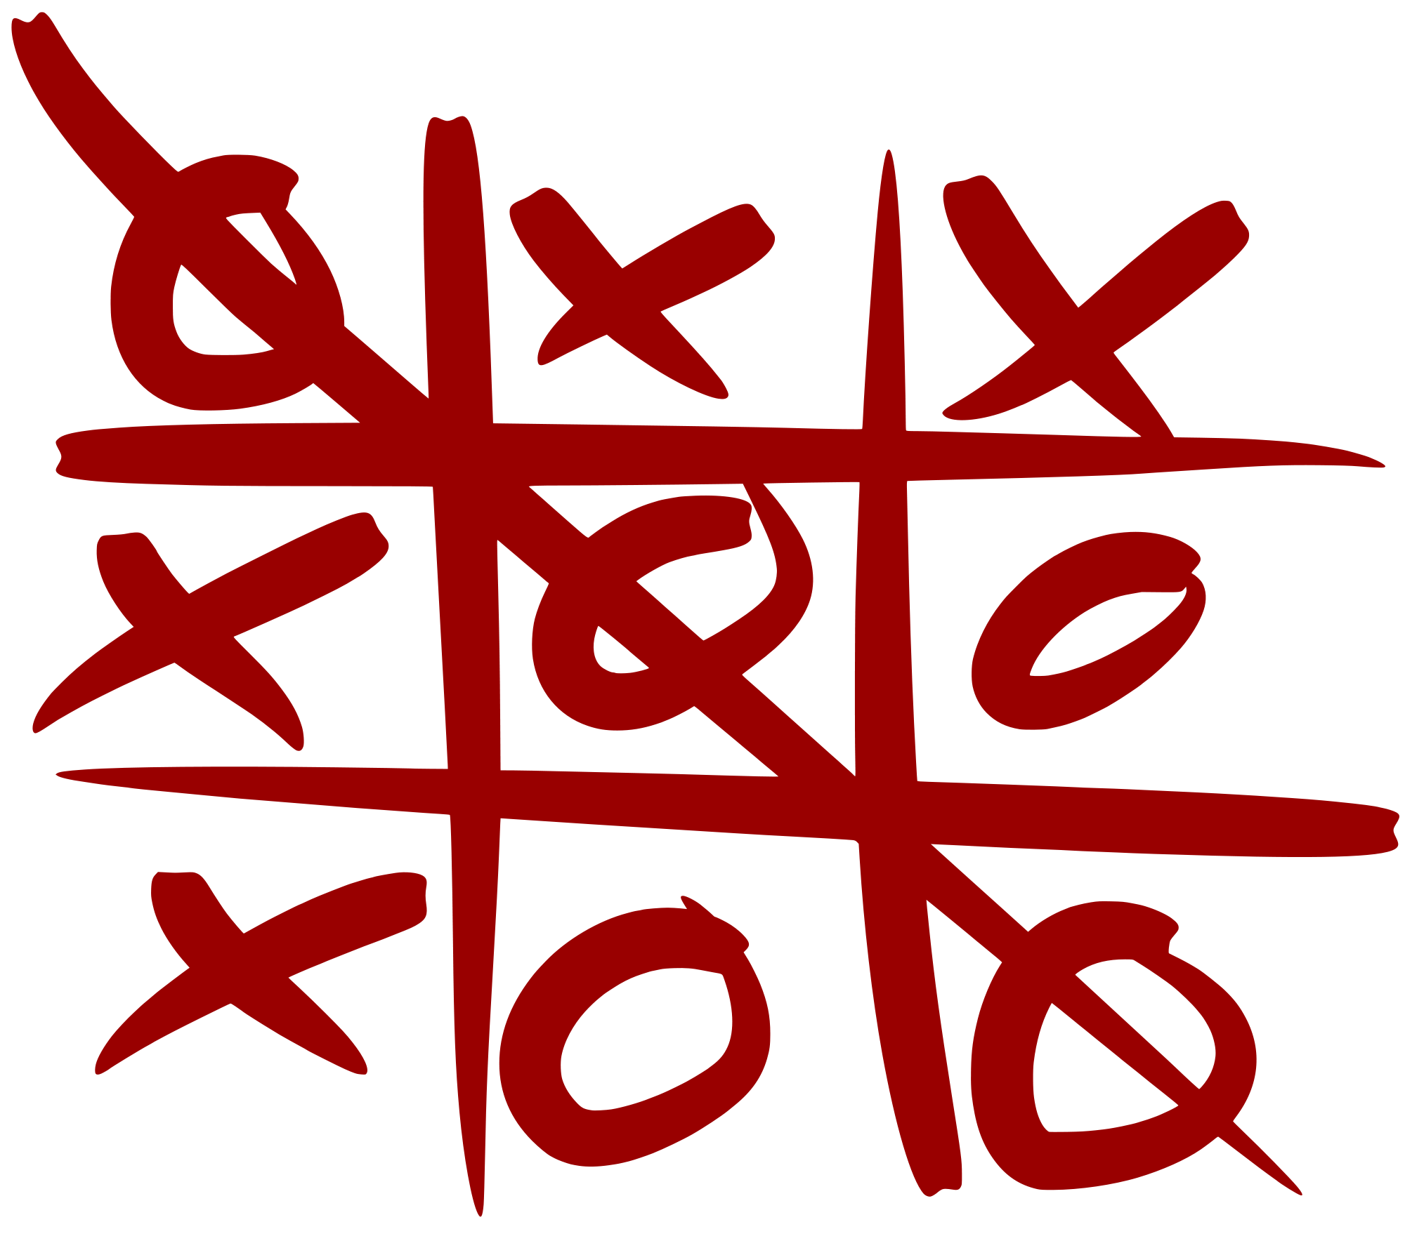
How to play it?
Its similar to Tic Tac Toe
But five in a row to win
And inside 15x15 grid

Slide 6
What if you can play it in terminal?

Slide 7
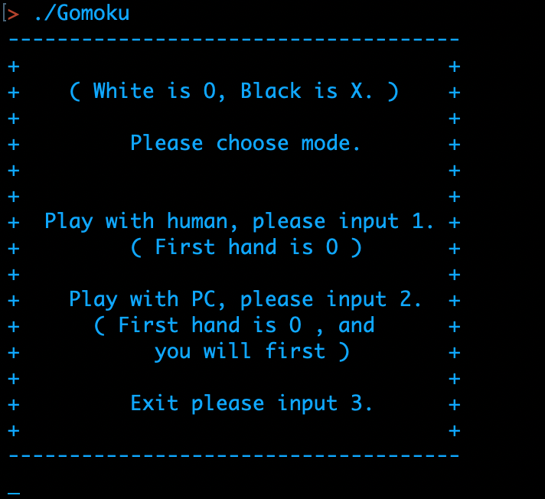

Slide 8
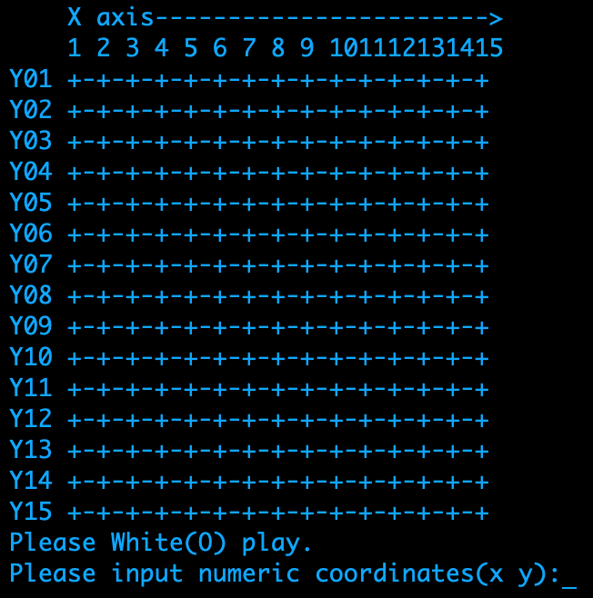

Slide 9
There are two modes
Human vs Human
Gomoku
Human vs Computer

Slide 10
How to play it in terminal?
Choose mode
Human vs Human
Human vs Computer
Type coordinates of X and Y

Slide 11
Our process is easy
Run Gomoku
Choose mode
Play

Slide 12

Place your screenshot here
Desktop look

Slide 13
Thanks!
Any questions?

