Slide 1
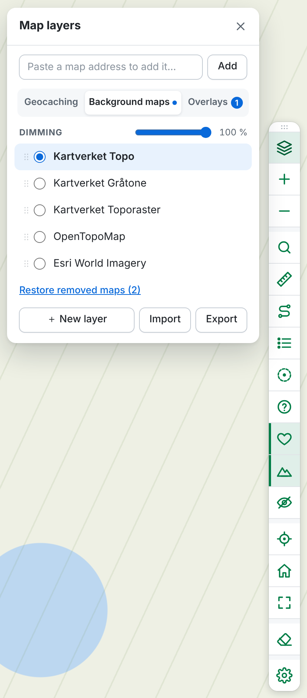
Geocaching Map –
Custom Tile Layers
Your own maps and handy tools right in the geocaching.com maps
Userscript · version 1.53.0 · English and Norwegian
Notes:
This userscript turns the geocaching.com maps into a flexible map workbench: your own background maps and overlays, place search, coordinates, measuring, projecting and 161 m circles – gathered in one toolbar.

Slide 2






Everything you need on the map, in one toolbar
Any map
Kartverket, OpenStreetMap, aerial photos – or your own XYZ, WMTS, WMS and ArcGIS services
Place search
Place names and addresses from Kartverket, places abroad and coordinates – in one list
Coordinates and projecting
DMM, DD, DMS and UTM (32, 33, 35), projecting, and measuring distance and bearing
161 m circles
Around traditional and solved caches and visible physical stages – with clickable marks
Home, location, Street View
Go home or to your location, and open Street View from the right-click menu
New: routes for your GPS
Pick caches and pins from a list or on the map, preview and download as a GPX route
Notes:
Six main areas. The site's own zoom, location and map buttons are folded into the same toolbar, so there are no duplicate buttons.

Slide 3










One toolbar instead of many buttons
Map layers
Choose background map and overlays
D/T
Difficulty/terrain below the caches – on/off
Find a place
Shortcut: press / on the map
Hide geocaches
A clean map – click again to show them
Measure
Distance and bearing between points
My location
With an accuracy circle
Route
Build a route and download it as GPX
Home
Right-click to change the address
Geocaches on the map
A list that follows the map (/map)
Fullscreen
The map fills the whole screen
161 m circles
Where something is placed – from zoom 15
Clear drawings
Marks, measurements and circles
Marks
Solved caches, also without circles
Settings
Position, language and the site's buttons
Favourite points
♥ and the count above the caches – on/off
Notes:
The toolbar can sit on the right (default), left, top or bottom, in one or two rows. Choose in Settings, or drag it by its handle to another edge. It keeps clear of the site's search panel and moves below buttons such as “Create Route” when needed. The layer panel and the dialogs open beside the toolbar, and the site's own zoom buttons are always hidden.

Slide 4




Choose maps and overlays
Three tabs
Geocaching.com's own maps, background maps and overlays – each on its own, so the list stays short
Background and overlays
Kartverket, OpenTopoMap, OpenStreetMap and Esri – plus your own. As many overlays as you like
Fading towards white
The background can be faded by up to 50 %, so the caches stand out
Your order
Drag the maps up and down. The overlay at the top of the list is drawn on top
Tidy the list
Remove maps you don't use – also geocaching.com's own – and bring them back whenever you like
Notes:
The chosen map is marked in blue, and the tabs show where the background map and the overlays in use are. Change the order by dragging the handle on the left of the row, or with the arrow keys. The background map is always drawn fully opaque, so the geocaching.com map never shows through. The cache icons are always on top.

Slide 5
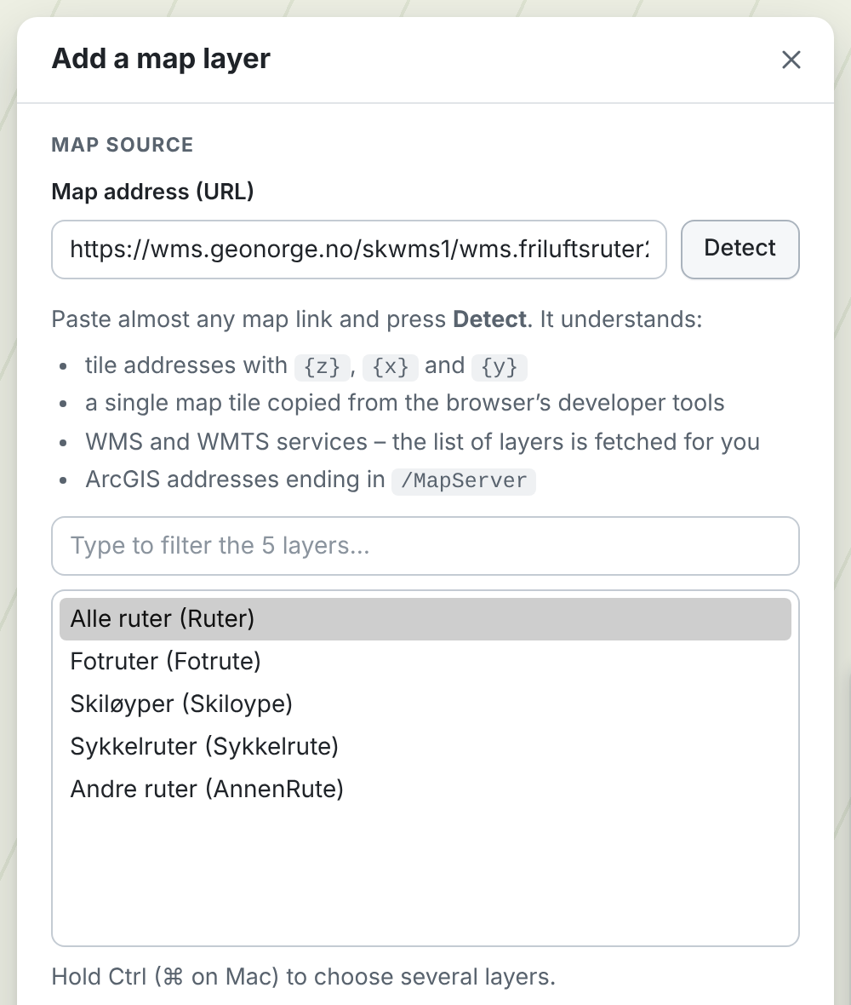
Add your own maps
Paste almost any map link and press Detect:
XYZ / TMS
Tile addresses with {z} {x} {y}
WMTS
The list of layers is fetched automatically
WMS
Pick one or more layers
ArcGIS
Addresses ending in /MapServer
Preview on the map before you save
Import and export your layers as a file
A single map tile from the developer tools is enough
Notes:
The layer editor recognises the address and fetches the list of layers from WMS and WMTS services. Only services in Web Mercator can be shown, as the geocaching.com map uses that projection.

Slide 6
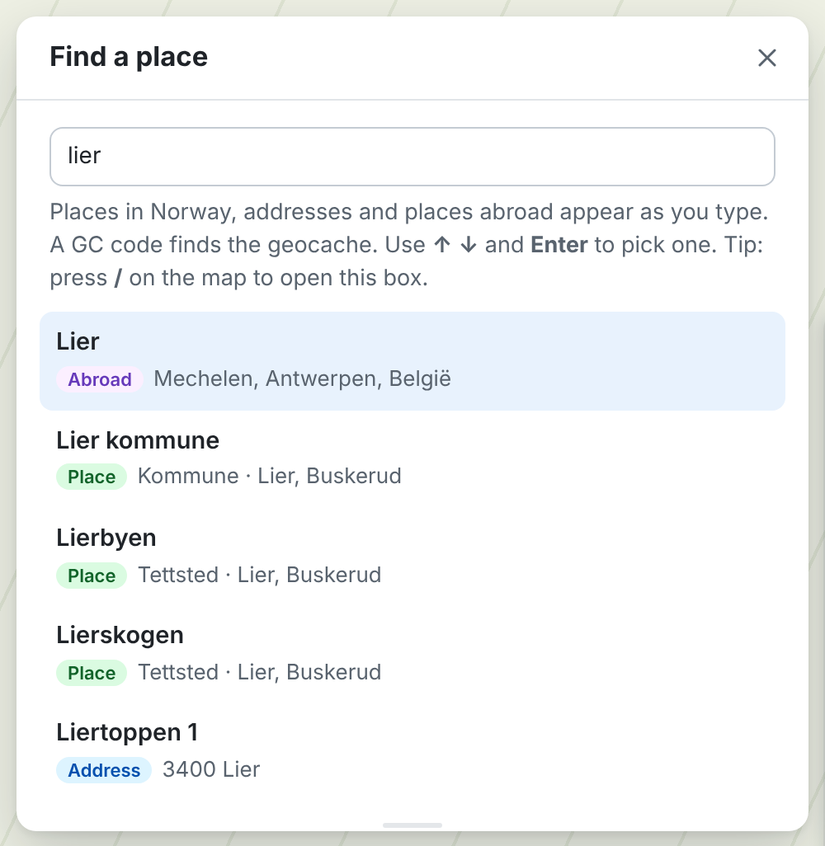

Find places, addresses and coordinates
One combined list
Hits appear as you type, best match first – whatever the source
Places, addresses and abroad
Kartverket's place names and addresses, and places abroad via Photon (OpenStreetMap)
Coordinates
Type DMM, DD, DMS or UTM – the script recognises them
Home address
The same search box is used to save your home address
Notes:
Use the arrow keys and Enter to pick one. The map zooms to a level that suits the hit: county, municipality, town or address.

Slide 7
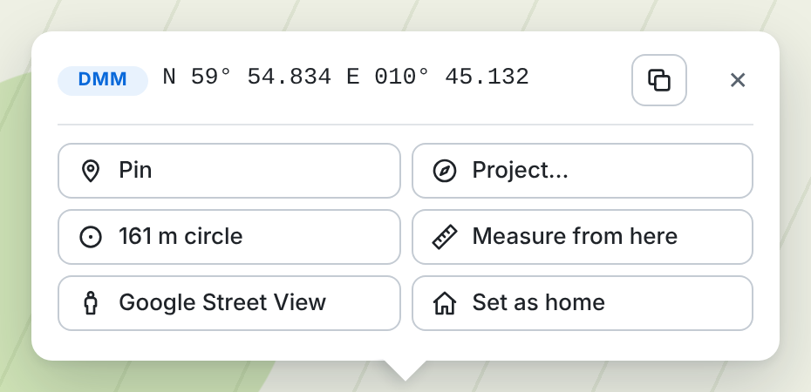
Coordinates in every format
Format | Example (Oslo)
DMM | N 59° 54.834 E 010° 45.132
DD | 59.913900, 10.752200
DMS | N 59° 54' 50.0" E 10° 45' 07.9"
UTM | 32V 597980E 6643119N
UTM 33 | 33V 262560E 6649444N
Right-click the map: one coordinate line that opens in DMM. Click the line to switch format, and copy with one click. The Google Street View button opens Street View at the spot. The zoom level is at the bottom – type a number to zoom.
UTM 32, 33 and 35 with a fixed zone, as Norwegian maps use. Accurate to about a millimetre (Krüger series).
Notes:
The coordinates under the mouse are also shown at the bottom right. Click the display to switch format; the choice is remembered.

Slide 8
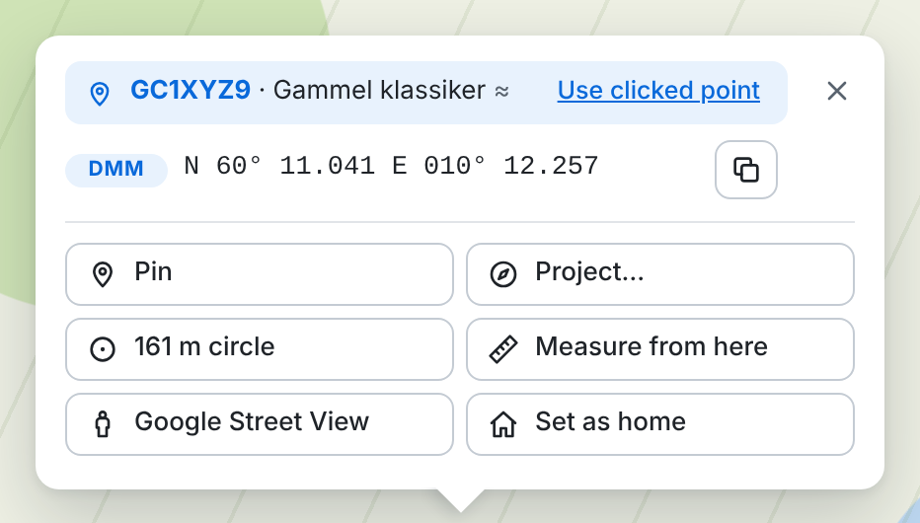
Right-click a cache – straight to its coordinates
Snaps to the cache
Right-click on or right next to a geocache, and the popup uses the cache's coordinates
GC code, name and ♥
Favourite points are shown; click the GC code to open the cache page
All tools come along
Pin, projecting, measuring and the 161 m circle start from the cache
Use the clicked spot
One click switches to the exact spot you clicked
Exact coordinates from geocaching.com's cache search – also on /map. Only before the search has answered is the position worked out from the icon (≈).
Notes:
The popup snaps when you right-click within about 12 pixels of the cache – the size of the icon. Right-click further away and you get the clicked spot as before.

Slide 9
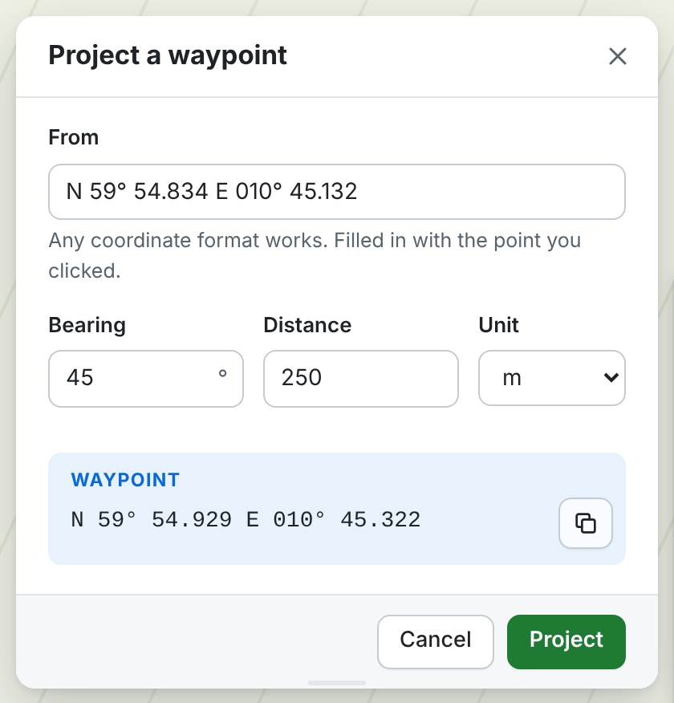

Project waypoints and measure distances
Project from a point
The start point is filled in for you. Type bearing and distance in m, km or ft
See the result at once
The waypoint shows as you type, with a dashed line on the map and a copy button
Measure distance and bearing
Click points on the map – total length and the last leg are shown
Good enough for geocaching
The error is well below a metre at ordinary distances
Notes:
Enter or Project places the point with a pin, a line and a label with bearing and distance. Cancel removes the preview.

Slide 10
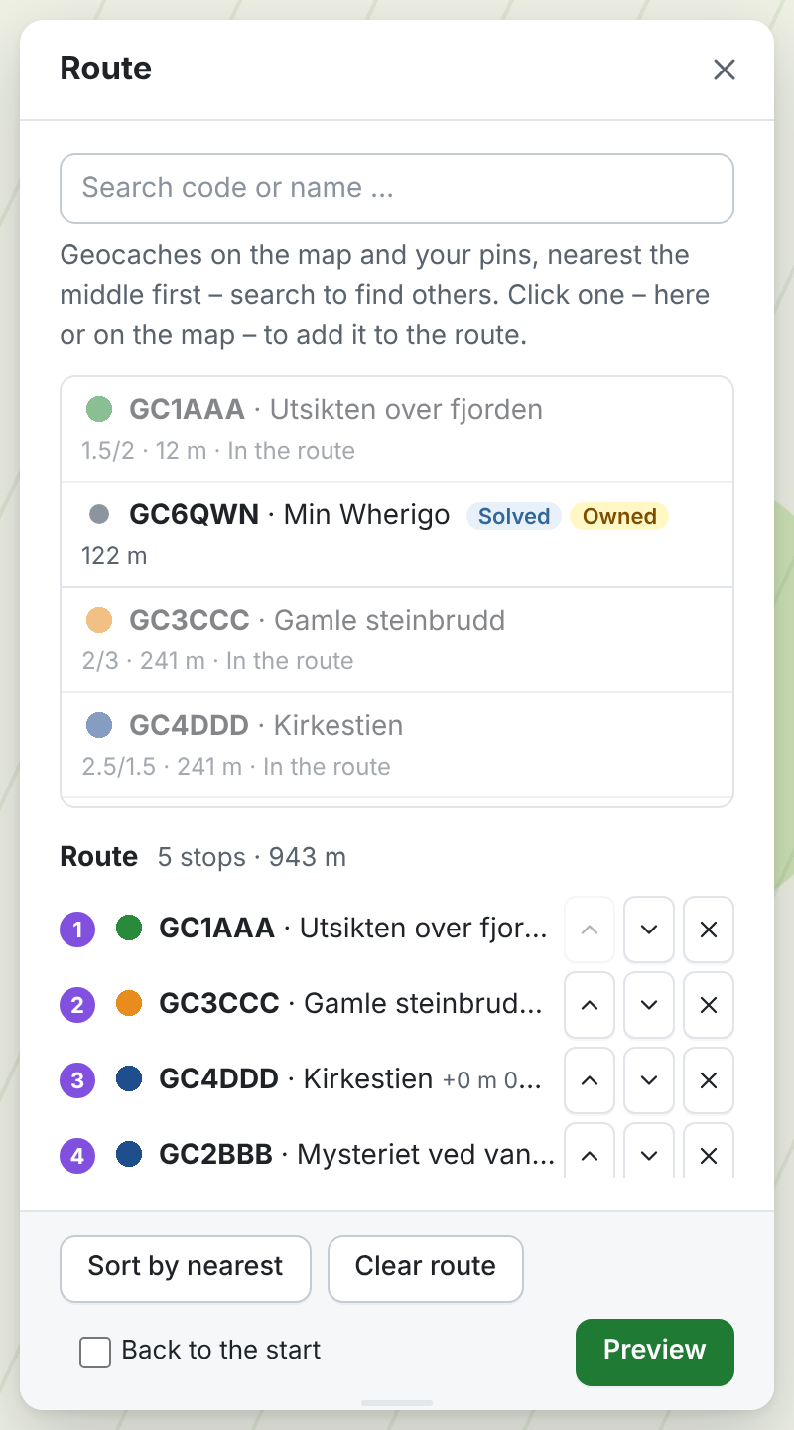

New: build a route and take it with you on your GPS
Searchable list
Nearby geocaches and pins – and any GC code worldwide
Pick on the map
Click caches and pins while the route window is open, or use the right-click popup
Order and round trip
Move stops, sort by nearest, see every leg – and end at the start
Preview and download
GPX with Garmin symbols – optionally with full cache data (paperless caches)
Notes:
The route window opens with the route button in the toolbar. The preview shows exactly what the GPX file contains: name in the GPS, description, coordinates and legs. Caches get Garmin's Geocache symbol (Geocache Found when found), pins the blue pin.

Slide 11
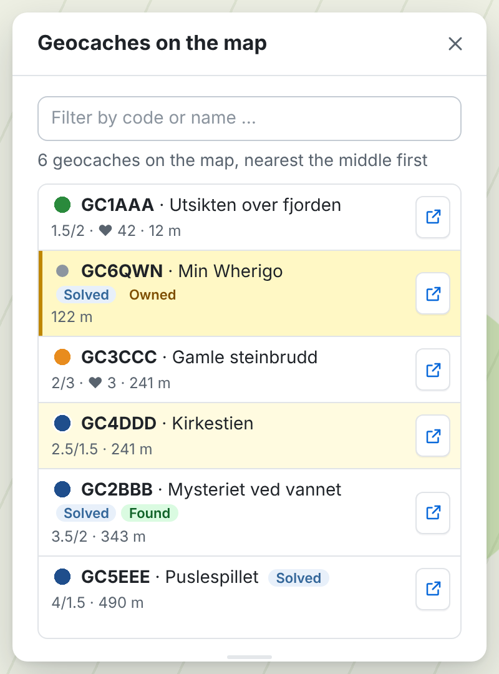

New: the geocaches on the map in a list
Follows the map
The geocaches on the map you see, nearest the middle first – with Solved, Found, Owned, D/T and ♥
Point and find
Point at a cache on the map and it is highlighted in the list. Filter by code or name
Zoom with a glow
Click to zoom all the way in – the cache glows on the map. Click again to go back
The cache page
The button on the line opens the cache page in a new tab
Notes:
The cache list is on /map; /play/map has a list of its own. The list and the route window sit at the top right or left of the map (Settings), clear of the site's side panel, and the two buttons switch between them.

Slide 12
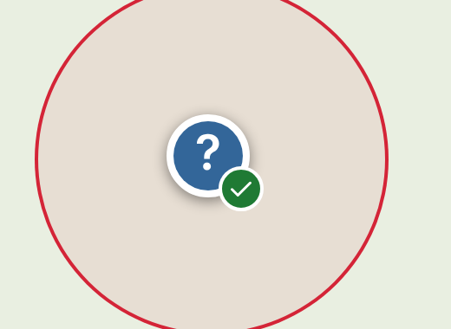
161 m circles where something is placed
Traditional caches
At their exact posted coordinates
Solved caches
At your corrected coordinates – also when the icon has moved back after a find
Physical stages and finals
Visible stages of multis, mysteries, Wherigos and letterboxes, read from the cache page
Where no cache icon shows the spot, a clickable mark sits in the middle of the circle. Hovering over a solved cache shows “Final location”; right-click gives the exact coordinates.
Single circle
Right-click anywhere and choose 161 m circle
Notes:
The circles show from zoom level 15. The cache types, the exact coordinates and your solved coordinates come from geocaching.com's own cache search. Physical stages are read from the list of additional waypoints on the cache page – only those the owner has made visible. Blue mark with a question mark and a green tick: a solved cache you have found. Small blue dot: physical stage. Small green dot: final location. Your own caches, which the cache search leaves out, are read from the cache pages; there the site's icon and popup are kept, but the hover text becomes “Final location”.

Slide 13
161 m circles, cache pages and home
161 m circles
Cache pages
Home
Where something is placed – see the previous slide
Shown from zoom level 15
Follow the map and never block clicks
Single circle: right-click
The small map shows your chosen map
Same fading and overlays
Keeps the site's view
Never changes your choice
One click takes you home
The first time you look up the address
Stored only in your browser
Notes:
161 m is the minimum distance between caches in the guidelines. On /map the script finds the positions from a hidden grid the site loads; on /play/map the exact positions are used.

Slide 14
How the map layers are stacked
ABOVE THE MAP TILES
Controls
controls · 1000
the toolbar, the layer panel, the coordinate display and the credits
Popups
popupPane · 700
the right-click popup and other map popups
Markers
markerPane · 600
the cache icons on /play/map, pins, labels and your location
Drawings
overlayPane · 400
161 m circles, measuring lines, projection lines and the accuracy circle
THE MAP TILES (TILEPANE · 200) – SORTED BY Z-INDEX
The site's other tiles
z = bz + 10
the cache icons on /map – always lifted above your layers
Preview
z = bz + 3
the layer you are trying in the layer editor
Your overlays
z = bz + 2
hiking routes, property boundaries, hillshade – their own opacity slider
Your background map
z = bz + 1
fully opaque – faded towards white with a colour filter, at most 50 %
The geocaching.com map
z = bz
the site's background – covered by your map, faded when it is chosen itself
bz = the z-index of the site's background. On /play/map the site's background is a vector map (WebGL). On /map an invisible cache grid (UTFGrid) is loaded as well, used for the 161 m circles and for snapping the right-click popup to caches.
Notes:
The browser draws Leaflet's controls on top, then the popups, markers and drawings, and the map tiles at the bottom. Among the tiles the script sorts by z-index: the site's background at the bottom, then your background map, the overlays and the preview, and on top the site's other tiles – on /map those are the cache icons. The site's background is found from the site's layer switcher, otherwise as the lowest tile layer. The dialogs sit outside the map, attached to the page, so the side panel doesn't cover them.

Slide 15
Under the hood
Never removes the site's layers
The script slots its own layers in between, sorted by z-index
Finds the map by itself
Catches Leaflet as the page loads, also on /play/map and the cache pages
No seams between the tiles
Tiles are drawn 1 pixel larger, also at 110 and 125 % display scaling
Leaves the form alone
No button can submit the page's ASP.NET form, so the page never reloads
Fading without show-through
A colour filter bleaches the map towards white – the site's map never shows through
Built-in troubleshooting
gcctReport(), gcctCacheDebug(), gcctStageTest() and gcctSnapTest() in the console give short reports without personal data
Notes:
The script starts before the page and catches Leaflet the moment the page defines it. Its own errors never reach the site's code.

Slide 16
Get started in three minutes
1
2
3
Install a userscript manager
Tampermonkey or Violentmonkey in Chrome, Edge, Firefox or Safari
Add the script
Open geocaching-custom-tiles.user.js and save it in the manager
Open a map
geocaching.com/map or /play/map – the toolbar appears on the right
Privacy
The script collects and sends no personal data and has no server of its own. It only contacts the map servers you switch on, Kartverket and Photon when you search, and geocaching.com's own cache search and cache pages when the 161 m circles are on. Your location is only requested when you ask for it. All settings are stored in the browser.
Notes:
The script needs no special permissions (@grant none). The settings are shared between the map pages and the cache pages.

Slide 17
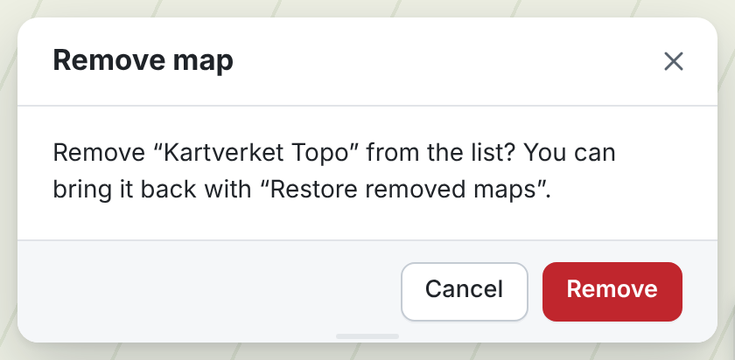
Better maps for
better trips
User guides in English and Norwegian are included. Use gcctReport() in the browser console if something doesn't work.
Notes:
Thank you for your attention. Questions?

