Slide 1
FAANG STOCK ANALYSIS
Kristin Nwadike

Slide 2
ABOUT THE DATA SET
The S&P 500 dataset for 2013-2018 contains information on the daily stock prices of the top 500 publicly traded companies in the United States, as represented by the S&P 500 index. Today’s analysis will be over the top five tech companies or FAANG companies. For each day within the six-year period, the dataset includes the following variables for each of the 500 companies:
High: the highest price the stock reached during the day
Low: the lowest price the stock reached during the day
Open: the opening price of the stock at the start of trading
Close: the closing price of the stock at the end of trading
Volume: the number of shares that were traded during the day

Slide 3
OUR QUESTIONS
1
?
2
What are the patterns and correlation in terms of price movements and time for the S&P 500 index?
What is the general trend of the FAANG stocks in the S&P 500? What is the estimated forecast for next year?

Slide 4
Data Manipulations
The analysis used the average close value for all 500 stocks in the S&P 500 index to assess overall trends in the market
The analysis focused specifically on six high-performing stocks which were then used to forecast future performance, using the predictive modeling.
Based trend of the average close price of 6 stocks from years 2013 to 2017, data of these stocks in Years 2018 and 2019 was forecasted. These stocks were selected based off their YoY changes, and relative growth in the S&P 500 before working with the data.

Slide 5
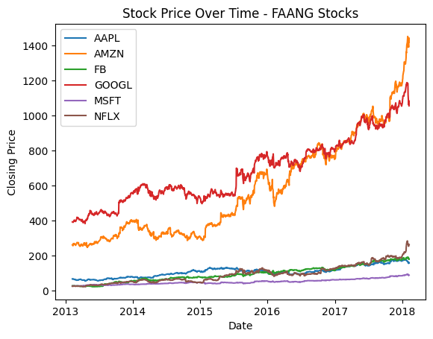
Results
*Using Python*
Notes:
Purpose of graph: to look for general across several stocks over a period of time. To look for any signals of seasonality over a period of time. Identify characteristics amongst different stocks with SP 500

Slide 6
Results
*Using Excel*

Slide 7
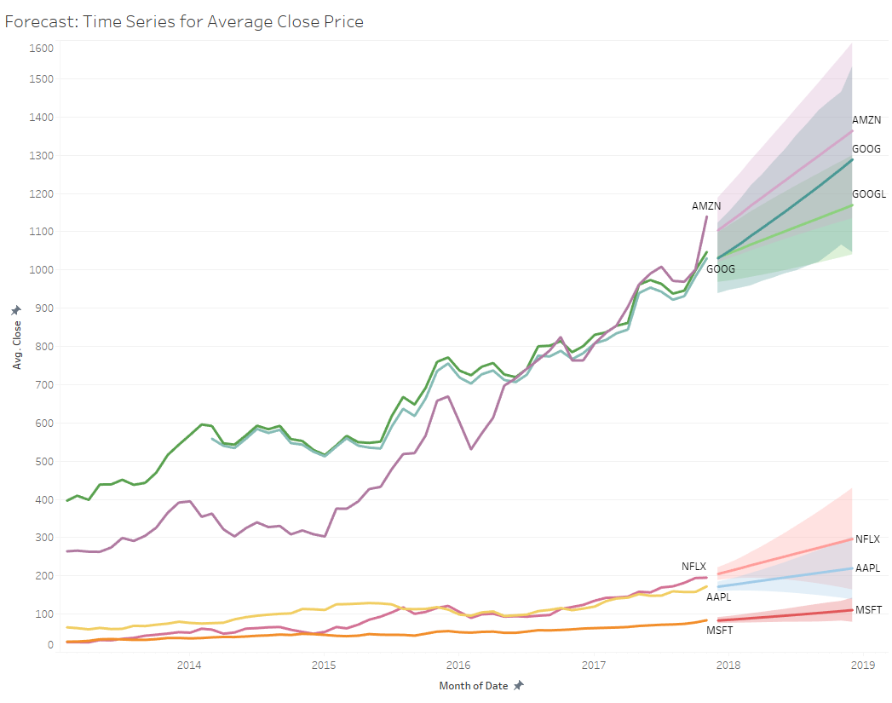
Results
*Using Tableau*

Slide 8
Conclusion
The findings of the analysis suggest that the S&P 500 index may be a good indicator of the overall health of the US stock market​.
It is important to note that past performance is not necessarily indicative of future results, and that any investment carries risk. Forecasting also does not consider potential global economic issues that could invariably change individual and industry wide performance (COVID-19 pandemic).
Investors should be aware of bias based on Prospect Theory when making financial decisions and should seek to balance potential gains and losses based on their individual risk tolerance and investment goals.

