Slide 1

“American Werewolves in america”
Team progressbar
Dave kingsley, Erin lampa, justin miller, ricky ravin, & Katie wright

Slide 2

Motivation and summary
Popular culture has tales of people turning into werewolves during full moons, wreaking havoc on cities through the night
This led us to ask if there is a noticeable change in crime on days when there is a full moon?
Our alternate hypothesis (H_{a}) is, “if werewolves exist, then average crime will be significantly higher during a full moon”.
Our null hypothesis (H₀) is, “if werewolves don’t exist, then there will be no significant change in average crime during a full moon”.
Our question to ask is “Is there a increase in crime during full moons?”
Looking at 5 major cities in the United States, there is no significant increase (or decrease) in crime when the moon is full or near full.

Slide 3

Question & data
“Is there a increase in crime during full moons?”
To determine an increase in crime during full moons, we need the total number of crime reports for each day in the period between 1/1/2015 and 12/31/2017 and a chart of moon illumination by date for the same period.
We found crime data on 5 cities: Denver, CO; Minneapolis, MN; New York City, NY; Portland, OR; and San Francisco, CA. This data was found from the individual city governments’ websites.
We compiled the moon data from The United States Naval Observatory’s website.

Slide 4
Data Cleanup & Exploration
Each city’s data provided unique challenges, but all the data originated from comma-separated values (csv) files.
Data munging was performed in Jupyter Notebooks.
The munging process included:
Removing unnecessary columns
Changing date formats
Removing cells with blank data
Calculating total daily crime and average daily crime

Slide 5
Data Cleanup & Exploration Continued:
Exploration Pros:
Crime databases were user friendly
Csv files were readily available to download
Csv files were complete, well organized and had a generally consistency in formatting across cities
That said, the data wasn’t perfect, and we had to abandon a city early on because it was missing a significant amount of dates. In addition, some of the data was in multiple csv’s and we had to append the data.
Exploration Challenges:
Determining how to categorize the data.
The Moon’s illumination cycle is not linear requiring us to divided the frequency of illumination percentages into 10 groups (deciles) to determine the bins to use.
Determining the best way to visualize the data.
Performing statistical testing on the data and interpreting the result.

Slide 6
Data Analysis
Calculated the total number of crimes for each calendar day in the date range.
Grouped the dates by corresponding percent illumination.
Calculated the average total daily crimes for each group.
Plotted the average total daily crimes per group to determine if there were more crimes when the moon was full or nearly full (97-100%).

Slide 7
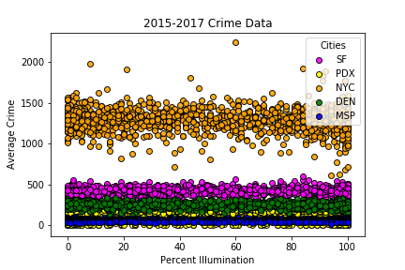
Visualizations & Discussion
Notes:
Take-aways here:
Average crime is relatively consistent throughout the moon cycle.
New York City has higher overall average crime than the other cities in this analysis.
Portland and Minneapolis have relatively equivalent average crime.
These differences in average crime are related to population size.
MSP = ~422K
PDX = ~648K
DEN = ~705K
SF = ~884K
NYC = ~8.62 million

Slide 8
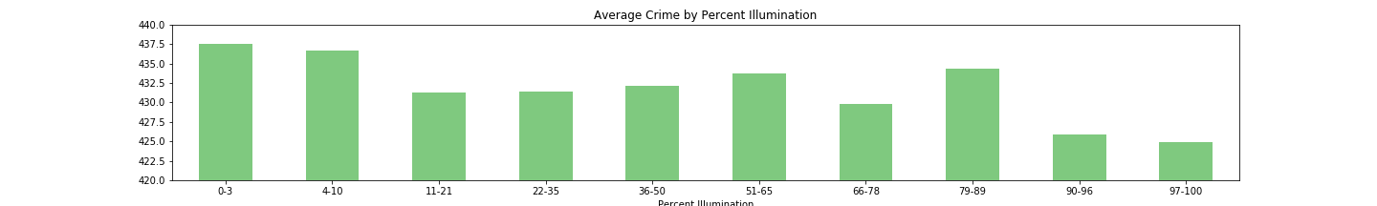
Notes:
Take-aways here:
Average crime is not higher during the full moon.
It was conjectured at the start of this project that the relationship between crime and full moon might be inversely proportional due to increased darkness during new moon phases, this appears to be true.
Overall there is not much change in average crime across a moon cycle.

Slide 9
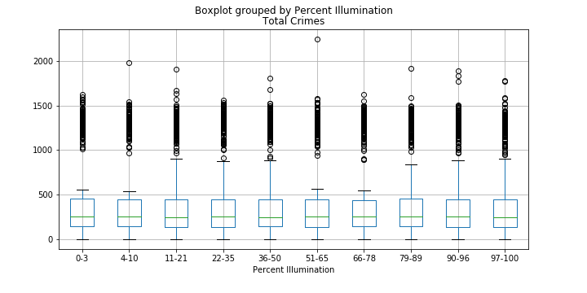
Notes:
Take-aways here:
The box plots are comparatively short suggesting that an overall agreement between percent illumination ranges.
The box plots are also all in line with one another, no one is higher than the rest indicating an overall consistency in total crime median across percent illumination ranges.
The sections of ~ half of the box plots are equal while the 6 at 11-21, 22-35, 36-50, 79-89, 90-96, 97-100 have long upper whiskers indicating that total crime is more varied during those percent illumination ranges.
Dots above (or below) represent outliers that are >1.5 times the upper quartile

Slide 10
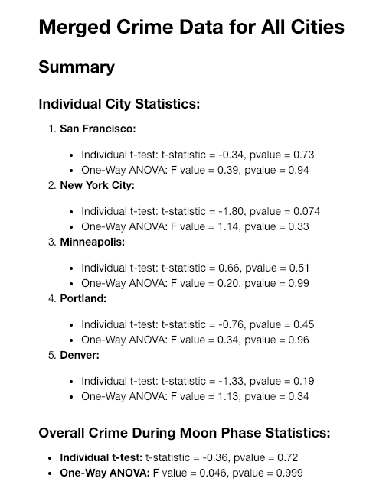
Statistical Analysis
p-values are all >0.05, indicating acceptance of the null hypothesis (H_{o} ).
t-statistics are all between -2 and 2, also indicating that our H_{o} is likely true.
Relatively low F values indicate that for majority of the cities, total crime distribution is not far from the mean.
All results indicate that there is not much variance from the mean and the probability of observing significant variance from the mean is low.
The bottom line here is: we have failed to reject our H_{o}.

Slide 11
Post Mortem
Difficulties we experienced:
Open source API’s with large, complete and reliable data sets
Complete crime data was not as easy to find during our date range as initially expected.
Additional questions worth asking:

Slide 12
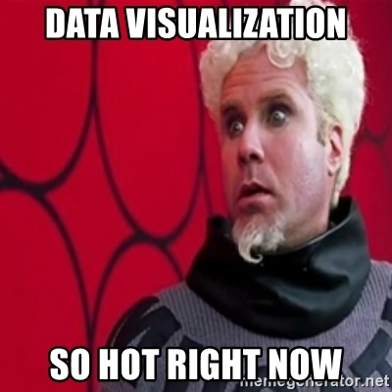
Questions?

Slide 13
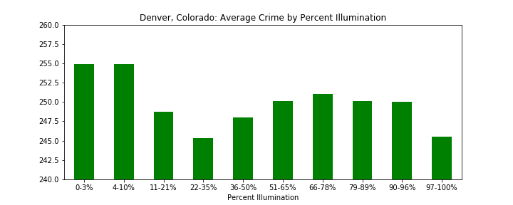
Appendix: Additional Visualizations for EA. City

Slide 14
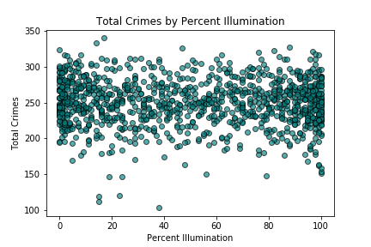
Denver, Colorado Total Crimes by Percent Illumination

Slide 15
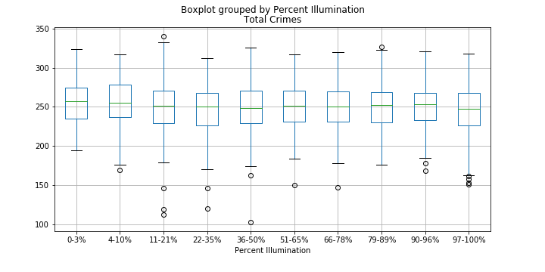
Denver, Colorado Box Plot

Slide 16
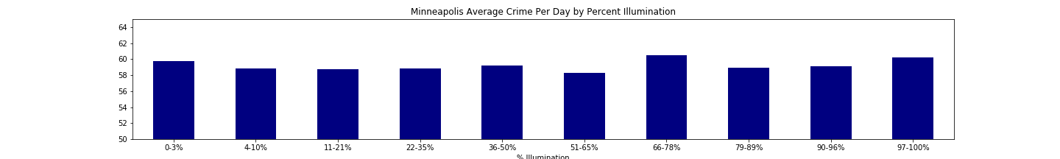

Slide 17
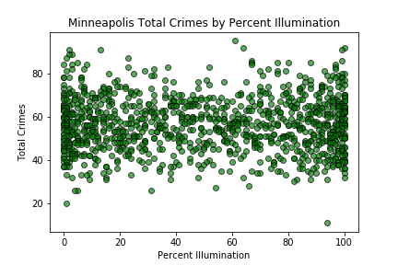

Slide 18
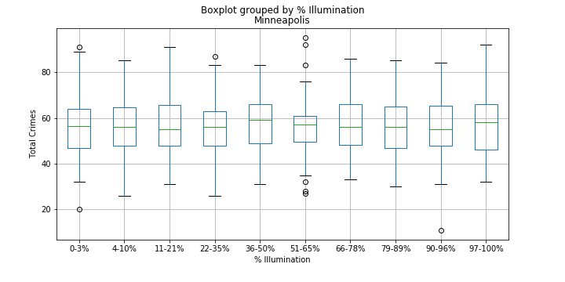

Slide 19
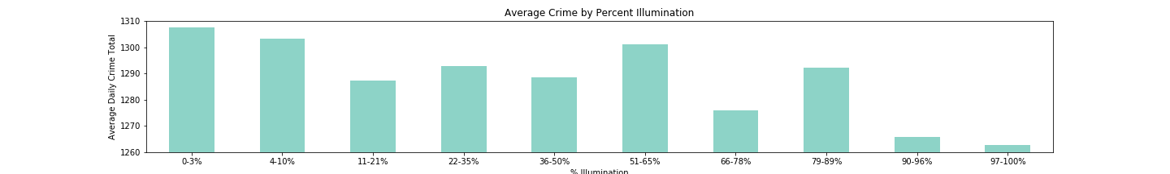
New York City Average Crime by Percent Illumination

Slide 20
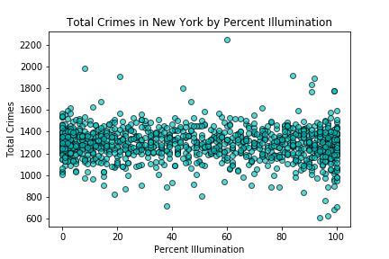

Slide 21
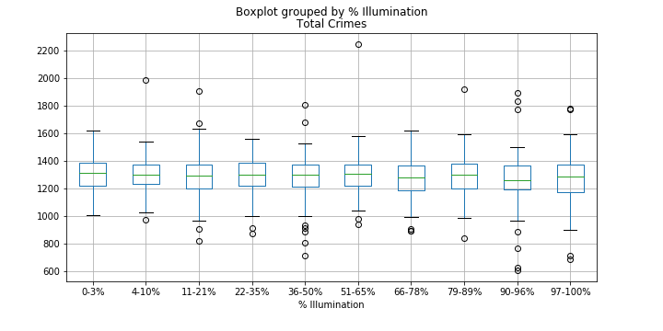
New York City Boxplot

Slide 22
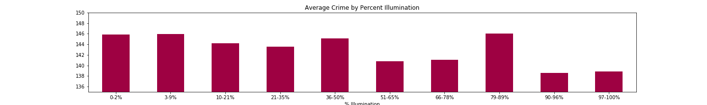
Portland, OR Average Crime by Percent Illumination

Slide 23
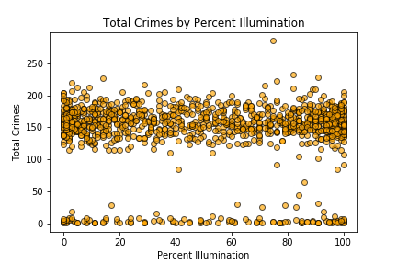
Portland, Or Total Crimes by percent illumination

Slide 24
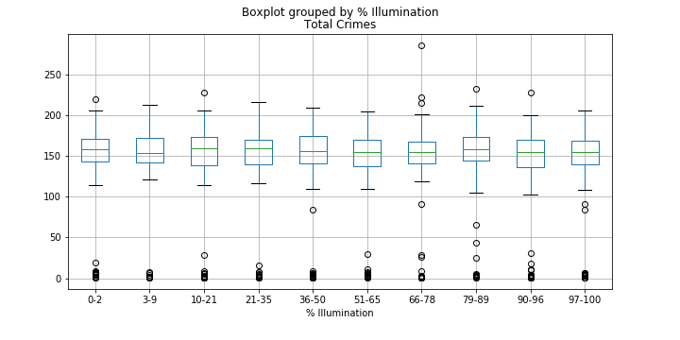
Portland, OR Boxplot

Slide 25
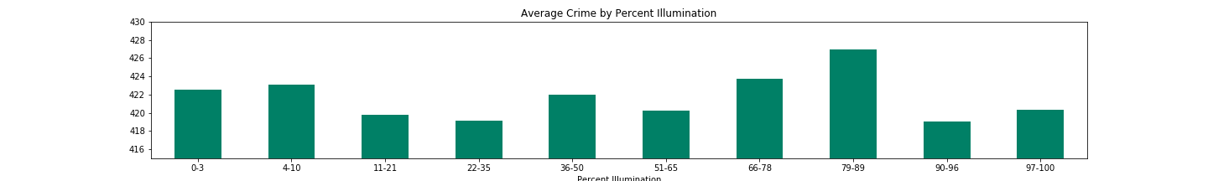
San Francisco Average Crime by percent illumination

Slide 26
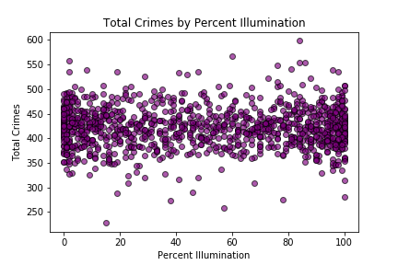
San Francisco Total Crimes by Percent illumination

Slide 27
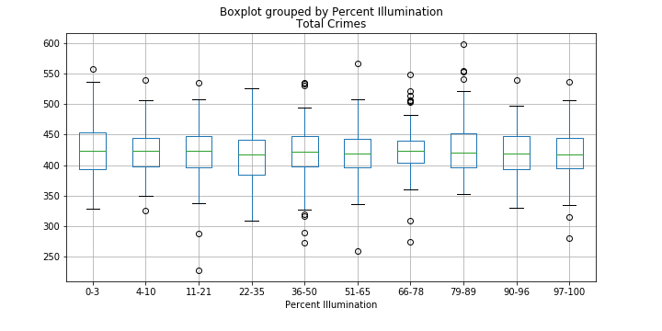
San Francisco Boxplot

