Slide 1
“American Werewolves in america”
Team progressbar
Dave kingsley, Erin lampa, justin miller, ricky ravin, & Katie wright

Slide 2
Motivation and summary
Popular culture has tales of people turning into werewolves during full moons, wreaking havoc on cities through the night.
This led us to ask if there is a noticeable change in crime on days when there is a full moon?
Our alternate hypothesis (H_{a}) is, “if werewolves exist, then average crime will be significantly higher during a full moon”.
Our null hypothesis (H₀) is, “if werewolves don’t exist, then there will be no significant change in average crime during a full moon”.
Our question to ask is “Is there a increase in crime during full moons?”
Looking at 5 major cities in the United States, there is no significant increase (or decrease) in crime when the moon is full or near full.

Slide 3
Question & data
“Is there a increase in crime during full moons?”
To determine an increase in crime during full moons, we need the total number of crime reports for each day in the period between 1/1/2015 and 12/31/2017 and a chart of moon illumination by date for the same period.
We found crime data on 5 cities: Denver, CO; Minneapolis, MN; New York City, NY; Portland, OR; and San Francisco, CA. This data was found from the individual city governments’ websites.
We compiled the moon data from The United States Naval Observatory.

Slide 4
Data Cleanup & Exploration
Each city’s data provided unique challenges, but all the data originated from comma-separated values (csv) files.
Data munging was performed in Jupyter Notebooks.
The munging process included:
Removing unnecessary columns
Changing date formats
Removing cells with blank data
Calculating total daily crime and average daily crime

Slide 5
Data Cleanup & Exploration Continued:
Exploration Pros:
Crime databases were user friendly
Csv files were readily available to download
Csv files were complete, well organized and had a generally consistency in formatting across cities
That said, the data wasn’t perfect, and we had to abandon a city early on because it was missing a significant amount of dates. In addition, some of the data was in multiple csv’s and we had to append the data.
Exploration Challenges:
Determining how to categorize the data.
The Moon’s illumination cycle is not linear requiring us to divided the frequency of illumination percentages into 10 groups (deciles) to determine the bins to use.
Determining the best way to visualize the data.
Performing statistical testing on the data and interpreting the result.

Slide 6
Data Analysis
Calculated the total number of crimes for each calendar day in the date range.
Grouped the dates by corresponding percent illumination.
Calculated the average total daily crimes for each group.
Plotted the average total daily crimes per group to determine if there were more crimes when the moon was full or nearly full (97-100%).

Slide 7
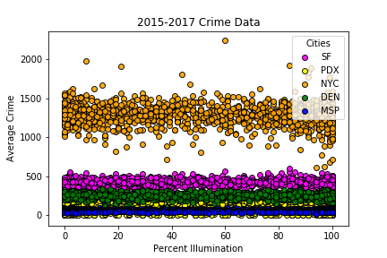
Visualizations & Discussion

Slide 8
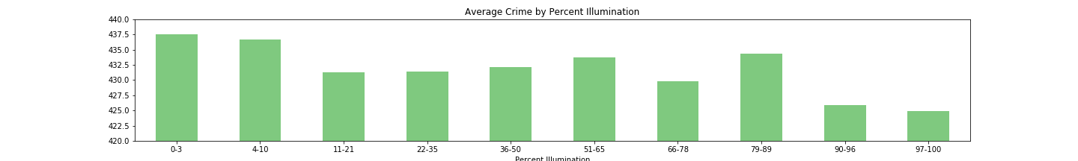

Slide 9
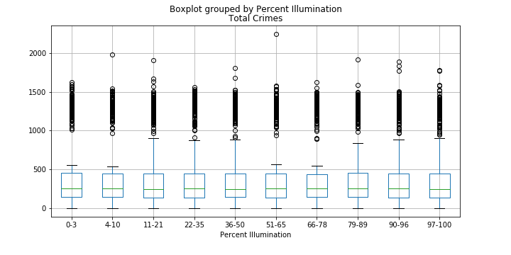

Slide 10
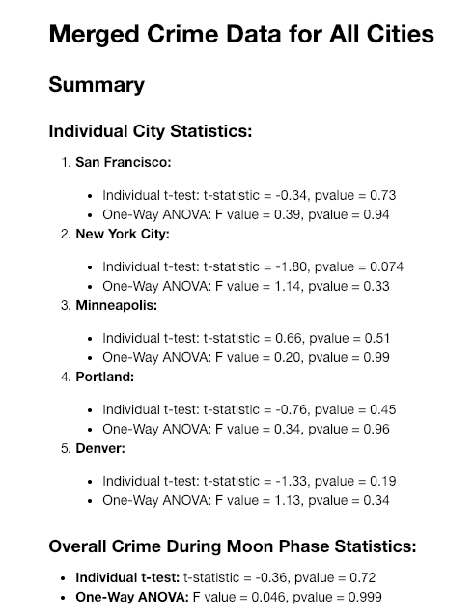
Statistical Analysis
p-values are all >0.05, indicating acceptance of the null hypothesis (H_{o} ).

Slide 11
Discussion
Discuss your findings. Did you find what you expected to find? If not, why not? What inferences or general conclusions can you draw from your analysis?

Slide 12
Post Mortem
Discuss any difficulties that arose, and how you dealt with them
Discuss any additional questions that came up, but which you didn't have time to answer: What would you research next, if you had two more weeks?

Slide 13
Questions?

Slide 14
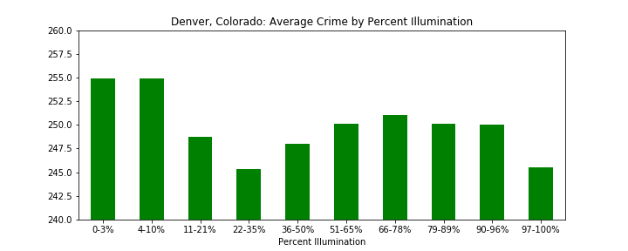
Appendix: Additional Visualizations for EA. City

Slide 15
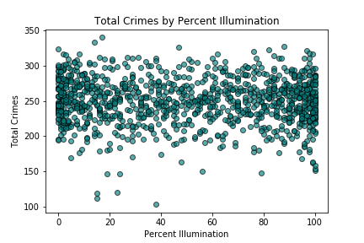
Denver, Colorado Total Crimes by Percent Illumination

Slide 16
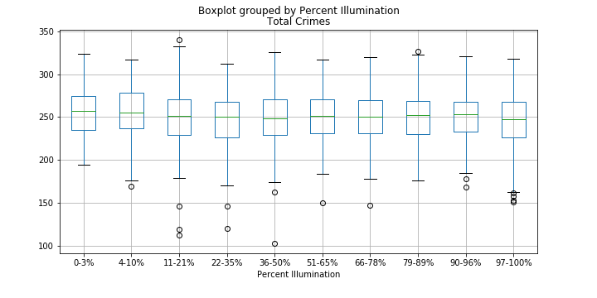
Denver, Colorado Box Plot

Slide 17
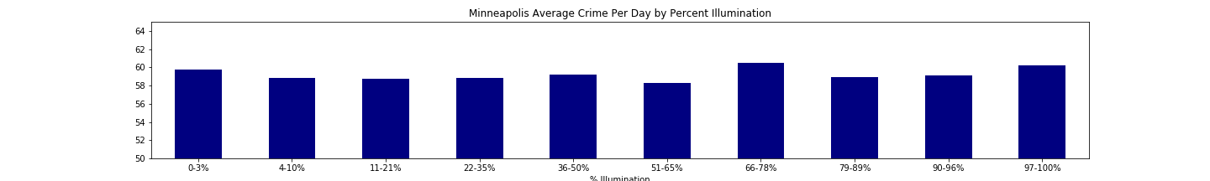

Slide 18
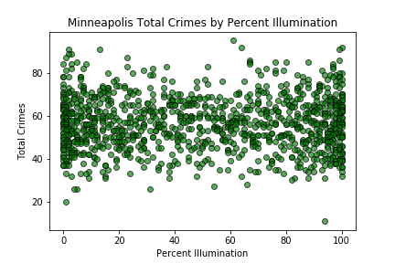

Slide 19
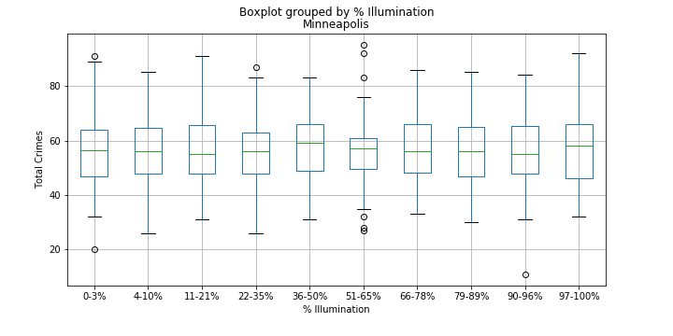

Slide 20
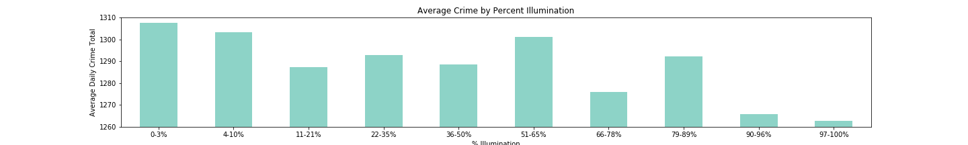
New York City Average Crime by Percent Illumination

Slide 21
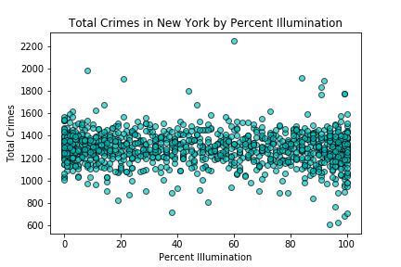

Slide 22
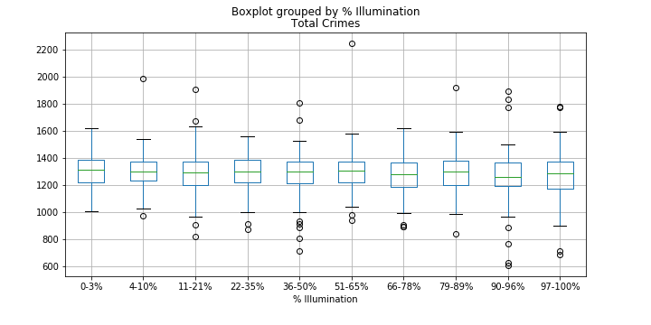
New York City Boxplot

Slide 23
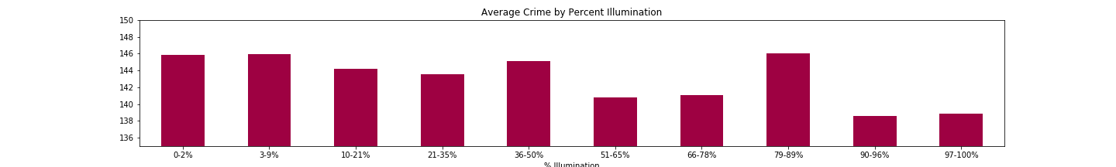
Portland, OR Average Crime by Percent Illumination

Slide 24
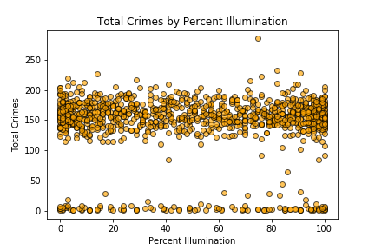
Portland, Or Total Crimes by percent illumination

Slide 25
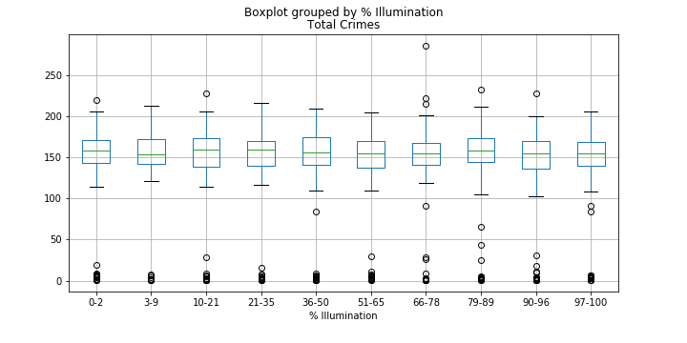
Portland, OR Boxplot

Slide 26
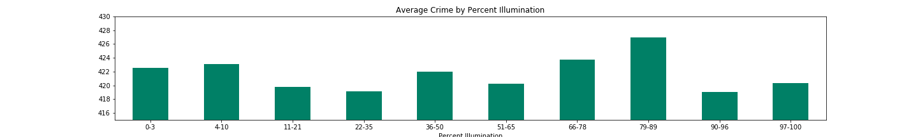
San Francisco Average Crime by percent illumination

Slide 27
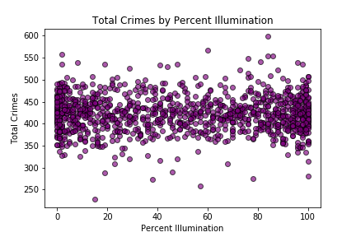
San Francisco Total Crimes by Percent illumination

Slide 28
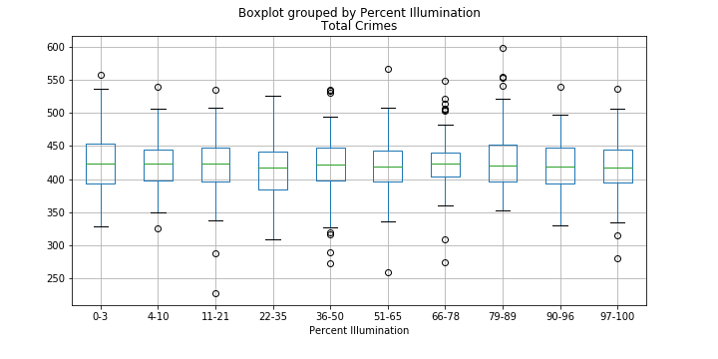
San Francisco Boxplot

