Slide 1
Rust
(The Programming Language)

Slide 2
Agenda
The Marketing Pitch
Corporate Backing
Memory Models, Ownership and Borrowing
Concurrency
Recommendations for the Future

Slide 3
Marketing Pitch
Modern
Low-Level
High-Performance
Highly productive
Rated as the “Most loved” language by the StackOverflow surveys
No garbage collector

Slide 4
Memory Models
Manual Memory Management (C-style)
Automatic Garbage Collection (Java-Style)
The Rust Way

Slide 5
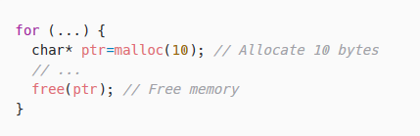
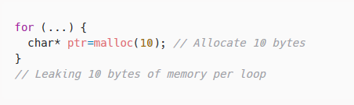
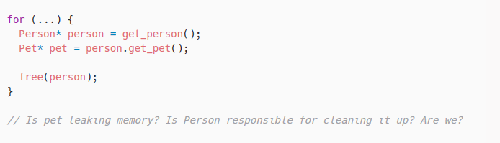
Memory Models: Manual

Slide 6
Memory Models: Manual
Fast
Good for embedded
Memory-Leaks
Use-After-Free vulnerabilities
Undefined behavior (double free)

Slide 7
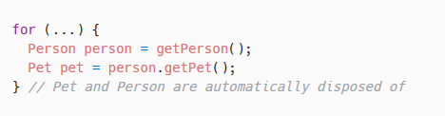
Memory Models: Garbage-Collected
Easier
Safer
Slower
Larger runtime

Slide 8
The Rust Way
Safe
Fast
Easy

Slide 9
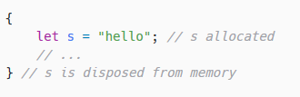
Ownership: The Rules
Each value has a variable which is its owner
There can only be one owner at a time
When the owner goes out of scope, the value will be disposed of

Slide 10
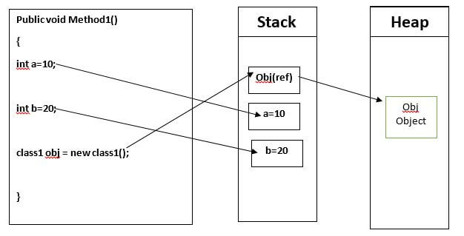
Ownership: Stack and Heap
Primitives are fixed-size and stored on the stack
Objects are variable-size and stored on the heap, with a pointer on the stack

Slide 11
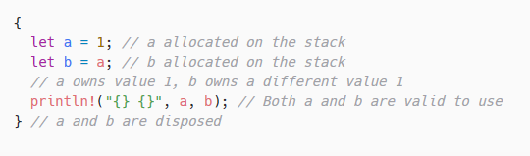
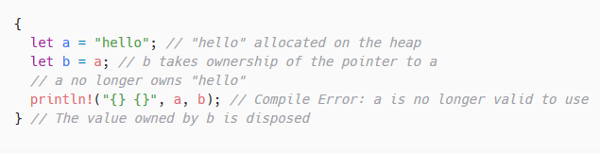
Ownership: Primitives and Object Types
Primitives are copied
Objects are transferred ownership

Slide 12
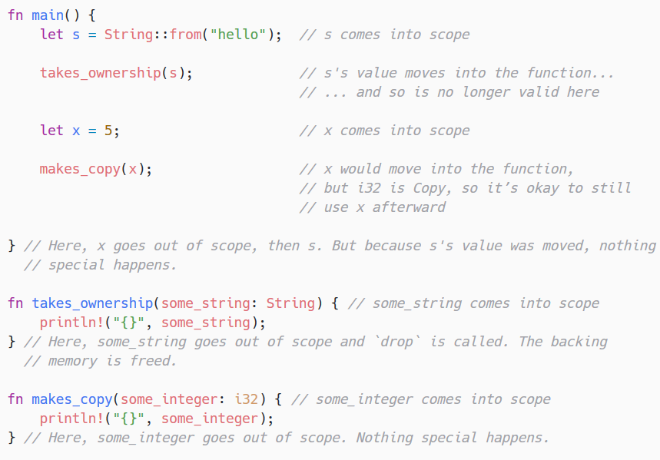
Ownership: Primitives and Object Types

Slide 13
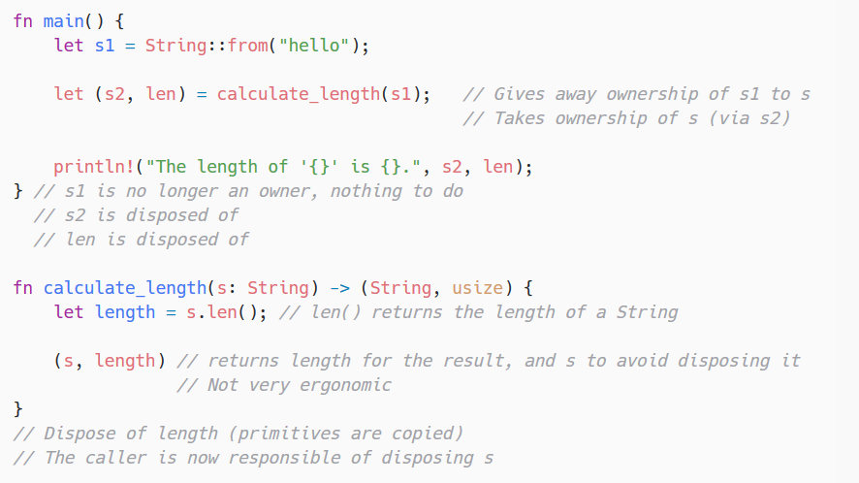
Ownership: Reclaiming
Returning
Borrowing

Slide 14
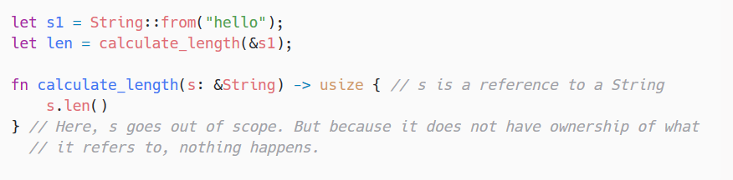
Ownership: Borrowing

Slide 15
Borrowing: The Rules
Borrowing values whose lexical lifetime is shorter than the borrowers is not allowed
Each value can be borrowed in one of two ways, but not both at the same time.
One or more immutable references
One mutable reference

Slide 16
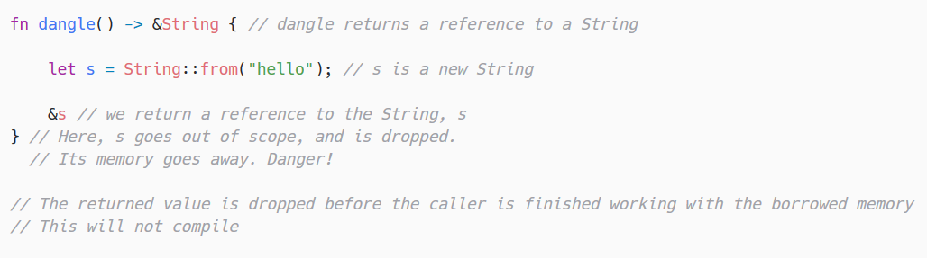
Borrowing: Dangling References

Slide 17
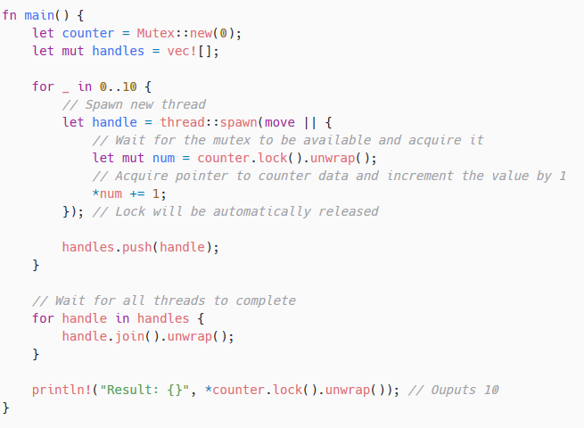
Concurrency
No Race-Conditions
Guaranteed atomicity
Backed by the Type System and Ownership Rules

Slide 18
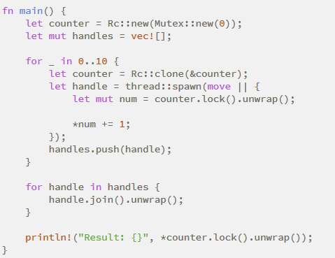
Reference Counting
Maintain counter for each pointer
Increment when cloned
Decrement when dropped
Dispose of value when at 0

Slide 19
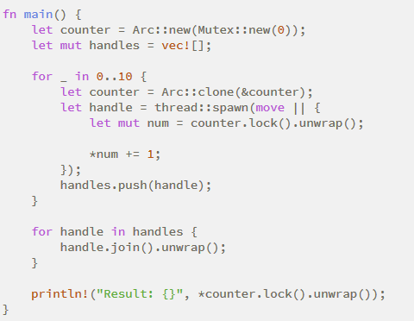
Atomic Reference Counting

Slide 20
Notes
Subtle changes to ownership model
Left out important information
Quality of Life Features
Governance
Type System
Immutability

Slide 21
Recommendation
Rust has enormous value in learning about
Type Theory
Concurrency
Memory Management
Rust rewards documentation and testing which can avoid learning that it’s a chore by demonstrating immediate value
The Rust compiler strictly enforces best practices, which translate well into other languages
Integrating the Rust language in part or in full would be beneficial

