Slide 1
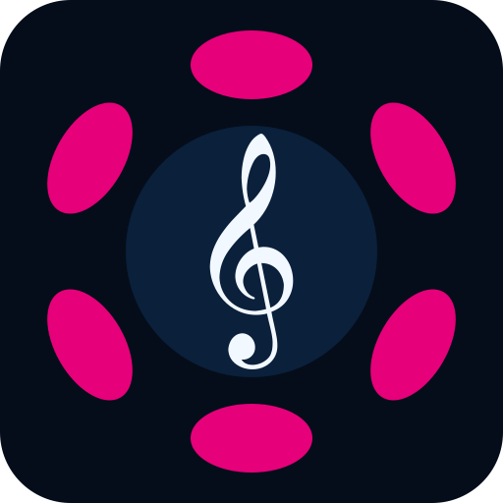
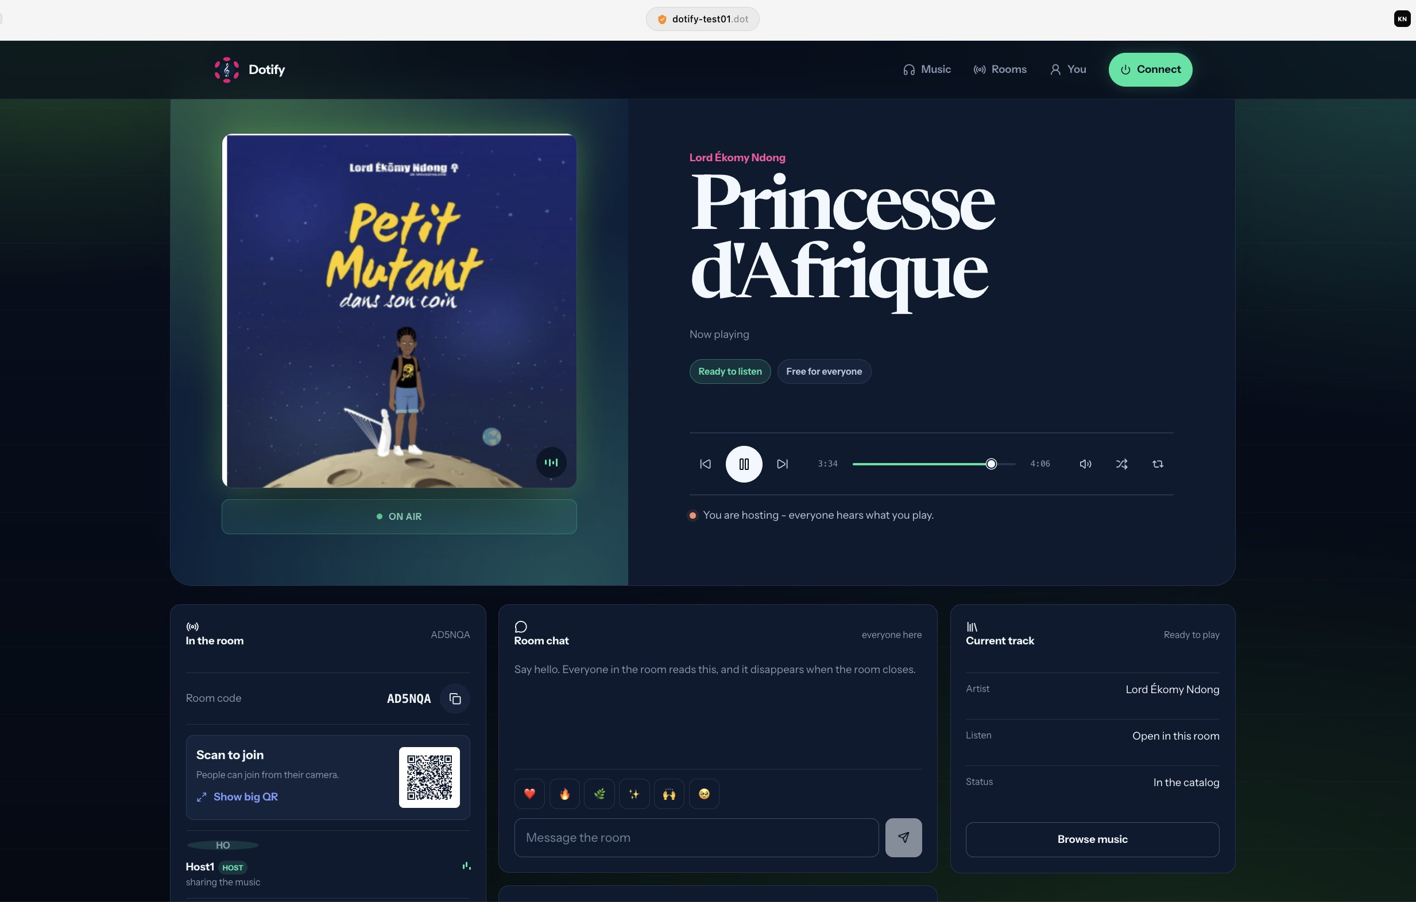
Protocol Builders Program • Polkadot Blockchain Academy
ALUMNI PROJECT SHOWCASE · 2026
Dotify
Let the Music connect the dots.
A shared common listening space where music reconnects people, and where artists keep control of their work.
shared listening
artist sovereignty
cultural commons
dotify-test01.dot
Dotify · Kevin Nzeng Essimengane
1
Notes:
Opening thesis: Dotify should be introduced as a human and cultural product before any protocol detail.
The Product DevNet screenshot is used as evidence that this is already a real hosted experience, not only a concept.
- Screenshot source: /Users/th0t_nzeng/Coding/blockchain/Polkadot/PBP-Lisbon/Presentation/Dotify-screen 2.jpeg.
[Sources]
- User request in this conversation, September 2, 2026.
- Dotify philosophical north star: docs/context/dotify-philosophical-north-star.md.
- Dotify product memory: docs/context/dotify-product-memory.md.
- Dotify technical memory: docs/context/dotify-technical-memory.md.
- Current project overview: README.md and docs/index.html.

Slide 2
Protocol Builders Program • Polkadot Blockchain Academy
ALUMNI PROJECT SHOWCASE · 2026
Shared places have become private bubbles.
In buses, trains, streets and public rooms, people stand together while listening alone.
Common spaces
Common gesture
Common possibility
The physical place is shared, but the moment is often private.
Most people inside the bubble are doing the same thing: listening.
Music can reopen a small bridge between people who are already near each other.
Dotify turns shared spaces into spaces of commons.
Dotify · Kevin Nzeng Essimengane
2
Notes:
This slide is intentionally philosophical and social. It reframes the user's bus/train/public-space observation as the core product problem.
No statistical loneliness claim is made on-slide because no external data source was used.
[Sources]
- User request in this conversation, September 2, 2026.
- Dotify philosophical north star: docs/context/dotify-philosophical-north-star.md.
- Dotify product memory: docs/context/dotify-product-memory.md.
- Dotify technical memory: docs/context/dotify-technical-memory.md.
- Current project overview: README.md and docs/index.html.

Slide 3
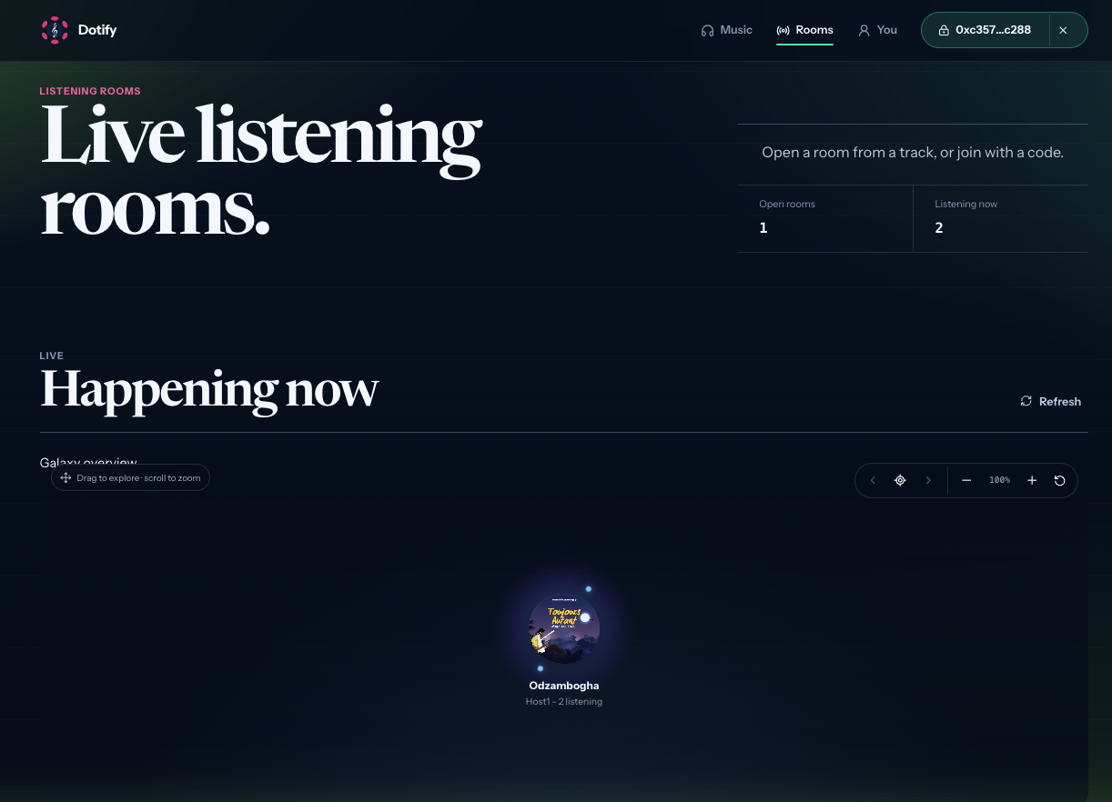
Protocol Builders Program • Polkadot Blockchain Academy
ALUMNI PROJECT SHOWCASE · 2026
The room is the new musical commons.
A host opens a listening moment. Others enter with a link. The music becomes shared presence instead of isolated consumption.
one room · one link · one shared moment
Discovery starts from people, not only from feeds.
A room makes listening visible, temporary and human. The catalogue is still there, but the social moment becomes the front door.
Dotify · Kevin Nzeng Essimengane
3
Notes:
This slide uses the rooms view as evidence that Dotify's social core is already represented in the app.
- Screenshot source: /Users/th0t_nzeng/Desktop/Capture d'écran 2026-08-26 à 11.09.54.png.
[Sources]
- User request in this conversation, September 2, 2026.
- Dotify philosophical north star: docs/context/dotify-philosophical-north-star.md.
- Dotify product memory: docs/context/dotify-product-memory.md.
- Dotify technical memory: docs/context/dotify-technical-memory.md.
- Current project overview: README.md and docs/index.html.

Slide 4
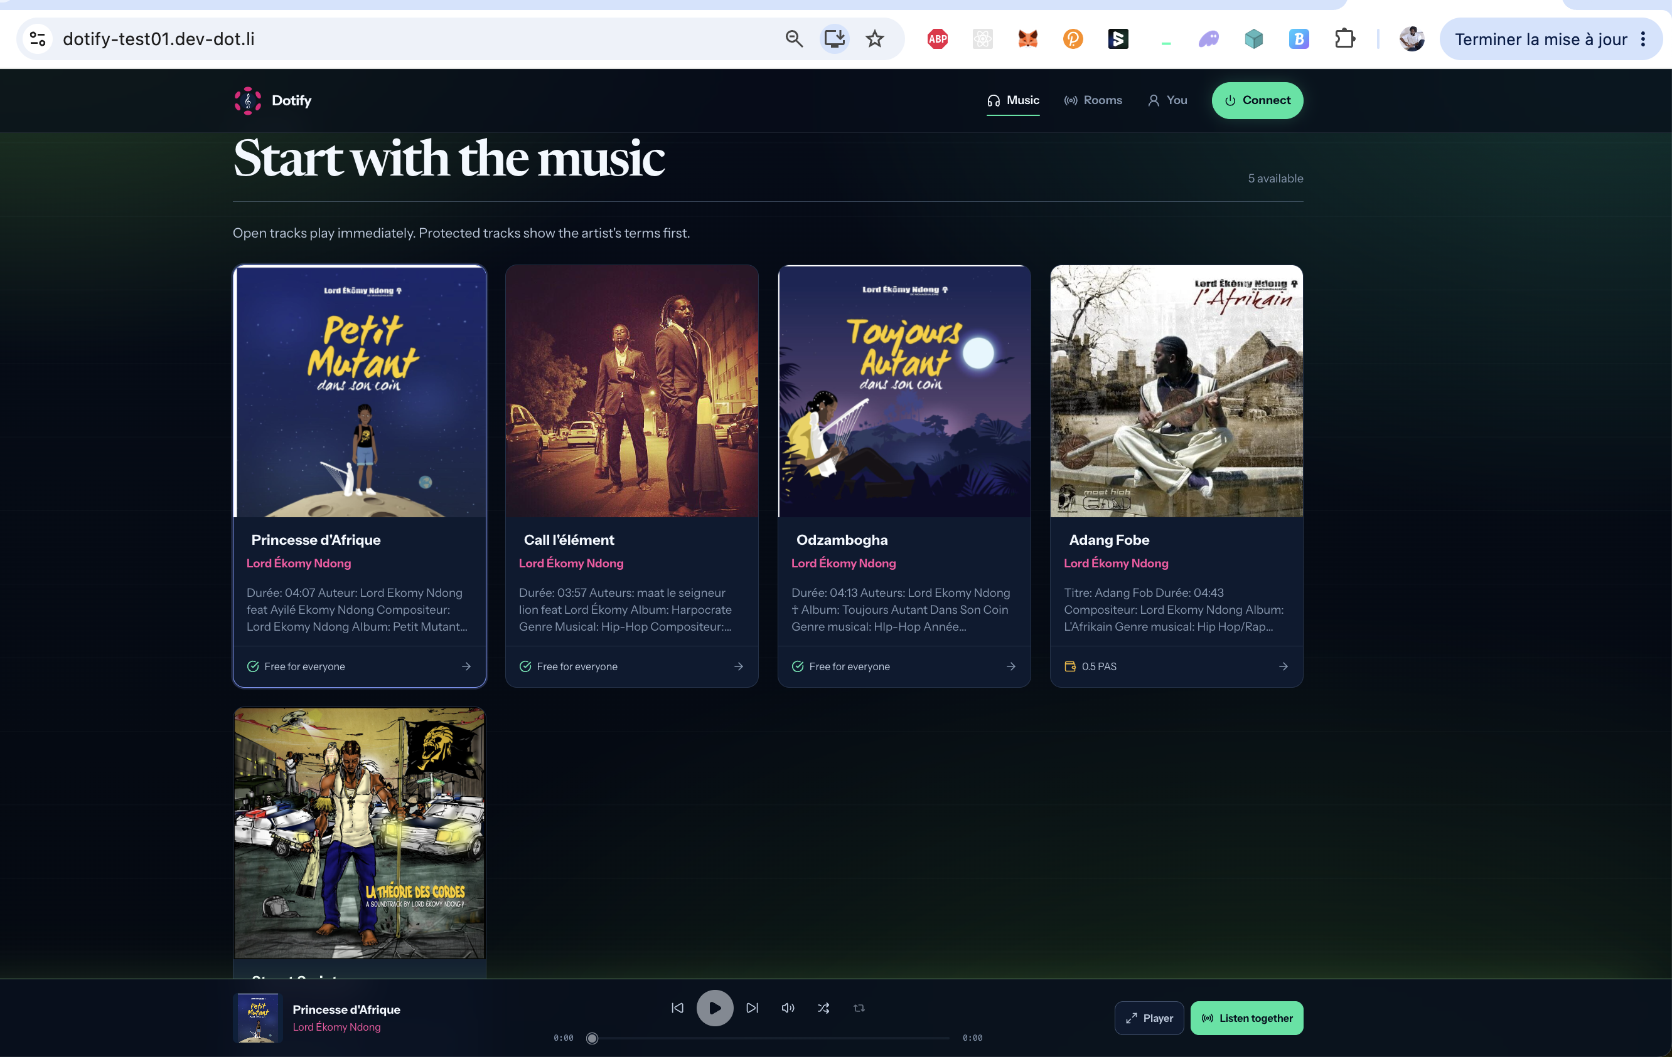
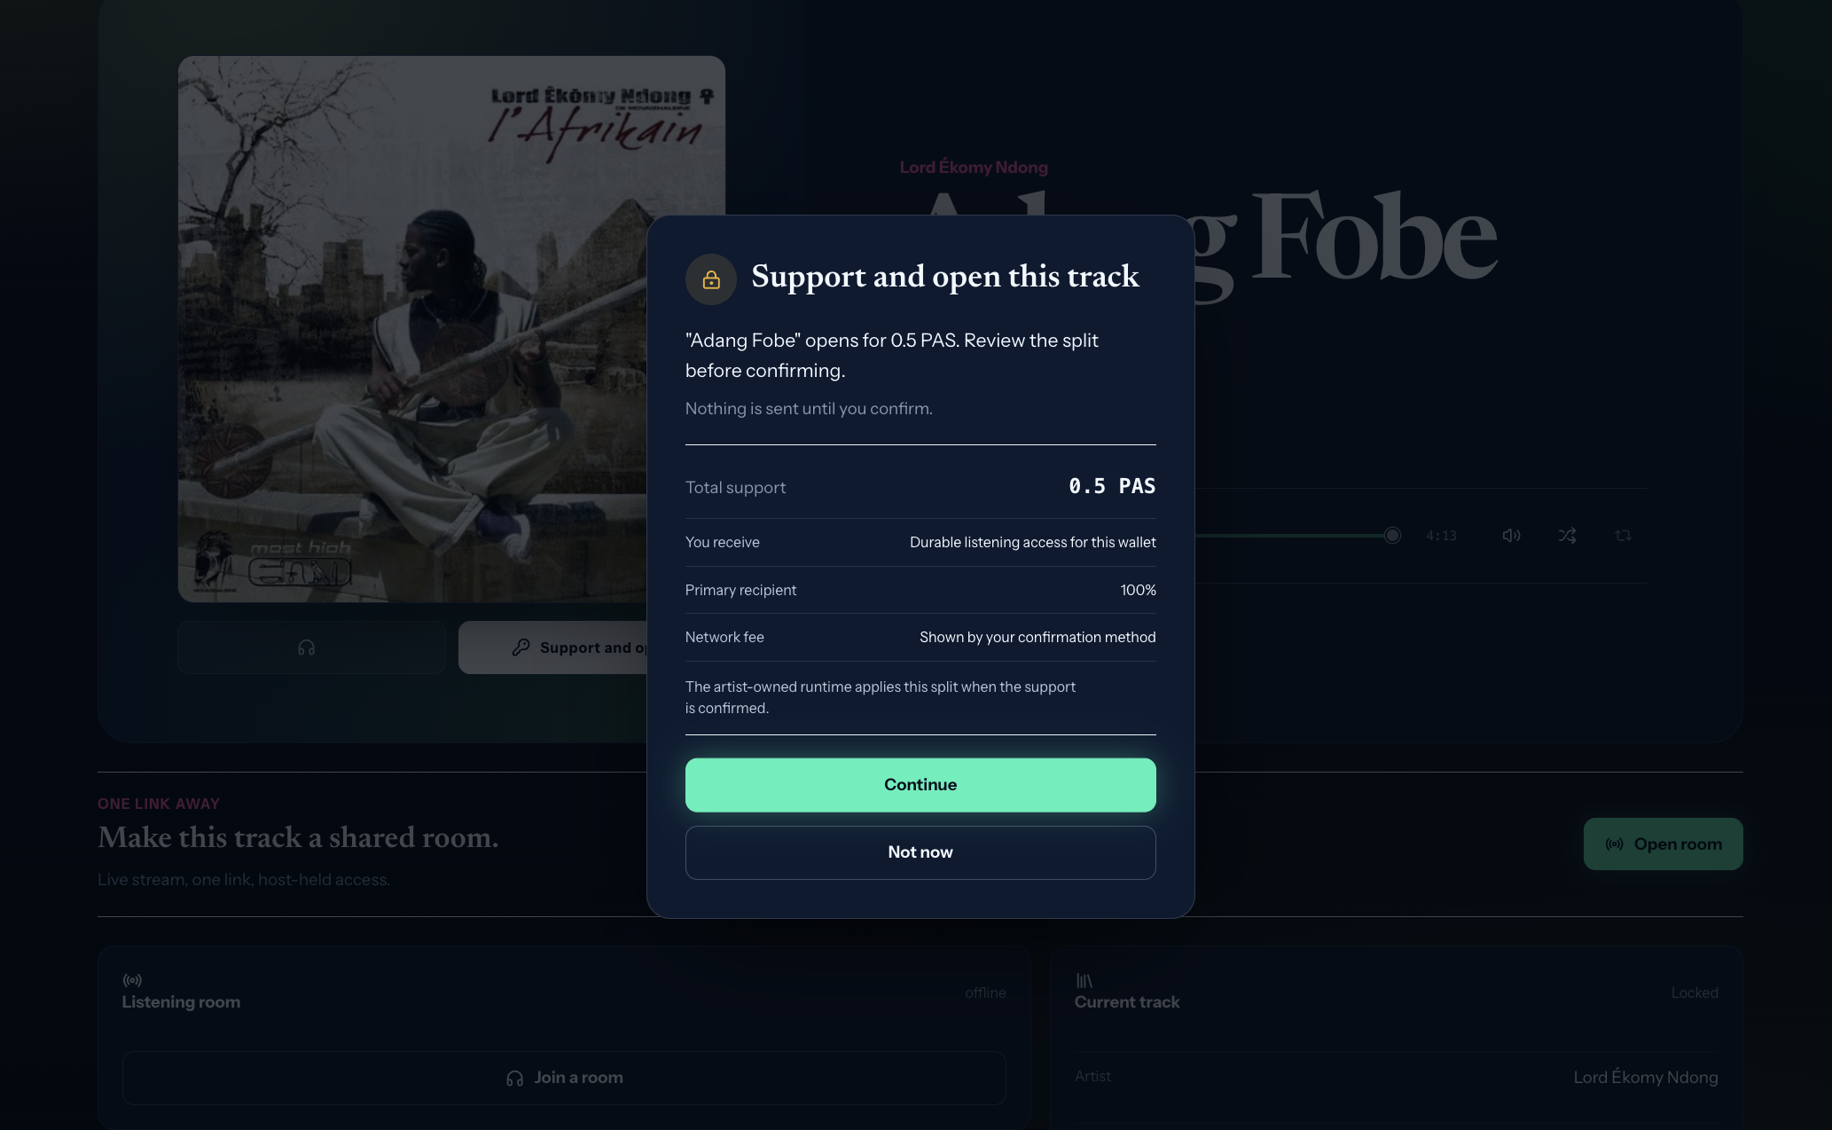
Protocol Builders Program • Polkadot Blockchain Academy
ALUMNI PROJECT SHOWCASE · 2026
A working slice already connects music, rooms and access.
The current testnet experience shows the product loop: browse tracks, open a room, invite listeners, and handle protected support transparently.
Browse the catalog
Open a room
Support with clarity
Five registered releases create a first public listening field.
The host turns a track into a shared moment with one link.
Protected tracks show the artist's terms before access opens.
The visible experience stays simple; the trust layer stays mostly invisible.
Dotify · Kevin Nzeng Essimengane
4
Notes:
This slide keeps concrete implementation proof, but avoids exposing internal technology names as the main story.
- Catalog screenshot source: /Users/th0t_nzeng/Desktop/Capture d'écran 2026-08-26 à 11.04.58.png.
- Room screenshot source: /Users/th0t_nzeng/Coding/blockchain/Polkadot/PBP-Lisbon/Presentation/Dotify-screen 2.jpeg.
- Unlock screenshot source: /Users/th0t_nzeng/Desktop/Capture d'écran 2026-08-26 à 11.11.23.png.
[Sources]
- User request in this conversation, September 2, 2026.
- Dotify philosophical north star: docs/context/dotify-philosophical-north-star.md.
- Dotify product memory: docs/context/dotify-product-memory.md.
- Dotify technical memory: docs/context/dotify-technical-memory.md.
- Current project overview: README.md and docs/index.html.

Slide 5
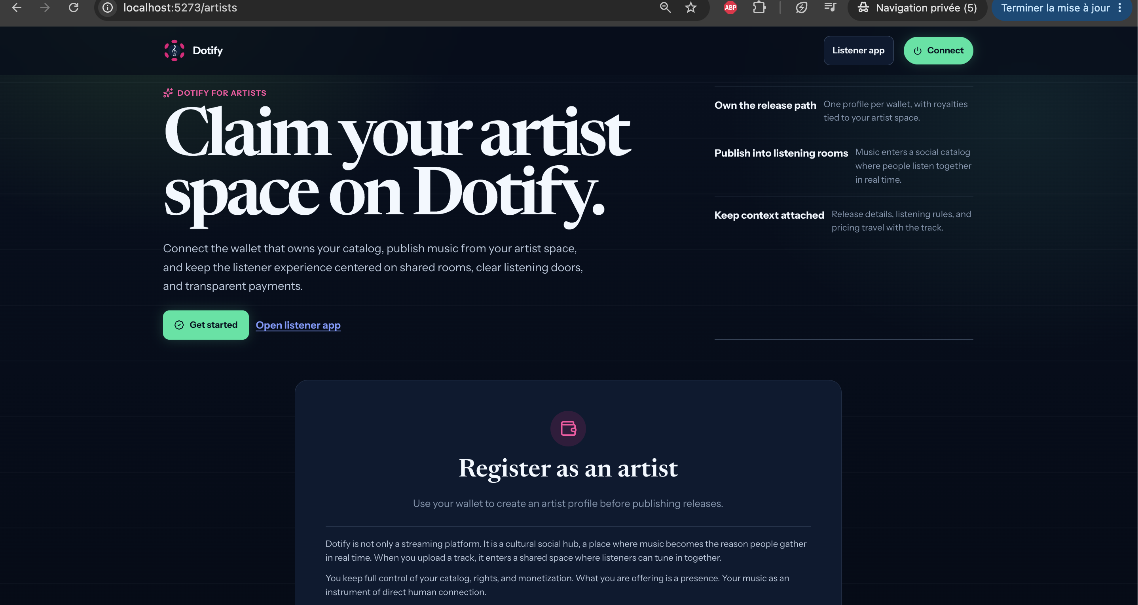
Protocol Builders Program • Polkadot Blockchain Academy
ALUMNI PROJECT SHOWCASE · 2026
Artists need a space they govern.
Dotify is not a platform that swallows the artist. It gives each artist a smart space for their work.
distribution
Where the release can circulate.
rights
Who participates in the work.
access
Who may listen, support or enter.
value flows
How payments are routed between rights holders.
The artist-owned runtime is an ethical boundary: the platform should serve the work, not capture it.
Dotify · Kevin Nzeng Essimengane
5
Notes:
The technical term 'runtime' is kept in notes and used sparingly on-slide as 'smart space' and 'artist-owned runtime'.
- Artist portal screenshot source: /Users/th0t_nzeng/Bureau - Ancien/Capture d'écran 2026-07-22 à 17.02.12.png.
[Sources]
- User request in this conversation, September 2, 2026.
- Dotify philosophical north star: docs/context/dotify-philosophical-north-star.md.
- Dotify product memory: docs/context/dotify-product-memory.md.
- Dotify technical memory: docs/context/dotify-technical-memory.md.
- Current project overview: README.md and docs/index.html.

Slide 6
Protocol Builders Program • Polkadot Blockchain Academy
ALUMNI PROJECT SHOWCASE · 2026
A cultural commons still needs rules that respect people.
Dotify treats music as a common listening experience without pretending that rights, authorship and payment disappear.
01
02
03
Free listening
Classic support
Human-free path
Some tracks can travel freely and open the room immediately.
A listener can support a track and see the split before confirming.
Future personhood access should protect dignity, privacy and agency.
Trust is not decoration. It is what lets the social experience stay open without dispossessing the artist.
Dotify · Kevin Nzeng Essimengane
6
Notes:
This slide preserves the access model but reframes it as a cultural and ethical design question.
Human-free access is presented as future path because the current codebase still treats live personhood integration as open.
- Unlock screenshot source: /Users/th0t_nzeng/Desktop/Capture d'écran 2026-08-26 à 11.11.23.png.
[Sources]
- User request in this conversation, September 2, 2026.
- Dotify philosophical north star: docs/context/dotify-philosophical-north-star.md.
- Dotify product memory: docs/context/dotify-product-memory.md.
- Dotify technical memory: docs/context/dotify-technical-memory.md.
- Current project overview: README.md and docs/index.html.

Slide 7
Protocol Builders Program • Polkadot Blockchain Academy
ALUMNI PROJECT SHOWCASE · 2026
Polkadot Product is the direction because the product should not become another silo.
The standalone web app remains the first public path. Product DevNet lets Dotify test a more native, less centralized way to distribute the same shared-listening experience.
Live now
dotify-test01.dot through Bulletin and DotNS.
Being proven
Product-native signatures and contract writes.
Known boundary
Mobile host WebRTC support depends on host capabilities.
Goal: infrastructure becomes trust.
Dotify · Kevin Nzeng Essimengane
7
Notes:
This slide keeps Product DevNet in the story but avoids overclaiming. It is an active direction, not the entire product dependency.
The mobile-host WebRTC limitation is named honestly in notes and summarized as a known boundary.
- Product DevNet screenshot source: /Users/th0t_nzeng/Coding/blockchain/Polkadot/PBP-Lisbon/Presentation/Dotify-screen 2.jpeg.
[Sources]
- User request in this conversation, September 2, 2026.
- Dotify philosophical north star: docs/context/dotify-philosophical-north-star.md.
- Dotify product memory: docs/context/dotify-product-memory.md.
- Dotify technical memory: docs/context/dotify-technical-memory.md.
- Current project overview: README.md and docs/index.html.

Slide 8
Protocol Builders Program • Polkadot Blockchain Academy
ALUMNI PROJECT SHOWCASE · 2026
What comes next is depth, not noise.
01
Reliable public rooms
First sound should be fast and stable across real browsers, gateways and mobile contexts.
02
Product-native value flow
Classic support, royalty splits and DOT-related actions should move through the Product host when supported.
03
Human-aware access
Personhood can open free cultural access, but only with privacy and dignity preserved.
04
Ambassador transmission
Reward people who help music travel with care, not empty referral mechanics.
Music as shared social infrastructure, with artists in control.
github.com/knzeng-e/dotify
dotify-test01.dev-dot.li
Kevin Nzeng Essimengane
Dotify · Kevin Nzeng Essimengane
8
Notes:
Closing resolves the opening: Dotify's next steps deepen the public room, Product value flow, human-aware access and cultural transmission.
The deck intentionally avoids presenting tokenomics or speculative rewards as delivered product.
[Sources]
- User request in this conversation, September 2, 2026.
- Dotify philosophical north star: docs/context/dotify-philosophical-north-star.md.
- Dotify product memory: docs/context/dotify-product-memory.md.
- Dotify technical memory: docs/context/dotify-technical-memory.md.
- Current project overview: README.md and docs/index.html.

