Slide 1
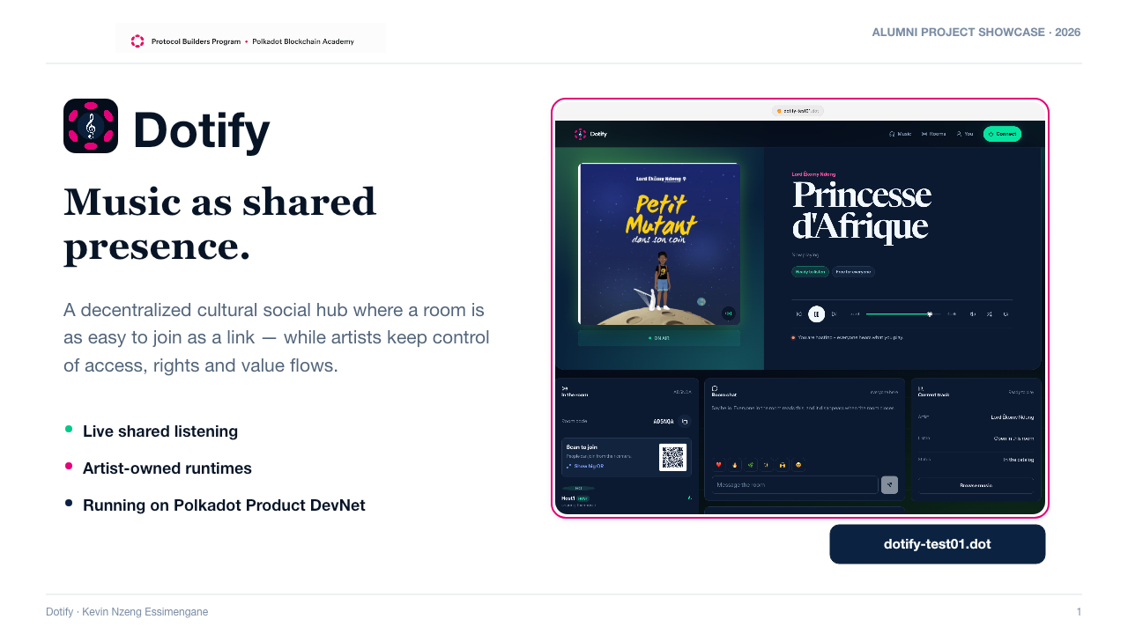
Notes:
[Sources]
Dotify product, technical, and philosophical memory in the repository.
User-provided screenshot: Capture d’écran 2026-08-26 à 11.04.09.png.
Dotify logo asset: web/product-icon.png.

Slide 2
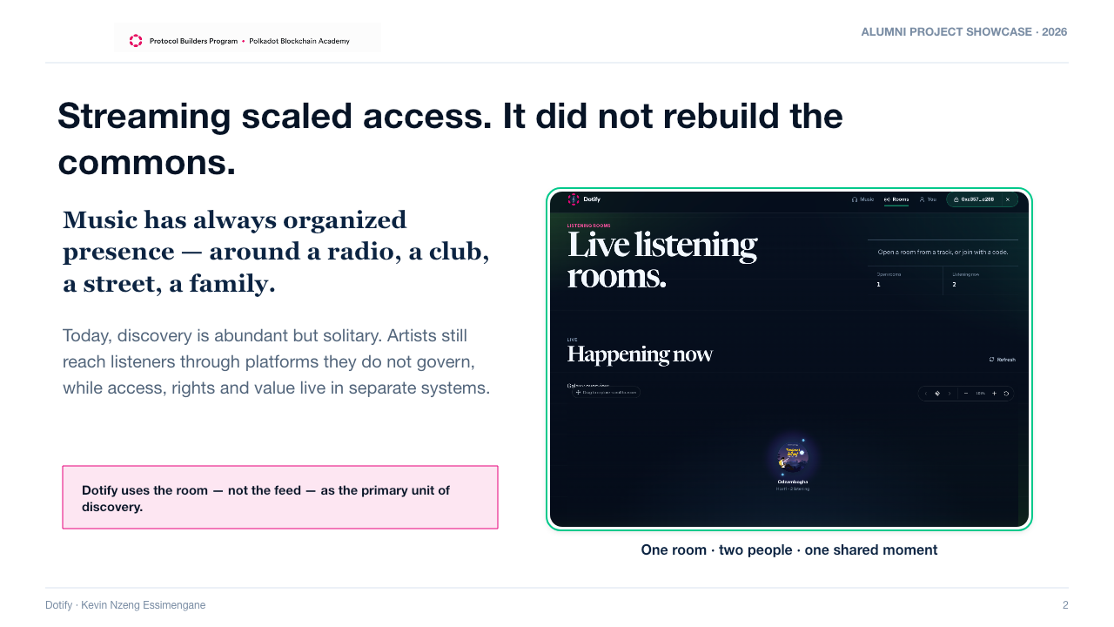
Notes:
[Sources]
docs/context/dotify-philosophical-north-star.md and docs/context/dotify-product-memory.md.
User-provided screenshot: Capture d’écran 2026-08-26 à 11.09.54.png.

Slide 3
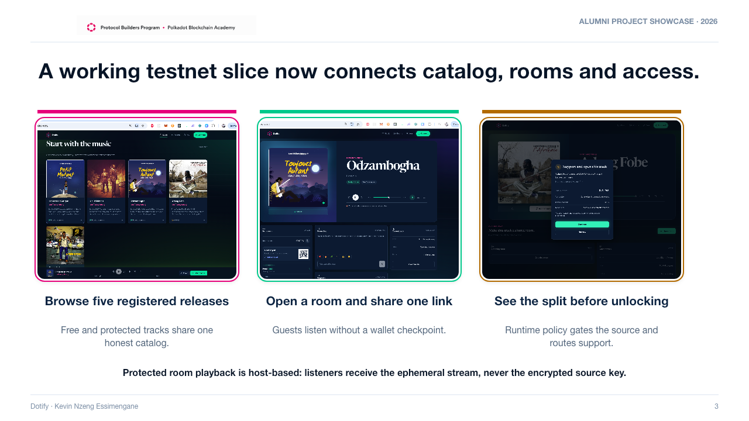
Notes:
[Sources]
README.md and docs/context/dotify-technical-memory.md for catalog, room-access, and protected-key boundaries.
User-provided screenshots: Capture d’écran 2026-08-26 à 11.04.58.png, 11.09.09.png, and 11.11.23.png.

Slide 4
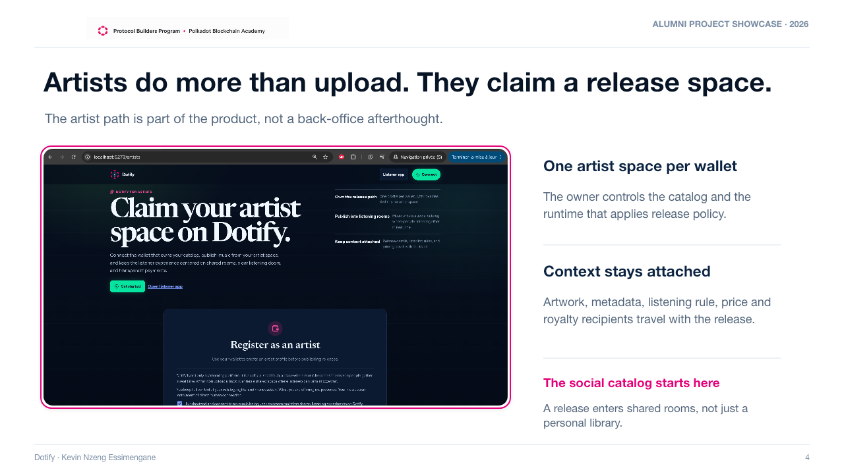
Notes:
[Sources]
spec.md section 2.3 and docs/context/dotify-product-memory.md for the artist workflow and sovereignty boundary.
User-provided screenshot: Capture d’écran 2026-07-22 à 17.02.12.png.

Slide 5
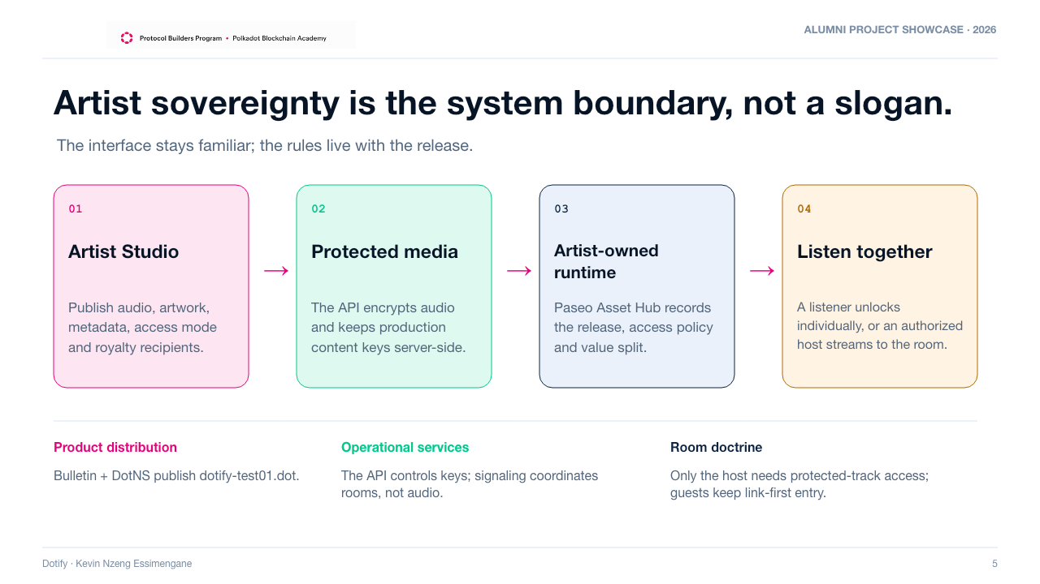
Notes:
[Sources]
spec.md sections 2–7, README.md, and docs/explanation/product-devnet-architecture.md.
Architecture wording deliberately distinguishes media/key custody, chain policy, and room signaling.

Slide 6
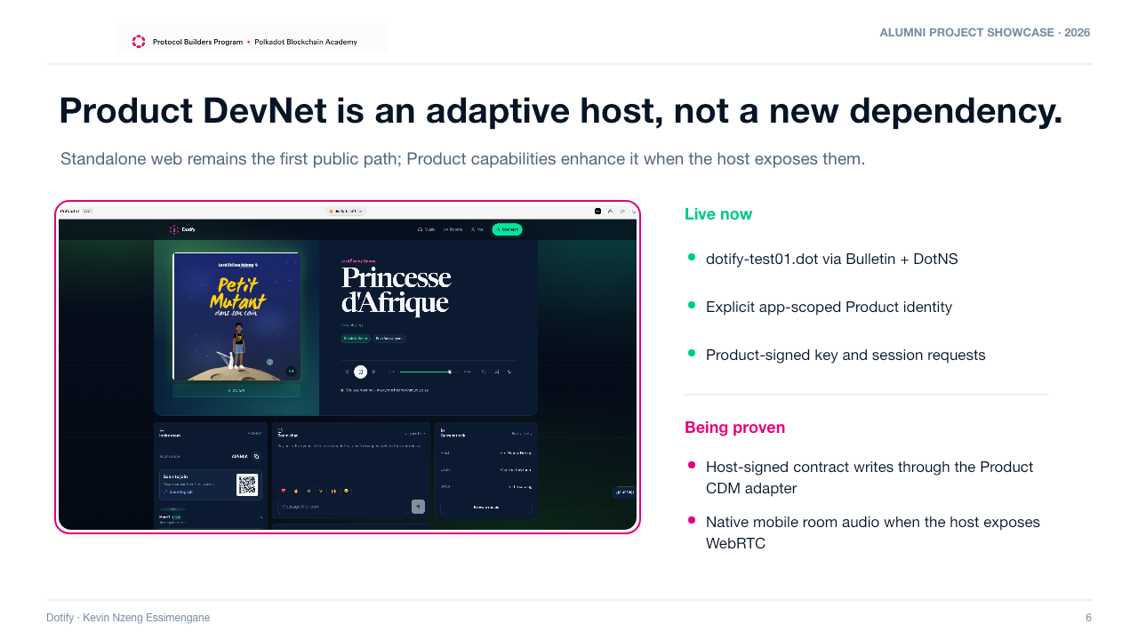
Notes:
[Sources]
docs/backlog/polkadot-product-readiness-and-killer-dapp-roadmap.md.
docs/explanation/product-devnet-architecture.md capability matrix and Product Mobile WebRTC boundary.
User-provided screenshot: Capture d’écran 2026-08-26 à 11.04.09.png.

Slide 7
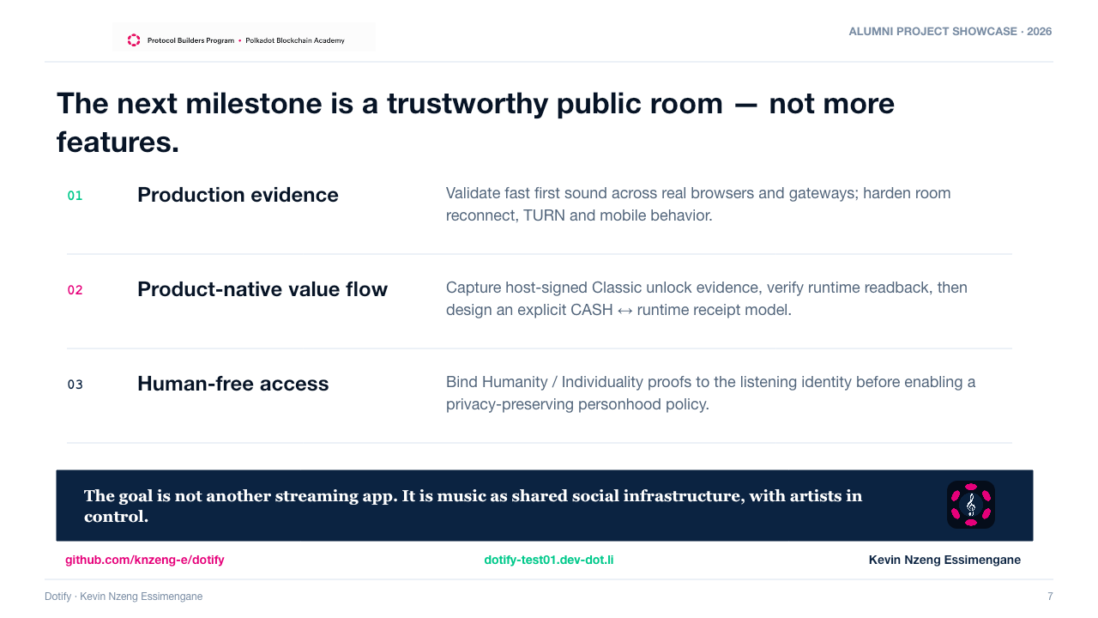
Notes:
[Sources]
docs/backlog/improvement-plan.md and docs/backlog/polkadot-product-readiness-and-killer-dapp-roadmap.md.
docs/context/dotify-philosophical-north-star.md for the closing product thesis.

