Slide 1
Formation Damage
During Drilling:
Mechanisms, Skin Quantification,
and Mitigation Strategies
Supervisor: [Prof. Name]
Department of Petroleum and Gas Engineering · [University]
Seminar · [Month Year]
Image: [source / licence]
23 slides + 5 hidden backups
Notes:
Welcome. This seminar covers how formation damage forms during drilling, how we quantify it with skin, and what we can do about it. Fill in your name, supervisor, department and date before presenting.

Slide 2
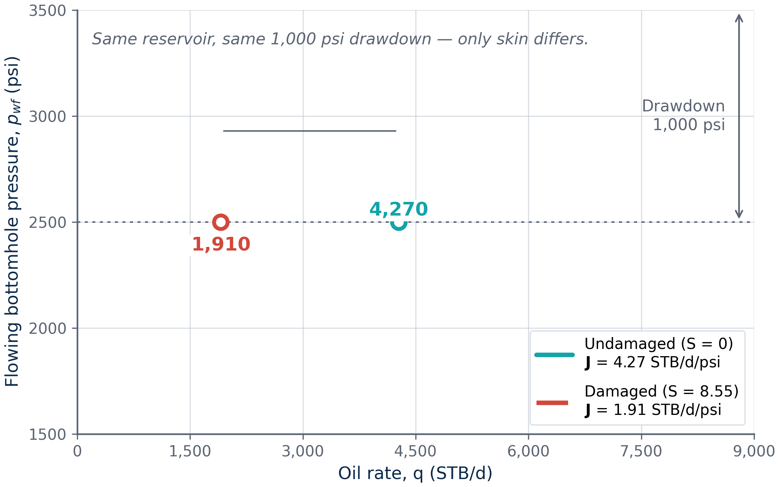
Same drawdown, but damage cuts the rate by more than half
−55%
rate at the same drawdown
4,270 → 1,910
STB/d, undamaged → damaged
(S = 0 → S = 8.55)
At p_{wf} = 2,500 psi, same drawdown.
Illustrative data (k = 100 md, h = 50 ft). Author's calculation.
2
Notes:
Open with the punchline: same reservoir, same drawdown, only skin differs — and the damaged well delivers less than half the rate. Everything that follows explains where skin 8.5 comes from and what to do about it.

Slide 3
Damage is invisible while drilling but costly during production
Problem: drilling fluids impair near-wellbore permeability
1
2
3
1. Mechanisms
2. Quantification
3. Strategies
Explain how damage forms
Measure the loss with skin
Compare prevention and remediation
3
Notes:
Three questions frame the talk: how does damage form, how do we measure the loss, and what can we do about it? Stress that damage is invisible while drilling but shows up as lost rate once the well is on production.

Slide 4
Five steps, from flow physics to my project plan
1
2
3
4
5
Fundamentals
Mechanisms
Quantification
Solutions
Next steps
Flow near the well
How damage forms
Skin and productivity
Prevention and cure
Economics and project
4
Notes:
Roadmap: near-well flow fundamentals, the mechanisms that create damage, quantification through skin, prevention and remediation, then economics and my graduation project plan.

Slide 5
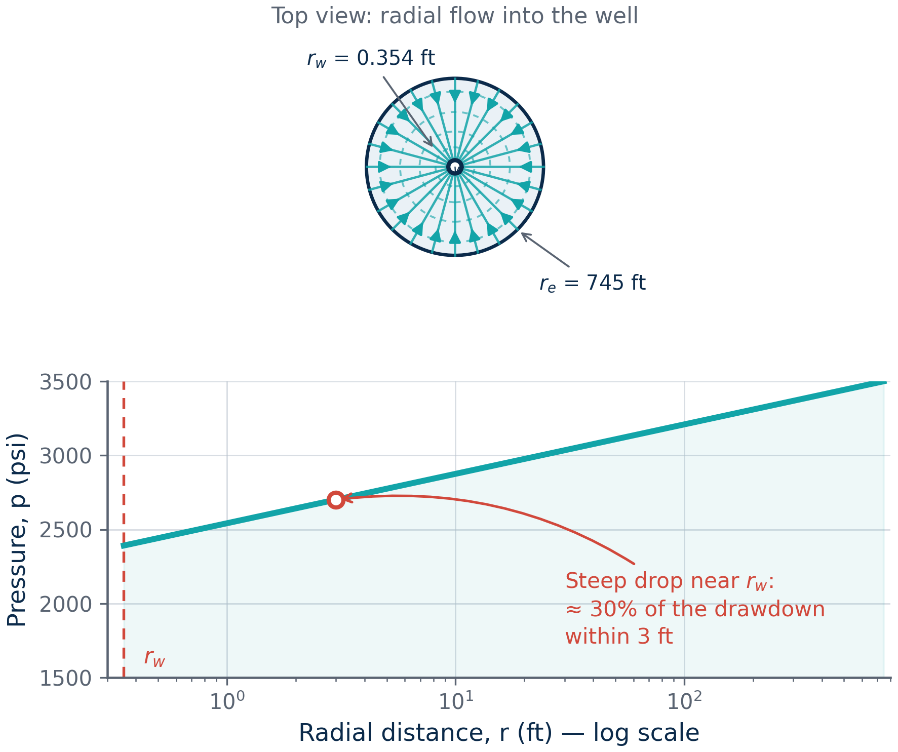
The near-wellbore zone controls inflow
Fundamentals
Mechanisms
Quantification
Solutions
Next steps
• Flow area shrinks toward the well
• Pressure gradient is steepest near the wellbore
• About 30% of drawdown occurs within 3 ft
• Small damaged zone, large effect
Schematic by author. Undamaged pseudo-steady-state flow.
5
Notes:
Flow converges into the well, so the pressure gradient is steepest right at the wellbore. About 30% of the drawdown from the drainage boundary is spent within 3 ft of the well — a tiny volume that controls inflow.

Slide 6
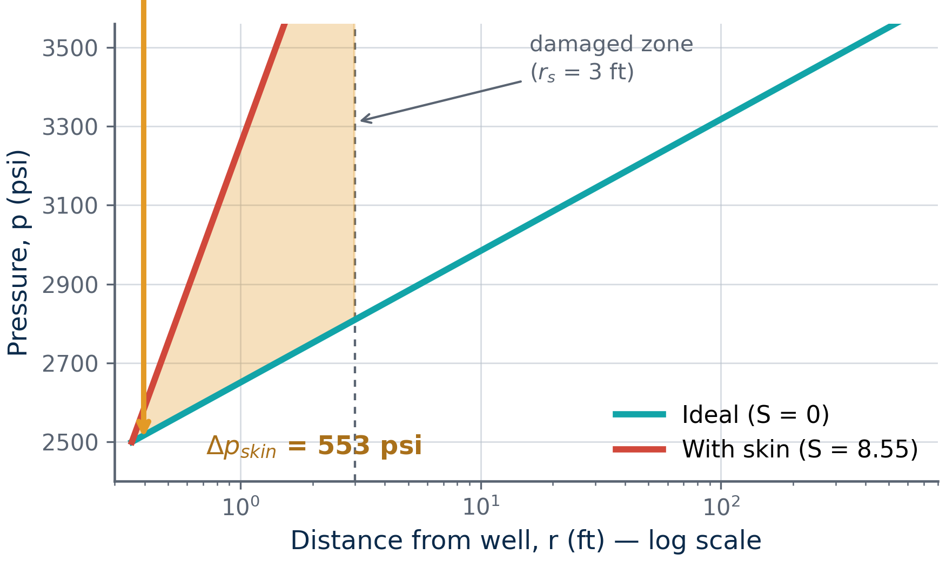
Skin factor measures deviation from ideal radial flow
Fundamentals
Mechanisms
Quantification
Solutions
Next steps
• S > 0: damaged
• S = 0: ideal, undisturbed
• S < 0: stimulated (acid, fracture)
• Skin converts disturbance into extra pressure drop
Δp_{skin} = 141.2 q B μ S / (k h)
Schematic by author. After van Everdingen (1953); Hawkins (1956).
6
Notes:
Skin is a dimensionless pressure-drop knob: positive means damage, zero is ideal, negative means stimulation. It converts everything happening near the wellbore into one extra pressure drop, which is why it is so useful.

Slide 7
In the radial-flow equation, skin adds directly to resistance
Fundamentals
Mechanisms
Quantification
Solutions
Next steps
q = 0.00708 k h (p̄ − p_{wf}) / [ μ B ( ln(r_{e}/r_{w}) − 0.75 + S ) ]
q oil rate (STB/d)
k permeability (md)
• Skin adds to the geometric term
• Here ln(r_{e}/r_{w}) − 0.75 ≈ 6.9
• So S ≈ 7 halves the rate
h net thickness (ft)
p̄ average reservoir pressure (psi)
p_{wf} flowing bottomhole pressure (psi)
μ viscosity (cP)
B formation volume factor
r_{e}, r_{w} drainage / well radius (ft)
S skin (dimensionless)
Pseudo-steady-state radial flow, field units. Economides et al.
7
Notes:
Walk the equation. In the denominator, skin adds to the geometry term ln(re/rw) − 0.75, which is about 6.9 here — so a skin of roughly 7 doubles the resistance and halves the rate. Note that S is dimensionless.

Slide 8
Damage can occur at every stage of the well's life
Fundamentals
Mechanisms
Quantification
Solutions
Next steps
1
2
3
4
5
Drilling
Cementing
Completion
Workover
Production
Mud invasion
Cement filtrate
Perforation damage,
completion fluid
Kill-fluid loss
Scale, fines,
asphaltenes
This talk focuses on drilling-fluid damage
Adapted from Krueger (1986).
8
Notes:
Damage is not only a drilling problem: every stage from drilling to production can impair the near-wellbore zone. This talk focuses on drilling-fluid damage, the earliest and most preventable source.

Slide 9
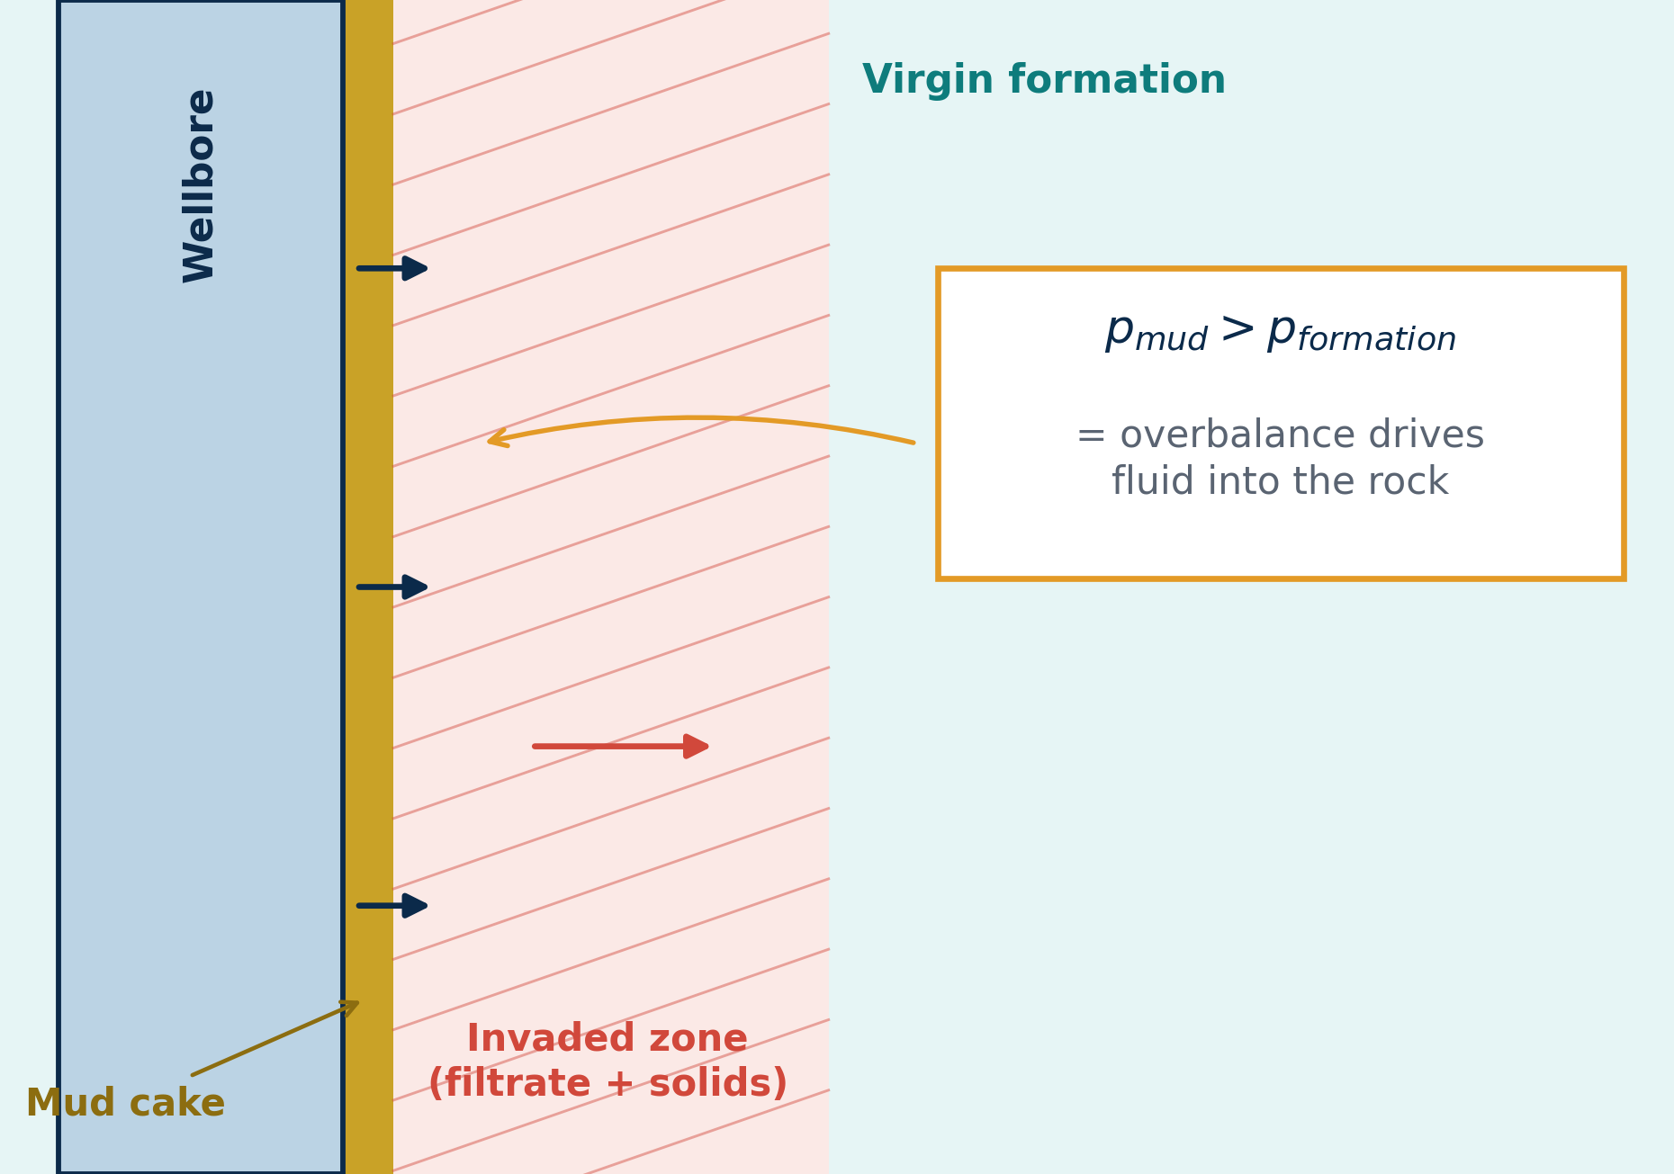
Drilling-fluid invasion is the primary source of damage
Fundamentals
Mechanisms
Quantification
Solutions
Next steps
• Overbalance pushes fluid into the rock
• Spurt loss, then filtrate, then filter cake
• Severity grows with overbalance and exposure time
• Mud properties and permeability also matter
Schematic by author.
9
Notes:
Invasion is driven by overbalance: mud pressure above formation pressure. The sequence is spurt loss, then filtrate invasion, while a filter cake builds. Severity grows with overbalance and exposure time, and depends on mud properties and formation permeability.

Slide 10
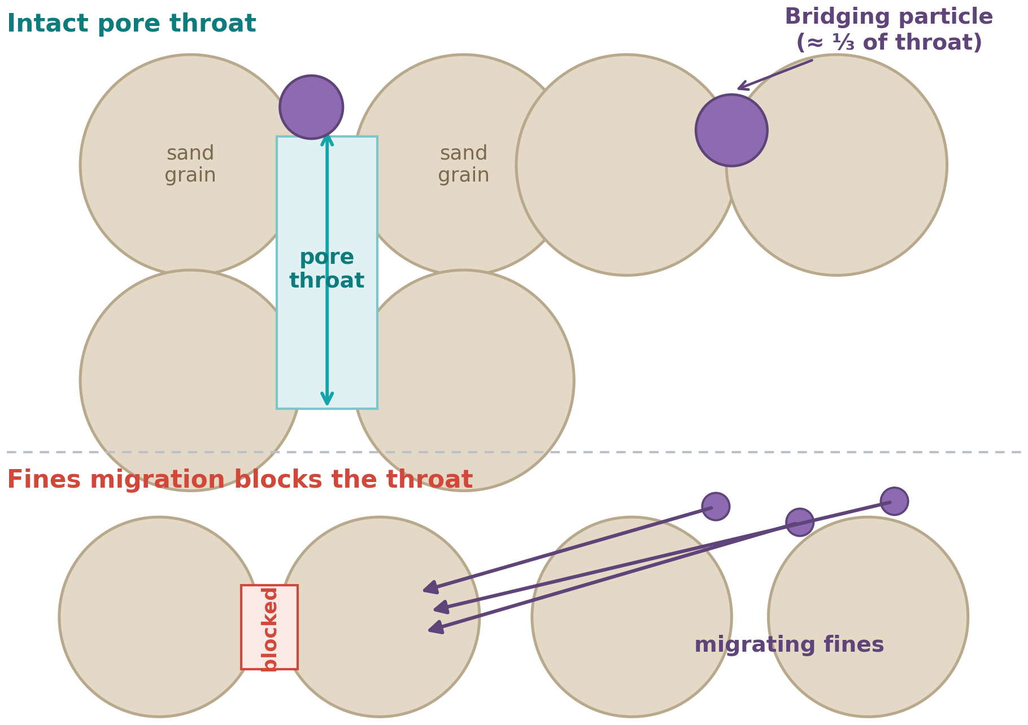
Solids and fines plug pore throats
Fundamentals
Mechanisms
Quantification
Solutions
Next steps
• Mud solids bridge or enter pore throats
• Formation fines detach and migrate
• Result: severe, hard-to-reverse permeability loss
Schematic by author. [Or: SEM image, source, year]
10
Notes:
Two solid-related mechanisms: mud solids bridge at the pore throats or invade deeper, and formation fines detach and migrate until they block a throat. Both can cause severe permeability loss that is hard to reverse.

Slide 11
Incompatible water makes clays swell and migrate
Fundamentals
Mechanisms
Quantification
Solutions
Next steps
Clay | Main damage behaviour
Smectite | Swells, blocks pores
Illite | Migrates as fines
Kaolinite | Detaches and migrates
Chlorite | Iron precipitates with acid
• Fresh filtrate triggers swelling and dispersion
• Salinity and ion composition matter
• Fix: KCl brines, clay stabilizers
Simplified from Civan, Reservoir Formation Damage.
11
Notes:
Clay chemistry drives water sensitivity. Smectite swells, illite and kaolinite migrate as fines, chlorite releases iron when acidised. The fixes are inhibitive brines such as KCl and clay stabilisers.

Slide 12
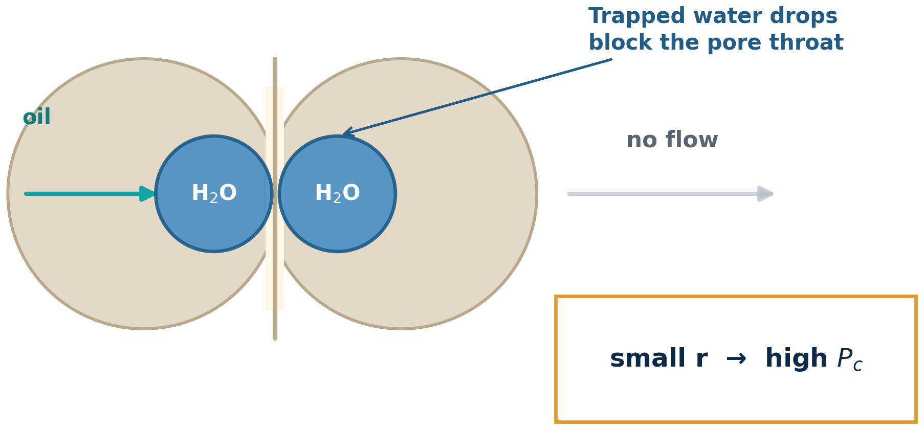
Capillary forces trap filtrate near the wellbore
Fundamentals
Mechanisms
Quantification
Solutions
Next steps
• Water block cuts hydrocarbon relative permeability
• Strongest in low-permeability rock
• Emulsions and wettability change add resistance
P_{c} = 2σ cosθ / r
(σ = interfacial tension, θ = contact angle, r = pore-throat radius)
Schematic by author.
12
Notes:
Capillary forces trap filtrate in the pore space. A water block cuts the relative permeability to hydrocarbon, worst in low-permeability rock, where small pore throats give high capillary pressure — hence the equation.

Slide 13
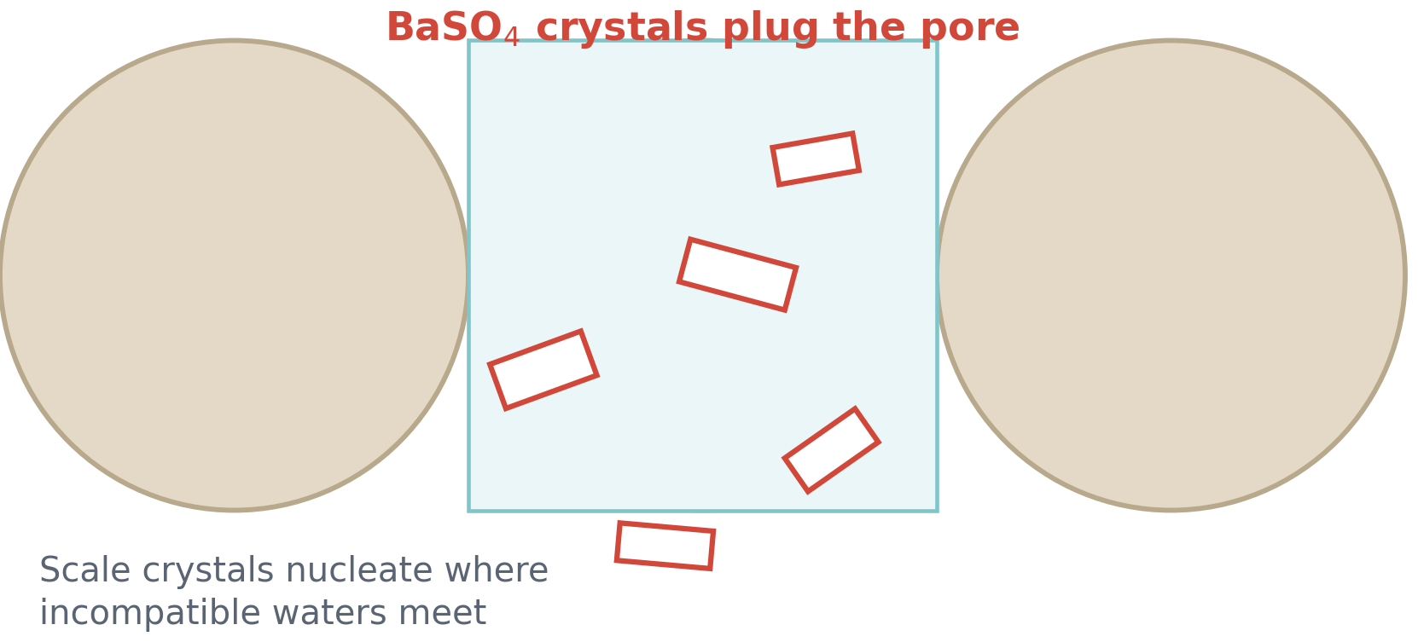
Fluid incompatibility creates precipitates in the pores
Fundamentals
Mechanisms
Quantification
Solutions
Next steps
• Filtrate + brine can form CaCO₃, CaSO₄, BaSO₄
• Acids or high-pH fluids: gels, sludges
• Prevent: lab compatibility tests before pumping
Schematic by author.
13
Notes:
Incompatible fluids can precipitate solids in the pore space: calcium carbonate, calcium sulphate, barium sulphate, and gels or sludges with acids or high-pH fluids. Run compatibility tests before pumping.

Slide 14
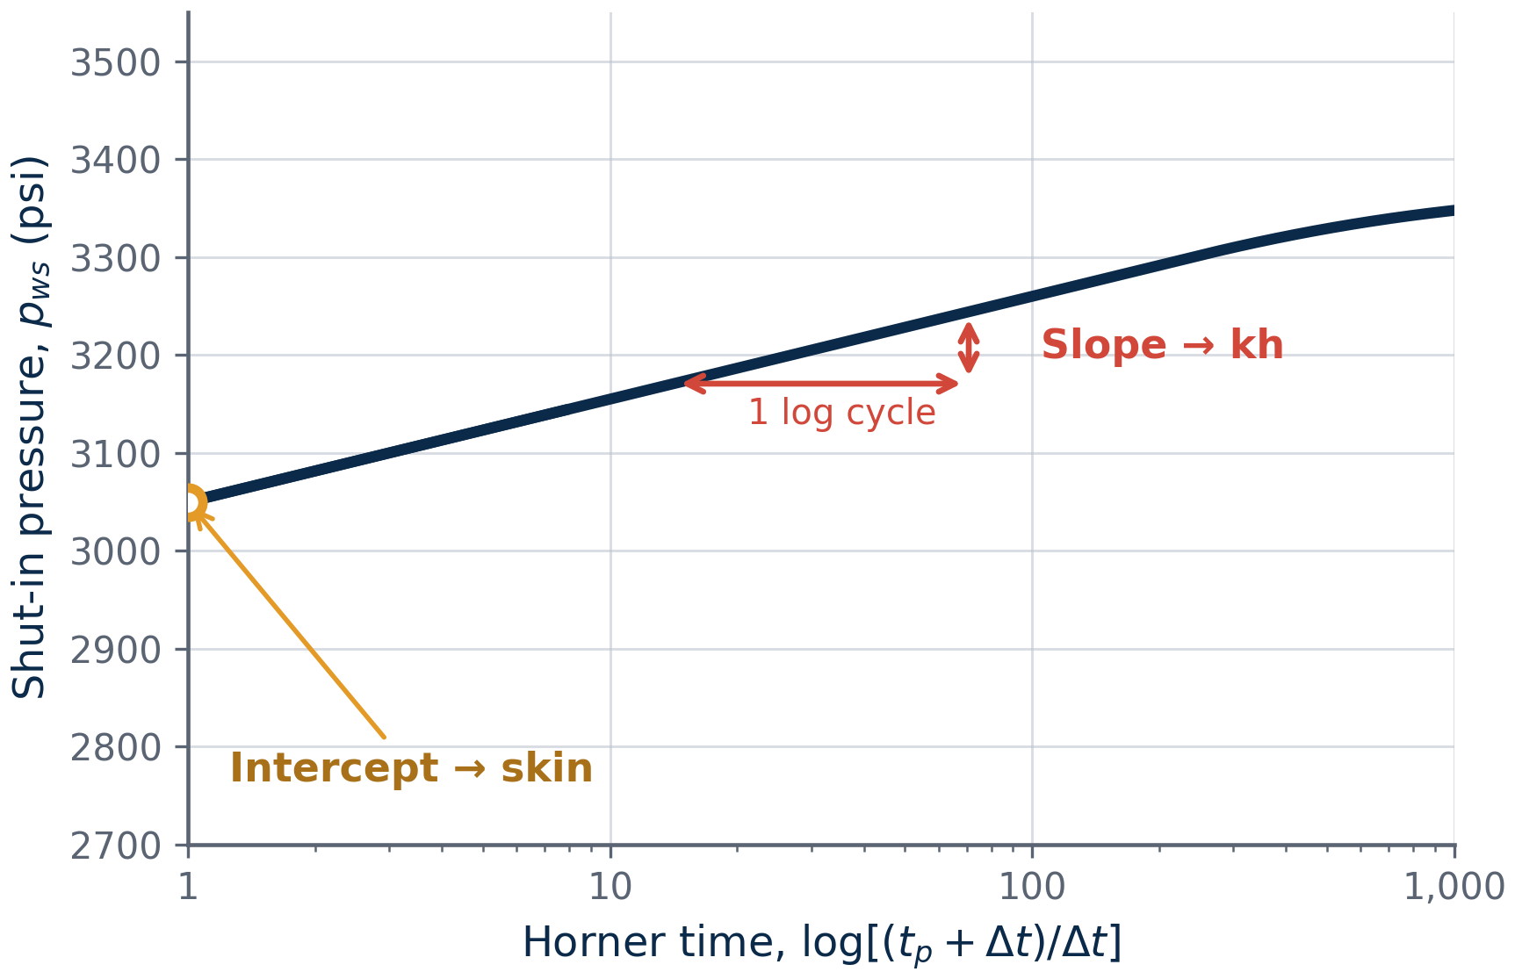
Damage is detected by tests and production data
Fundamentals
Mechanisms
Quantification
Solutions
Next steps
Method | What it shows
Pressure buildup test | Total skin
PI versus offset wells | Underperformance
Core flow test | Return permeability
Production logging | Inflow profile
Nodal analysis | Expected versus actual rate
Return permeability = k_{after} / k_{before}
Test skin is total skin, not only damage
Concept sketch by author. After Earlougher (1977).
14
Notes:
Detection toolkit: pressure-buildup analysis gives total skin, offset-well comparison and production logging locate the loss, core flow tests give return permeability, and nodal analysis compares expected with actual rate. Note that test skin is total skin.

Slide 15
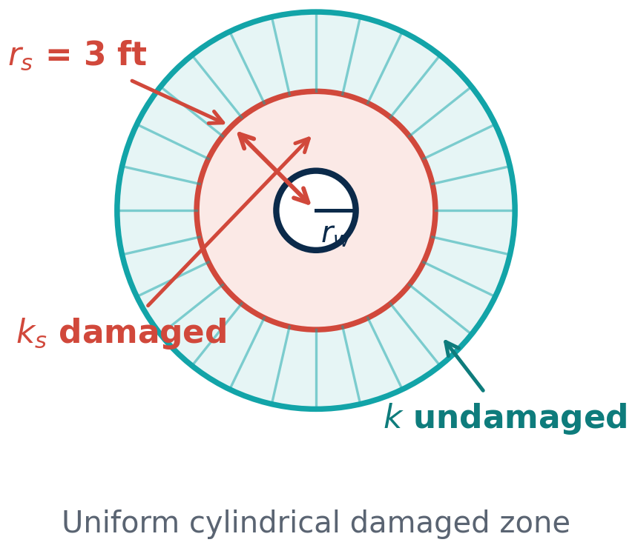
Hawkins' equation links the damaged zone to skin
Fundamentals
Mechanisms
Quantification
Solutions
Next steps
S = (k/k_{s} − 1) ln(r_{s}/r_{w})
k
undamaged permeability (md)
k_{s}
damaged permeability (md)
r_{s}
damage radius (ft)
r_{w}
wellbore radius (ft)
• Severity (k/k_{s}) acts linearly
• Depth (r_{s}) acts logarithmically
• Assumes a uniform, cylindrical damaged zone
• Well-test skin is total skin
Hawkins (1956), Trans. AIME 207.
15
Notes:
Hawkins' equation is the workhorse: the severity of the permeability reduction acts linearly and the depth of the damaged zone enters logarithmically. Two cautions: the model assumes a uniform cylindrical damaged zone, and well-test skin is total skin, not only damage.

Slide 16
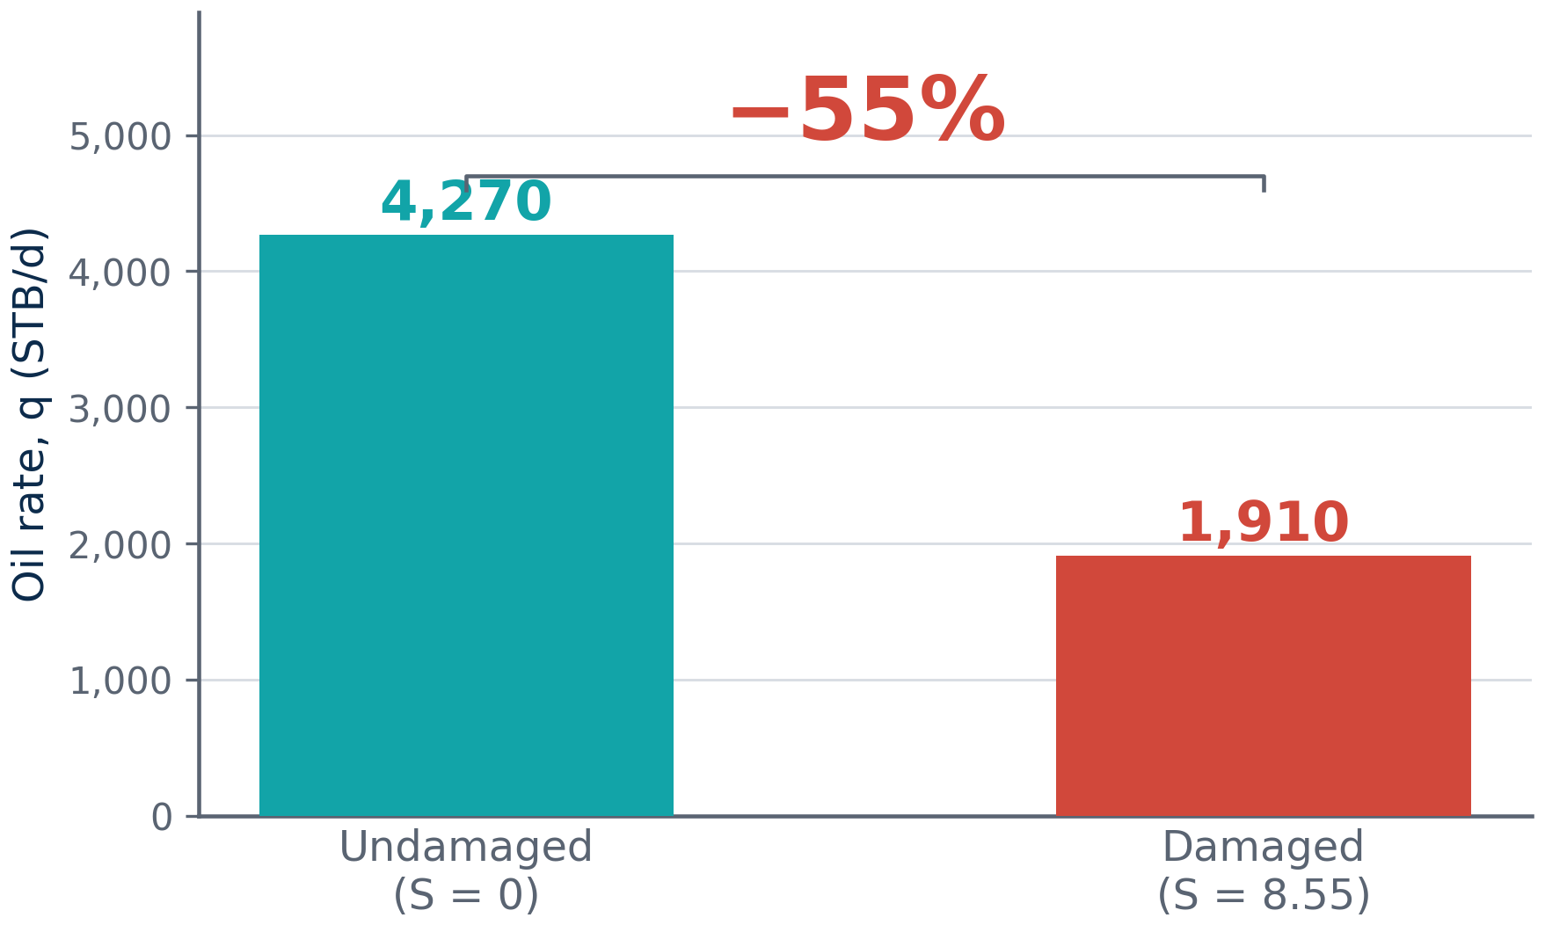
Worked example: a skin of 8.5 costs 55% of productivity
ILLUSTRATIVE DATA
INPUT | OUTPUT
k, k_{s}: 100, 20 md | S = 8.55
h = 50 ft | q (S = 0) = 4,270 STB/d
r_{w}, r_{e}: 0.354, 745 ft | q (damaged) = 1,910 STB/d
r_{s} = 3 ft | FE = 0.447
p̄, p_{wf}: 3,500, 2,500 psi | Δp_{skin} = 553 psi
μ = 1 cP, B = 1.2 rb/STB
Author's calculation using Hawkins (1956) and radial Darcy flow.
16
Notes:
Worked example with illustrative data: a permeability ratio of five over a 3 ft zone gives a skin of 8.55, which cuts the rate from 4,270 to 1,910 STB/d — 55% of productivity lost. The skin pressure drop is 553 psi of the 1,000 psi drawdown.

Slide 17
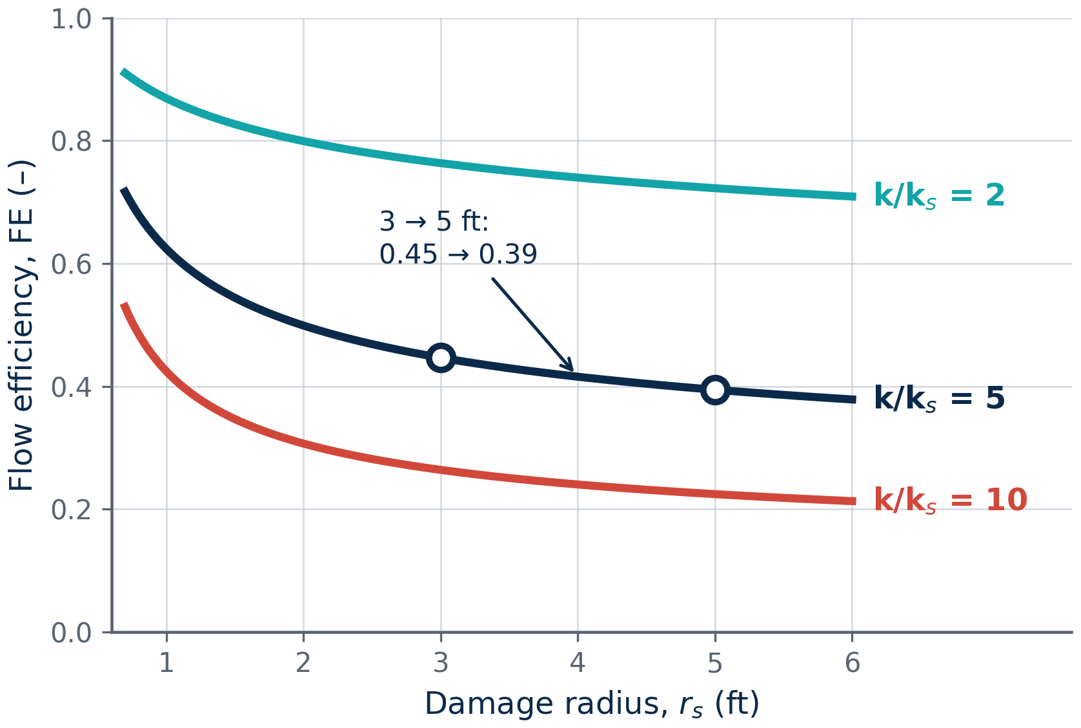
Severity of permeability reduction matters more than depth
ILLUSTRATIVE DATA
k/k_{s} | r_{s} = 1 ft | r_{s} = 3 ft | r_{s} = 5 ft
2 | 1.0 / 0.87 | 2.1 / 0.76 | 2.6 / 0.72
5 | 4.2 / 0.62 | 8.5 / 0.45 | 10.6 / 0.39
10 | 9.3 / 0.42 | 19.2 / 0.26 | 23.8 / 0.22
Depth 3 → 5 ft: FE 0.45 → 0.39
Severity 2 → 10: FE 0.76 → 0.26
S = skin · FE = flow efficiency
Author's calculation. Same reservoir as slide 16.
17
Notes:
Sensitivity study: growing the damage radius from 3 to 5 ft moves flow efficiency from 0.45 to 0.39, while worsening severity from 2 to 10 moves it from 0.76 to 0.26. Severity dominates — so aim to recover permeability rather than to chase the last foot of penetration.

Slide 18
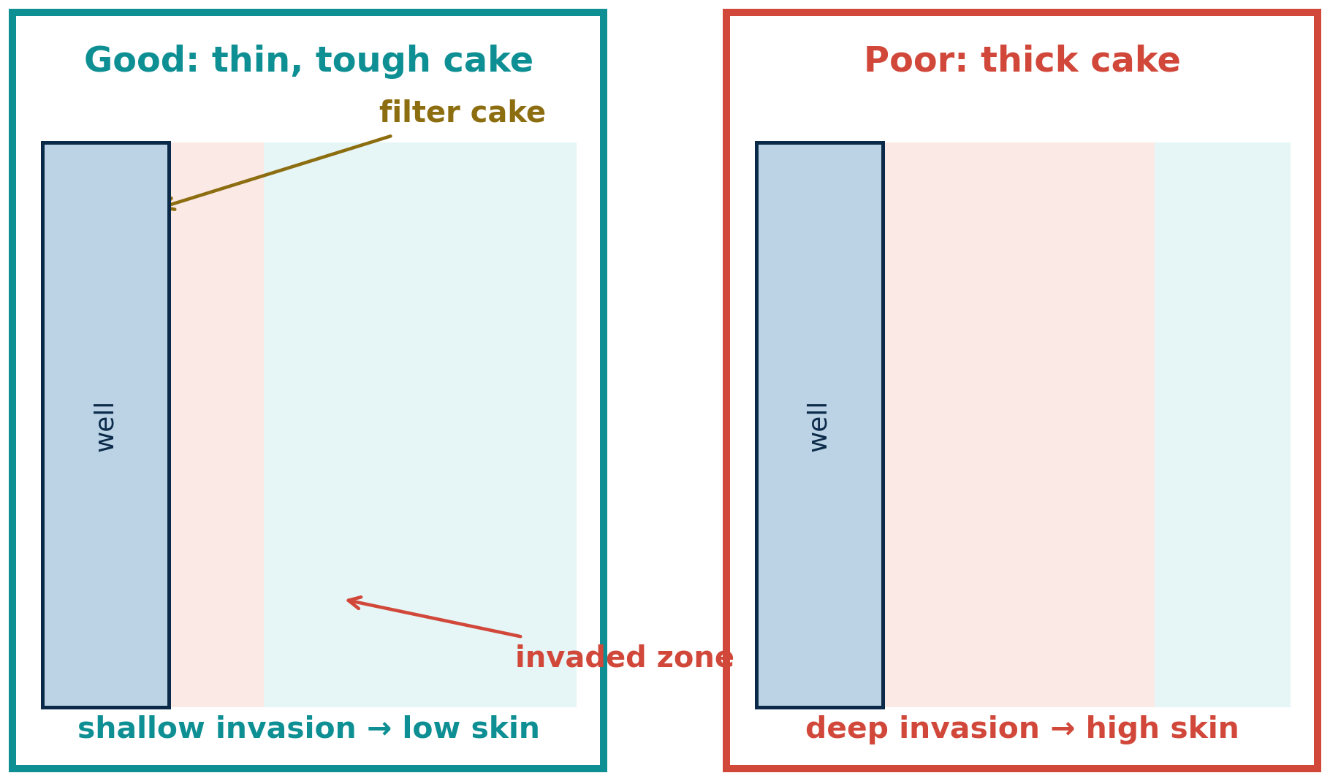
Prevention starts with fluid design
Fundamentals
Mechanisms
Quantification
Solutions
Next steps
• Size bridging agents ≈ ⅓ of pore throats
• Use acid-soluble CaCO₃ bridging particles
• Low filtrate loss: thin, tough filter cake
• Inhibitive brines (KCl) protect clays
• Minimize overbalance and exposure time
Schematic by author. Bridging rule after Abrams (1977).
18
Notes:
Prevention is really fluid design: bridging particles sized at about one third of the pore throats, acid-soluble carbonate bridging solids, low filtrate loss, inhibitive brines such as KCl, and minimum overbalance and exposure time.

Slide 19
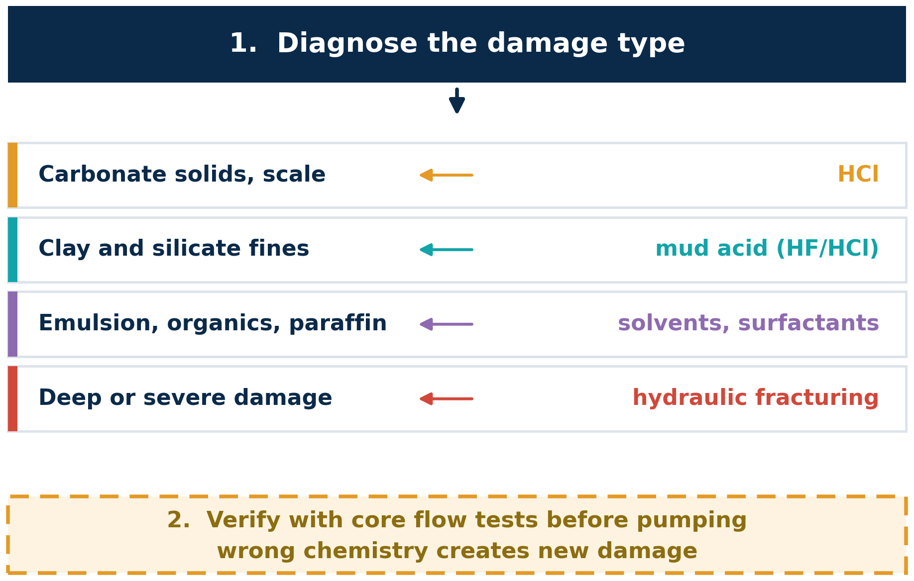
Remediation must match the damage type
Fundamentals
Mechanisms
Quantification
Solutions
Next steps
Damage | Typical treatment
Carbonate solids, scale | HCl
Clay and silicate fines | Mud acid (HF/HCl)
Emulsion, organics, paraffin | Solvents, surfactants
Deep or severe damage | Hydraulic fracturing
Diagnose first. Wrong treatment creates new damage.
Simplified from Economides et al. Always verify with lab tests.
19
Notes:
Remediation must match the damage: acid for carbonate solids and scale, mud acid for clays and fines, solvents for organics, fracturing for deep or severe damage. Diagnose first — the wrong chemistry creates new damage.

Slide 20
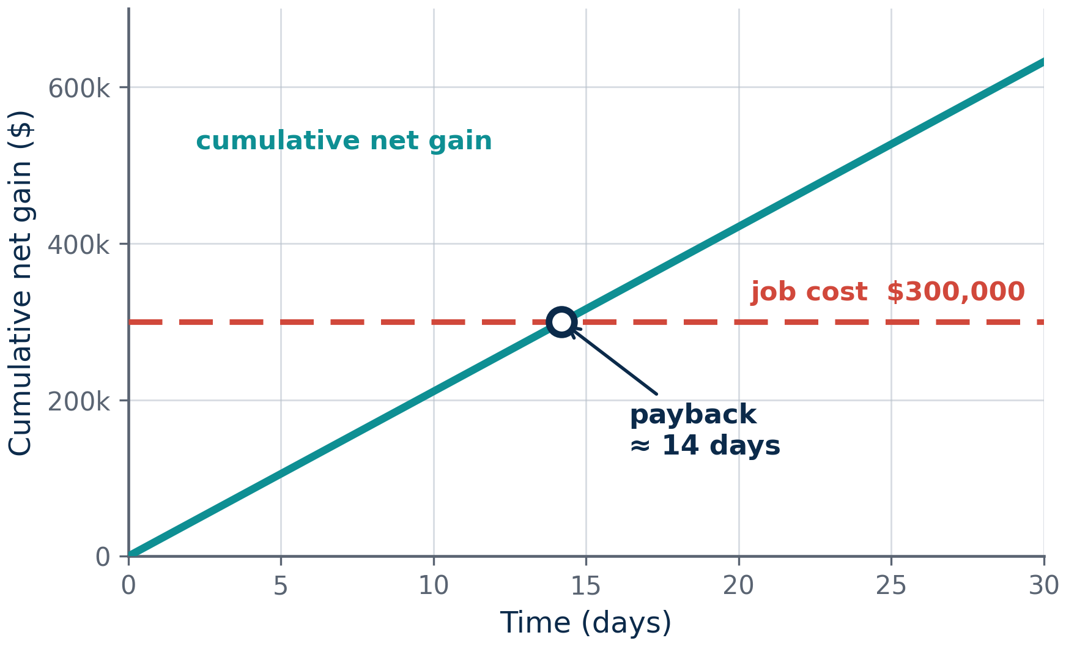
Remediation can pay back fast, but prevention avoids cost and risk
ILLUSTRATIVE DATA
• Acidizing example: S falls from 8.55 to 2
• Rate rises 1,910 → 3,310 STB/d
• Payback ≈ 14 days (assumed values)
• HSE: acid handling, flowback disposal
• Prevention avoids both cost and risk
Assumed: margin $30/bbl · 50% of gain sustained
job cost $300,000 · net gain ≈ $21,075/day
Author's calculation. Economic inputs are assumptions.
20
Notes:
Economics with assumed inputs: acidising takes skin from 8.55 to 2, adding 1,405 STB/d; at a $30 per barrel margin with half of the gain sustained, the job pays back in about 14 days. Add the HSE side: acid handling and flowback disposal.

Slide 21
Next step: a skin-based screening model for drilling-fluid damage
Fundamentals
Mechanisms
Quantification
Solutions
Next steps
1
2
3
4
5
Inputs
Skin
Productivity
Economics
Decision
k, h, k_{s}, r_{s}, drawdown
Hawkins equation
q and FE
Payback, net value
Prevent, treat, or ignore
Gap: damage is often treated qualitatively
Tools: Excel or Python, literature return-permeability data
Output: sensitivity charts and a decision guide
21
Notes:
The graduation project: a spreadsheet or Python screening model that takes k, h, ks, rs and drawdown, applies Hawkins, predicts rate and flow efficiency, adds simple economics, and outputs a prevent / treat / ignore recommendation.

Slide 22
Conclusions: damage is quantifiable and largely preventable
1. Mechanisms
2. Quantification
3. Strategies
• Invasion damages by plugging, swelling, trapping
• Example: skin 8.5 costs 55%
• Severity outweighs depth
• Prevention beats remediation
• Match treatment to damage type
22
Notes:
Three conclusions. First: invasion damages by plugging, swelling and trapping. Second: a skin of 8.5 costs 55% of rate, and severity outweighs depth. Third: prevention beats remediation, and any treatment must match the damage type.

Slide 23
References and questions
1. Hawkins, M.F. (1956). A note on the skin effect. Trans. AIME, 207.
2. van Everdingen, A.F. (1953). The skin effect and its influence on the productive capacity of a well. Trans. AIME, 198.
3. Krueger, R.F. (1986). An overview of formation damage and well productivity in oilfield operations. JPT, 38(2).
4. Abrams, A. (1977). Mud design to minimize rock impairment due to particle invasion. JPT, 29(5).
5. Earlougher, R.C. (1977). Advances in Well Test Analysis. SPE Monograph 5.
6. Civan, F. Reservoir Formation Damage. Gulf Professional Publishing.
7. Economides, M.J. et al. Petroleum Production Systems. Prentice Hall.
8. Bourgoyne, A.T. et al. (1986). Applied Drilling Engineering. SPE.
Thank you.
Questions?
Verify every reference in your library (volume, pages, editions) before submitting.
23
Notes:
Thank the audience, point to the reference list, and invite questions. Note that items 9 to 12 must come from your own literature table before submitting.

Slide 24
Backup: Hawkins' formula comes from series radial resistances
Damaged zone: Δp_{s} = [ q B μ / (0.00708 k_{s} h) ] ln(r_{s}/r_{w})
Undamaged zone: Δp_{u} = [ q B μ / (0.00708 k h) ] [ ln(r_{e}/r_{s}) − 0.75 ]
Sum: ln(r_{e}/r_{w}) − 0.75 + (k/k_{s} − 1) ln(r_{s}/r_{w})
Skin term: S = (k/k_{s} − 1) ln(r_{s}/r_{w})
Both zones are in series, so the pressure drops add — and the extra term is the skin.
B1
Notes:
Backup: the derivation of Hawkins' equation from two radial resistances in series — the damaged zone and the undamaged zone.

Slide 25
Backup: test skin combines several effects
S_{total} = S_{damage} + S_{perforation} + S_{partial penetration} + S_{deviation} + S_{non-Darcy}
Only S_{damage} is removable by damage treatment
A high test skin is not automatically a formation-damage problem — check completion and geometry first.
B2
Notes:
Backup: total test skin is the sum of damage, perforation, partial penetration, deviation and non-Darcy effects. Only the damage part can be removed by a damage treatment.

Slide 26
Backup: bridging theory sets particle size
• Median bridging particle ≈ ⅓ median pore throat
• Bridging solids ≥ 5% by volume (Abrams)
• Too fine: deep invasion. Too coarse: no bridge
Sizing is a balance: fine enough to form a bridge, coarse enough to stay on the wall.
B3
Notes:
Backup: the Abrams bridging rule — bridging particles at about one third of the median pore-throat size, with enough solids to build the bridge.

Slide 27
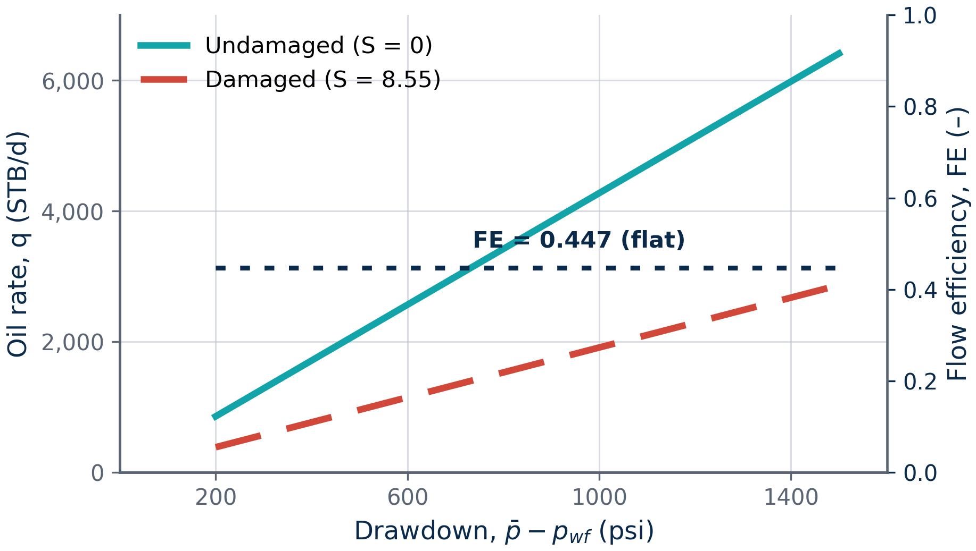
Backup: drawdown scales rate, not flow efficiency
• q scales linearly with drawdown
• FE depends only on ln(r_{e}/r_{w}) − 0.75 and S
• Relative loss is independent of drawdown
B4
Notes:
Backup: increasing drawdown lifts both rates proportionally, so flow efficiency stays at 0.447 — you cannot produce your way out of damage.

Slide 28
Backup: fluid comparison (qualitative)
Fluid | Main advantage | Main damage risk
Water-based | Low cost | Clay swelling, water block
Oil-based | Shale inhibition | Wettability change, emulsions
Formate brine | Low solids | High cost
Polymer + CaCO₃ | Thin, acid-soluble cake | Polymer residue
Check this table against your course notes. The risks depend on the formation.
B5
Notes:
Backup: a qualitative comparison of drilling-fluid families, with the main advantage and the main damage risk of each.

