Slide 1
Artificial Intelligence
A subfield of computer science called artificial intelligence (AI) seeks to build devices or systems that are capable of carrying out operations that ordinarily call for human intelligence.
Reasoning, learning, problem-solving, perception, language comprehension, and decision-making are some of these tasks.
Artificial intelligence (AI) systems are meant to mimic human cognitive capacities and to grow and change with time as a result of experience.

Slide 2
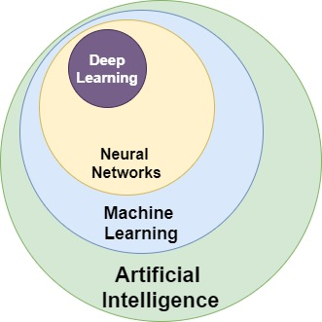
Key concepts in Artificial Intelligence

Slide 3
Key concepts in AI
1. Machine Learning:
Machine learning is a subset of AI that focuses on enabling machines to learn from data and improve their performance over time without being explicitly programmed. Common machine-learning techniques include supervised learning, unsupervised learning, and reinforcement learning.
2. Deep Learning:
Deep learning is a type of machine learning that utilizes artificial neural networks with multiple layers to learn complex patterns and representations from data. Deep learning has led to significant breakthroughs in areas such as image recognition, speech recognition, and natural language processing.
3. Natural Language Processing (NLP):
NLP is a subfield of AI that focuses on enabling computers to understand, interpret, and generate human language. NLP techniques are used in applications such as language translation, sentiment analysis, and chatbots.
4. Computer Vision:
Computer vision is the field of AI that focuses on enabling computers to interpret and analyze visual information from the real world. Computer vision techniques are used in applications such as image recognition, object detection, and facial recognition.

Slide 4
Application of Artificial Intelligence
Healthcare: AI is utilized in drug research, medical image analysis, disease diagnosis, tailored therapy suggestions, and healthcare administration systems.
Finance: Artificial intelligence is used in chatbots for customer support, credit scoring, algorithmic trading, fraud detection, and risk assessment.
Transportation: AI drives ridesharing algorithms, driverless vehicles, traffic management systems, logistics optimization, and predictive maintenance for transportation infrastructure.
Retail: Demand forecasting, supply chain optimization, inventory management, automated customer support, and personalized suggestions are all made possible by AI.
Education: AI makes it possible to create educational content, detect plagiarism, analyze student performance, and provide tailored learning platforms and intelligent tutoring systems.

Slide 5
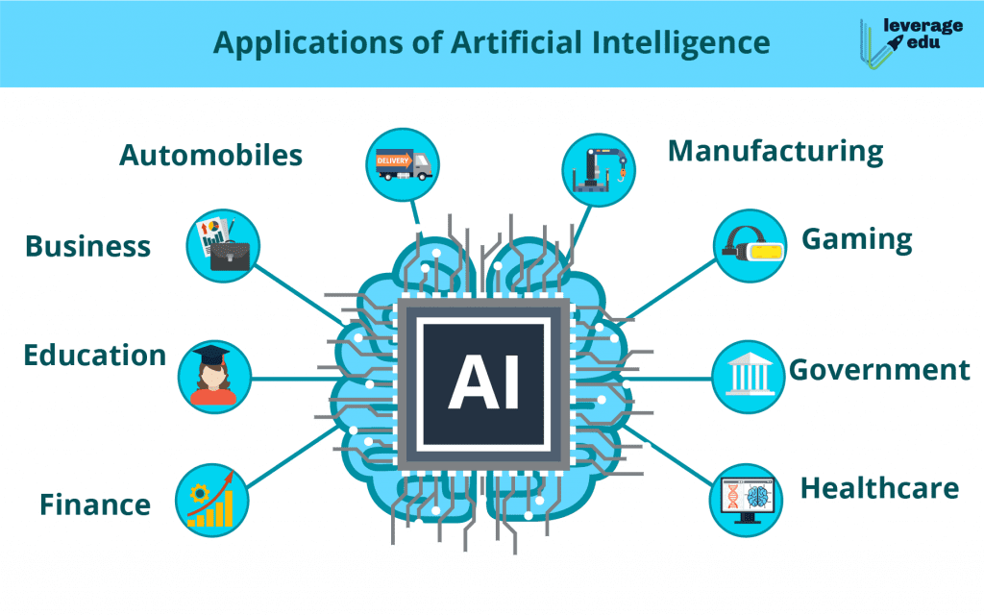

Slide 6
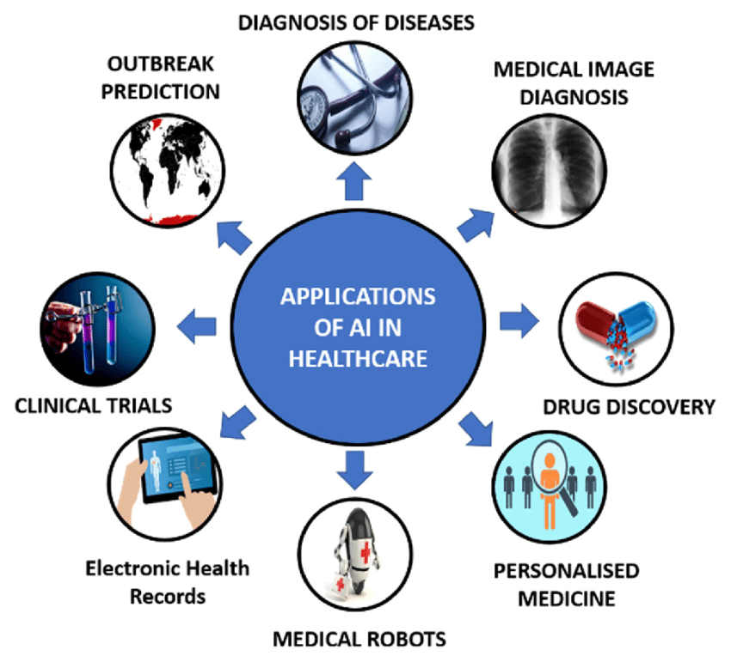

Slide 7
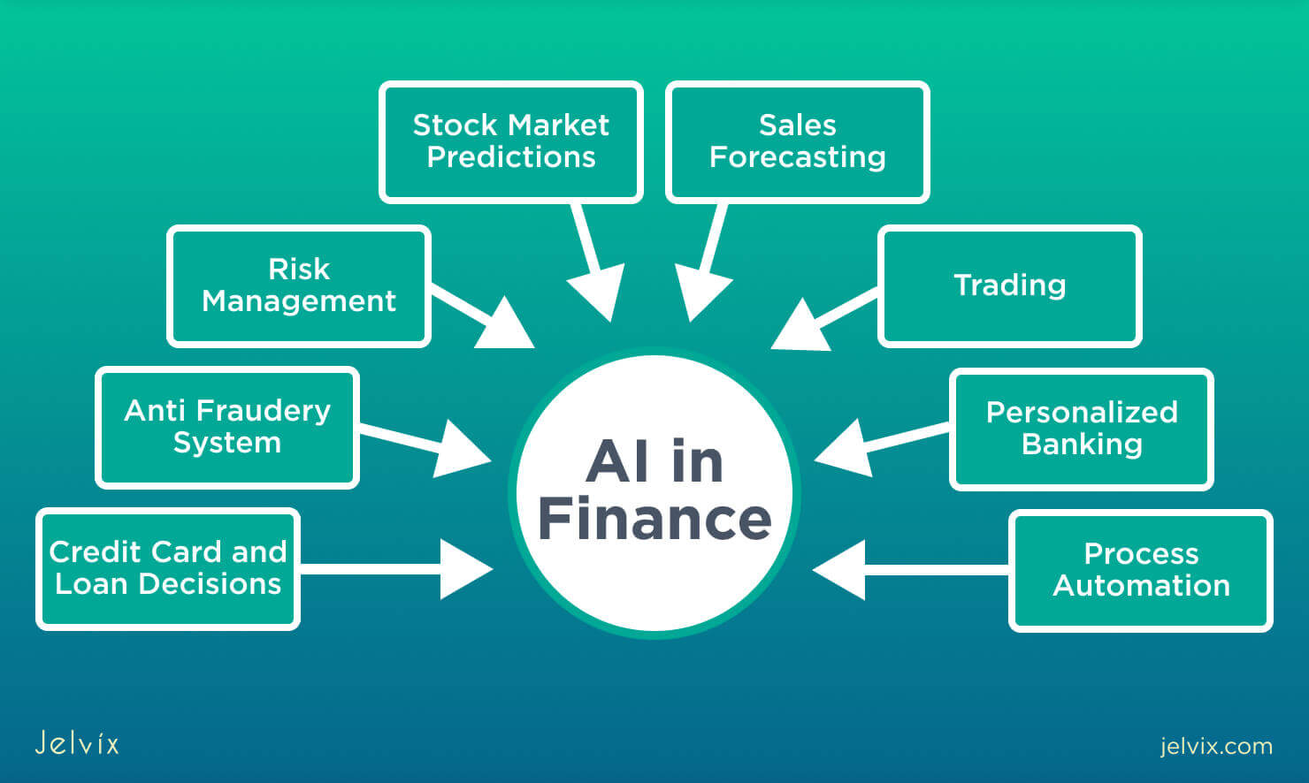

Slide 8
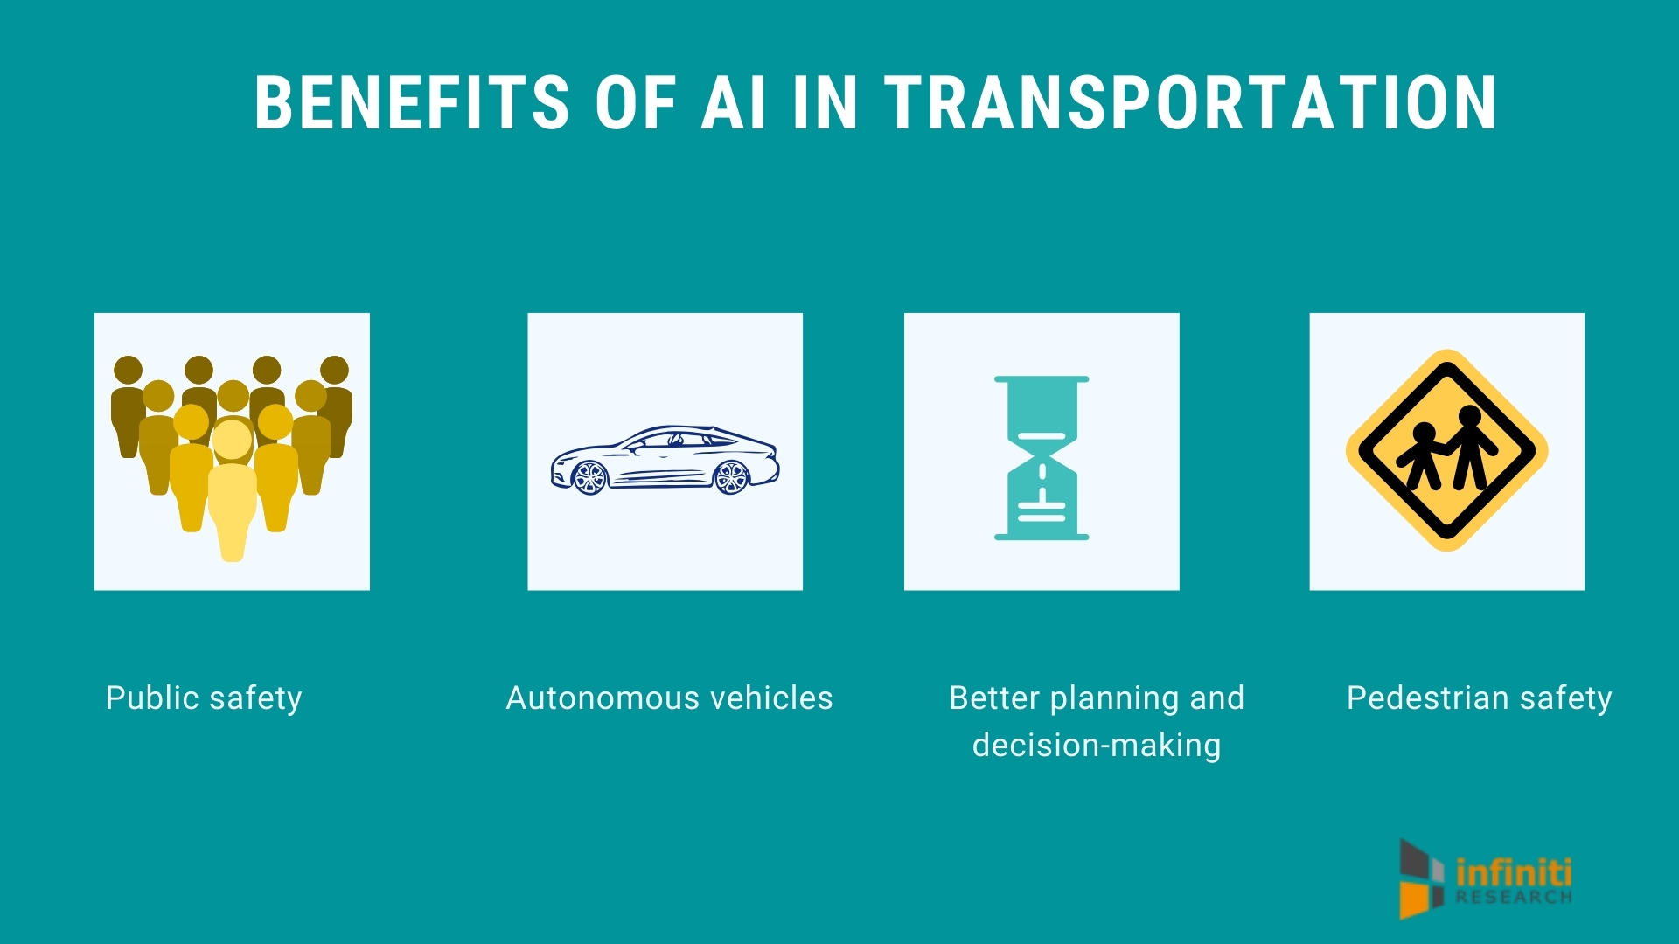

Slide 9
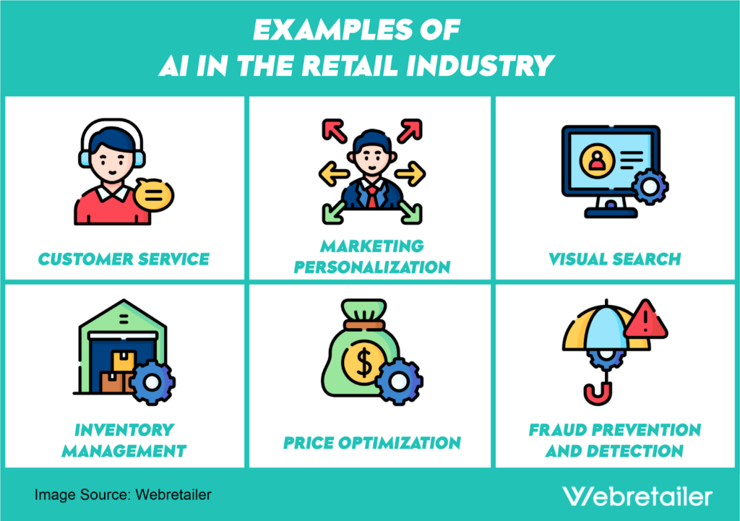

Slide 10
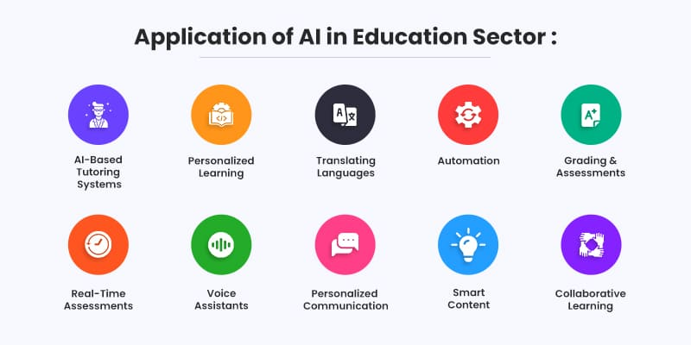

Slide 11
Challenges and considerations in Ai
Ethical Considerations: Issues regarding AI systems' effects on society, privacy, bias, justice, accountability, and transparency.
Data Quality and Bias: High-quality data is necessary, as are steps to overcome data biases that may cause unfair or discriminating results in AI systems.
Interpretability and Clarity: The difficulty of comprehending and analyzing the choices and actions of sophisticated artificial intelligence systems, particularly in crucial fields like banking and healthcare.
Robustness and Security: Making sure AI systems adhere to security and privacy laws and are resistant to malicious attempts, mistakes, and failures.

Slide 12
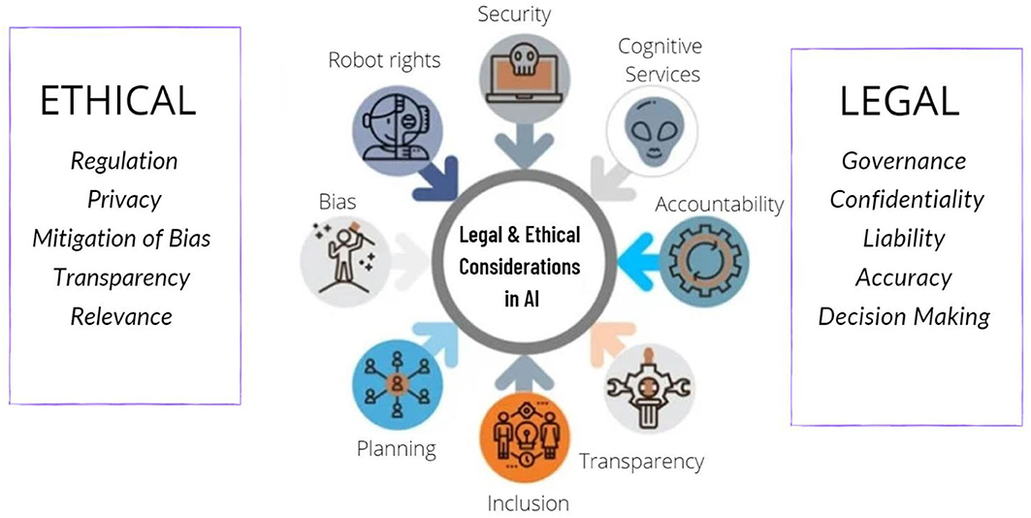

Slide 13
Future trends in AI
Collaboration between humans and AI systems: The development of AI systems that work with people to increase productivity, improve decision-making, and augment human capabilities.
Autonomous Systems: Technological developments in drones, robotics, autonomous cars, and smart infrastructure that result in more automation and autonomy across a range of industries.
AI for Good: The use of AI for social good, including applications in healthcare, education, environmental sustainability, disaster response, and poverty alleviation.

Slide 14
Developments in Deep Learning: Ongoing study and research into deep learning methods like Transformers and GANs (Generative Adversarial Networks).
AI-Powered Healthcare: AI-powered advancements in drug development, medical imaging, and patient diagnosis and treatment.

