Slide 1
Machine learning
Machine Learning (ML) is an area of artificial intelligence (AI) that studies the creation of algorithms and models that allow computers to learn from data and make predictions or judgments without being explicitly programmed for each task. It entails developing systems that can automatically learn and improve via experience, allowing them to do jobs more precisely or effectively over time.

Slide 2
It involves the creation of systems that can automatically learn and improve from experience, enabling them to perform tasks more accurately or efficiently over time

Slide 3
key steps machine learning
1. Problem Definition
First things first, where are we headed? Clearly define the problem you want to solve and the goals you aim to achieve. Are you predicting customer churn, diagnosing diseases, or generating creative content?
2. Data Collection
Gather relevant data from various sources, ensuring it is clean, relevant, and sufficient for the task.
3. Data Preprocessing
Data preprocessing is like cleaning, sorting, and preparing those ingredients. Address missing values, outliers, and inconsistencies to ensure your data is ready for the next step.

Slide 4
4. Feature Engineering
Select, extract, or create meaningful features from the data to improve model performance.
5. Model Selection
Choose appropriate machine learning algorithms based on the problem type, data characteristics, and desired outcomes.
6. Model Training
Train the selected model on the training data using appropriate techniques such as cross-validation to optimize performance.

Slide 5
7. Model Evaluation
Evaluate the trained model's performance using appropriate metrics and validate it on separate test data to assess generalization
8. Model Tuning
Fine-tune hyperparameters and adjust model complexity to improve performance. Fine-tuning is like adjusting the seasoning in your dish.
9. Deployment
Deploy the trained model into production, integrating it into existing systems or applications for real-world use.

Slide 6
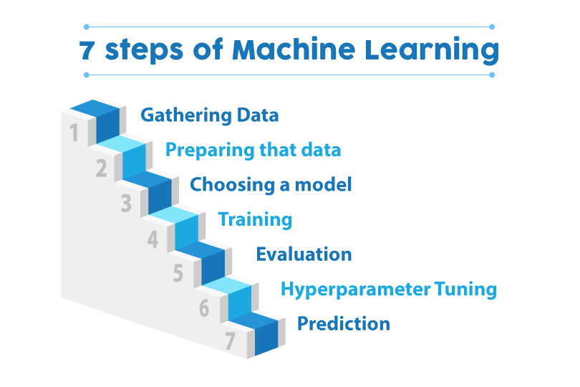
Key concepts in Artificial Intelligence

Slide 7
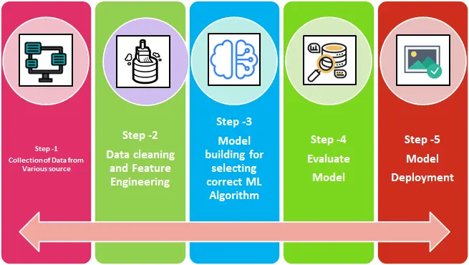

Slide 8
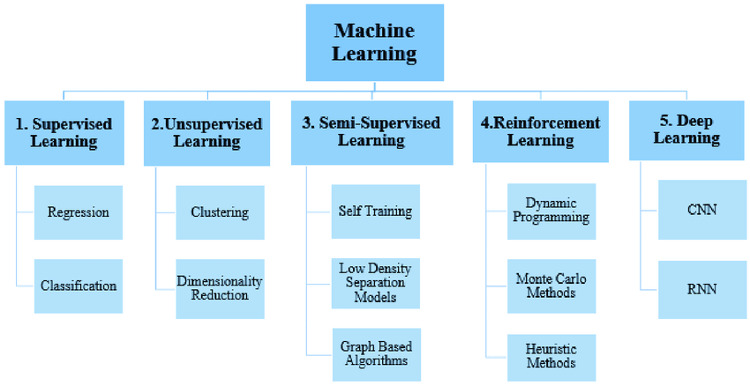

Slide 9
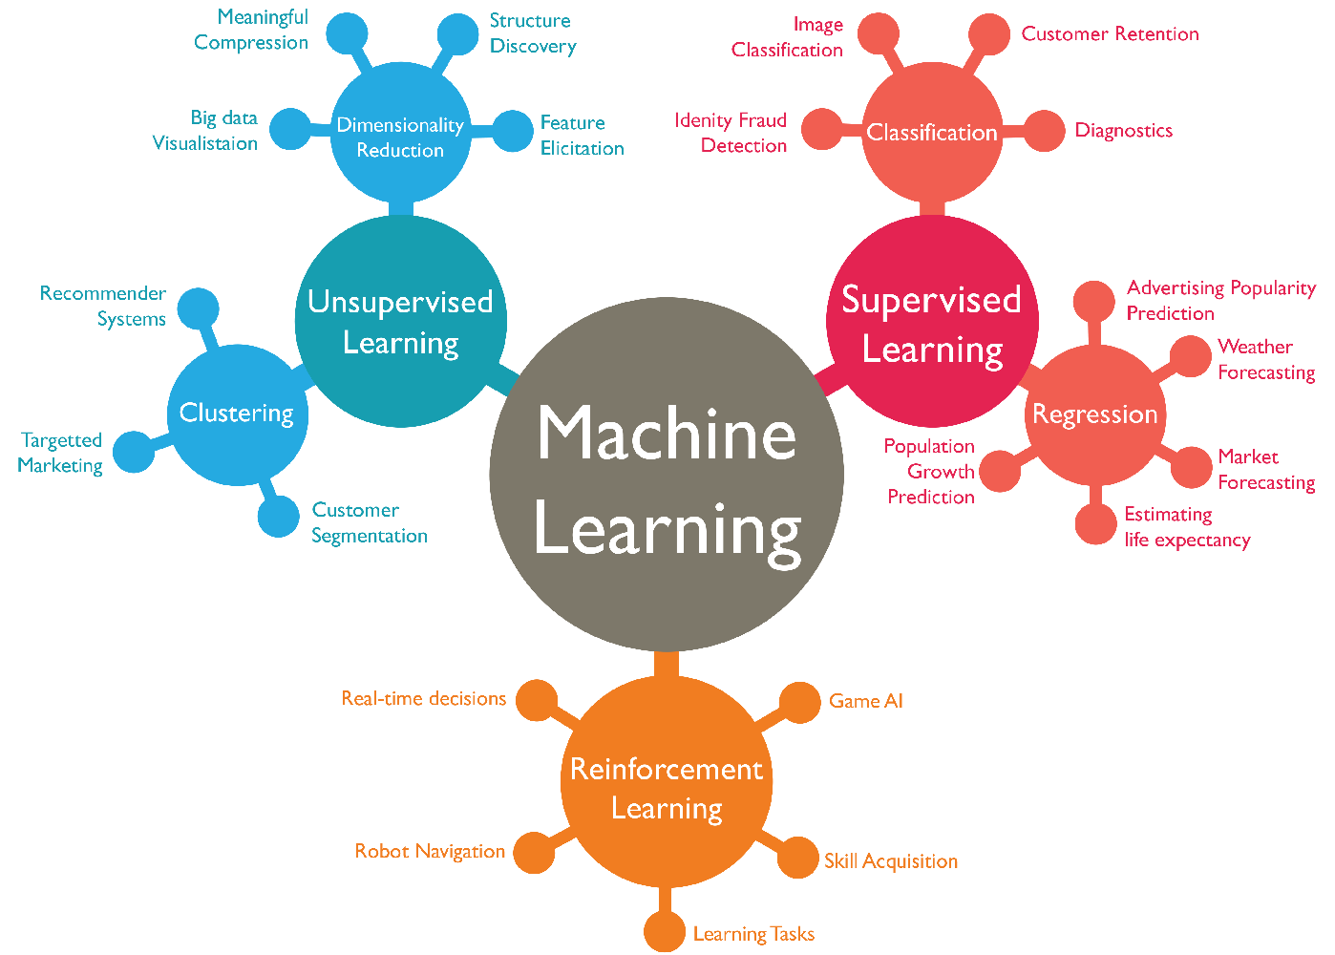

Slide 10
Supervised learning
It’s a type of machine learning where the algorithm learns from labeled data, meaning each training example consists of an input-output pair.
The algorithm learns to map inputs to outputs based on the provided examples.
Supervised machine learning is a powerful technique for solving classification and regression problems by learning from labeled data.
By training models to recognize patterns and relationships in data, supervised learning enables the development of predictive models that can make accurate predictions on unseen inputs.

Slide 11
Classification: In classification tasks, the algorithm learns to predict a categorical label or class for a given input. For example, classifying emails as spam or not spam, or identifying an image as a cat or a dog.
Regression: In regression tasks, the algorithm learns to predict a continuous numerical value for a given input. For example, predicting house prices based on features such as location, size, and number of bedrooms.

Slide 12
Labeled data
Labeled data is made up of input-output pairs, where the algorithm accepts data as input and outputs the matching label or category to that data.
Labels can be numerical (e.g., property prices, temperature readings) or categorical (e.g., dog/cat, spam/not spam).

Slide 13
Training procedure
In the course of training, the algorithm builds a model that encapsulates the underlying patterns and relationships between inputs and outputs by iteratively learning from the labeled data.
To decrease the discrepancy between the expected outputs and the actual labels in the training data, the algorithm modifies its internal parameters or structure.

Slide 14
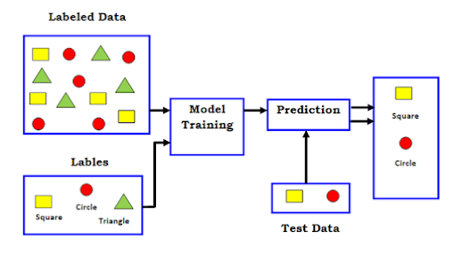

Slide 15
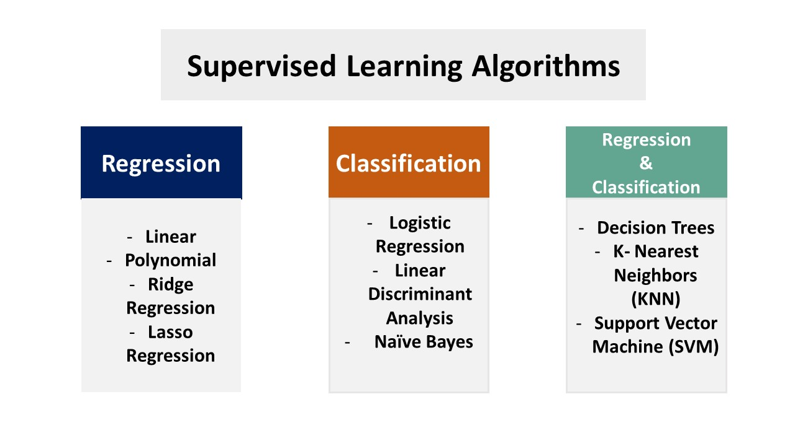

Slide 16
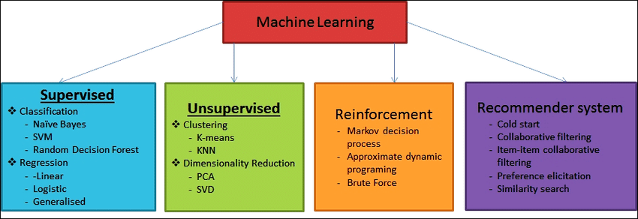
Supervised learning algorithms

Slide 17
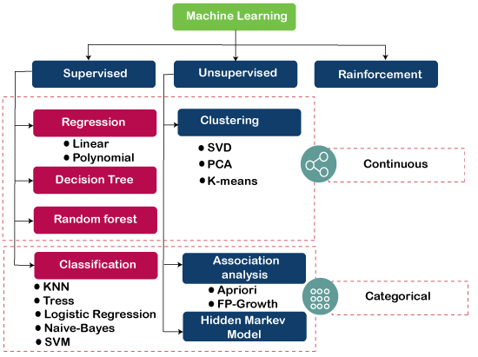

Slide 18
Linear regression
Linear regression is a simple and widely used regression algorithm that models the relationship between a dependent variable (target) and one or more independent variables (features) by fitting a linear equation to the observed data points.
It is commonly used for predicting continuous numerical values.
Imagine you are trying to estimate the price of a car based on its mileage. Linear regression can help you model this relationship by fitting a straight line to the data, where each point represents a car's mileage and price

Slide 19
How linear regression works
Data Points: It analyzes data points, each with an independent variable (like size) and a dependent variable (like price).
Finding the Line: It draws a straight line that best fits the data points, minimizing the overall error between the line's predictions and the actual values.
Prediction Power: Once the line is fitted, you can use it to predict the dependent variable for new data points. For example, if a new house has a certain size and location, the line can estimate its price.

Slide 20
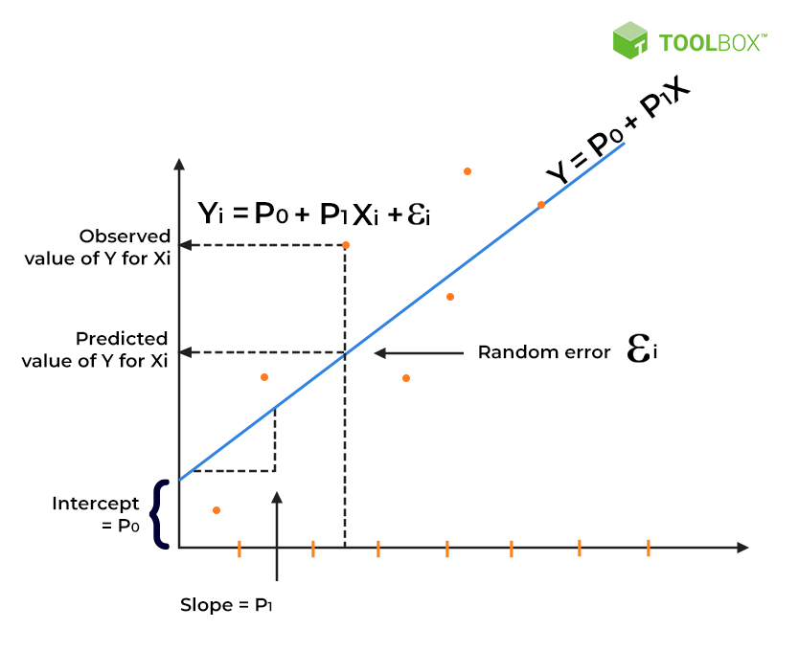

Slide 21
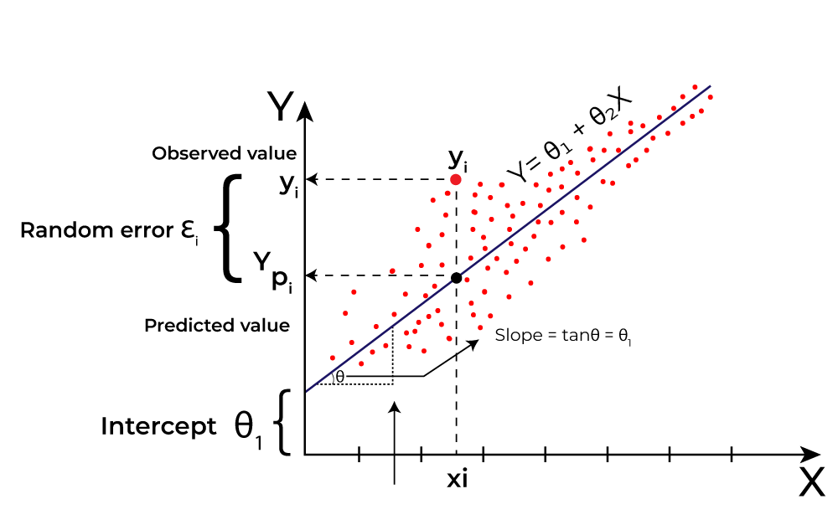

Slide 22
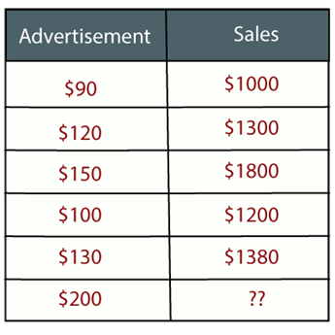

Slide 23
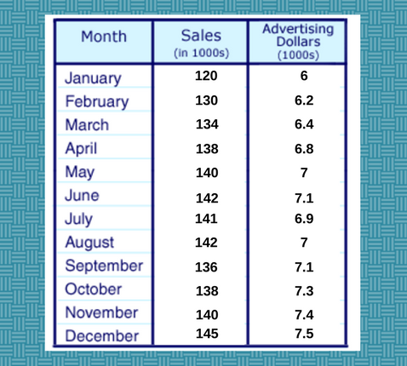

Slide 24
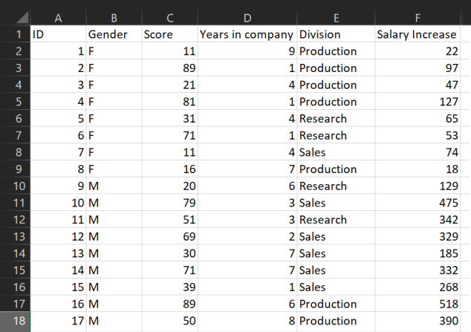

Slide 25
Logistics regression
Logistic regression is a classification algorithm used for binary classification tasks, where the output variable (target) is binary (0 or 1).
It models the probability that a given input belongs to a particular class using the logistic function (sigmoid function).
Imagine you want to classify emails as spam or not spam.
That's where logistic regression.
It takes an input, analyzes it, and predicts the probability of it belonging to one of two classes (in this case, spam or not spam).

Slide 26
How logistics regression works
Data Points: It analyzes data points, each with features and a binary target variable (0 or 1).
Probability Power: It uses the logistic function (sigmoid function), which squishes any input value between 0 and 1. This essentially translates the analysis into a probability of belonging to class 1 (e.g., spam).
Decision Time: Based on a chosen threshold (usually 0.5), it predicts class 1 if the probability is above the threshold, and class 0 otherwise. So, if the spam probability is 0.8, it's classified as spam; if it's 0.3, it's likely not spam.

Slide 27
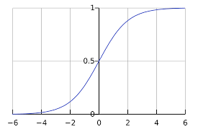
Logistic regression graph

Slide 28
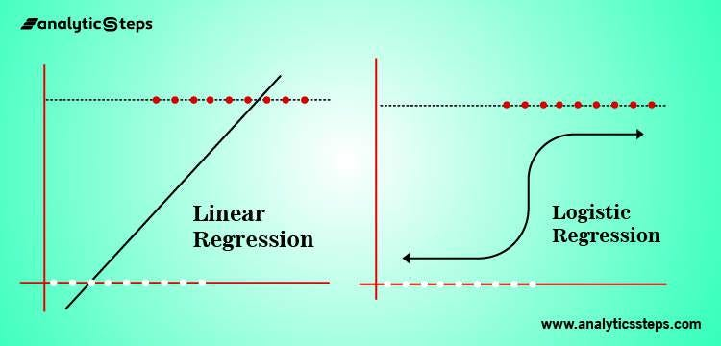

Slide 29
Decision trees
Decision trees are versatile supervised learning algorithms that can perform both classification (predicting categories) and regression (predicting numerical values) tasks.
They work by recursively partitioning the feature space into regions based on the values of input features, with each partition representing a decision or split in the tree.
Decision trees are like intelligent decision-makers in the world of machine learning.

Slide 30
Decision tree algorithms are a widely used machine learning tool for classification and regression tasks.
They divide the dataset repeatedly into subsets based on feature values, resulting in a tree-like structure with each node representing a feature and each branch representing a choice based on that feature.
The operation continues until the data is properly partitioned or a halting requirement is fulfilled.
Decision trees are interpretable and adaptable, able to handle both numerical and categorical information.
They improve comprehension of decision-making processes and can deal with nonlinear relationships.
They may, however, experience overfitting if not cleaned or regularized adequately.

Slide 31
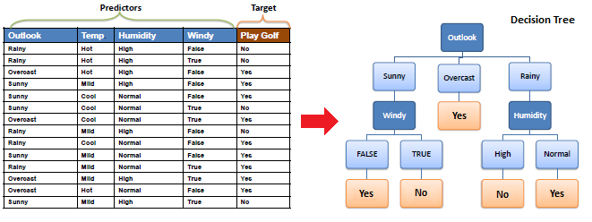

Slide 32
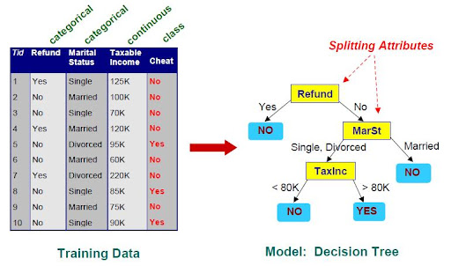

Slide 33
Random forest
Random forests are ensemble learning methods that combine multiple decision trees to improve predictive accuracy and reduce overfitting.
They train multiple decision trees on random subsets of the training data and aggregate their predictions to make the final prediction.
Random Forest is an ensemble learning technique for classification and regression applications.

Slide 34
During training, it constructs numerous decision trees and outputs their mode (for classification) or mean prediction (for regression).
Each tree is constructed using a random selection of features and bootstrapped samples from the training data, which introduces unpredictability while reducing overfitting.
During prediction, the ensemble of trees aggregates their outputs, yielding robust and reliable results.
Random Forest is well-known for its simplicity, scalability, and capacity to handle high-dimensional data, making it a popular choice for machine learning applications.

Slide 35
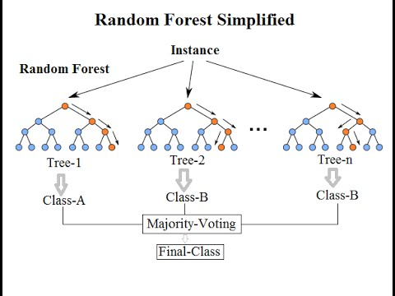

Slide 36
Support vector machines (SVM)
Support Vector Machines (SVMs) are a distinct breed of supervised learning algorithms, specifically designed for classification tasks.
They work by creating a clear dividing line, called a hyperplane, between different groups of data points. But unlike other algorithms, SVMs don't just draw any line – they strive for the optimal hyperplane that maximizes the margin between the classes.
Think of it like separating two groups of friends at a party. You wouldn't just draw a random line down the middle, would you? You'd try to find the widest possible gap, ensuring the two groups are as distinct as possible. That's the essence of SVMs.

Slide 37
Neural networks
Neural networks are a class of machine learning models inspired by the structure and function of the human brain. They consist of interconnected layers of neurons (nodes) that process and transform input data to produce output predictions. Neural networks can learn complex patterns and relationships in data through a process called training, where the model adjusts its parameters to minimize the difference between predicted and actual outputs.
Components of a Neural Network:
Input Layer: Receives input data and passes it to the next layer.
Hidden Layers: Intermediate layers between the input and output layers. Each neuron in a hidden layer performs a computation based on the inputs it receives and passes the result to the next layer.
Output Layer: Produces the final predictions or outputs of the model.
Weights and Biases: Parameters of the model that are learned during training to adjust the strength of connections between neurons and the neuron's activation threshold, respectively.
Activation Functions: Non-linear functions applied to the output of neurons to introduce non-linearity into the model, enabling it to learn complex relationships.

Slide 38
Types of Neural Networks
Feedforward Neural Networks (FNN): Neurons are organized in layers, and information flows in one direction, from input to output.
Convolutional Neural Networks (CNN): Designed for processing grid-like data, such as images, by using convolutional layers to detect spatial patterns.
Recurrent Neural Networks (RNN): Designed for sequential data, such as time series or natural language, by introducing connections between neurons to capture temporal dependencies.
Long Short-Term Memory Networks (LSTM): A type of RNN that can learn long-term dependencies by maintaining a memory state over time.

Slide 39
Example
Consider an image classification task where we want to classify images of handwritten digits (0-9) using a neural network.
We can use a convolutional neural network (CNN) for this task.
The CNN will learn to detect features like edges and shapes in the input images through convolutional layers and make predictions about the digit present in the image through its output layer

