Slide 1

Makeathon 2026 · Bot Companion
Jarvis
Your private AI companion
that lives on your desk
On-device AI
Private by design
Works offline
Team The Spark 2.0
Krati Omer · Varad Kalambarkar · Shailesh Jadhav · Gayatri Gopireddi · Shubhangi Dwivedi
Notes:
TITLE (about 15 seconds)
Hi, we're team The Spark 2.0. This is Jarvis, your private AI companion that lives on your desk.
Everything you see today runs on the device itself: the speech recognition, the AI and the voice. It's private by design, and it keeps working even without internet.
The logo is Jarvis's real face from its screen: two glowing eyes and a smile.
Team The Spark 2.0: Krati Omer, Varad Kalambarkar, Shailesh Jadhav, Gayatri Gopireddi, Shubhangi Dwivedi.

Slide 2




Why Jarvis?
The problem with today's assistants
Your voice goes to the cloud
Tools, not companions
No internet, no help
Most assistants send what you say, even health and mood, to company servers.
They answer commands but don't remember you or care how you feel.
Cloud assistants stop working the moment the Wi-Fi drops.
Notes:
Today's assistants have three problems. They send your voice to the cloud, they are tools rather than companions, and they stop working without internet. Jarvis fixes all three.

Slide 3





Core Vision Elements
Private
On-device
Companion
Transparency
Honest
1
2
3
4
5
Your voice and personal data stay on the device.
Core features run fully on a Raspberry Pi 5.
Remembers you, gets things done, helps you focus and feel better.
The light shows when it's listening, the screen shows what goes online, and the switch shows the mic is truly off.
Says "I'm not sure" instead of guessing.
Notes:
Five ideas guide Jarvis: private, on-device, a real companion, transparent and honest.

Slide 4





Jarvis: end-to-end flow
From “Hey Jarvis” to a spoken answer, all on the Raspberry Pi 5
1 Listen
2 Understand
3 Decide
4 Check
5 Respond
Mic + mute switch
“Hey Jarvis” wakes it
Green LED on
Whisper turns speech
into text
Fixes mishearings
Safety first, then code,
a tool, then local AI
(Qwen 2.5)
Confidence ≥ 0.85
No guesses about you
No false claims
Piper speaks
Screen shows it
Memory (on device)
SQLite: memories, lists, settings
Online, only when you ask
Weather · news · Wikipedia · every call logged
All AI runs on the device · audio never leaves · every online call is shown on screen
Notes:
END-TO-END FLOW (about 30 seconds)
One sentence, start to finish.
Listen: the mic is open only when the mute switch is off. Saying Hey Jarvis wakes it, and the green light comes on.
Understand: Whisper turns your speech into text on the device, and we fix common mishearings.
Decide: safety comes first: emergencies and harmful requests are handled by code before anything else. Then plain code answers, like lists, reminders and emergencies. If a live fact is needed, a tool fetches it. Only then does the local AI, Qwen 2.5, answer, using your memories stored on the device.
Check: if the AI is less than 85 percent confident, it says it's not sure; it never guesses facts about you, and false claims like 'I've added it' are blocked.
Respond: Piper speaks the answer and the screen shows it.
Key message: all AI runs on the device, audio never leaves it, and every online call is shown on screen.

Slide 5
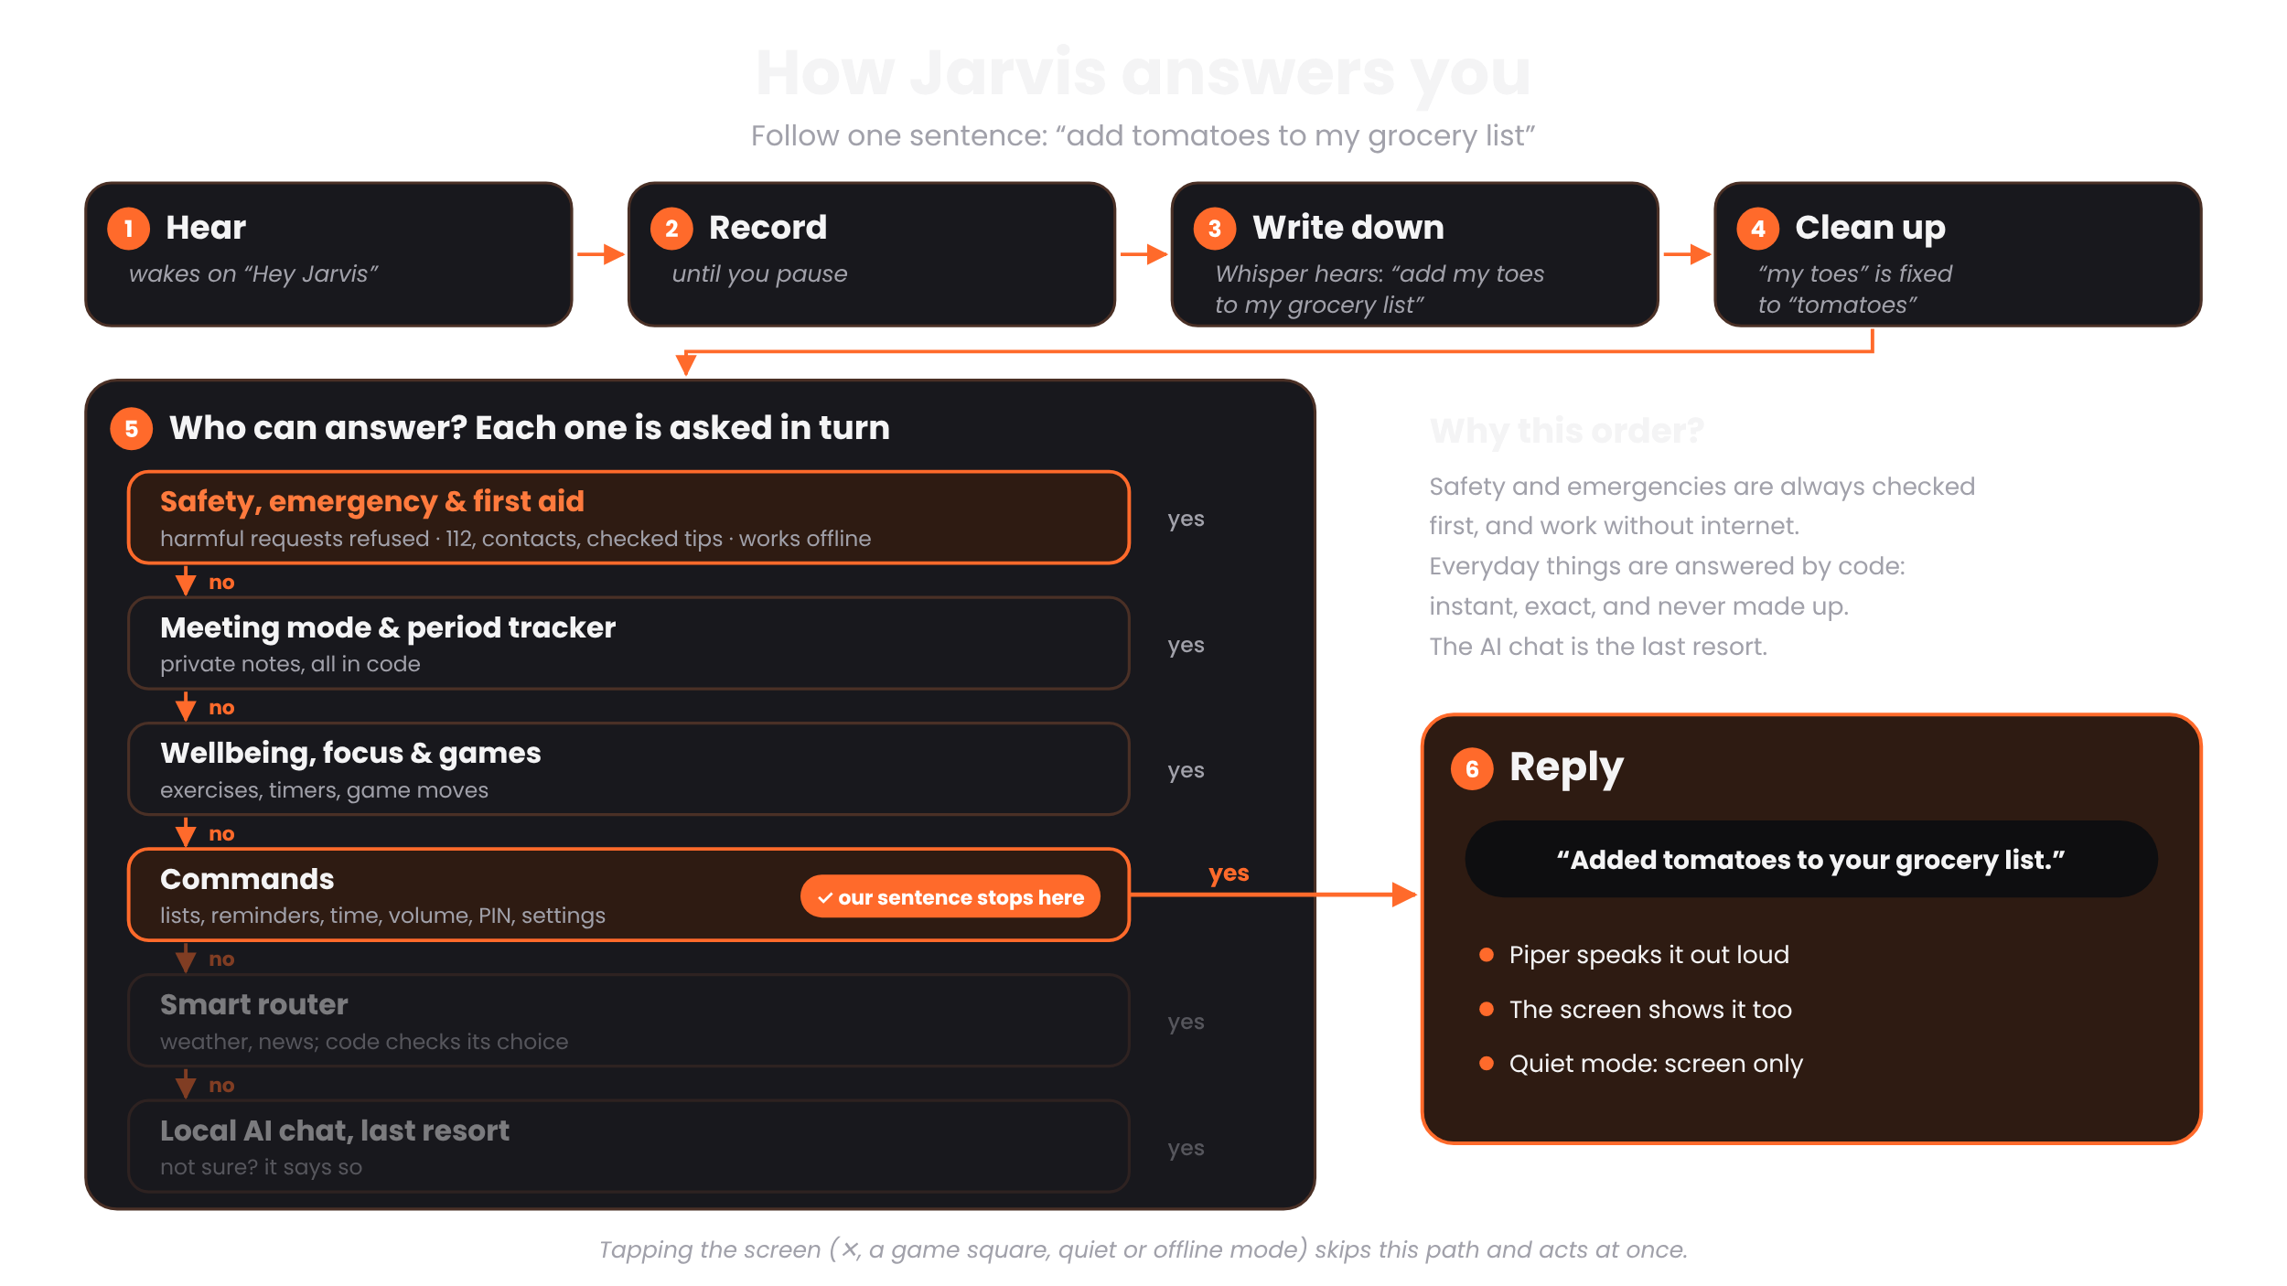

Slide 6
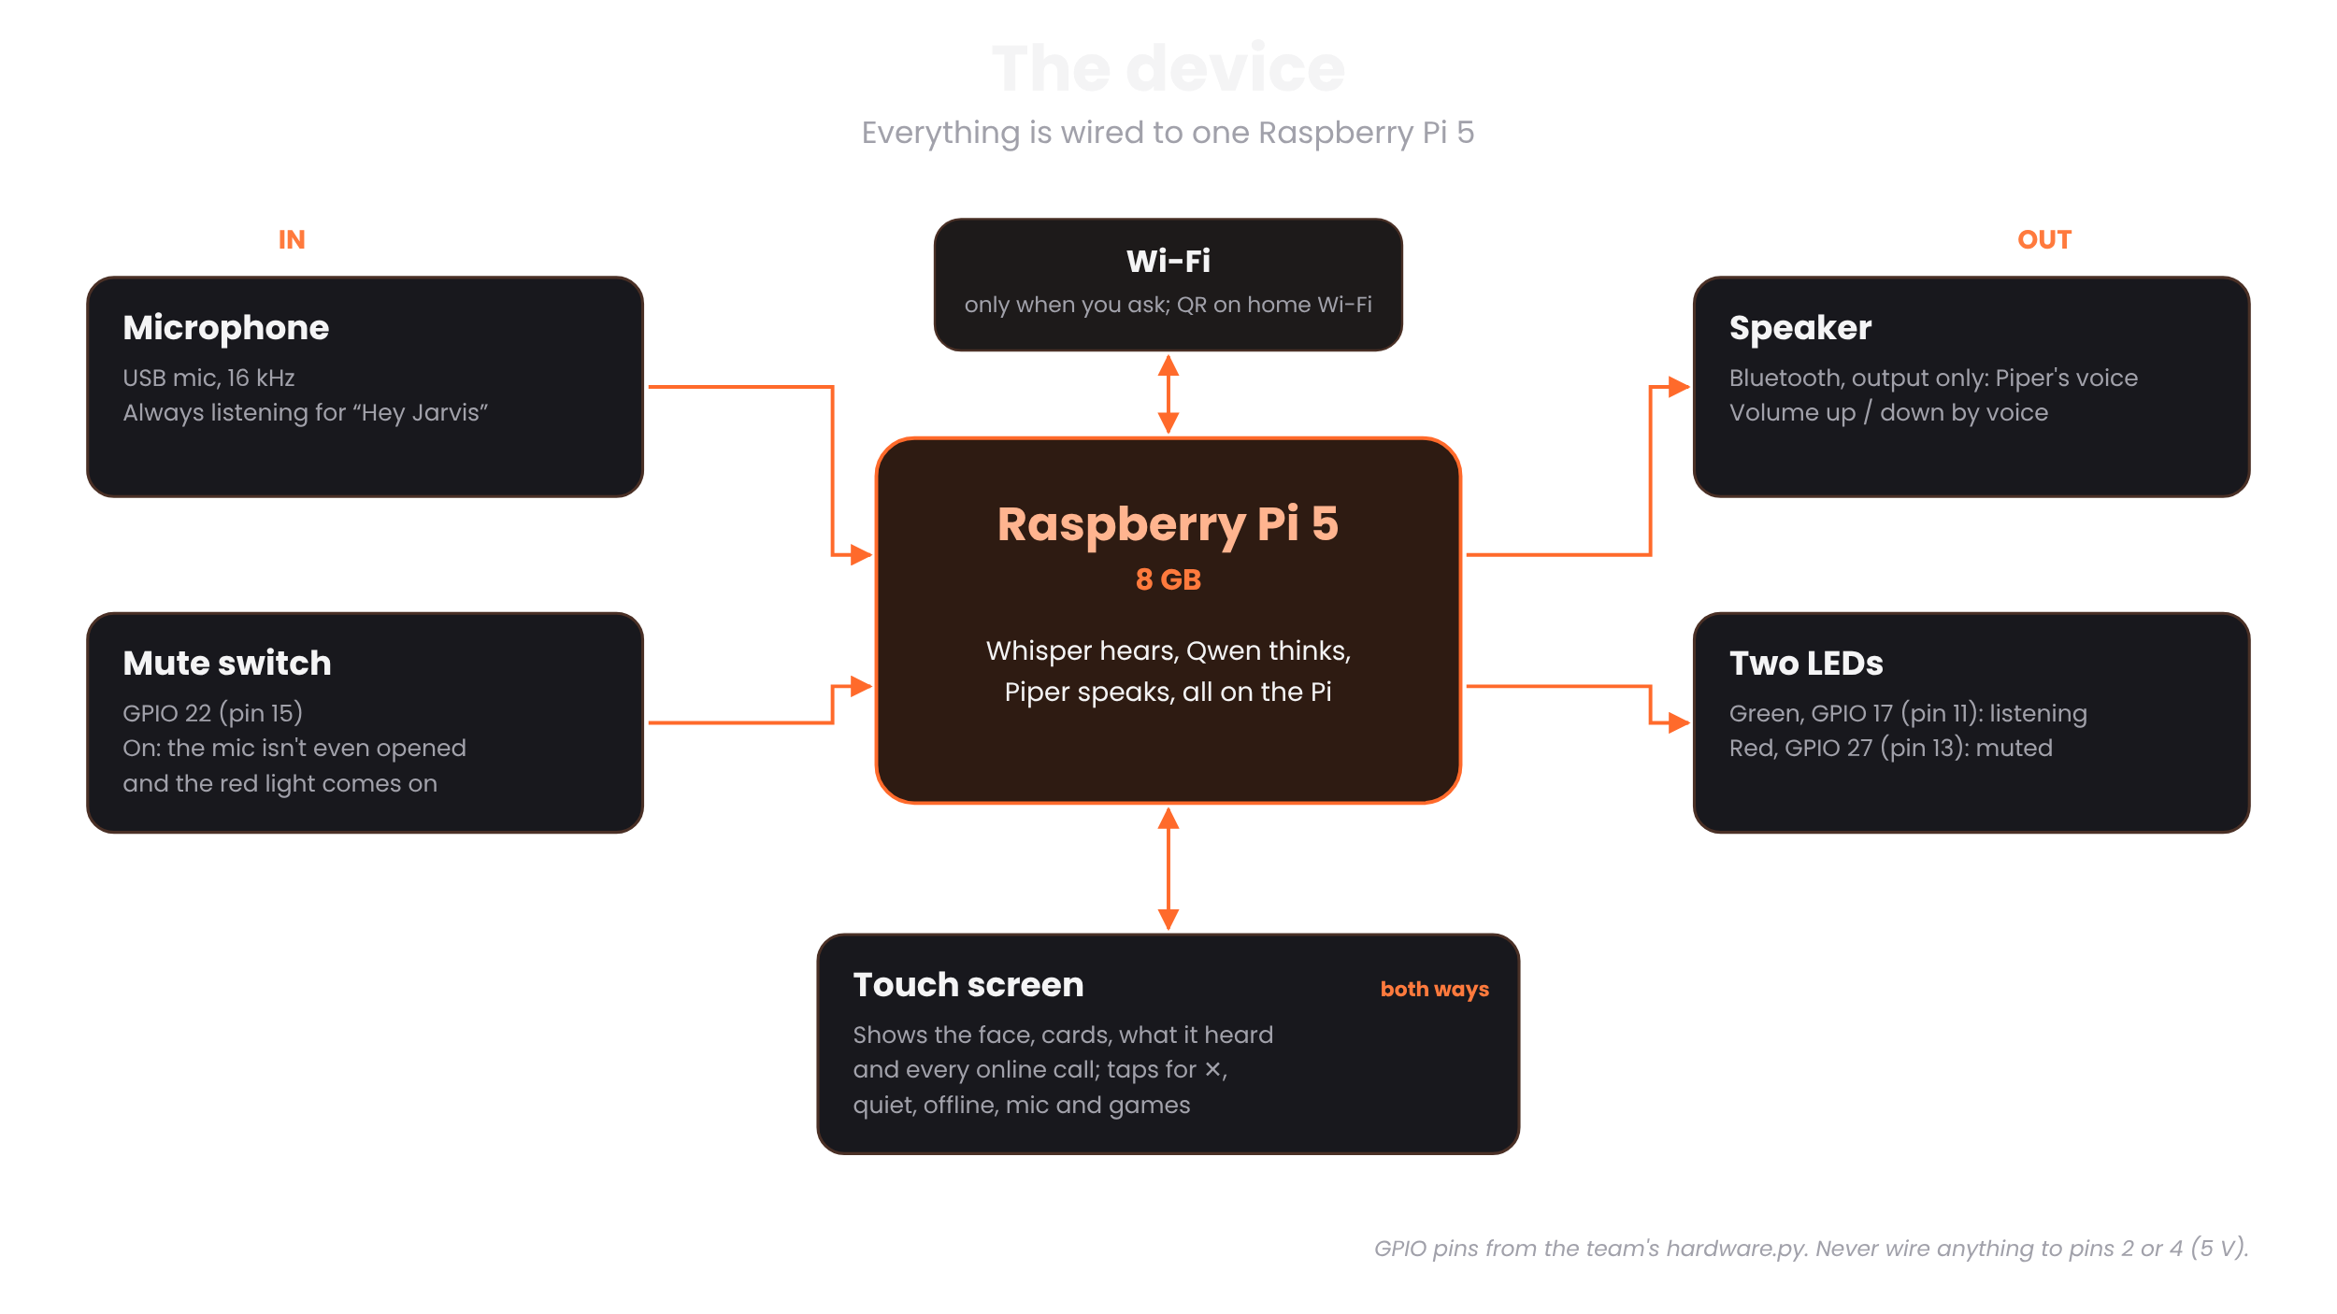

Slide 7
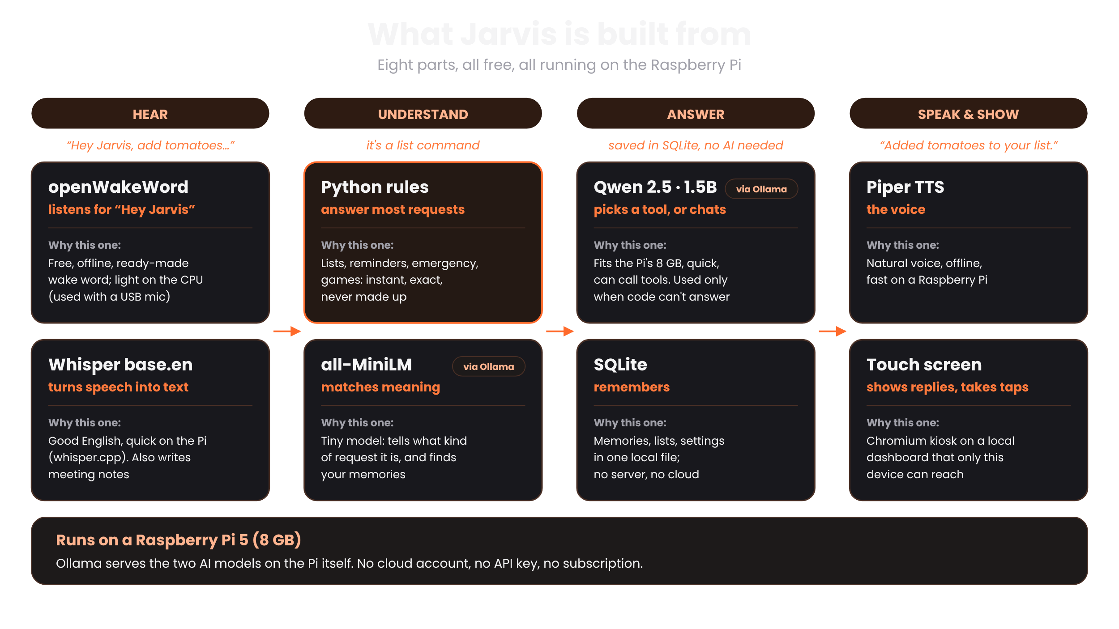

Slide 8
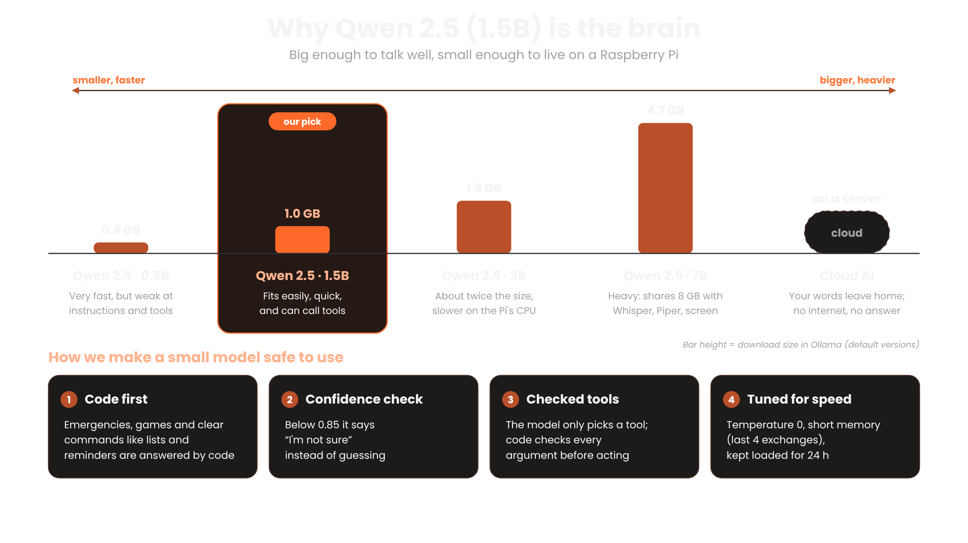

Slide 9
Requirements Checklist
Must have
Good to have
✓
Bot companion on a Raspberry Pi 5
✓
Online look-ups alongside local reasoning
✓
End-to-end use case with a live demo
✓
Many human-potential areas on one device
✓
Privacy safeguards ★
✓
Honest fallback: “I'm not sure”
✓
Continuous local audio awareness ★
✓
Desk-friendly, adapts from feedback
✓
All AI on-device; online only for live facts ★
✓
Power-efficient design
✓
Raw audio never leaves the device
✓
Listening + muted lights, mute switch
Notes:
REQUIREMENTS CHECKLIST (about 30 seconds)
Here's how Jarvis covers the problem statement. On the left, the must-haves: it's a bot companion on a Raspberry Pi 5, with an end-to-end use case we'll demo live. The three starred must-haves are all met: privacy safeguards, continuous local audio awareness, and all AI on the device with online calls only for live facts. Raw audio never leaves the device, and the listening and muted lights and the mute switch are on the Pi's GPIO pins.
On the right, the good-to-haves: online look-ups alongside local reasoning, five human-potential areas on one device, honest 'I'm not sure' answers, adapting to your preferences, and a power-efficient design: a small model, and most answers come from code without the AI. If asked about battery: it's our next step.
CHECK BEFORE PRESENTING: the mute switch row assumes the switch is wired; if it isn't, say 'mute switch coded, being installed'. Don't claim battery life: the row says power-efficient design on purpose.

Slide 10







Beyond the Requirements
Extra features we built on top of the must-haves and good-to-haves
Meeting mode
Brain games
Emergency help
Wellbeing
Notes plans and tasks, asks before saving, never keeps the transcript
Tic-tac-toe by voice or touch, memory sequence, mental maths
112, 108, Tele MANAS 14416 and your contacts, even offline
Guided breathing and grounding, matched to how you feel; a private period tracker
Daily summary
QR share, no cloud
Guest mode
“What's my day?”: schedule, reminders and weather in one answer
Your list on your phone over your own Wi-Fi; link expires in 10 min
Keeps your private things private while a friend is talking
Notes:
BEYOND THE REQUIREMENTS (about 35 seconds)
On top of the requirements, we built features that make Jarvis feel like a real companion.
Meeting mode listens for plans and tasks, asks before saving anything, and never keeps the transcript. Brain games like tic-tac-toe work by voice or touch. In an emergency, Jarvis shows 112, the ambulance number 108, the Tele MANAS mental health line and your own contacts, even offline. Wellbeing offers guided breathing and grounding matched to how you feel. 'What's my day?' gives your schedule, reminders and weather in one answer. You can share a list to your phone with a QR code over your own Wi-Fi, with no cloud. And guest mode keeps your private things private while a friend is talking.
All of these run on the device; only the weather in the daily summary goes online.
Demo idea: 'Share my grocery list', then scan the QR code with a phone.

Slide 11
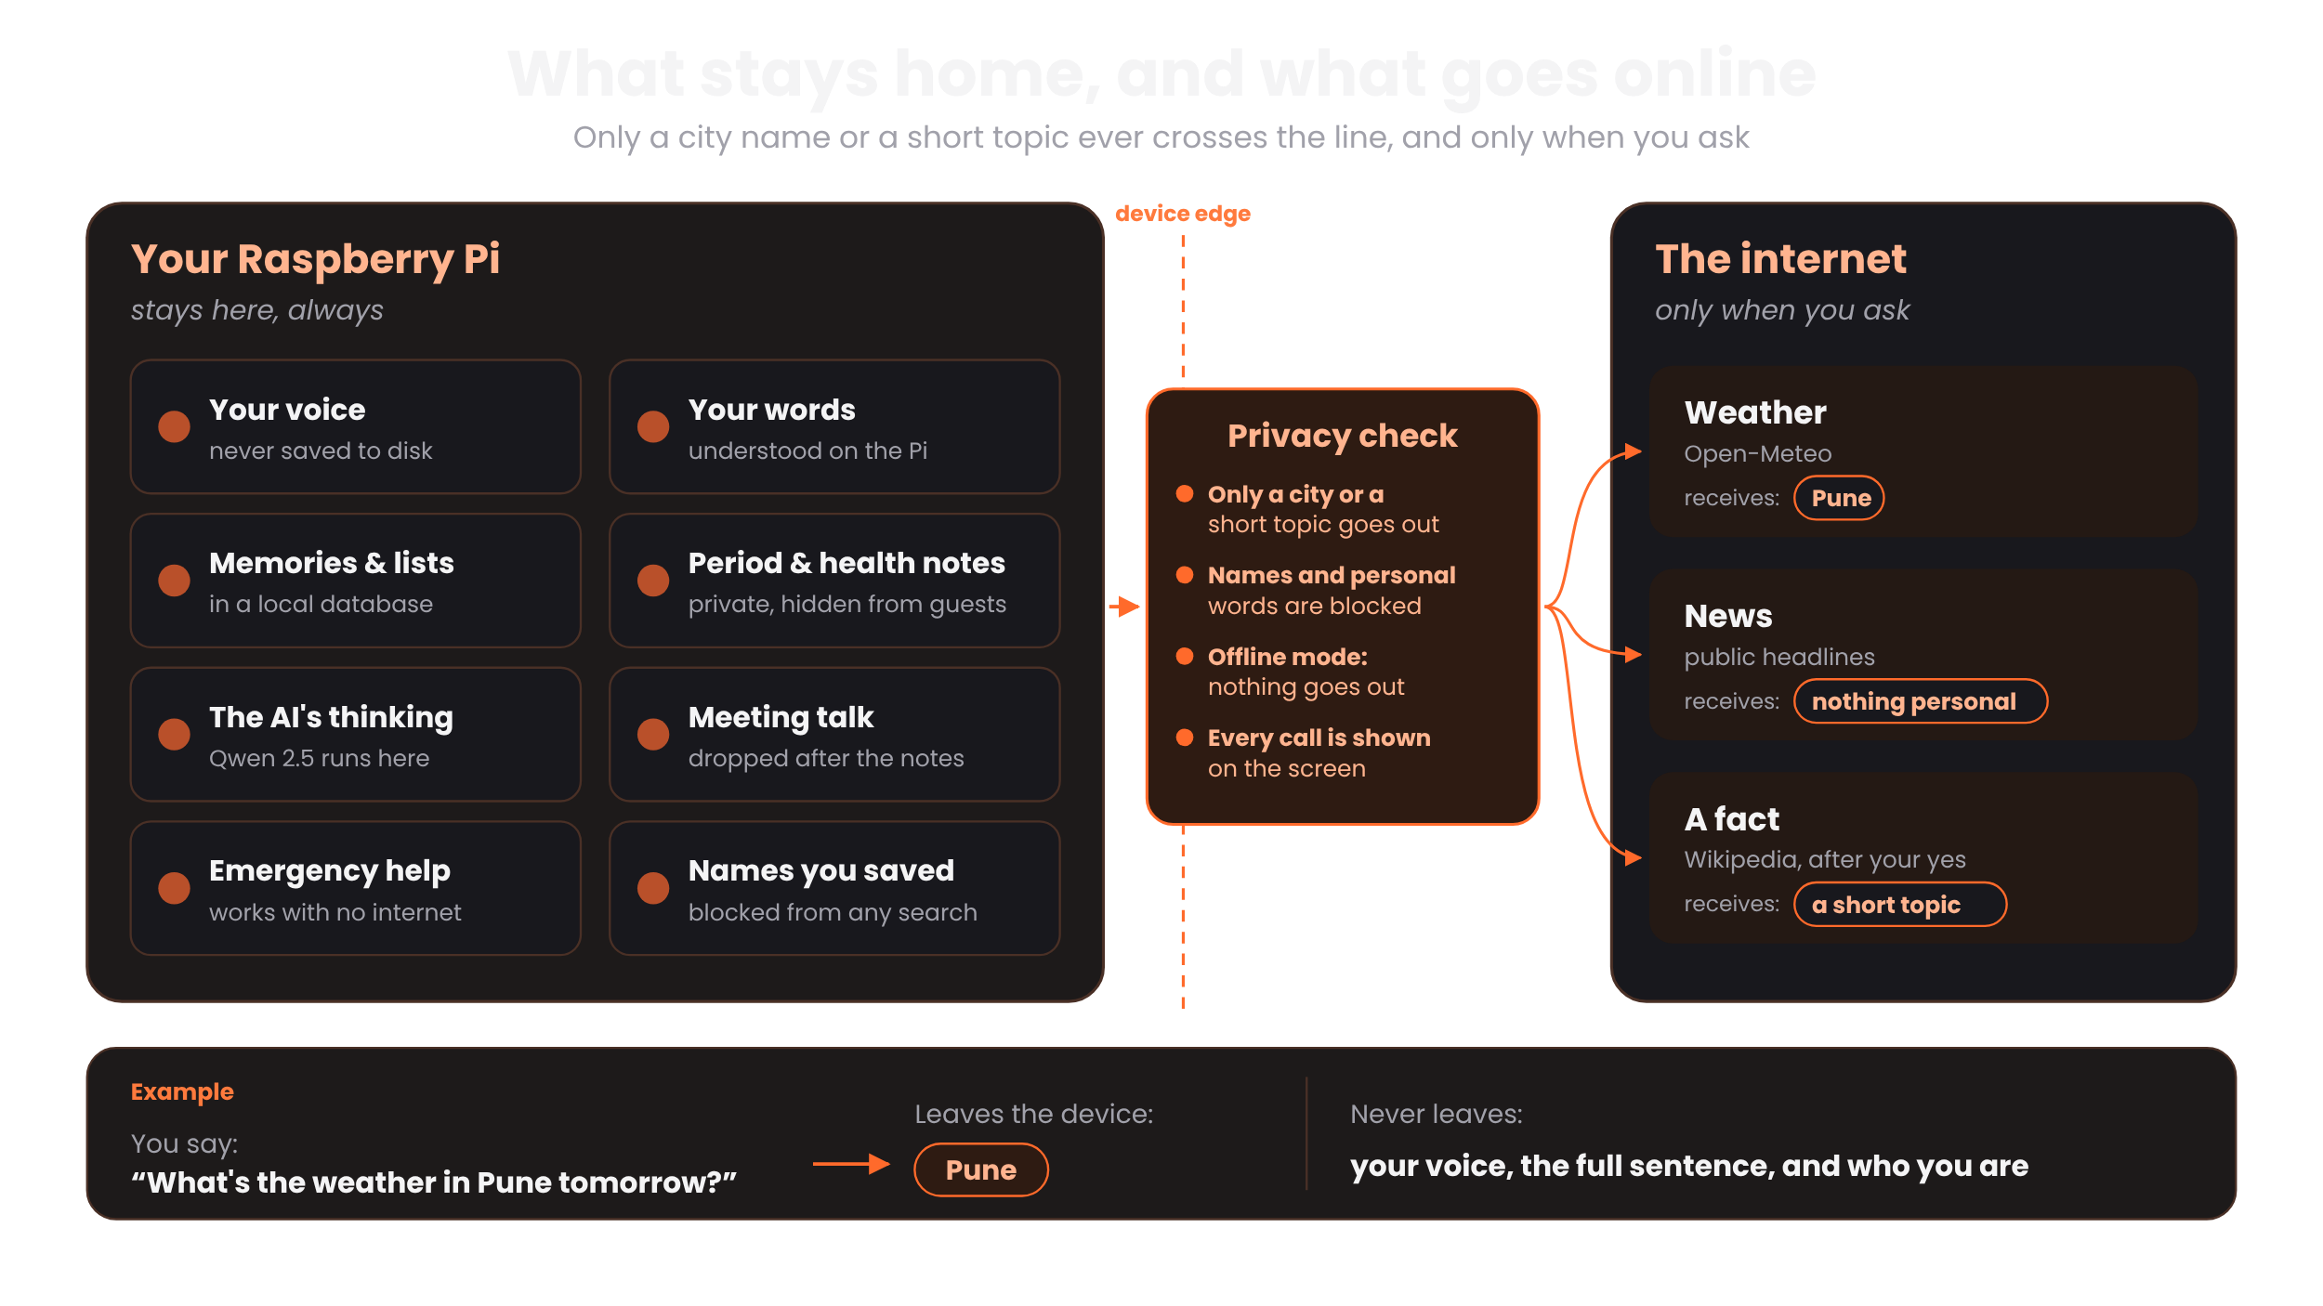

Slide 12








Real Problems, Real Fixes
What we found building and testing on the real device, and how we fixed it
1
2
3
4
Mic noise
Hallucination
Latency
Efficiency
Auto-gain off, gain lowered: noise dropped from 8775 to 136.
Code owns every fact; fake “I've done it” replies are blocked.
Whisper reads only the recorded audio: 5 s → 1.2 s per sentence.
Lists, reminders, games and emergencies need 0 AI calls.
5
6
7
8
Scalability
Accuracy
Feasibility
Privacy
Hardware sits in one layer; same code runs on Pi or laptop.
Below 0.85 confidence, Jarvis says “I'm not sure” instead of guessing.
Runs fully on a Raspberry Pi 5 with free open-source models.
Only a city or topic goes online, and every call is shown on screen.
Notes:
REAL PROBLEMS, REAL FIXES (about 45 seconds)
Testing on the real device taught us a lot.
1 Mic noise: auto-gain was amplifying the room; turning it off dropped the noise level from 8775 to 136.
2 Hallucination: a small model can invent things, so code owns every fact and action, and replies claiming something was done when it wasn't are blocked.
3 Latency: Whisper read a fixed 30-second window for every sentence; fitting it to the recording took it from about 5 seconds to 1.2 on the Pi.
4 Efficiency: lists, reminders, games and emergencies are answered by code with zero AI calls.
5 Scalability: the hardware lives in one layer, so the same code runs on the Pi or a laptop, and a bigger model is one setting away.
6 Accuracy: we use the model's own confidence; below 0.85 it says I'm not sure and offers to look it up.
7 Feasibility: it all runs on a Raspberry Pi 5 with free open-source models, no cloud or API costs.
8 Privacy: only a city name or a short topic ever goes online, never personal data, and every call is shown on the screen. The AI router never even sees your memories.
IF ASKED: confidence = average token probability from the model's logprobs. The mic-noise numbers are the team's own measurement; keep them only if that's what you measured.

Slide 13



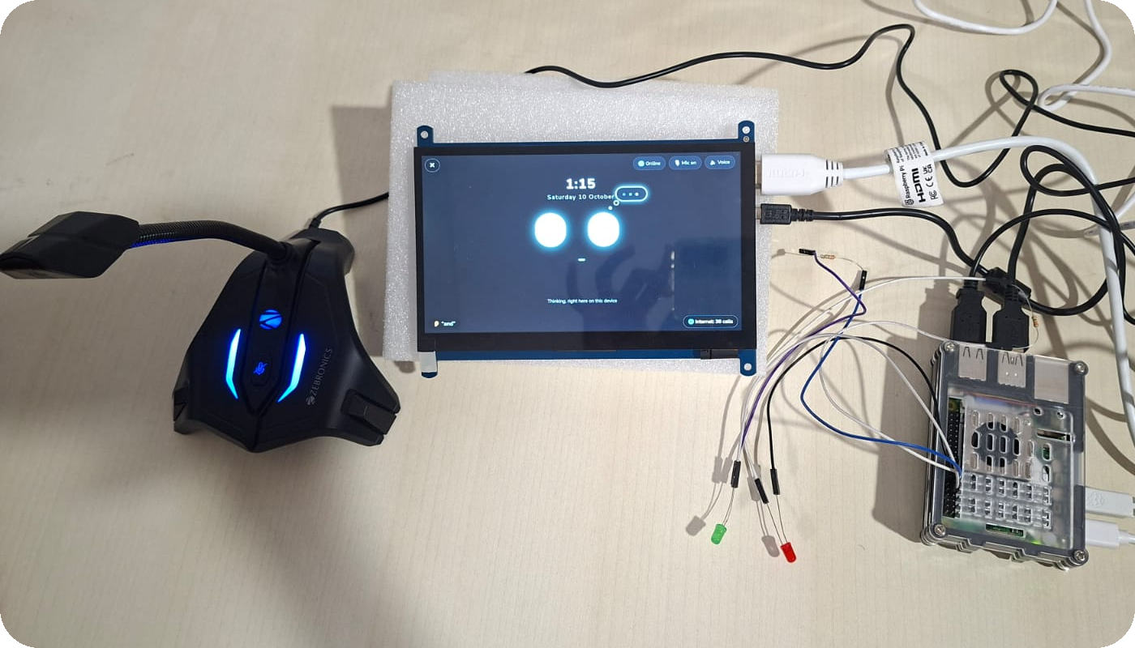
Results
Our working device
188 / 188
~1.2 s
~5 s
8 GB Pi 5
test conversations pass on the Pi
to understand you; simple commands answer instantly
for an AI answer, generated on the device
runs everything, on your desk
Notes:
RESULTS (about 25 seconds)
This is our working device: a Raspberry Pi 5 with a touch screen showing Jarvis's face, a USB microphone, and the green listening and red muted lights.
All 188 scripted test conversations pass on the Pi.
It takes about 1.2 seconds to understand what you said, and simple commands like lists, reminders and the time then answer instantly, without the AI.
An AI-generated answer takes about 5 seconds, all on the device.
And all of it runs on an 8 GB Raspberry Pi 5 on your desk.
CHECK BEFORE PRESENTING: ~1.2 s is the team's measured speech-to-text time on the Pi (fix 24); ~5 s is from our Pi speed checks. If you time it again from jarvis_run.txt, put your own numbers on the slide.

Slide 14






Personal routines
Jarvis learns your daily habits, on the device.
Multilingual
What's
Next
Hindi, Hinglish and more Indian languages.
Privacy & data security
Encrypted storage and a hardware mic cut-off.
Voice & face recognition
Knows who's talking, for real guest privacy.
Finished device
A compact case with built-in mic, speaker and battery.
Noise cancellation
A mic array that hears you in noisy rooms.
Notes:
WHAT'S NEXT (about 35 seconds)
Here's where we take Jarvis next.
Personal routines: Jarvis learns your daily habits, all on the device, and suggests things at the right time.
Multilingual: Hindi, Hinglish and more Indian languages. Whisper and Qwen are already multilingual, so this is realistic.
Privacy and data security: encrypting the data stored on the device, and a hardware switch that cuts the microphone's power.
Voice and face recognition: recognising who is talking, on the device, so guest privacy is based on identity, not on what people say.
A finished device: a compact case with a built-in mic, speaker and battery, so it's a real product on your desk.
Noise cancellation: a microphone array that filters background noise, so Jarvis hears you in busy rooms.
IF ASKED: today guest mode works from what people say; storage is on the device but not yet encrypted; the mute switch is read by software. These are exactly the gaps this roadmap closes.

Slide 15
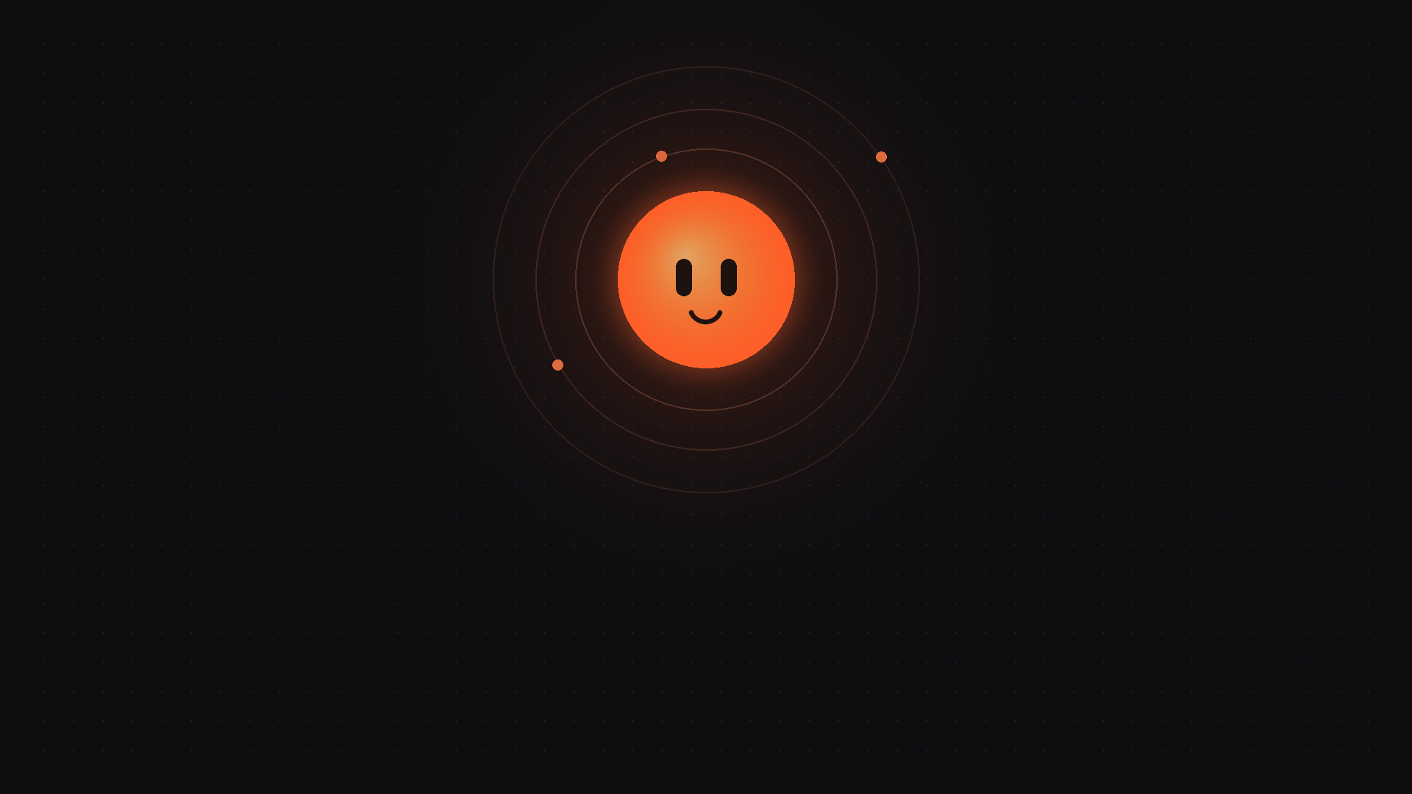
Thank you!
Questions? Ask Jarvis… or ask us 🙂

