Slide 1
SentinelAI - AI Cybersecurity Assistant
Unified Threat Detection & Response Platform
Mohammed Moneer Al-absi | ID: 2023050086 | Section: Cybersecurity (CS)
Supervisor: Eng. Sondos Saif | Date: 10 September 2026
Notes:
Opening: one system - three engines (flows, texts, files) + anomaly detection + a learned response policy + an agent.

Slide 2
The Problem
• SOC teams face thousands of heterogeneous events per day
• Signatures miss zero-day behaviour; manual triage is slow
• The RESPONSE decision (monitor / alert / block / isolate) is left to overworked analysts
• Wrong decisions: FN = breach, FP = business disruption
• Goal: ONE AI system that detects AND decides AND reports
Notes:
Why it matters + who uses it (analysts, network & mail ops).

Slide 3
System at a Glance (Level 3 - Expert)
• Supervised: 6 classifiers on 32,445 real network flows
• Unsupervised: K-Means + DBSCAN + Isolation Forest
• Deep Learning: MLP compared vs classic ML
• NLP: spam/phishing on REAL UCI data (5,572 msgs)
• Computer Vision: CNN malware families (byte-plots)
• Reinforcement Learning: from-scratch Q-Learning policy
• AI Agent: routing + risk fusion + decisions + reports
Notes:
All mandatory + all advanced components in one pipeline.

Slide 4
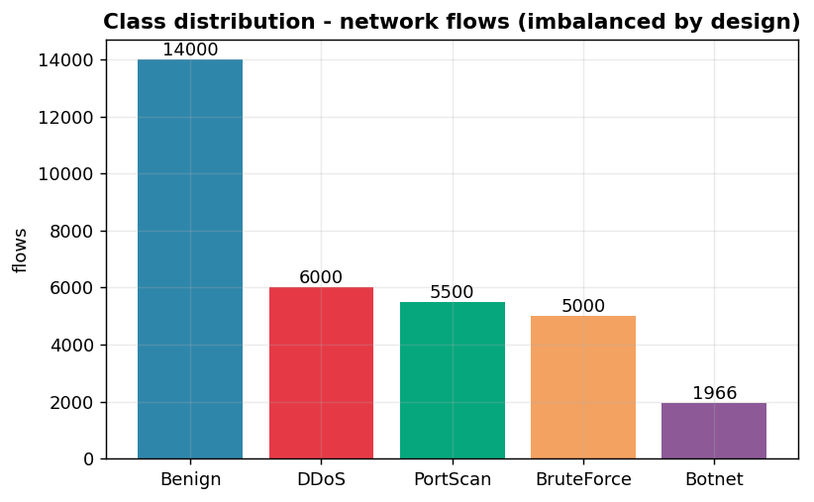
Data Collection (Stage 2) - REAL datasets
• Network flows: 32,466 REAL CICIDS2017 captured flows, mapped to 16 features, 5 classes (imbalanced)
• Malware images: REAL Malimg corpus - Allaple.A, C2LOP.P, Lolyda.AA2, Alueron.gen!J resized to 48x48
• Spam texts: REAL - UCI SMS Spam Collection (5,572 messages)
• Threat-intel feed: REAL - 18k+ malware domains downloaded over HTTPS (web/network programming)
• Offline fallback: documented synthetic generators
Notes:
Defensible source story: 4 real sources (captured traffic, real malware corpus, public SMS data, live feed) + documented offline fallback.

Slide 5
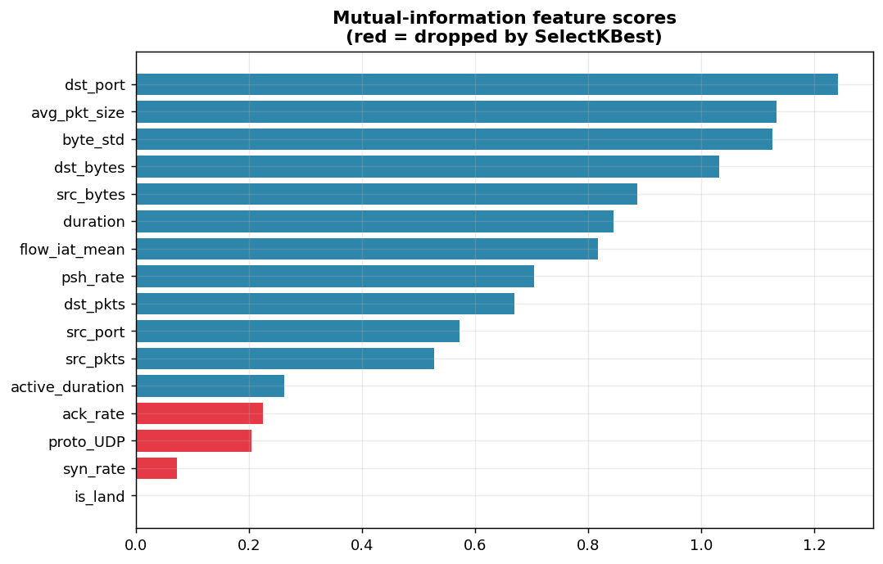
Preprocessing (Stage 3) - every step justified
• Removed 21 duplicates (bias removal)
• Median imputation of missing values (robust to skew)
• One-hot 'protocol'; label-encoded target
• log1p on skewed byte/packet counters
• StandardScaler fitted on TRAIN only (no leakage)
• SelectKBest kept 12 / 16 features
• Stratified 80/20 split
Notes:
Rubric wants WHY - each bullet has a reason.

Slide 6
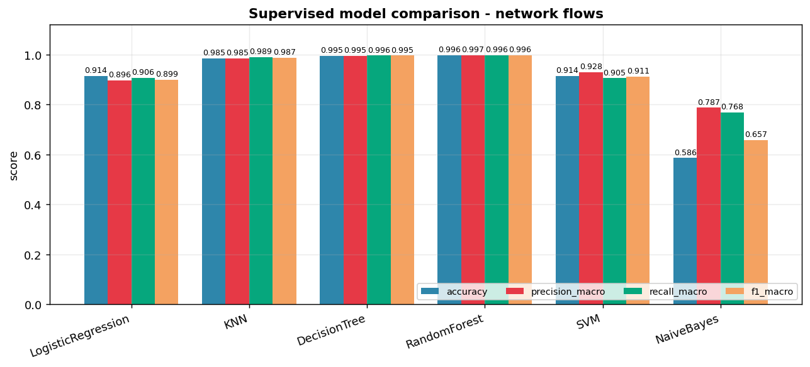
Supervised Learning - RandomForest wins
• Best: RandomForest - accuracy 99.6%, macro-F1 99.6%
• Linear models ~93% - class overlap is real
• Tree ensembles handle non-linear boundaries + interactions
• SVM fitted on 10k subsample (O(n^2) cost) - documented trade-off
• 5-fold CV validates stability (99.7% ± 0.0004)
• GridSearchCV tuning: {'max_depth': None, 'n_estimators': 400}
Notes:
Mention cross-validation + tuning - shows rigor.

Slide 7
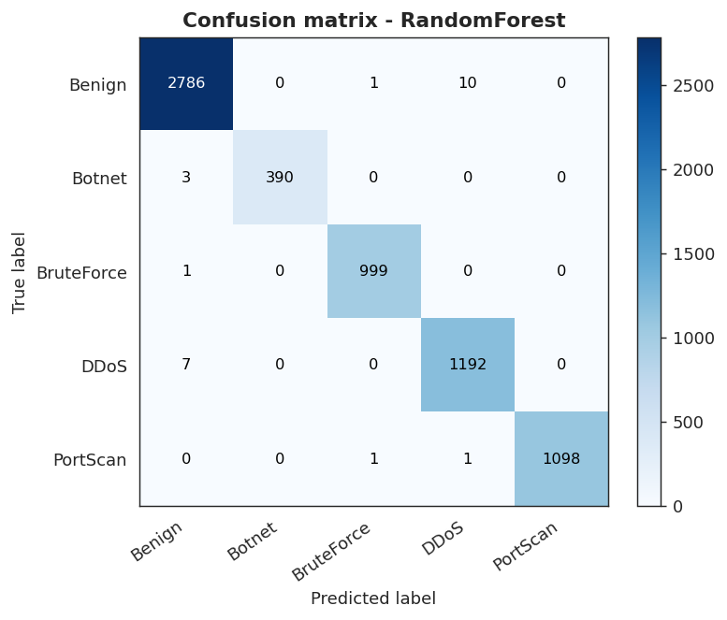
Evaluation (Stage 5)
• Confusion matrix + accuracy/precision/recall/F1 (macro+weighted)
• DDoS & PortScan: perfect (distinctive signatures)
• FP: benign IT/SSH sessions read as BruteForce (6 cases)
• FN: Botnet/BruteForce hiding in benign-like patterns
• FN is the expensive error in a SOC -> recall prioritized
• ROC AUC ~1.0 for all classes

Slide 8
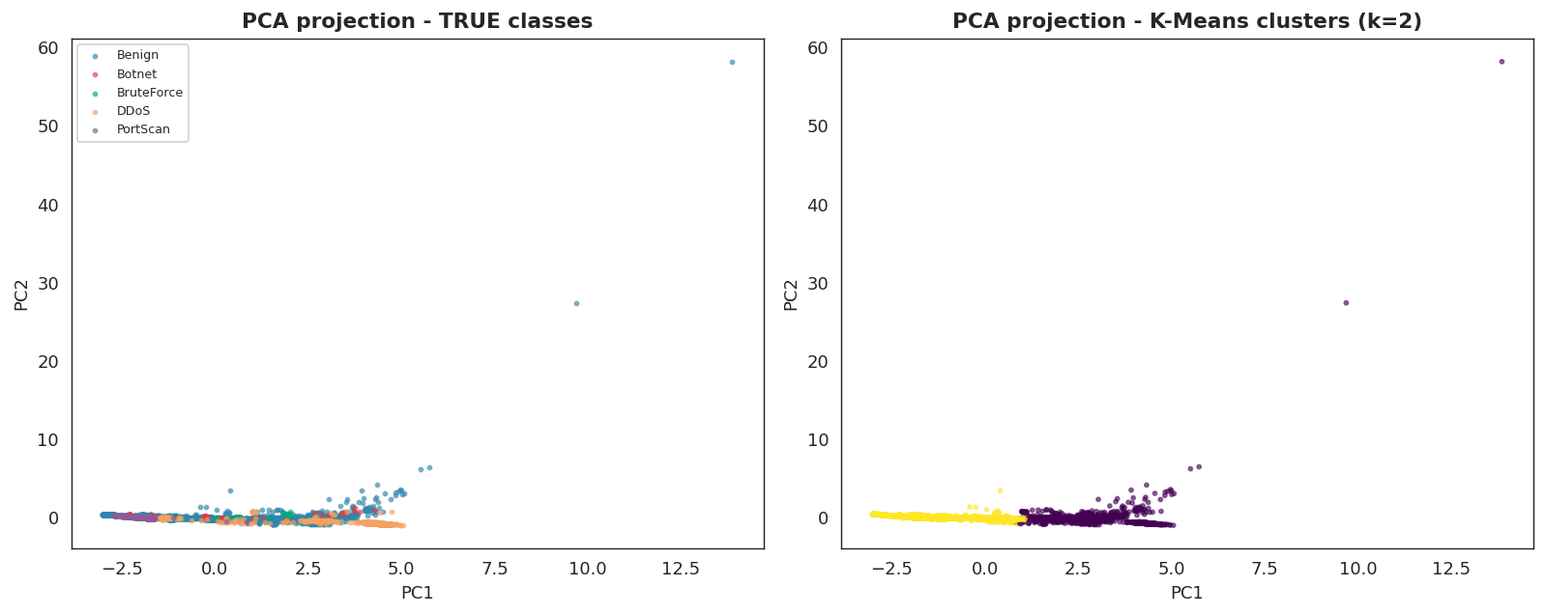
Unsupervised Learning (Stage 6)
• K-Means: k=2 chosen by silhouette; purity 46.3%, ARI 0.07 WITHOUT labels
• Hierarchical (Ward): dendrogram confirms the same structure (ARI 0.09)
• DBSCAN: 1 clusters + 0.4% noise on PCA subspace
• Isolation Forest trained on BENIGN only (one-class)
• Anomaly detection: precision 88.3%, recall 24.1%
• Supervised = WHICH attack? Unsupervised = is it UNUSUAL?

Slide 9
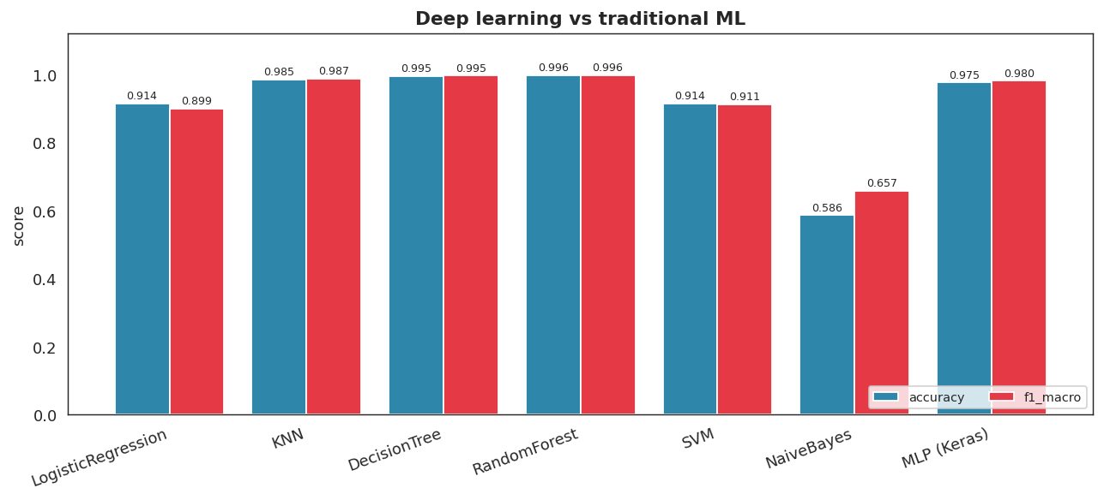
Deep Learning - MLP (Stage 7)
• 12 -> 64 -> 32 -> 5 MLP (3,077 params), Adam + early stopping
• Accuracy 97.5%, macro-F1 98.0%
• vs RandomForest 99.6% - ensembles win on small tabular data
• Honest comparison, as required - and explained

Slide 10
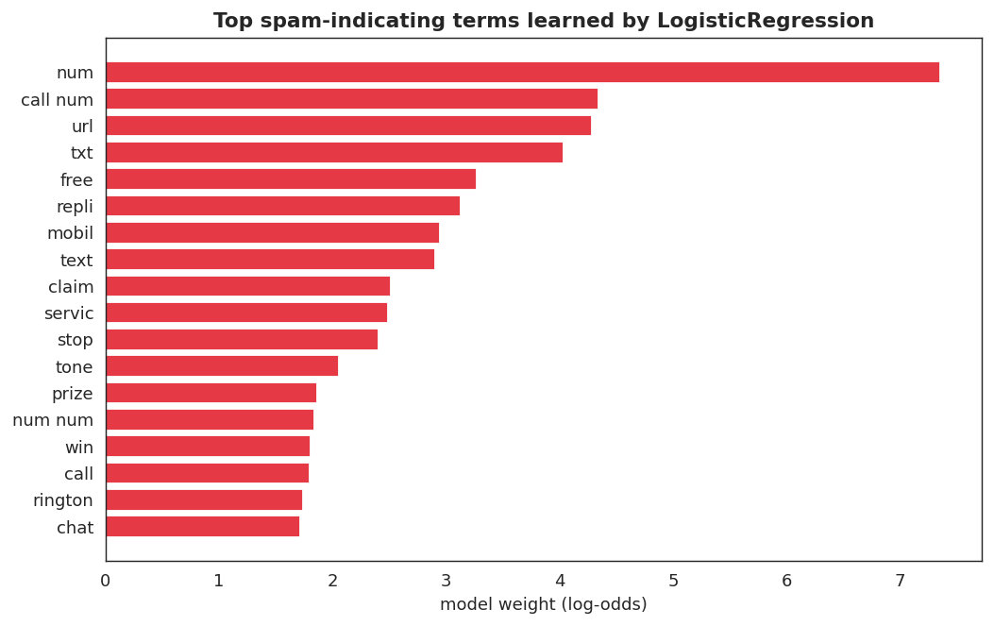
NLP on Real Data (Stage 8)
• UCI SMS Spam: 5,572 real messages (13.4% spam)
• Pipeline: lowercase, URL/EMAIL/NUM masking, stop-words, stemming, TF-IDF (1-2 grams)
• Logistic Regression: acc 97.9%, F1 91.8%
• LSTM sequence model: F1 94.4% - word ORDER adds signal
• Learned spam words: free, claim, txt, win, urgent...
• Weak spot: recall - 'polite' spam looks like ham

Slide 11
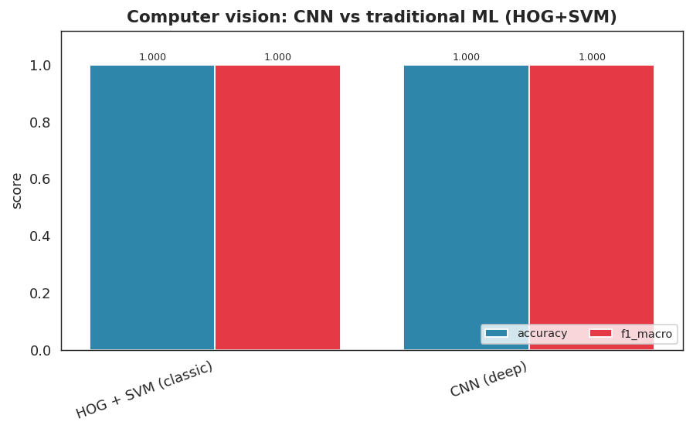
Computer Vision - CNN (Stage 9)
• Malware byte-plots: 48x48 grayscale, 4 families
• Conv(32) -> Conv(64) -> Dense(128) -> Softmax
• Test accuracy 100.0% on 155 unseen images
• Traditional baseline (HOG+SVM): 100.0% - both saturate this task; CNN scales better on real corpora
• REAL Malimg byte-plots (native sizes 256x264 - 768x683, resized on load)

Slide 12
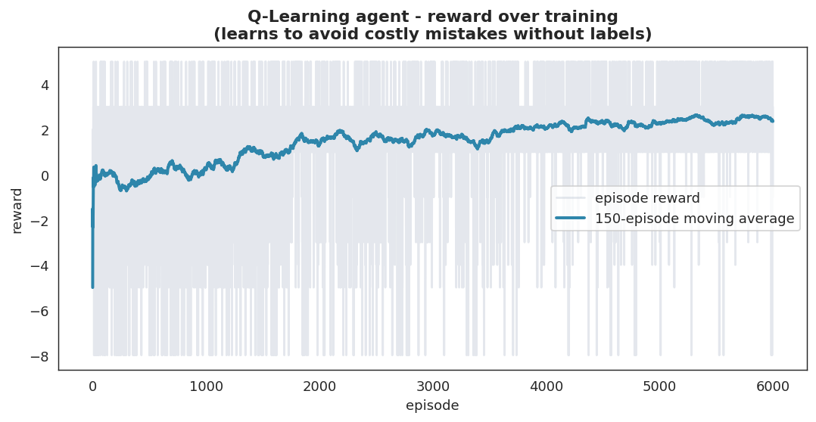
Reinforcement Learning (Stage 10)
• Q-Learning implemented FROM SCRATCH (no RL library)
• 18 states (threat x confidence x criticality) x 4 actions
• Reward = SOC cost model: missed attack -8, blocking benign -3...
• Q[s,a] += alpha*(r + gamma*max Q[s',a'] - Q[s,a])
• Learned policy avg reward 2.44 vs AlwaysBlock 1.00, AlwaysMonitor -3.67
• It learned from REWARDS, not labels

Slide 13
The Agent (Stage 11) - SentinelAgent
• 1. Receives event (flow / message / file image)
• 2. ROUTES to the right engine automatically
• 3. Prediction + confidence + anomaly second opinion
• 4. Threat-intel IOC enrichment (18k real blacklisted domains)
• 5. Fuses a 0-100 risk score
• 6. RL policy decides: Monitor / Alert / Block / Isolate
• 7. Writes incidents + security report + recommendations
• Demo: 27 events -> {'Isolate_Host': 11, 'Monitor': 7, 'Alert_Analyst': 6, 'Block_IP': 3}
Notes:
Walk through one event end-to-end during the talk.

Slide 14
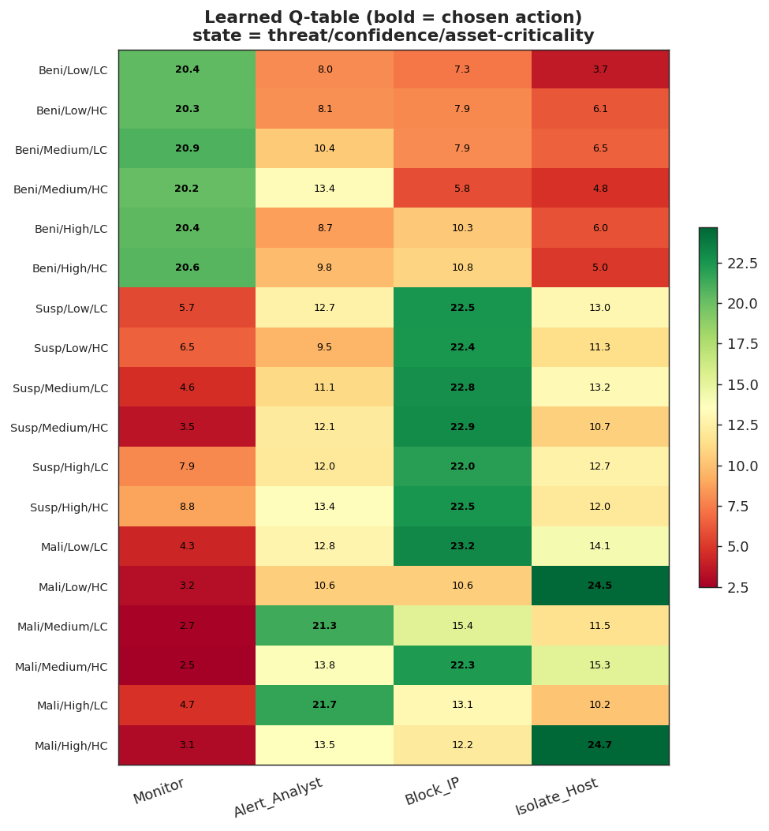
Sample Agent Decisions
• DDoS flow, high confidence, critical server -> Isolate_Host
• Benign web session -> Monitor (no analyst time wasted)
• Spam message with p(spam)=0.97 -> Block sender + purge
• Message judged 'ham' by the model BUT matched a real blacklisted domain (IOC) -> isolated anyway - layered defense!
• All decisions + Q-values saved to results/predictions/

Slide 15
Results Summary
• Supervised (RandomForest): 99.6% accuracy / 99.6% macro-F1 (5-fold CV validated)
• MLP: 97.5% (compared honestly)
• NLP: LSTM F1 94.4% beats TF-IDF 91.8% (real data)
• CNN: 100.0% (vs HOG+SVM 100.0%)
• Isolation Forest: precision 88.3%
• RL policy beats all baselines (2.44 avg reward)
• 21/21 automated tests pass; full reproducible pipeline

Slide 16
Future Work
• Scale to the full CICIDS2017 corpus (2.8M flows) and all 25 Malimg families
• LSTM / transformer text models for higher spam recall
• SHAP explainability for every agent decision
• Continual learning for evolving 'normal'
• Multi-agent RL (network + mail + endpoint responders)
• Streaming deployment with analyst feedback

Slide 17
Conclusion
• Complete AI workflow on one coherent security problem
• Every mandatory + every advanced component implemented
• Every preprocessing step and algorithm justified
• Errors analysed (FP/FN) - not hidden
• The AI output directly supports response decisions
• Thank you - questions?

