Slide 1
PARKING LOT SIMULATION
Marcos Costa - up202108869
Rodrigo Póvoa - up202108890
Rodrigo Moucho - up202108855
Modelling and Simulation 25/26 - Group EIC2_12

Slide 2
PROBLEM ADDRESSED
Parking Facilities face strong demand variability over time, with peak periods causing congestion and off-peak periods leading to underused capacity
Static Pricing and simple access rules may fail to adapt to these dynamics which can cause lost revenue
Strategies like Dynamic Pricing or Reservations are risky to deploy directly because they might cause unintended and unexpected consequences
Therefore, there is a need for a controlled, realistic evaluation framework to study how different parking management strategies affect system performance before real-world implementation

Slide 3
PROJECT OBJECTIVES
Model a private parking lot using an agent-based simulation
Simulate realistic driver behavior and parking lot mechanics: arrivals, queueing, parking duration and willingness to pay
Evaluate and compare parking management strategies: static pricing, reservation-based access, and dynamic pricing
Measure key metrics
Provides a decision-support tool to test policies safely before deployment

Slide 4
METHODOLOGY
Agent-Based simulation in Mesa with discrete time steps
Spatial grid representation: entry/exit gate, queue lane and multiple parking rows
Stochastic demand model: dependent arrival probability to model peak/off-peak traffic or budget decisions, parking durations sampled from mixture distribution
Driver state machine: ARRIVING → APPROACHING_GATE → (WAITING_AT_GATE) → DRIVING_TO_SPOT → PARKED → EXITING → EXITED
Measure Key Outcomes: occupancy, revenue, rejected demand and queue time
Simulate time from 6 A.M. to 10 P.M.

Slide 5
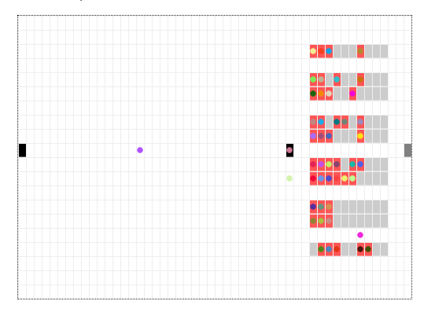
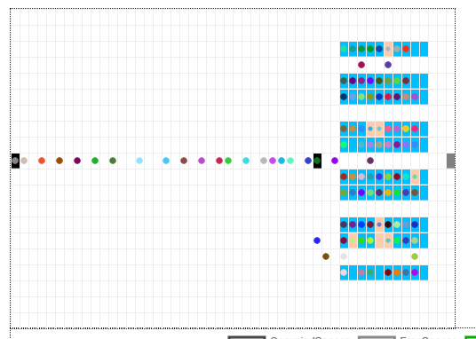
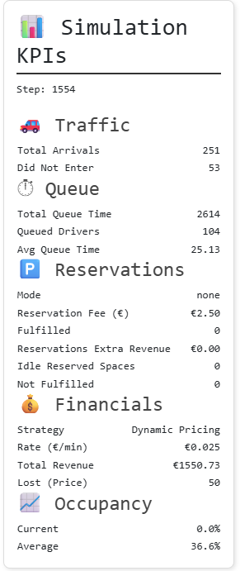
PROPOSED APPROACH
Baseline (static pricing) with capacity-based admission
Reservations where, for an increased fee, Drivers can reserve a parking spot for a specific duration (small chance of no-shows for realism)
Dynamic Pricing in which price is updated based on the occupancy of the parking lot. When prices are lower, more Drivers want to enter the park, when the prices are higher, less Drivers want to park at the parking lot.

Slide 6
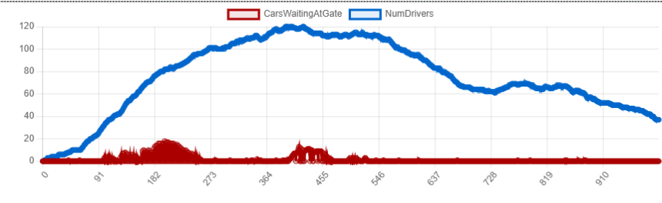
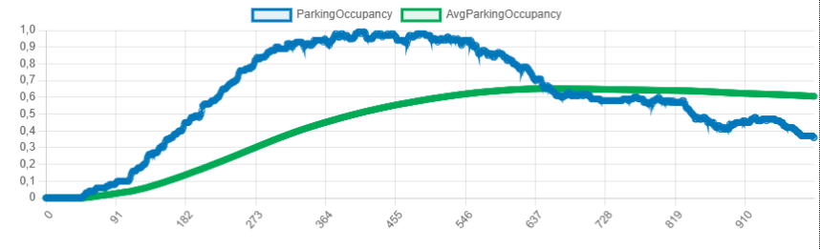
RESULTS AND DISCUSSION - STATIC STRATEGY
Total Revenue: 1454$
Average Queue Time: 14.47
Rejected Demand:9 from long queues
Average Occupancy: 60.6%
Stable performance, decent occupancy and low congestion

Slide 7
RESULTS AND DISCUSSION - RESERVATIONS STRATEGY
One: Additional Lane for Reservation Entry Only
Two: Only one Lane
Strategy One and Two
Total Revenue: 1483$ 1503$
Average Queue Time: 38.32 53.48
Rejected Demand (long queue): 25 28
Average Occupancy: 62.1% 61.3%
More reservations➟ less normal spots and “protected” reservation spots ➟ bigger queues
One gate: people who reserve still have to stay in line
Two gates: yield good revenue and occupancy and decreases queues

Slide 8
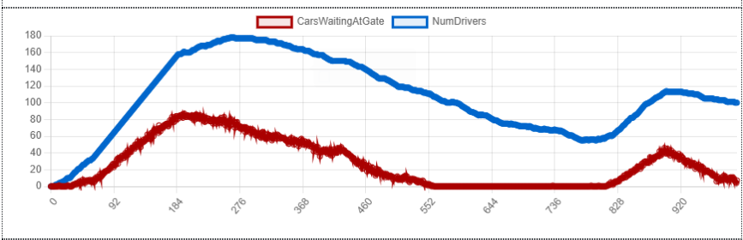
RESULTS AND DISCUSSION - DYNAMIC PRICE STRATEGY
One: Low prices increases demand slightly
Two: Low prices increases demand significantly
Strategy One and Two
Total Revenue: 1275$ 1510$
Average Queue Time: 140.36 137.94
Rejected Demand (long queue): 69 (price) + 23 (queue) 55 (price) + 27 (queue)
Average Occupancy: 59.0% 64.1%
Only worth it if low prices can increase demand significantly
More attractive prices when occupancy is low ➟ more demand ➟ higher occupancy rate
Extremely high queue times and rejected demand may discourage future use by clients
Higher revenue for second strategy but relies on attracting much bigger demand
Two

Slide 9
RESULTS AND DISCUSSION
Revenue does not correlate linearly with occupancy. Highest occupancy occurs under dynamic pricing (Two), but static pricing achieves competitive revenue with much lower congestion ➟ maximizing occupancy alone is not an optimal objective
Reservation must be coupled with separate access lanes rules to be effective, which is often difficult to do in real-life
Demand elasticity is the critical factor for dynamic pricing success
Dynamic pricing and reservation strategies increase waiting times ➟ infrastructure changes that allow queue-aware admission are paramount

Slide 10
CONCLUSIONS & FUTURE WORK
Conclusions
Static pricing offers the best trade–offs between revenue and congestion, although other strategies can outperform it in pure revenue and occupancy rate
All strategies are constrained by a single entry bottleneck, limiting policy-only solutions
Future Work
Evaluate infrastructure layouts such as multiple gates or priority access
Extend demand modelling with learning or memory effects (users reacting to past congestion)
Calibrate willingness-to-pay and arrival patterns using real-world data

Slide 11
THANK YOU!
Marcos Costa - up202108869
Rodrigo Póvoa - up202108890
Rodrigo Moucho - up202108855
Modelling and Simulation 25/26 - Group EIC2_12

