Slide 1
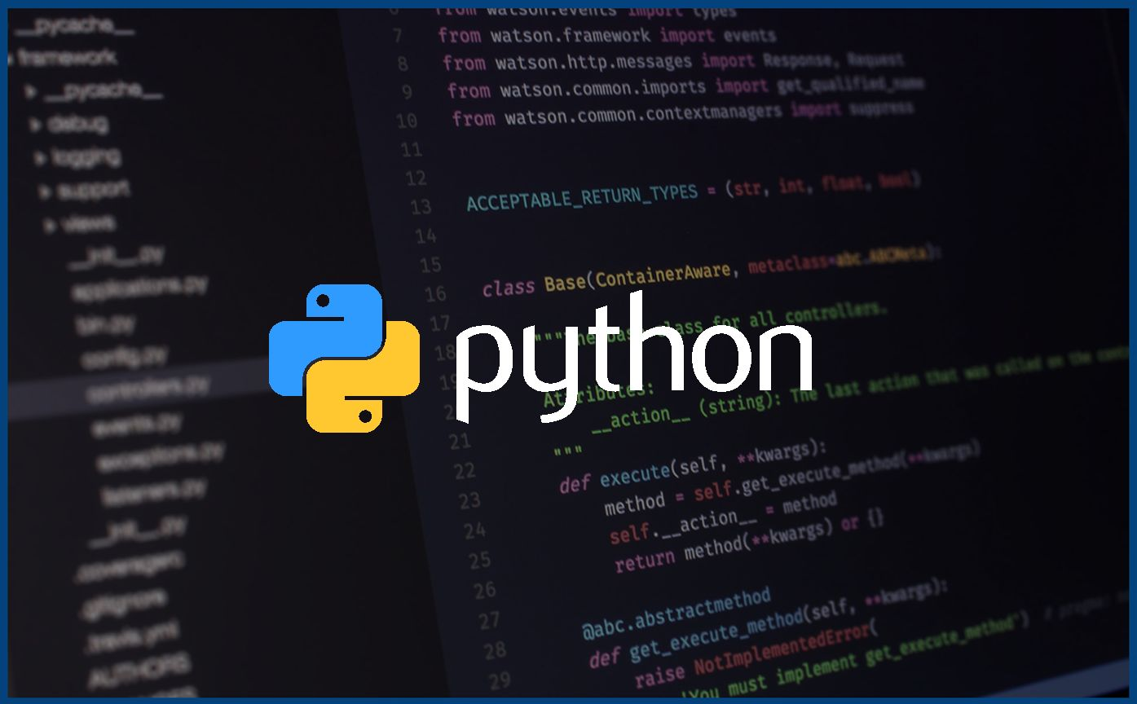
Intro To PYTHON
Intro To
This Photo by Unknown Author is licensed under CC BY-SA-NC

Slide 2

Open-source
Multipurpose
Readability

Slide 3
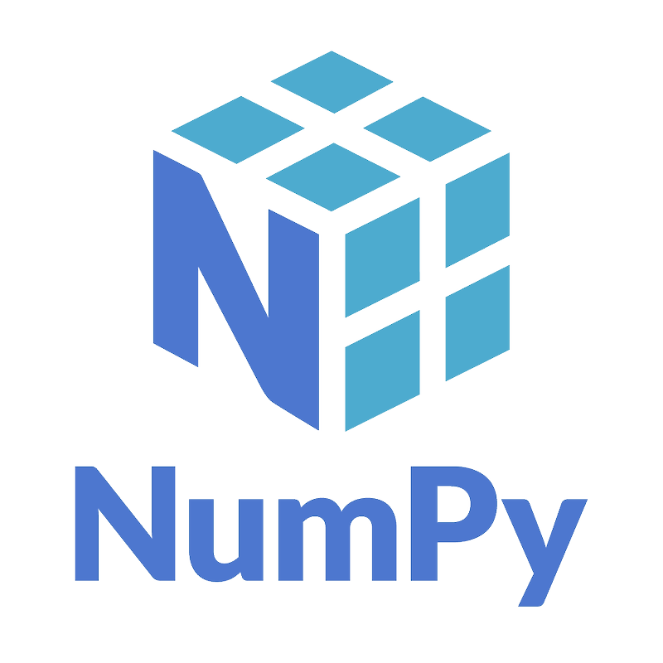
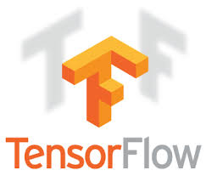
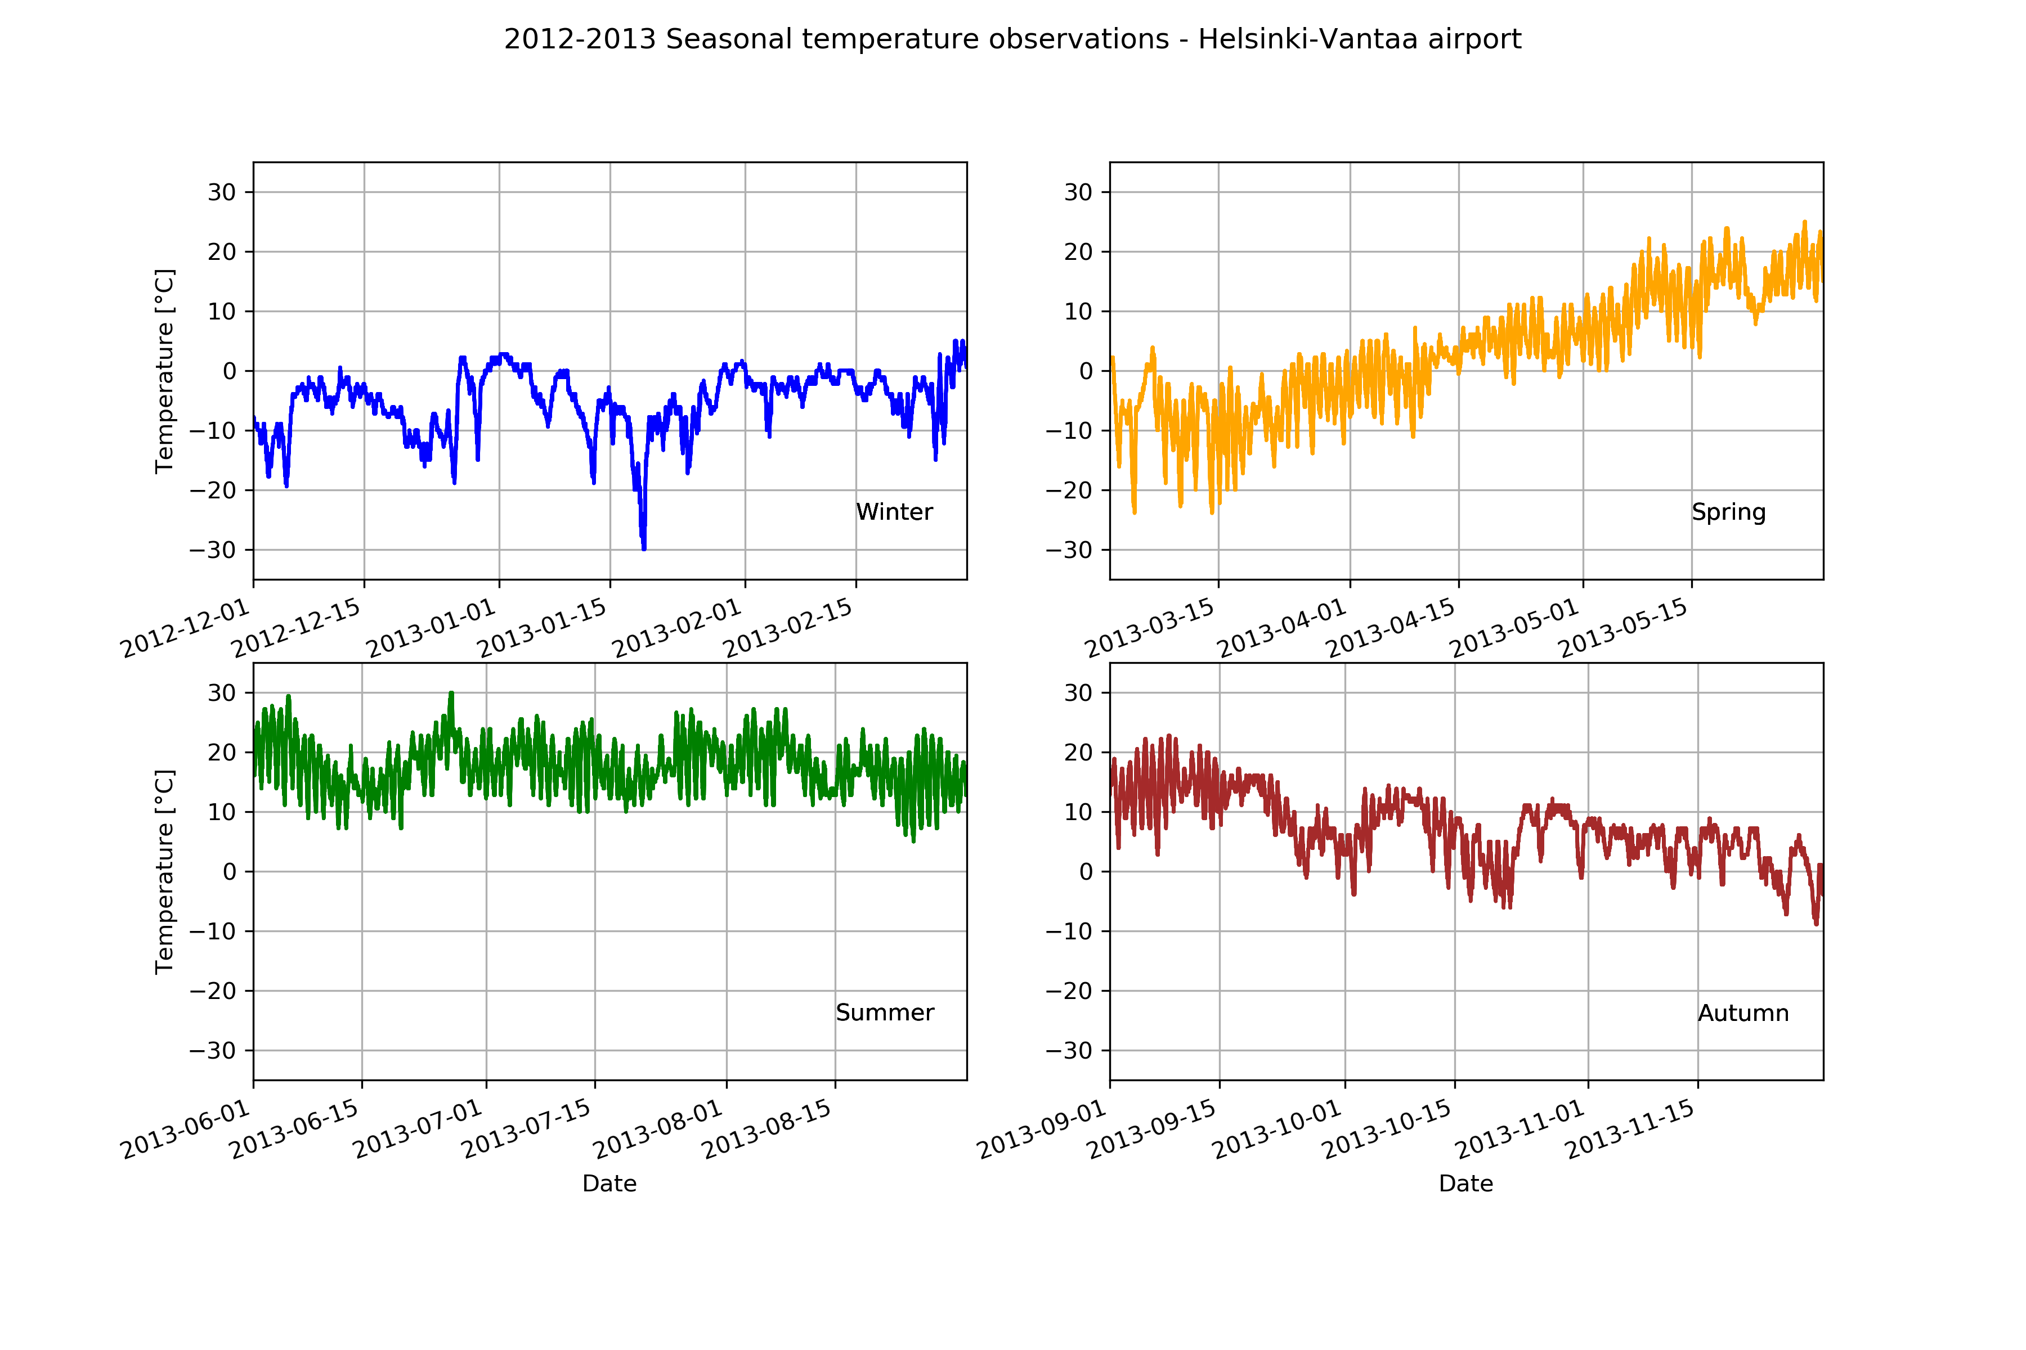
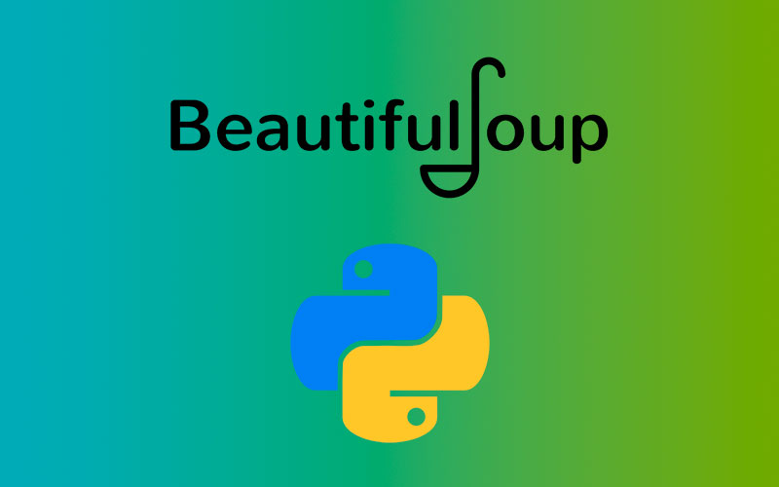


What can you do in Python?

Slide 4
Python or R (for data science)
Collection
Exploration
Modeling
Visualization

Slide 5
Demo.
HTTP requests & APIs
Pandas
Matplotlib

Slide 6
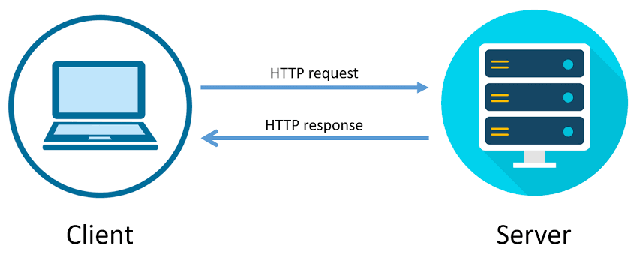

Slide 7
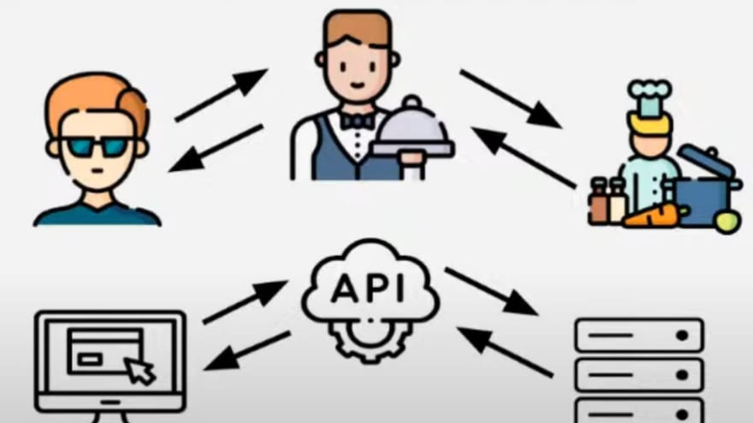

Slide 8
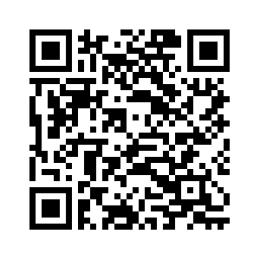
GitHub Repo

