Slide 1


http://phylosift.wordpress.com
Notes:
Marker genes across all domains – bacteria, archeaa, eukaryotes & viruses
rRNA genes, Protein-coding orthologs, lineage-specific gene families
----- Meeting Notes (5/22/12 10:42) -----
Marker genes to make higher level taxon assignments
Lineages-specific gene families to narrow down assignments to lower taxonomic levels

Slide 2
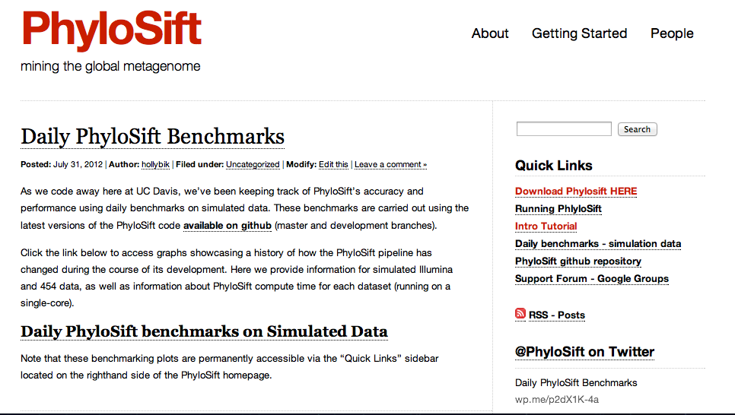
http://phylosift.wordpress.com

Slide 3
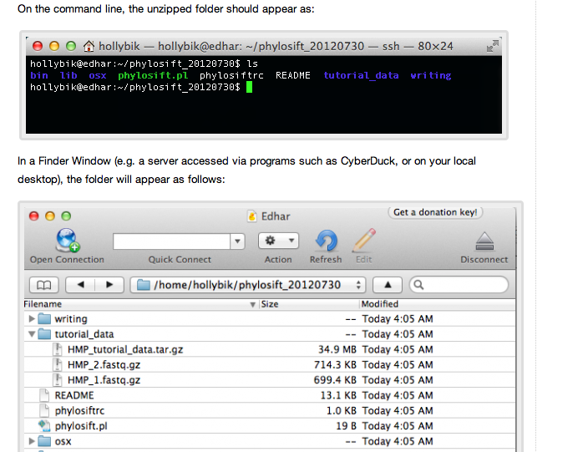
Website
Tutorial

Slide 4
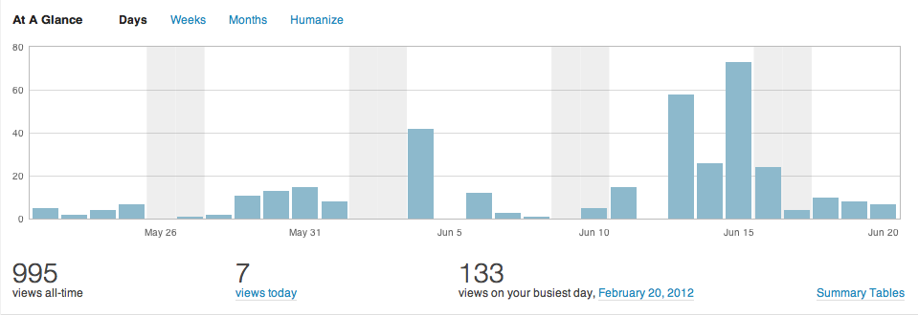
Website Visitors - June 2012

Slide 5
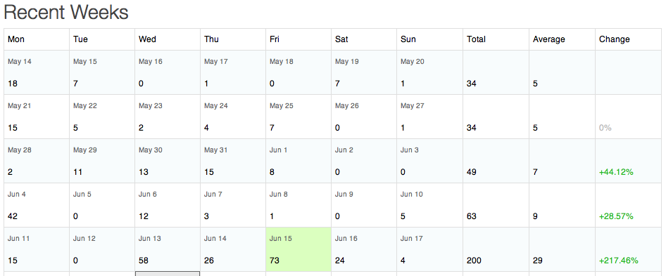
Website Visitors - June 2012

Slide 6
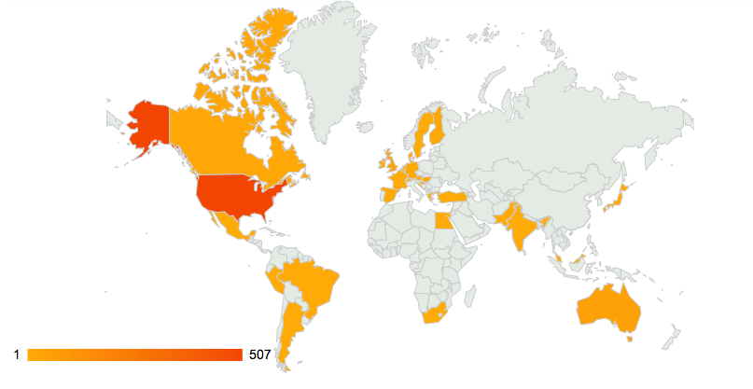
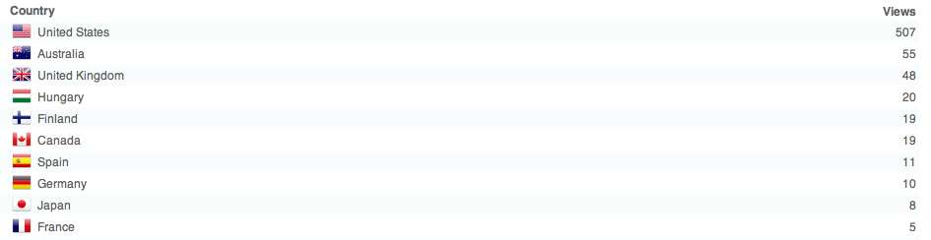
Website Visitors June 2012

Slide 7
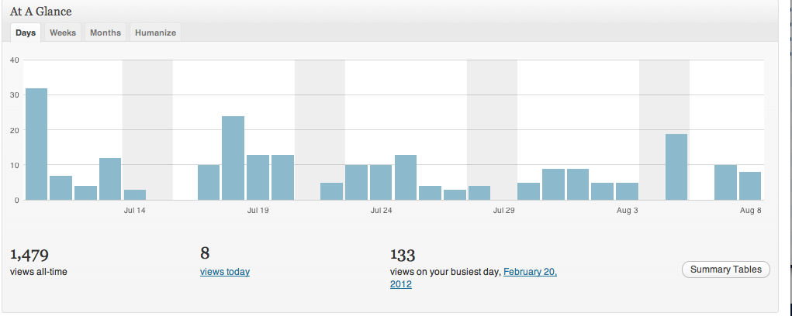
Website visitors – August 2012

Slide 8
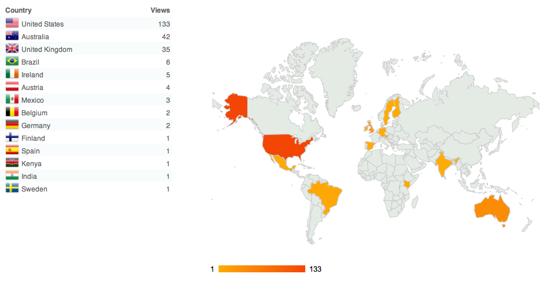
Website Visitors – August 2012

Slide 9
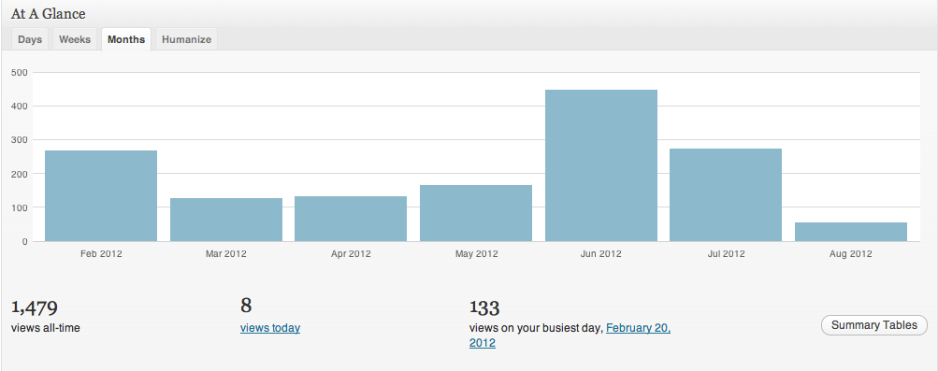
Website Visitors
Monthly page views since blog’s inception in Feb 2012 (1,479 cumulative visits)

Slide 10
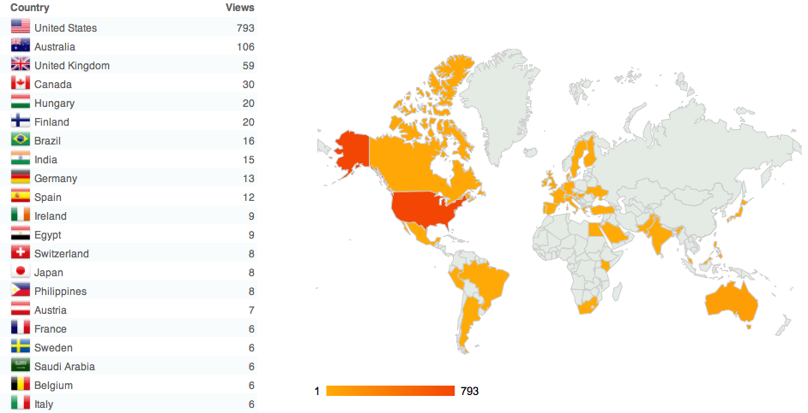
Website Visitors – all time

Slide 11
PhyloSift web presence
Website (Wordpress Blog) – Download links, tutorials, software documentation
GitHub – repository storing stable and development code
Twitter – Blog updates also disseminated via @PhyloSift account
Google Group – PhyloSift support forum for user queries, discussion, and documentation of known issues
Daily Benchmark Site – uses simulated data to track accuracy and compute time of PhyloSift over time

