Slide 1
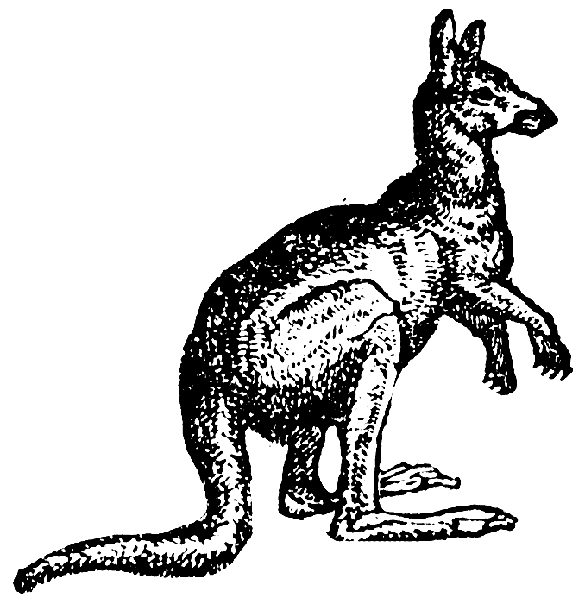
Genome Directory
Define the number of genomes to pick (default = 10) and number of reads to generate per file (default = 100,000)
Execute simulate mode
PD on concatenated tree
Determines PD contributions for taxa present in concatenated guide tree in PhyloSift marker directory
Two separate approaches used:
Select some number of taxa that contribute to PD (user input, default = 10 taxa)
Sample taxa uniformly without replacement
Select Taxa
Compute metrics between target and remaining taxa
Calculated metrics include: the distance to nearest neighbors, connecting branch lengths, and the number of sampled nodes within various PD units of connecting nodes.
Knockout Swaths of Taxa
Workflow plugs into updateDB to remove genomes which have been used to simulate metagenome data, as well as a swath of related taxa.
Generated Simulated Reads
Grinder algorithm randomly generates reads from selected genomes, outputs simulated PE-Illumina and 454 datasets
Simulation Marker Directory
A new marker directory is created, where simulated genomes have been knocked out from marker packages.

