Slide 1
Week Log 0914
Liang Bo Wang

Slide 2
Goal
Find human miRNAs
All works on Galaxy under certain workflow
using multiple prediction tools such as mirDeep, mirAnalyzer …

Slide 3
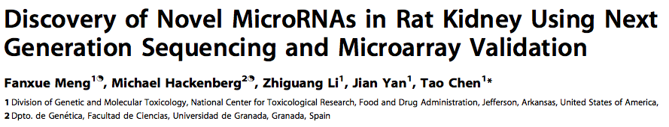
Reference - Workflow
Meng, F., et al. (2012) Discovery of Novel MicroRNAs in Rat Kidney Using Next Generation Sequencing and Microarray Validation, PLoS ONE, 7, e34394.

Slide 4
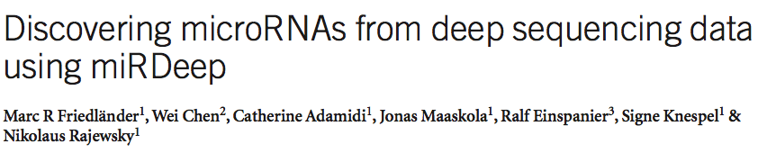
Reference - miRDeep, a All-in-one Tool
Friedlander, M.R., et al. (2008) Discovering microRNAs from deep sequencing data using miRDeep, Nat Biotech, 26, 407-415.

Slide 5
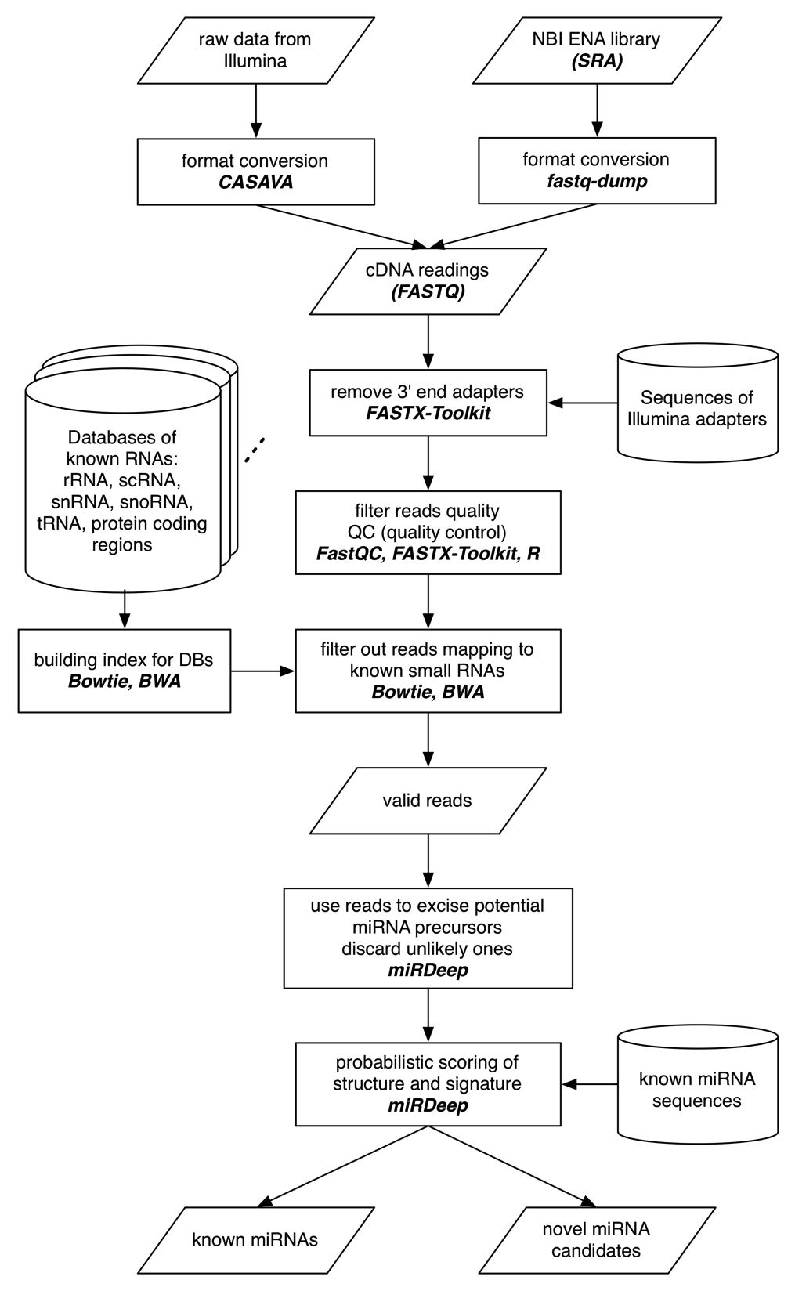
Workflow
All can be done merely on Galaxy
miRDeep takes the whole core, compared to the workflow of reference.

Slide 6
Workflow (part1)

Slide 7
Workflow (part2)

Slide 8
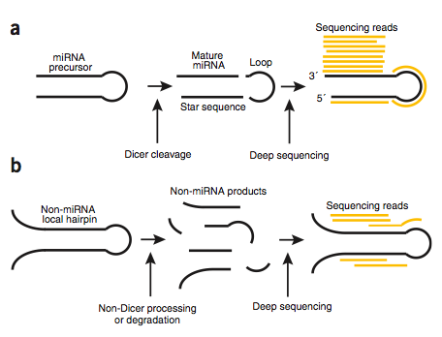
How miRDeep finds miRNAs

Slide 9
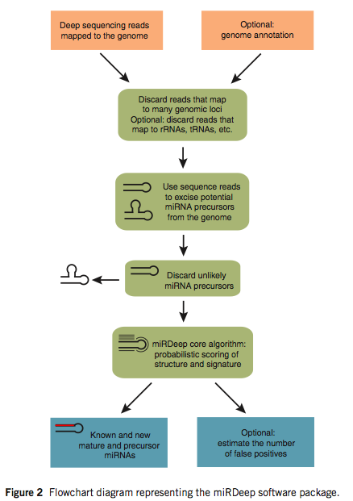
How miRDeep finds miRNAs (cont’d)

Slide 10
Workflow (part3)

