Slide 1
Flexible koala conservation on private land under climate change
Frankie Cho

Slide 2
Flexible adaptation
Koalas declared endangered in NSW, QLD and ACT
Climate change threatens koala habitat
NSW Koala Strategy: 7,000ha koala habitat to be protected on NSW private land by 2025

Slide 3
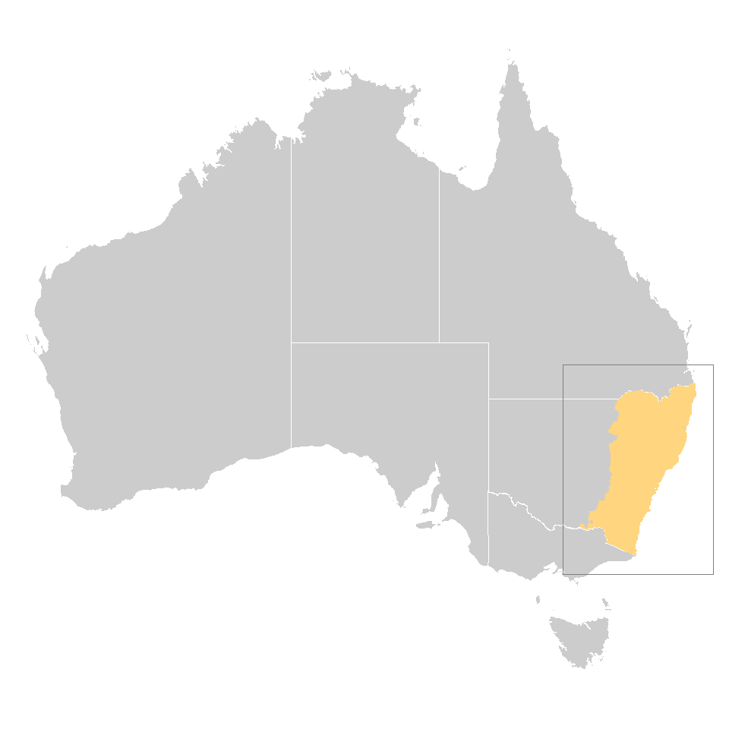
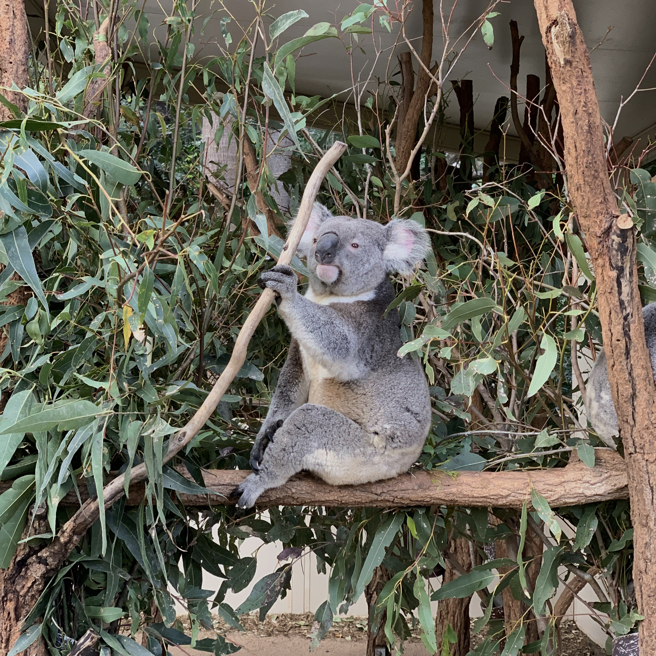

Slide 4
7,000ha koala habitat on private land
Koala habitat: KITL index > 0.25
CC: Enough protection under current conditions
RI: Robust but inflexible protection
F: Flexible protection – add new covenants in 2050
F+L: Flexible protection + learning and adapting to climate change

Slide 5
Flexible adaptation 50% more cost-effective
CC: $51M ($44-61M)
RI: $108M ($101-117M)
F: $72M ($63-81M) – 37% cost reduction
Flexible + Learning: $59M ($48-74M) – 49% cost reduction

Slide 6
Flexibility: adding protection more valuable than ending
CC: $51M ($44-61M)
RI: $108M ($101-117M)
F: $72M ($63-81M) – 37% cost reduction

Slide 7
Key findings
Strategic flexibility alters first-stage decisions
Flexibility mitigates trade-offs between maximizing conservation outcomes and managing risks
Flexibility to offer new covenants much more valuable than flexibility to end interventions

Slide 8
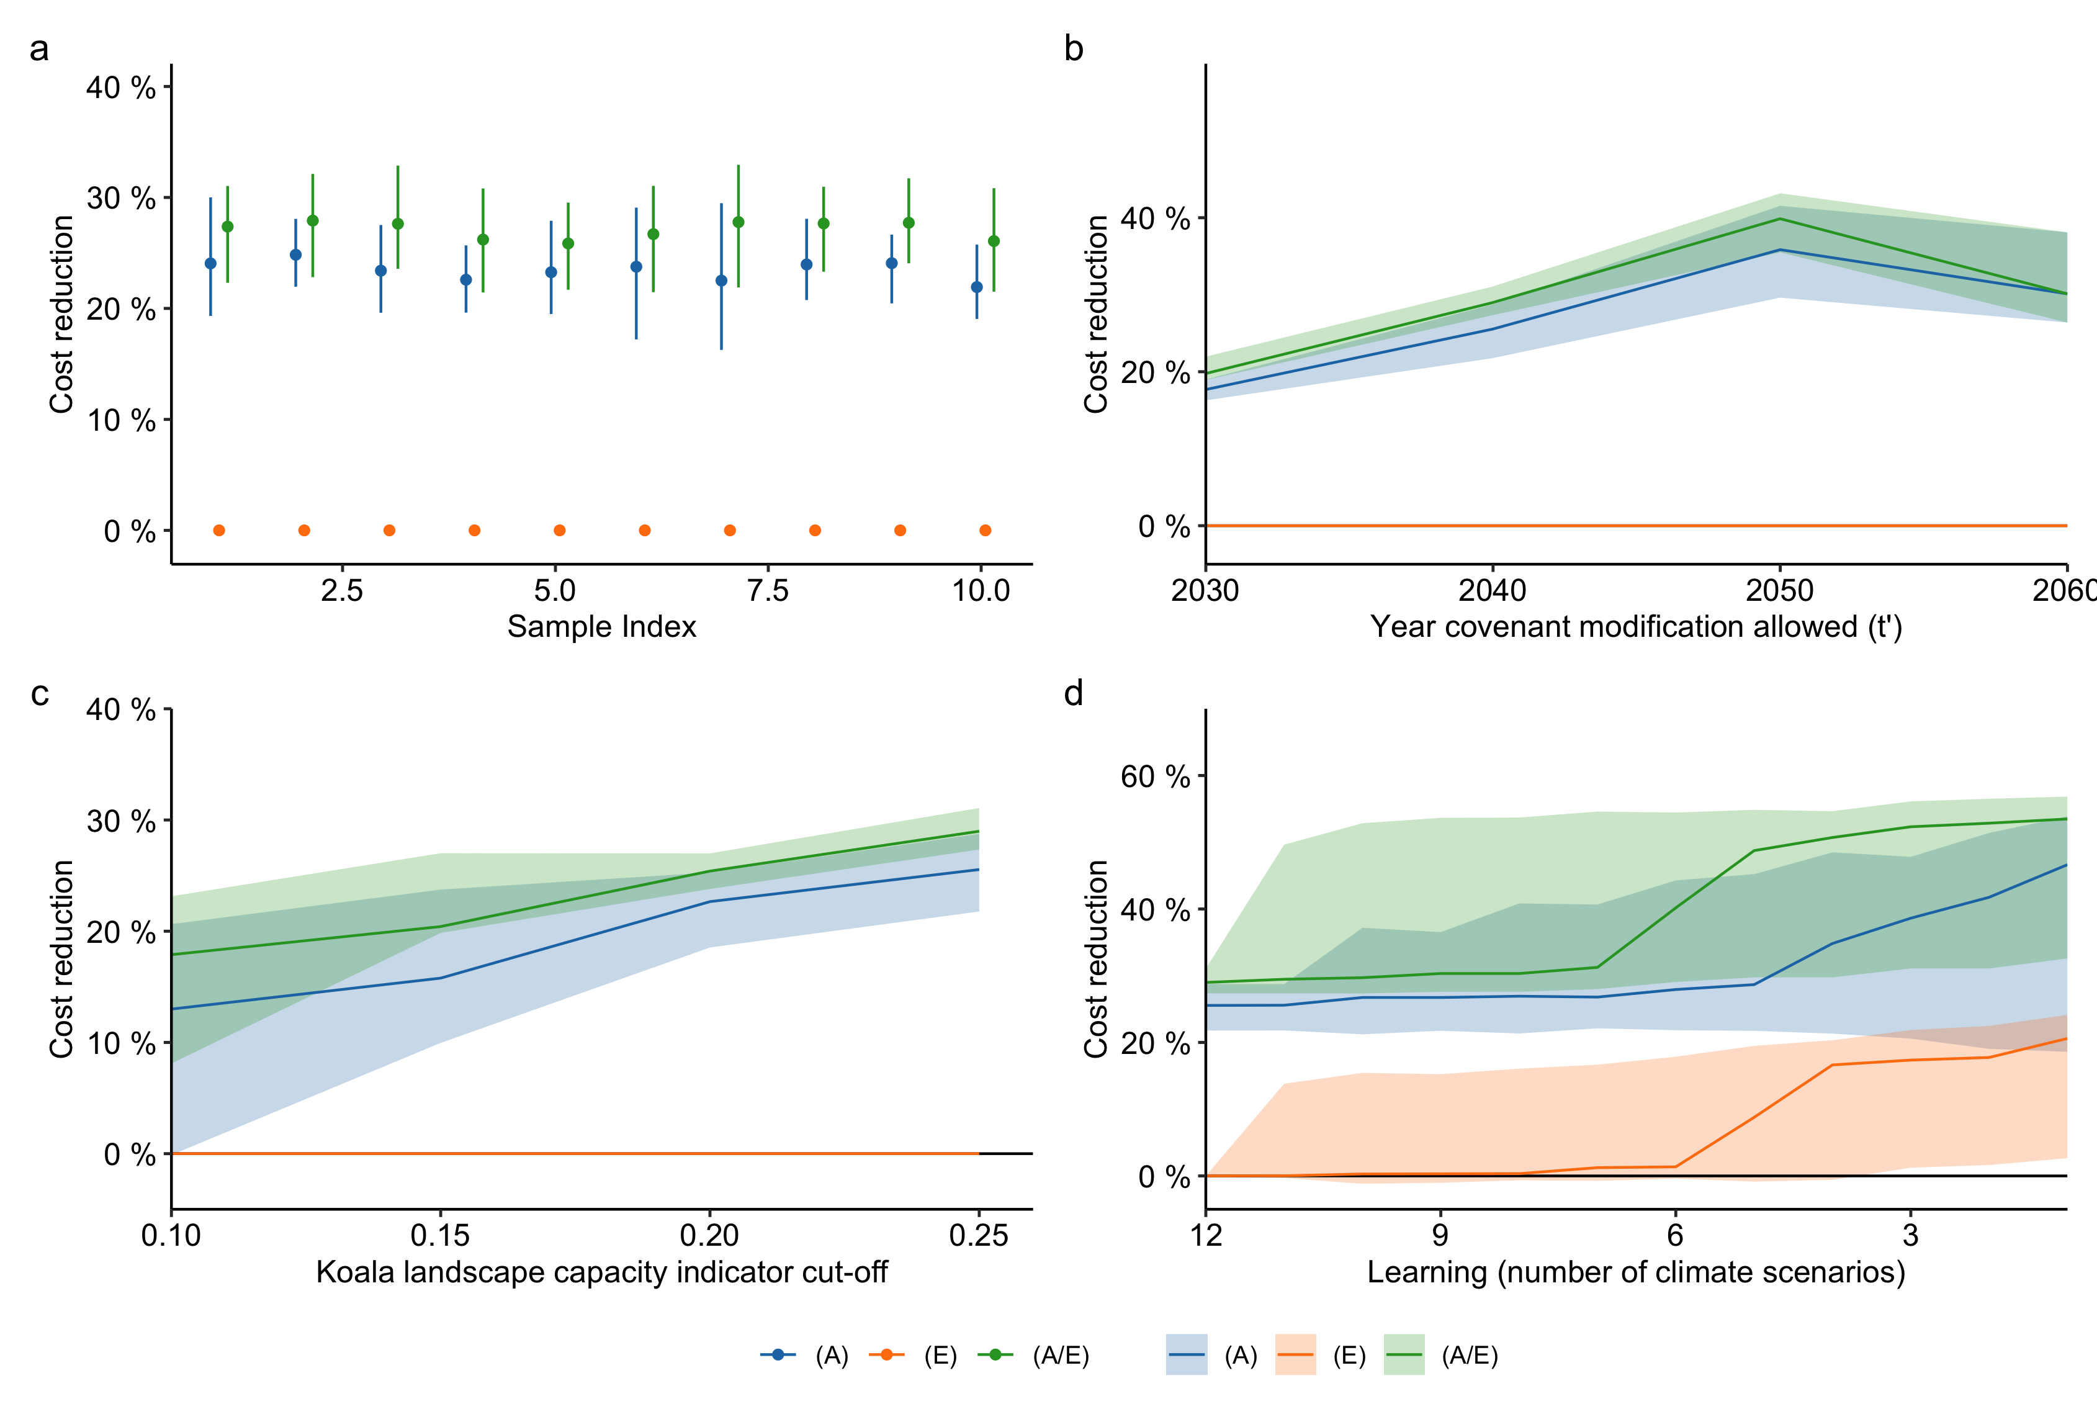
Appendix 1: Sensitivity analysis
Sensitivities of estimates of the value of flexibility (A, E and A/E) under changes to the default parameters, showing sensitivities to a, sampling of 10 study populations randomly sampled with the stratified sampling approach (default index = 1), b, year covenant modification is allowed - t’ (default = 2050). c, koala landscape capacity indicator cut-off (default = 0.25) across a range of cut-offs where feasible solutions to the problem are found, and d. Amount of learning based on the number of climate scenarios decision-makers are uncertain about (1 being perfect certainty over climate change, default = 12), with “No Learning”, “Partial Learning” and “Full Learning” having parameters of 12, 3 and 1 respectively.

Slide 9
Appendix 2: Two-stage stochastic optimization
$$ \min_x E_{j \in J}\Big[\sum_i \sum_t c_{ijt}x_i + E_{S\in\xi}[Q(x,S)]\Big] \\ Q_j(x,S) := \min_{y,w} E_{s\in S}\Big[\sum_i \sum_{t\geq t'} c_{ijt}y_{is} - c_{ijt}w_{is}\Big] \\ s.t. \sum_i m_{ijts} x_i \geq K \quad \forall t=1,s\in S, j \in J \\ \sum_i m_{ijts}(x_i + y_{is} - w_{is} \geq K \quad \forall t \geq t', s \in S, j \in J \\ \sum_i m_{ijts} x_i \geq K \quad \forall t = 1, s \in S, j \in J \\ x_i + y_{is} \leq 1 \quad \forall i \in N, s \in S \\ x_i \geq w_{is} \quad \forall i \in N, s \in S \\ y_{is} = 0 \quad \forall i \in N, s \in S \\ w_{is} = 0 \quad \forall i \in N, s \in S \\ x,y,w \in [0,1] $$

Slide 10
Appendix 3
Conservation under Current Conditions (CC)
Total habitat reaches 7,000 ha in 2020 on average
Robust and Inflexible (RI)
Total habitat is higher than 7,000 for all time-steps, all climate scenarios and all social behavior realizations
Covenant offers same across time
Flexible (F)
Total habitat is higher than 7,000 for all time-steps, all climate scenarios and all social behavior realizations
New covenant offers can be added in 2050
Flexible with Learning (F+L)
Total habitat is higher than 7,000 for time-steps before 2050, all climate scenarios and all social behavior realizations
After 2050, total habitat must be higher than 7,000 for a particular climate scenario (offers can be different across scenarios) on the average social behavior realization
New covenant offers can be added in 2050

