Slide 1
Data Madness
Group 2
Simon Garland
PierrePaul Charbonnier,
Filip Straka

Slide 2


Slide 3
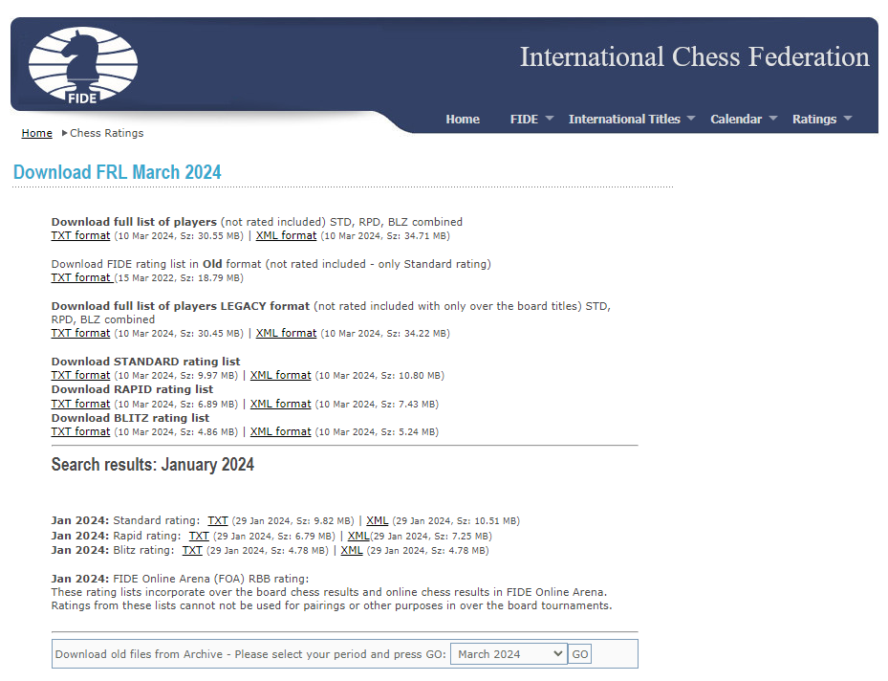

Slide 4
What do we want learn from this data?
How is the ranking changing – can we predict the future changes?
Who is dominating the chess scene?
What sex is better at chess?
Which countries are the best at chess?

Slide 5
Is it ok to use this data?
This data is open-source
Every participant has agreed to have this data public
This analysis does not affect the subjects in any way
We are not interested in any singular subject of the analysis

Slide 6
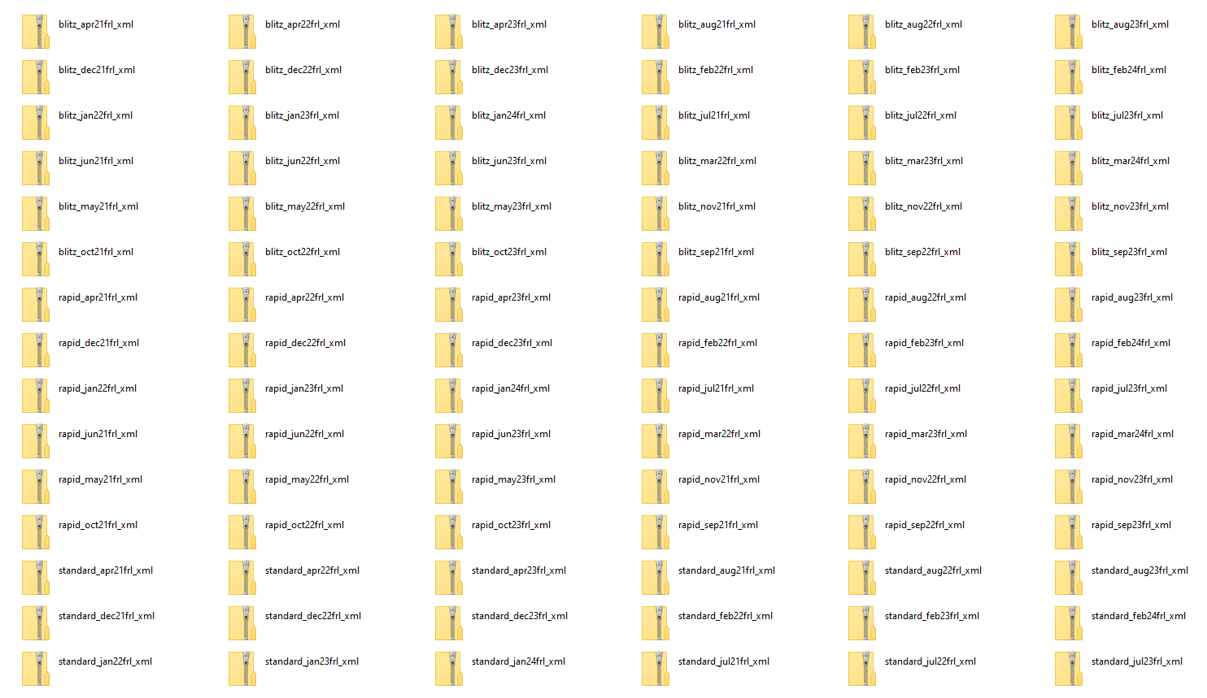

Slide 7
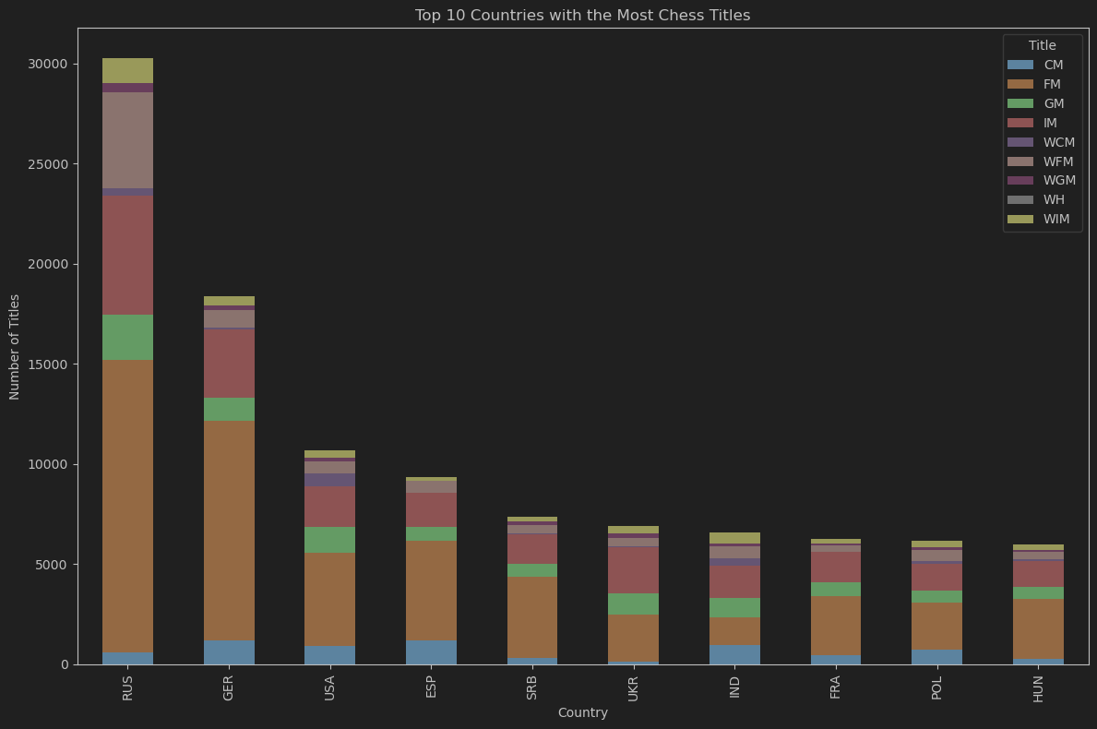

Slide 8
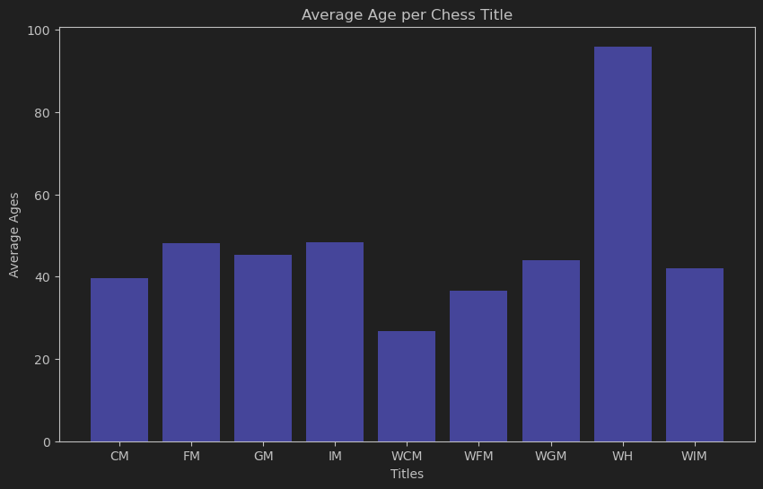

Slide 9
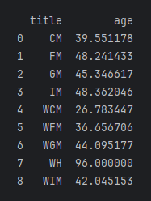
(can’t find it here)

Slide 10
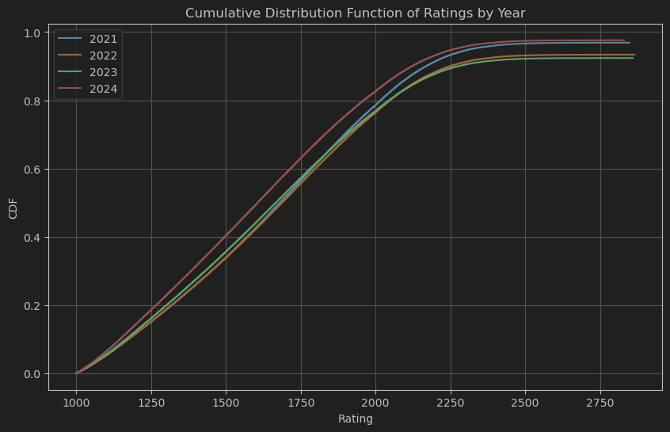
Nice, similar CDFs…

Slide 11
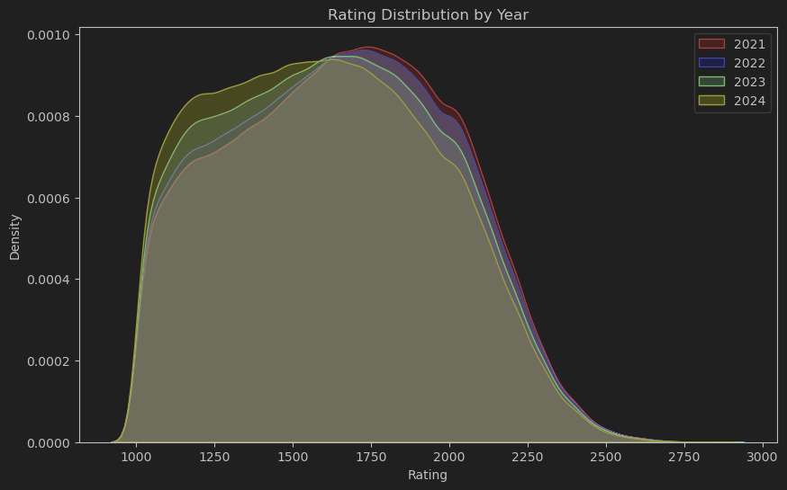
But what about this?
People under rating 1000 can’t compete
That’s why it begins so steeply
That violates CLT!

Slide 12
So, what now?
People under rating 1000 can’t compete
That violates CLT!
Does it Though?
Let’s just introduce artificial bounds!
This gives us truncated data, but still viable

Slide 13

Are all the months alright though?
i.e. is the data consistent?

Slide 14
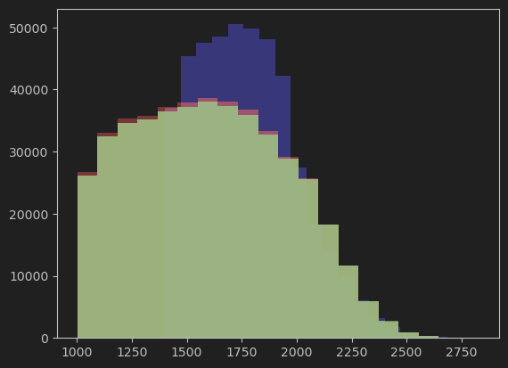
No, it is not!
January 2024
March 2024
Our data originally spanned April 2021 – March 2024
The rest seems to follow the same pattern
Now we can’t use March 2024
But we still have 47 other months
February 2024

Slide 15
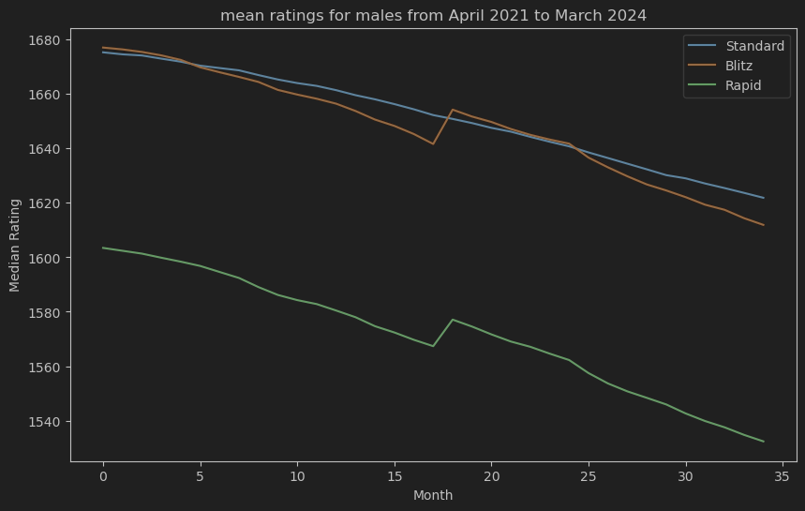
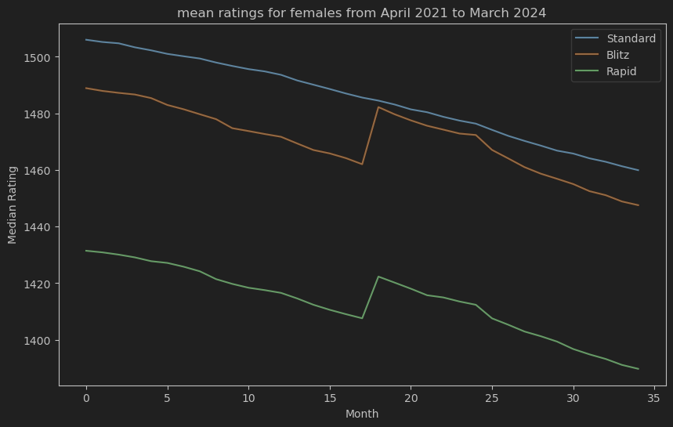
So, what does this actually look like?
Shockingly similar, right?
The scales are not the same on purpose
But what is that spike everywhere but in Standard?

Slide 16
So, what does this actually look like?
Shockingly similar, right?
The scales are not the same on purpose
But what is that spike everywhere but in Standard?

Slide 17

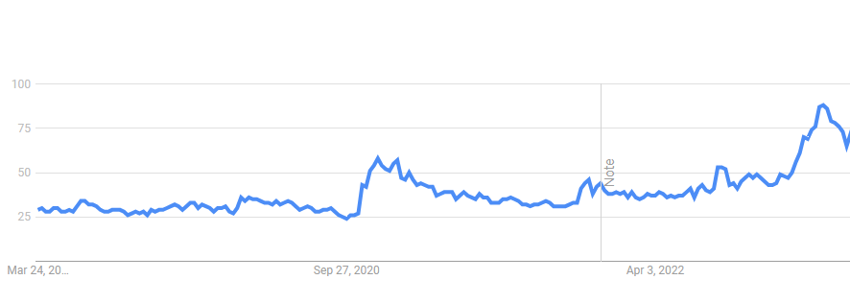
October 2022 – what happened?
Hans Niemann and his “helper tool” scandal
Chess slowly gaining popularity (as a result?)
Google Trends
October 22

Slide 18
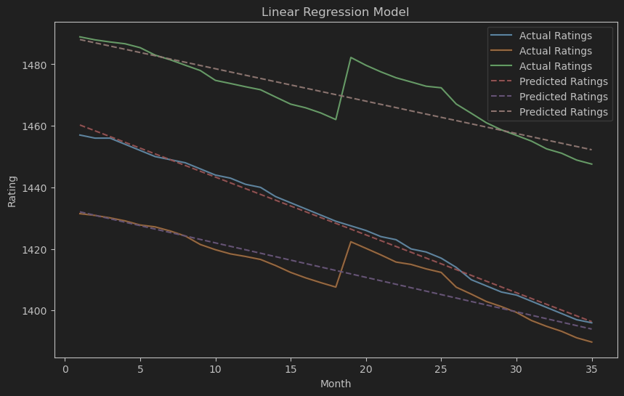
Getting back to our questions
Can we predict what the ratings are going to look like?
No – because of the new cutoff!
Can we see what demographic is dominant though?
Yes – Let’s see about sex!

Slide 19
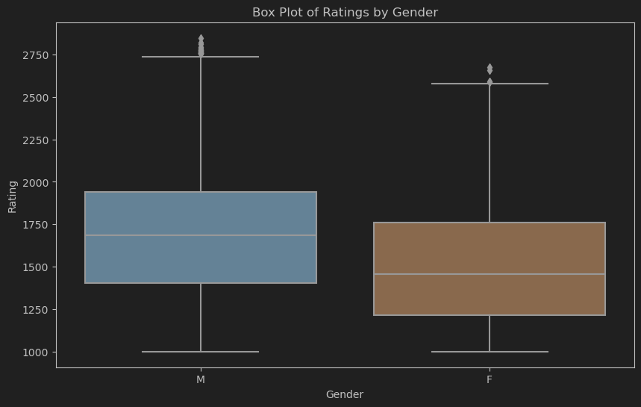
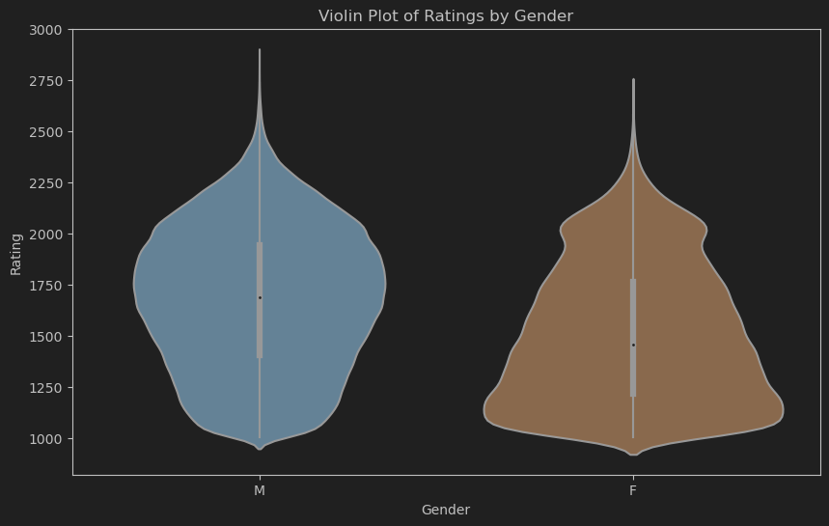
What sex is better at chess?

Slide 20
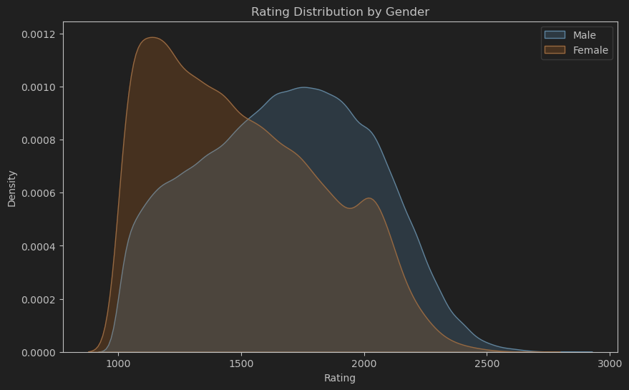
What sex is better at chess?

Slide 21
Thank you!
More to be found in our notebook

