Slide 1
Content Plan Table
Portfolio Project
Project Name | Skills | Tools/Languages | Short Description/Objective | Members | Planning Stage | Wireframes | Development Plan* | Code Snippets | Homepage Screenshots | Takeaway | Link to Website | Link To GitHub
Portfolio Project | ✔ | ✔ | ✔ | ✔ | ✔ | ✔ | - | ✔ | ✔ | ✔ | ✔ | ✔
Capstone Project | ✔ | ✔ | ✔ | ✔ | ✔ | ✔ | ✔ | ✔ | ✔ | ✔ | ✔ | ✔
React Project | ✔ | ✔ | ✔ | ✔ | ✔ | - (mockup) | ✔ | ✔ | ✔ | ✔ | ✔ | ✔
HTML/CSS Group Project | ✔ | ✔ | ✔ | ✔ | - | - | - | - | ✔ | ✔ | ✔ | ✔
Business Brochure | ✔ | ✔ | ✔ | ✔ | ✔ | ✔ | - | - | ✔ | ✔ | ✔ | ✔
Country Project | ✔ | ✔ | ✔ | - | - | - | - | - | ✔ | ✔ | ✔ | -
Capstone and React Projects will have a development plan based on Wordpress Plan assignment (CPT, taxonomies, ACF, templates, files…etc.), and other important elements of the project (npm install…etc.)

Slide 2
Content Plan Table
Home Section
Image of myself
Brief introductory paragraph
About Section
3 paragraphs about myself, highlights, how I got started into web development
Tools/languages table
Contact Section
LinkedIn
Twitter
E-mail
Phone number
Contact form

Slide 3
Site Map
Home
About
Work
Contact
Portfolio Project
Capstone Project
Details (see content plan table)
React Project
HTML/CSS Project
Business Brochure
Parts of the work page
Country Project
All other pages

Slide 4
My Story
Hello everybody! My name is Alfred Ko and I am a Vancouver-based front-end web developer. I have graduated from the TWD (Technical Web Designer) Program at BCIT. Before entering this program, I obtained my BA in Speech Sciences at UBC, but I felt that I wanted a career change. After pulling up Codecademy one day and trying out their HTML and CSS course out of curiosity, I really got into coding, and when I discovered that there was such a field that uses coding called “web development”, that was when I felt really sold on it. I love not only the problem solving aspect of the field, but with coding you can also enrich the visual outlook and browsing experience of websites as well.
I have been working in teams for various projects during the TWD Program, so the program has allowed me to become a better communicator, and a more co-operative person. I also aim to use all that I learned to make sure that clients get the most beautiful, dynamic and innovative websites as possible.
When I am not at work, you can find me swimming, jogging, running, or casually picking up a new language.
Thank you, and I hope to hear from you soon!

Slide 5
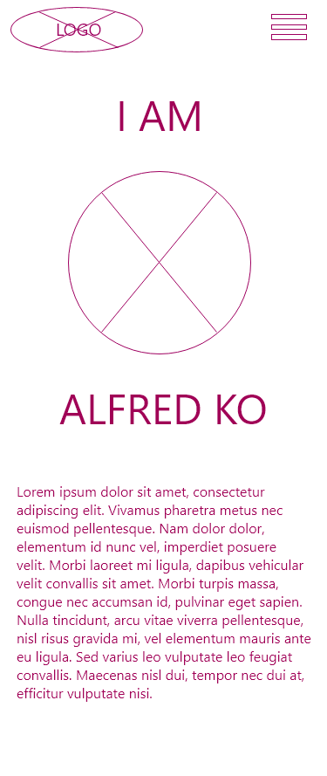
Home Page (mobile)

Slide 6
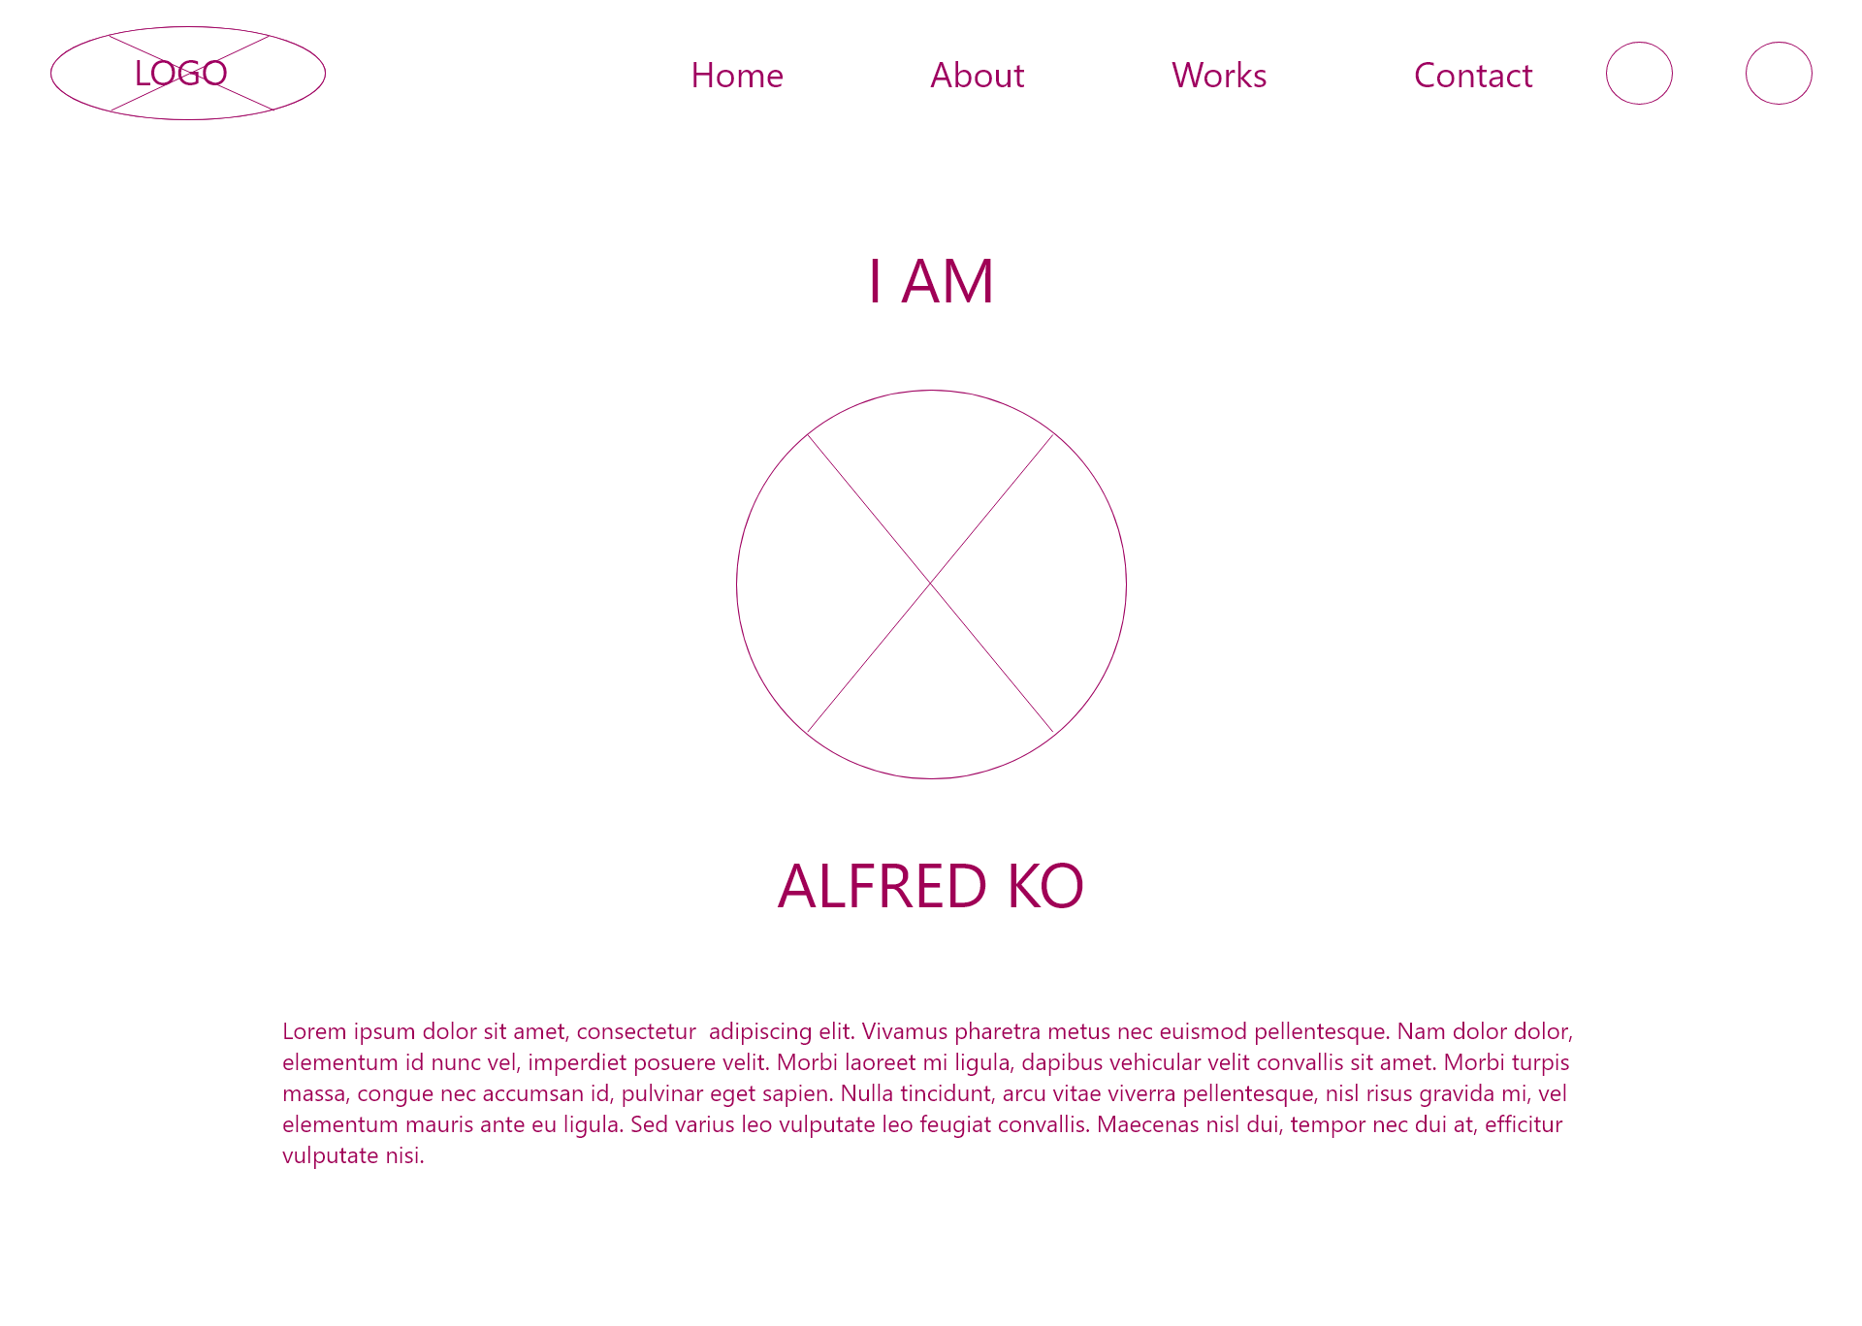
Home Page (desktop)

Slide 7
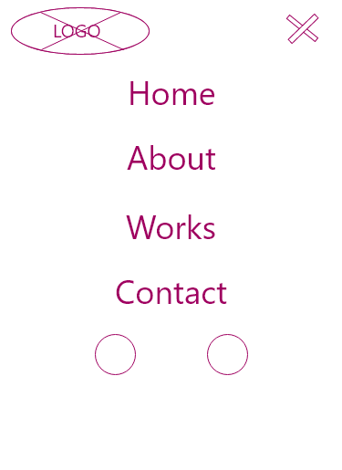
Menu (Mobile)

Slide 8
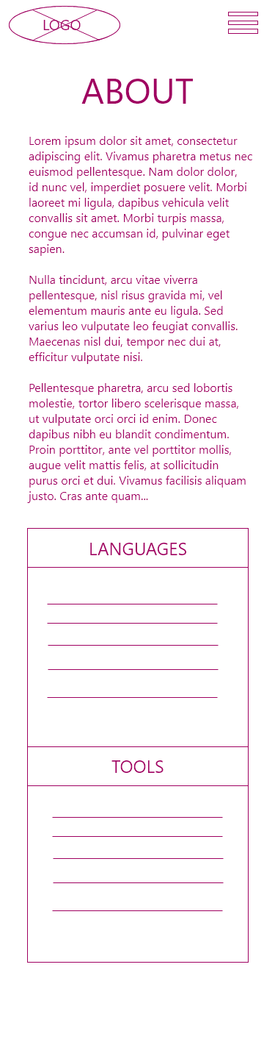
About Page (Mobile)

Slide 9
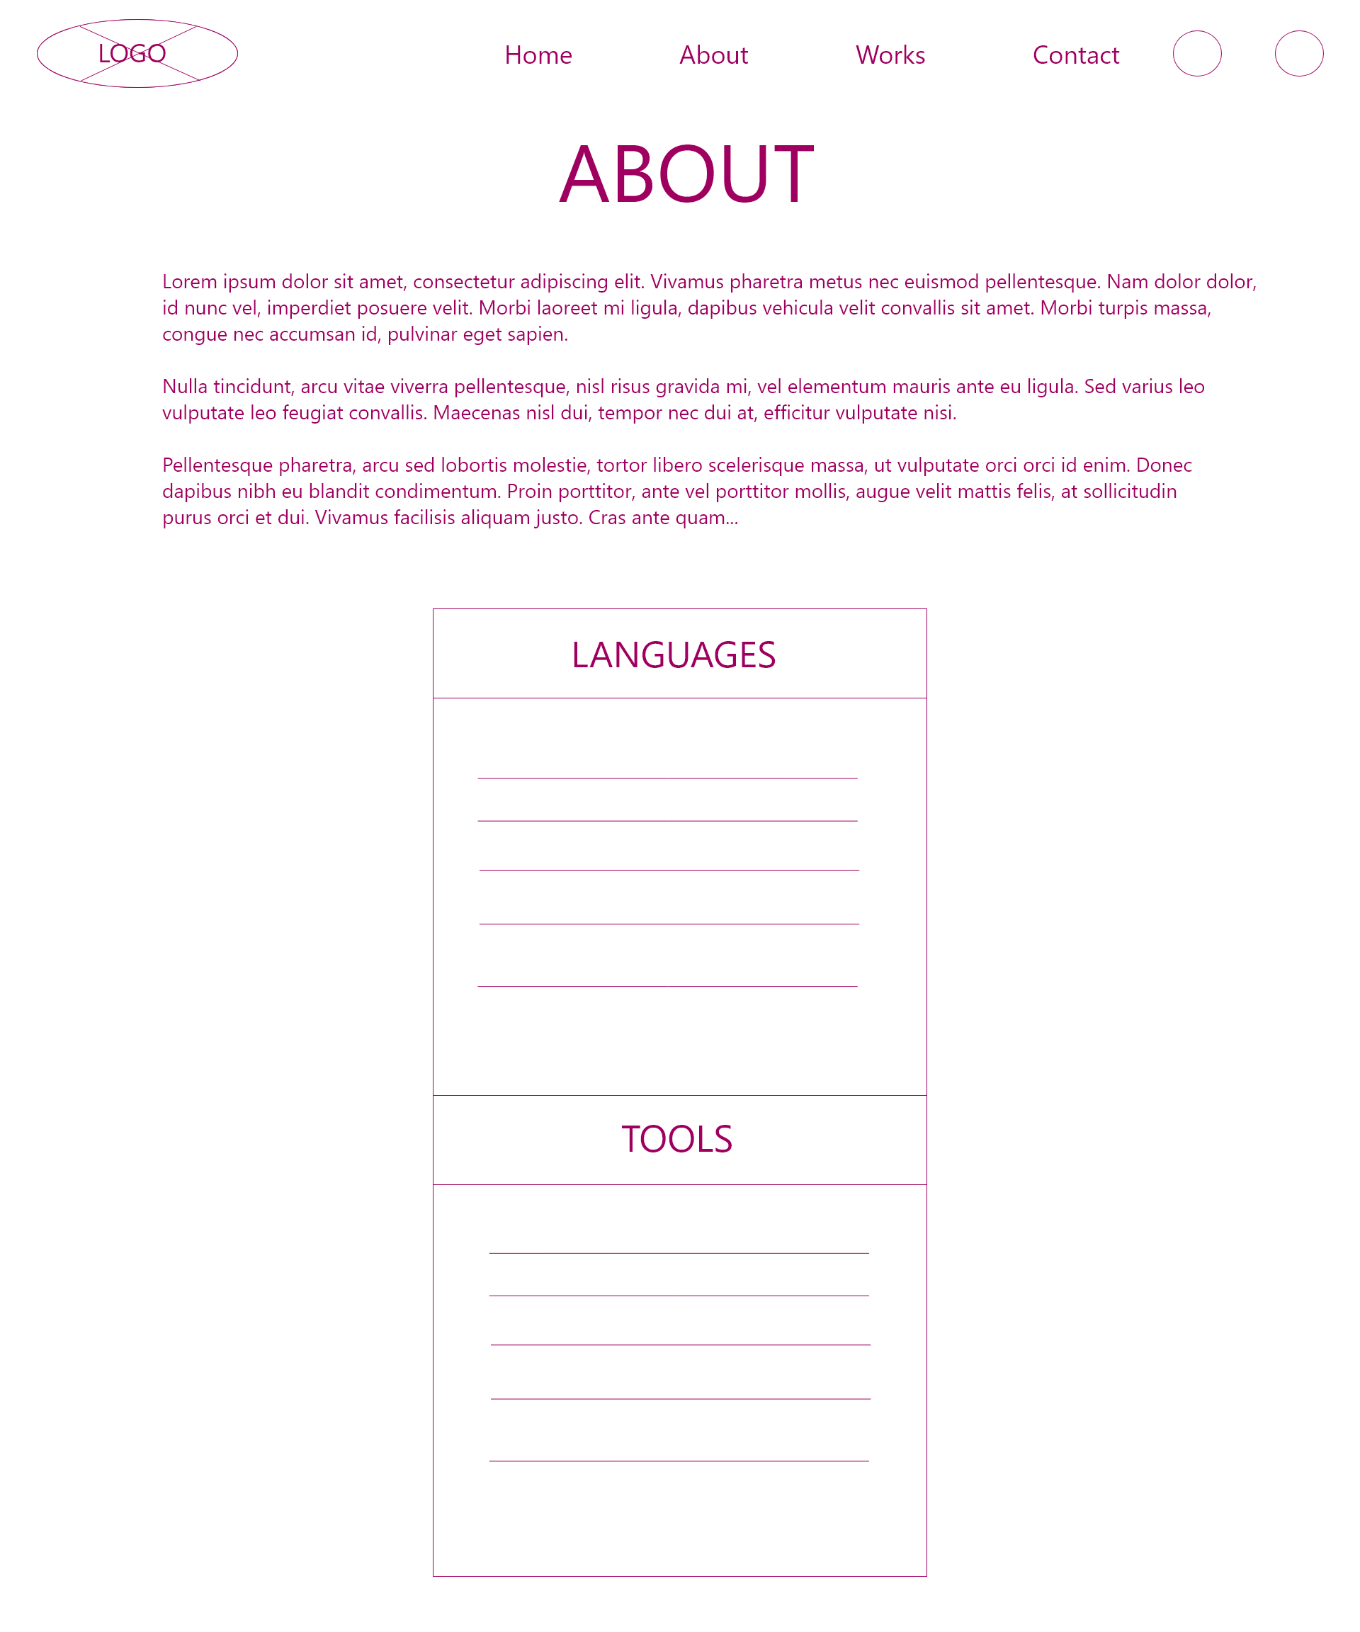
About Page (desktop)

Slide 10
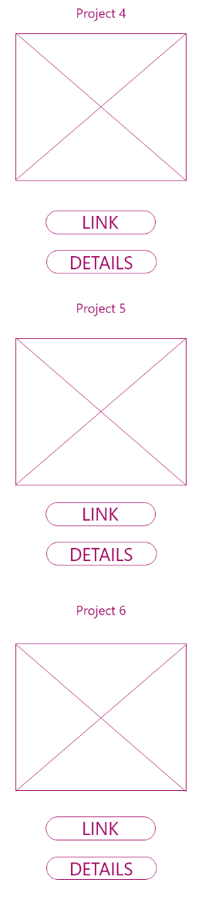
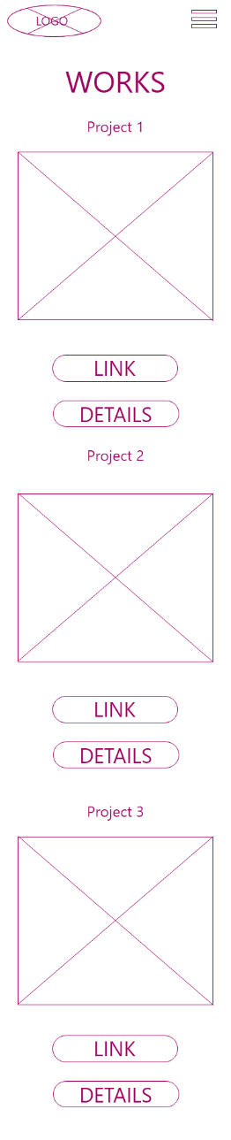
Works Page (mobile)

Slide 11
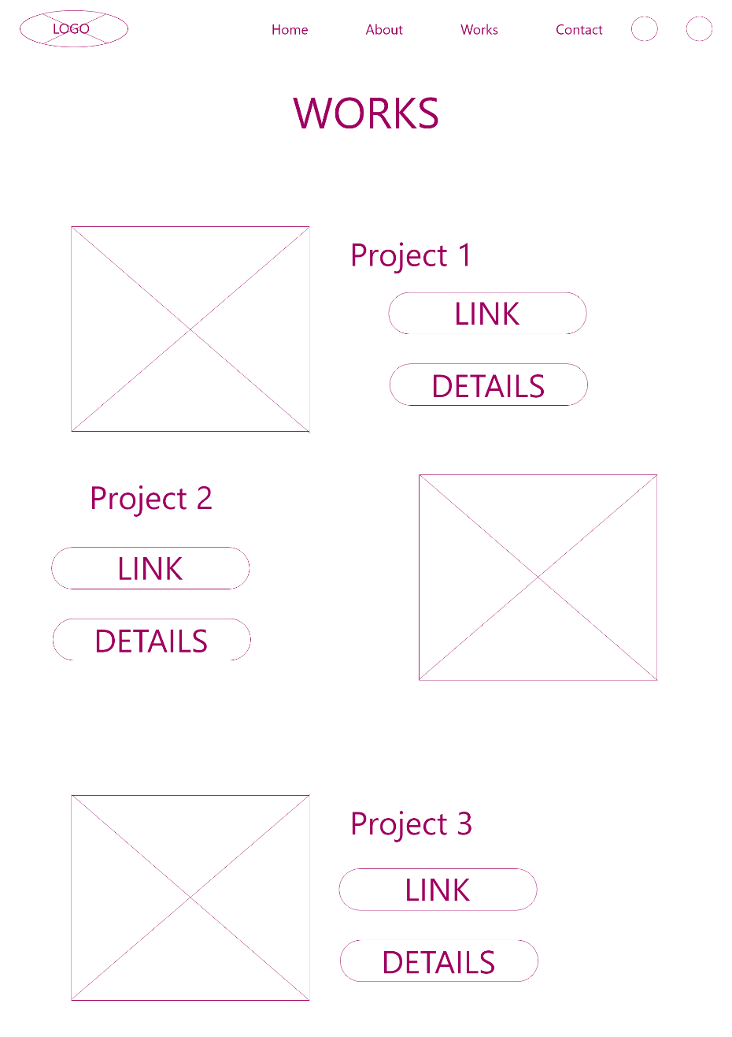
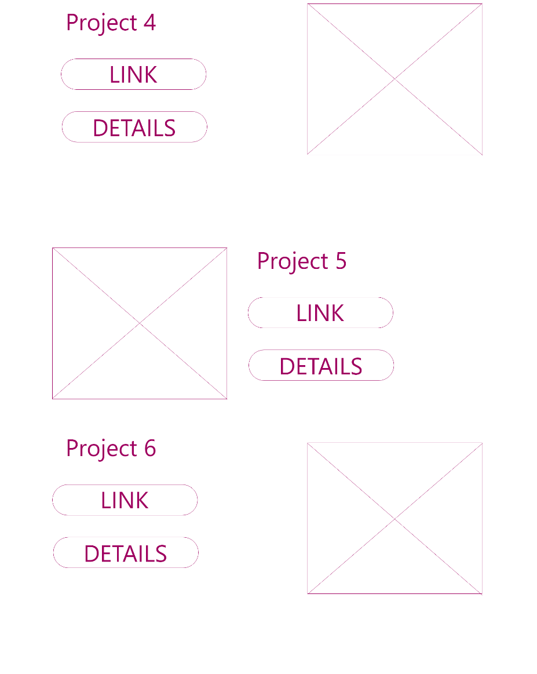
Works Page (desktop)

Slide 12
Work Detail Page (mobile)

Slide 13
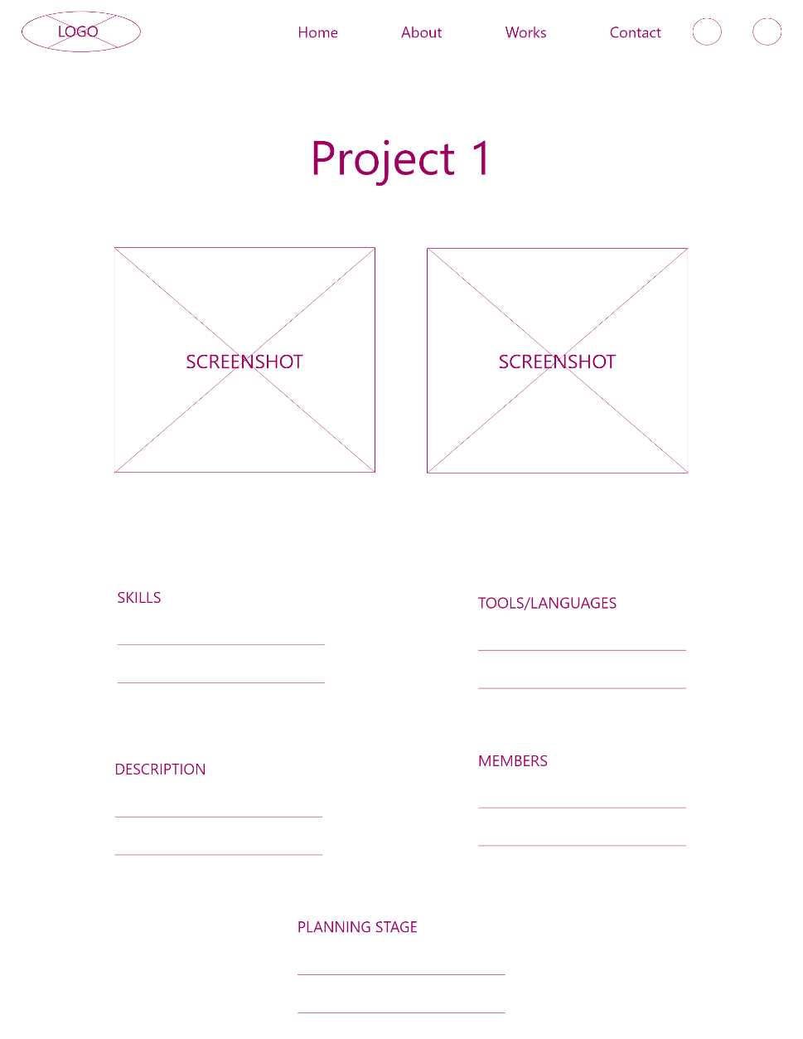
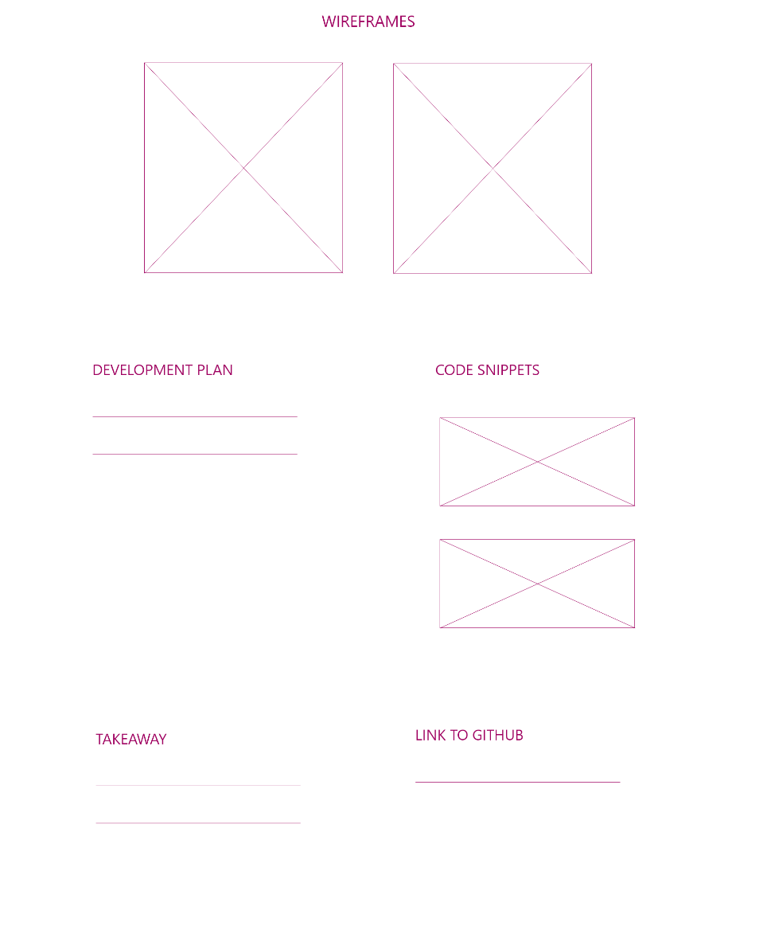
Work Detail Page (desktop)

Slide 14
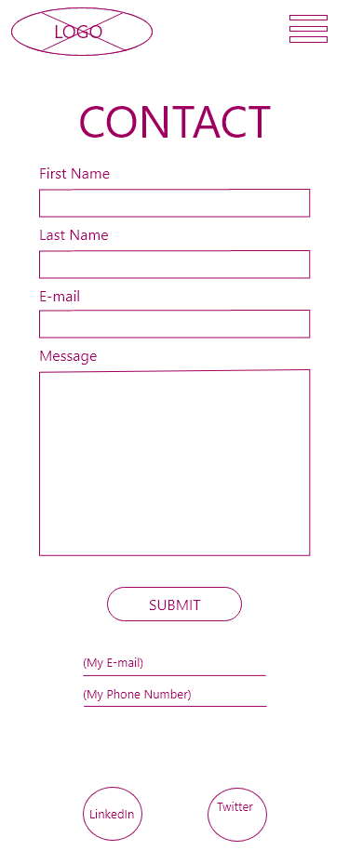
Contact Page (mobile)

Slide 15
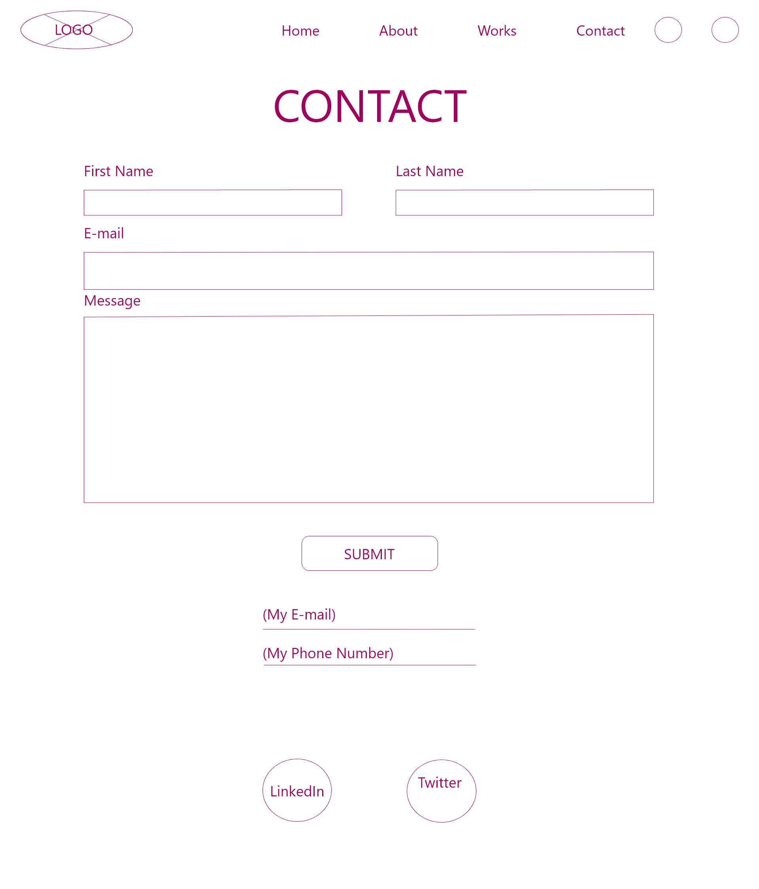
Contact Page (desktop)

