Slide 1
Update Team: Eugin and Seng Tian
20th March 2020

Slide 2
Things we have done
1) Clean up the python code
2) url -> parse -> model -> output -> model
3) Streamlit, and Flask
4) Try out different BERT models – evaluation by runtime (DistillBERT)

Slide 3
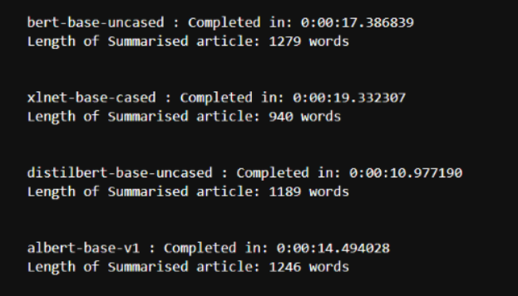
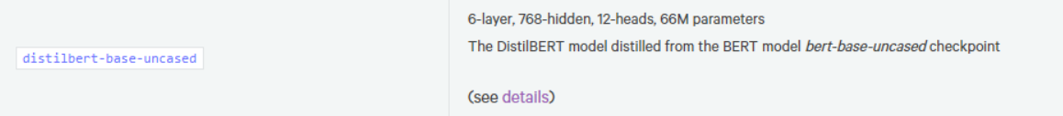
DistilBERT vs BERT-base- uncased (default)

Slide 4
Things for next week
More research ☺
Retraining and update the model (any clues?)
Deployment: error messages

Slide 5





Architecture
News Websites
User Interface
Server Processing
URL
content
Filename, indices
+
File
Hugging Face

