Slide 1
KOMBI-MSIA
BY XIN YI KOAY & KA KIT LENG

Slide 2

INTRODUCTION
KOMBI-MSIA is a webpage introducing various Malaysian cuisines
The name derived from ‘Kombinasi Malaysia’ meaning combination of Malaysia
The logo on navbar is Malaysia’s landmark – KLCC Petronas Twin Tower
Directs to the home page
We used Awardspace web hosting
The URL is http://kombimsia.atwebpages.com/

Slide 3
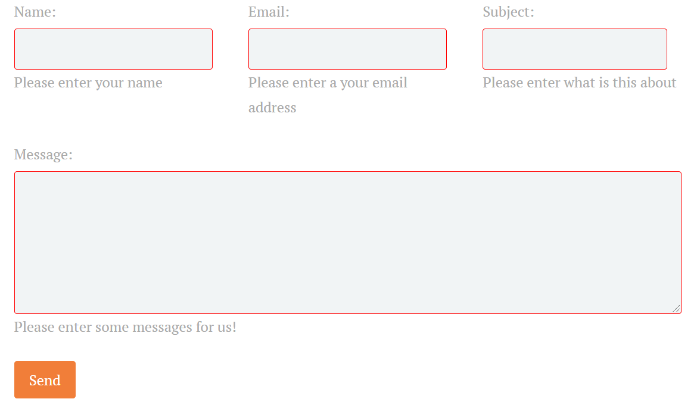
ABOUT US
The ‘about us’ page was implemented using php, sql database and jQuery validation
Users can send messages and the data is stored in ‘about’ table.
Auto increment for ID
JQuery deals with error handling - red box border and error message
For example, email should have ‘@’
A ‘thank you’ message appears if successfully sent

Slide 4
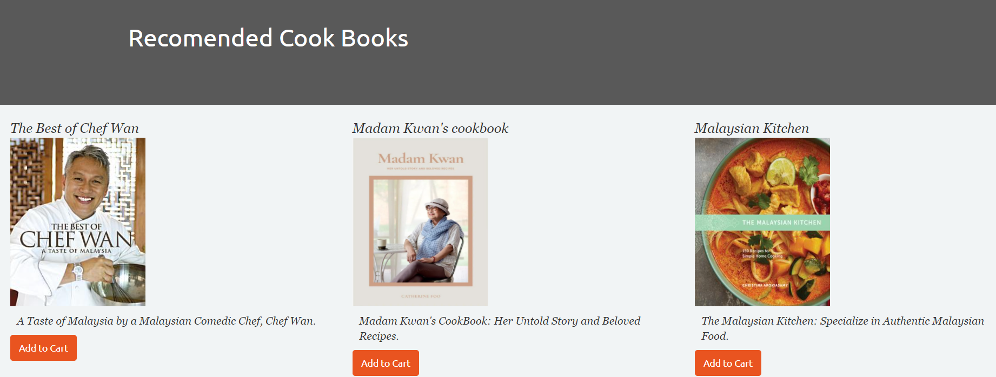
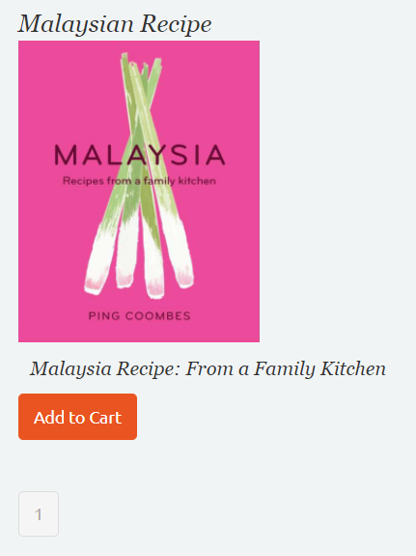
SHOP
The shop page displays recommended cookbooks
Users can add and update items into cart
A message appears if successful
Directed to cart page
There are number of pages at the bottom

Slide 5
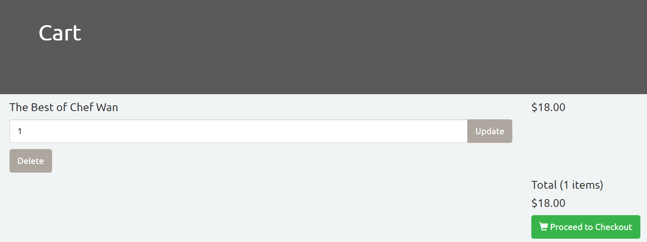
CART
In the cart page, users can view their selected cookbooks
Items can be added or removed from cart
A message appears if successful
Users can increase or decrease item quantity
Proceed to checkout

Slide 6
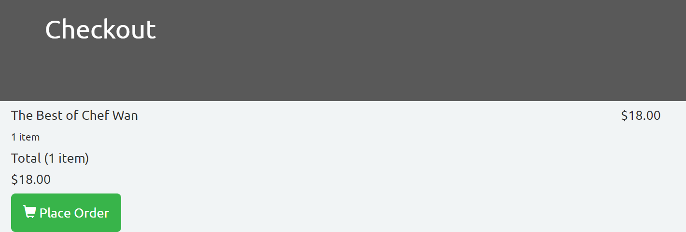
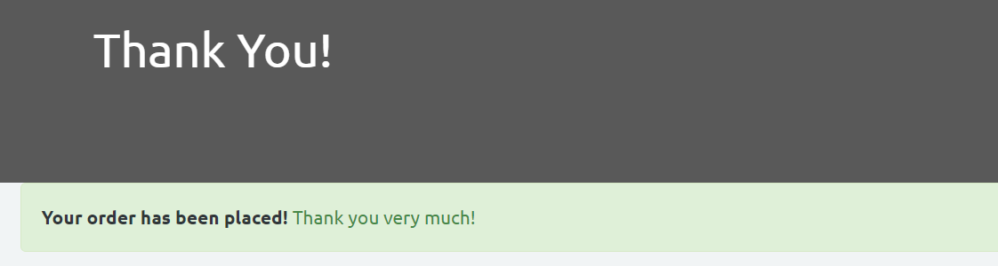
CHECKOUT & PLACE ORDER
Checkout page displays items to be checked out
Place order page allows users to place order
A message appears if successful

