Slide 1
Introduction to Gradle
Koby Aharon
April 2015

Slide 2
A little about me
Developer in the DI lab (iSpreads team)
Joined Citi about 5 months ago
Worked as a build manager in previous job
5+ years of experience with java build tools

Slide 3
Agenda
Build tools overview
Why Gradle?
Gradle overview
Demo
Summary
Gradle resources

Slide 4
Build Tools Overview

Slide 5

Ant - Overview
Java based build tool from Apache
Started as part of Tomcat
Moved to a separate project in early 2000
Imperative build tool
Files are written in XML
Notes:
Imperative – You need to tell the tool exactly what to do and also how to do it. Very verbose.

Slide 6

Ant - Overview
Java based build tool from Apache
Started as part of Tomcat
Moved to a separate project in early 2000
Imperative build tool
Files are written in XML
Notes:
Imperative – You need to tell the tool exactly what to do and also how to do it. Very verbose.

Slide 7

What does it take to build a java app?
Download 3rd party dependencies
Compile source code
Run tests - optional
Create distribution file (jar)

Slide 8
Ant - Build file example
<project name=“example” default= basedir=".">
<property name="src" location="src"/>
<property name="build" location="build"/>
<property name="dist" location="dist"/>
<target name=“clean”>
<delete dir=“${build}”/>
<mkdir dir="${build}"/>
</target>
<target name=“compile” depends= >
<javac srcdir="${src}" destdir="${build}"/>
</target>
<target name=“dist” depends= >
<mkdir dir="${dist}/lib"/>
<jar jarfile="${dist}/lib/example.jar"
basedir="${build}"/>
</target>
</project>
”dist”
dist
Input: compiled code + output paths
Output: jar file
compile
Input: source + compiled code paths
Output: compiled files
”clean”
”compile”
clean
Input: compiled code path
Output: empty folder

Slide 9



What does it takes to build a java app?
Download 3rd party dependencies
Compile source code
Run tests - optional
Create a distribution file (jar)

Slide 10

What does it takes to build a java app?
Download 3rd party dependencies
Compile source code
Run tests - optional
Create a distribution file (jar)

Slide 11

Maven - Overview
Released in 2004
Most popular java build tool
Declarative build tool
Introduced dependency management
Introduced multi-module builds
Relies on convention over configuration
Uses plugin architecture
Files are written in XML
Notes:
Declarative - You describe your project and the aspects of it and the tool does all the work.

Slide 12

Maven - Overview
Released in 2004
Most popular java build tool
Declarative build tool
Introduced dependency management
Introduced multi-module builds
Relies on convention over configuration
Files are written in XML
Notes:
Declarative - You describe your project and the aspects of it and the tool does all the work.

Slide 13
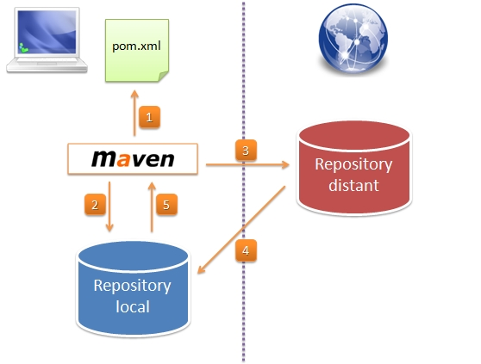
Maven – architecture
Notes:
Maven build life cycles:
1. clean → pre-clean,clean,post-clean
2. default (build)
3. site → pre-site, site, post-site, site-deploy

Slide 14
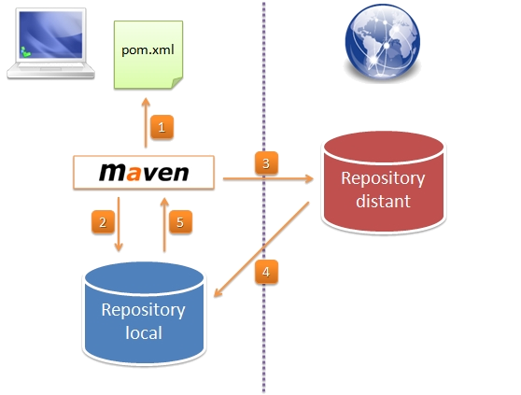
Maven – architecture
Notes:
Maven build life cycles:
1. clean → pre-clean,clean,post-clean
2. default (build)
3. site → pre-site, site, post-site, site-deploy

Slide 15
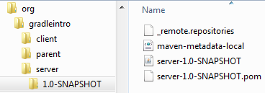
Maven – dependency management
Every module has 3 required fields defining its “address”:
groupId – a unique namespace (usually the company name)
artifactId – the artifact’s name (matches the jar name)
version – the artifact’s version
Example:
<groupId>org.gradleintro</groupId>
<artifactId>server</artifactId>
<version>1.0-SNAPSHOT</version>

Slide 16
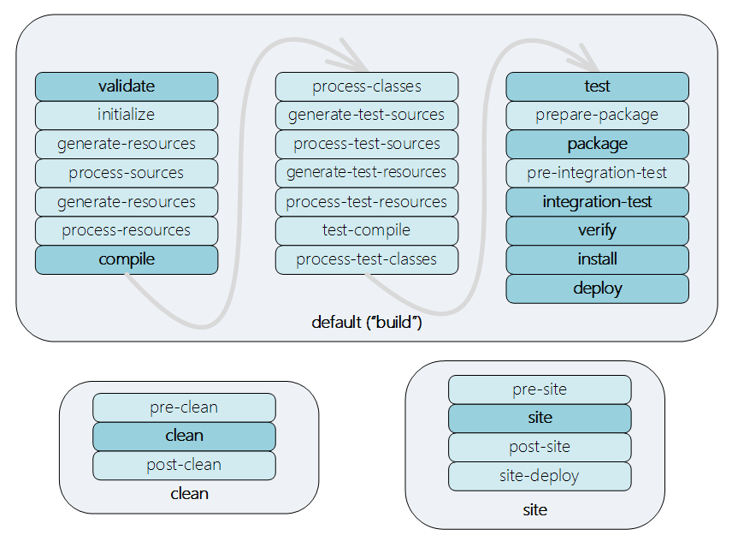
Maven – build lifecycles

Slide 17
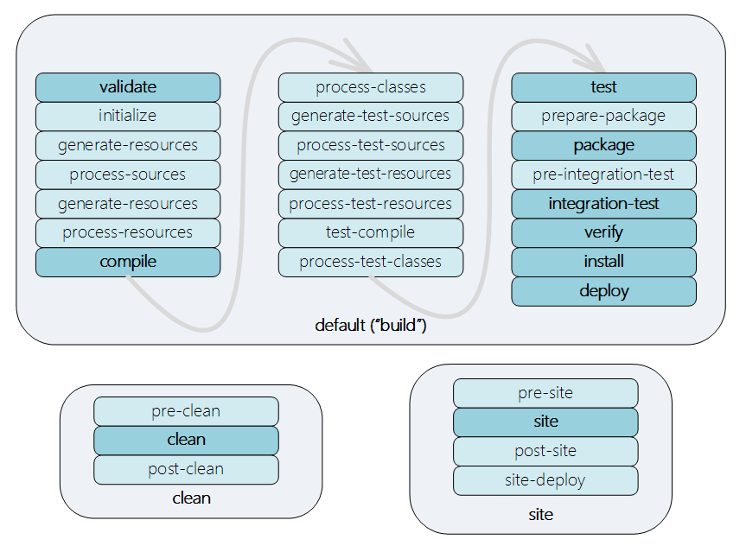
Maven – build lifecycles

Slide 18
Maven – POM example
<project>
<modelVersion>4.0.0</modelVersion>
<groupId>org.gradleintro</groupId>
<artifactId>example</artifactId>
<version>1.0-SNAPSHOT</version>
<packaging>jar</packaging>
<dependencies>
<dependency>
<groupId>junit</groupId>
<artifactId>junit</artifactId>
<version>4.11</version>
<scope>test</scope>
</dependency>
</dependencies>
</project>
Module’s
coordinates
Module’s
dependency
list

Slide 19
What does it takes to build a java app?
Download 3rd party dependencies
Compile source code
Run tests - optional
Create a distribution file (jar)

Slide 20
What does it takes to build a java app?
Download 3rd party dependencies
Compile source code
Run tests - optional
Create a distribution file (jar)

Slide 21
Why
Gradle?

Slide 22
Gradle - Personal story
Worked on a multi-module Maven project containing more than 200 modules
Maven build times:
Full build without tests – 40 minutes
Full build with unit tests – 50 minutes
Full build with full tests suite (unit + integration + async) – 1:30 hours
Hybrid Gradle + Maven build time - ~12 minutes
Example code is hosted on Github.

Slide 23

Gradle - Overview
First released in 2009
Project automation tool
Builds upon the concepts of Maven and Ant
Declarative as well as imperative
Files are written in Groovy using a dedicated DSL

Slide 24

Gradle - Overview
First released in 2009
Project automation tool
Builds upon the concepts of Maven and Ant
Declarative as well as imperative
Files are written in Groovy using a dedicated DSL

Slide 25
Gradle –java module build file
Gradle
Maven
apply plugin: 'java'
group = 'org.gradleintro'
version = '1.0-SNAPSHOT'
dependencies {
testCompile 'junit:junit:4.11'
}
<project>
…
<groupId>org.gradleintro</groupId>
<artifactId>example</artifactId>
<version>1.0-SNAPSHOT</version>
<packaging>jar</packaging>
<dependencies>
<dependency>
<groupId>junit</groupId>
<artifactId>junit</artifactId>
<version>4.11</version>
<scope>test</scope>
</dependency>
</dependencies>
</project>

Slide 26
DEMO

Slide 27
Gradle @Citi Innovation lab

Slide 28
Summary

Slide 29
Build Tools – Pros/Cons
 | Ant | Maven | Gradle
Pros | Easy to learn and use Full control over the build process No “Magic” | Very good IDE support Standard build process Build files are mostly the same across different projects Lot of plugins | Very flexible Incremental build Large community Great documentation Groovy code Declarative as well as imperative Easy migration
Cons | Large XML files Hard to maintain XML format to write “code” Imperative build tool | Learning curve Not flexible Partial multi-module support Not optimal for large projects A lot of “Magic” | Fragile IDE support Learning curve Groovy code A lot of “Magic”
Notes:
Maven:
Partial multi module support -> modules are dependent as artifacts. For example if A depends on B, and you want to build only A, B will be searches for in the repository and won’t be build automatically (supported in Maven 3 using “–pl” and “–am”, however you need to explicitly list the module and can be executed only from the
root).

Slide 30
Gradle – Resources
Documentation:
User guide: http://www.gradle.org/docs/current/userguide/userguide.html
DSL:
http://www.gradle.org/docs/current/dsl/
Javadoc:
http://www.gradle.org/docs/current/dsl/
Groovy Doc:
http://www.gradle.org/docs/current/groovydoc/
Plugin search: https://plugins.gradle.org/

Slide 31
Thx!

