Slide 1
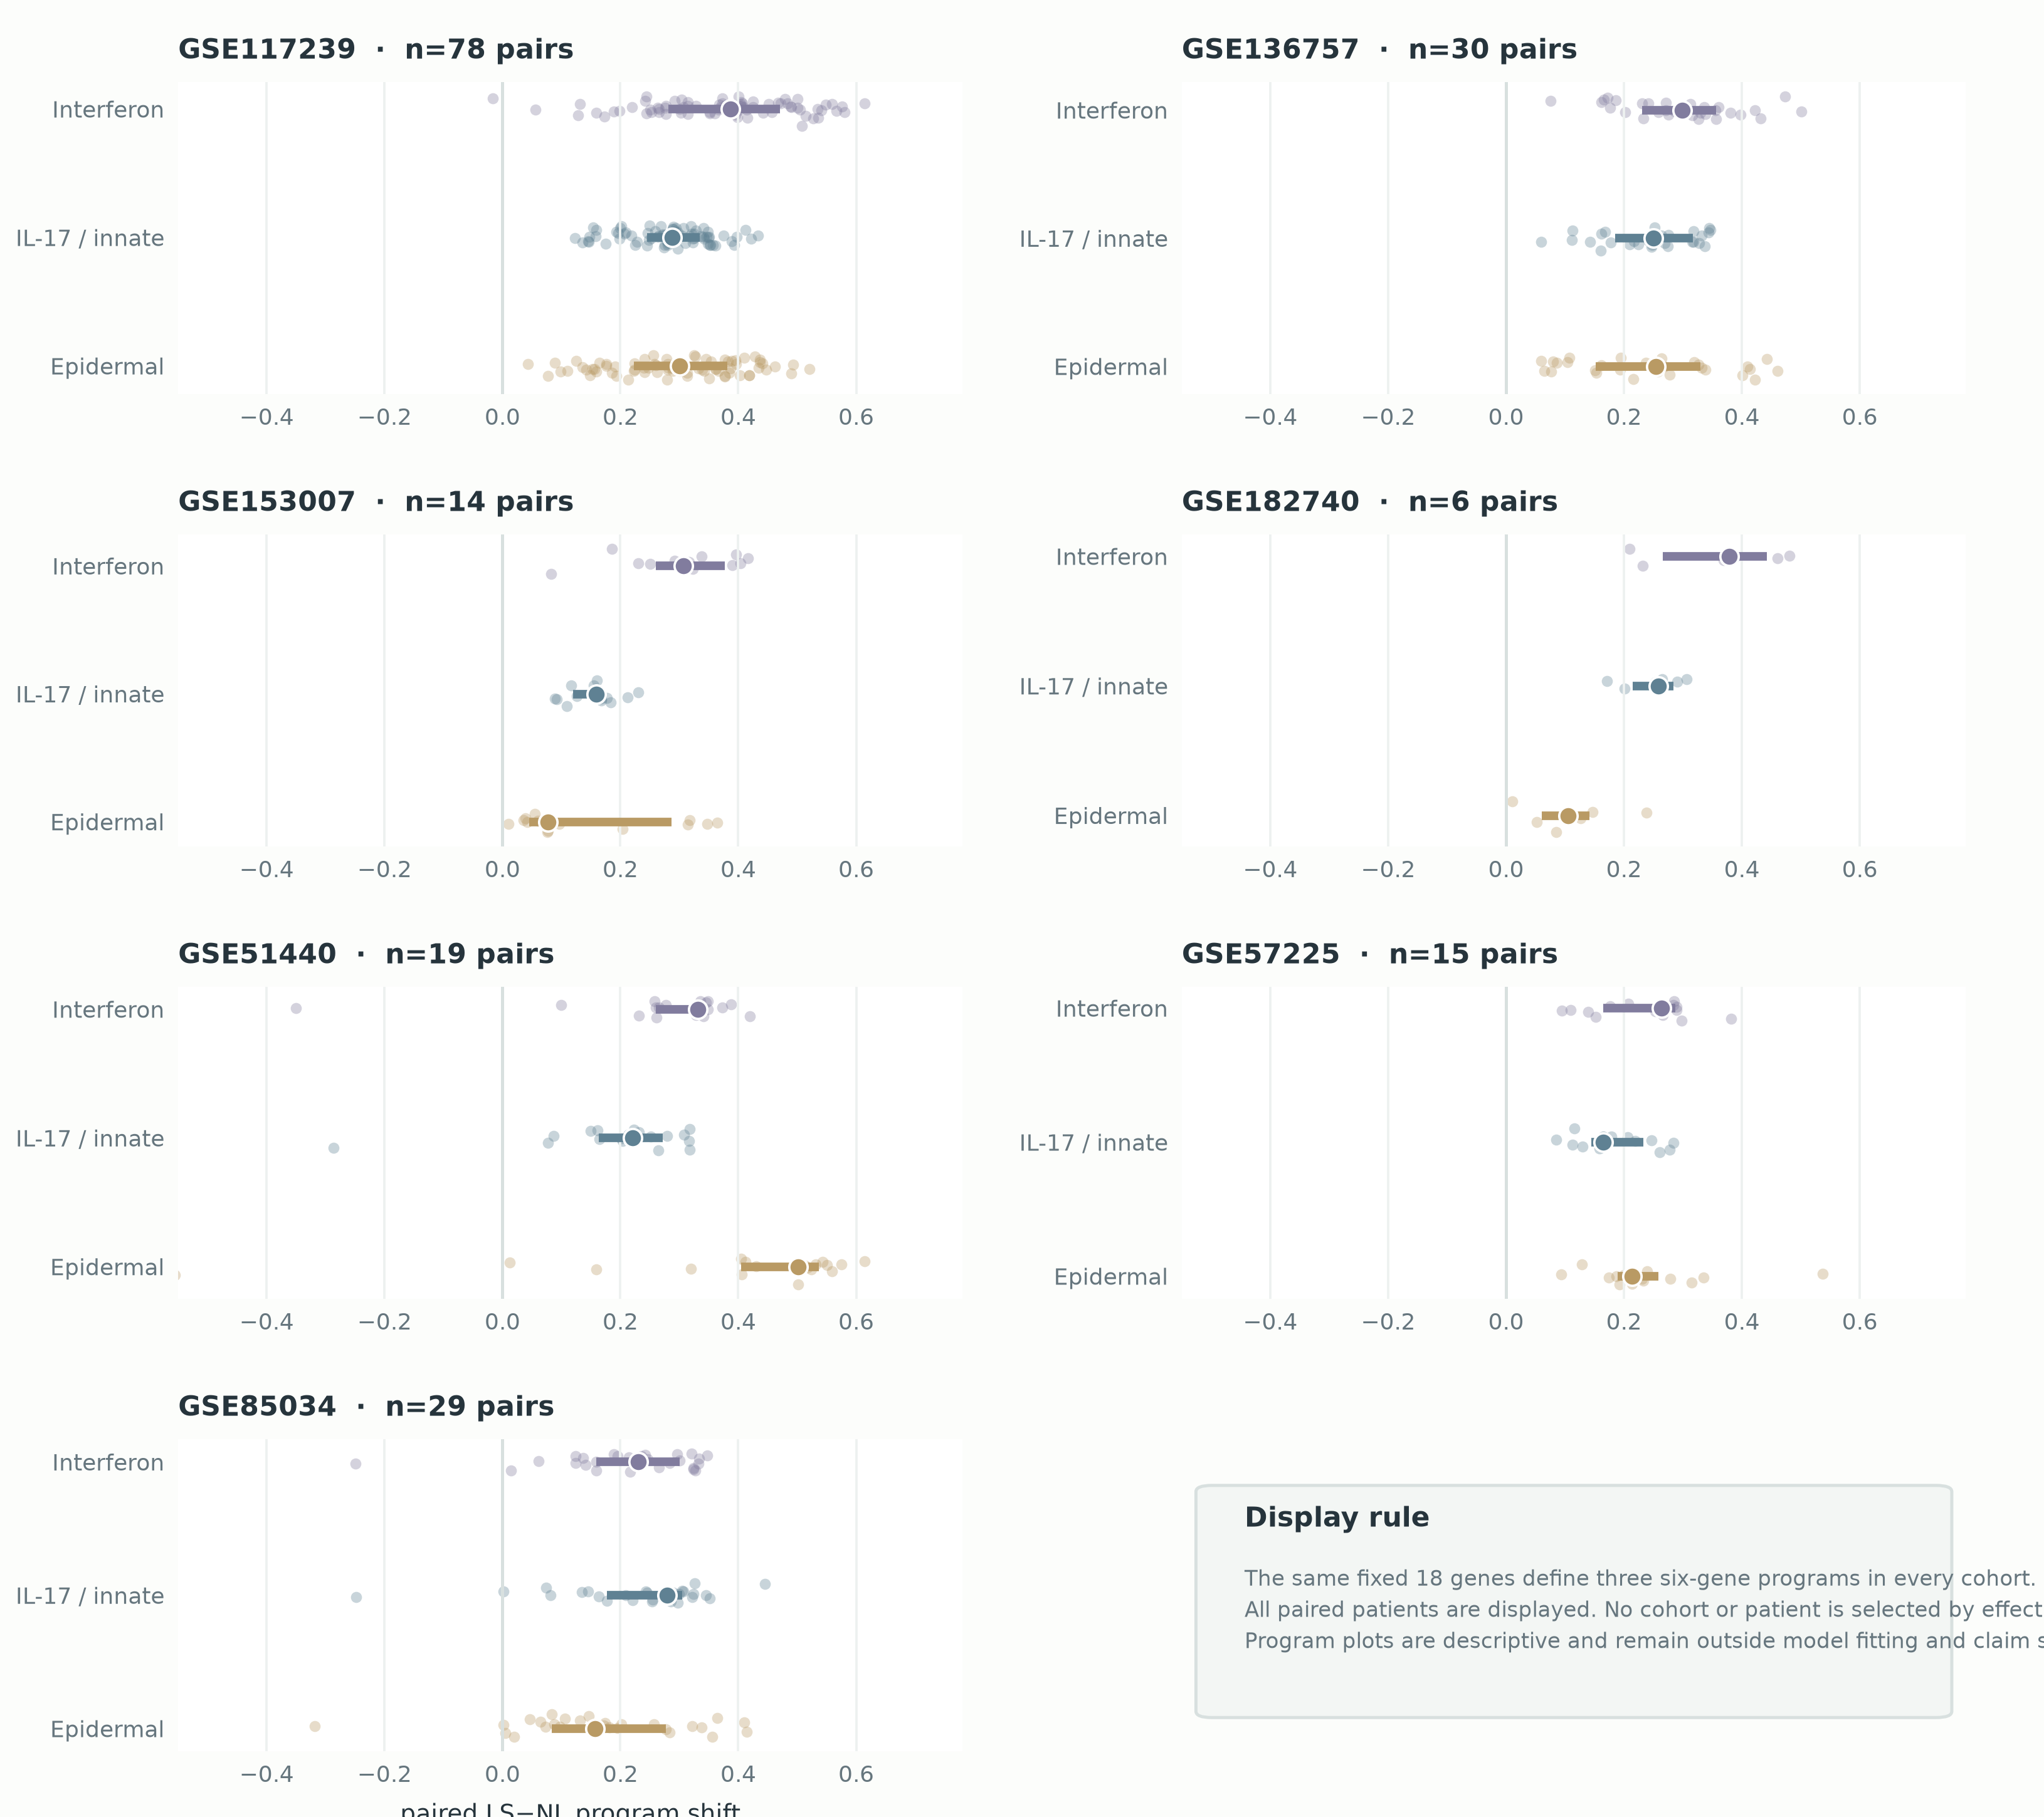
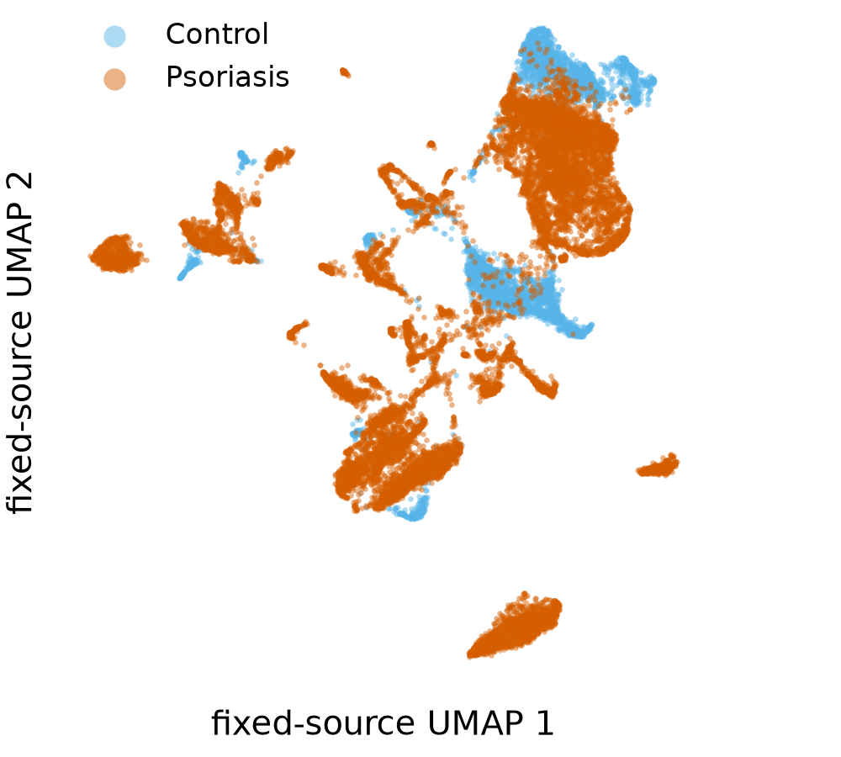
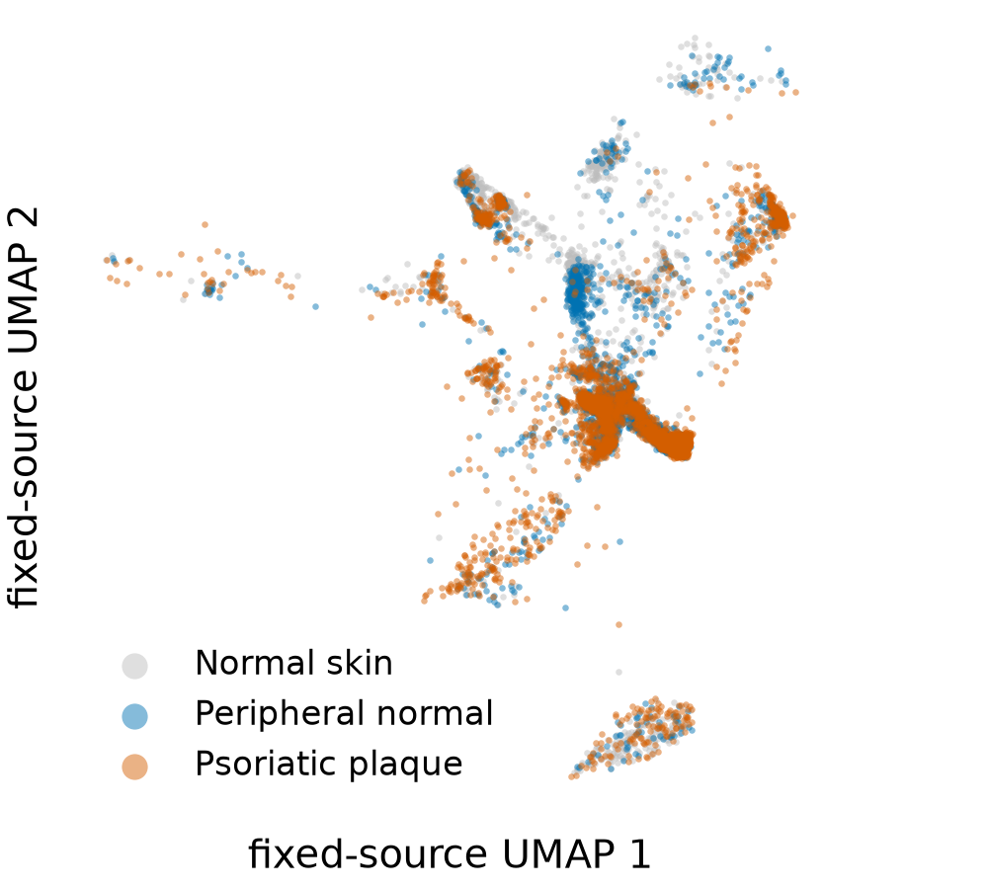
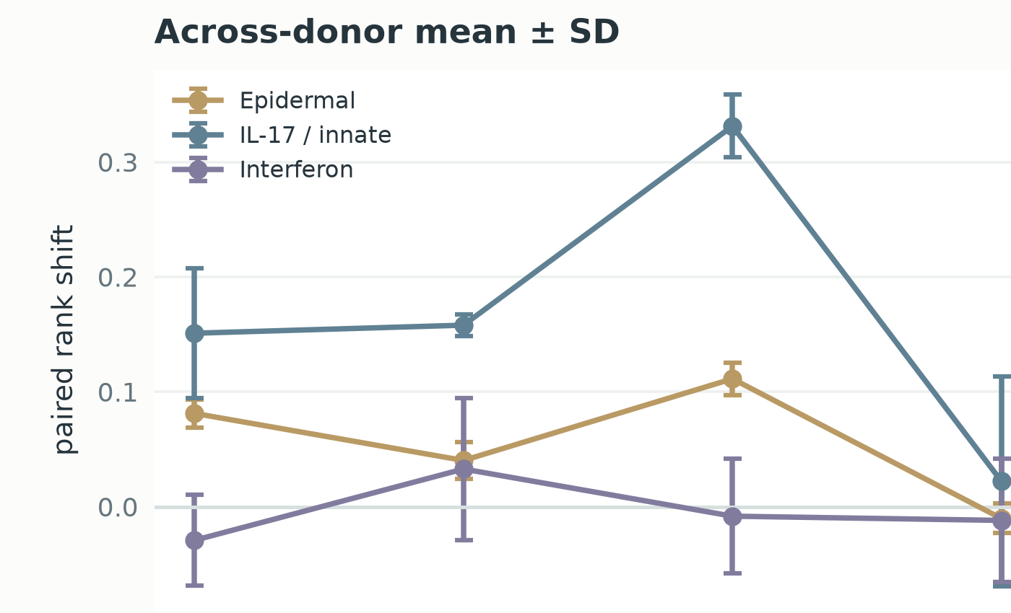
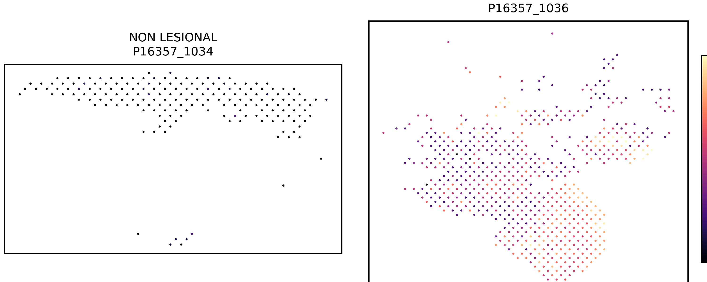
PUBLIC-DATA FOUNDATION
FIGURE 1
Eleven datasets map psoriasis at four biological scales
Every panel below is computed from the deposited expression matrix—no illustrative substitute is used.
PAIRED BULK · 7 COHORTS · 191 PATIENT PAIRS
HIGH-RESOLUTION + PERTURBATION
GSE151177
GSE173706
scRNA-seq · 19,868 displayed cells
scRNA-seq · 14,493 displayed cells
GSE206391
GSE24767
spatial · 12 paired patients
IL-17/TNF · 3 donors
Fixed programs: Epidermal · IL-17 / innate · Interferon
The same disease question is observed at four resolutions; the independent unit remains the patient or donor.
Notes:
[Sources]
- https://www.ncbi.nlm.nih.gov/geo/query/acc.cgi?acc=GSE117239
- https://www.ncbi.nlm.nih.gov/geo/query/acc.cgi?acc=GSE136757
- https://www.ncbi.nlm.nih.gov/geo/query/acc.cgi?acc=GSE153007
- https://www.ncbi.nlm.nih.gov/geo/query/acc.cgi?acc=GSE182740
- https://www.ncbi.nlm.nih.gov/geo/query/acc.cgi?acc=GSE51440
- https://www.ncbi.nlm.nih.gov/geo/query/acc.cgi?acc=GSE57225
- https://www.ncbi.nlm.nih.gov/geo/query/acc.cgi?acc=GSE85034
- https://www.ncbi.nlm.nih.gov/geo/query/acc.cgi?acc=GSE151177
- https://www.ncbi.nlm.nih.gov/geo/query/acc.cgi?acc=GSE173706
- https://www.ncbi.nlm.nih.gov/geo/query/acc.cgi?acc=GSE206391
- https://www.ncbi.nlm.nih.gov/geo/query/acc.cgi?acc=GSE24767
- figED13_bulk_patient_program_distributions.png
- figED11_observed_single_cell_landscapes.png
- gse206391_representative_LS_NL_spatial_map.png
- figED14_calm_cytokine_donor_responses.png

Slide 2
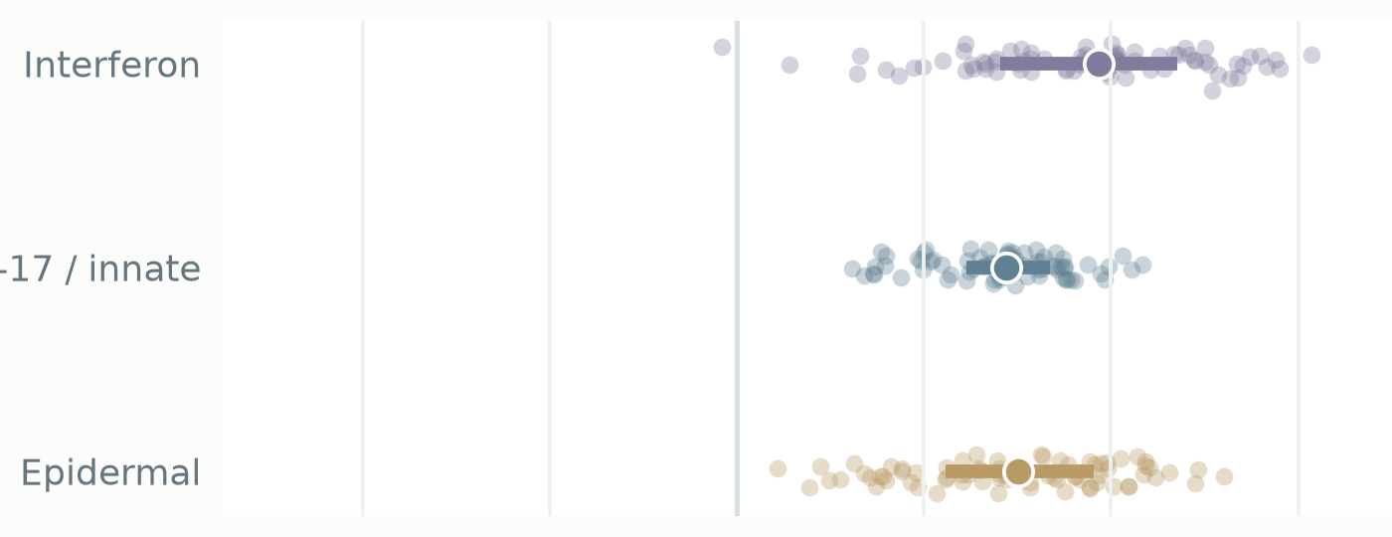
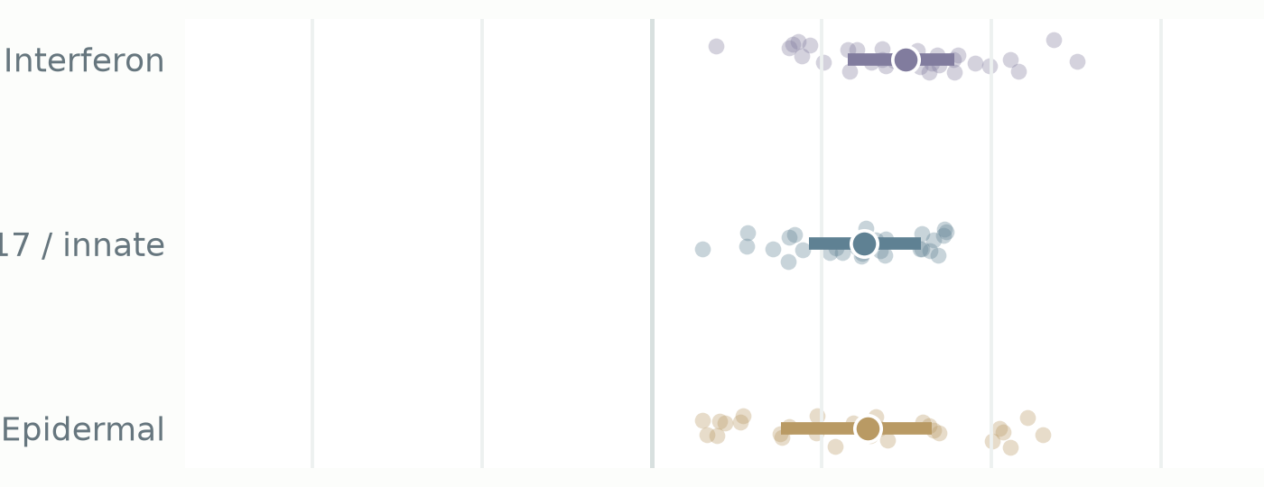
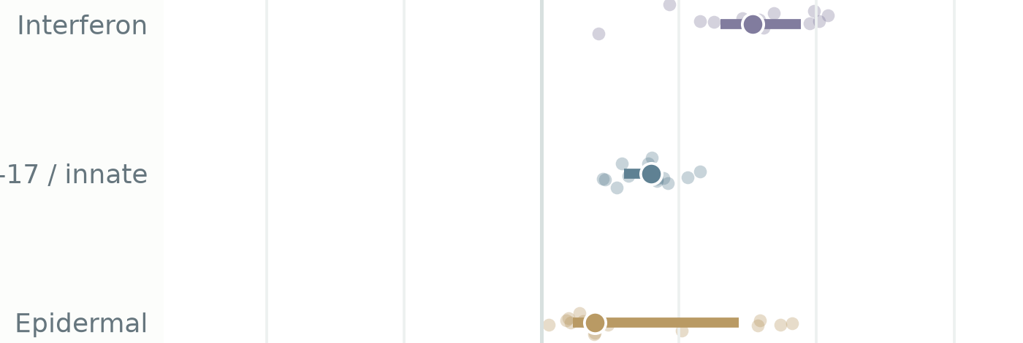
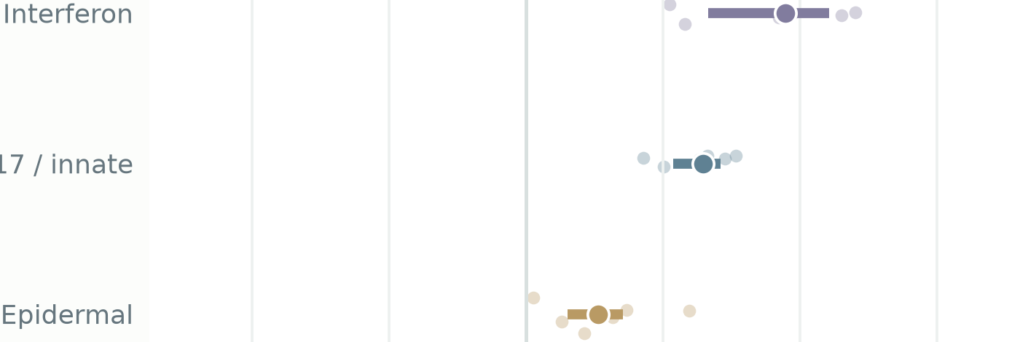
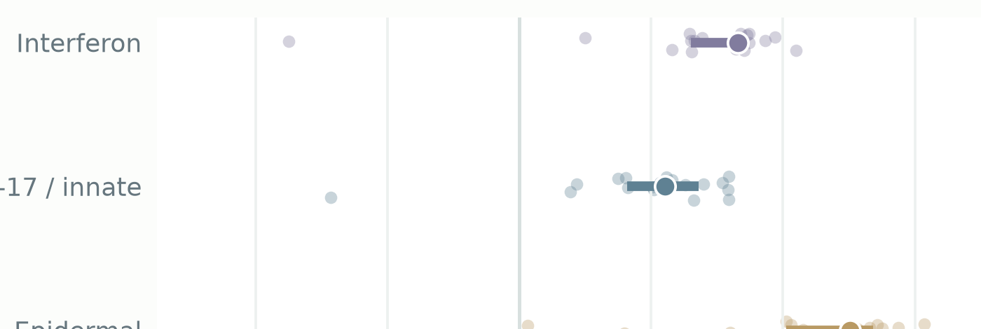
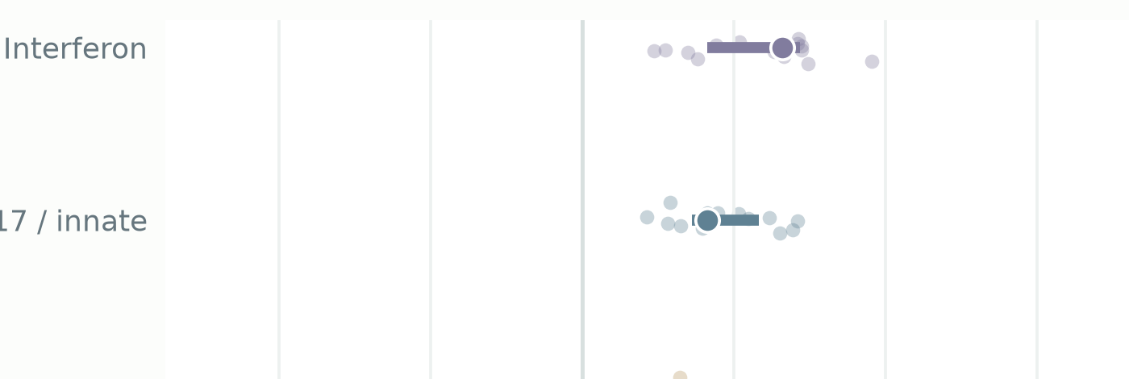
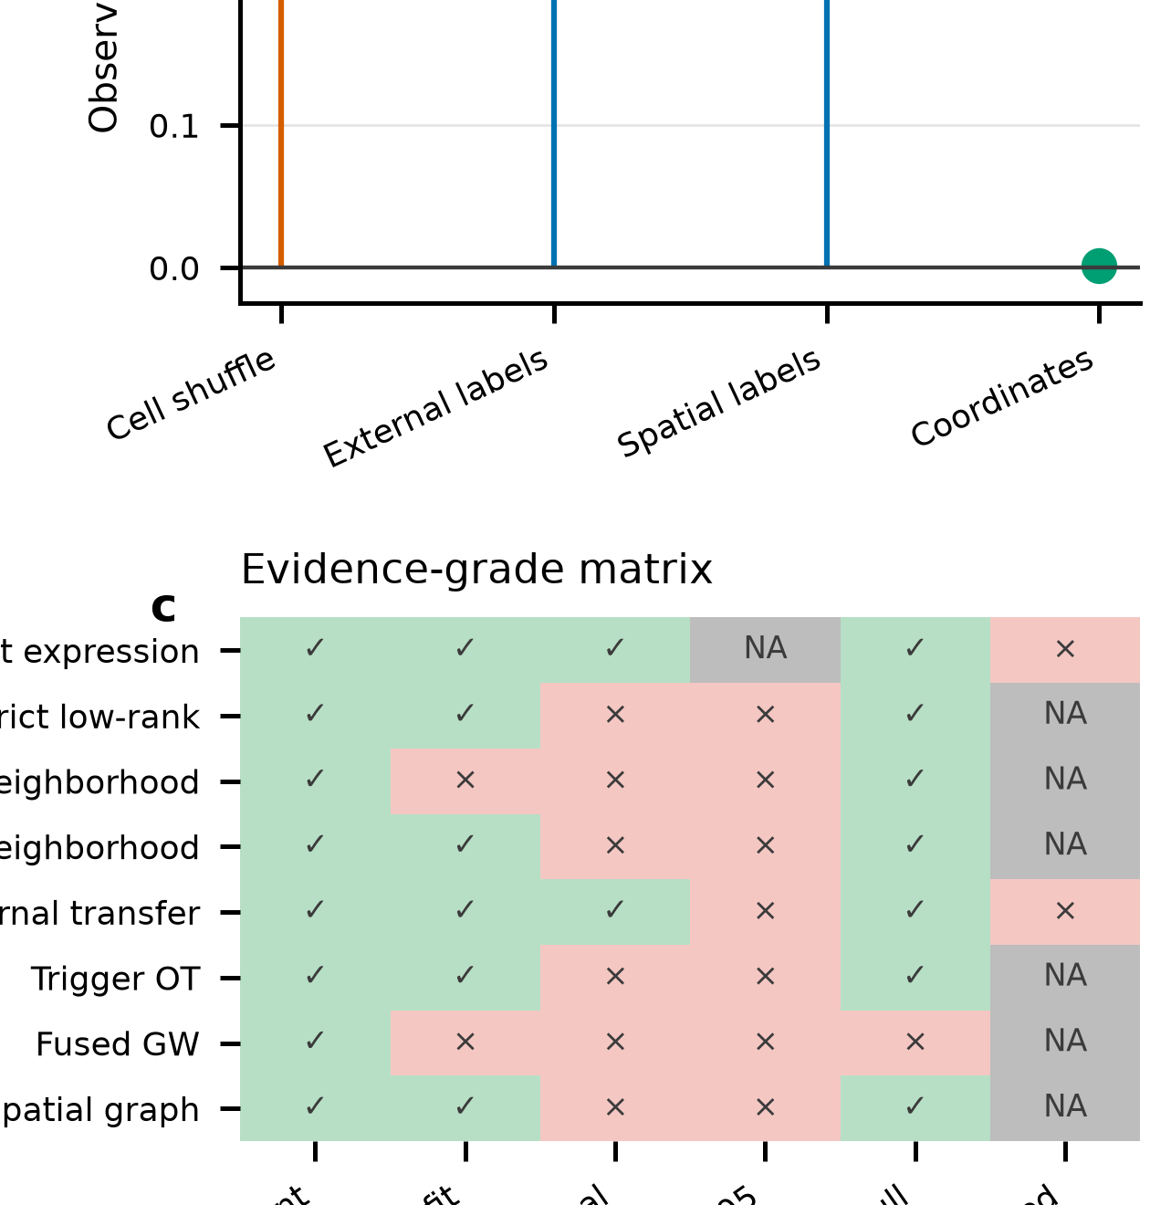
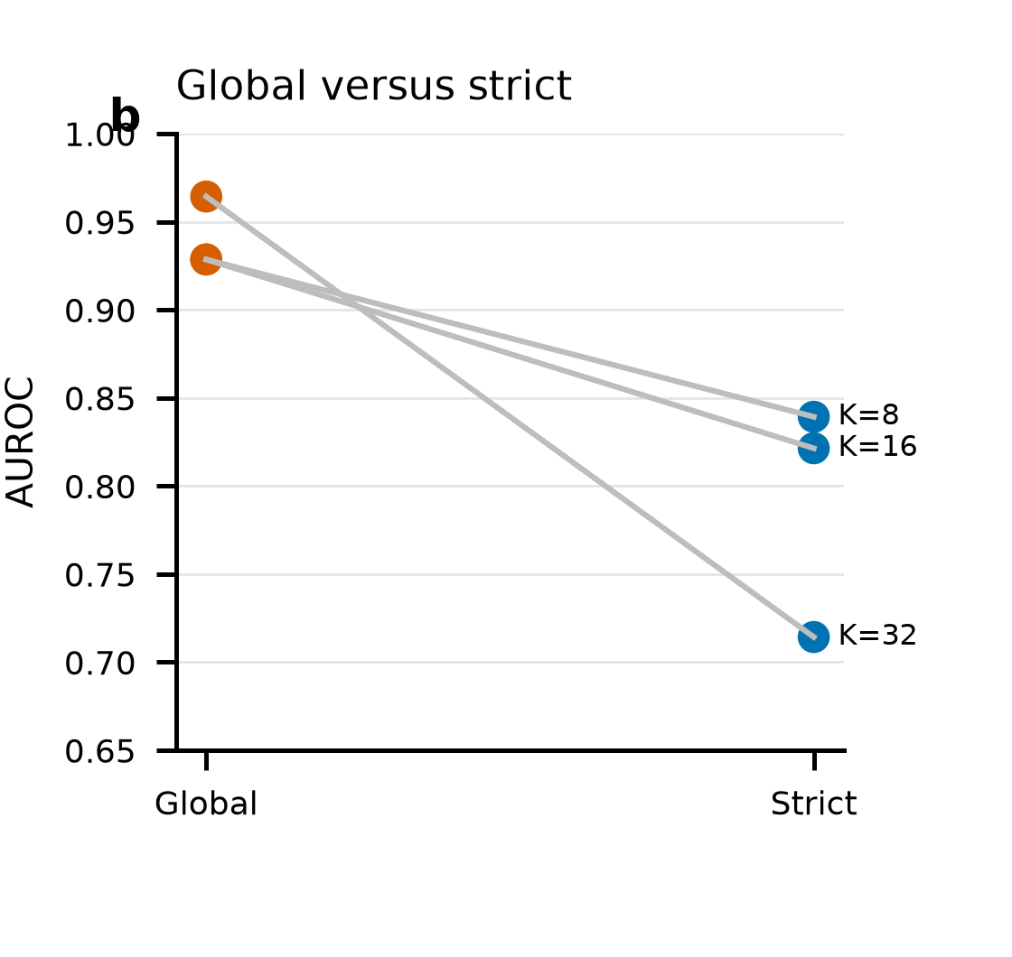
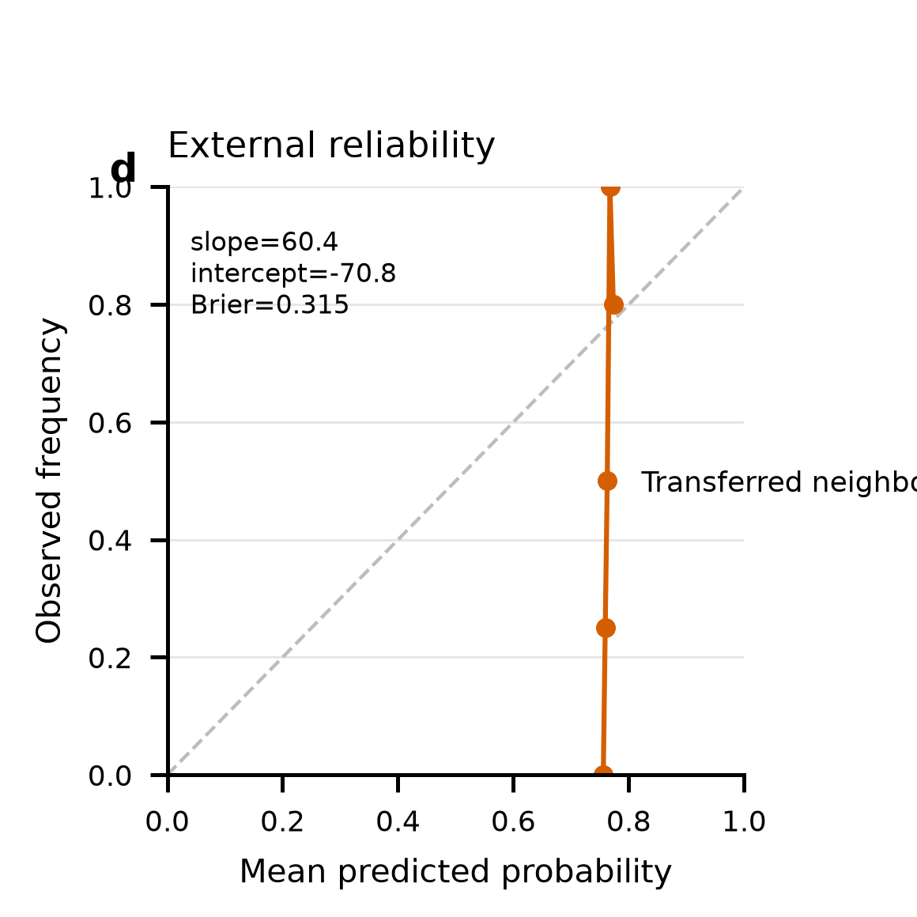
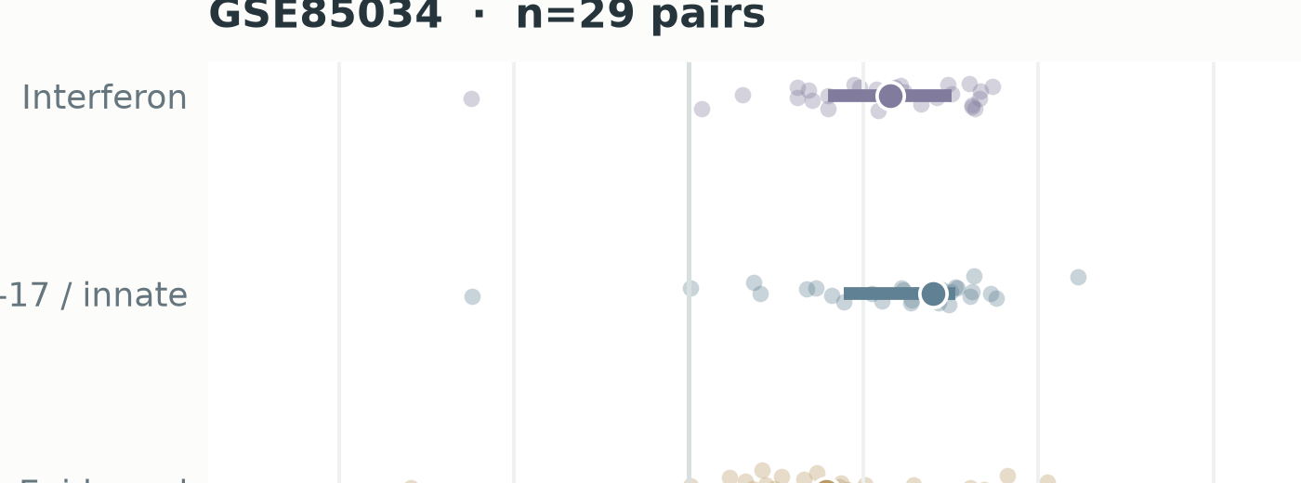
OVERALL FRAMEWORK
FIGURE 2
Patient boundaries remain intact from public data to evidence
Actual cohort views remain attached to their role throughout construction, comparison and falsification.
STAGE A
STAGE B
STAGE C
STAGE D
Public evidence
Fold-local build
Matched audit
Falsification gate
GSE117239
GSE136757
GSE153007
bulk
bulk
bulk
M1 · UNIT GUARD
M4 · MATCHED COMPARATOR
M5 · NULL ENGINES
patient / donor = outer fold
no cell- or spot-level split
candidate representation
versus
matched expression view
cell shuffle
external labels
spatial labels
coordinates
GSE182740
GSE51440
GSE57225
bulk
bulk
bulk
ΔAUROC = AUROC(candidate) − AUROC(expression)
M2 · FOLD-LOCAL BUILDER
HVGs · scaling · PCA/NMF
KMeans · graph · OT
fit on training units only
GSE85034
GSE151177
GSE173706
bulk
scRNA
scRNA
M3 · RESOLUTION ENCODERS
GSE206391
GSE24767
optimism gap
external calibration
spatial
trigger
Patient/donor bootstrap
M6 · CLAIM GATE
expression · low-rank · neighborhoods
spatial graph · trigger OT
95% CI and practical-value gate: Δ ≥ 0.05
supported
bounded
refuted
Fixed roles
ceiling · development · external transfer · spatial validation · frozen trigger prior
Primary conclusion: reproducible disease-state signal; no demonstrated resolution-specific incremental value.
Notes:
[Sources]
- https://www.ncbi.nlm.nih.gov/geo/query/acc.cgi?acc=GSE117239
- https://www.ncbi.nlm.nih.gov/geo/query/acc.cgi?acc=GSE136757
- https://www.ncbi.nlm.nih.gov/geo/query/acc.cgi?acc=GSE153007
- https://www.ncbi.nlm.nih.gov/geo/query/acc.cgi?acc=GSE182740
- https://www.ncbi.nlm.nih.gov/geo/query/acc.cgi?acc=GSE51440
- https://www.ncbi.nlm.nih.gov/geo/query/acc.cgi?acc=GSE57225
- https://www.ncbi.nlm.nih.gov/geo/query/acc.cgi?acc=GSE85034
- https://www.ncbi.nlm.nih.gov/geo/query/acc.cgi?acc=GSE151177
- https://www.ncbi.nlm.nih.gov/geo/query/acc.cgi?acc=GSE173706
- https://www.ncbi.nlm.nih.gov/geo/query/acc.cgi?acc=GSE206391
- https://www.ncbi.nlm.nih.gov/geo/query/acc.cgi?acc=GSE24767
- all 11 data-derived asset crops
- fig5_unsupervised_optimism.png
- fig6_external_transfer.png
- fig8_falsification_evidence_map.png

Slide 3
ALGORITHM ARCHITECTURE
FIGURE 3
PRI-Audit pairs each representation with matched expression
The outer unit is locked before any representation is fitted; held-out patients never enter the builder.
INDEPENDENT UNIT
paired patient for LS/NL · donor for cell-state transfer · paired patient for spatial validation
held-out unit bypasses all fitting
DATA INPUTS
M3 · ENCODER LIBRARY
Bulk LS/NL
M1 · Unit Guard
M4
M6 · Gate
GSE117239 + six cohorts
group registry
outer folds
bootstrap unit
Expression ranks
Matched comparator
matched baseline
same outer split
same feature budget
same classifier
Single-cell
Low-rank
GSE151177 → GSE173706
M2 · Fold builder
PCA / NMF
ΔAUROC
select HVGs
scale / reduce
cluster / graph
fit on training only
Cell neighborhoods
Spatial
frozen source map
M5
SUPPORTED
GSE206391 · LS/NL
Falsification engine
disease-state signal
Spatial graph
6-NN local statistics
patient bootstrap
cell shuffle
external labels
spatial labels
coordinates
BOUNDED
Trigger prior
incremental value
not demonstrated
GSE24767 · IL-17/TNF
Trigger OT
IL-17/TNF prior
REFUTED
CI · calibration · null
Candidate and comparator are generated inside the same outer fold
Notes:
[Sources]
- https://www.ncbi.nlm.nih.gov/geo/query/acc.cgi?acc=GSE117239
- https://www.ncbi.nlm.nih.gov/geo/query/acc.cgi?acc=GSE136757
- https://www.ncbi.nlm.nih.gov/geo/query/acc.cgi?acc=GSE153007
- https://www.ncbi.nlm.nih.gov/geo/query/acc.cgi?acc=GSE182740
- https://www.ncbi.nlm.nih.gov/geo/query/acc.cgi?acc=GSE51440
- https://www.ncbi.nlm.nih.gov/geo/query/acc.cgi?acc=GSE57225
- https://www.ncbi.nlm.nih.gov/geo/query/acc.cgi?acc=GSE85034
- https://www.ncbi.nlm.nih.gov/geo/query/acc.cgi?acc=GSE151177
- https://www.ncbi.nlm.nih.gov/geo/query/acc.cgi?acc=GSE173706
- https://www.ncbi.nlm.nih.gov/geo/query/acc.cgi?acc=GSE206391
- https://www.ncbi.nlm.nih.gov/geo/query/acc.cgi?acc=GSE24767
- data-derived input panels
- fig8_falsification_evidence_map.png

Slide 4
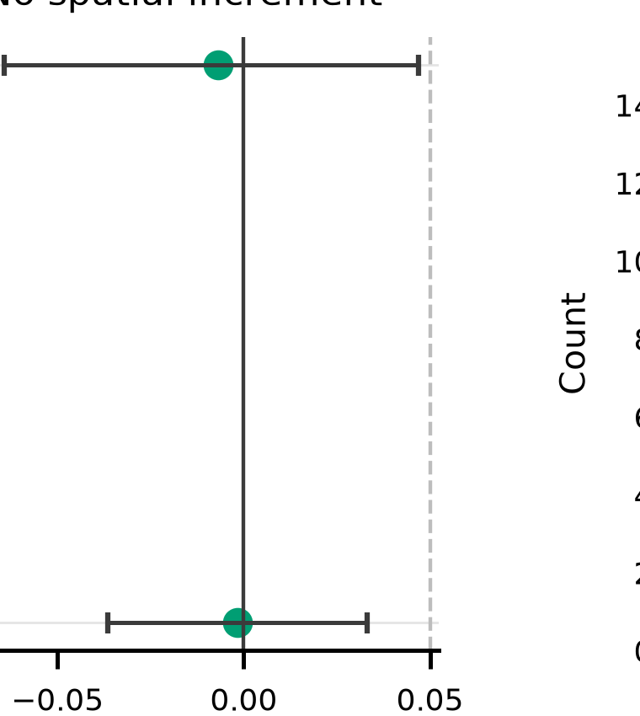
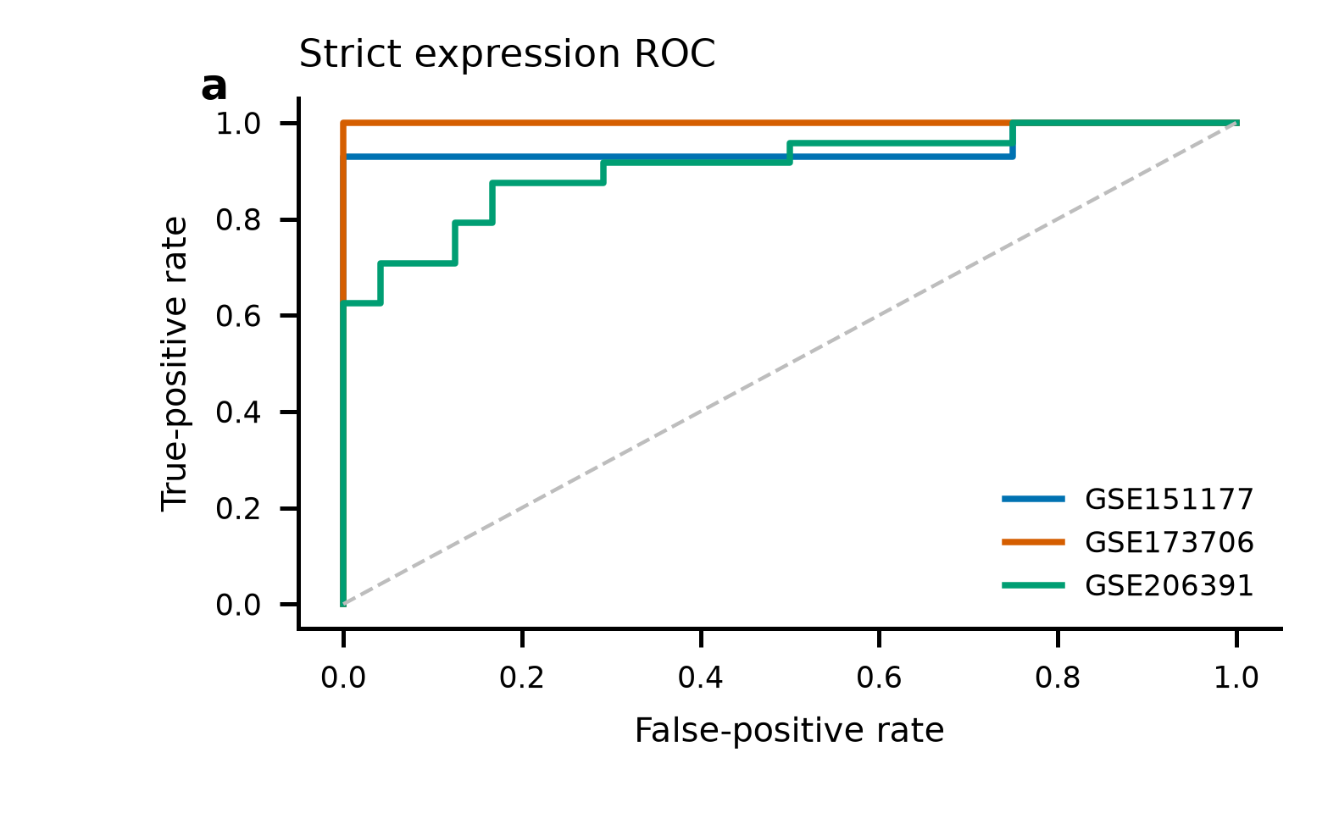
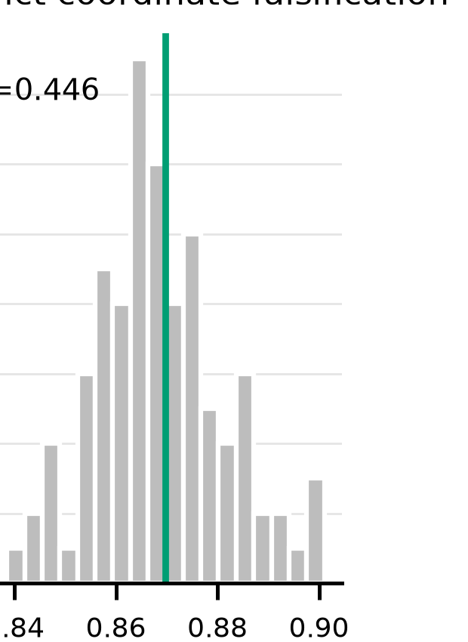
EVIDENCE CLOSURE
FIGURE 8
Strict validation separates disease signal from incremental gain
Four empirical checks close the paper's argument without turning association into unsupported causality.
A
Disease signal transfers
B
Global fitting is optimistic
C
Ranking ≠ calibration
D
Coordinates add no detectable gain
Strict patient-level ROC
Fold-local refit reduces AUROC
External reliability remains poor
No spatial increment
EVIDENCE-GRADED CONCLUSION
Supported
patient-level psoriasis state is reproducible across resolutions
Bounded
low-rank, cell-neighborhood and spatial graph views do not add reproducible ΔAUROC ≥ 0.05
Notes:
[Sources]
- https://www.ncbi.nlm.nih.gov/geo/query/acc.cgi?acc=GSE151177
- https://www.ncbi.nlm.nih.gov/geo/query/acc.cgi?acc=GSE173706
- https://www.ncbi.nlm.nih.gov/geo/query/acc.cgi?acc=GSE206391
- fig10_robustness_multiverse.png
- fig5_unsupervised_optimism.png
- fig6_external_transfer.png
- fig7_strict_spatial_value.png

