Slide 1
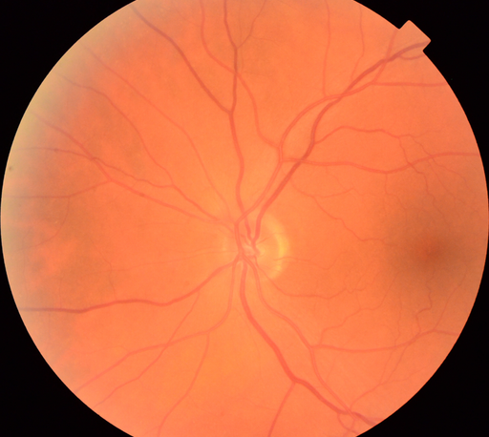
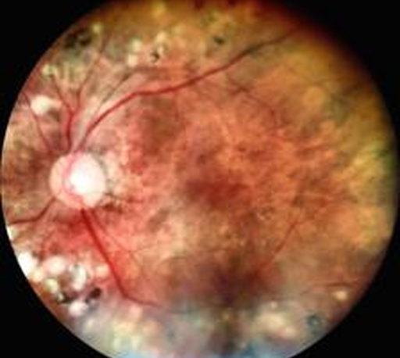
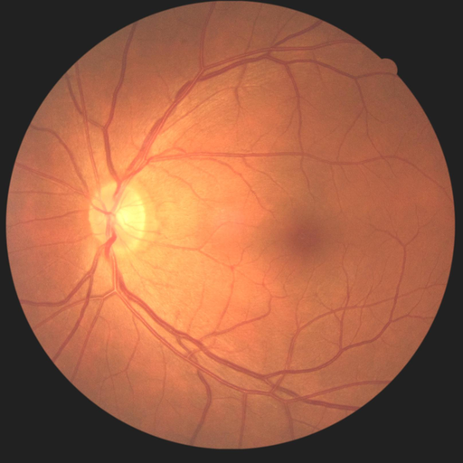
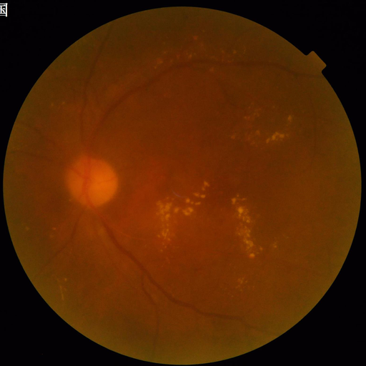
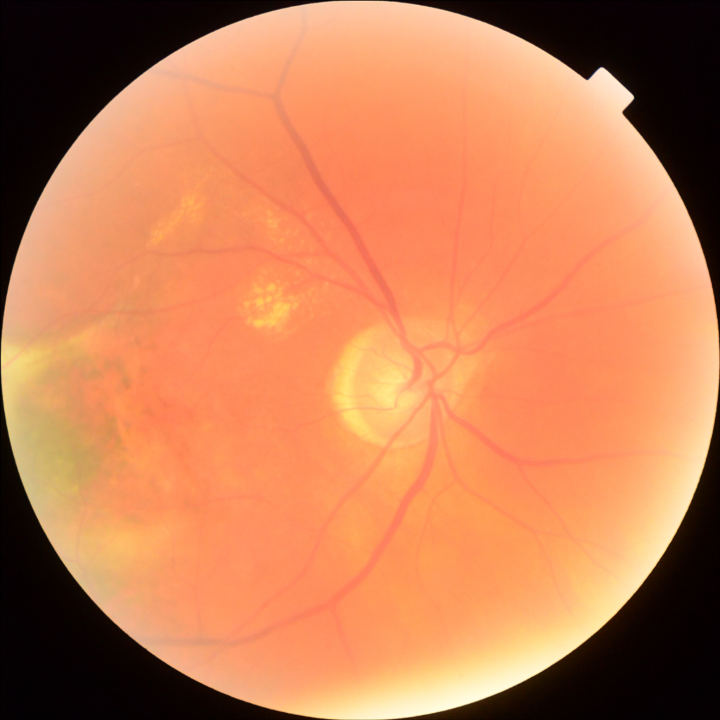
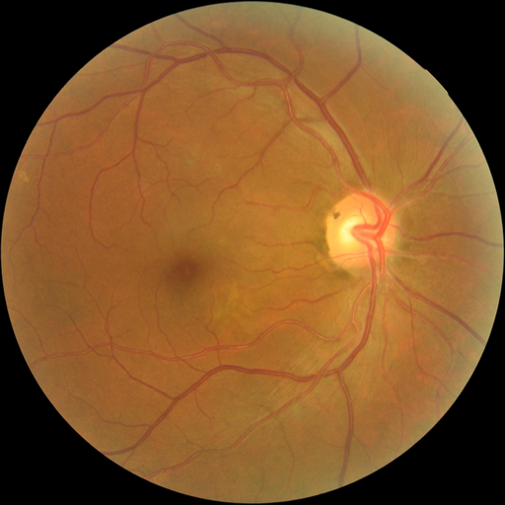
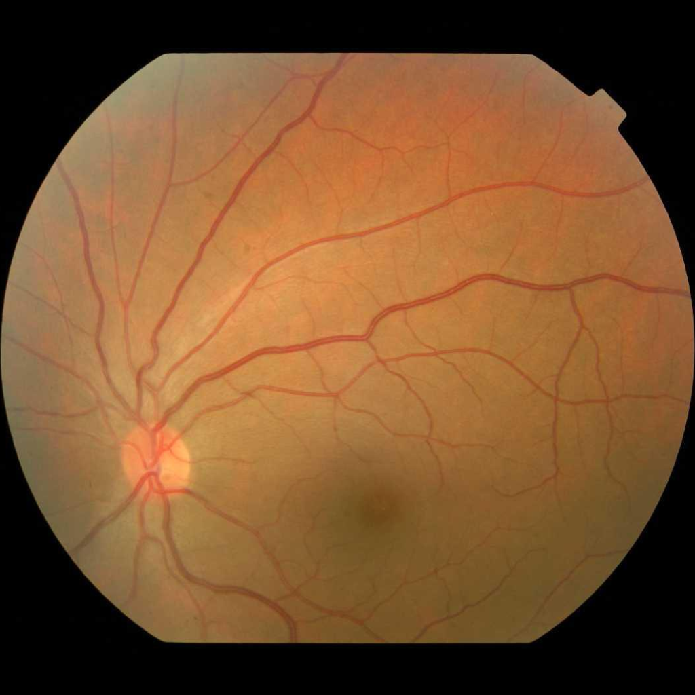
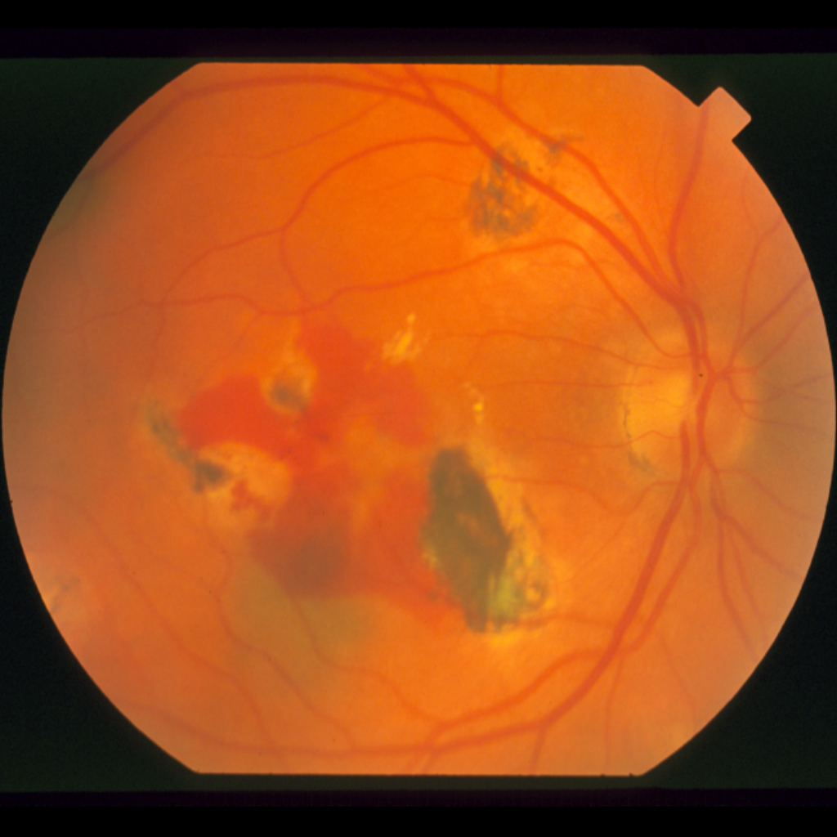
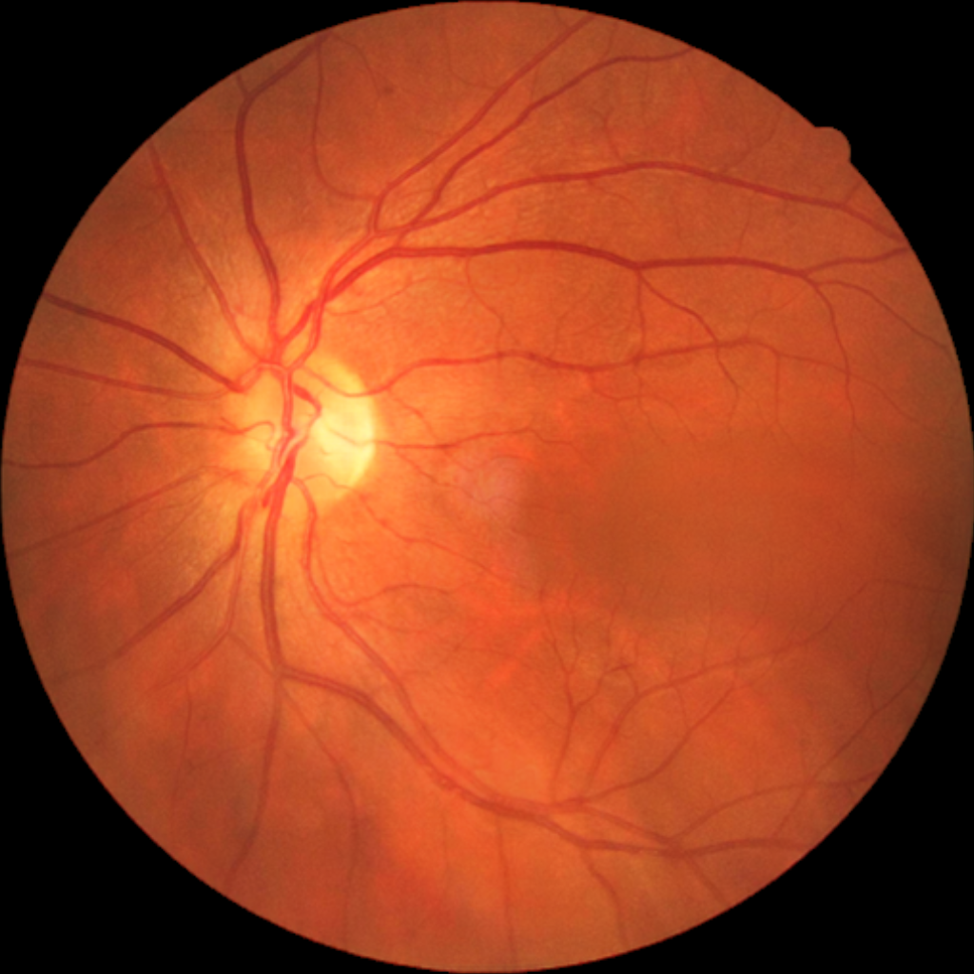
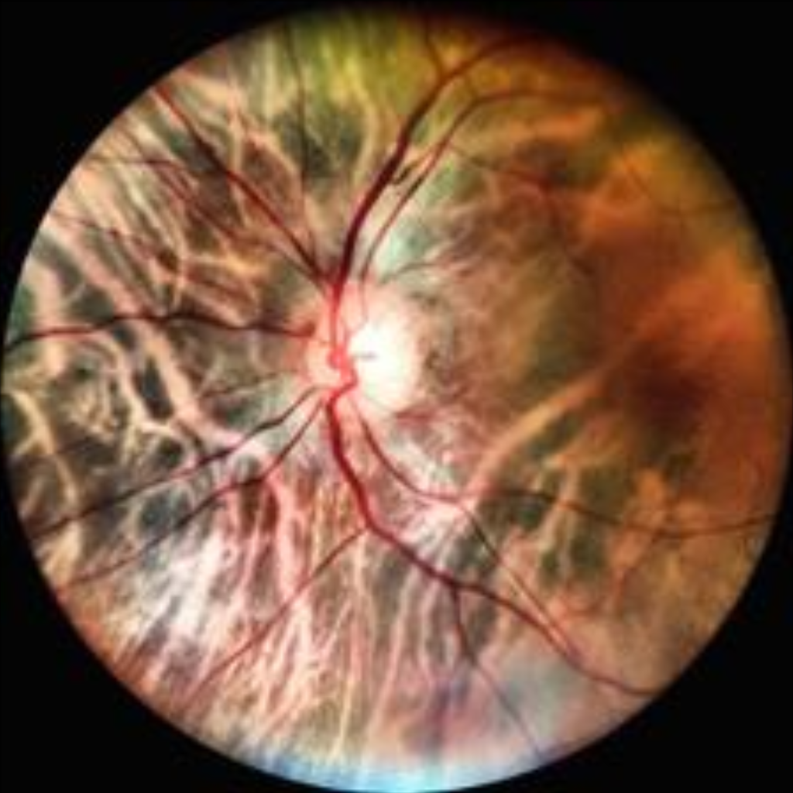
FIGURE 1 · STUDY LOGIC
A good vessel mask can still produce a bad biomarker
A
The overlooked contradiction
GATES CANNOT
SUBSTITUTE
Passing one gate
does not rescue
failure at another.
1 Pixel validity
2 Repeatable phenotype
3 Clinical increment
Can arteries and veins be measured
in a new image domain?
Does the number survive a second
photograph of the same eye?
Does it add information beyond
age, sex, and standard covariates?
B
Seven retinal image resources, prespecified roles and boundaries
FIVES
RAV
Fundus-AVSeg
AFIO
800 images
206 images
100 eyes
100 images
occupancy training
VascX audit + UDCT development
locked external test
external transport
TRAIN
DEVELOP / AUDIT
LOCKED TEST
MEASURE
STARE
China Fundus–CIMT
mBRSET mirror
397 images
2,603 + 200
1,287 patients
frozen migration
development + lock
repeatability + proxy
STRESS
DEVELOP
AUDIT
Role firewall: Fundus-AVSeg is the locked external UDCT test; reliability is fixed before outcomes.
Notes:
[Sources]
All thumbnails are real local project images. FIVES/RAV/Fundus-AVSeg/CIMT/mBRSET: paper_concept/figures_real/assets/. AFIO: artifacts/afio_mendeley/vascx_anatomy/preprocessed_rgb/IM000001.png. STARE: artifacts/structure_migration/stare_vascx/preprocessed_rgb/im0103.png.
Study sizes and cohort roles: paper_integration_20260813/RMDB_BiRAP_数据整合_图表设计与论文大纲.md.
[/Sources]

Slide 2
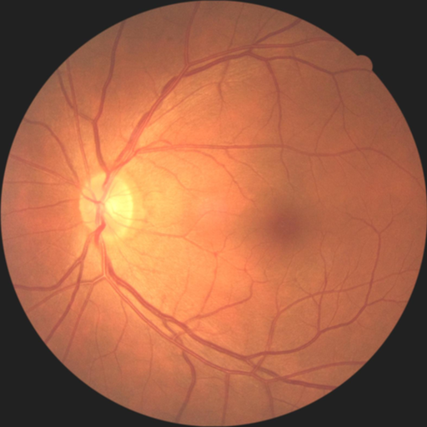
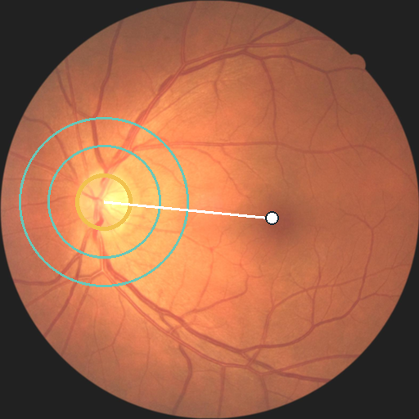
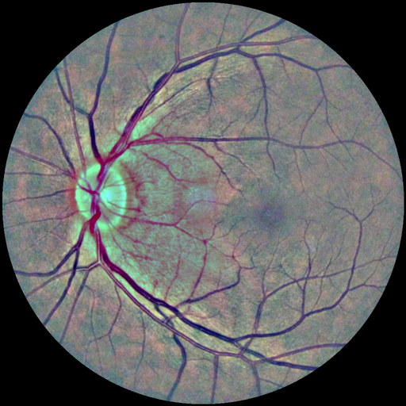
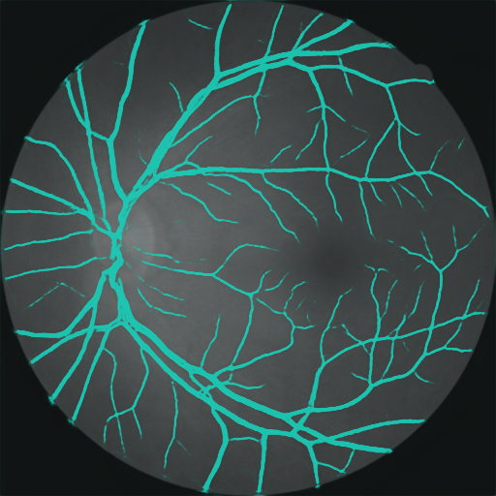
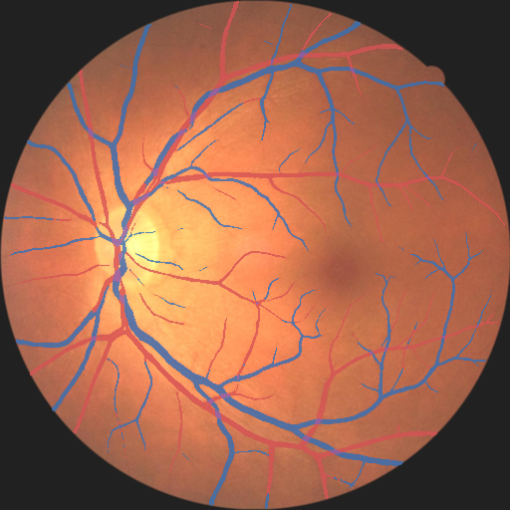


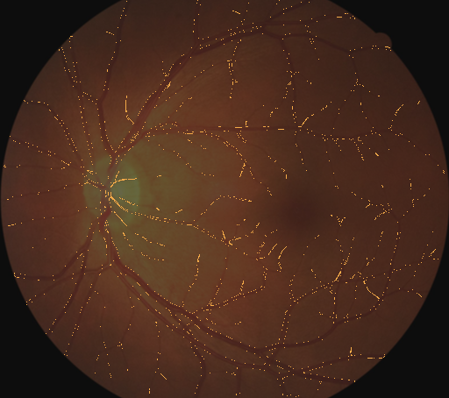
FIGURE 2 · CORE ALGORITHM
RMDB–BiRAP separates vascular existence from vascular identity
A
Real image → anatomy standardized inputs
UDCT residual corrector
Inputs: RGB + frozen logits + entropy + Hessian direction
Two residual steps refine identity without retraining the upstream segmenter.
Raw photograph
Standardization
Disc–fovea frame
Enhanced anatomy
B
Dual readout and anatomy-aware phenotype construction
Frozen readouts
Mass preserving
Phenotype operators
BiRAP reliability gate
Vessel mass
Skeleton density
A/V balance
Entropy
Patient vector
P(vessel)
same eye repeats
ICC(1,1) ≥ 0.60
bilateral mean
+ between eye difference
A / V / crossing
Weak vascular support retained
Outcome blind
Retain 4 of 9
Freeze before labels
→ nested CV
Factorized
Readout agreement audit
STOP if any gate fails
Existence ≠ identity; repeatability is estimated before outcome fitting.
Notes:
[Sources]
All retinal images and processed maps are real local project outputs from paper_concept/figures_real/assets/f1_*.png.
Method definitions: scripts/extract_dual_readout_phenotypes.py; project protocols and manuscript Methods 2.3–2.6.
[/Sources]

Slide 3
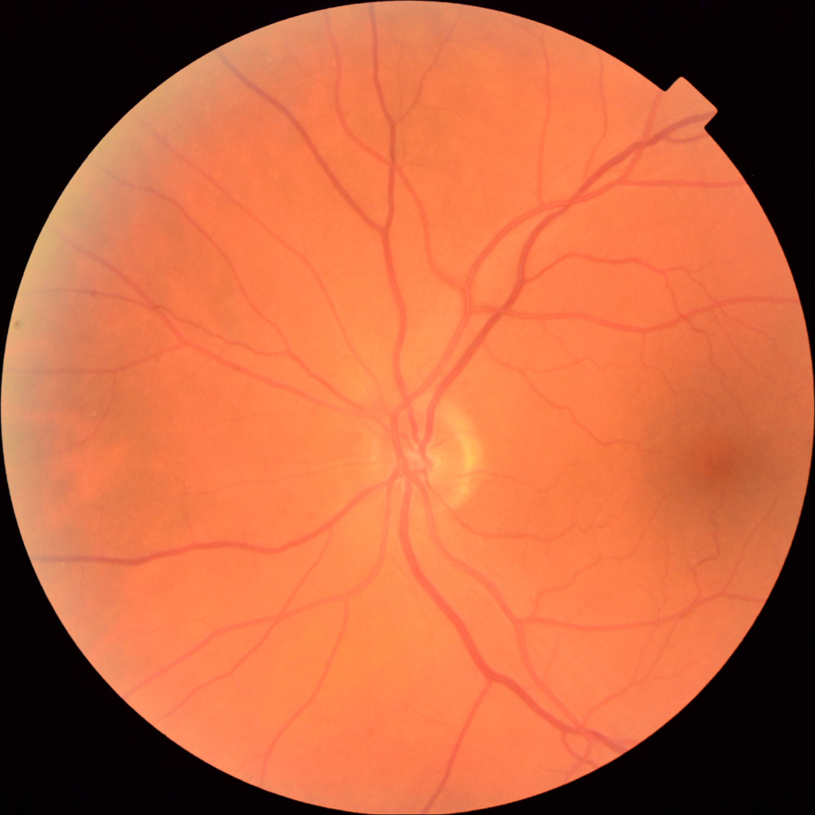
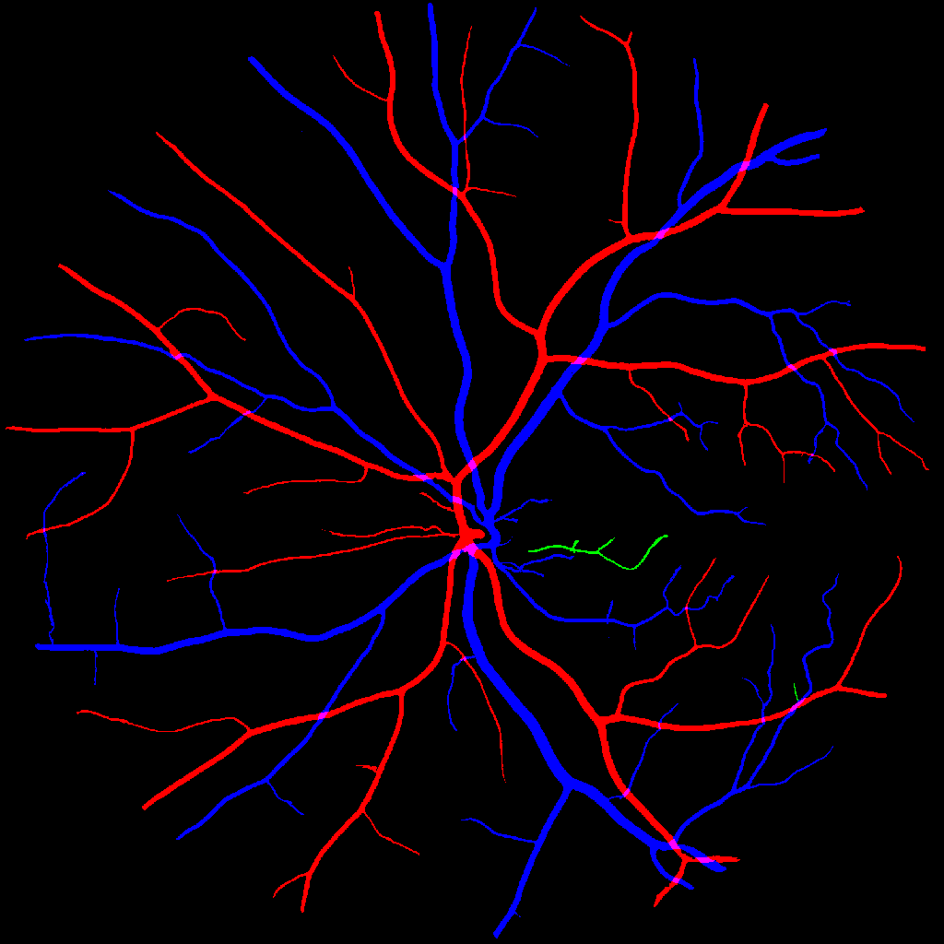
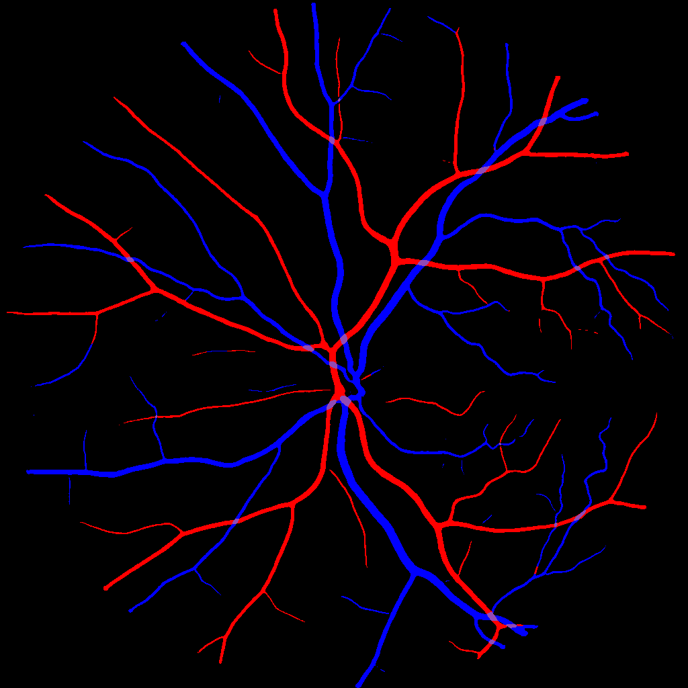
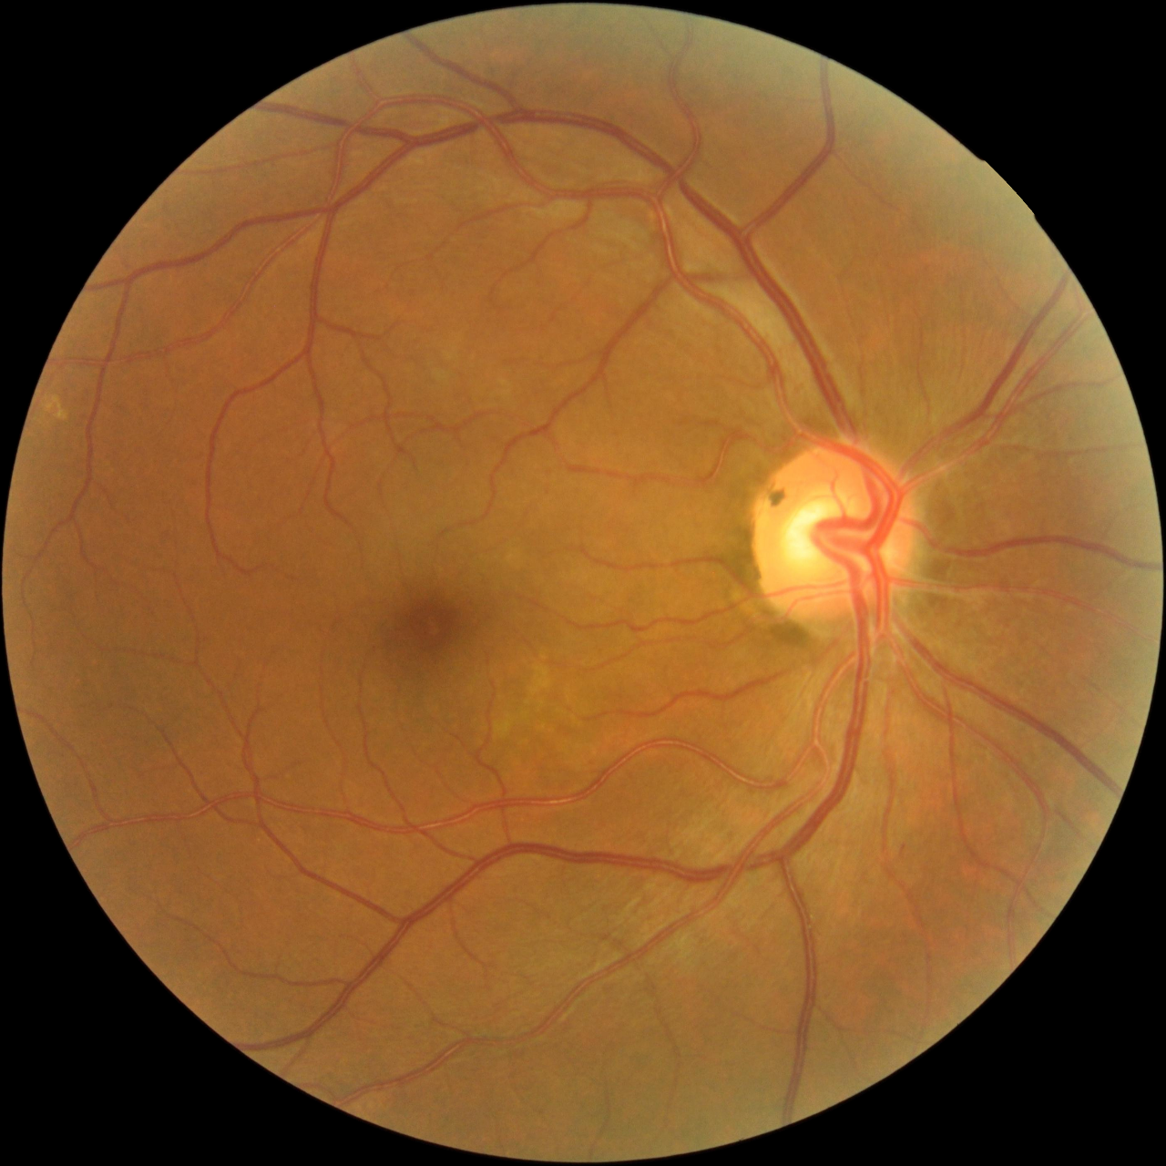
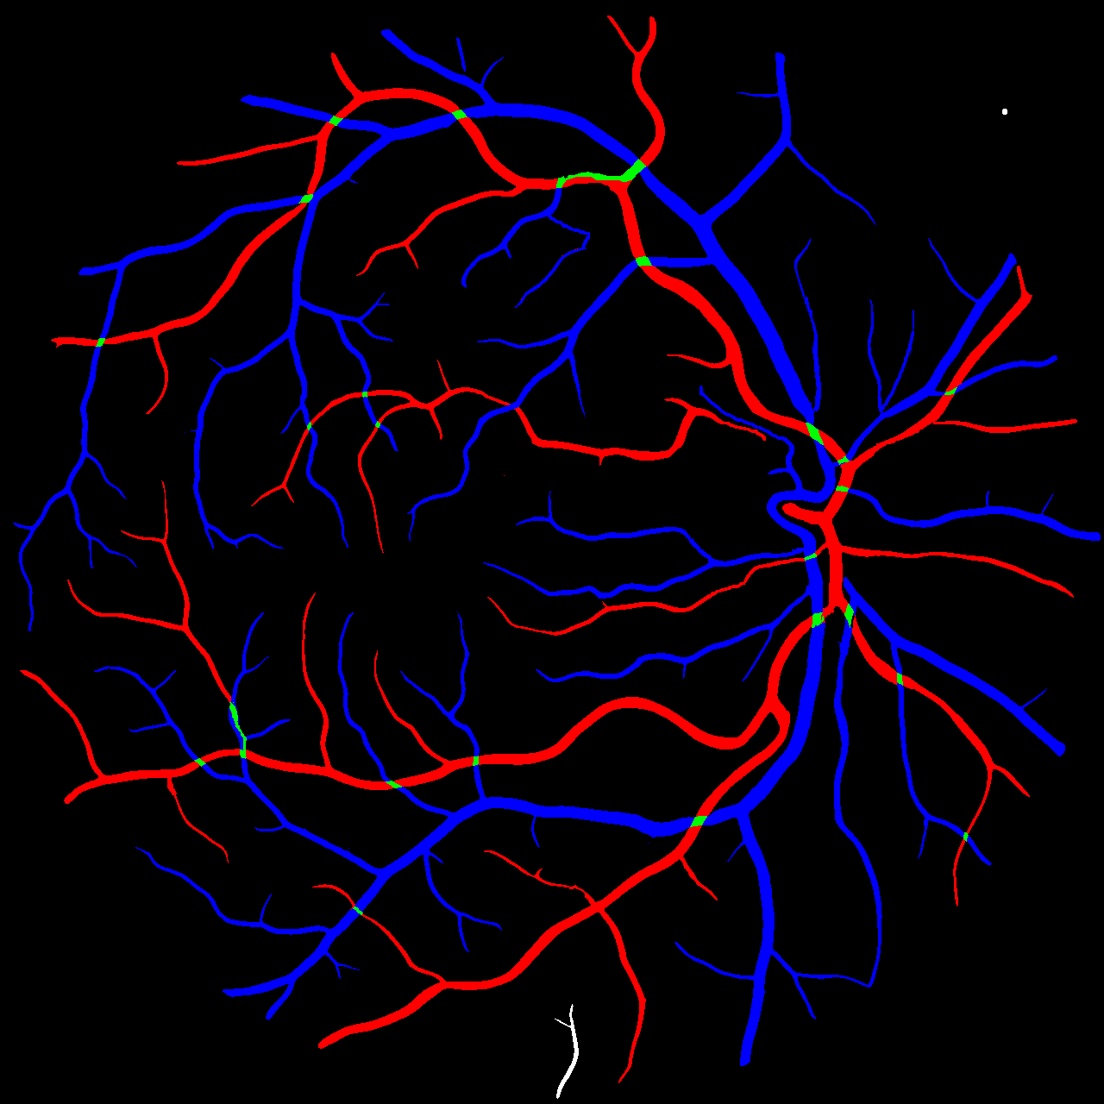
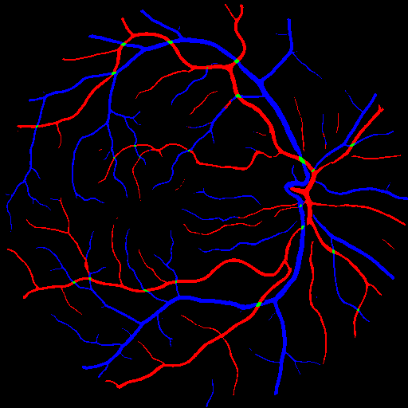
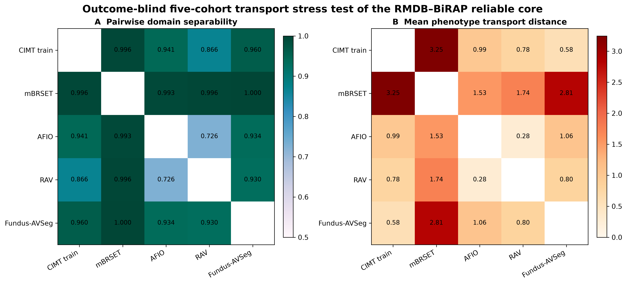
FIGURE 3 · MEASUREMENT AND TRANSPORT
Measurement can pass while phenotype scales remain nonexchangeable
A
Dataset specific references and predictions
RAV · frozen VascX audit
Fundus-AVSeg · locked external UDCT test
real RGB
reference mask
frozen VascX
real RGB
reference mask
locked Mass-UDCT
B
Exact measurement performance
C
Outcome blind transport audit
Mean artery/vein Dice
RAV · VascX
0.8256
AVSeg · VascX
0.5545
AVSeg · Mass-UDCT
0.5635
AVSeg · Factorized
0.5560
Mass-UDCT Δ = +0.0090
Four frozen phenotypes · patient-eye median · 2,000 bootstrap repetitions
High domain separability defines a transport boundary; it is not evidence of clinical validity.
Notes:
[Sources]
RAV image, reference, and frozen VascX output: /Users/tongyue/Documents/ppf/papers/baseline/artifacts/rav_vascx_full/preprocessed_rgb/RAV_795449.png, /Users/tongyue/Documents/ppf/papers/data/external/RAV/dataset/av_masks/RAV_795449.png, and archived logits rendered with the project color map. Fundus-AVSeg image, reference, and locked Mass-UDCT output: /Users/tongyue/Documents/ppf/papers/data/external/Fundus-AVSeg/Fundus-AVSeg/images/040_G.png, /Users/tongyue/Documents/ppf/papers/data/external/Fundus-AVSeg/Fundus-AVSeg/annotation/040_G.png, and /Users/tongyue/Documents/ppf/papers/baseline/artifacts/fundus_avseg_external_validation/predictions/mass_udct/040_G.png.
Exact measurement values: manuscript Table 2. Exact transport heatmaps: /Users/tongyue/Documents/ppf/papers/baseline/artifacts/four_cohort_transport/four_cohort_transport.png; pairwise values from pairwise_domain_transport.csv.
[/Sources]

Slide 4
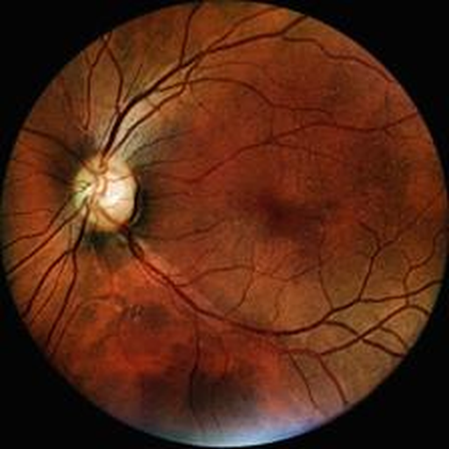
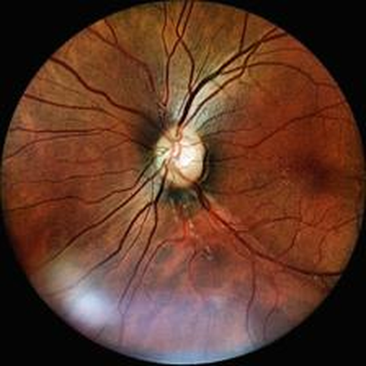
FIGURE 4 · SAME EYE RELIABILITY
Only four of nine candidate phenotypes survive a label blind repeatability gate
A
Natural repeated acquisition
B
Reliability, not outcome association, defines the phenotype core
Occupancy disagreement
0.811
Factorized skeleton density
0.772
Mass skeleton density
0.688
View 1
View 2
Soft vessel mass fraction
0.676
same patient · same eye · different capture
2,359 repeat pairs
Identity entropy
0.503
Mass branch density
0.484
BiRAP decision
Soft A/V log-mass ratio
0.384
Retain if ICC(1,1) ≥ 0.60
The threshold is prespecified and calculated
before systemic outcomes are accessed.
Factorized A/V log-area
0.360
Base to mass disagreement
0.282
5 candidates excluded
0.20
0.36
0.52
0.69
0.85
Negative results remain reported;
no outcome driven rescue search.
ICC(1,1), bootstrap 95% CI
Repeatability shrinks the hypothesis space from 9 prespecified candidates to a core of 4.
mBRSET 224 px mirror · 1,287 patients · 189 optic disc fallbacks documented
Notes:
[Sources]
Same eye images: paper_concept/figures_real/assets/raw_primary.png and raw_repeat.png.
ICC values and confidence intervals: artifacts/mbrset_external/repeatability_core/repeatability_icc.csv.
[/Sources]

Slide 5
FIGURE 5 · INTERNAL OUTCOME EXPERIMENTS
Better measurement did not translate into confirmed CIMT increment
A
Prespecified model ladder
E0
E4
E7
E8
E9
E10A
E12B
Clinical baseline
+ 104D direct fusion
Normative deviation
Double orthogonal
Frozen validation
Conditional centile
ICC gated replacement
MAE 0.11456
worse
small dev gain
24/25 folds
CI crosses 0
MAE 0.10775
worse
Direct feature stacking failed; residualized normative modeling found only a small development signal.
B
Paired differences and stopping decisions
Frozen validation resolves the claim
E4 direct fusion − E0
+0.00089 mm
0.14147
normative baseline
MAE
E7 normative − baseline
−0.00075 mm
E8 double orthogonal − raw
−0.00019 mm
0.14023
E8 model
E9 frozen validation − normative
−0.00124 mm
ΔMAE −0.00124 mm
E12B ICC core − E10A
+0.00057 mm
95% CI −0.00346 to +0.00109
-0.004
-0.002
-0.001
0.001
0.002
Paired ΔMAE (mm); negative favors retinal model
Directional, not confirmatory
CIMT development: n=2,603 · single locked validation: n=200
No fixed test data were used for new model selection or evaluation.
Notes:
[Sources]
Exact CIMT results: artifacts/cimt_dual_readout_development/outer_cv/metrics.json; artifacts/cimt_dual_readout_development/normative_e7/metrics.json; artifacts/cimt_dual_readout_development/e8_double_orthogonal/metrics.json; artifacts/cimt_dual_readout_validation/e9_locked/metrics.json; artifacts/e12_repeatability_gated_centile_full/metrics.json.
[/Sources]

Slide 6
FIGURE 6 · CLAIM BOUNDARY
The evidence boundary is a result, not a caveat
A
mBRSET: calibrated reliable core adds no stable hypertension increment
B
Leakage control passes, but does not create increment
200 patient level label permutations
Overall · n=1,276
+0.0019
observed 0.666
No DR · n=882
−0.0005
Strict disc QC · n=1,105
+0.0056
-0.012
-0.005
0.002
0.009
0.016
Reliable core null 95%: 0.451–0.533
Paired ΔAUROC (reliable core − clinical)
All confidence intervals cross zero; calibrated Brier differences are also null.
empirical p = 0.005
outer fold patient overlap = 0
C
What the study can claim
SUPPORTED
External pixel measurement
RAV + locked AVSeg
SUPPORTED
SUPPORTED
Outcome blind repeatability
4 of 9 phenotypes
SUPPORTED
EXPLORATORY
Conditional CIMT deviation
development signal only
EXPLORATORY
NOT SUPPORTED
Clinical incremental value
intervals cross zero
NOT SUPPORTED
MISSING
Independent high resolution outcome confirmation
new cohort required
MISSING
RMDB–BiRAP contributes an auditable measurement system and a prespecified reason to stop.
Notes:
[Sources]
Exact calibrated mBRSET effects: artifacts/mbrset_external/cv_hypertension_reliable_core_calibration/metrics.json; artifacts/mbrset_external/cv_hypertension_reliable_core_calibration_no_dr/metrics.json; artifacts/mbrset_external/cv_hypertension_reliable_core_calibration_strict_disc/metrics.json.
Permutation control: artifacts/mbrset_external/permutation_negative_control/metrics.json.
Claim boundary: locked protocols and submission manuscript.
[/Sources]

