Slide 1
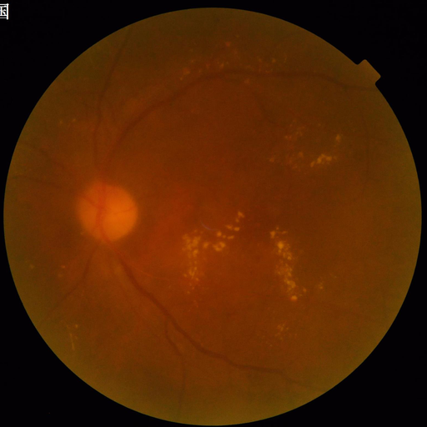
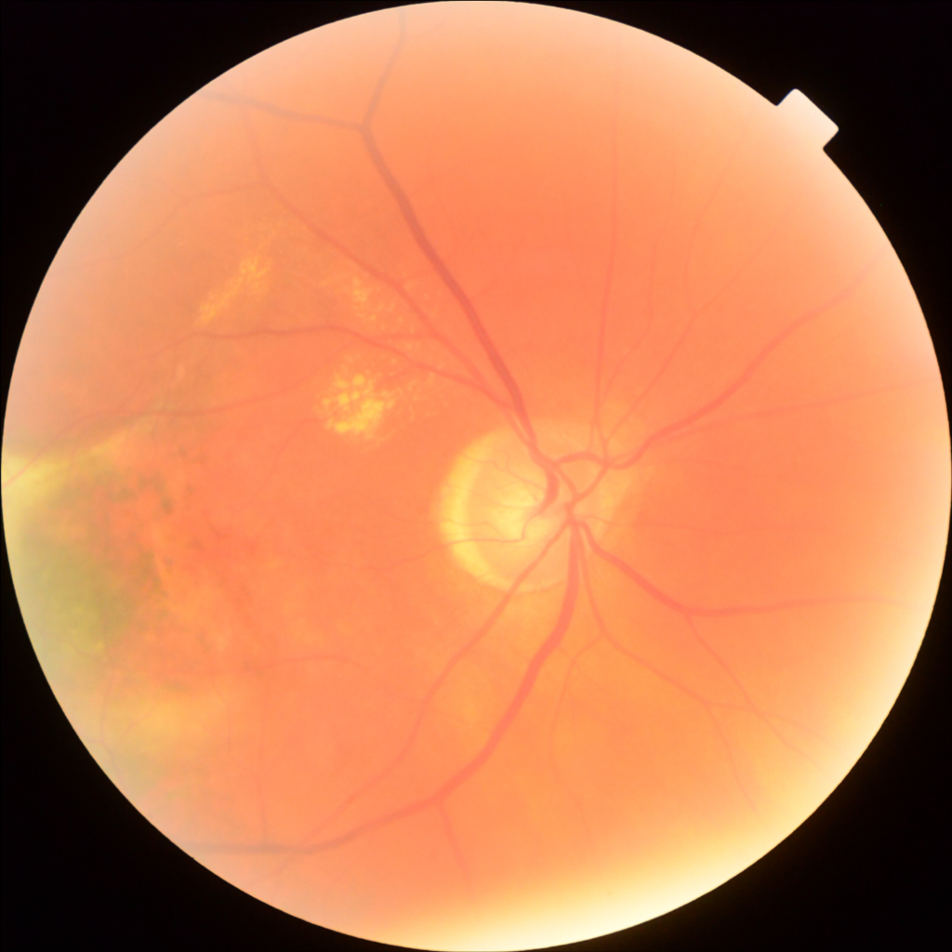
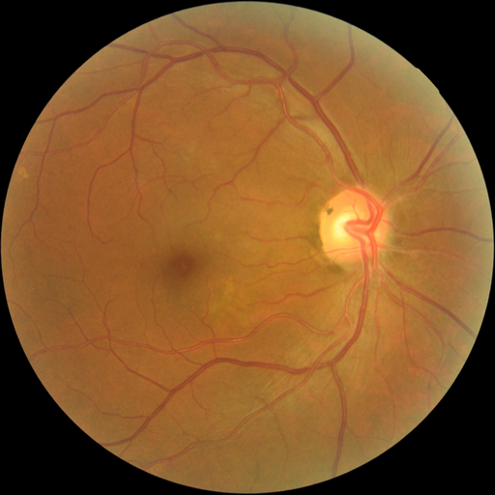
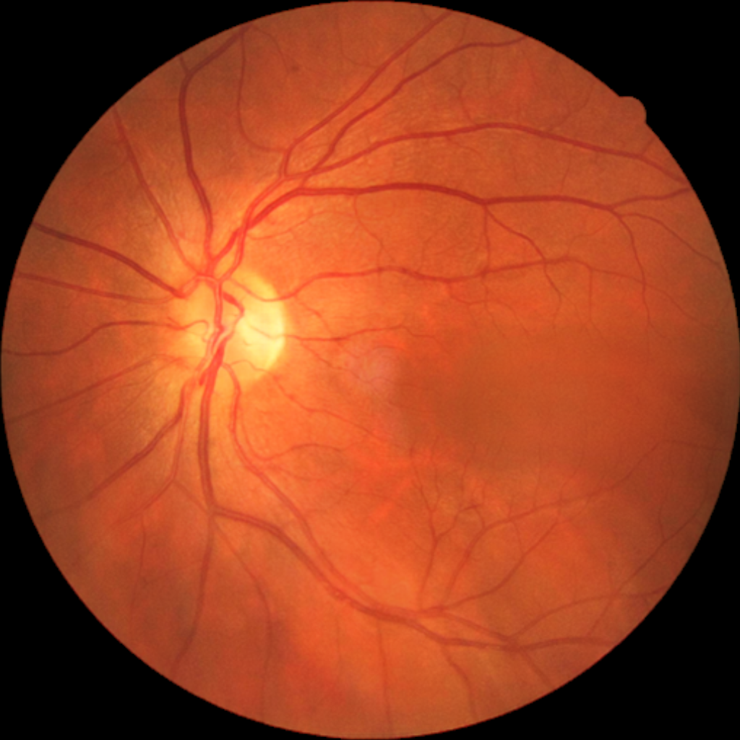
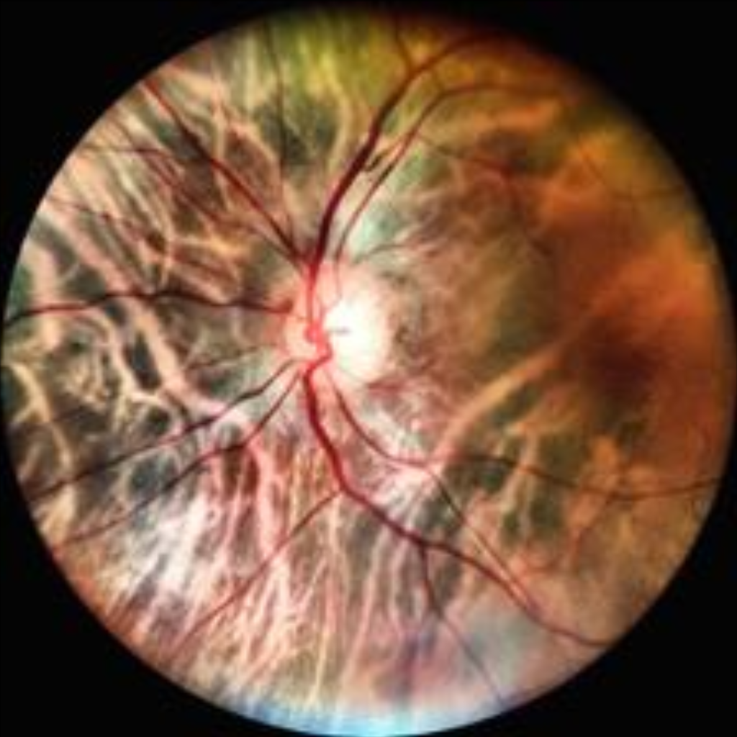
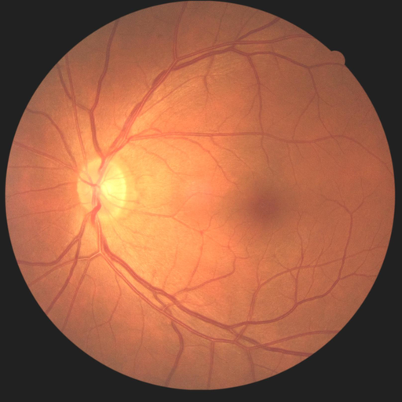
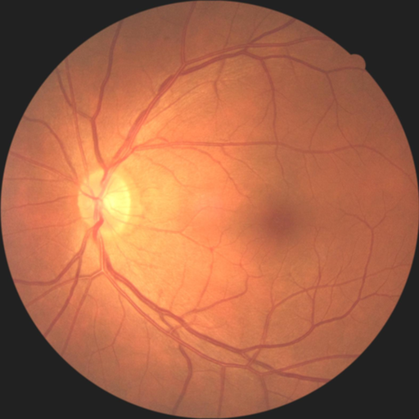
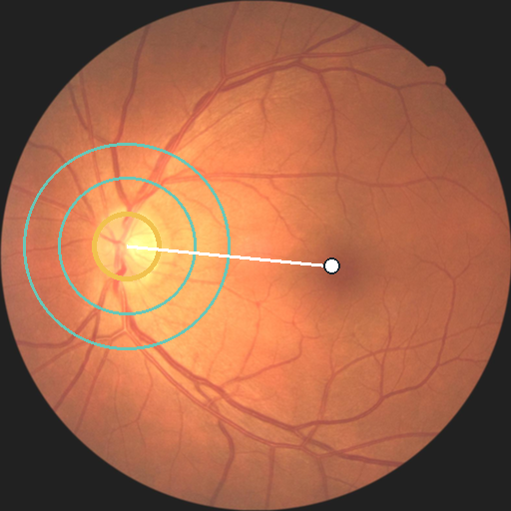
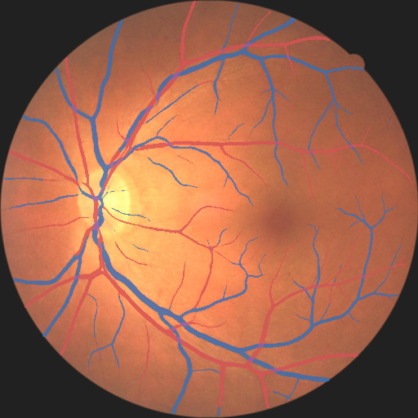

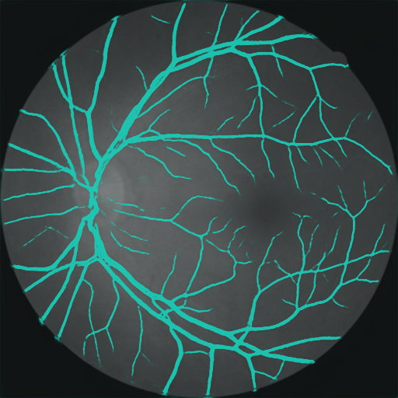

A
Prespecified resource roles
No cohort changes role after outcomes are inspected
FIVES
RAV
Fundus-AVSeg
China Fundus
CIMT
mBRSET mirror
800 images
206 images
100 images
2,603 dev
200 frozen val
1,287 participants
Occupancy
development
Identity audit
UDCT development
Locked A/V
measurement
Repeatability
clinical exploration
CIMT mechanism
B
RMDB–BiRAP phenotype construction
matched eye | frozen branches | outcome-blind gate
1
Anatomy standardisation
2
Separate support from identity
3
Dual readouts
4
BiRAP gate
IDENTITY
Mass-UDCT
9 prespecified
VascX + UDCT ×2
eye-level phenotypes
M = P(A,V,C | I*)
P(A,V,C | I*)
mass retained
ICC(1,1) ≥ 0.60
Raw
Standardised
Disc–fovea
same-eye, outcome-blind
Coordinate first
phenotype second
OCCUPANCY
Factorized-UDCT
4-feature core
Frozen FIVES head
F = O × P(identity)
retained before labels
No phenotype is calculated from raw I alone.
P(vessel | I*)
support gated
Patient vector
bilateral grouped summary
C
Four distinct evidence claims
Parallel interpretations, not a universal sequential checklist
MEASUREMENT
REPEATABILITY
TRANSPORT
CLINICAL INCREMENT
SUPPORTED
SUPPORTED
BOUNDARY
UNCONFIRMED
RAV mean A/V Dice 0.8256
2,359 same-eye pairs
Cohort AUROC 0.866-0.996
mBRSET ΔAUROC +0.00188
Fundus-AVSeg ΔDice +0.0090
4 of 9 phenotypes retained
Naive pooling prohibited
No independent high-res cohort
Notes:
[Sources]
/Users/tongyue/Documents/ppf/papers/RMDB/paper/figures/Figure1_refined_source_manifest.csv
/Users/tongyue/Documents/ppf/papers/RMDB/protocols/RMDB_BiRAP_forward_reverse_results_20260821.md
/Users/tongyue/Documents/ppf/papers/RMDB/paper/FINAL_QC_REPORT.md
All retinal photographs and processed maps are embedded from the local manuscript asset archive.

