Slide 1
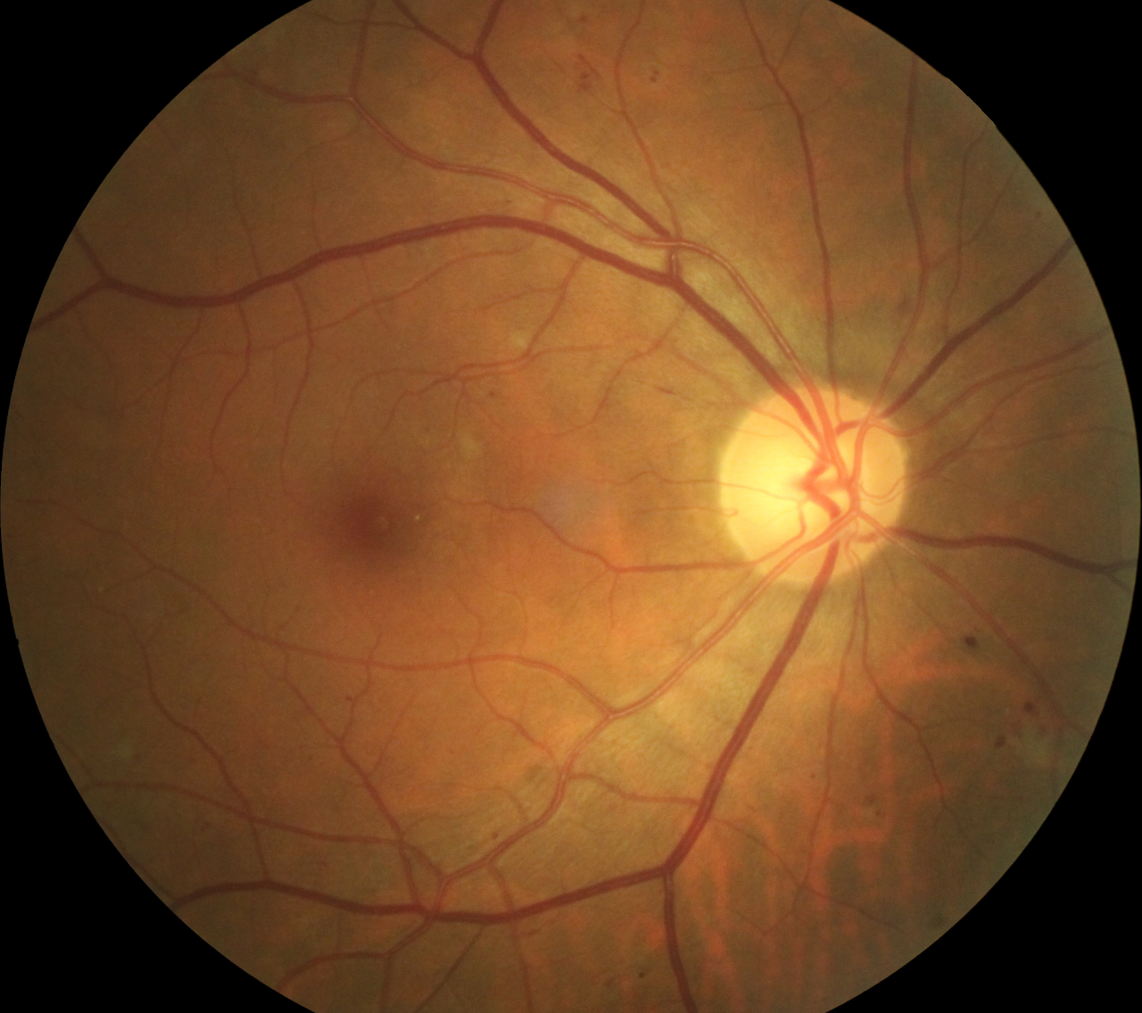

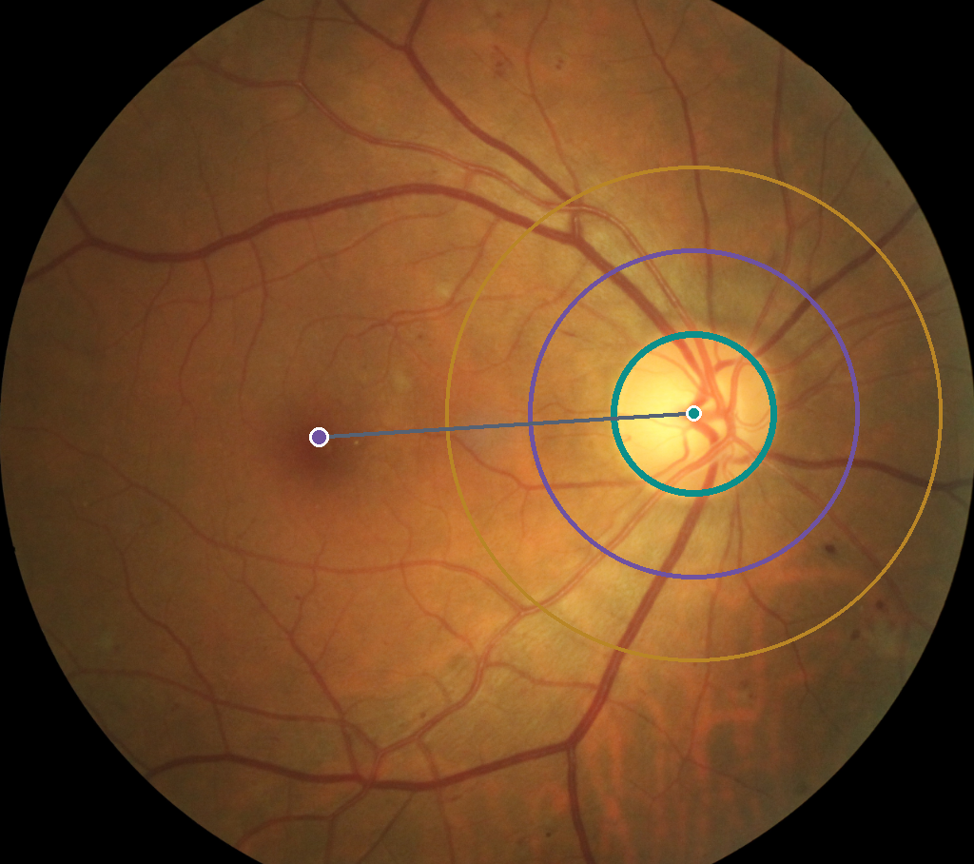
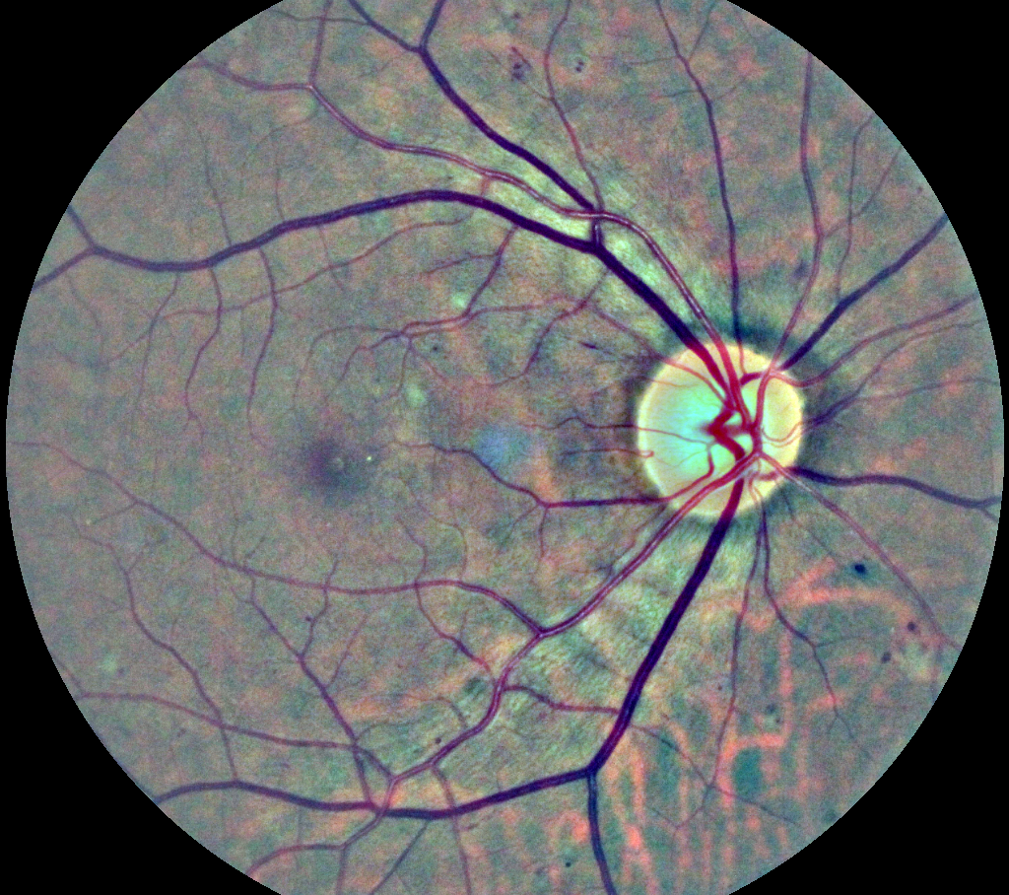
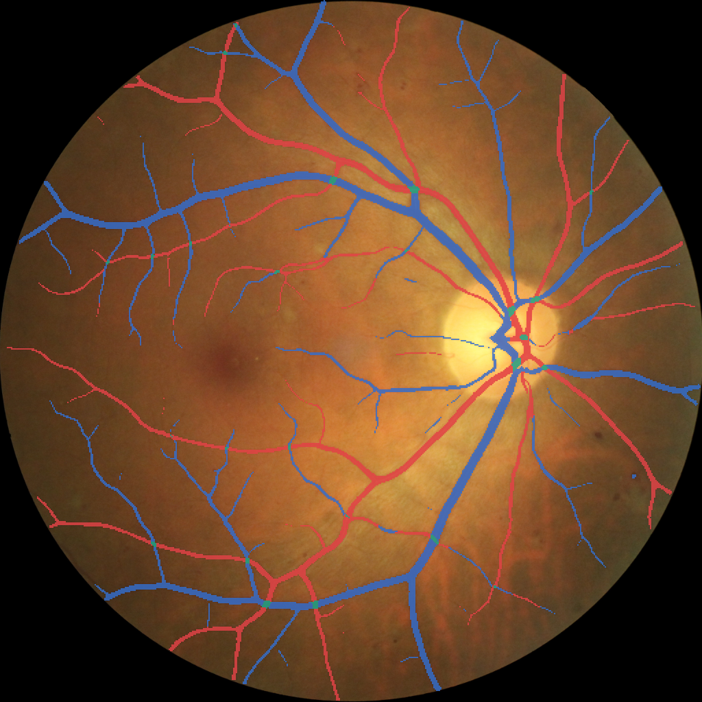

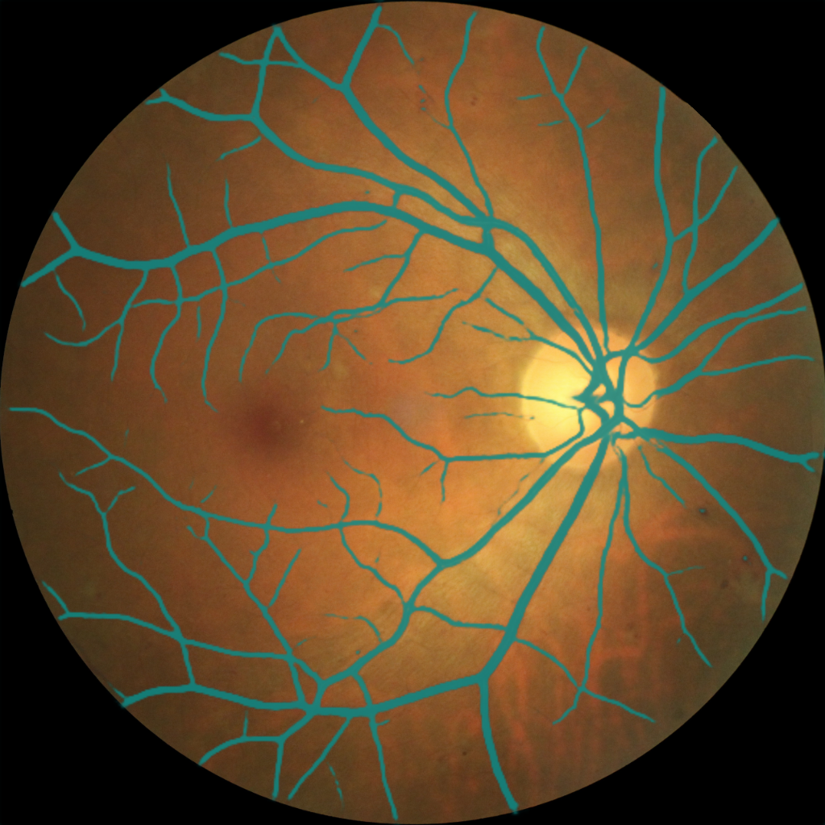

A
Anatomy is fixed before phenotype measurement
Fundus-AVSeg 059_D · real study image · saved pipeline outputs
COORDINATE FIRST
No phenotype is calculated from raw I alone
Field of view, optic disc and fovea establish a common retinal frame. Disc failure is retained as provenance; it does not silently generate a Zone B value.
Raw photograph
Standardised RGB
Disc–fovea frame
Enhanced vessel view
I
I*
Zone B only after QC
shared frozen input
B
Separate vascular identity from vessel support
Two frozen branches answer noninterchangeable questions
SHARED INPUT I*
IDENTITY
READOUT 1
PRESPECIFIED OPERATORS
VascX + UDCT ×2
Mass-UDCT
Phenotype candidates
P(A,V,C | I*)
M = P(A,V,C | I*)
artery · vein · crossing
retains calibrated mass
vessel mass
skeleton density
branch density
A/V balance
OCCUPANCY
READOUT 2
entropy
readout disagreement
Same anatomy
Frozen FIVES estimator
Factorized-UDCT
one image, two questions
F = O × P(identity | vessel)
Agreement and disagreement are retained separately; neither branch is allowed to silently redefine the other.
O = P(vessel | I*)
requires vessel support first
support only; no A/V identity
Identity ≠ vessel support. The two readouts remain explicit until reliability is established.
C
BiRAP gates features before any clinical outcome is modelled
same-eye repeatability · outcome blind · patient grouped
OUTCOME BLIND
◉ ↻ ◉
Reliability statistic
Retained reliable core
Patient-level phenotype vector
same eye, paired views
ICC(1,1) ≥ 0.60
4 of 9 phenotypes
bilateral mean + |L − R|
2,359 pairs
for each prespecified feature
fixed before labels are fitted
patient-grouped folds · no view leakage
FAIL QC OR ICC → STOP: the feature does not enter outcome modelling.
Notes:
[Sources]
/Users/tongyue/Documents/ppf/papers/RMDB/restored_assets/Fundus_AVSeg/Fundus-AVSeg/images/059_D.png
/Users/tongyue/Documents/ppf/papers/RMDB/artifacts/reverse_open/FundusAVSeg/anatomy/preprocessed_rgb/059_D.png
/Users/tongyue/Documents/ppf/papers/RMDB/artifacts/reverse_open/FundusAVSeg/anatomy/preprocessed_ce/059_D.png
/Users/tongyue/Documents/ppf/papers/RMDB/artifacts/reverse_open/FundusAVSeg/anatomy/disc/059_D.png
/Users/tongyue/Documents/ppf/papers/RMDB/artifacts/reverse_open/FundusAVSeg/anatomy/fovea.csv
/Users/tongyue/Documents/ppf/papers/RMDB/artifacts/reverse_open/FundusAVSeg/occupancy/059_D.npy
/Users/tongyue/Documents/ppf/papers/RMDB/artifacts/reverse_open/FundusAVSeg/locked_evaluation/predictions/vascx/059_D.png
/Users/tongyue/Documents/ppf/papers/RMDB/artifacts/reverse_open/FundusAVSeg/locked_evaluation/predictions/mass_udct/059_D.png
/Users/tongyue/Documents/ppf/papers/RMDB/artifacts/reverse_open/FundusAVSeg/locked_evaluation/predictions/factorized_mass_udct/059_D.png
/Users/tongyue/Documents/ppf/papers/RMDB/artifacts/reverse_open/FundusAVSeg/phenotypes/per_eye.csv
All retinal panels are exact study photographs or deterministic visualisations of saved model outputs.

