Slide 1
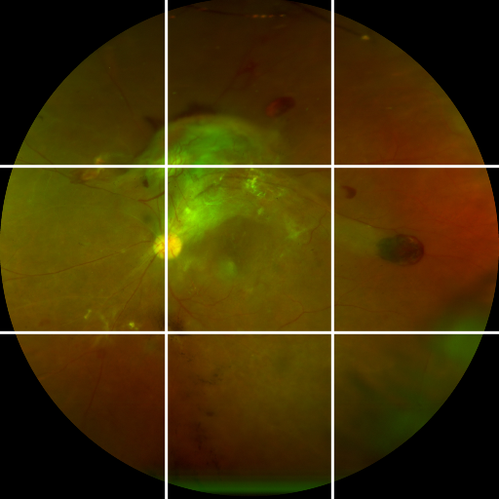
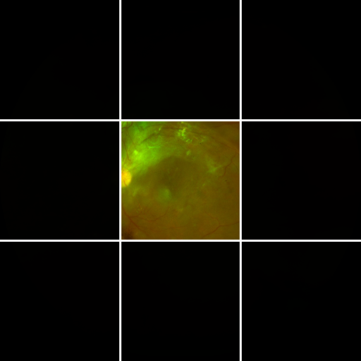
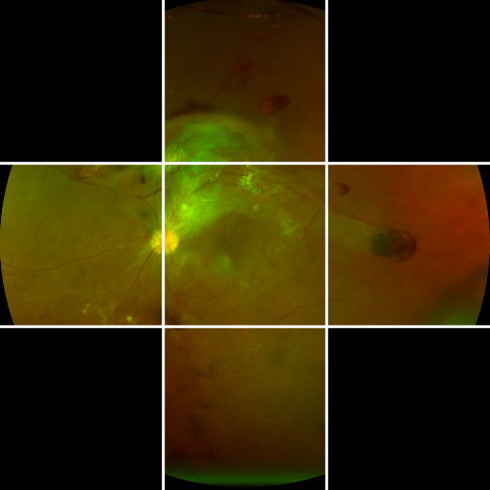
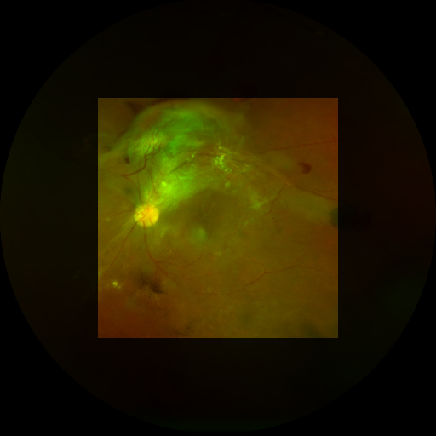
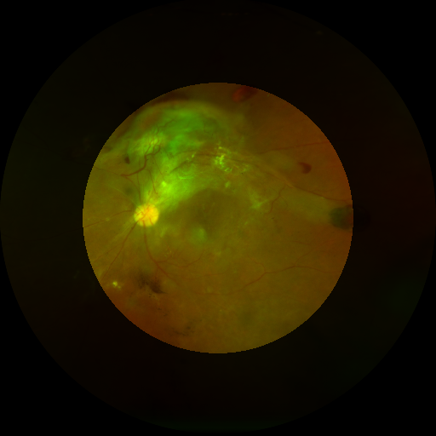
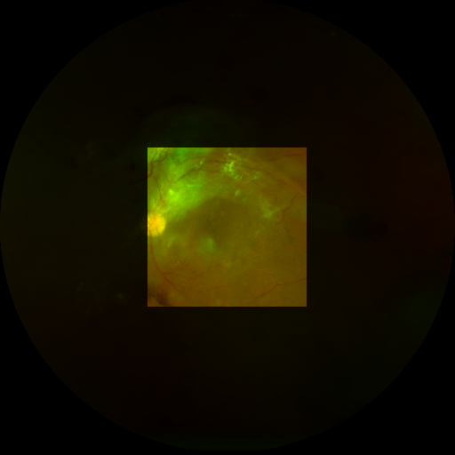
RegionSuff: auditing model-specific retinal evidence availability under limited fields of view
FIGURE 1
A clear acquisition may still omit task-relevant retinal evidence; RegionSuff makes model-specific retinal evidence availability explicit and testable.
A
Quality is not evidence
B
Controlled masks
C
Visibility-conditioned
D
Evidence chain
Same source image; different visible retinal evidence
Regional topology
Only regions marked visible enter the model
The story is tested, not assumed
Visibility mask
Internal test
Selects visible
evidence
390 held-out images
five source-training seeds
Full-view
Center-only
Center-plus-cross
Full-view
Center-only view
Pixel-space apertures
Functional occlusion test
One-region occlusion
versus learned attention
Clear retina ≠ evidence availability
Visibility-conditioned aggregation
A clear acquisition can still omit retinal evidence needed by the fixed DR model.
Unavailable regions contribute zero evidence; visible regions are combined for DR severity inference.
Centered rect.
f = 0.55
Matched circle
f = 0.55
Severe rect.
f = 0.35
Independent UWF evaluation
MMRDR-UWF: 2,597 images
no target adaptation
Audit question
Three-class DR severity prediction
How does a fixed DR model behave as model-specific retinal evidence availability is restricted?
Source DR label fixed; available evidence changes by area, location, shape, or topology.
Predicted class
Paired-view audit
Normal
NPDR
PDR
Ranks limited-view underestimation
requires two predictions
Core finding: DR model behavior depends on which retinal evidence is available and how it is spatially organized—not on photographic quality or field area alone.
Notes:
[Sources]
- Figure 1 study overview.
- Diagnostic sufficiency is the clinical motivation. Model-specific retinal evidence availability is the operational construct examined here. Figure 1 intentionally contains no mathematical equations: it states the study question, controlled restrictions, model role, and validation chain. Figure 2 contains the single core masked-attention equation.
- Source image: one local de-identified UWF fundus image in the RegionSuff project assets.
- Method labels and cohort counts: RegionSuff_1.9.docx, Methods Sections 2.3–2.8.

