Slide 1
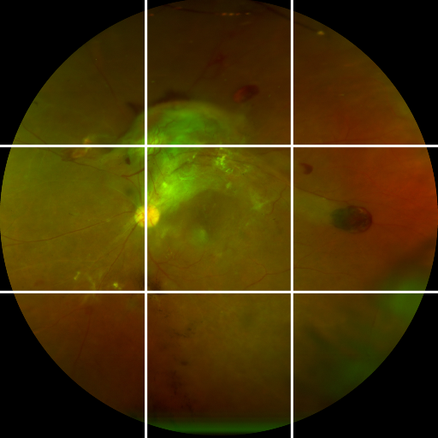
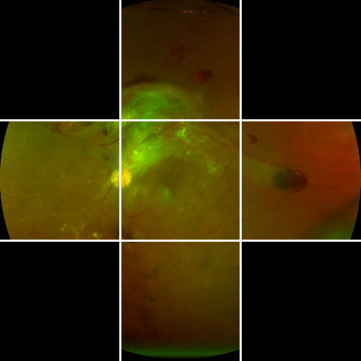
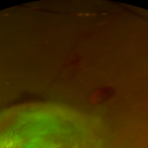
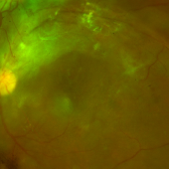
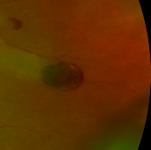
RegionSuff model: visibility-conditioned DR severity inference
FIGURE 2
The same source UWF image is processed under explicit visibility masks; these control model-specific retinal evidence availability—not photographic quality.
A
Same source image, different visible evidence
B
Shared RegionSuff severity model
C
Downstream paired-view audit
Each 3 × 3 token is a real retinal crop, not an abstract placeholder
Visible retinal crops pass through one shared encoder → projection → masked-attention pathway
One severity model; two visibility masks
Visibility
masks
Actual visible regional crops
Frozen retinal quality
encoder
Trainable projection
RetinaRadar
EfficientNet-B0
One 128-D token
per visible region
Full-view
prediction p_F
Center-plus-cross
prediction p_L
Full-view
Visibility-conditioned masked attention
Compare p_F and p_L
Raw UWF evidence bank
Probability, severity, and
entropy differences
Center-plus-
cross
mᵢ marks whether region i is visible; unavailable regions receive zero weight.
Visibility is an explicit model input
Rank limited-view underestimation risk
Exploratory paired-view audit
The source DR label is retained; black tiles withhold the corresponding regional evidence from the model.
Aggregate visible evidence → three-class DR prediction
Normal
NPDR
PDR
Requires both predictions; not a single-image triage rule.
Core mechanism: visibility explicitly controls model-specific retinal evidence availability; paired risk is assessed only after comparing two severity predictions.
Notes:
[Sources]
- Figure 2 architecture.
- The one displayed equation is the core masked-attention operation. Full, limited, and regional-crop images all derive from the same local UWF source image. The masks are synthetic visibility restrictions, not real paired acquisitions. The paired audit begins only after p_F and p_L are available. Diagnostic sufficiency is the clinical motivation; model-specific retinal evidence availability is the operational construct.
- Source image: one local de-identified UWF fundus image in the RegionSuff project assets.
- Method labels and cohort counts: RegionSuff_1.9.docx, Methods Sections 2.3–2.8.

