Slide 1
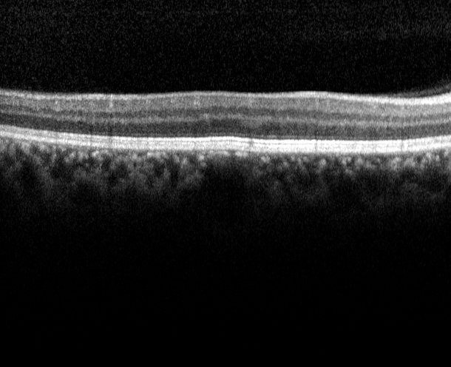
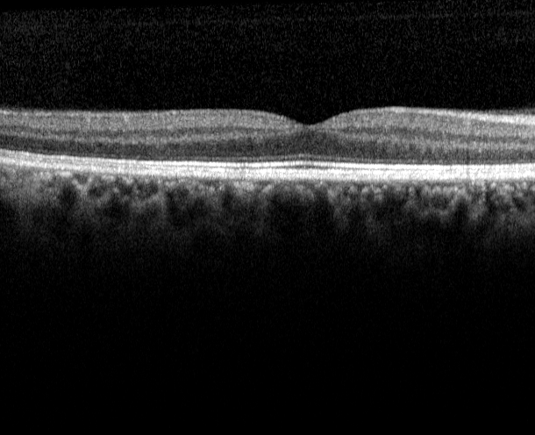
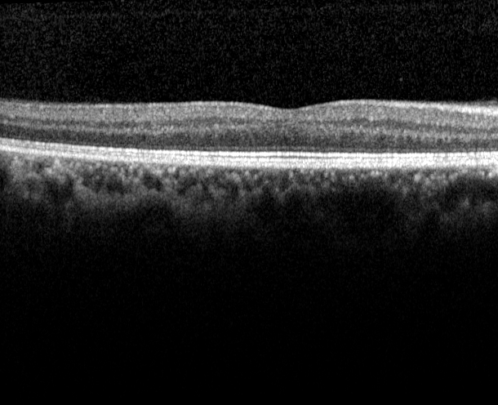
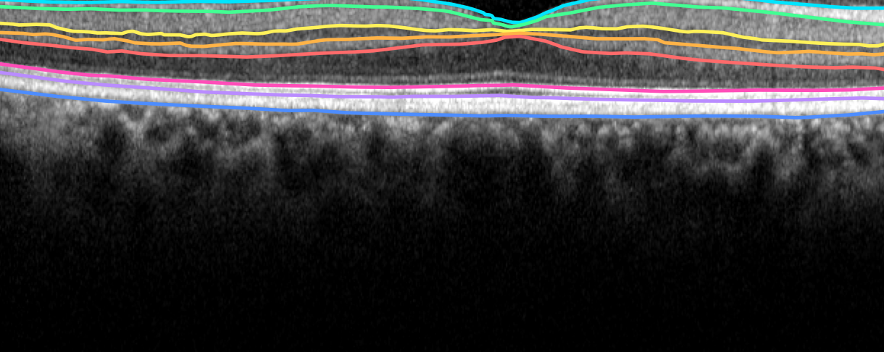
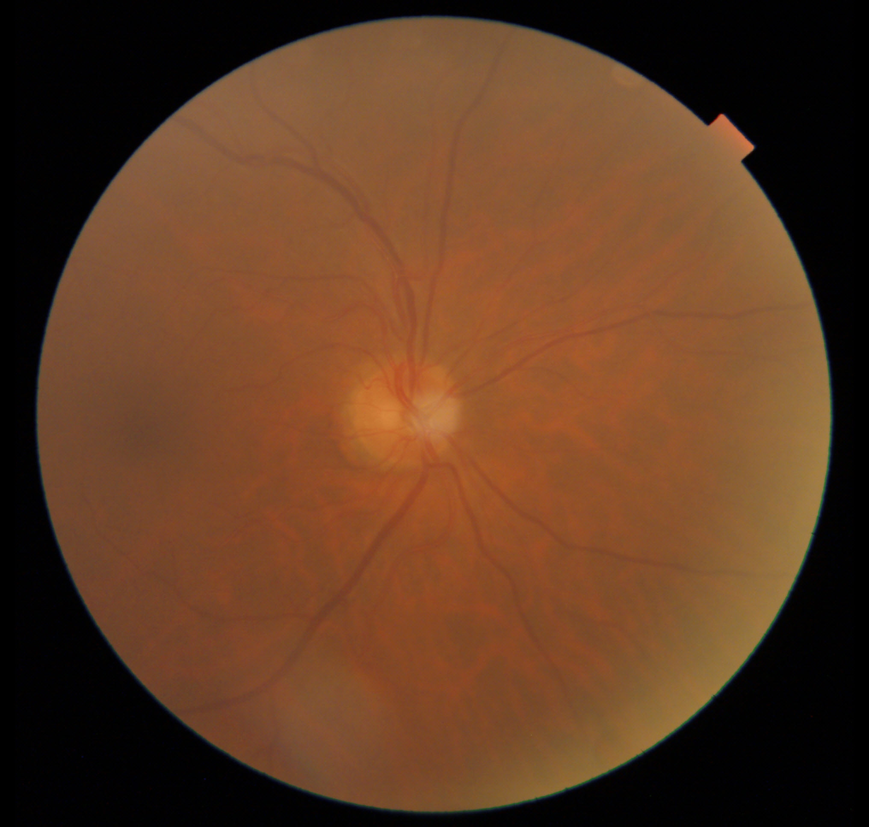
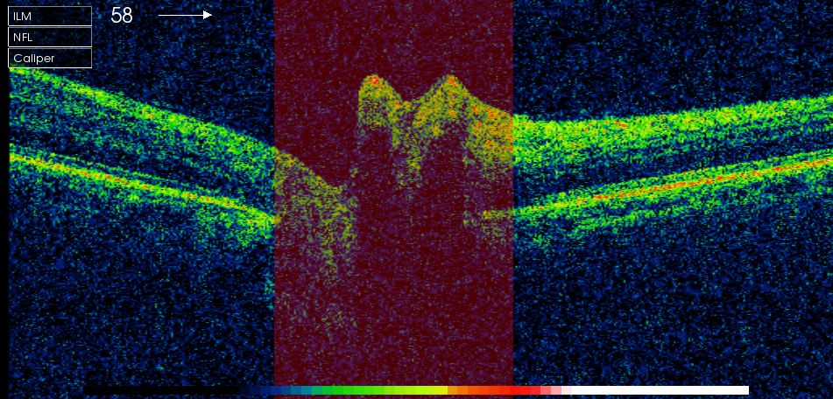
RetiESS-Seg: raw retinal data → boundary prediction → correlation-aware evidence audit
The images below are released dataset examples; the Tian 3D segmentation study remains the primary evidence path.
RAW DATA VISIBLE
A
Released data and unit of inference
B
Conventional boundary predictor
C
Correlation-aware ESS audit
D
Leakage-safe evaluation
10 complete volumes · 100 B-scans
PRIMARY · Tian 3D OCT segmentation
predictive path
128 × 256 B-scan
label-free appearance zi + slice position ti
9 complete
volumes
1 held-out
volume
3-stage
encoder
heatmap
decoder
vertical
soft-argmax
outer leave-one-volume-out × 10
B-scan 3
B-scan 5
B-scan 7
8 continuous retinal boundaries
same volume · adjacent anatomy · correlated evidence
nested model selection
60 inner epochs
→ selected refit: 120 epochs
paired fixed 60-epoch test
8 released layer boundaries
Lseg = SmoothL1 + 0.25 Lorder
ΔMAE = −0.019 px
95% CI crosses 0 · p = 0.375
SECONDARY · AFIO paired 2D feasibility
R = 0.5 Kpos + 0.5 Kapp
Prediction branch is identical in SliceCNN and RetiESS-Seg.
nₑff = (wᵀRw)⁻¹
training: (nₑff / m) scales LΔ
audit: report redundancy-risk signal
Mechanistic redundancy result
no ESS feature enters inference
raw slices: 5 → 10 → 20
ESS: 1.562 → 1.536 → 1.519
49 pairs / 26 patients · not Tian external validation
separate from inference · no accuracy claim
claim gate: no proven accuracy gain
fundus
OCT
TAKE-HOME
Duplicated B-scans inflate the raw sample count, not independent evidence. RetiESS reports this redundancy risk; it does not replace the predictor or justify an unobserved diagnostic gain.
Notes:
[Sources]
/Users/tongyue/Documents/ppf/papers/retiess_experiment/data/tian_octrima/extracted/FiletoShareforPONE/Subject1.mat (volumedata; Observer1; Observer2)
/Users/tongyue/Documents/ppf/papers/retiess_experiment/data/afio_glaucoma/extracted/Data on OCT and Fundus Images/P 15/1691587_20150916_103043_Color_R_001.jpg
/Users/tongyue/Documents/ppf/papers/retiess_experiment/data/afio_glaucoma/extracted/Data on OCT and Fundus Images/P 15/1691587_20150916_103043_B-scan_R_001.jpg
/Users/tongyue/Documents/ppf/papers/retiess_experiment/results/tian_nested_augmentation/summary.json
/Users/tongyue/Documents/ppf/papers/retiess_experiment/results/tian_loo_60e/summary.json
/Users/tongyue/Documents/ppf/papers/retiess_experiment/paper_assets/enhanced/raw_examples/README.txt
[/Sources]
Scope: Tian is the primary complete-volume 3D segmentation study. AFIO is shown only as a separate 2D paired-data feasibility extension.

