Slide 1
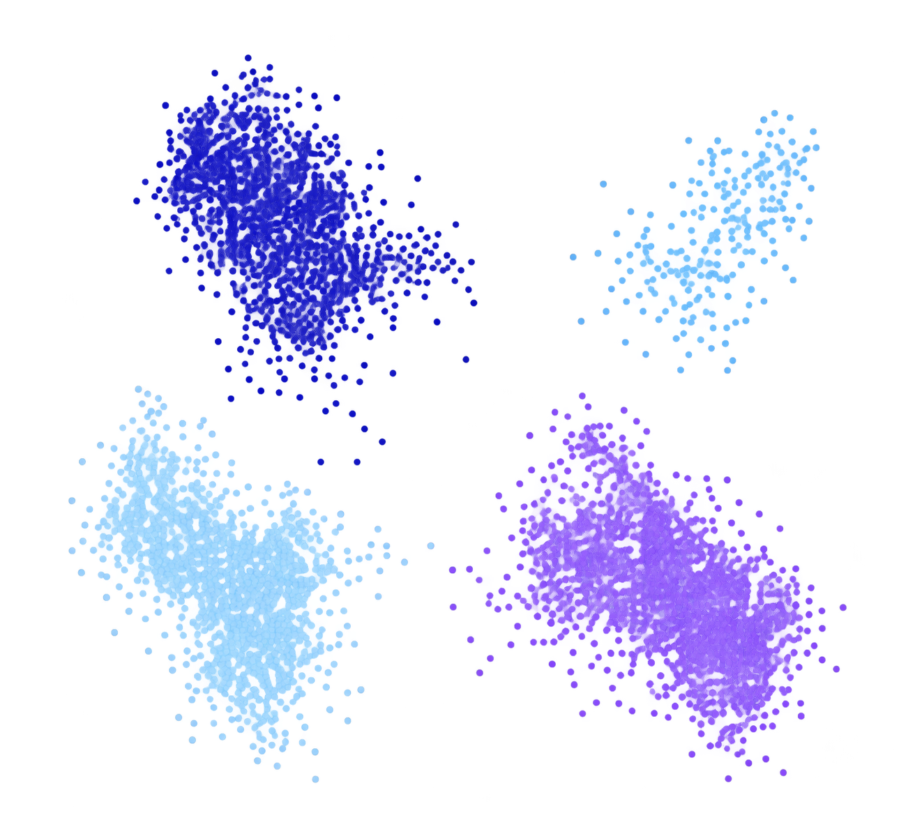
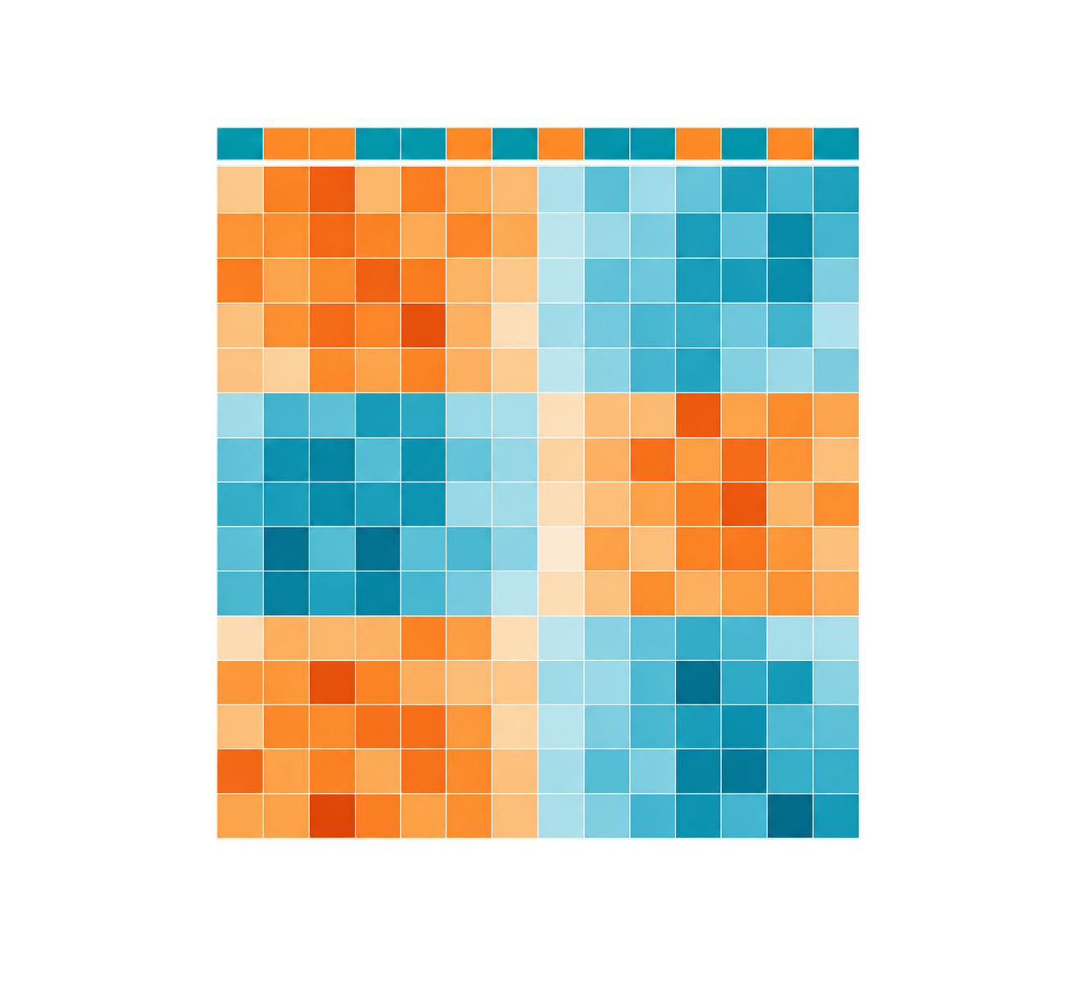
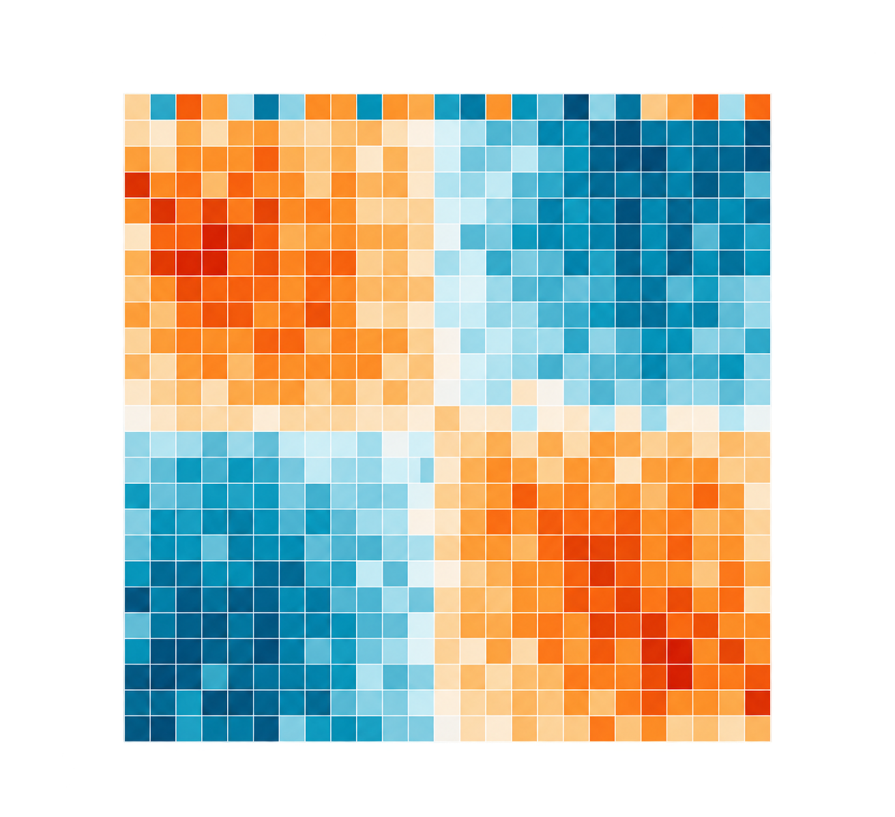
TRACER evidence-graph workflow
Registered source records define the evidence. The LLM drafts a candidate; deterministic checks decide research-priority eligibility.
1
Registry evidence
2
LLM candidate
3
Deterministic checks
4
Priority decision
Frozen dataset views
Untrusted draft
Registry-derived
Auditable output
GSE120575 / GSE91061 / GSE78220
scRNA
bulk
bulk
Small LLM
Provenance
PASS
LOW / ABSTAIN
drafts a research candidate
Transport
PASS
Keep the trace.
Specify a compatible next test.
↓
Source links
PASS
CANDIDATE CARD
All-cohort FDR
PASS
HIGH / priority eligible
hypothesis + replication
requested next test
All required checks pass.
Preserve the audit trace.
Pre-register a discriminating test.
scRNA-seq and bulk RNA
are different measurement levels.
Perturbation
PASS
Model text cannot create evidence.
All required checks must pass for HIGH.
Eligibility only—not biological truth
or clinical validity.
Typed source fields remain frozen.
Dataset relationships and typed evidence fields—not model prose—determine eligibility.
Notes:
Dataset-rich framework figure. The data thumbnails correspond to the schematic source-record views GSE120575, GSE91061, and GSE78220. They do not communicate a biological or clinical result. Every native text element is set to 8 pt or larger.

