Slide 1
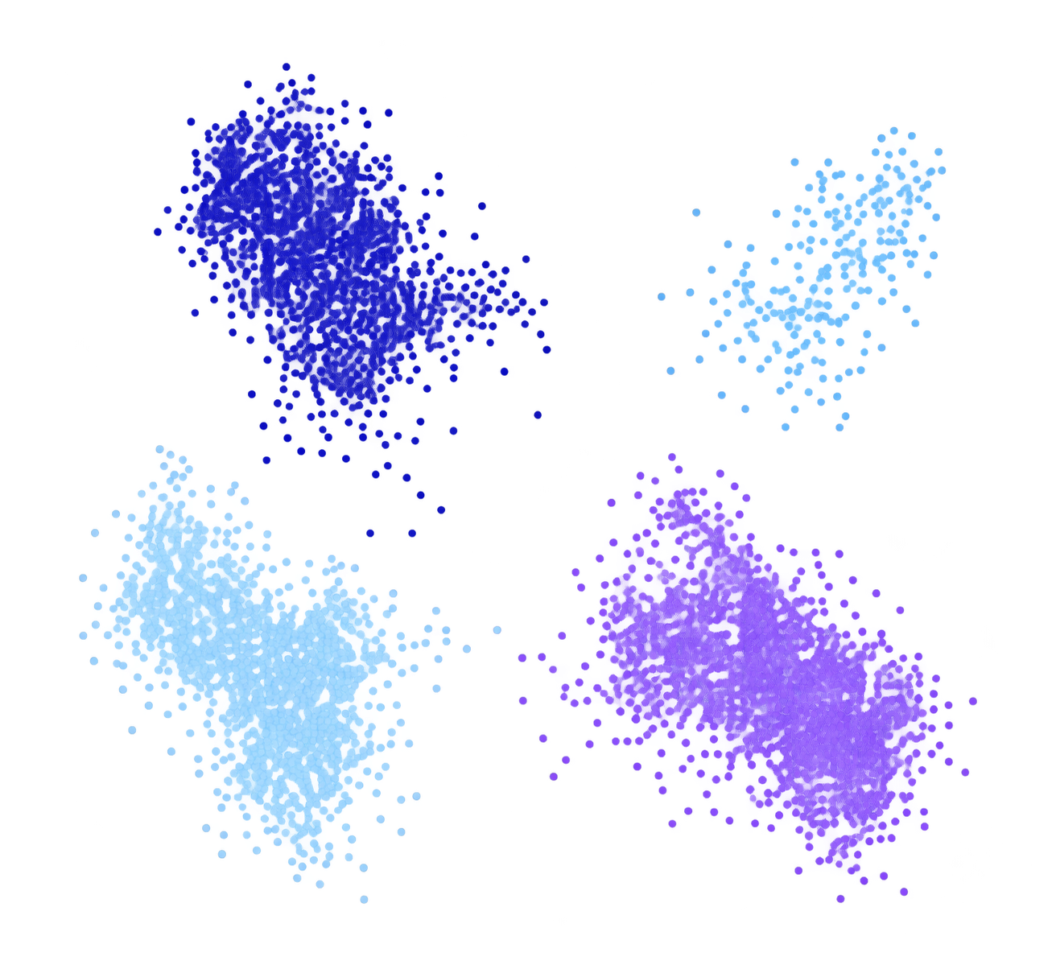
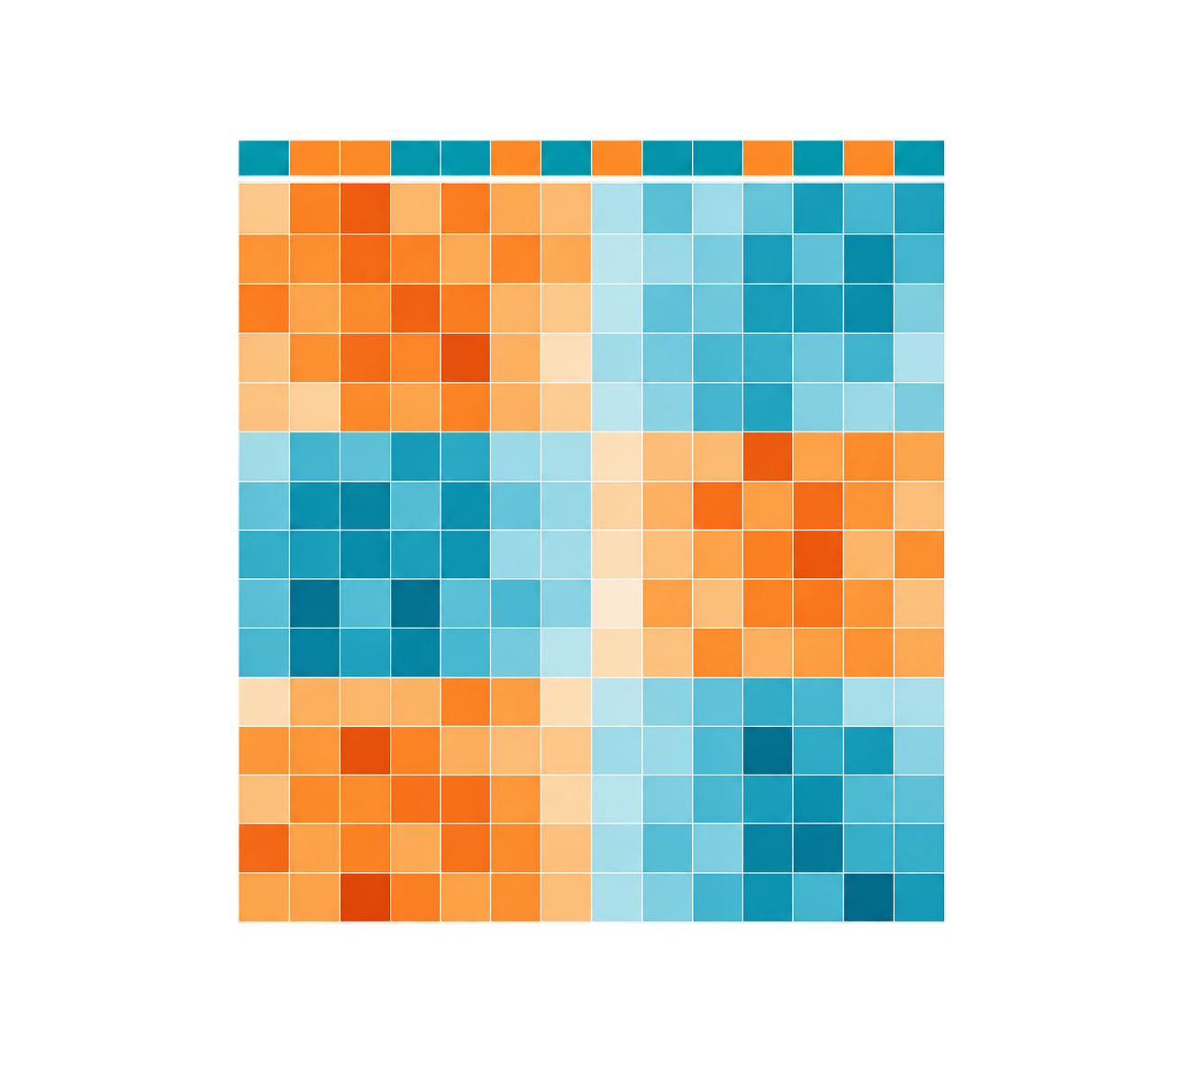
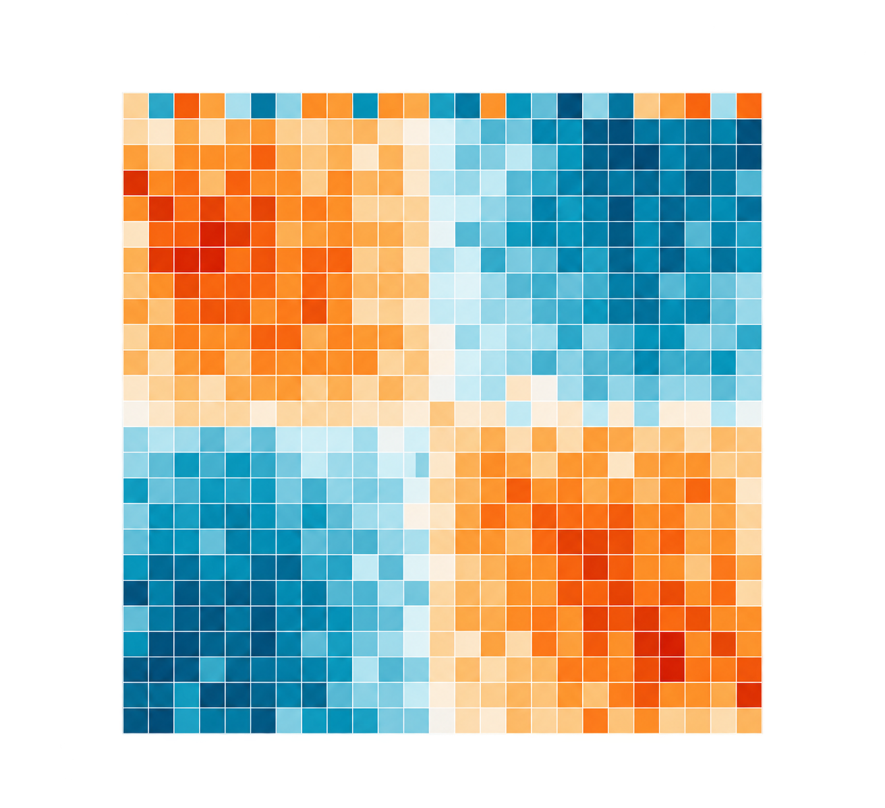
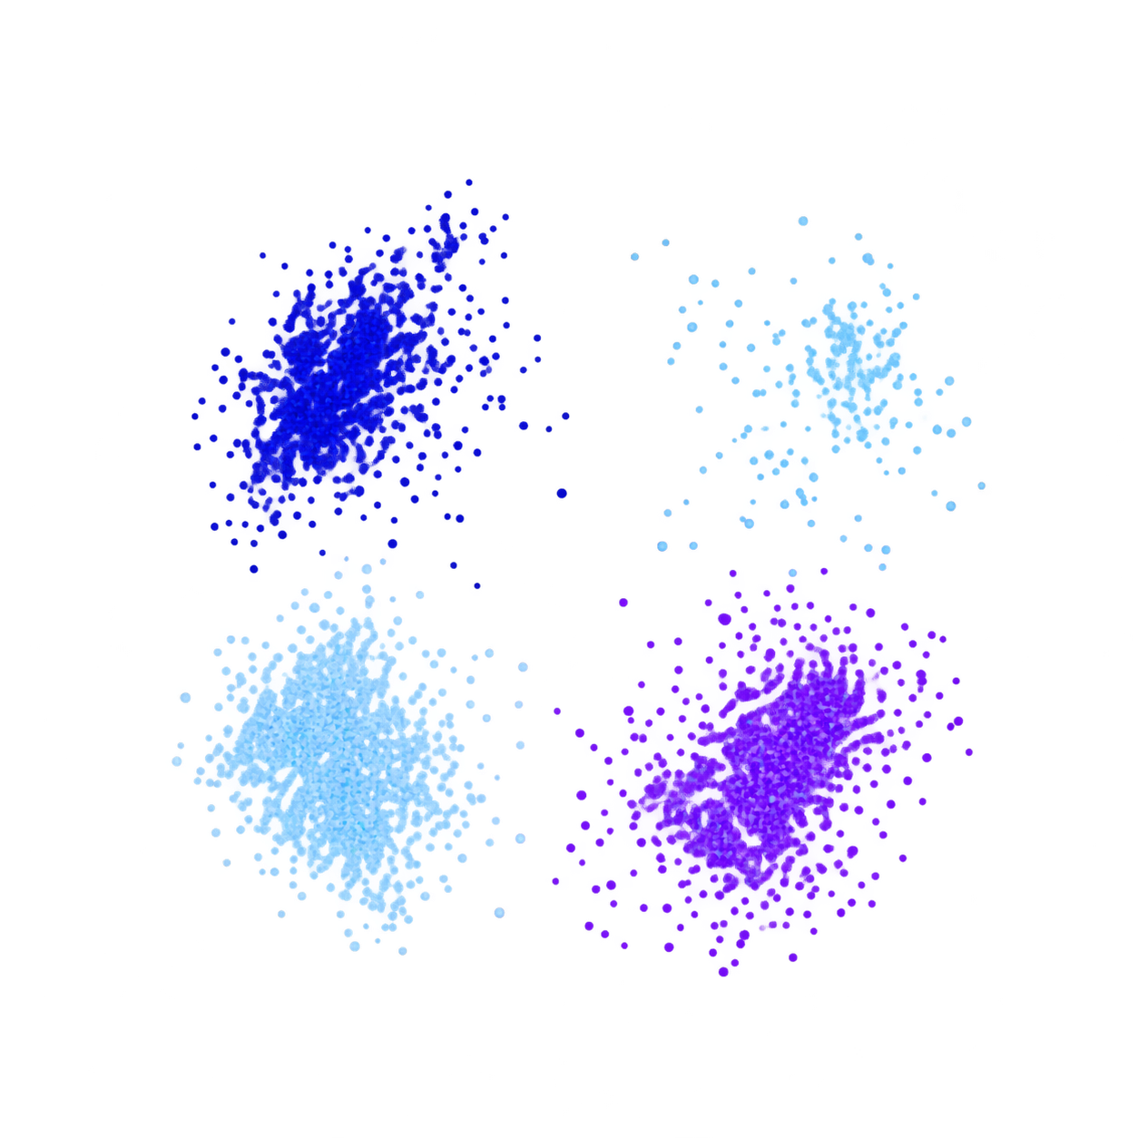
Cross-measurement hard negative
The registered single-cell record and two bulk-RNA records differ in measurement level; that conflict blocks the stated replication claim.
A
Registered dataset views
B
Candidate claim and audit
C
LOW / ABSTAIN and next test
GSE120575 / GSE91061 / GSE78220
Model prose cannot create evidence
Auditable research path
scRNA
bulk
bulk
UNTRUSTED CLAIM
LOW / ABSTAIN
“same-measurement replication”
Keep the trace; no HIGH priority for this claim.
Compatible next experiment
TRANSPORT GATE
scRNA-seq ≠ bulk RNA
Same-measurement replication fails.
Registered measures differ:
scRNA-seq versus bulk RNA
Independent scRNA-seq cohort
matched compartment and endpoint
Three registered data views make the transport conflict visible.
The audit retains the draft but blocks the claimed replication.
This repairs the evidence gap; it does not validate the original claim.
TRACER redirects a cross-measurement conflict to a compatible independent experiment.
Notes:
Dataset-rich cross-measurement hard-negative figure. The thumbnails are labeled schematic source-record views for GSE120575, GSE91061, and GSE78220. They display no gene-level, effect-size, or clinical result. Every native text element is set to 8 pt or larger.

