Slide 1
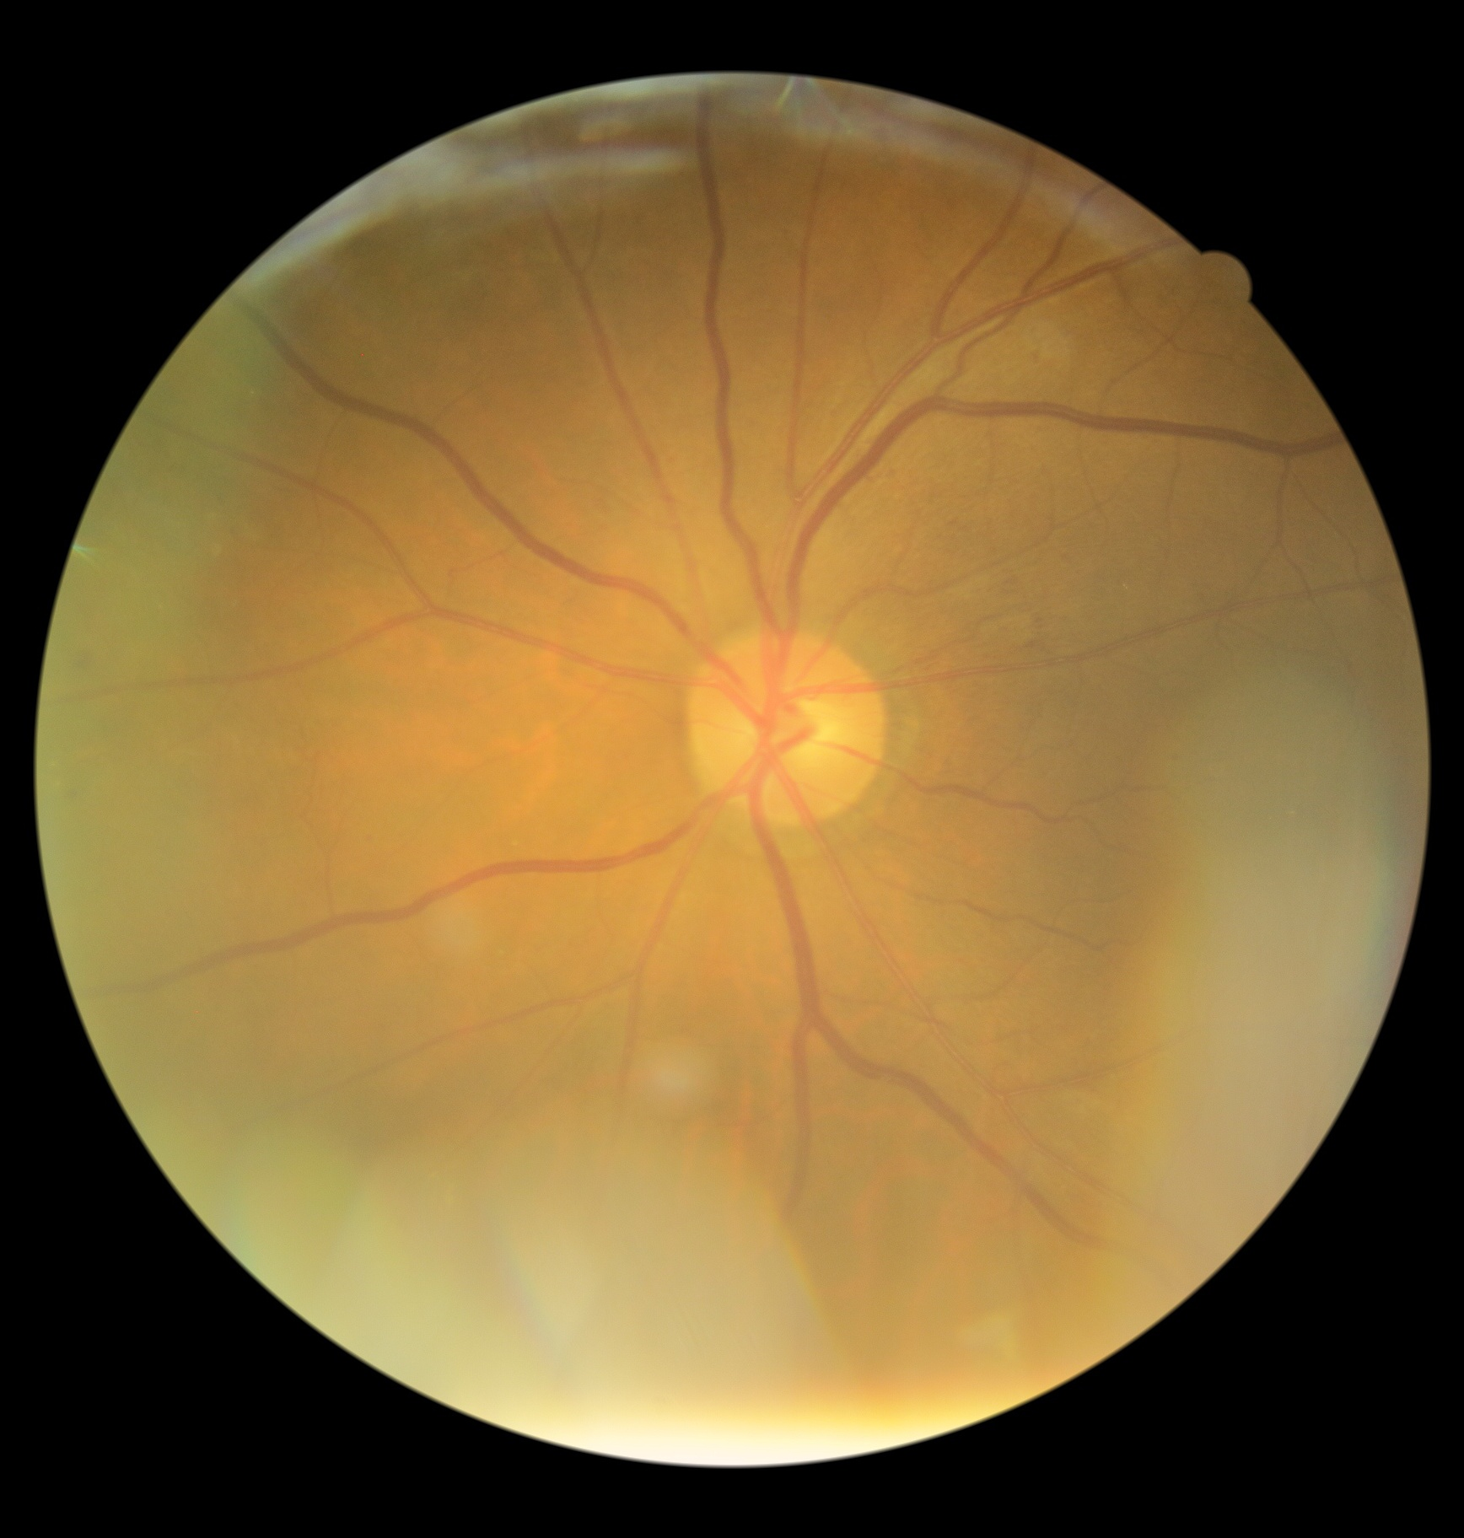
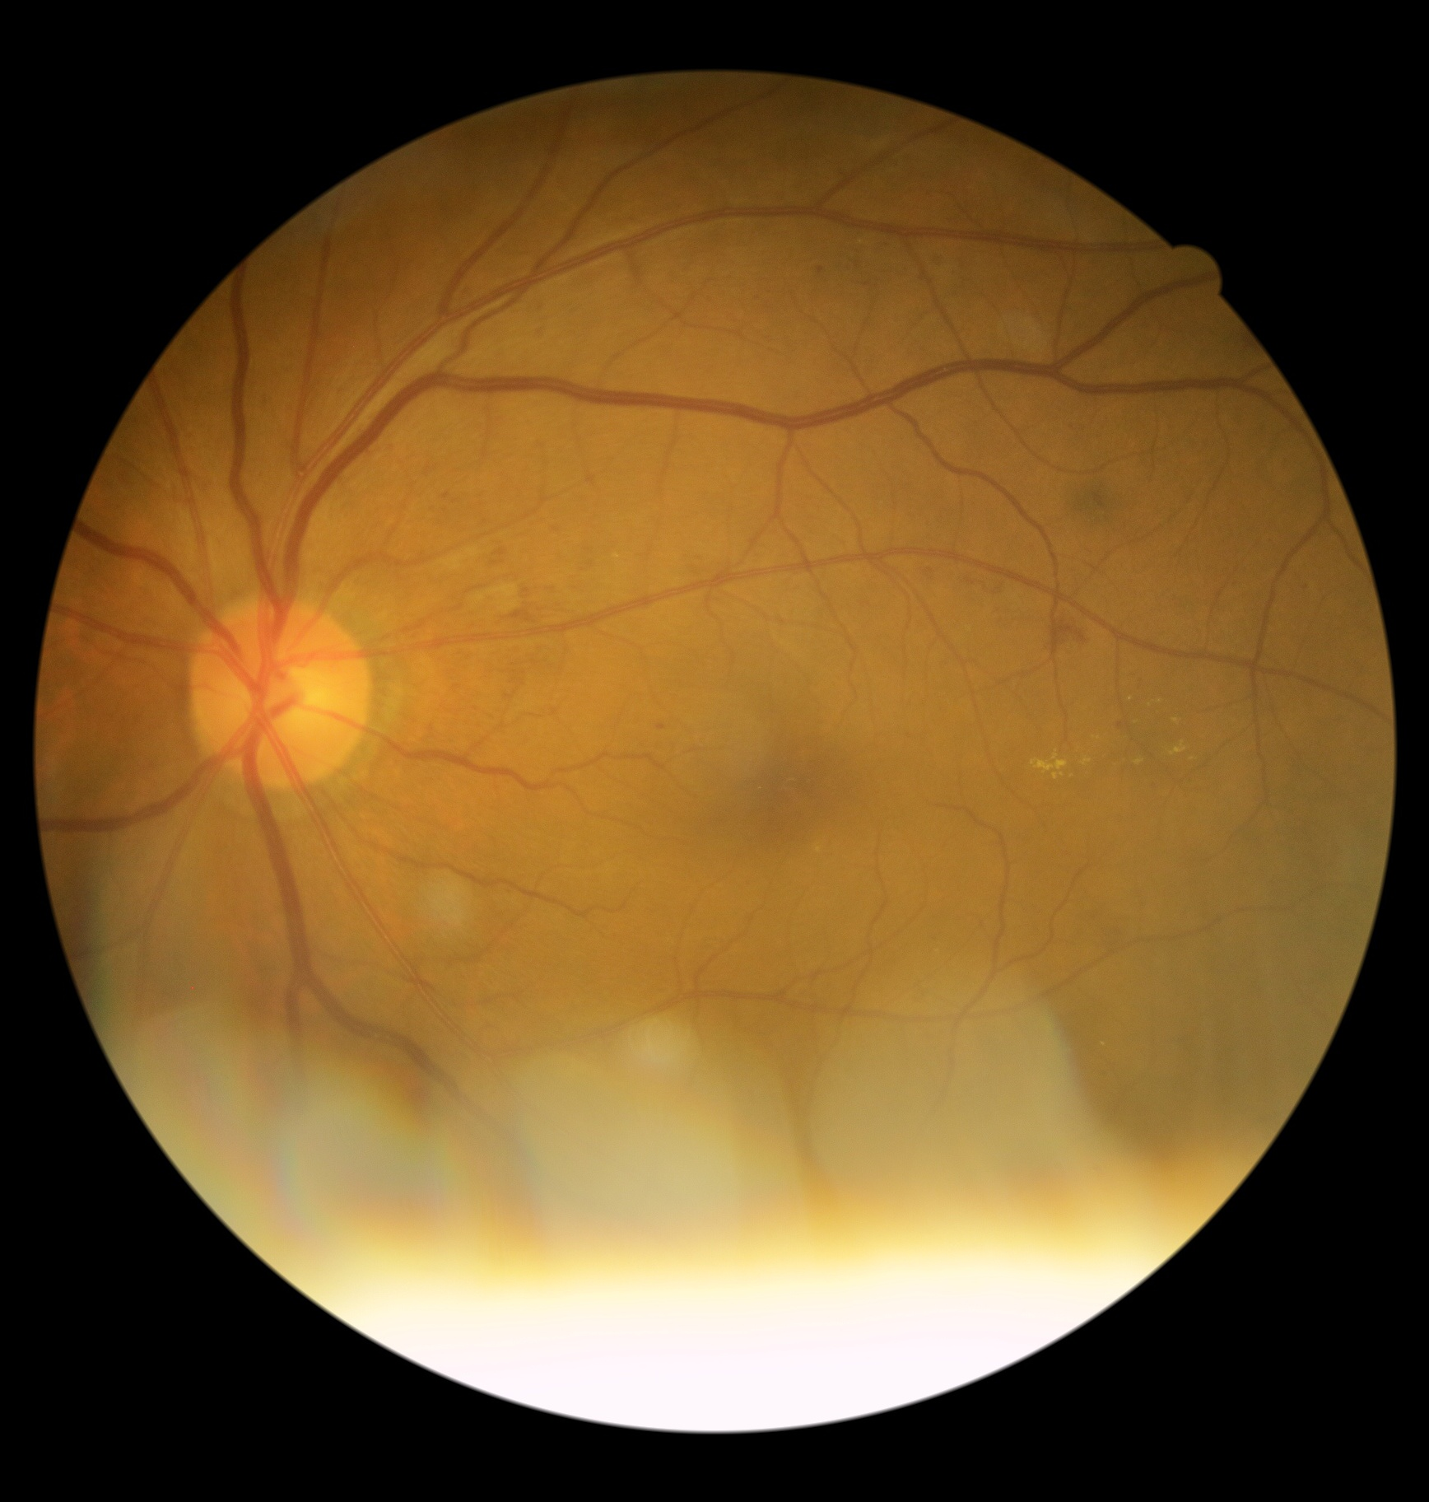
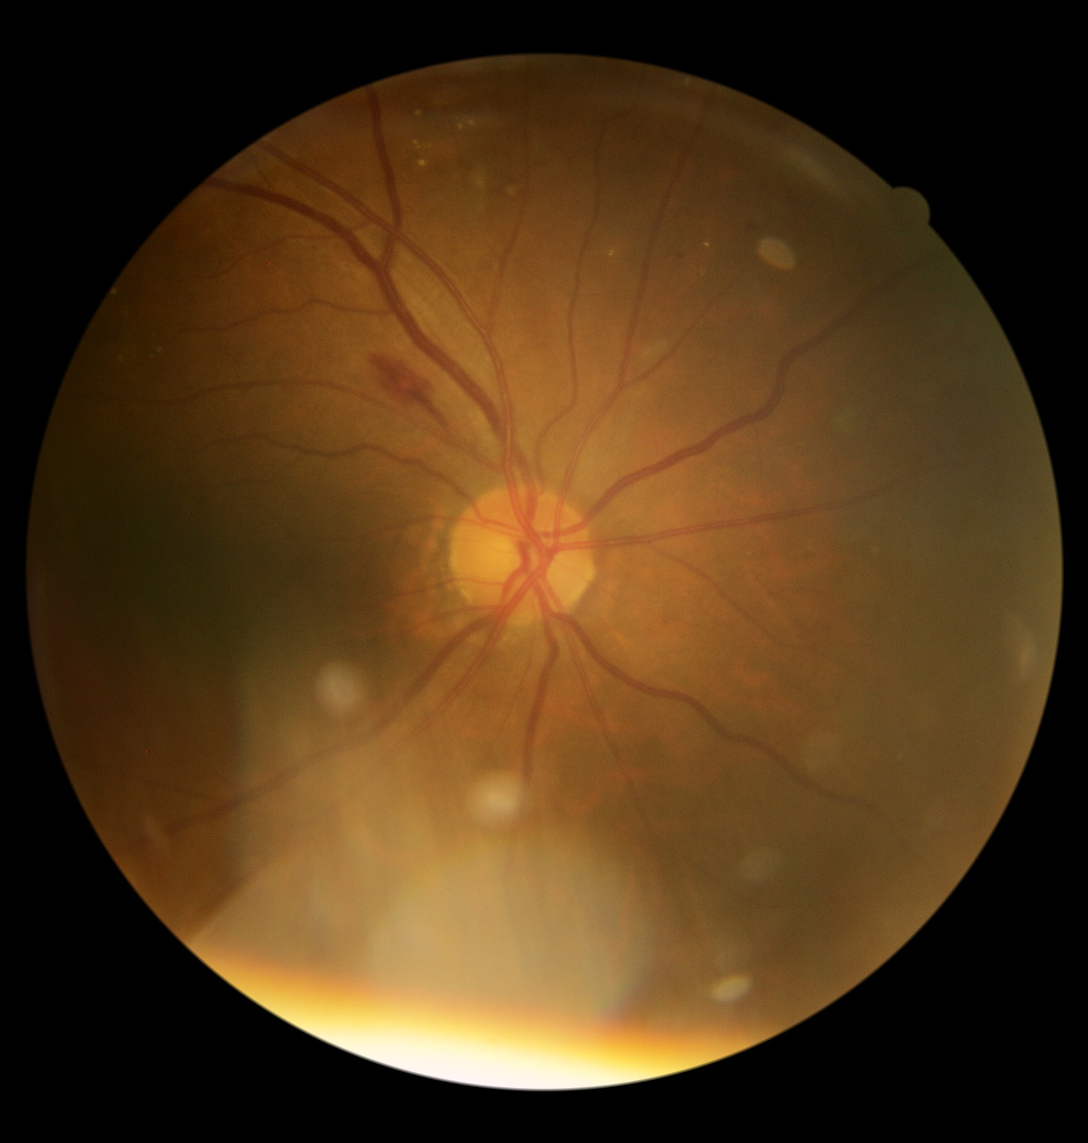
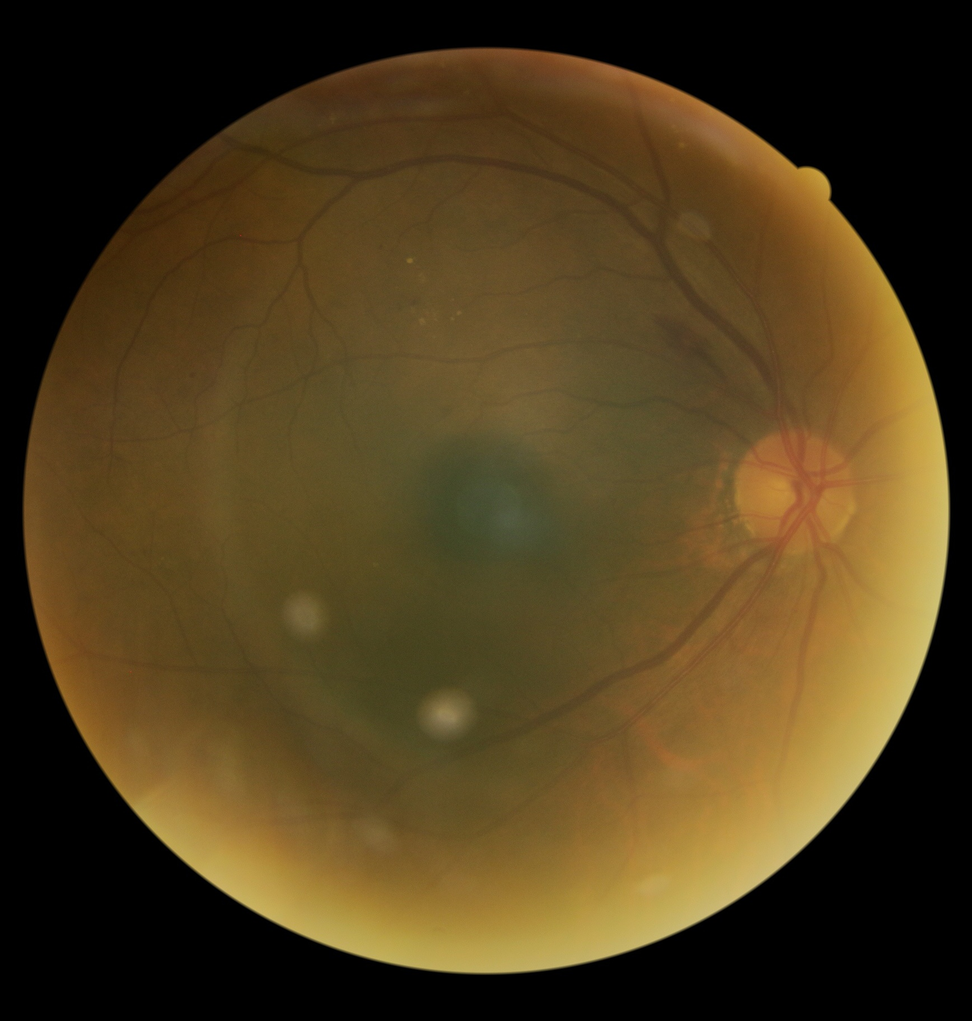
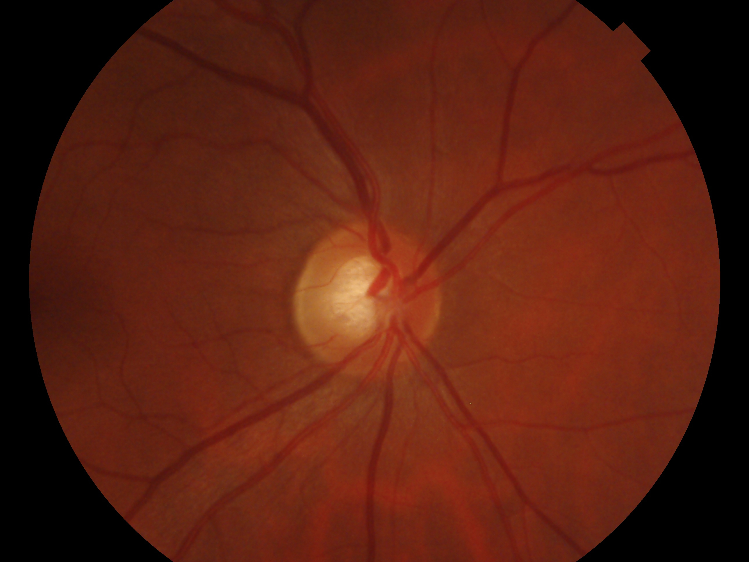
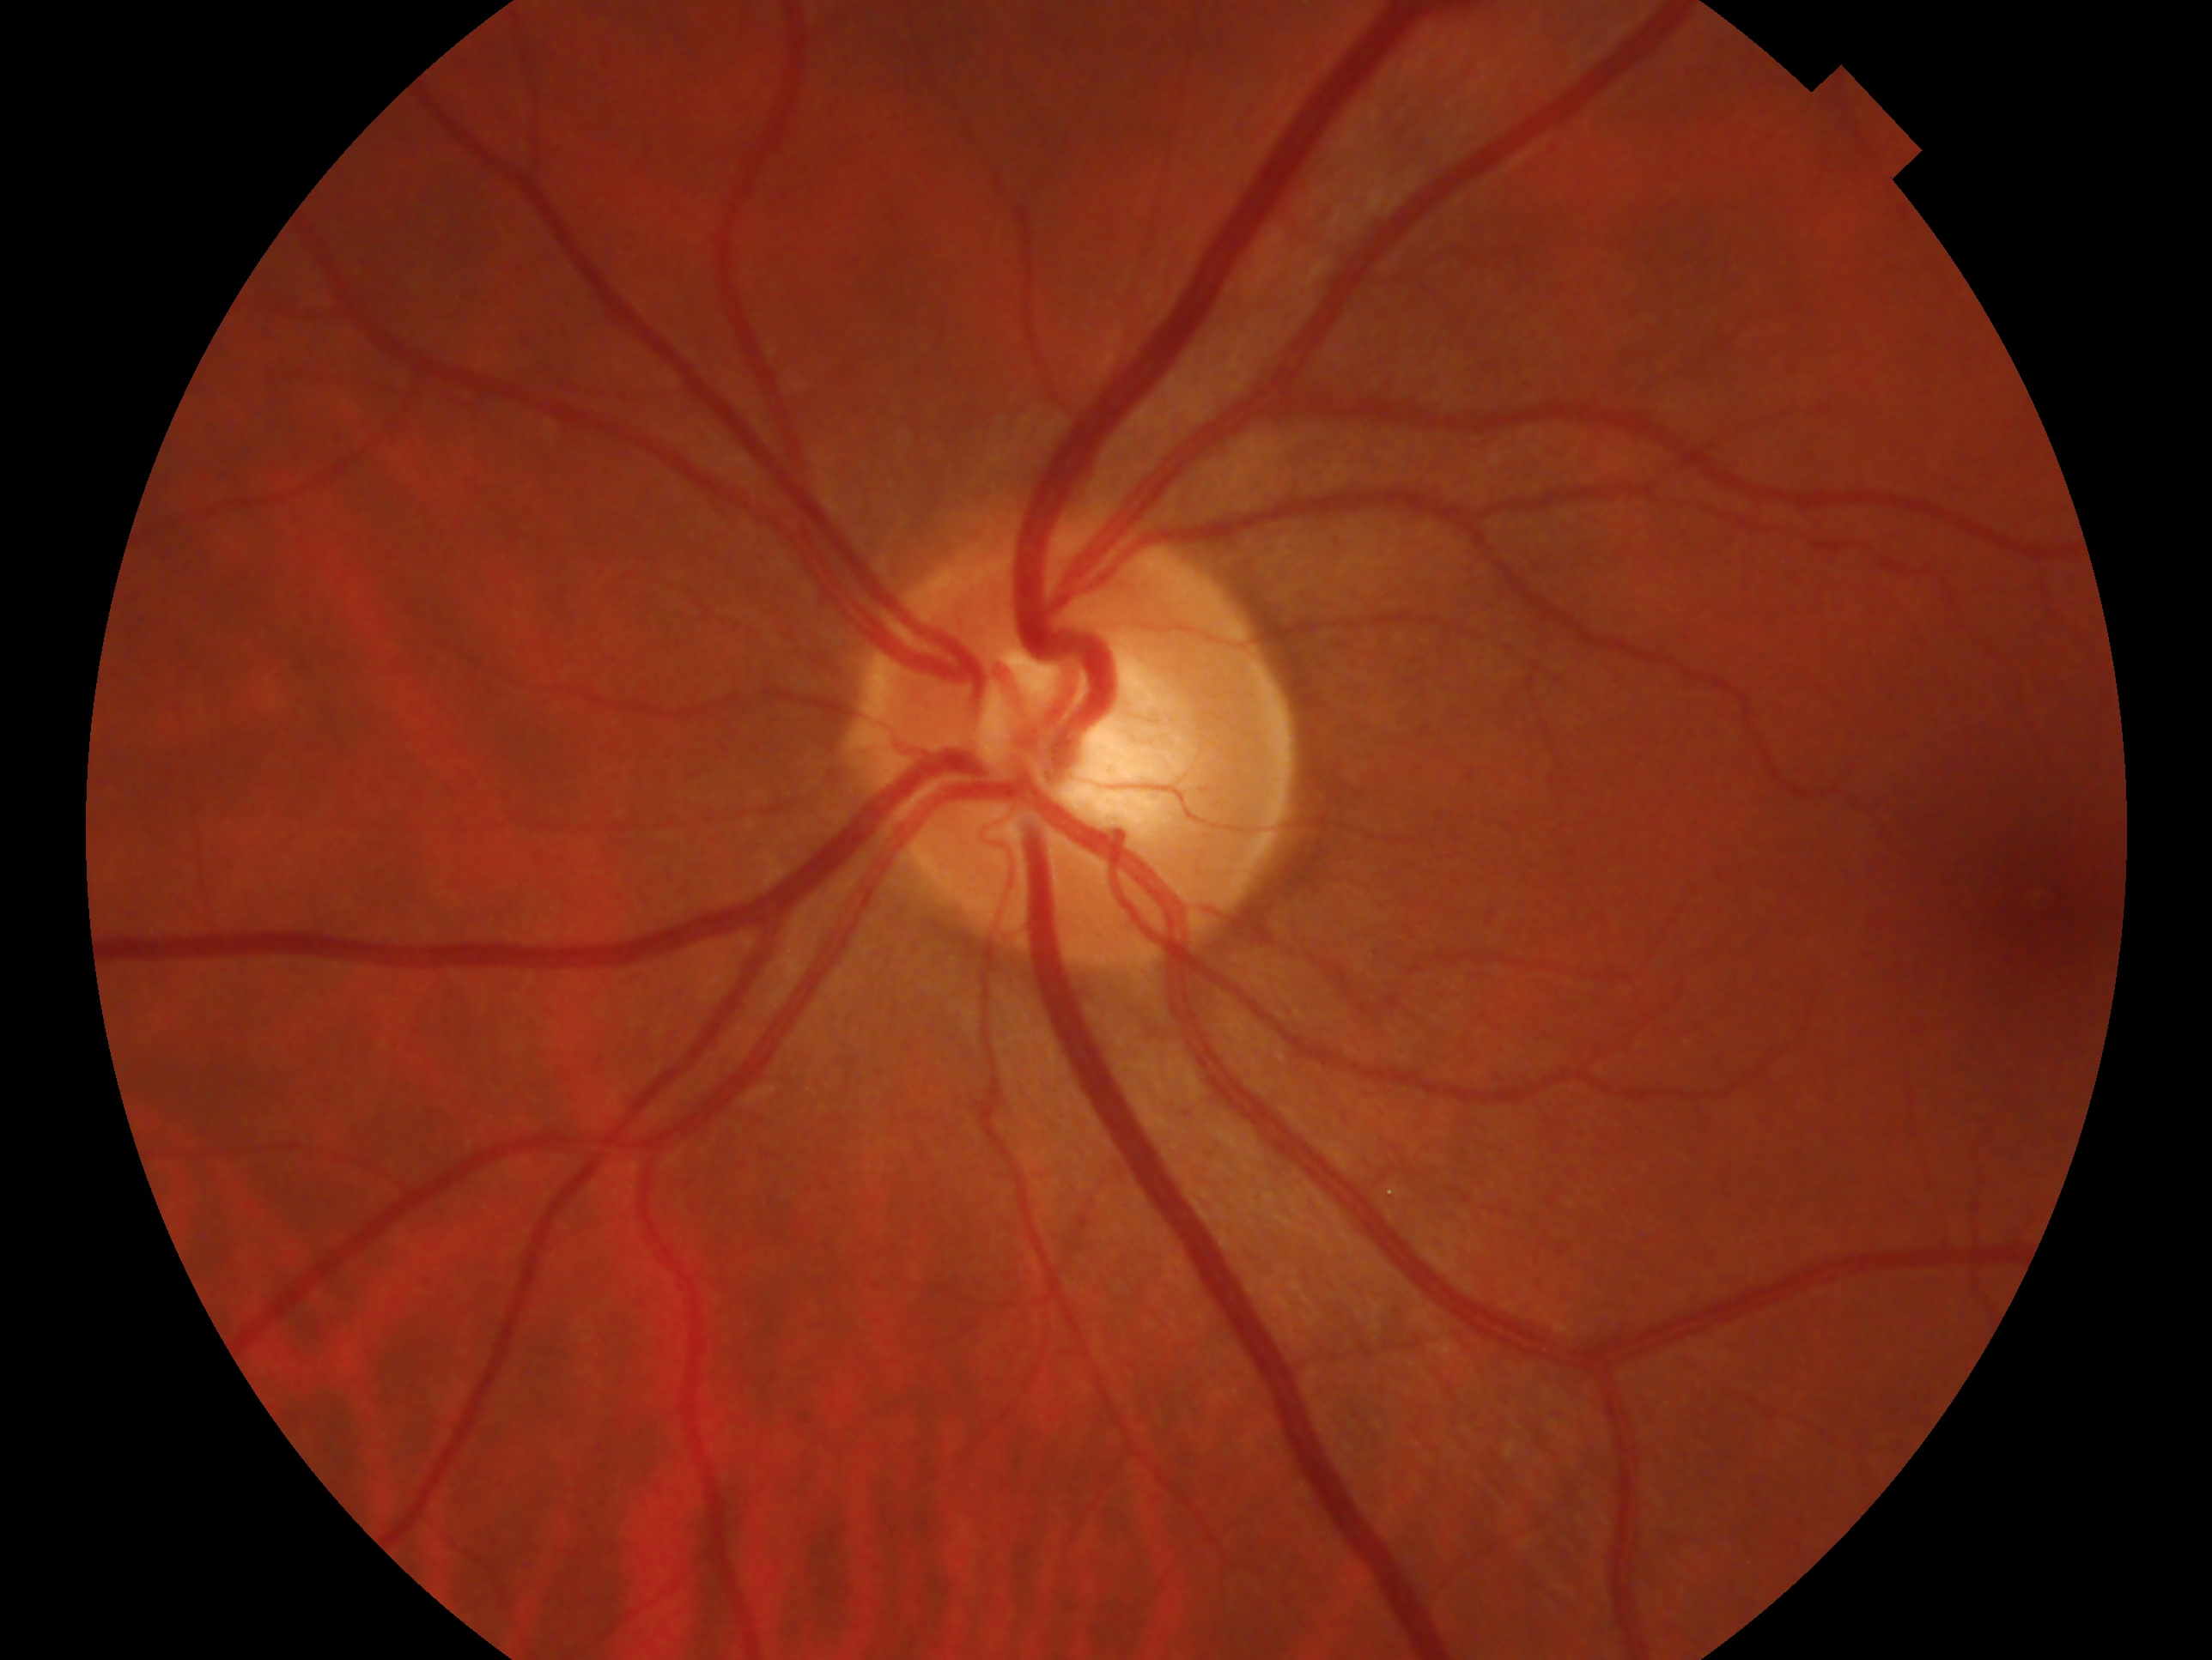
STUDY FRAMEWORK
Conditional bilateral correspondence: from images to evidence
Test cross-eye correspondence against grade and quality controls; audit view effects separately.
A
B
C
Patient as the unit
Define the contrasts
Measure correspondence
DeepDRiD · 300 complete bilateral patients
One source patient; preserve eye and view labels
Frozen raw representation · no feature tuning
SOURCE COHORT
POSITIVE
ImageNet ResNet-50
Patient i
L(i) ↔ R(i)
same patient, opposite eyes
same fixed encoder for each image
2 eyes × 2 views = 4 images
NEGATIVE
L(i) ↔ R(j)
Cosine score s(L, R)
different patients; j ≠ i
L1
L2
View checks
Pair AUROC + cosine gap
L1–R1 · L1–R2 · L2–R1 · L2–R2
R1
Same-eye repeats (L1–L2, R1–R2) audit hierarchy.
R2
Auxiliary: grade / quality metadata probes
Five fixed patient-level negative assignments
Patient-disjoint train / val / test: 210 / 46 / 44
D
Make cross-patient negatives progressively harder
The positive pairs and frozen features stay fixed; only negative-patient matching changes.
01 DISEASE CONTROL
02 JOINT CONTROL
03 SENSITIVITY
Same DR grade
Grade + exact quality tier
Grade + nearest quality
Mean |Δ quality| 0.198
Mean |Δ quality| 0.071
Mean |Δ quality| 0.024
grade stratum · patient derangement
exact grade × tier bucket
within grade · nearest assignment
E
Audit at three evidence levels
DeepDRiD
CFP–OCT
PAPILA
INTERNAL MEASUREMENT
DEVELOPMENT STRESS
LOCKED EXTERNAL BASELINE
Full 300: condition controls
Test: four-view n=43; probes n=44
137 eligible: raw vs H-CBFD
Candidate loses to raw baseline
244 patients · one image/eye
Frozen raw features only
OD
OS
Claim boundary: correspondence does not establish patient identity or a disease-independent biomarker.

