Slide 1
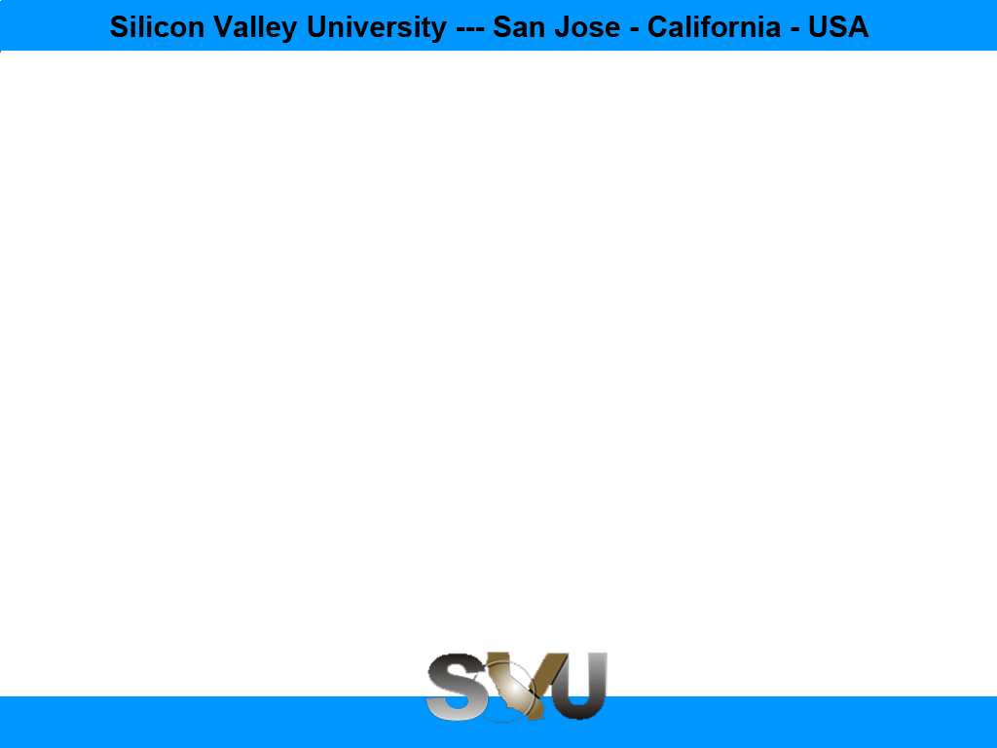
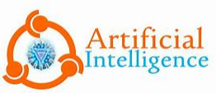
AI with Python Chapter 1: AI Introduction
Peter H. Chen, PhDCS/EE

Slide 2

1 AI Introduction

Slide 3

1 AI Introduction
Introduction
https://www.tutorialspoint.com/artificial_intelligence_with_python/index.htm
Artificial intelligence is the intelligence demonstrated by machines, in contrast to the intelligence displayed by humans.
This tutorial covers the basic concepts of various fields of artificial intelligence like Artificial Neural Networks, Natural Language Processing, Machine Learning, Deep Learning, Genetic algorithms etc., and its implementation in Python.
We assume that the reader has basic knowledge about Artificial Intelligence and Python programming. He/she should be aware about basic terminologies used in AI along with some useful python packages like nltk, OpenCV, pandas, OpenAI Gym, etc.
Python with AI - CS596

Slide 4

END of CHAPTER

