Slide 1


AI with Python Chapter 5: Data Preparation
Peter H. Chen, PhDCS/EE

Slide 2

5 Data Preparation

Slide 3

5 Data Preparation
Introduction
https://www.tutorialspoint.com/artificial_intelligence_with_python/artificial_intelligence_with_python_data_preparation.htm
We have already studied supervised as well as unsupervised machine learning algorithms.
These algorithms require formatted data to start the training process.
We must prepare or format data in a certain way so that it can be supplied as an input to ML algorithms.
This chapter focuses on data preparation for machine learning algorithms.
AI with Python - CS596

Slide 4
5.1 Data Preprocessing

Slide 5
5.1 Data Preprocessing
Introduction
https://www.tutorialspoint.com/artificial_intelligence_with_python/artificial_intelligence_with_python_data_preparation.htm
In our daily life, we deal with lots of data but this data is in raw form.
To provide the data as the input of machine learning algorithms, we need to convert it into a meaningful data.
That is where data preprocessing comes into picture.
In other simple words, we can say that before providing the data to the machine learning algorithms we need to preprocess the data.
AI with Python - CS596

Slide 6
5.1 Data Preprocessing
Introduction
https://www.tutorialspoint.com/artificial_intelligence_with_python/artificial_intelligence_with_python_data_preparation.htm
Data preprocessing steps
Follow these steps to preprocess the data in Python −
Step 1 − Importing the useful packages − If we are using Python then this would be the first step for converting the data into a certain format, i.e., preprocessing. It can be done as follows
C:\ > pip3 install numpy # for numpy
C:\ > pip3 install scikit-learn # for sklearn
C:\> pip3 install scipy # from scipy in sklearn
C:\> python
>>> import numpy as np # np is an alias pointing to numpy
>>> from sklearn import preprocessing
AI with Python - CS596

Slide 7
5.1 Data Preprocessing
Introduction
https://www.tutorialspoint.com/artificial_intelligence_with_python/artificial_intelligence_with_python_data_preparation.htm
Here we have used the following two packages −
NumPy − Basically NumPy is a general purpose array-processing package designed to efficiently manipulate large multi-dimensional arrays of arbitrary records without sacrificing too much speed for small multi-dimensional arrays.
Sklearn.preprocessing − This package provides many common utility functions and transformer classes to change raw feature vectors into a representation that is more suitable for machine learning algorithms.
Step 2 − Defining sample data − After importing the packages, we need to define some sample data so that we can apply preprocessing techniques on that data.
AI with Python - CS596

Slide 8
5.1 Data Preprocessing
Introduction
https://www.tutorialspoint.com/artificial_intelligence_with_python/artificial_intelligence_with_python_data_preparation.htm
We will now define the following sample data
input_data = np.array([[2.1, -1.9, 5.5],
[-1.5, 2.4, 3.5],
[0.5, -7.9, 5.6],
[5.9, 2.3, -5.8]])
Step3 − Applying preprocessing technique − In this step, we need to apply any of the preprocessing techniques.
The following section describes the data preprocessing techniques.
AI with Python - CS596

Slide 9
5.2 Technique for Data Preprocessing

Slide 10
5.2 Technique for Data Preprocessing
Introduction
https://www.tutorialspoint.com/artificial_intelligence_with_python/artificial_intelligence_with_python_data_preparation.htm
The python code:
ch05.py
import numpy as np # np is an alias pointing to numpy
from sklearn import preprocessing
input_data = np.array(
[[2.1, -1.9, 5.5],
[-1.5, 2.4, 3.5],
[0.5, -7.9, 5.6],
[5.9, 2.3, -5.8]])
data_binarized = preprocessing.Binarizer(threshold = 0.5).transform(input_data)
print("\nBinarized data:\n", data_binarized)
AI with Python - CS596

Slide 11
5.2 Technique for Data Preprocessing
Introduction
https://www.tutorialspoint.com/artificial_intelligence_with_python/artificial_intelligence_with_python_data_preparation.htm
The techniques for data preprocessing are described below −
Binarization
This is the preprocessing technique which is used when we need to convert our numerical values into Boolean values.
We can use an inbuilt method to binarize the input data say by using 0.5 as the threshold value in the following way
data_binarized = preprocessing.Binarizer(threshold = 0.5).transform(input_data)
print("\nBinarized data:\n", data_binarized)
AI with Python - CS596

Slide 12
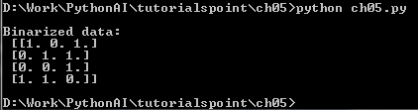
5.2 Technique for Data Preprocessing
Introduction
https://www.tutorialspoint.com/artificial_intelligence_with_python/artificial_intelligence_with_python_data_preparation.htm
Now, after running the above code we will get the following output, all the values above 0.5 (threshold value) would be converted to 1 and all the values below 0.5 would be converted to 0.
AI with Python - CS596

Slide 13
5.2 Technique for Data Preprocessing
Introduction
https://www.tutorialspoint.com/artificial_intelligence_with_python/artificial_intelligence_with_python_data_preparation.htm
Mean Removal
It is another very common preprocessing technique that is used in machine learning.
Basically it is used to eliminate the mean from feature vector so that every feature is centered on zero.
We can also remove the bias from the features in the feature vector. For applying mean removal preprocessing technique on the sample data, we can write the Python code shown below.
The code will display the Mean and Standard deviation of the input data
print("Mean = ", input_data.mean(axis = 0))
print("Std deviation = ", input_data.std(axis = 0))
AI with Python - CS596

Slide 14
5.2 Technique for Data Preprocessing
Introduction
https://www.tutorialspoint.com/artificial_intelligence_with_python/artificial_intelligence_with_python_data_preparation.htm
We will get the following output after running the above lines of code
Data_scaled Mean = [ 1.11022302e-16 0.00000000e+00 0.00000000e+00]
Data_scaled Std deviation = [ 1. 1. 1.]
AI with Python - CS596

Slide 15
5.2 Technique for Data Preprocessing
Introduction
https://www.tutorialspoint.com/artificial_intelligence_with_python/artificial_intelligence_with_python_data_preparation.htm
Scaling
It is another data preprocessing technique that is used to scale the feature vectors.
Scaling of feature vectors is needed because the values of every feature can vary between many random values.
In other words we can say that scaling is important because we do not want any feature to be synthetically large or small.
With the help of the following Python code, we can do the scaling of our input data, i.e., feature vector −
# Min max scaling
data_scaler_minmax = preprocessing.MinMaxScaler(feature_range=(0,1)) data_scaled_minmax = data_scaler_minmax.fit_transform(input_data)
print ("\nMin max scaled data:\n", data_scaled_minmax)
AI with Python - CS596

Slide 16
5.2 Technique for Data Preprocessing
Introduction
https://www.tutorialspoint.com/artificial_intelligence_with_python/artificial_intelligence_with_python_data_preparation.htm
We will get the following output after running the above lines of code −
Min max scaled data
[ [ 0.48648649 0.58252427 0.99122807]
[ 0. 1. 0.81578947]
[ 0.27027027 0. 1. ]
[ 1. 0. 99029126 0. ]]
AI with Python - CS596

Slide 17
5.2 Technique for Data Preprocessing
Introduction
https://www.tutorialspoint.com/artificial_intelligence_with_python/artificial_intelligence_with_python_data_preparation.htm
Normalization
It is another data preprocessing technique that is used to modify the feature vectors.
Such kind of modification is necessary to measure the feature vectors on a common scale.
Followings are two types of normalization which can be used in machine learning −
L1 Normalization
It is also referred to as Least Absolute Deviations.
This kind of normalization modifies the values so that the sum of the absolute values is always up to 1 in each row.
It can be implemented on the input data with the help of the following Python code:
# Normalize data
data_normalized_l1 = preprocessing.normalize(input_data, norm = ‘l1')
print("\nL1 normalized data:\n", data_normalized_l1)
AI with Python - CS596

Slide 18
5.2 Technique for Data Preprocessing
Introduction
https://www.tutorialspoint.com/artificial_intelligence_with_python/artificial_intelligence_with_python_data_preparation.htm
The above line of code generates the following output &miuns;
L1 normalized data:
[[ 0.22105263 -0.2 0.57894737]
[ -0.2027027 0.32432432 0.47297297]
[ 0.03571429 -0.56428571 0.4 ]
[ 0.42142857 0.16428571 -0.41428571]]
AI with Python - CS596

Slide 19
5.2 Technique for Data Preprocessing
Introduction
https://www.tutorialspoint.com/artificial_intelligence_with_python/artificial_intelligence_with_python_data_preparation.htm
L2 Normalization
It is also referred to as least squares.
This kind of normalization modifies the values so that the sum of the squares is always up to 1 in each row.
It can be implemented on the input data with the help of the following Python code
# Normalize data
data_normalized_l2 = preprocessing.normalize(input_data, norm = 'l2')
print("\nL2 normalized data:\n", data_normalized_l2)
AI with Python - CS596

Slide 20
5.3 Labeling the Data

Slide 21
5.3 Labeling the Data
Introduction
https://www.tutorialspoint.com/artificial_intelligence_with_python/artificial_intelligence_with_python_data_preparation.htm
We already know that data in a certain format is necessary for machine learning algorithms.
Another important requirement is that the data must be labeled (names must converted into number for fast processing) properly before sending it as the input of machine learning algorithms.
For example, if we talk about classification, there are lot of labels on the data.
Those labels are in the form of words, numbers, etc. Functions related to machine learning in sklearn expect that the data must have number labels.
Hence, if the data is in other form then it must be converted to numbers.
This process of transforming the word labels into numerical form is called label encoding.
Label encoding steps
Follow these steps for encoding the data labels in Python −
Step1 − Importing the useful packages
If we are using Python then this would be first step for converting the data into certain format, i.e., preprocessing. It can be done as follows
import numpy as np
from sklearn import preprocessing
AI with Python - CS596

Slide 22
5.3 Labeling the Data
Introduction
https://www.tutorialspoint.com/artificial_intelligence_with_python/artificial_intelligence_with_python_data_preparation.htm
Step 2 − Defining sample labels
After importing the packages, we need to define some sample labels so that we can create and train the label encoder. We will now define the following sample labels
# Sample input labels
input_labels = ['red','black','red','green','black','yellow','white']
Step 3 − Creating & training of label encoder object
In this step, we need to create the label encoder and train it. The following Python code will help in doing this
# Creating the label encoder
encoder = preprocessing.LabelEncoder()
encoder.fit(input_labels)
AI with Python - CS596

Slide 23
5.3 Labeling the Data
Introduction
https://www.tutorialspoint.com/artificial_intelligence_with_python/artificial_intelligence_with_python_data_preparation.htm
Following would be the output after running the above Python code
LabelEncoder()
Step4 − Checking the performance by encoding random ordered list
This step can be used to check the performance by encoding the random ordered list.
Following Python code can be written to do the same
# encoding a set of labels
test_labels = ['green','red','black']
encoded_values = encoder.transform(test_labels)
print("\nLabels =", test_labels)
The labels would get printed as follows
Labels = ['green', 'red', 'black']
AI with Python - CS596

Slide 24
5.3 Labeling the Data
Introduction
https://www.tutorialspoint.com/artificial_intelligence_with_python/artificial_intelligence_with_python_data_preparation.htm
Now, we can get the list of encoded values i.e. word labels converted to numbers as follows
print("Encoded values =", list(encoded_values))
The encoded values would get printed as follows
Encoded values = [1, 2, 0]
Step 5 − Check decode a set of numbers into encode label−
This step can be used to check the performance by decoding the random set of numbers.
Following Python code can be written to do the same
# decoding a set of values
encoded_values = [3,0,4,1]
decoded_list = encoder.inverse_transform(encoded_values)
print("\nEncoded values =", encoded_values)
AI with Python - CS596

Slide 25
5.3 Labeling the Data
Introduction
https://www.tutorialspoint.com/artificial_intelligence_with_python/artificial_intelligence_with_python_data_preparation.htm
Now, Encoded values would get printed as follows
print("Encoded values =", list(encoded_values))
Now, decoded values would get printed as follows
Decoded labels = ['white', 'black', 'yellow', 'green']
AI with Python - CS596

Slide 26
5.3 Labeling the Data
Introduction
https://www.tutorialspoint.com/artificial_intelligence_with_python/artificial_intelligence_with_python_data_preparation.htm
Labeled v/s Unlabeled Data
Unlabeled data mainly consists of the samples of natural or human-created object that can easily be obtained from the world. Those include, audio, video, photos, news articles, etc.
On the other hand, labeled data takes a set of unlabeled data and augments each piece of that unlabeled data with some tag or label or class that is meaningful.
For example, if we have a photo then the label can be put based on the content of the photo, i.e., it is photo of a boy or girl or animal or anything else.
Labeling the data needs human expertise or judgment about a given piece of unlabeled data.
There are many scenarios where unlabeled data is plentiful and easily obtained but labeled data often requires a human/expert to annotate.
Semi-supervised learning attempts to combine labeled and unlabeled data to build better models.
AI with Python - CS596

Slide 27
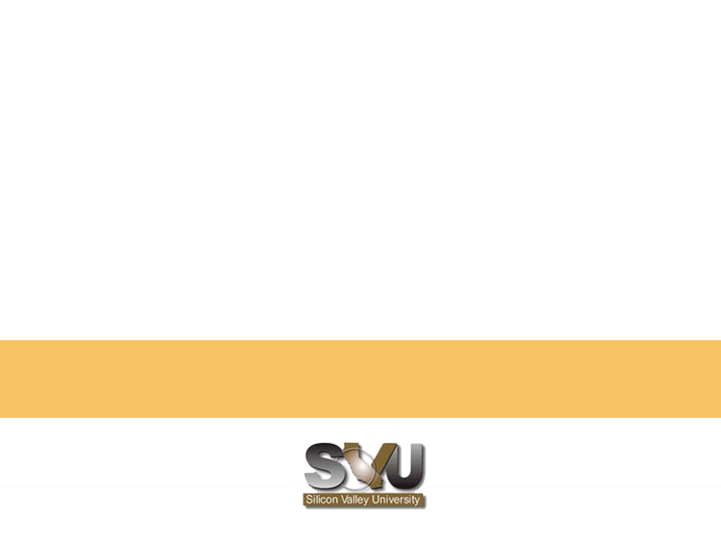
END of CHAPTER

