Slide 1


AI with Python Chapter 7: Supervised Learning Regression
Peter H. Chen, PhDCS/EE

Slide 2

7 Supervised Learning Regression

Slide 3

7 Supervised Learning Regression
Introduction
https://www.tutorialspoint.com/artificial_intelligence_with_python/artificial_intelligence_with_python_supervised_learning_regression.htm
Regression is one of the most important statistical and machine learning tools.
We would not be wrong to say that the journey of machine learning starts from regression.
It may be defined as the parametric technique that allows us to make decisions based upon data or in other words allows us to make predictions based upon data by learning the relationship between input and output variables.
Here, the output variables dependent on the input variables, are continuous-valued real numbers.
In regression, the relationship between input and output variables matters and it helps us in understanding how the value of the output variable changes with the change of input variable.
Regression is frequently used for prediction of prices, economics, variations, and so on.
AI with Python - CS596

Slide 4
7.1 Building Regressors in Python

Slide 5
7.1 Building Regressors in Python
Introduction
http://scikit-learn.org/stable/auto_examples/linear_model/plot_ols.html
This example uses the only the first feature of the diabetes dataset, in order to illustrate a two-dimensional plot of this regression technique.
The straight line can be seen in the plot, showing how linear regression attempts to draw a straight line that will best minimize the residual sum of squares between the observed responses in the dataset, and the responses predicted by the linear approximation.
The coefficients, the residual sum of squares and the variance score are also calculated.
AI with Python - CS596

Slide 6
7.1 Building Regressors in Python
Introduction
http://scikit-learn.org/stable/auto_examples/linear_model/plot_ols.html
Code (1):
import matplotlib.pyplot as plt
import numpy as np
from sklearn import datasets, linear_model
from sklearn.metrics import mean_squared_error, r2_score
# Load the diabetes dataset
diabetes = datasets.load_diabetes()
# Use only one feature
diabetes_X = diabetes.data[:, np.newaxis, 2]
# Split the data into training/testing sets
diabetes_X_train = diabetes_X[:-20]
diabetes_X_test = diabetes_X[-20:]
# Split the targets into training/testing sets
diabetes_y_train = diabetes.target[:-20]
diabetes_y_test = diabetes.target[-20:]
# Create linear regression object
regr = linear_model.LinearRegression()
# Train the model using the training sets
regr.fit(diabetes_X_train, diabetes_y_train)
AI with Python - CS596

Slide 7
7.1 Building Regressors in Python
Introduction
http://scikit-learn.org/stable/auto_examples/linear_model/plot_ols.html
Code (2):
# Make predictions using the testing set
diabetes_y_pred = regr.predict(diabetes_X_test)
# The coefficients
print('Coefficients: \n', regr.coef_)
# The mean squared error
print("Mean squared error: %.2f"
% mean_squared_error(diabetes_y_test, diabetes_y_pred))
# Explained variance score: 1 is perfect prediction
print('Variance score: %.2f' % r2_score(diabetes_y_test, diabetes_y_pred))
# Plot outputs
plt.scatter(diabetes_X_test, diabetes_y_test, color='black')
plt.plot(diabetes_X_test, diabetes_y_pred, color='blue', linewidth=3)
plt.xticks(())
plt.yticks(())
plt.show()
AI with Python - CS596

Slide 8
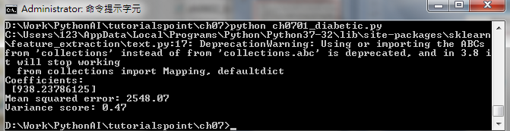
7.1 Building Regressors in Python
Introduction
http://scikit-learn.org/stable/auto_examples/linear_model/plot_ols.html
Output:
AI with Python - CS596

Slide 9
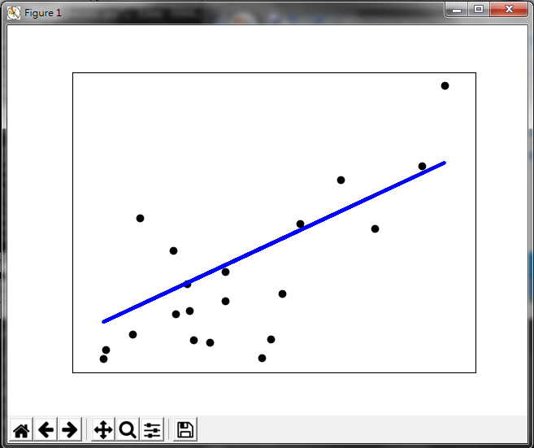
7.1 Building Regressors in Python
Introduction
http://scikit-learn.org/stable/auto_examples/linear_model/plot_ols.html
Result:
AI with Python - CS596

Slide 10
7.2 Building Multiple Regressors

Slide 11
7.2 Building Multiple Regressors in Python
Introduction
http://www.scipy-lectures.org/packages/statistics/auto_examples/plot_regression_3d.html
This example uses the only the first feature of the diabetes dataset, in order to illustrate a two-dimensional plot of this regression technique.
The straight line can be seen in the plot, showing how linear regression attempts to draw a straight line that will best minimize the residual sum of squares between the observed responses in the dataset, and the responses predicted by the linear approximation.
The coefficients, the residual sum of squares and the variance score are also calculated.
AI with Python - CS596

Slide 12
7.2 Building Multiple Regressors in Python
Introduction
http://www.scipy-lectures.org/packages/statistics/auto_examples/plot_regression_3d.html
Code (1):
import numpy as np
import matplotlib.pyplot as plt
import pandas
# For 3d plots. This import is necessary to have 3D plotting below
from mpl_toolkits.mplot3d import Axes3D
# For statistics. Requires statsmodels 5.0 or more
from statsmodels.formula.api import ols
# Analysis of Variance (ANOVA) on linear models
from statsmodels.stats.anova import anova_lm
# Generate and show the data
x = np.linspace(-5, 5, 21)
# We generate a 2D grid
X, Y = np.meshgrid(x, x)
AI with Python - CS596

Slide 13
7.2 Building Multiple Regressors in Python
Introduction
http://www.scipy-lectures.org/packages/statistics/auto_examples/plot_regression_3d.html
Code (2):
# To get reproducable values, provide a seed value
np.random.seed(1)
# Z is the elevation of this 2D grid
Z = -5 + 3*X - 0.5*Y + 8 * np.random.normal(size=X.shape)
# Plot the data
fig = plt.figure()
ax = fig.gca(projection='3d')
surf = ax.plot_surface(X, Y, Z, cmap=plt.cm.coolwarm,
rstride=1, cstride=1)
ax.view_init(20, -120)
ax.set_xlabel('X')
ax.set_ylabel('Y')
ax.set_zlabel('Z')
plt.show()
AI with Python - CS596

Slide 14
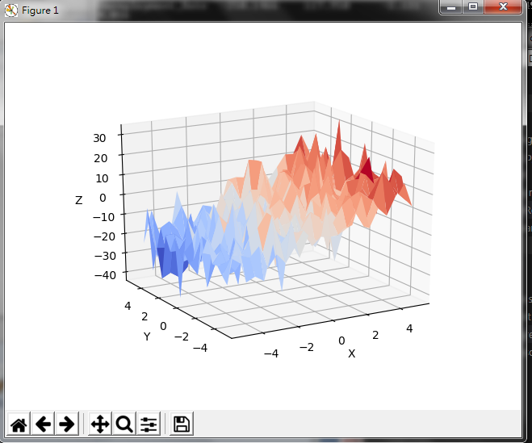
7.2 Building Multiple Regressors in Python
Introduction
http://www.scipy-lectures.org/packages/statistics/auto_examples/plot_regression_3d.html
Result
AI with Python - CS596

Slide 15

END of CHAPTER

