Slide 1


AI with Python Chapter 9: Supervised Learning: Clustering
Peter H. Chen, PhDCS/EE

Slide 2

9 Unsupervised Learning: Clustering

Slide 3

9 Unsupervised Learning: CLustering
Introduction
https://www.tutorialspoint.com/artificial_intelligence_with_python/artificial_intelligence_with_python_unsupervised_learning_clustering.htm
Unsupervised machine learning algorithms do not have any supervisor to provide any sort of guidance.
That is why they are closely aligned with what some call true artificial intelligence.
In unsupervised learning, there would be no correct answer and no teacher for the guidance.
Algorithms need to discover the interesting pattern in data for learning.
AI with Python - CS596

Slide 4
9 Unsupervised Learning: CLustering
Introduction
https://www.tutorialspoint.com/artificial_intelligence_with_python/artificial_intelligence_with_python_unsupervised_learning_clustering.htm
What is Clustering?
Clustering is a type of unsupervised learning method and a common technique for statistical data analysis used in many fields.
Clustering mainly is a task of dividing the set of observations into subsets, called clusters, in such a way that observations in the same cluster are similar in one sense and they are dissimilar to the observations in other clusters.
In simple words, we can say that the main goal of clustering is to group the data on the basis of similarity and dissimilarity.
AI with Python - CS596

Slide 5
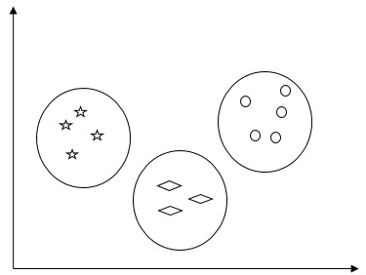
9 Unsupervised Learning: Clustering
Introduction
https://www.tutorialspoint.com/artificial_intelligence_with_python/artificial_intelligence_with_python_unsupervised_learning_clustering.htm
For example, the following diagram shows similar kind of data in different clusters
AI with Python - CS596

Slide 6
9.1 K-Mean Algorithm

Slide 7
9.1 K-Mean Algorithm
Introduction
https://www.tutorialspoint.com/artificial_intelligence_with_python/artificial_intelligence_with_python_unsupervised_learning_clustering.htm
Following are a few common algorithms for clustering the data −
K-Means algorithm
K-means clustering algorithm is one of the well-known algorithms for clustering the data.
We need to assume that the numbers of clusters are already known.
This is also called flat clustering.
It is an iterative clustering algorithm.
C:\> pip3 install seaborn
AI with Python - CS596

Slide 8
9.1 K-Mean Algorithm
Introduction
https://www.tutorialspoint.com/artificial_intelligence_with_python/artificial_intelligence_with_python_unsupervised_learning_clustering.htm
The steps given below need to be followed for this algorithm
Step 1 − We need to specify the desired number of K subgroups.
Step 2 − Fix the number of clusters and randomly assign each data point to a cluster. Or in other words we need to classify our data based on the number of clusters.
In this step, cluster centroids should be computed.
As this is an iterative algorithm, we need to update the locations of K centroids with every iteration until we find the global optima or in other words the centroids reach at their optimal locations.
The following code will help in implementing K-means clustering algorithm in Python.
AI with Python - CS596

Slide 9
9.1 K-Mean Algorithm
Introduction
https://www.tutorialspoint.com/artificial_intelligence_with_python/artificial_intelligence_with_python_unsupervised_learning_clustering.htm
We are going to use the Scikit-learn module.
Let us import the necessary packages:
import matplotlib.pyplot as plt
import seaborn as sns; sns.set()
import numpy as np
from sklearn.cluster import KMeans
The following line of code will help in generating the two-dimensional dataset, containing four blobs, by using make_blob from the sklearn.dataset package.
from sklearn.datasets.samples_generator import make_blobs
X, y_true = make_blobs(n_samples = 500, centers = 4, cluster_std = 0.40, random_state = 0)
AI with Python - CS596

Slide 10
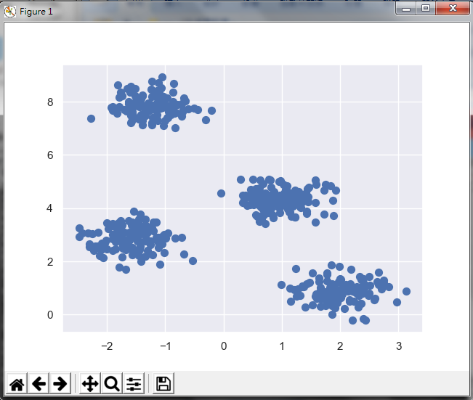
9.1 K-Mean Algorithm
Introduction
https://www.tutorialspoint.com/artificial_intelligence_with_python/artificial_intelligence_with_python_unsupervised_learning_clustering.htm
We can visualize the dataset by using the following code
plt.scatter(X[:, 0], X[:, 1], s = 50);
plt.show()
AI with Python - CS596

Slide 11
9.1 K-Mean Algorithm
Introduction
https://www.tutorialspoint.com/artificial_intelligence_with_python/artificial_intelligence_with_python_unsupervised_learning_clustering.htm
Here, we are initializing kmeans to be the KMeans algorithm, with the required parameter of how many clusters (n_clusters).
kmeans = KMeans(n_clusters = 4)
We need to train the K-means model with the input data.
kmeans.fit(X)
y_kmeans = kmeans.predict(X)
plt.scatter(X[:, 0], X[:, 1], c = y_kmeans, s = 50, cmap = 'viridis')
centers = kmeans.cluster_centers_
AI with Python - CS596

Slide 12
9.1 K-Mean Algorithm
Introduction
https://www.tutorialspoint.com/artificial_intelligence_with_python/artificial_intelligence_with_python_unsupervised_learning_clustering.htm
The code given below will help us plot and visualize the machine's findings based on our data, and the fitment according to the number of clusters that are to be found.
plt.scatter(centers[:, 0], centers[:, 1], c = 'black', s = 200, alpha = 0.5);
plt.show()
AI with Python - CS596

Slide 13
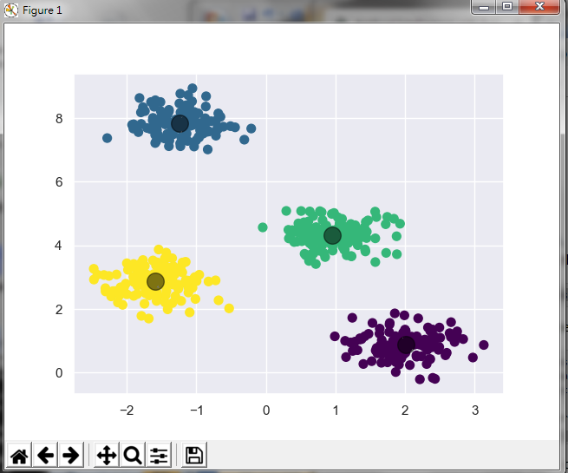
9.1 K-Mean Algorithm
Introduction
https://www.tutorialspoint.com/artificial_intelligence_with_python/artificial_intelligence_with_python_unsupervised_learning_clustering.htm
The code given below will help us plot and visualize the machine's findings based on our data, and the fitment according to the number of clusters that are to be found.
plt.scatter(centers[:, 0], centers[:, 1], c = 'black', s = 200, alpha = 0.5);
plt.show()
AI with Python - CS596

Slide 14
9.1 K-Mean Algorithm
Introduction
https://www.tutorialspoint.com/artificial_intelligence_with_python/artificial_intelligence_with_python_unsupervised_learning_clustering.htm
Following are a few common algorithms for clustering the data :
AI with Python - CS596

Slide 15
9.2 Mean Shift Algorithm

Slide 16
9.2 Mean Shift Algorithm
Introduction
https://www.tutorialspoint.com/artificial_intelligence_with_python/artificial_intelligence_with_python_unsupervised_learning_clustering.htm
It is another popular and powerful clustering algorithm used in unsupervised learning.
It does not make any assumptions hence it is a non-parametric algorithm.
It is also called hierarchical clustering or mean shift cluster analysis.
Followings would be the basic steps of this algorithm −
First of all, we need to start with the data points assigned to a cluster of their own.
Now, it computes the centroids and update the location of new centroids.
By repeating this process, we move closer the peak of cluster i.e. towards the region of higher density.
This algorithm stops at the stage where centroids do not move anymore.
With the help of following code we are implementing Mean Shift clustering algorithm in Python.
We are going to use Scikit-learn module.
Let us import the necessary packages
AI with Python - CS596

Slide 17
9.2 Mean Shift Algorithm
Introduction
https://www.tutorialspoint.com/artificial_intelligence_with_python/artificial_intelligence_with_python_unsupervised_learning_clustering.htm
Let us import the necessary packages
import numpy as np
from sklearn.cluster import MeanShift
import matplotlib.pyplot as plt
from matplotlib import style
style.use("ggplot")
AI with Python - CS596

Slide 18
9.2 Mean Shift Algorithm
Introduction
https://www.tutorialspoint.com/artificial_intelligence_with_python/artificial_intelligence_with_python_unsupervised_learning_clustering.htm
The following code will help in generating the two-dimensional dataset, containing three blobs, by using make_blob from the sklearn.dataset package.
from sklearn.datasets.samples_generator import make_blobs
We can visualize the dataset with the following code
# plot
centers = [[2,2],[4,5],[3,10]]
X, _ = make_blobs(n_samples = 500, centers = centers, cluster_std = 1)
plt.scatter(X[:,0],X[:,1])
plt.show()
AI with Python - CS596

Slide 19
9.2 Mean Shift Algorithm
Introduction
https://www.tutorialspoint.com/artificial_intelligence_with_python/artificial_intelligence_with_python_unsupervised_learning_clustering.htm
Now, we need to train the Mean Shift cluster model with the input data.
ms = MeanShift()
ms.fit(X)
labels = ms.labels_
cluster_centers = ms.cluster_centers_
The following code will print the cluster centers and the expected number of cluster as per the input data
print(cluster_centers)
n_clusters_ = len(np.unique(labels))
print("Estimated clusters:", n_clusters_)
AI with Python - CS596

Slide 20
9.2 Mean Shift Algorithm
Introduction
https://www.tutorialspoint.com/artificial_intelligence_with_python/artificial_intelligence_with_python_unsupervised_learning_clustering.htm
The code given below will help plot and visualize the machine's findings based on our data, and the fitment according to the number of clusters that are to be found.
colors = 10*['r.','g.','b.','c.','k.','y.','m.']
for i in range(len(X)):
plt.plot(X[i][0], X[i][1], colors[labels[i]], markersize = 10)
plt.scatter(cluster_centers[:,0],cluster_centers[:,1],
marker = "x",color = 'k', s = 150, linewidths = 5, zorder = 10)
plt.show()
AI with Python - CS596

Slide 21
9.2 Mean Shift Algorithm
Introduction
https://www.tutorialspoint.com/artificial_intelligence_with_python/artificial_intelligence_with_python_unsupervised_learning_clustering.htm
Code (1):
import numpy as np
from sklearn.cluster import MeanShift
import matplotlib.pyplot as plt
from matplotlib import style
style.use("ggplot")
# 2D-dataset
from sklearn.datasets.samples_generator import make_blobs
# plot
centers = [[2,2],[4,5],[3,10]]
X, _ = make_blobs(n_samples = 500, centers = centers, cluster_std = 1)
plt.scatter(X[:,0],X[:,1])
plt.show()
# train the mean shift model with input data
ms = MeanShift()
ms.fit(X)
labels = ms.labels_
cluster_centers = ms.cluster_centers_
AI with Python - CS596

Slide 22
9.2 Mean Shift Algorithm
Introduction
https://www.tutorialspoint.com/artificial_intelligence_with_python/artificial_intelligence_with_python_unsupervised_learning_clustering.htm
Code (2):
# print the cluster centers
print(cluster_centers)
n_clusters_ = len(np.unique(labels))
print("Estimated clusters:", n_clusters_)
# Plot centroids
colors = 10*['r.','g.','b.','c.','k.','y.','m.']
for i in range(len(X)):
plt.plot(X[i][0], X[i][1], colors[labels[i]], markersize = 10)
plt.scatter(cluster_centers[:,0],cluster_centers[:,1],
marker = "x",color = 'k', s = 150, linewidths = 5, zorder = 10)
plt.show()
AI with Python - CS596

Slide 23
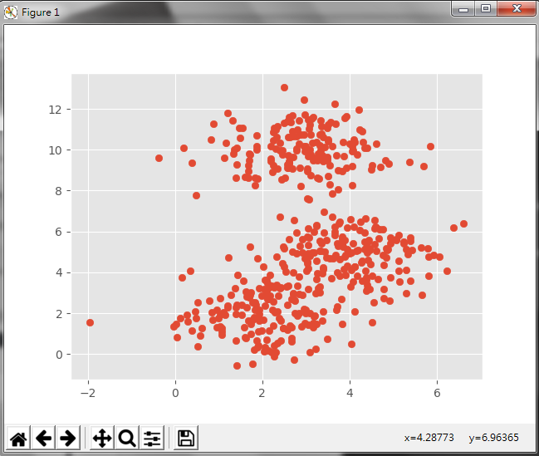
9.2 Mean Shift Algorithm
Introduction
https://www.tutorialspoint.com/artificial_intelligence_with_python/artificial_intelligence_with_python_unsupervised_learning_clustering.htm
Visualize the dataset.
AI with Python - CS596

Slide 24
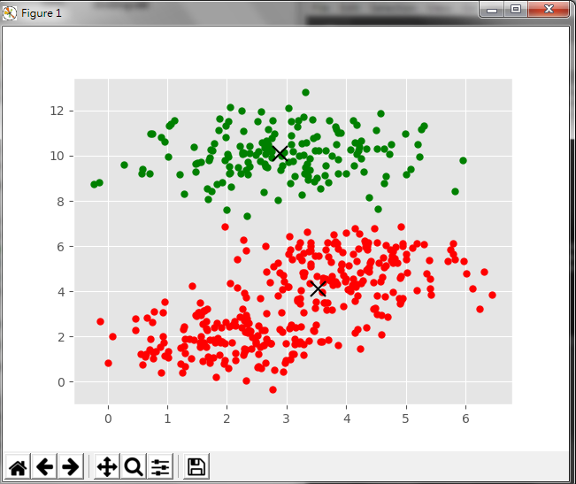
9.2 Mean Shift Algorithm
Introduction
https://www.tutorialspoint.com/artificial_intelligence_with_python/artificial_intelligence_with_python_unsupervised_learning_clustering.htm
Plot Centroids of Mean Shift
AI with Python - CS596

Slide 25
9.3 Measure Cluster Performance

Slide 26
9.3 Measure Cluster Performance
Introduction
https://www.tutorialspoint.com/artificial_intelligence_with_python/artificial_intelligence_with_python_unsupervised_learning_clustering.htm
The real world data is not naturally organized into number of distinctive clusters.
Due to this reason, it is not easy to visualize and draw inferences.
That is why we need to measure the clustering performance as well as its quality.
It can be done with the help of silhouette analysis.
Silhouette Analysis
This method can be used to check the quality of clustering by measuring the distance between the clusters.
Basically, it provides a way to assess the parameters like number of clusters by giving a silhouette score.
This score is a metric that measures how close each point in one cluster is to the points in the neighboring clusters.
AI with Python - CS596

Slide 27
9.3 Measure Cluster Performance
Introduction
https://www.tutorialspoint.com/artificial_intelligence_with_python/artificial_intelligence_with_python_unsupervised_learning_clustering.htm
Analysis of silhouette score
The score has a range of [-1, 1].
Following is the analysis of this score.
Score of +1: Score near +1 indicates that the sample is far away from the neighboring cluster.
Score of 0: Score 0 indicates that the sample is on or very close to the decision boundary between two neighboring clusters.
Score of -1: Negative score indicates that the samples have been assigned to the wrong clusters.
AI with Python - CS596

Slide 28

9.3 Measure Cluster Performance
Introduction
https://www.tutorialspoint.com/artificial_intelligence_with_python/artificial_intelligence_with_python_unsupervised_learning_clustering.htm
Calculating Silhouette Score
In this section, we will learn how to calculate the silhouette score.
Silhouette score can be calculated by using the following formula −
Here, 𝑝 is the mean distance to the points in the nearest cluster that the data point is not a part of.
And, 𝑞 is the mean intra-cluster distance to all the points in its own cluster.
For finding the optimal number of clusters, we need to run the clustering algorithm again by importing the metrics module from the sklearn package.
In the following example, we will run the K-means clustering algorithm to find the optimal number of clusters:
Import the necessary packages as shown
AI with Python - CS596

Slide 29
9.3 Measure Cluster Performance
Introduction
https://www.tutorialspoint.com/artificial_intelligence_with_python/artificial_intelligence_with_python_unsupervised_learning_clustering.htm
For finding the optimal number of clusters, we need to run the clustering algorithm again by importing the metrics module from the sklearn package.
In the following example, we will run the K-means clustering algorithm to find the optimal number of clusters
Install the packages:
C:\> pip3 install Kmeans
C:\> pip3 install metrics
Import the necessary packages as shown
import matplotlib.pyplot as plt
import seaborn as sns; sns.set()
import numpy as np
from sklearn.cluster import Kmeans # pip3 install KMeans
from sklearn import metrics # pip3 install metrics
AI with Python - CS596

Slide 30
9.3 Measure Cluster Performance
Introduction
https://www.tutorialspoint.com/artificial_intelligence_with_python/artificial_intelligence_with_python_unsupervised_learning_clustering.htm
Generate the two-dimensional dataset, containing four blobs, by using make_blob from the sklearn.dataset package.
from sklearn.datasets.samples_generator import make_blobs
X, y_true = \
make_blobs(n_samples = 500, centers = 4, cluster_std = 0.40, random_state = 0)
Initialize the variables as shown. Cluster number are 2 … 10.
scores = []
values = np.arange(2, 10)
AI with Python - CS596

Slide 31
9.3 Measure Cluster Performance
Introduction
https://www.tutorialspoint.com/artificial_intelligence_with_python/artificial_intelligence_with_python_unsupervised_learning_clustering.htm
We need to iterate the K-means model through all the values and also need to train it with the input data.
for num_clusters in values:
kmeans = KMeans(init = 'k-means++', n_clusters = num_clusters, n_init = 10)
kmeans.fit(X)
Now, estimate the silhouette score for the current clustering model using the Euclidean distance metric
score = metrics.silhouette_score(X, kmeans.labels_, \
metric = 'euclidean', sample_size = len(X))
AI with Python - CS596

Slide 32
9.3 Measure Cluster Performance
Introduction
https://www.tutorialspoint.com/artificial_intelligence_with_python/artificial_intelligence_with_python_unsupervised_learning_clustering.htm
The following line of code will help in displaying the number of clusters as well as Silhouette score.
print("\nNumber of clusters =", num_clusters)
print("Silhouette score =", score)
scores.append(score)
You will receive the following output.
Number of clusters = 9 Silhouette score = 0.340391138371
AI with Python - CS596

Slide 33
9.3 Measure Cluster Performance
Introduction
https://www.tutorialspoint.com/artificial_intelligence_with_python/artificial_intelligence_with_python_unsupervised_learning_clustering.htm
Print the Optimal cluster number.
num_clusters = np.argmax(scores) + values[0]
print('\nOptimal number of clusters =', num_clusters)
Now, the output for optimal number of clusters would be as follows
Optimal number of clusters = 2
AI with Python - CS596

Slide 34
9.3 Measure Cluster Performance
Introduction
https://www.tutorialspoint.com/artificial_intelligence_with_python/artificial_intelligence_with_python_unsupervised_learning_clustering.htm
Code (1):
import matplotlib.pyplot as plt
import seaborn as sns; sns.set()
import numpy as np
from sklearn.cluster import KMeans # pip3 install KMeans
from sklearn import metrics # pip3 install metrics
# genrate 4-clusters
from sklearn.datasets.samples_generator import make_blobs
X, y_true = \
make_blobs(n_samples = 500, centers = 4, cluster_std = 0.40, random_state = 0)
# Initialized the score.
scores = []
values = np.arange(2, 10)
for num_clusters in values:
kmeans = KMeans(init = 'k-means++', n_clusters = num_clusters, n_init = 10)
kmeans.fit(X)
AI with Python - CS596

Slide 35
9.3 Measure Cluster Performance
Introduction
https://www.tutorialspoint.com/artificial_intelligence_with_python/artificial_intelligence_with_python_unsupervised_learning_clustering.htm
Code (2):
score = metrics.silhouette_score(X, kmeans.labels_, \
metric = 'euclidean', sample_size = len(X))
# print number of clusters
print("\nNumber of clusters =", num_clusters)
print("Silhouette scores =", score)
scores.append(score)
print ('scores: ', scores)
# Get optimal number of cluster
num_clusters = np.argmax(scores) + values[0]
print('\nnp.argmax(scores) =', np.argmax(scores))
print('\nnp.argmax(scores) =', values[0])
print('\nOptimal number of clusters =', num_clusters)
AI with Python - CS596

Slide 36
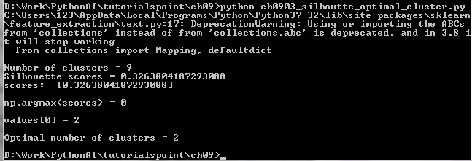
9.3 Measure Cluster Performance
Introduction
https://www.tutorialspoint.com/artificial_intelligence_with_python/artificial_intelligence_with_python_unsupervised_learning_clustering.htm
Result:
AI with Python - CS596

Slide 37
9.4 Find Nearest Neighbor

Slide 38
9.4 Find Nearest Neighbor
Introduction
https://www.tutorialspoint.com/artificial_intelligence_with_python/artificial_intelligence_with_python_unsupervised_learning_clustering.htm
If we want to build recommender systems such as a movie recommender system then we need to understand the concept of finding the nearest neighbors. It is because the recommender system utilizes the concept of nearest neighbors.
The concept of finding nearest neighbors may be defined as the process of finding the closest point to the input point from the given dataset. The main use of this KNN (K-Nearest Neighbors) algorithm is to build classification systems that classify a data point on the proximity of the input data point to various classes.
The Python code given below helps in finding the K-nearest neighbors of a given data set
AI with Python - CS596

Slide 39
9.4 Find Nearest Neighbor
Introduction
https://www.tutorialspoint.com/artificial_intelligence_with_python/artificial_intelligence_with_python_unsupervised_learning_clustering.htm
Import the necessary packages as shown below. Here, we are using the NearestNeighbors module from the sklearn package
import numpy as np
import matplotlib.pyplot as plt
from sklearn.neighbors import NearestNeighbors
Let us now define the input data
X = np.array([[3.1, 2.3], [2.3, 4.2], [3.9, 3.5], [3.7, 6.4], [4.8, 1.9],
[8.3, 3.1], [5.2, 7.5], [4.8, 4.7], [3.5, 5.1], [4.4, 2.9],])
Now, we need to define the number of nearest neighbors
k = 3
AI with Python - CS596

Slide 40
9.4 Find Nearest Neighbor
Introduction
https://www.tutorialspoint.com/artificial_intelligence_with_python/artificial_intelligence_with_python_unsupervised_learning_clustering.htm
Give the test data from which the nearest neighbors is to be found.
test_data = [3.3, 2.9]
We build the K Nearest Neighbor. The object also needs to be trained
knn_model = \
NearestNeighbors(n_neighbors = k, algorithm = 'auto').fit(X)
distances, indices = knn_model.kneighbors([test_data])
We can print the K nearest neighbors as follows
print("\nK Nearest Neighbors:")
for rank, index in enumerate(indices[0][:k], start = 1):
print(str(rank) + " is", X[index])
AI with Python - CS596

Slide 41
9.4 Find Nearest Neighbor
Introduction
https://www.tutorialspoint.com/artificial_intelligence_with_python/artificial_intelligence_with_python_unsupervised_learning_clustering.htm
We can visualize the nearest neighbors along with the test data point
plt.figure() plt.title('Nearest neighbors')
plt.scatter(X[:, 0], X[:, 1], marker = 'o', s = 100, color = 'k')
plt.scatter(X[indices][0][:][:, 0], X[indices][0][:][:, 1], marker = 'o', s = 250, color = 'k', facecolors = 'none')
plt.scatter(test_data[0], test_data[1], marker = 'x', s = 100, color = 'k')
plt.show()
AI with Python - CS596

Slide 42
9.4 Find Nearest Neighbor
Introduction
https://www.tutorialspoint.com/artificial_intelligence_with_python/artificial_intelligence_with_python_unsupervised_learning_clustering.htm
Code (1):
# To run: python ch0904_find_nearest_neighbors.py
import numpy as np
import matplotlib.pyplot as plt
from sklearn.neighbors import NearestNeighbors
X = np.array([[3.1, 2.3], [2.3, 4.2], [3.9, 3.5], [3.7, 6.4], [4.8, 1.9],
[8.3, 3.1], [5.2, 7.5], [4.8, 4.7], [3.5, 5.1], [4.4, 2.9],])
#define nearest neighor
k = 3
test_data = [3.3, 2.9]
plt.figure()
plt.title('Input data')
plt.scatter(X[:,0], X[:,1], marker = 'o', s = 100, color = 'black')
plt.show()
AI with Python - CS596

Slide 43
9.4 Find Nearest Neighbor
Introduction
https://www.tutorialspoint.com/artificial_intelligence_with_python/artificial_intelligence_with_python_unsupervised_learning_clustering.htm
Code (2):
# Build K nearest neighbors
knn_model = \
NearestNeighbors(n_neighbors = k, algorithm = 'auto').fit(X)
distances, indices = knn_model.kneighbors([test_data])
# Print nearest neighbors
print("\nK Nearest Neighbors:")
for rank, index in enumerate(indices[0][:k], start = 1):
print(str(rank) + " is", X[index])
# plot nearest neighbor
plt.figure()
plt.title('Nearest neighbors')
plt.scatter(X[:, 0], X[:, 1], marker = 'o', s = 100, color = 'k')
plt.scatter(X[indices][0][:][:, 0], X[indices][0][:][:, 1],
marker = 'o', s = 250, color = 'k', facecolors = 'none')
plt.scatter(test_data[0], test_data[1],
marker = 'x', s = 100, color = 'k')
plt.show()
AI with Python - CS596

Slide 44
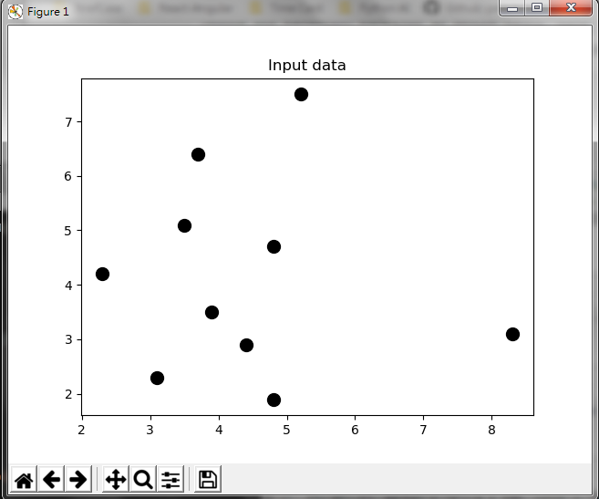
9.4 Find Nearest Neighbor
Introduction
https://www.tutorialspoint.com/artificial_intelligence_with_python/artificial_intelligence_with_python_unsupervised_learning_clustering.htm
Plot data:
AI with Python - CS596

Slide 45

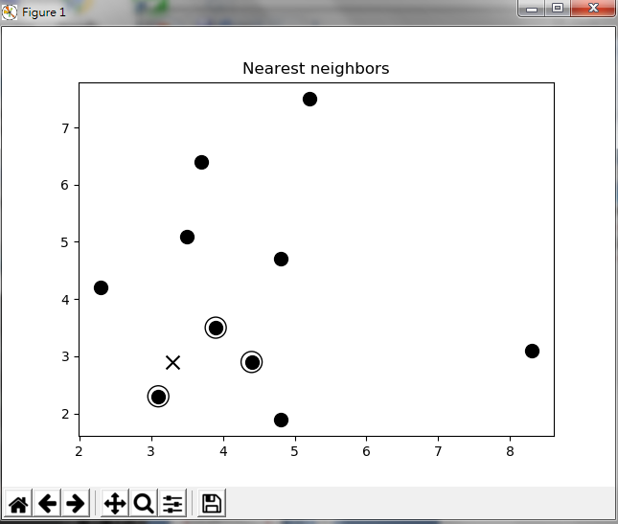
9.4 Find Nearest Neighbor
Introduction
https://www.tutorialspoint.com/artificial_intelligence_with_python/artificial_intelligence_with_python_unsupervised_learning_clustering.htm
Print and plot nearest neighbor:
1 is [ 3.1 2.3]
2 is [ 3.9 3.5]
3 is [ 4.4 2.9]
AI with Python - CS596

Slide 46
9.5 K-Nearest Neighbor Classifier

Slide 47
9.5 K-Nearest Neighbor Classifier
Introduction
https://www.tutorialspoint.com/artificial_intelligence_with_python/artificial_intelligence_with_python_unsupervised_learning_clustering.htm
A K-Nearest Neighbors (KNN) classifier is a classification model that uses the nearest neighbors algorithm to classify a given data point.
We have implemented the KNN algorithm in the last section, now we are going to build a KNN classifier using that algorithm.
AI with Python - CS596

Slide 48
9.5 K-Nearest Neighbor Classifier
Introduction
https://www.tutorialspoint.com/artificial_intelligence_with_python/artificial_intelligence_with_python_unsupervised_learning_clustering.htm
Concept of KNN Classifier
The basic concept of K-nearest neighbor classification is to find a predefined number, i.e., the 'k' - of training samples closest in distance to a new sample, which has to be classified.
New samples will get their label from the neighbors itself. The KNN classifiers have a fixed user defined constant for the number of neighbors which have to be determined.
For the distance, standard Euclidean distance is the most common choice.
The KNN Classifier works directly on the learned samples rather than creating the rules for learning. The KNN algorithm is among the simplest of all machine learning algorithms. It has been quite successful in a large number of classification and regression problems, for example, character recognition or image analysis.
AI with Python - CS596

Slide 49
9.5 K-Nearest Neighbor Classifier
Introduction
https://www.tutorialspoint.com/artificial_intelligence_with_python/artificial_intelligence_with_python_unsupervised_learning_clustering.htm
Example
We are building a KNN classifier to recognize digits. For this, we will use the MNIST dataset. We will write this code in the Jupyter Notebook.
Import the necessary packages as shown below.
Here we are using the KNeighborsClassifier module from the sklearn.neighbors package.
AI with Python - CS596

Slide 50
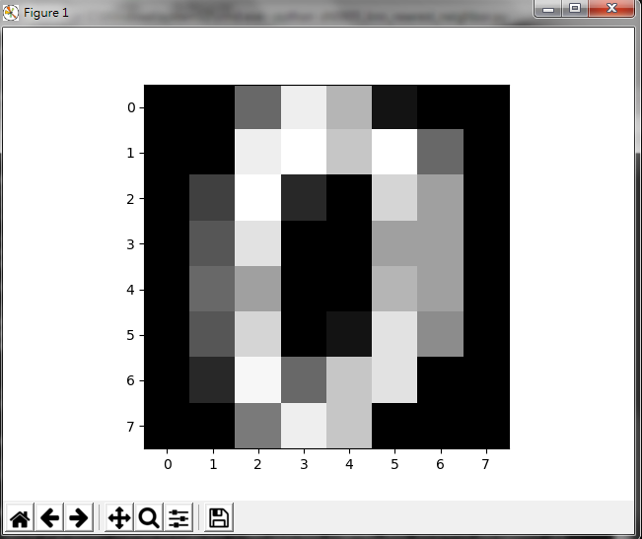
9.5 K-Nearest Neighbor Classifier
Introduction
https://www.tutorialspoint.com/artificial_intelligence_with_python/artificial_intelligence_with_python_unsupervised_learning_clustering.htm
Plot image[0]:
AI with Python - CS596

Slide 51

END of CHAPTER

