Slide 1


AI with Python Chapter 16: Artificial Neural Network
Peter H. Chen, PhDCS/EE

Slide 2

16 Artificial Neural Network

Slide 3

16 Artificial Neural Network
Introduction
https://www.tutorialspoint.com/artificial_intelligence_with_python/artificial_intelligence_with_python_neural_networks.htm
Neural networks are parallel computing devices that are an attempt to make a computer model of brain.
The main objective behind is to develop a system to perform various computational task faster than the traditional systems.
These tasks include Pattern Recognition and Classification, Approximation, Optimization and Data Clustering.
AI with Python - CS596

Slide 4
16 Artificial Neural Network
Introduction
https://www.tutorialspoint.com/artificial_intelligence_with_python/artificial_intelligence_with_python_neural_networks.htm
Artificial Neural network (ANN) is an efficient computing system whose central theme is borrowed from the analogy of biological neural networks.
ANNs are also named as Artificial Neural Systems, Parallel Distributed Processing Systems, and Connectionist Systems.
ANN acquires large collection of units that are interconnected in some pattern to allow communications between them.
These units, also referred to as nodes or neurons, are simple processors which operate in parallel.
Every neuron is connected with other neuron through a connection link.
Each connection link is associated with a weight having the information about the input signal.
This is the most useful information for neurons to solve a particular problem because the weight usually excites or inhibits the signal that is being communicated.
Each neuron is having its internal state which is called activation signal.
Output signals, which are produced after combining input signals and activation rule, may be sent to other units.
If you want to study neural networks in detail then you can follow the link − Artificial Neural Network.
AI with Python - CS596

Slide 5
16.1 Building Neural Network

Slide 6
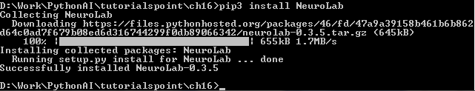
16.1 Building Neural Network
Introduction
https://www.tutorialspoint.com/artificial_intelligence_with_python/artificial_intelligence_with_python_neural_networks.htm
Install ANN Packages
For creating neural networks in Python, we can use a powerful package for neural networks called NeuroLab.
It is a library of basic neural networks algorithms with flexible network configurations and learning algorithms for Python.
You can install this package with the help of the following command on command prompt
C:\ pip3 install NeuroLab
AI with Python - CS596

Slide 7
16.1 Building Neural Network
Introduction
https://www.tutorialspoint.com/artificial_intelligence_with_python/artificial_intelligence_with_python_neural_networks.htm
In this section, let us build some neural networks in Python by using the NeuroLab package.
C:\ pip3 install NeuroLab
AI with Python - CS596

Slide 8
16.1 Building Neural Network
Introduction
https://www.tutorialspoint.com/artificial_intelligence_with_python/artificial_intelligence_with_python_neural_networks.htm
Perceptron based Classifier
Perceptrons are the building blocks of ANN. If you want to know more about Perceptron, you can follow the link − artificial_neural_network
Following is a stepwise execution of the Python code for building a simple neural network perceptron based classifier −
Import the necessary packages as shown
import matplotlib.pyplot as plt
import neurolab as nl
Enter the input values. Note that it is an example of supervised learning, hence you will have to provide target values too
input = [[0, 0], [0, 1], [1, 0], [1, 1]]
target = [[0], [0], [0], [1]]
AI with Python - CS596

Slide 9
16.1 Building Neural Network
Introduction
https://www.tutorialspoint.com/artificial_intelligence_with_python/artificial_intelligence_with_python_neural_networks.htm
Create the network with 2 inputs and 1 neuron
net = nl.net.newp([[0, 1],[0, 1]], 1)
Now, train the network. Here, we are using Delta rule for training.
error_progress = net.train(input, target, epochs=100, show=10, lr=0.1)
AI with Python - CS596

Slide 10
16.1 Building Neural Network
Introduction
https://www.tutorialspoint.com/artificial_intelligence_with_python/artificial_intelligence_with_python_neural_networks.htm
Now, visualize the output and plot the graph
plt.figure()
plt.plot(error_progress)
plt.xlabel('Number of epochs')
plt.ylabel('Training error')
plt.grid()
plt.show()
AI with Python - CS596

Slide 11
16.1 Building Neural Network
Introduction
https://www.tutorialspoint.com/artificial_intelligence_with_python/artificial_intelligence_with_python_neural_networks.htm
Code:
# import ANN packages
import matplotlib.pyplot as plt
import neurolab as nl
# SUpervised Learning with input and target
input = [[0, 0], [0, 1], [1, 0], [1, 1]]
target = [[0], [0], [0], [1]]
# Create ANN with two input and one target
net = nl.net.newp([[0, 1],[0, 1]], 1)
# Train the ANN with delta rule
error_progress = net.train(input, target, epochs=100, show=10, lr=0.1)
# plot
plt.figure()
plt.plot(error_progress)
plt.xlabel('Number of epochs')
plt.ylabel('Training error')
plt.grid()
plt.show()
AI with Python - CS596

Slide 12
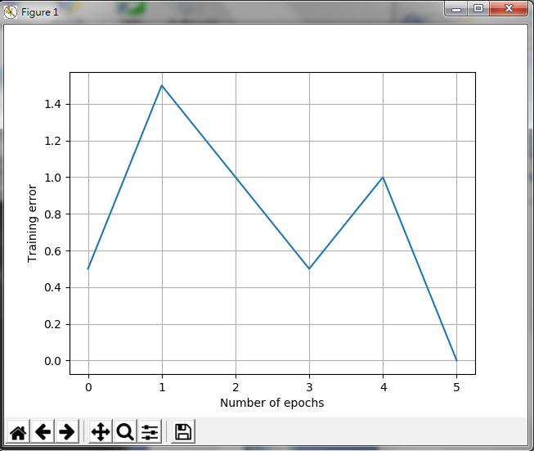
16.1 Building Neural Network
Introduction
https://www.tutorialspoint.com/artificial_intelligence_with_python/artificial_intelligence_with_python_neural_networks.htm
Result:
AI with Python - CS596

Slide 13
16.2 Single Layer ANN

Slide 14
16.2 Single Layer ANN
Introduction
https://www.tutorialspoint.com/artificial_intelligence_with_python/artificial_intelligence_with_python_neural_networks.htm
In the neural network terminology:
one epoch = one forward pass and one backward pass of all the training examples
batch size = the number of training examples in one forward/backward pass. The higher the batch size, the more memory space you'll need.
number of iterations = number of passes, each pass using [batch size] number of examples. To be clear, one pass = one forward pass + one backward pass (we do not count the forward pass and backward pass as two different passes).
Example: if you have 1000 training examples, and your batch size is 500, then it will take 2 iterations to complete 1 epoch
AI with Python - CS596

Slide 15
16.2 Single Layer ANN
Introduction
https://www.tutorialspoint.com/artificial_intelligence_with_python/artificial_intelligence_with_python_neural_networks.htm
In this section, let us build some neural networks in Python by using the NeuroLab package.
C:\ pip3 install NeuroLab
AI with Python - CS596

Slide 16
16.2 Single Layer ANN
Introduction
https://www.tutorialspoint.com/artificial_intelligence_with_python/artificial_intelligence_with_python_neural_networks.htm
Code (1):
import numpy as np
import matplotlib.pyplot as plt
import neurolab as nl
#load data
#input_data = np.loadtxt('./ch1602_neural_simple.txt')
input_data = np.array ([
[2., 4., 0., 0.],
[1.5, 3.9, 0., 0.],
[2.2, 4.1, 0., 0.],
[1.9, 4.7, 0., 0.],
[5.4, 2.2, 0., 1.],
[4.3, 7.1, 0., 1.],
[5.8, 4.9, 0., 1.],
[6.5, 3.2, 0., 1.],
[3., 2., 1., 0.],
[2.5, 0.5, 1., 0.],
[3.5, 2.1, 1., 0.],
[2.9, 0.3, 1., 0.],
[6.5, 8.3, 1., 1.],
[3.2, 6.2, 1., 1.],
[4.9, 7.8, 1., 1.],
[2.1, 4.8, 1., 1.]])
AI with Python - CS596

Slide 17
16.2 Single Layer ANN
Introduction
https://www.tutorialspoint.com/artificial_intelligence_with_python/artificial_intelligence_with_python_neural_networks.htm
Code (2):
#print ('input_data: ', input_data)
# the first two column are features
# the last two columns are labels
data = input_data[:, 0:2]
#print ('data: ', data)
labels = input_data[:, 2:]
#print ('labels: ', labels)
# plot input data
plt.figure()
print ('data[:,0]: ', data[:,0])
print ('data[:,1]: ', data[:,1])
plt.scatter(data[:,0], data[:,1])
plt.xlabel('Dimension 1')
plt.ylabel('Dimension 2')
plt.title('Input data')
# define min and max
dim1_min, dim1_max = data[:,0].min(), data[:,0].max()
dim2_min, dim2_max = data[:,1].min(), data[:,1].max()
#define number of neuron in output layer
nn_output_layer = labels.shape[1]
AI with Python - CS596

Slide 18
16.2 Single Layer ANN
Introduction
https://www.tutorialspoint.com/artificial_intelligence_with_python/artificial_intelligence_with_python_neural_networks.htm
Code (3):
#define single-layer ANN
dim1 = [dim1_min, dim1_max]
dim2 = [dim2_min, dim2_max]
neural_net = nl.net.newp([dim1, dim2], nn_output_layer)
# Train the neural network with number of epochs
error = neural_net.train(data, labels, epochs = 200, show = 20, lr = 0.01)
# Plot data
plt.figure()
plt.plot(error)
plt.xlabel('Number of epochs')
plt.ylabel('Training error')
plt.title('Training error progress')
plt.grid()
plt.show()
# print test result
print('\nTest Results:')
data_test = [[1.5, 3.2], [3.6, 1.7], [3.6, 5.7],[1.6, 3.9]]
for item in data_test:
print(item, '-->', neural_net.sim([item])[0])
AI with Python - CS596

Slide 19
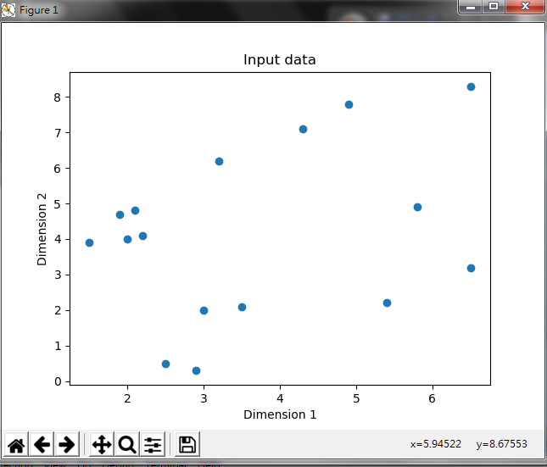
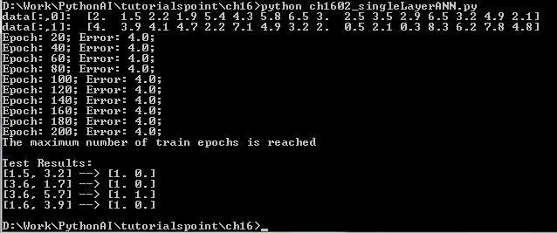
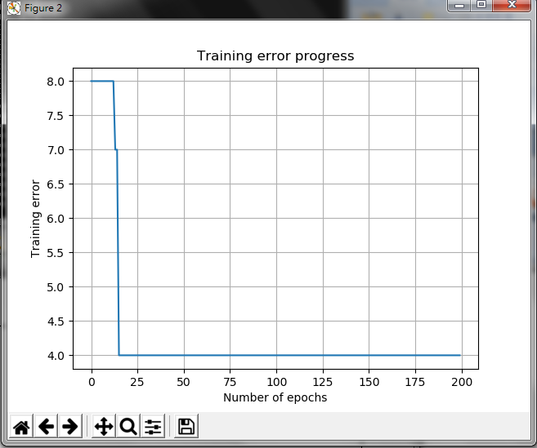
16.2 Single Layer ANN
Introduction
https://www.tutorialspoint.com/artificial_intelligence_with_python/artificial_intelligence_with_python_neural_networks.htm
You can see the following graphs as the output of the code discussed till now
AI with Python - CS596

Slide 20
16.3 Multi-Layer Neural Network

Slide 21
16.3 Multi-Layer Neural Network
Introduction
https://www.tutorialspoint.com/artificial_intelligence_with_python/artificial_intelligence_with_python_neural_networks.htm
In this example, we are creating a multi-layer neural network that consists of more than one layer to extract the underlying patterns in the training data.
This multilayer neural network will work like a regressor.
We are going to generate some data points based on the equation: y = 2x²+8.
Import the necessary packages as shown
import numpy as np
import matplotlib.pyplot as plt
import neurolab as nl
AI with Python - CS596

Slide 22
16.3 Multi-Layer Neural Network
Introduction
https://www.tutorialspoint.com/artificial_intelligence_with_python/artificial_intelligence_with_python_neural_networks.htm
Generate some data point based on the above mentioned equation
min_val = -30
max_val = 30
num_points = 160
x = np.linspace(min_val, max_val, num_points)
y = 2 * np.square(x) + 8
y /= np.linalg.norm(y)
Now, reshape this data set as follows
data = x.reshape(num_points, 1)
labels = y.reshape(num_points, 1)
AI with Python - CS596

Slide 23
16.3 Multi-Layer Neural Network
Introduction
https://www.tutorialspoint.com/artificial_intelligence_with_python/artificial_intelligence_with_python_neural_networks.htm
Visualize and plot the input data set using the following commands
plt.figure()
plt.scatter(data, labels)
plt.xlabel('Dimension 1')
plt.ylabel('Dimension 2')
plt.title('Data-points')
Now, build the neural network having two hidden layers with neurolab with ten neurons in the first hidden layer, six in the second hidden layer and one in the output layer.
neural_net = nl.net.newff([[min_val, max_val]], [10, 6, 1])
AI with Python - CS596

Slide 24
16.3 Multi-Layer Neural Network
Introduction
https://www.tutorialspoint.com/artificial_intelligence_with_python/artificial_intelligence_with_python_neural_networks.htm
Now use the gradient training algorithm
neural_net.trainf = nl.train.train_gd
Now train the network with goal of learning on the data generated above
error = neural_net.train(data, labels, epochs = 1000, show = 100, goal = 0.01)
Now train the network with goal of learning on the data generated above
output = neural_net.sim(data)
y_pred = output.reshape(num_points)
AI with Python - CS596

Slide 25
16.3 Multi-Layer Neural Network
Introduction
https://www.tutorialspoint.com/artificial_intelligence_with_python/artificial_intelligence_with_python_neural_networks.htm
Now plot and visualization task
plt.figure()
plt.plot(error)
plt.xlabel('Number of epochs')
plt.ylabel('Error')
plt.title('Training error progress')
AI with Python - CS596

Slide 26
16.3 Multi-Layer Neural Network
Introduction
https://www.tutorialspoint.com/artificial_intelligence_with_python/artificial_intelligence_with_python_neural_networks.htm
Now we will be plotting the actual versus predicted output
x_dense = np.linspace(min_val, max_val, num_points * 2)
y_dense_pred = neural_net.sim(x_dense.reshape(x_dense.size,1)).reshape(x_dense.size)
plt.figure()
plt.plot(x_dense, y_dense_pred, '-', x, y, '.', x, y_pred, 'p')
plt.title('Actual vs predicted')
plt.show()
AI with Python - CS596

Slide 27
16.3 Multi-Layer Neural Network
Introduction
https://www.tutorialspoint.com/artificial_intelligence_with_python/artificial_intelligence_with_python_neural_networks.htm
Code (1):
import numpy as np
import matplotlib.pyplot as plt
import neurolab as nl
min_val = -30
max_val = 30
num_points = 160
x = np.linspace(min_val, max_val, num_points)
y = 2 * np.square(x) + 8
y /= np.linalg.norm(y)
data = x.reshape(num_points, 1)
labels = y.reshape(num_points, 1)
plt.figure()
plt.scatter(data, labels)
plt.xlabel('Dimension 1')
plt.ylabel('Dimension 2')
plt.title('Data-points')
AI with Python - CS596

Slide 28
16.3 Multi-Layer Neural Network
Introduction
https://www.tutorialspoint.com/artificial_intelligence_with_python/artificial_intelligence_with_python_neural_networks.htm
Code (2):
neural_net = nl.net.newff([[min_val, max_val]], [10, 6, 1])
neural_net.trainf = nl.train.train_gd
error = neural_net.train(data, labels, epochs = 1000, show = 100, goal = 0.01)
output = neural_net.sim(data)
y_pred = output.reshape(num_points)
plt.figure()
plt.plot(error)
plt.xlabel('Number of epochs')
plt.ylabel('Error')
plt.title('Training error progress')
x_dense = np.linspace(min_val, max_val, num_points * 2)
y_dense_pred = neural_net.sim(x_dense.reshape(x_dense.size,1)).reshape(x_dense.size)
plt.figure()
plt.plot(x_dense, y_dense_pred, '-', x, y, '.', x, y_pred, 'p')
plt.title('Actual vs predicted')
plt.show()
AI with Python - CS596

Slide 29
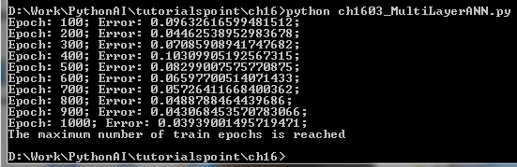
16.3 Multi-Layer Neural Network
Introduction
https://www.tutorialspoint.com/artificial_intelligence_with_python/artificial_intelligence_with_python_neural_networks.htm
In this example, we are creating a multi-layer neural network that consists of more than one layer to extract the underlying patterns in the training data.
AI with Python - CS596

Slide 30
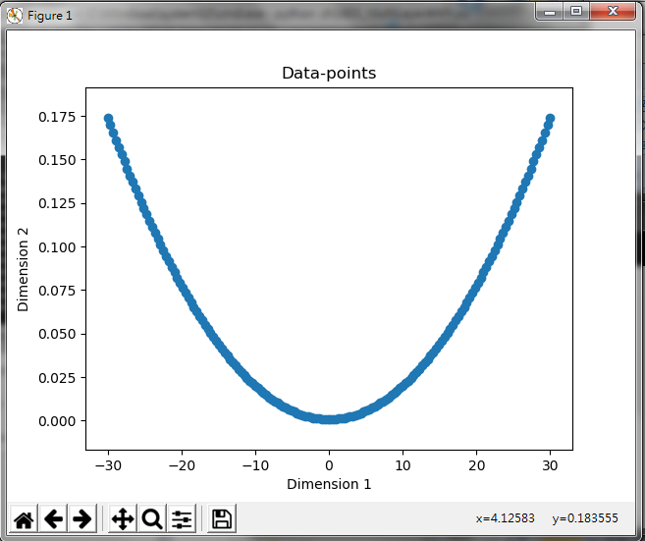
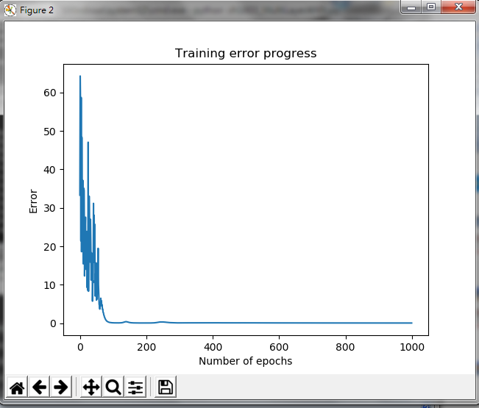
16.3 Multi-Layer Neural Network
Introduction
https://www.tutorialspoint.com/artificial_intelligence_with_python/artificial_intelligence_with_python_neural_networks.htm
As a result of the above commands, you can observe the graphs as shown below
AI with Python - CS596

Slide 31
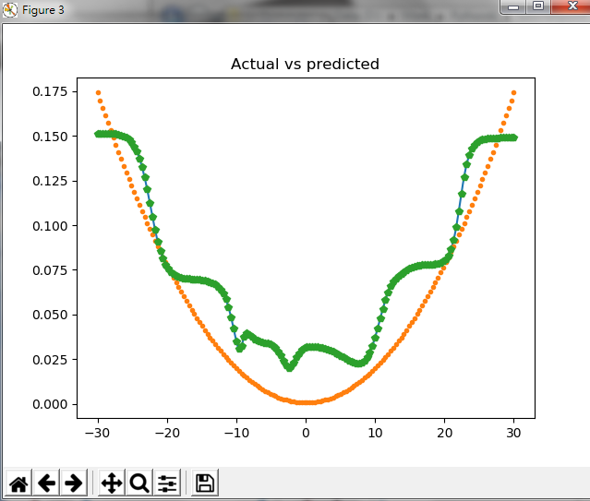
16.3 Multi-Layer Neural Network
Introduction
https://www.tutorialspoint.com/artificial_intelligence_with_python/artificial_intelligence_with_python_neural_networks.htm
As a result of the above commands, you can observe the graphs as shown below
AI with Python - CS596

Slide 32

END of CHAPTER

