Slide 1


Credit Card Approval Prediction Using MACHINE LEARNING MODELS
Objective:
Construct a machine learning model to predict whether an applicant will be a Creditworthy or Credit Risky. Unlike standard tasks, the criteria for Creditworthy or Credit Risky are not predefined in this Dataset. Employ techniques to formulate labels. Additionally, address the challenge of imbalanced data, a significant issue in this context.

Slide 2

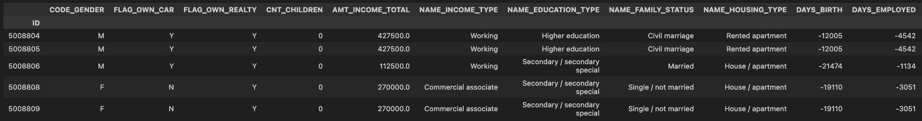
Data map
INTRODUCTION TO DATASETS:
APPLICATION RECORD:
Demographic and Financial info about applicants
Gender
Age
Income
Education
Employment Type
Income Type
Days of Employment
and more 435,000 unique IDs

Slide 3
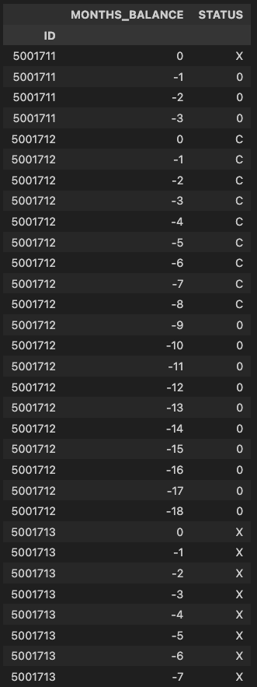
Data map
INTRODUCTION TO DATASETS:
CREDIT RECORD:
Months on Book Count
Payment Status
45,000 unique IDs
Two datasets share more than 36,000 IDs

Slide 4
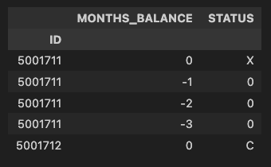
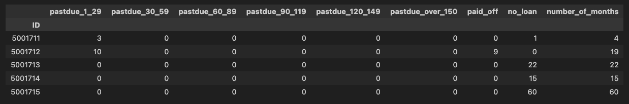
Data map
CREDIT RECORD
We used One-Hot Encoding and grouping.

Slide 5
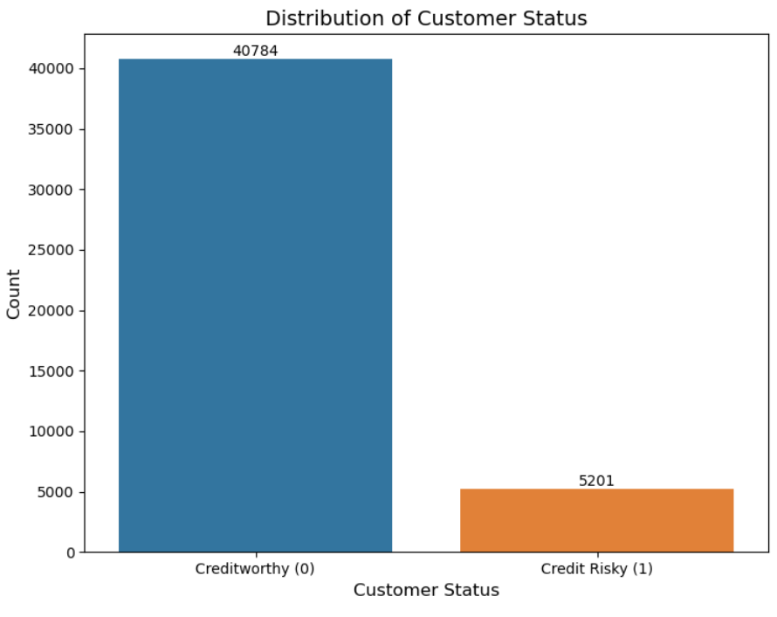
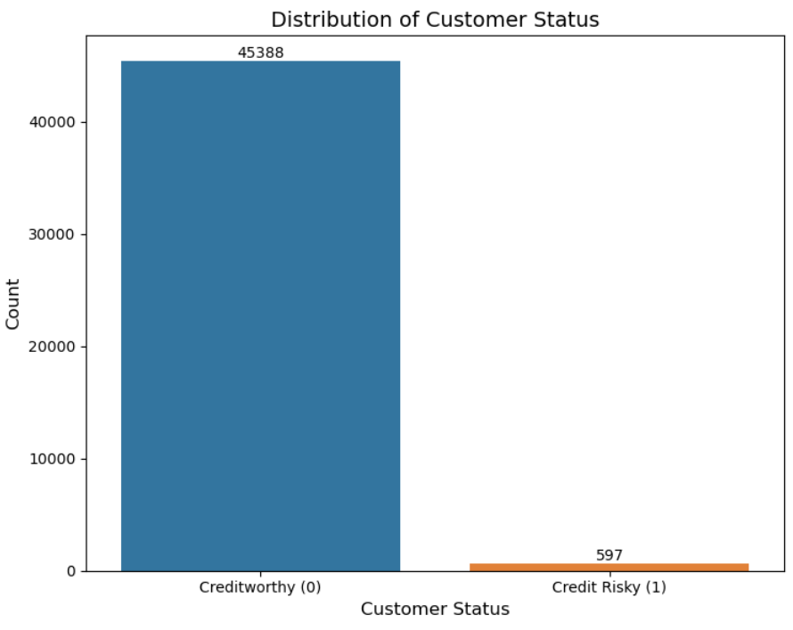
Data map
30 days or more once
60 days or more once

Slide 6
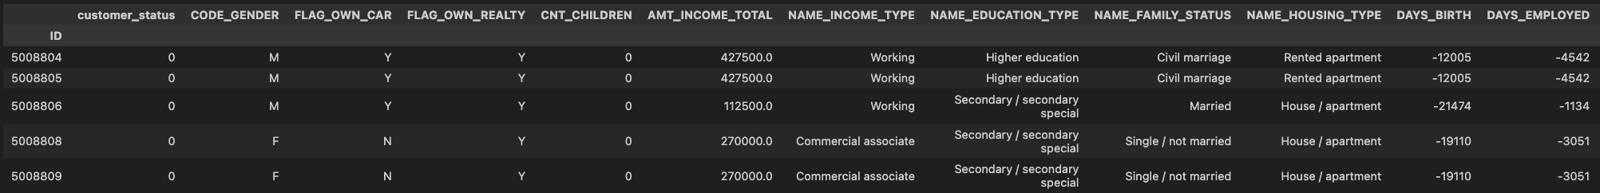
EDA
Merged Dataset :
Unique 36500 IDs as index
Customer Status, 0 (Credit Worthy) and 1(Credit Risky)
Gender
Car Ownership
Real Estate Ownership
Children Count
Family Member Count
Income Amount
Income Type
Education Type
Marital Status
Housing Type
Age
Employment Duration
Occupation Type

Slide 7
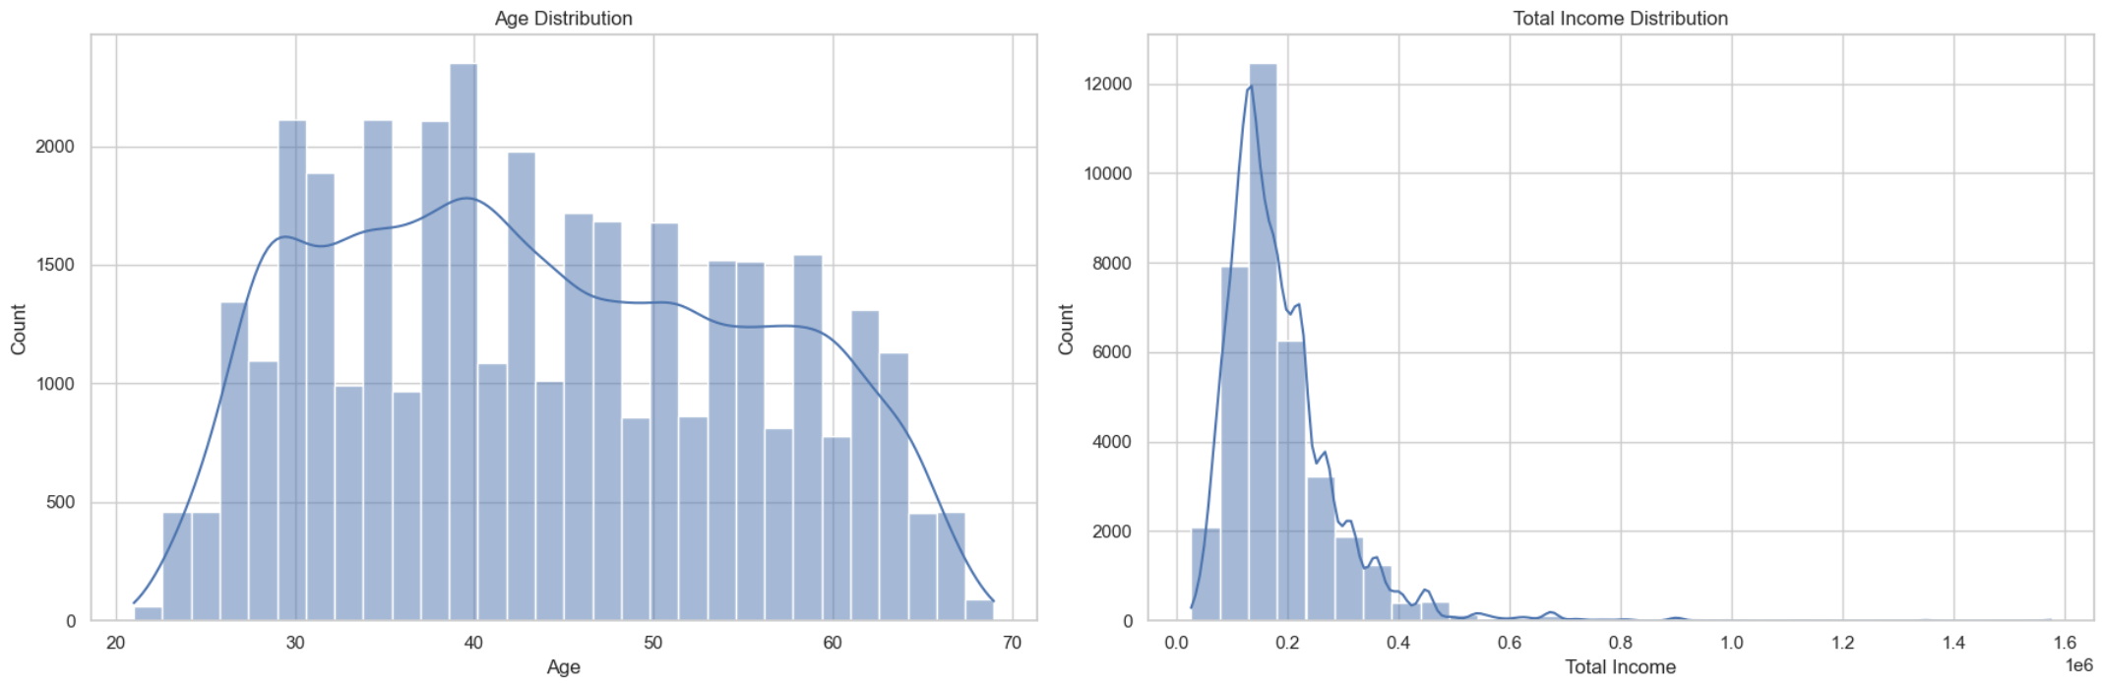
EDA

Slide 8
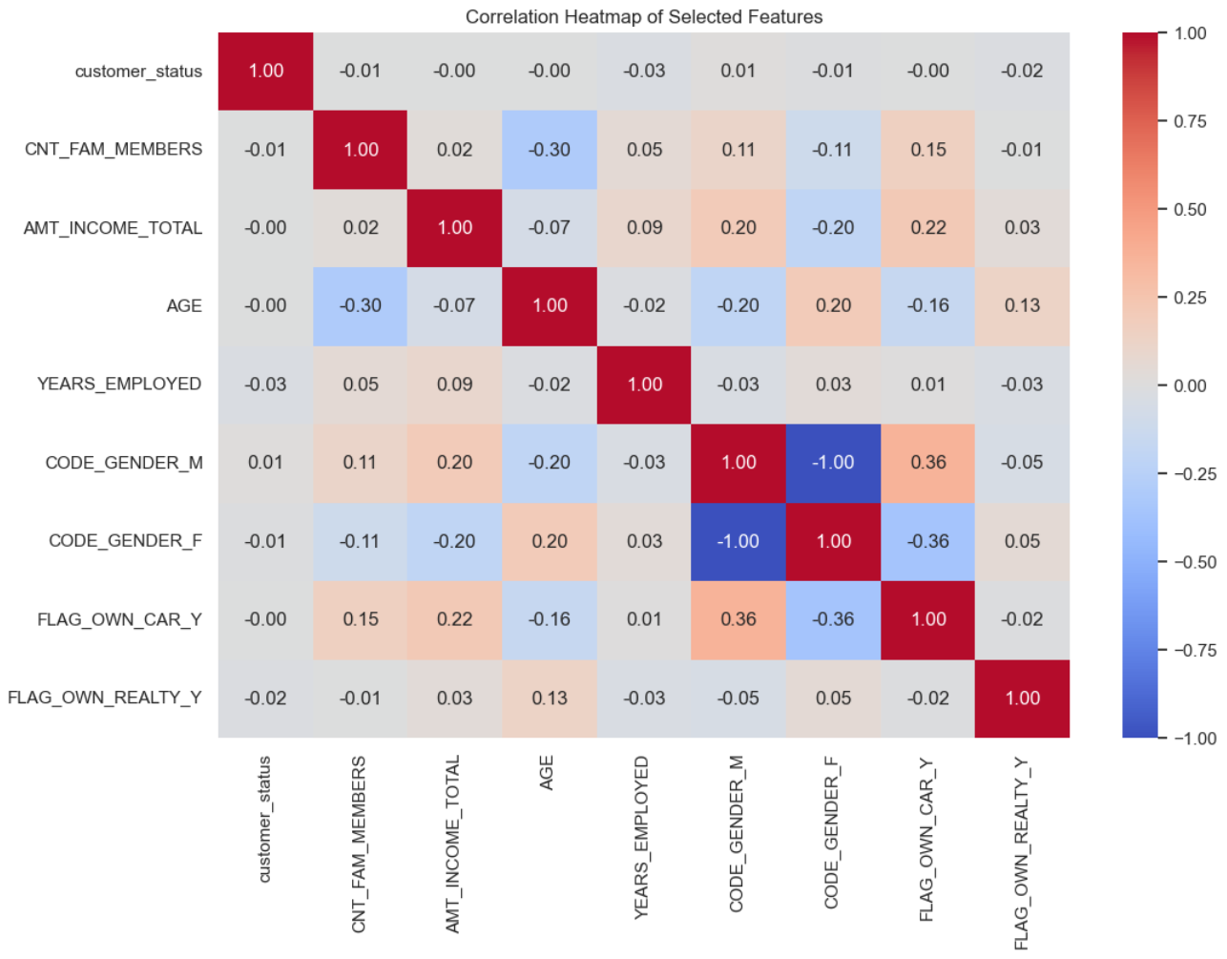

Slide 9
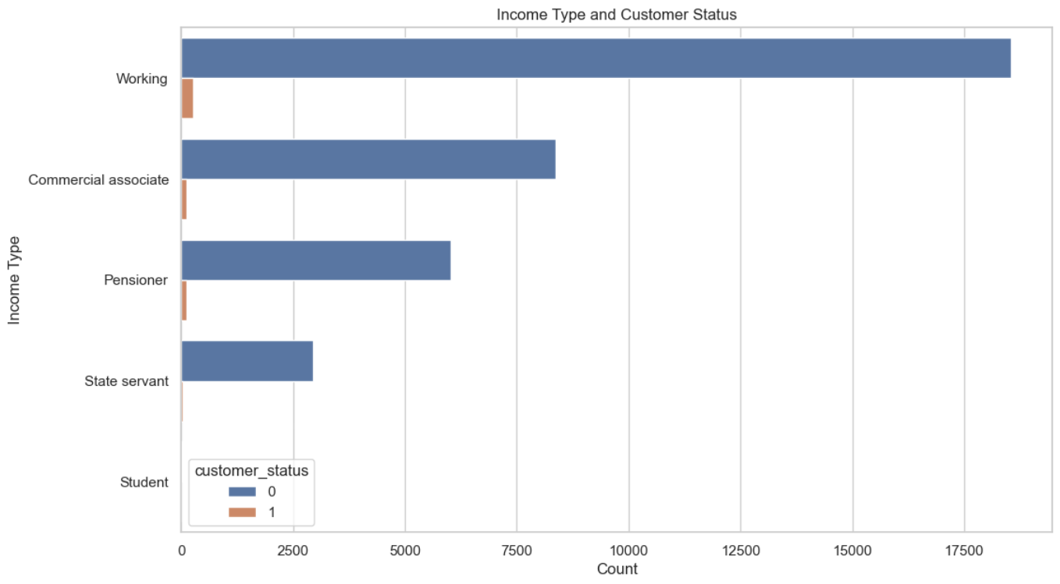
EDA

Slide 10
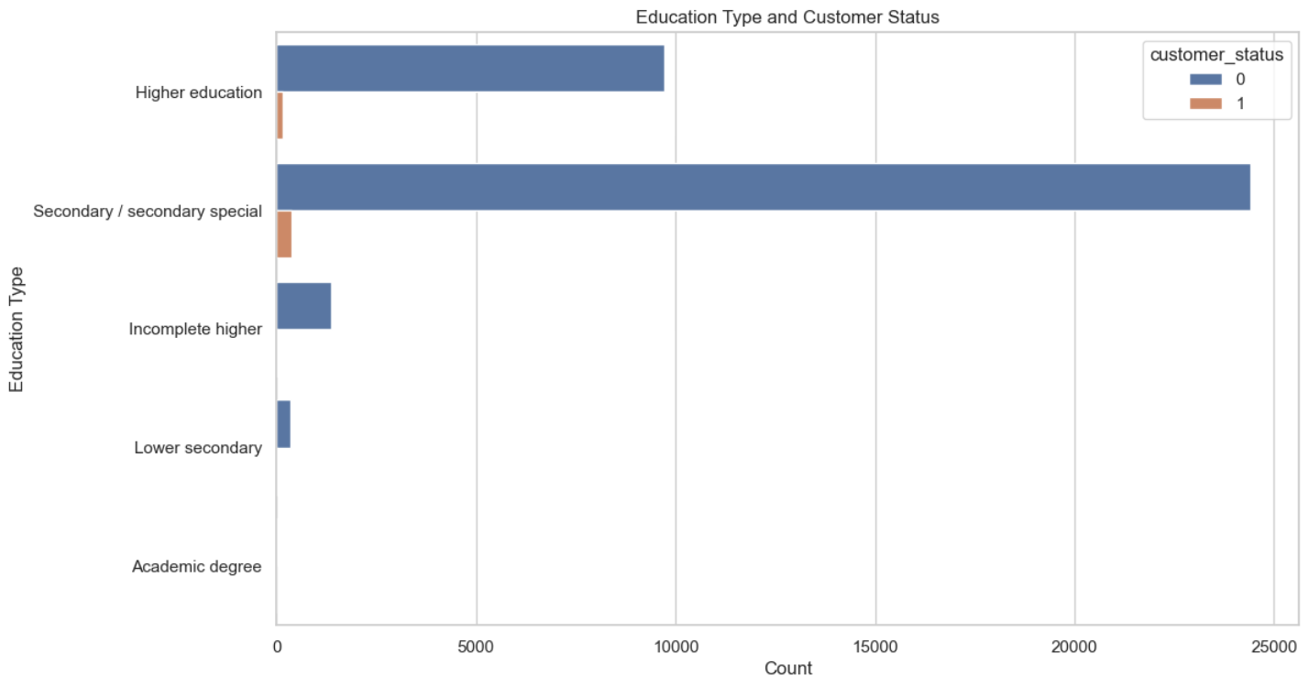
EDA

Slide 11
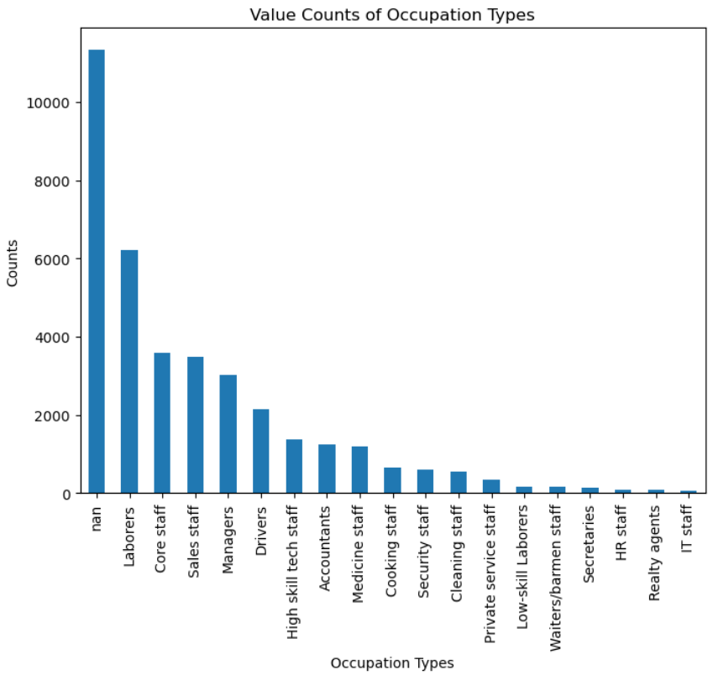
Feature engineering

Slide 12
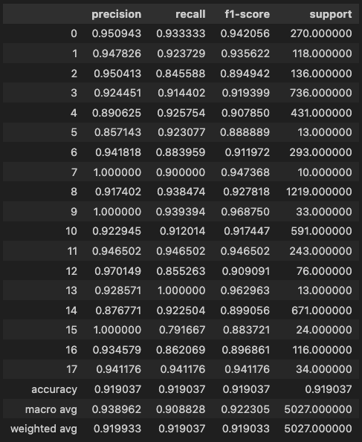
Feature engineering
We used Random Forest Classifier to predict the missing “Occupation Type” values

Slide 13
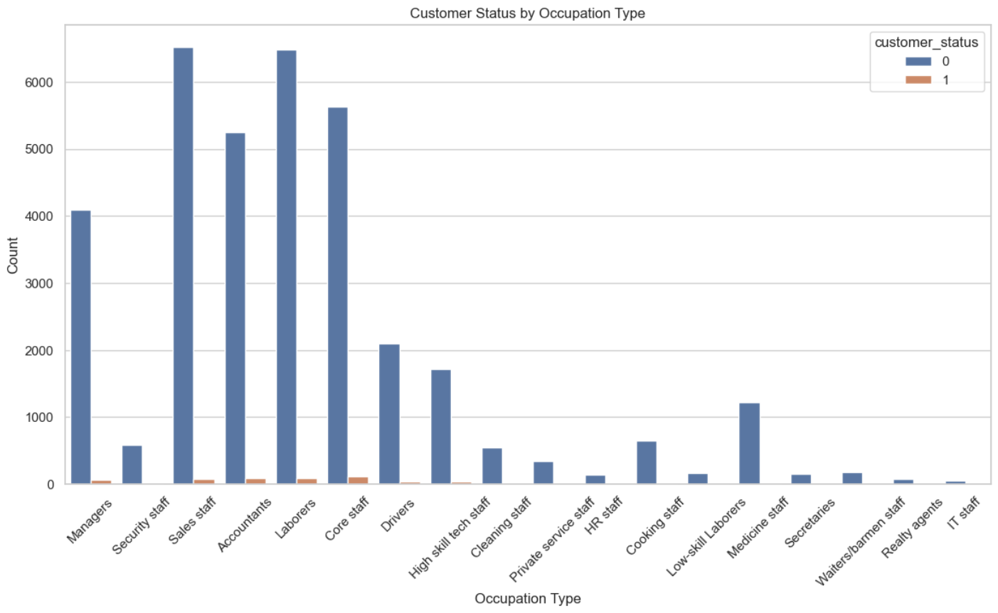
Feature engineering

Slide 14
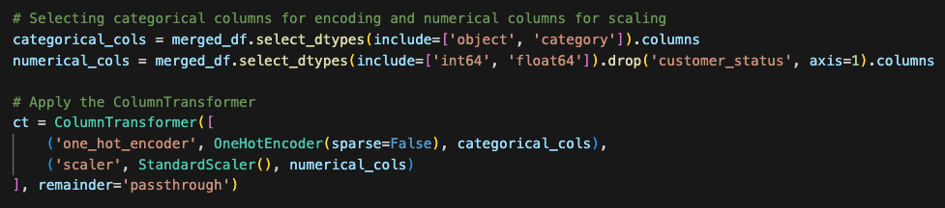
Feature engineering
ColumnTransformer in Scikit-learn
ColumnTransformer is designed to apply different transformations to different columns of a DataFrame or array.
It allows to specify which transformations should be applied to which columns. For instance, you can standardize only the numerical data, encode categorical data using one-hot encoding, and leave certain columns untouched.

Slide 15
EDA & Feature engineering
EDA and Feature Engineering Recap:
From “Credit Record”, we’ve tagged clients as 0 and 1, clients that are 60 days past due once were deemed as Credit Risky.
“Days_Birth” and Employment Days converted to Years.
Missing “Occupation Type” values filled using RFC
Irrelevant, Nondecisive columns removed (e.g. Children Count, a subset of Family Member Count, FLAG_MOBIL, FLAG_EMAIL)

Slide 16
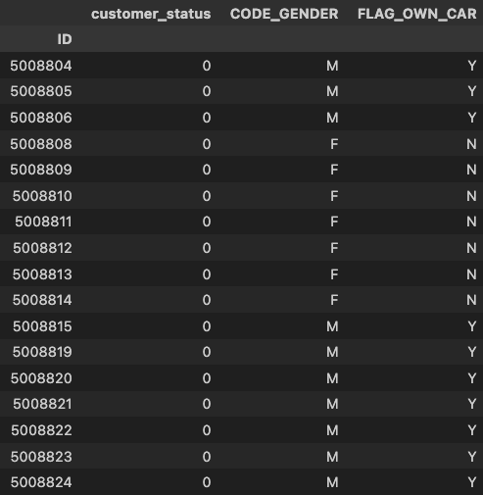
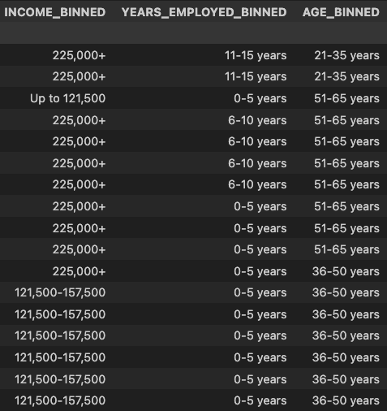
EDA & Feature engineering
EDA and Feature Engineering Recap:
Tried binning method for Age, Income Amount, and Employment Years. Ran the models but realized it’s lowering accuracy.

Slide 17

EDA & Feature engineering
EDA and Feature Engineering Recap:
Applied Synthetic Minority Oversampling Technique (SMOTE) and Random Over Sampler to training data.
SMOTE is a statistical technique for increasing the number of cases in dataset in a balanced way. It generates synthetic samples from the minority class by selecting examples that are close in the feature space, drawing a line between the examples in the feature space, and drawing a new sample at a point along that line.
Random Over Sampler is a straightforward method to balance the dataset by randomly duplicating instances of the minority class. This technique helps to overcome the imbalances by increasing the presence of the minority class to a level comparable to the majority class, potentially improving the performance of classifiers on imbalanced datasets.
Fun Fact about Random_State=42
The number 42 is sort of an ongoing inside joke in the scientific and science fiction community and is derived from the legendary "Hitchhiker’s Guide to the Galaxy” by Douglas Adams wherein an enormous supercomputer named Deep Thought calculates the “Answer to the Ultimate Question of Life…” over the period of 7.5 million years and the answer turns out to be 42…

Slide 18
modeling
We started with 4 models:
Logistic Regression (sklearn.linear_model)
Random Forest Classifier (sklearn.ensemble)
XGBoost Classifier (XGBoost)
MLP Classifier (sklearn.neural_network)

Slide 19
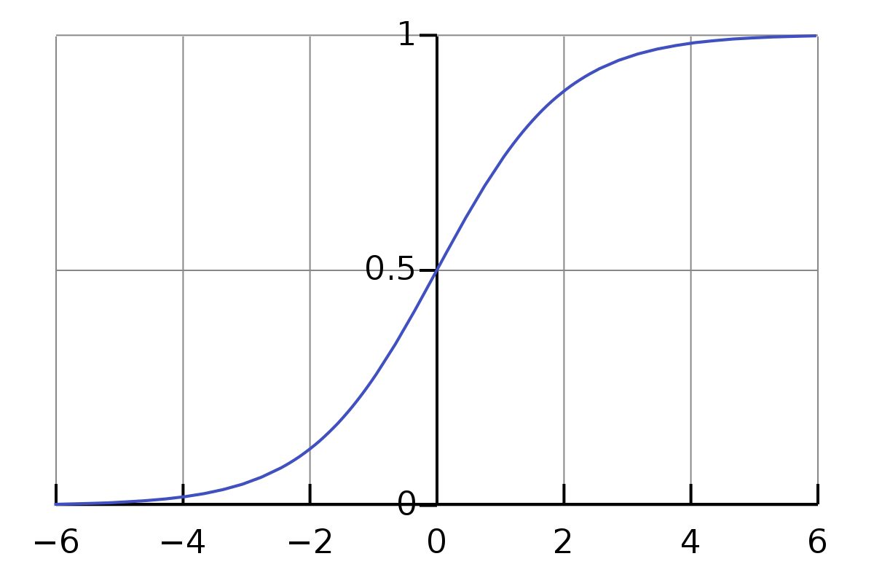
modeling
Logistic Regression (sklearn.linear_model)
Logistic Regression is a statistical model used for binary classification tasks, which predicts the probability of an instance belonging to a default class.
The core of logistic regression is the sigmoid function, which maps any real-valued number into a value between 0 and 1, making it useful for a probability estimation.
The logistic regression model calculates the probability of the default class, then makes its predictions based on where the calculated probability falls in relation to a decision boundary.
Logistic Regression is simple, interpretable, and efficient for linearly separable classes. However, it's not suitable for complex relationships in data and doesn't perform well with independent variables that are not linearly related to the log odds.

Slide 20
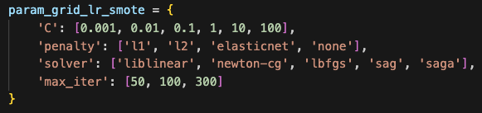
modeling
Logistic Regression (sklearn.linear_model)
Regularization Strength (C parameter): Controls the strength of regularization; lower values specify stronger regularization. Tuning it can help prevent overfitting.
Regularization Type (penalty): Choice between L1 or L2 regularization, or a combination (Elastic Net), depending on the dataset.
Solver: Choice of algorithm for optimization (liblinear, sag, saga, newton-cg, lbfgs), each having different characteristics suitable for particular datasets.
Class Weight: Useful for handling imbalanced datasets, can be set to 'balanced' or customized as per the class frequencies.
Max Iterations (max_iter): Maximum number of iterations taken for the solvers to converge. Increasing this number can help in achieving convergence but at the cost of longer training times.

Slide 21
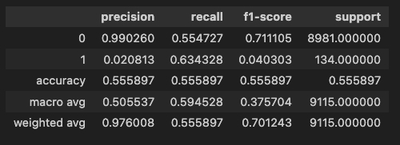
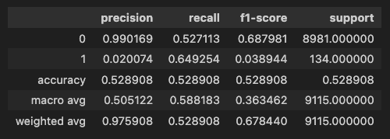
modeling
Logistic Regression (sklearn.linear_model)
SMOTE Data
Undersampled Data

Slide 22
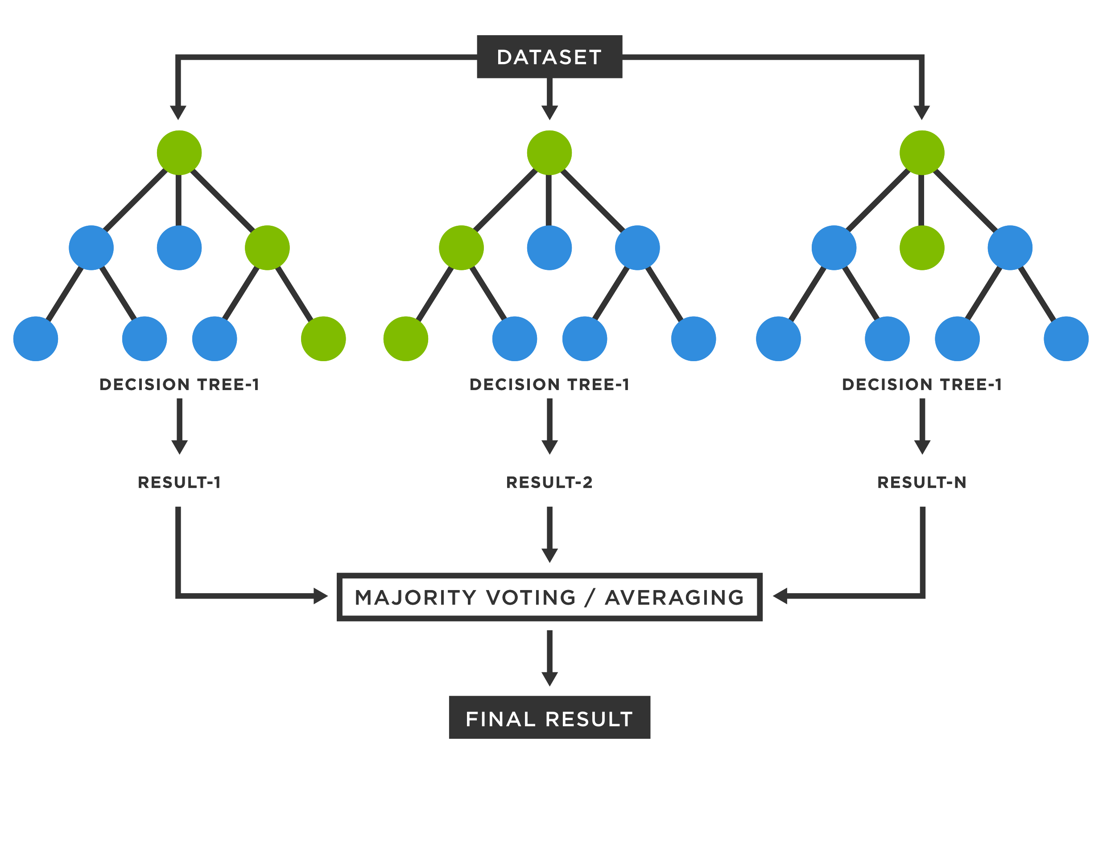
modeling
Random Forest Classifier (sklearn.ensemble)
The Random Forest Classifier is an ensemble learning method known for its accuracy, versatility, and robustness. It operates by constructing a multitude of decision trees during training and outputs the class.
Often more accurate than other simple classifiers, especially when dealing with large datasets.
Widely used in both classification and regression tasks.
Ideal for applications like medical diagnosis, stock market prediction, and many areas in the field of data science and machine learning.

Slide 23
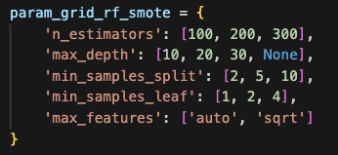
modeling
Random Forest Classifier (sklearn.ensemble)
Number of Trees (n_estimators): Refers to the number of trees in the forest. Generally, more trees increase performance but also computation time.
Maximum Depth of Trees (max_depth): The maximum depth of each tree. Deeper trees can model more complex patterns but can also lead to overfitting.
Minimum Samples Split (min_samples_split): The minimum number of samples required to split an internal node. Higher values prevent creating nodes that only work well for the training data, hence reducing overfitting.
Minimum Samples Leaf (min_samples_leaf):The minimum number of samples required to be at a leaf node. Similar to min_samples_split, higher values increase the robustness of the tree to noise.

Slide 24
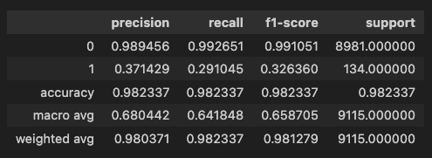
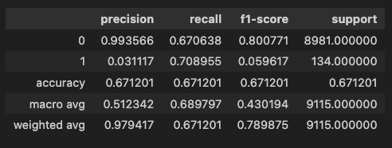
modeling
Random Forest Classifier (sklearn.ensemble)
SMOTE Data
Undersampled Data

Slide 25
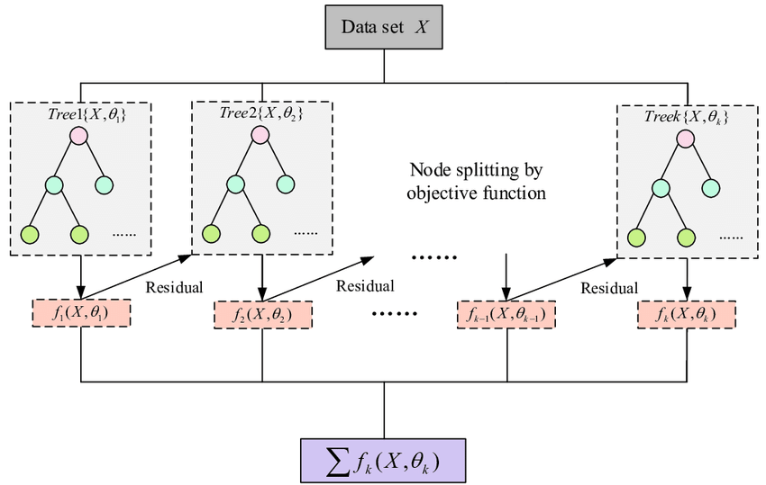
modeling
XGBoost Classifier (XGBoost)
XGBoost belongs to a family of boosting algorithms. It sequentially adds predictors and corrects its predecessors, focusing on reducing the residual errors of the previous models.
It uses gradient descent to minimize the loss when adding new models.
Often faster and more efficient then RandomForest, especially in terms of handling large datasets. It also tends to provide higher predictive accuracy.
Generally, less interpretable due to the complexity and sequential nature of boosting.
XGBoost includes L1 (Lasso regression) and L2 (Ridge regression) regularization, which helps in reducing overfitting and improving model performance.
Unlike other gradient boosting techniques that stop growing trees when they cannot find a positive gain, XGBoost grows a full tree and then prunes it back, offering more control over tree complexity.

Slide 26
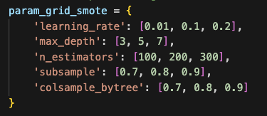
modeling
XGBoost Classifier (XGBoost)
Learning Rate (eta): Determines the step size at each iteration and controls how quickly the model fits the residual error using additional base learners. A lower value (like 0.01-0.1) makes the boosting process more conservative, reducing the chances of overfitting but requiring more trees (n_estimators) to model all relations.
Number of Trees (n_estimators): The number of boosting rounds or trees to build. It should be balanced with the learning rate. More trees can improve accuracy but also increase computational time and risk of overfitting
Max Depth of Trees (max_depth): Maximum depth of a tree. Increasing this value will make the model more complex and more likely to overfit.
Subsample: The fraction of samples to be used for fitting each individual base learner. Values slightly lower than 1 make the model more robust by reducing variance.
Colsample_bytree / Colsample_bylevel / Colsample_bynode: These parameters control the subsample ratio of columns for each split, for each level, and for each tree. Similar to subsample, setting these less than 1 can help in preventing overfitting.

Slide 27
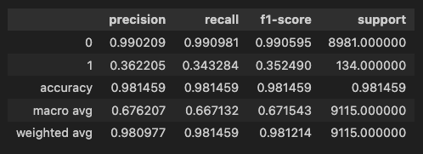
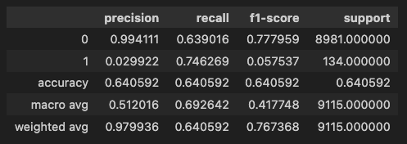
modeling
XGBoost Classifier (XGBoost)
SMOTE Data
Undersampled Data

Slide 28
modeling
MLP Classifier (sklearn.neural_network)
The MLPClassifier is a Multi-layer Perceptron (MLP) classifier which belongs to the category of neural network models. MLP is a class of feedforward artificial neural network.
MLP consists of at least three layers of nodes: an input layer, a hidden layer, and an output layer.
MLP utilizes backpropagation for training, meaning it calculates the gradient of the loss function with respect to the weights of the network for a given input-output pair and adjusts the weights to minimize the loss.
Offers less flexibility in terms of network design. The architecture is limited to fully connected layers, and customization options are relatively basic.

Slide 29
modeling
MLP Classifier (sklearn.neural_network)
Hidden Layer Sizes: Controls the number of layers and the number of neurons in each layer. hidden_layer_sizes=(100,) for one layer with 100 neurons, or (100, 50) for two layers with 100 and 50 neurons respectively. More layers/neurons can model complex patterns but increase the risk of overfitting and computational cost.
Activation Function: The activation function for the hidden layers. Options include relu, tanh, and logistic. relu generally works well; however, tanh or logistic might be better for certain problems.
Solver: The algorithm for weight optimization. lbfgs, sgd (stochastic gradient descent), adam. adam works well on relatively large datasets with thousands of training samples. For small datasets, lbfgs can converge faster and perform better
Alpha: L2 regularization term. Helps to avoid overfitting. Larger values penalize large weights more strongly.
Learning Rate (for sgd solver): Determines the step size at each iteration while moving toward a minimum of the loss function. Often requires experimentation; too high can overshoot minima, too low can slow down convergence.
Max Iterations and Tolerance: max_iter is the maximum number of iterations, and tol is the tolerance for the optimization. Higher max_iter allows more time for convergence, while tol controls when the algorithm should stop improving.

Slide 30
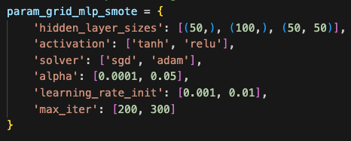
modeling
MLP Classifier (sklearn.neural_network)
SMOTE Data
Undersampled Data

Slide 31
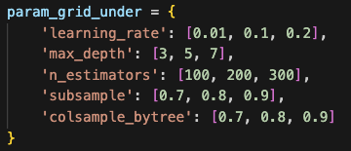
CHAMPION model
XGBoost Classifier (XGBoost)
SMOTE Data

Slide 32
conclusion
In our project, we aimed to develop a machine learning model to predict 'good' and 'bad' customers based on their application information and payment status.
The evaluation of our models was based on their ability to classify customers accurately. However, it's important to note that this is not a perfect evaluation metric.
In real-world scenarios, customer creditworthiness assessment often includes a comprehensive credit score analysis, which was not fully captured in our dataset.

Slide 33
THANK YOU FOR LISTENING

