Slide 1
Chapter 1 Introduction

Slide 2
Objectives
To provide a grand tour of the major operating systems components
To provide coverage of basic computer system organization
Operating System
Page <number>

Slide 3
Outlines for Chapter 1
What Operating Systems Do
Computer-System Organization
Operating-System Structure
Operating-System Operations
Process Management
Memory Management
Storage Management
Protection and Security
Operating System
Page <number>

Slide 4
Outlines for Chapter 1
What Operating Systems Do
Computer-System Organization
Operating-System Structure
Operating-System Operations
Process Management
Memory Management
Storage Management
Protection and Security
Operating System
Page <number>

Slide 5
Computer System Structure
Computer system can be divided into four components
  Hardware – provides basic computing resources
    CPU, memory, I/O devices
  Operating system
    Controls and coordinates use of hardware among various applications and users
  System & application programs
    define the ways in which the system resources are used to solve the computing problems of the users
    word processors, compilers, web browsers, database systems, video games
  Users
    People, machines, other computers
Operating System
Page <number>

Slide 6

Four Components of a Computer System
Operating System
Page <number>

Slide 7
What is an Operating System?
A program that acts as an intermediary between a user of a computer and the computer hardware.
Fundamental goal of computer systems
  Execute user programs and make solving user problems easier.
Operating System goals:
  Make the computer system convenient to use.
  Use the computer hardware in an efficient manner.
Operating System
Page <number>

Slide 8
Operating System Definition
OS is a resource allocator
  Manages all resources
  Decides between conflicting requests for efficient and fair resource use
OS is a control program
  Controls execution of programs to prevent errors and improper use of the computer
Operating System
Page <number>

Slide 9
Operating System Definition (Cont.)
No universally accepted definition
“Everything a vendor ships when you order an operating system” is good approximation
  But varies wildly
“The one program running at all times on the computer” is the kernel. Everything else is either a system program (ships with the operating system) or an application program
Operating System
Page <number>

Slide 10
Outlines for Chapter 1
What Operating Systems Do
Computer-System Organization
Operating-System Structure
Operating-System Operations
Process Management
Memory Management
Storage Management
Protection and Security
Operating System
Page <number>

Slide 11
Computer Startup
bootstrap program (or bootstrap loader) is loaded at power-up or reboot
  Typically stored in ROM or EPROM, generally known as firmware
  Initialize all aspects of system
  Loads operating system kernel and starts execution
Erasable Programmable Read-Only Memory
引导程序
固件，固化在硬件中的软件
Operating System
Page <number>

Slide 12

Computer System Operation
Computer-system operation
  One or more CPUs, device controllers connect through common bus providing access to shared memory
  Concurrent execution of CPUs and devices competing for memory cycles
Operating System
Page <number>

Slide 13
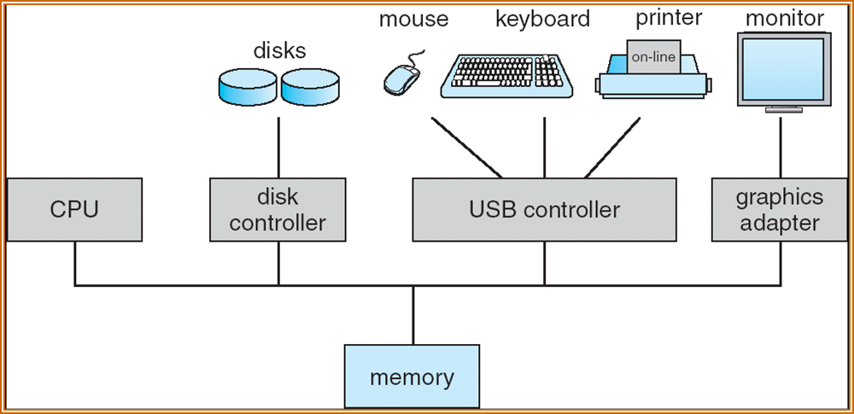
Computer-System Operation （cont’d）
  I/O devices and the CPU can execute concurrently.
  Each device controller has a local buffer (some special purpose registers).
  CPU moves data between main memory and local buffers
  I/O is between the device and local buffer of controller.
  Device controller informs CPU that it has finished its operation by causing an interrupt.
Operating System
Page <number>

Slide 14
Common Functions of Interrupts
Interrupt transfers control to the interrupt service routine generally, through the interrupt vector, which contains the addresses of all the service routines.
Interrupt architecture must save the address of the interrupted instruction.
A trap is a software-generated interrupt caused either by an error or a user request (the latter is often referred to as a system call ).
An operating system is interrupt driven.
Operating System
Page <number>

Slide 15

Interrupt Timeline
Operating System
Page <number>

Slide 16

I/O Method
After I/O starts, control returns to user program only upon I/O completion.
After I/O starts, control returns to user program without waiting for I/O completion.
Synchronous
Asynchronous
Operating System
Page <number>

Slide 17
Direct Memory Access Structure
Used for high-speed I/O devices able to transmit information at close to memory speeds.
Device controller transfers blocks of data from buffer storage directly to main memory without CPU intervention.
Only one interrupt is generated per block, rather than the one interrupt per byte.
Operating System
Page <number>

Slide 18
Storage Structure
Main memory
  only large storage media that the CPU can access directly.
Secondary storage
  extension of main memory that provides large nonvolatile storage capacity.
  Most common: Magnetic disks
    rigid metal or glass platters covered with magnetic recording material
    Disk surface is logically divided into tracks, which are subdivided into sectors.
    The disk controller determines the logical interaction between the device and the computer.
Operating System
Page <number>

Slide 19

Storage Hierarchy
Storage systems organized in hierarchy.
  Speed
  Cost
  Size
  Volatility
Operating System
Page <number>

Slide 20

Performance of Various Levels of Storage
Operating System
Page <number>

Slide 21
Caching
Caching
  Copying Information in use from slower to faster storage temporarily
Faster storage (cache) checked first to determine if information is there
  If it is, information used directly from the cache (fast)
  If not, use the information directly from the source, and putting a copy in the cache under the assumption that we will need it again soon
Important principle, performed at many levels in a computer (in hardware, operating system, software)
Cache smaller than storage being cached
Operating System
Page <number>

Slide 22

Migration of Integer A from Disk to Register
Movement between levels of storage hierarchy can be explicit or implicit
Multitasking environments must be careful to use most recent value, no matter where it is stored in the storage hierarchy（see figure）
Multiprocessor environment must provide cache coherency in hardware such that all CPUs have the most recent value in their cache
Operating System
Page <number>

Slide 23
Outlines for Chapter 1
What Operating Systems Do
Computer-System Organization
Operating-System Structure
Operating-System Operations
Process Management
Memory Management
Storage Management
Protection and Security
Operating System
Page <number>

Slide 24
Operating System Structure
Multiprogramming needed for efficiency (CPU utilization)
  Single user cannot keep CPU and I/O devices busy at all times
  Multiprogramming organizes jobs so CPU always has one to execute
  A subset of total jobs in system is kept in memory
  One job selected and run via job scheduling
  When it has to wait (for I/O for example), OS switches to another job
Operating System
Page <number>

Slide 25
Operating System Structure
Timesharing (multitasking) is logical extension, in which CPU switches jobs so frequently that users can interact with each job while it is running (interactivity)
  Response time should be < 1 second
  Each user has at least one program executing in memory process
  If several jobs ready to run at the same time  CPU scheduling
  If processes don’t fit in memory, swapping moves them in and out to run
  Virtual memory allows execution of processes not completely in memory
Operating System
Page <number>

Slide 26

Memory Layout for Multi-programmed System
Operating System
Page <number>

Slide 27
Outlines for Chapter 1
What Operating Systems Do
Computer-System Organization
Operating-System Structure
Operating-System Operations
Process Management
Memory Management
Storage Management
Protection and Security
Operating System
Page <number>

Slide 28
Operating-System Operations
Modern operating systems are Interrupt driven.
Software error or request creates trap (or exception)
  Division by zero, request for operating system service
Dual-mode operation allows OS to protect itself and other system components
User mode and kernel mode，
  Mode bit provided by hardware provides ability to distinguish when system is running user code or kernel code
  Some instructions designated as privileged, only executable in kernel mode
  System call changes mode to kernel, resets it to user when return from call
Operating System
Page <number>

Slide 29

Transition from User to Kernel Mode
Operating System
Page <number>

Slide 30
Outlines for Chapter 1
What Operating Systems Do
Computer-System Organization
Operating-System Structure
Operating-System Operations
Process Management
Memory Management
Storage Management
Protection and Security
Operating System
Page <number>

Slide 31
Process Management
A process is a program in execution. It is a unit of work within the system.
Program is a passive entity, process is an active entity.
Process needs resources to accomplish its task
  CPU, memory, I/O, files
Process termination requires reclaim of any reusable resources
Operating System
Page <number>

Slide 32
Process Management
Typically system has many processes, some user running concurrently on one or more CPUs
  Concurrency by multiplexing the CPUs among the processes / threads
Single-threaded process has one program counter specifying location of next instruction to execute
  Process executes instructions sequentially, one at a time, until completion
Multi-threaded process has one program counter per thread
Operating System
Page <number>

Slide 33
Process Management Activities
The operating system is responsible for the following activities in connection with process management:
  Creating and deleting both user and system processes
  Suspending and resuming processes
  Providing mechanisms for process synchronization
  Providing mechanisms for process communication
  Providing mechanisms for deadlock handling
Operating System
Page <number>

Slide 34
Outlines for Chapter 1
What Operating Systems Do
Computer-System Organization
Operating-System Structure
Operating-System Operations
Process Management
Memory Management
Storage Management
Protection and Security
Operating System
Page <number>

Slide 35
Memory Management
All data must be in memory before and after processing
All instructions must be in memory in order to execute
Memory management determines what is in memory
  Optimizing CPU utilization and computer response to users
Memory management activities
  Allocating and de-allocating memory space as needed
  Keeping track of which parts of memory are currently being used and by whom
  Deciding which processes and data to move into and out of memory
Operating System
Page <number>

Slide 36
Outlines for Chapter 1
What Operating Systems Do
Computer-System Organization
Operating-System Structure
Operating-System Operations
Process Management
Memory Management
Storage Management
Protection and Security
Operating System
Page <number>

Slide 37
Storage Management
OS provides uniform, logical view of information storage
  Each medium is controlled by device (i.e., disk drive, tape drive)
  Varying properties include access speed, capacity, data-transfer rate, access method (sequential or random)
  Abstracts physical properties to logical storage unit - file
Operating System
Page <number>

Slide 38
Storage Management
File-System management
  Files usually organized into directories
  Access control on most systems to determine who can access what
  OS activities include
    Creating and deleting files and directories
    Primitives to manipulate files and directories
    Mapping files onto secondary storage
    Backup files onto stable (non-volatile) storage media
Operating System
Page <number>

Slide 39
Mass-Storage Management
Usually disks used to store data that does not fit in main memory or data that must be kept for a “long” period of time.
Entire speed of computer operation hinges on disk subsystem and its algorithms
OS activities
  Free-space management
  Storage allocation
  Disk scheduling
依赖于
Operating System
Page <number>

Slide 40
I/O Subsystem
One purpose of OS is to hide peculiarities of hardware devices from the user
I/O subsystem responsible for
  Memory management of I/O including
    buffering (storing data temporarily while it is being transferred),
    caching (storing parts of data in faster storage for performance),
    spooling (the overlapping of output of one job with input of other jobs)
  General device-driver interface
  Drivers for specific hardware devices
Operating System
Page <number>

Slide 41
Outlines for Chapter 1
What Operating Systems Do
Computer-System Organization
Operating-System Structure
Operating-System Operations
Process Management
Memory Management
Storage Management
Protection and Security
Operating System
Page <number>

Slide 42
Protection and Security
Protection – any mechanism for controlling access of processes or users to resources defined by the OS
Systems generally first distinguish among users, to determine who can do what
  User identities (user IDs, security IDs) include name and associated number, one per user
  User ID then associated with all files, processes of that user to determine access control
  Group identifier (group ID) allows set of users to be defined and controls managed, then also associated with each process, file
Operating System
Page <number>

Slide 43
Protection and Security
Security – defense of the system against internal and external attacks
  Huge range, including denial-of-service, worms, viruses, identity theft, theft of service
Operating System
Page <number>

Slide 44
End of Chapter 1

