Slide 1
Chapter 3: Processes

Slide 2
Objectives
To introduce the notion of a process - a program in execution, which forms the basis of all computation
To describe the various features of processes, including
  scheduling
  creation and termination
  communication
To describe communication in client-server systems.
Operating System
Page <number>

Slide 3
Chapter 3: Processes
Process Concept
Process Scheduling
Operations on Processes
Interprocess Communication
Communication in Client-Server Systems
Operating System
Page <number>

Slide 4
Chapter 3: Processes
Process Concept
Process Scheduling
Operations on Processes
Inter-process Communication
Communication in Client-Server Systems
Operating System
Page <number>

Slide 5
Process Concept
An operating system executes a variety of programs:
  Batch system – jobs
  Time-shared systems – user programs or tasks
Textbook uses the terms job and process almost interchangeably
Process – a program in execution;
Operating System
Page <number>

Slide 6
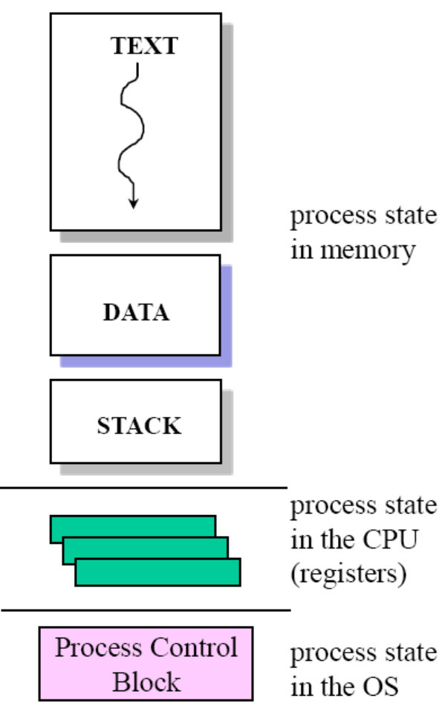
Process Concept
The components of a process are:
  the program to be executed
  the data on which the program will execute
  the resources required by the program—such as memory and file(s)
  the status of the execution
Operating System
Page <number>

Slide 7

Process in Memory
Operating System
Page <number>

Slide 8
Process State
As a process executes, it changes state
  new:
    The process is being created
  running:
    Instructions are being executed
  waiting:
    The process is waiting for some event to occur
  ready:
    The process is waiting to be assigned to a processor
  terminated:
    The process has finished execution
Operating System
Page <number>

Slide 9

Diagram of Process State
Operating System
Page <number>

Slide 10

Process Control Block (PCB)
Process is represent in the OS by a process control block
Operating System
Page <number>

Slide 11
Process Control Block (PCB)
Information associated with each process
  Process state
  Program counter
  CPU registers
  CPU scheduling information
  Memory-management information
  Accounting information
  I/O status information
Operating System
Page <number>

Slide 12

CPU Switch From Process to Process
Operating System
Page <number>

Slide 13
Chapter 3: Processes
Process Concept
Process Scheduling
Operations on Processes
Cooperating Processes
Interprocess Communication
Communication in Client-Server Systems
Operating System
Page <number>

Slide 14
Process Scheduling
The objective of multiprogramming is to have some process running at all times, to maximize CPU utilization
The objective of time sharing is to switch the CPU among process so frequently that users can interact with each program while it is running.
Process scheduler selects an available process for program execution on the CPU
Operating System
Page <number>

Slide 15
Process Scheduling Queues
Ready queue
  set of all processes residing in main memory, ready and waiting to execute
Device queues
  set of processes waiting for an I/O device
Processes “migrate ” among the various queues
Operating System
Page <number>

Slide 16

Ready Queue And Various I/O Device Queues
Operating System
Page <number>

Slide 17

Representation of Process Scheduling
Operating System
Page <number>

Slide 18
Schedulers
Long-term scheduler (or job scheduler)
  selects which processes should be brought into the ready queue
Short-term scheduler (or CPU scheduler)
  selects which process should be executed next and allocates CPU
Operating System
Page <number>

Slide 19

Addition of Medium Term Scheduling
Sometimes, it can be good to swap processes out.
Operating System
Page <number>

Slide 20
Schedulers (Cont.)
Short-term scheduler is invoked very frequently (milliseconds) ⇒ (must be fast)
Long-term scheduler is invoked very infrequently (seconds, minutes) ⇒ (may be slow)
The long-term scheduler controls the degree of multiprogramming
Operating System
Page <number>

Slide 21
Schedulers (Cont.)
Processes can be described as either:
  I/O-bound process – spends more time doing I/O than computations.
  CPU-bound process – spends more time doing computations
It is important that the long-term scheduler select a good process mix of I/O-bound and CPU-bound process
Operating System
Page <number>

Slide 22
Context Switch
When CPU switches to another process, the system must save the state of the old process and load the saved state for the new process
Context-switch time is pure overhead; the system does no useful work while switching - typically takes milliseconds
Time dependent on hardware support
Operating System
Page <number>

Slide 23
Chapter 3: Processes
Process Concept
Process Scheduling
Operations on Processes
Inter-process Communication
Communication in Client-Server Systems
Operating System
Page <number>

Slide 24
Process Creation
Parent process create children processes, which, in turn create other processes, forming a tree of processes
Execution
  Parent and children execute concurrently
  Parent waits until children terminate
Operating System
Page <number>

Slide 25

A tree of processes on a typical Solaris
Operating System
Page <number>

Slide 26
Process Creation (Cont.)
Address space
  Child duplicate of parent
  Child has a program loaded into it
UNIX examples
  fork system call creates new process
  exec system call used after a fork to replace the process’ memory space with a new program
Operating System
Page <number>

Slide 27

Process Creation (Cont.)
Operating System
Page <number>

Slide 28
C Program Forking Separate Process
int main()
{
pid_t pid;
/* fork another process */
pid = fork();
if (pid < 0) { /* error occurred */
fprintf(stderr, "Fork Failed");
exit(-1);
}
else if (pid == 0) { /* child process */
execlp("/bin/ls", "ls", NULL);
}
else { /* parent process */
/* parent will wait for the child to complete */
wait (NULL);
printf ("Child Complete");
exit(0);
}
}
Operating System
Page <number>

Slide 29
Process Termination
Process executes last statement and asks the operating system to delete it (exit)
  Output data from child to parent (via wait)
  Process’ resources are deallocated by operating system
Parent may terminate execution of children processes (abort)
  Child has exceeded allocated resources
  Task assigned to child is no longer required
  If parent is exiting
    Some operating system do not allow child to continue if its parent terminates
      All children terminated - cascading termination
Operating System
Page <number>

Slide 30
Chapter 3: Processes
Process Concept
Process Scheduling
Operations on Processes
Inter-process Communication
Communication in Client-Server Systems
Operating System
Page <number>

Slide 31
Inter-process Communication
Why do processes cooperate?
  Information sharing: several users may be interested in the same piece of information
  modularity: breaking up a system into several sub-systems
  convenience: a user may work on many tasks at the same time.
  speedup: a single program is run as several sub-programs
Operating System
Page <number>

Slide 32
Inter-process Communication
How do processes cooperate?
  communication abstraction: producers and consumers
    Producers produce a piece of information
    Consumers use this information
Two general classes of process cooperation techniques
  shared memory
  message passing
Operating System
Page <number>

Slide 33

Communications Models
Message Passing
Shared memory
Operating System
Page <number>

Slide 34
Shared Memory
Communicating processes establish a region of shared memory.
Shared memory resides in the address space of the process creating the shared-memory segment.
Other process attach it to their address space.
  remove the restriction of preventing one process from accessing another process’s memory.
Operating System
Page <number>

Slide 35
Message-Passing System
Message passing provides a mechanism for processes to communicate and to synchronize their actions without resorting to shared variables
Particularly useful in a distributed environment.
Message-passing facility provides two operations:
  send(message) – message size fixed or variable
  receive(message)
If P and Q wish to communicate, they need to:
  establish a communication link between them
  exchange messages via send/receive
Operating System
Page <number>

Slide 36
Logical Implementation
Direct or indirect communication
Synchronous or asynchronous communication
Automatic or explicit buffering
Operating System
Page <number>

Slide 37
Direct Communication
Processes must name each other explicitly:
  send (P, message) – send a message to process P
  receive(Q, message) – receive a message from process Q
Properties of communication link
  Links are established automatically
  A link is associated with exactly one pair of communicating processes
  Between each pair there exists exactly one link
  The link may be unidirectional, but is usually bi-directional
Operating System
Page <number>

Slide 38
Indirect Communication
Messages are sent to and received from mailboxes (also referred to as ports)
  Each mailbox has a unique id
  Processes can communicate only if they share a mailbox
Properties of communication link
  Link established only if processes share a common mailbox
  A link may be associated with many processes
  Each pair of processes may share several communication links
  Link may be unidirectional or bi-directional
Operating System
Page <number>

Slide 39
Indirect Communication
Operations
  create a new mailbox
  send and receive messages through mailbox
  destroy a mailbox
Primitives are defined as:
send(A, message) – send a message to mailbox A
receive(A, message) – receive a message from mailbox A
Operating System
Page <number>

Slide 40
Synchronization
Message passing may be either blocking or non-blocking
Blocking is considered synchronous
  Blocking send has the sender block until the message is received
  Blocking receive has the receiver block until a message is available
Non-blocking is considered asynchronous
  Non-blocking send has the sender send the message and continue
  Non-blocking receive has the receiver receive a valid message or null
Operating System
Page <number>

Slide 41
Buffering
Queue of messages attached to the link; implemented in one of three ways
  1. Zero capacity – 0 messages
  Sender must wait for receiver (rendezvous)
  2. Bounded capacity – finite length of n messages
  Sender must wait if link full
  3. Unbounded capacity – infinite length
  Sender never waits
Operating System
Page <number>

Slide 42
Chapter 3: Processes
Process Concept
Process Scheduling
Operations on Processes
Inter-process Communication
Communication in Client-Server Systems
Operating System
Page <number>

Slide 43
Client-Server Communication
Sockets
Remote Procedure Calls
Operating System
Page <number>

Slide 44
Sockets
A socket is defined as an endpoint for communication
Identified by an IP address concatenated with a port number
The socket 161.25.19.8:1625 refers to port 1625 on host 161.25.19.8
Communication consists between a pair of sockets
Operating System
Page <number>

Slide 45

Socket Communication
Operating System
Page <number>

Slide 46
Remote Procedure Calls
Remote procedure call (RPC) abstracts procedure calls between processes on networked systems.
Stubs – client-side proxy for the actual procedure on the server.
The client-side stub locates the server and marshals the parameters. Then transmits a message to the server using message passing.
The server-side stub receives this message, unpacks the marshaled parameters, and performs the procedure on the server.
Operating System
Page <number>

Slide 47
Remote Procedure Calls- Three Problems
Difference in data representation
  big-endian and little-endian
  Machine-independent representation
Common network errors, result in RPC fail or executed more than once
  At most once—timestamps
  Exactly once—ACK message
Binding the client and the sever port
  Fixed port address
  Matchmaker daemon on a fixed RPC port
Operating System
Page <number>

Slide 48
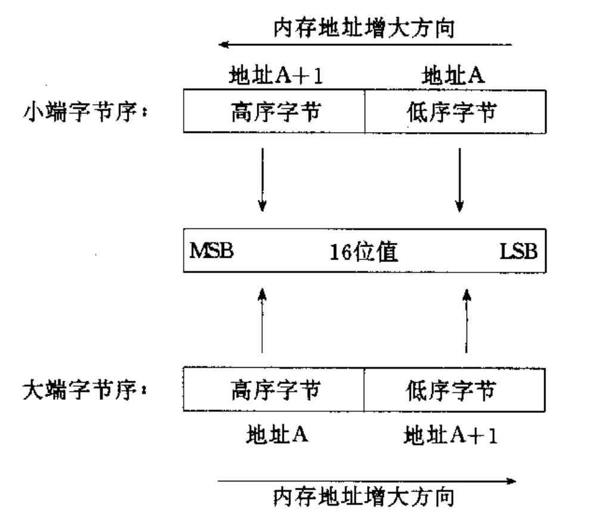
big-endian and little-endian
Operating System
Page <number>

Slide 49
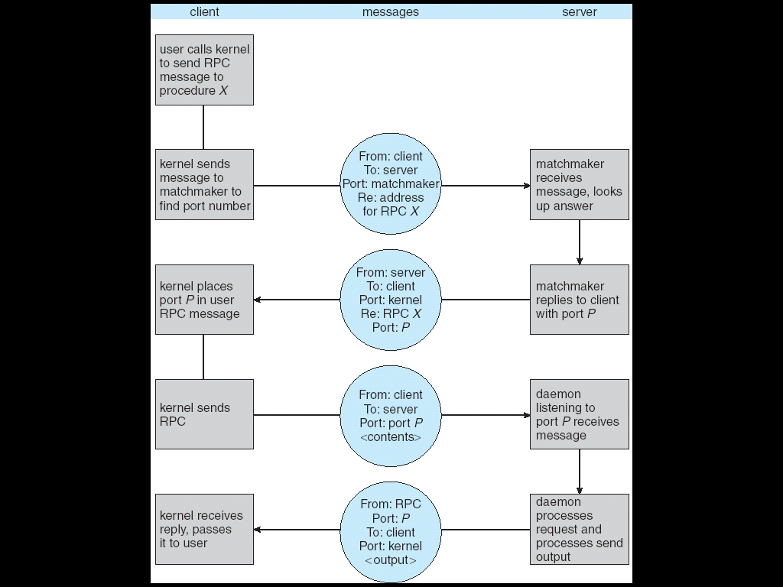
Execution of RPC
Operating System
Page <number>

Slide 50
Assignments
3.1, 3.2, 3.4
Operating System
Page <number>

Slide 51
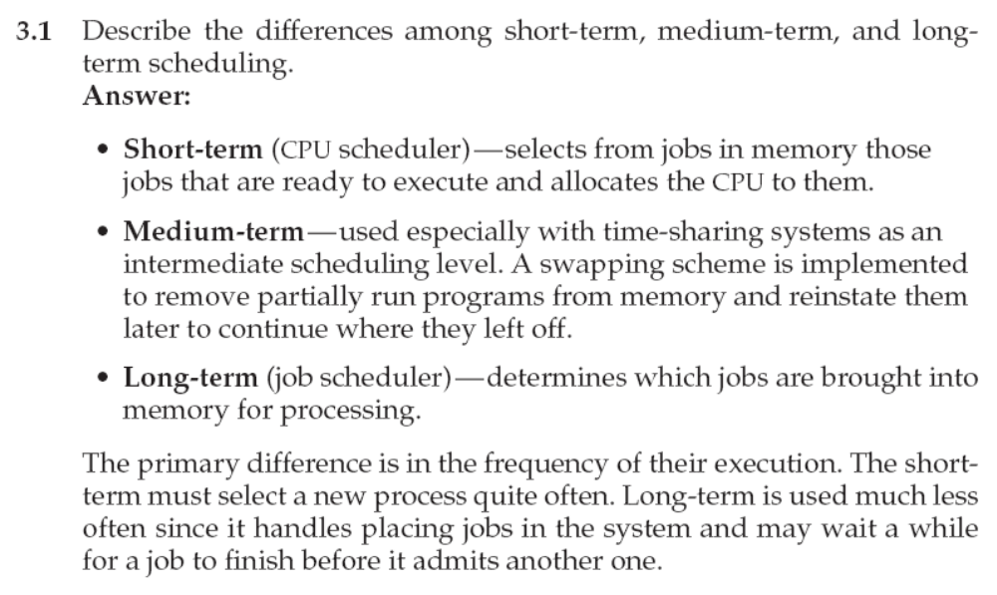
3.1 答案
Operating System
Page <number>

Slide 52
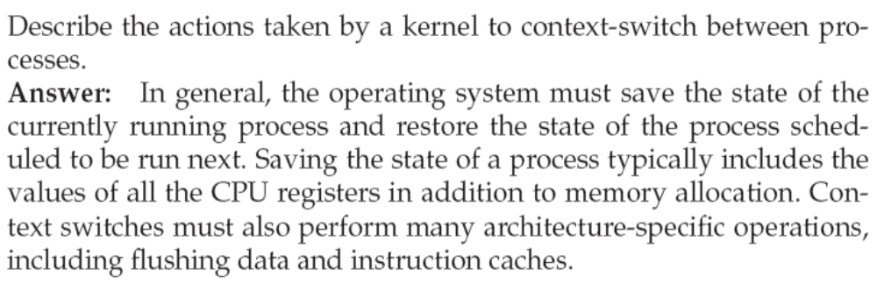
3.2 答案
Operating System
Page <number>

Slide 53
练习1
画出进程状态转换图，包括引起转换的原因
Operating System
Page <number>

Slide 54
练习2
简单列出PCB中包含的内容
  Process state
  Program counter
  CPU registers
  CPU scheduling information
  Memory-management information
  Accounting information
  I/O status information
Operating System
Page <number>

Slide 55
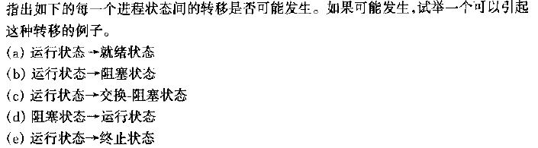
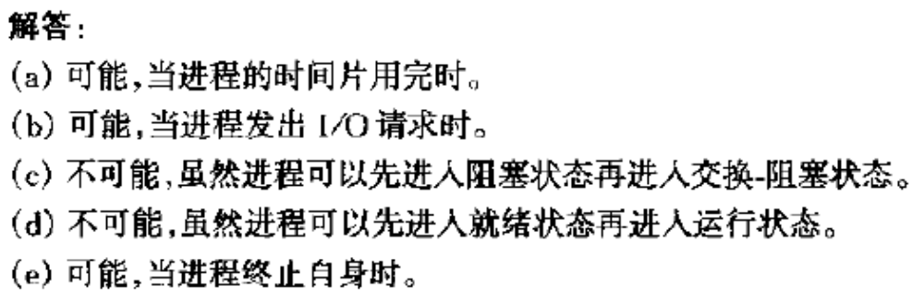
练习3
Operating System
Page <number>

Slide 56
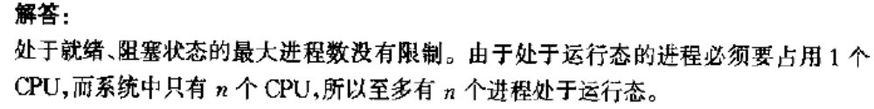
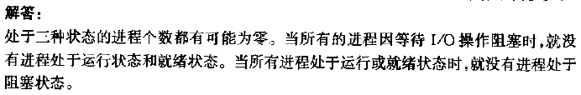
练习4
Operating System
Page <number>

Slide 57
End of Chapter 3

