Slide 1
Chapter 4: Threads

Slide 2
Objectives
To introduce the notion of a thread - a fundamental unit of CPU utilization that forms the basis of multithreaded computer systems.
To discuss the APIs for Pthreads, Win32, and Java thread libraries.
Operating System
Page <number>

Slide 3
Chapter 4: Threads
Overview
Multithreading Models
Threading Issues
Pthreads
Windows XP Threads
Linux Threads
Java Threads
Operating System
Page <number>

Slide 4
Chapter 4: Threads
Overview
Multithreading Models
Threading Issues
Pthreads
Windows XP Threads
Linux Threads
Java Threads
Operating System
Page <number>

Slide 5

Single and Multithreaded Processes
通信方便 创建快捷
Operating System
Page <number>

Slide 6
Benefits
Responsiveness
interactive applications
Resource Sharing
memory for code and data can be shared.
Economy
creating processes are more expensive.
Utilization of MP Architectures
multi-threading increases concurrency.
Operating System
Page <number>

Slide 7
Chapter 4: Threads
Overview
Multithreading Models
Threading Issues
Pthreads
Windows XP Threads
Linux Threads
Java Threads
Operating System
Page <number>

Slide 8
Multithreading Models
User Thread
Kernel Thread
Operating System
Page <number>

Slide 9
User Threads
Thread management done by user-level threads library
Three primary thread libraries:
  POSIX Pthreads
  Win32 threads
  Java threads
Operating System
Page <number>

Slide 10
Kernel Threads
Supported by the Kernel
Almost all contemporary OS implements kernel threads. Examples
  Windows XP/2000
  Solaris
  Linux
  Tru64 UNIX
  Mac OS X
Operating System
Page <number>

Slide 11
Multithreading Models
Many-to-One
One-to-One
Many-to-Many
Operating System
Page <number>

Slide 12
Many-to-One
Many user-level threads mapped to single kernel thread
Examples:
  Solaris Green Threads
  GNU Portable Threads
Operating System
Page <number>

Slide 13

Many-to-One Model
Operating System
Page <number>

Slide 14
Many-to-One Model
Many-to-One
  thread management is efficient
  but will block if making system call, kernel can schedule only one thread at a time
Operating System
Page <number>

Slide 15
One-to-One
Each user-level thread maps to one kernel thread
Examples
  Windows NT/XP/2000
  Linux
  Solaris 9 and later
Operating System
Page <number>

Slide 16

One-to-one Model
Operating System
Page <number>

Slide 17
One-to-one Model
One-to-One
  more concurrency
  but creating thread is expensive
Operating System
Page <number>

Slide 18
Many-to-Many Model
Allows many user level threads to be mapped to many kernel threads
Allows the operating system to create a sufficient number of kernel threads
Examples
  Solaris prior to version 9
  Windows NT/2000 with the ThreadFiber package
Operating System
Page <number>

Slide 19

Many-to-Many Model
Operating System
Page <number>

Slide 20
Many-to-Many Model
Many-to-Many
  suffer from neither of above shortcomings
  flexible
Operating System
Page <number>

Slide 21
Two-level Model
Similar to M:M, except that it allows a user thread to be bound to kernel thread
Examples
  IRIX
  HP-UX
  Tru64 UNIX
  Solaris 8 and earlier
Operating System
Page <number>

Slide 22

Two-level Model
Operating System
Page <number>

Slide 23
Chapter 4: Threads
Overview
Multithreading Models
Threading Issues
Pthreads
Windows XP Threads
Linux Threads
Java Threads
Operating System
Page <number>

Slide 24
Threading Issues
Semantics of fork() and exec() system calls
Thread cancellation
Signal handling
Thread pools
Thread-specific data
Scheduler activations
Operating System
Page <number>

Slide 25
Semantics of fork() and exec()
Does fork() duplicate only the calling thread or all threads?
Some unix systems have two versions of fork(), one that duplicates all threads and another that duplicates the thread that invokes fork().
Exec() will replace the entire process.
Operating System
Page <number>

Slide 26
Thread Cancellation
Terminating a thread before it has finished
Two general approaches:
  Asynchronous cancellation terminates the target thread immediately
  Deferred cancellation allows the target thread to periodically check via a flag if it should be cancelled
Operating System
Page <number>

Slide 27
Signal Handling
Signals are used in UNIX systems to notify a process that a particular event has occurred
A signal handler is used to process signals
  Signal is generated by particular event
  Signal is delivered to a process
  Signal is handled
Options: (method of delivery depends on the type of signal)
  Deliver the signal to the thread to which the signal applies
  Deliver the signal to every thread in the process
  Deliver the signal to certain threads in the process
  Assign a specific thread to receive all signals for the process
Operating System
Page <number>

Slide 28
Thread Pools
Create a number of threads in a pool where they await work
Advantages:
  Usually slightly faster to service a request with an existing thread than create a new thread
  Allows the number of threads in the application(s) to be bound to the size of the pool
Operating System
Page <number>

Slide 29
Scheduler Activations
Both M:M and Two-level models require communication to maintain the appropriate number of kernel threads allocated to the application
LWP is a virtual processor attached to kernel thread
Scheduler activations provide upcalls - a communication mechanism from the kernel to the thread library
This communication allows an application to maintain the correct number kernel threads
when an application thread is about to block, an upcall is triggered.
Operating System
Page <number>

Slide 30
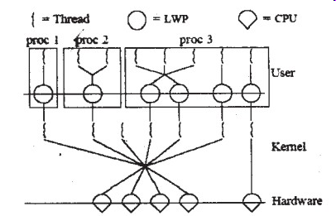
Scheduler Activations
Operating System
Page <number>

Slide 31
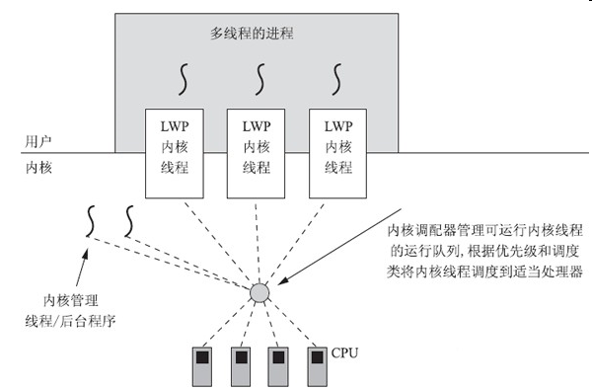
Solaris10线程模型
Operating System
Page <number>

Slide 32
Chapter 4: Threads
Overview
Multithreading Models
Threading Issues
Pthreads
Windows XP Threads
Linux Threads
Operating System
Page <number>

Slide 33
Pthreads
A POSIX standard (IEEE 1003.1c) API for thread creation and synchronization
API specifies behavior of the thread library, implementation is up to development of the library
Common in UNIX operating systems (Solaris, Linux, Mac OS X)
Operating System
Page <number>

Slide 34
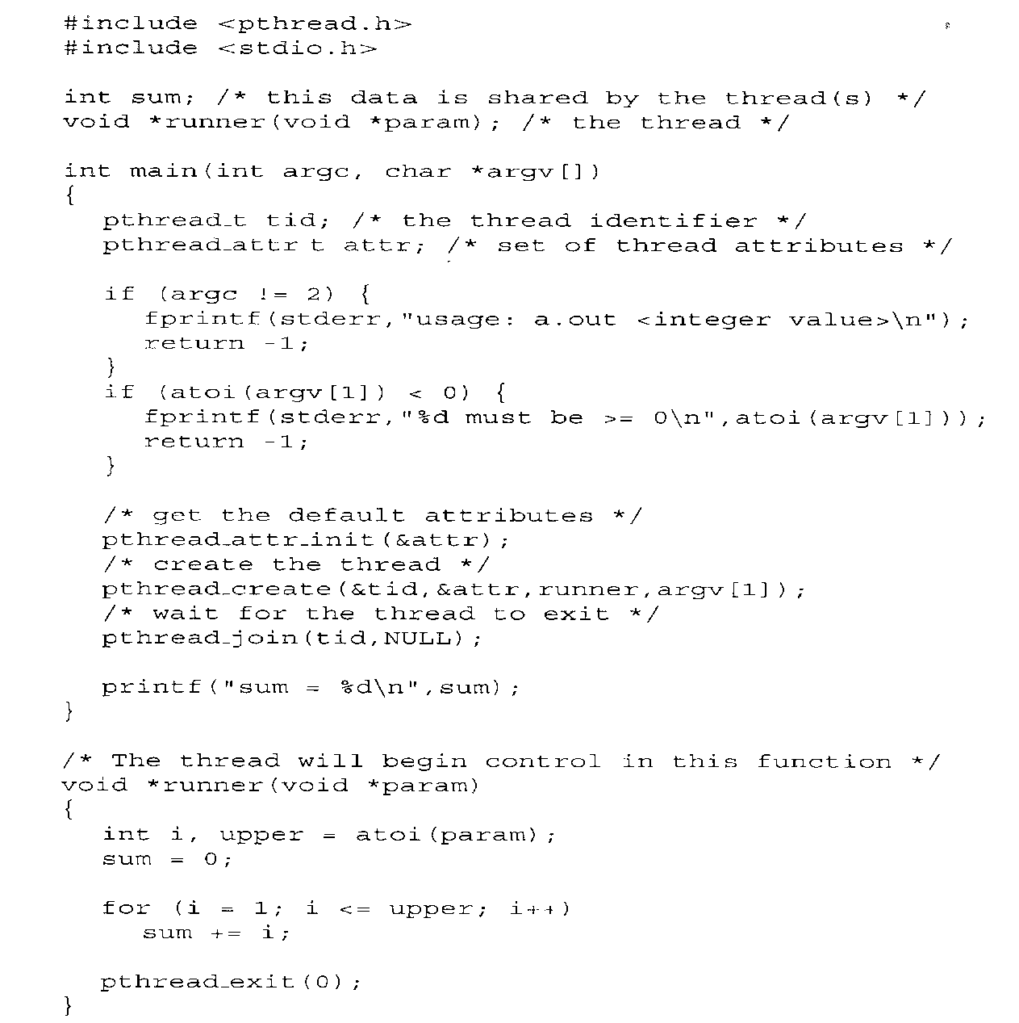
Pthreads
Operating System
Page <number>

Slide 35
Windows XP Threads
Implements the one-to-one mapping
Each thread contains
  A thread id
  Register set
  Separate user and kernel stacks
  Private data storage area
The register set, stacks, and private storage area are known as the context of the threads
Operating System
Page <number>

Slide 36
Linux Threads
Linux refers to them as tasks rather than threads
Thread creation is done through clone() system call
clone() allows a child task to share the address space of the parent task (process)
Operating System
Page <number>

Slide 37
Assignments
4.3，4.4, 4.5, 4.7
Operating System
Page <number>

Slide 38
4.3
Under what circumstances does a multithreaded solution using multiple kernel threads provide better performance than a single-threaded solution on a single-processor system?
Answer: When a kernel thread suffers a page fault, another kernel thread can be switched in to use the interleaving time in a useful manner. A single-threaded process, on the other hand, will not be capable of performing useful work when a page fault takes place. Therefore, in scenarios where a program might suffer from frequent page faults or has to wait for other system events, a multi-threaded solution would perform better even on a single-processor system
Operating System
Page <number>

Slide 39
4.4
Which of the following components of program state are shared across threads in a multithreaded process?
    a. Register values
    b. Heap memory
    c. Global variables
    d. Stack memory
Answer: The threads of a multithreaded process share heap memory and global variables. Each thread has its separate set of register values and a separate stack.
Operating System
Page <number>

Slide 40
4.5
Can a multithreaded solution using multiple user-level threads achieve better performance on a multiprocessor system than on a single-processor system?
Answer: A multithreaded system comprising of multiple user-level threads cannot make use of the different processors in a multiprocessor system simultaneously. The operating system sees only a single process and will not schedule the different threads of the process on separate processors. Consequently, there is no performance benefit associated with executing multiple user-level threads on a multiprocessor system.
Operating System
Page <number>

Slide 41
4.7
The program shown in Figure 4.11 uses the Pthreads API. What would be output from the program at LINE C and LINE P?
Answer: Output at LINE C is 5. Output at LINE P is 0.
Operating System
Page <number>

Slide 42
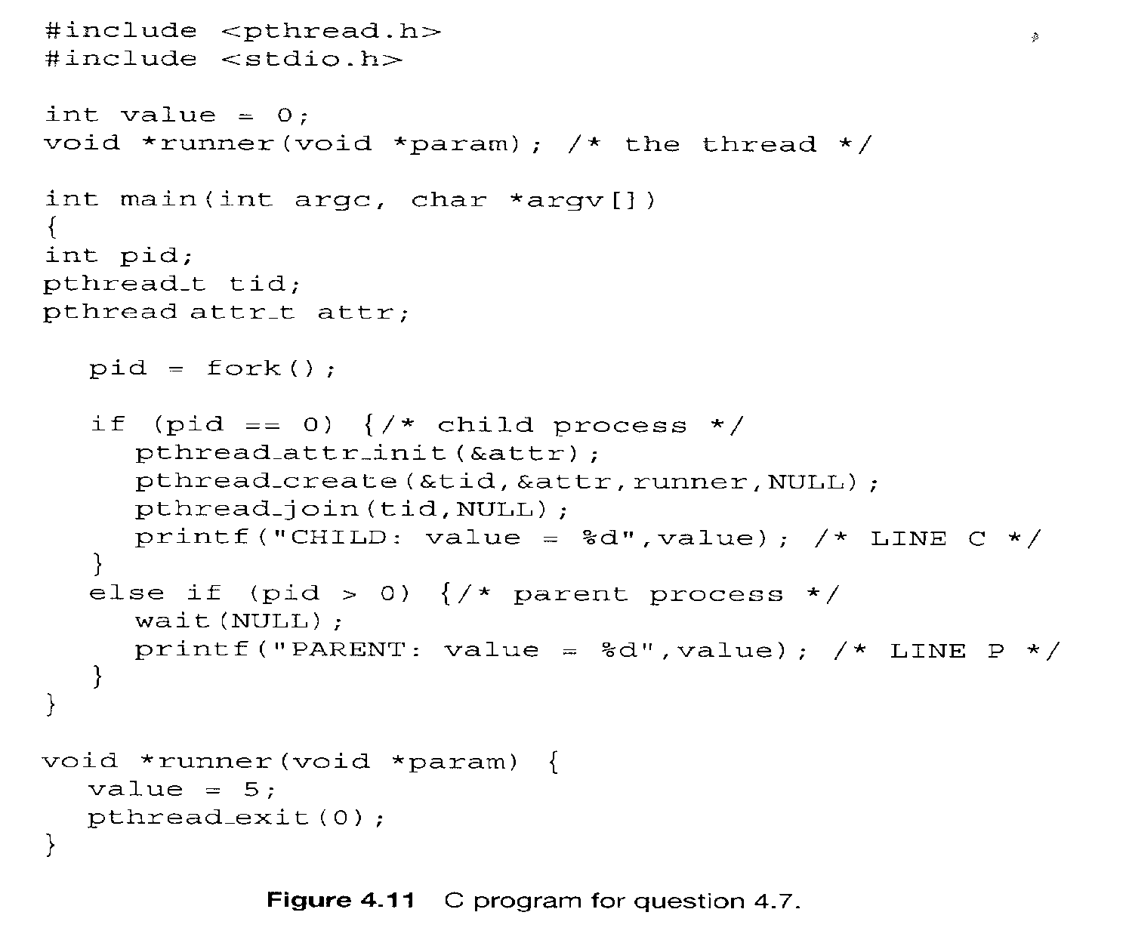
4.7
Operating System
Page <number>

Slide 43
End of Chapter 4

