Slide 1
Chapter 5: CPU Scheduling

Slide 2
Objectives
To introduce CPU scheduling
To describe various CPU-scheduling algorithms
To discuss evaluation criteria for selecting a CPU-scheduling algorithm
Operating System
Page <number>

Slide 3
Chapter 5: CPU Scheduling
Basic Concepts
Scheduling Criteria
Scheduling Algorithms
Multiple-Processor Scheduling
Thread Scheduling
Operating Systems Examples
Algorithm Evaluation
Operating System
Page <number>

Slide 4
Chapter 5: CPU Scheduling
Basic Concepts
Scheduling Criteria
Scheduling Algorithms
Multiple-Processor Scheduling
Thread Scheduling
Operating Systems Examples
Algorithm Evaluation
Operating System
Page <number>

Slide 5
Basic Concepts
Maximum CPU utilization obtained with multi-programming
CPU–I/O Burst Cycle
  Process execution consists of a cycle of CPU execution and I/O wait
Operating System
Page <number>
Notes:
1. 简单计算机工作模式 ->多道程序模式可以有效利用 -> CPU调度是操作系统的基本功能

Slide 6

Alternating Sequence of CPU And I/O Bursts
Operating System
Page <number>

Slide 7

Histogram of CPU-burst Times
CPU burst distribution is generally characterized as exponential or hyper-exponential
Operating System
Page <number>

Slide 8
CPU Scheduler
Selects from among the processes in memory that are ready to execute, and allocates the CPU to one of them
CPU scheduling decisions may take place when a process:
  1. Switches from running to waiting state
  2. Switches from running to ready state
  3. Switches from waiting to ready
  4. Terminates
Scheduling under 1 and 4 is nonpreemptive
All other scheduling is preemptive
Operating System
Page <number>

Slide 9
Dispatcher
Dispatcher module gives control of the CPU to the process selected by the short-term scheduler; this involves:
  switching context
  switching to user mode
  jumping to the proper location in the user program to restart that program
Dispatch latency
  time it takes for the dispatcher to stop one process and start another running
Operating System
Page <number>

Slide 10
Chapter 5: CPU Scheduling
Basic Concepts
Scheduling Criteria
Scheduling Algorithms
Multiple-Processor Scheduling
Thread Scheduling
Operating Systems Examples
Algorithm Evaluation
Operating System
Page <number>

Slide 11
Scheduling Criteria
CPU utilization
  keep the CPU as busy as possible
Throughput
  number of processes that complete their execution per time unit
Turnaround time
  amount of time to execute a particular process (submission → completion)
Waiting time
  amount of time a process has been waiting in the ready queue
Response time
  amount of time it takes from when a request was submitted until the first response is produced, not output (for time-sharing environment)
Operating System
Page <number>

Slide 12
Optimization Criteria
Max CPU utilization
Max throughput
Min turnaround time
Min waiting time
Min response time
Operating System
Page <number>

Slide 13
Chapter 5: CPU Scheduling
Basic Concepts
Scheduling Criteria
Scheduling Algorithms
Multiple-Processor Scheduling
Thread Scheduling
Operating Systems Examples
Algorithm Evaluation
Operating System
Page <number>

Slide 14
First-Come, First-Served (FCFS) Scheduling
Process Burst Time
P₁ 24
P₂ 3
P₃ 3
Suppose that the processes arrive in the order: P₁ , P₂ , P₃
The Gantt Chart for the schedule is:
Waiting time for P₁ = 0; P₂ = 24; P₃ = 27
Average waiting time: (0 + 24 + 27)/3 = 17
P₁
P₂
P₃
0
24
27
30
Operating System
Page <number>

Slide 15
FCFS Scheduling (Cont.)
Suppose that the processes arrive in the order
P₂ , P₃ , P₁
The Gantt chart for the schedule is:
Waiting time for P₁ = 6; P₂ = 0; P₃ = 3
Average waiting time: (6 + 0 + 3)/3 = 3
Much better than previous case
Convoy effect - short process behind long process
P₂
P₃
P₁
0
3
6
30
Operating System
Page <number>

Slide 16
Shortest-Job-First (SJF) Scheduling
Associate with each process the length of its next CPU burst. Use these lengths to schedule the process with the shortest time
Two schemes:
  nonpreemptive – once CPU given to the process it cannot be preempted until completes its CPU burst
  preemptive – if a new process arrives with CPU burst length less than remaining time of current executing process, preempt. This scheme is know as the
  Shortest-Remaining-Time-First (SRTF)
SJF is optimal –
  gives minimum average waiting time for a given set of processes
Operating System
Page <number>

Slide 17
Example of Non-Preemptive SJF
Process Arrival Time Burst Time
P₁ 0.0 7
P₂ 2.0 4
P₃ 4.0 1
P₄ 5.0 4
SJF (non-preemptive)
Average waiting time = (0 + 6 + 3 + 7)/4 = 4
P₁
P₃
P₂
P₄
0
3
7
8
12
16
Operating System
Page <number>

Slide 18
Example of Preemptive SJF
Process Arrival Time Burst Time
P₁ 0.0 7
P₂ 2.0 4
P₃ 4.0 1
P₄ 5.0 4
SJF (preemptive)
Average waiting time = (9 + 1 + 0 +2)/4 = 3
P₁
P₂
P₃
P₂
P₄
P₁
0
2
4
5
7
11
16
Operating System
Page <number>

Slide 19

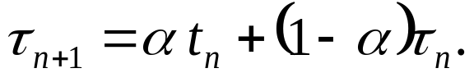
Determining Length of Next CPU Burst
Can only estimate the length
Can be done by using the length of previous CPU bursts, using exponential averaging
Operating System
Page <number>

Slide 20
Examples of Exponential Averaging
α =0
  τ_{n+1} = τ_{n}
  Recent history does not count
α =1
  τ_{n+1} = α t_{n}
  Only the actual last CPU burst counts
If we expand the formula, we get:
    τ_{n+1} = α t_{n}+(1 - α)α t_{n} ₋₁ + …
    +(1 - α )^{j} α t_{n} _{-j} + …
    +(1 - α )^{n +1} τ₀
Since both α and (1 - α) are less than or equal to 1, each successive term has less weight than its predecessor
Operating System
Page <number>
Notes:
predecessor
前任，前辈

Slide 21

Prediction of the Length of the Next CPU Burst
τ₀=10， α=1/2
Operating System
Page <number>

Slide 22
Priority Scheduling
A priority number (integer) is associated with each process
The CPU is allocated to the process with the highest priority (smallest integer ≡ highest priority)
  Preemptive
  nonpreemptive
SJF is a priority scheduling where priority is the predicted next CPU burst time
Problem
  Starvation – low priority processes may never execute
Solution
  Aging – as time progresses increase the priority of the process
Operating System
Page <number>
Notes:
三横线 恒等号，表示等式恒成立，与变量无关

Slide 23
Round Robin (RR)
Each process gets a small unit of CPU time (time quantum), usually 10-100 milliseconds. After this time has elapsed, the process is preempted and added to the end of the ready queue.
If there are n processes in the ready queue and the time quantum is q, then each process gets 1/n of the CPU time in chunks of at most q time units at once. No process waits more than (n-1)q time units.
Performance
  q large ⇒ FCFS
  q small ⇒ q must be large with respect to context switch, otherwise overhead is too high
Operating System
Page <number>

Slide 24
Example of RR with Time Quantum = 20
Process Burst Time
P₁ 53
P₂ 17
P₃ 68
P₄ 24
The Gantt chart is:
Typically, higher average turnaround than SJF, but better response
P₁
P₂
P₃
P₄
P₁
P₃
P₄
P₁
P₃
P₃
0
20
37
57
77
97
117
121
134
154
162
Operating System
Page <number>

Slide 25

Time Quantum and Context Switch Time
Operating System
Page <number>

Slide 26

Turnaround Time Varies With The Time Quantum
Operating System
Page <number>

Slide 27
Multilevel Queue
Ready queue is partitioned into separate queues:
  foreground (interactive)
  background (batch)
Each queue has its own scheduling algorithm
  foreground – RR
  background – FCFS
Scheduling must be done between the queues
  Fixed priority scheduling; (i.e., serve all from foreground then from background). Possibility of starvation.
  Time slice – each queue gets a certain amount of CPU time which it can schedule amongst its processes;
    i.e., 80% to foreground in RR，20% to background in FCFS
Operating System
Page <number>

Slide 28

Multilevel Queue Scheduling
Operating System
Page <number>

Slide 29
Multilevel Feedback Queue
A process can move between the various queues; aging can be implemented this way
Multilevel-feedback-queue scheduler defined by the following parameters:
  number of queues
  scheduling algorithms for each queue
  method used to determine when to upgrade a process
  method used to determine when to demote a process
  method used to determine which queue a process will enter when that process needs service
Operating System
Page <number>

Slide 30
Example of Multilevel Feedback Queue
Three queues:
  Q₀ – RR with time quantum 8 milliseconds
  Q₁ – RR with time quantum 16 milliseconds
  Q₂ – FCFS
Scheduling
  A new job enters queue Q₀ which is served RR. When it gains CPU, job receives 8 milliseconds. If it does not finish in 8 milliseconds, job is moved to queue Q₁.
  At Q₁ job is again served RR and receives 16 additional milliseconds. If it still does not complete, it is preempted and moved to queue Q₂.
Operating System
Page <number>

Slide 31

Multilevel Feedback Queues
Operating System
Page <number>

Slide 32
练习1
Process Burst Time
P₁ 15
P₂ 9
P₃ 2
画出FCFS调度算法的甘特图，给出平均等待时间
Operating System
Page <number>

Slide 33
练习2
Process Arrival Time Burst Time
P₁ 0.0 8
P₂ 3.0 4
P₃ 4.0 2
P₄ 5.0 4
1. 画出Preemptive SJF调度算法的甘特图，给出平均等待时间
2. 画出Non-Preemptive SJF调度算法的甘特图，给出平均等待时间
Operating System
Page <number>

Slide 34
练习3
Process Burst Time
P₁ 33
P₂ 17
P₃ 68
P₄ 24
画出RR 调度算法的甘特图，给出平均等待时间
Time Quantum = 20
Operating System
Page <number>

Slide 35
练习4
Process Arrival Time Burst Time
P₁ 0.0 6
P₂ 1.0 9
P₃ 2.0 3
P₄ 3.0 11
采用三级反馈队列调度，其中一级和二级队列采用RR调度，时间片分别为2和4，三级队列采用FCFS调度.
画出调度甘特图，给出平均等待时间
Operating System
Page <number>

Slide 36
Chapter 5: CPU Scheduling
Basic Concepts
Scheduling Criteria
Scheduling Algorithms
Multiple-Processor Scheduling
Thread Scheduling
Operating Systems Examples
Algorithm Evaluation
Operating System
Page <number>

Slide 37
Multiple-Processor Scheduling
CPU scheduling more complex when multiple CPUs are available
Homogeneous processors within a multiprocessor
Asymmetric multiprocessing
  Has all scheduling decisions, I/O processing, and other system activities handled by a single processor, the other processors execute only user code;
  only one processor accesses the system data structures, alleviating the need for data sharing
Symmetric multiprocessing (SMP)
  Each processor is self-scheduling
Operating System
Page <number>

Slide 38
Processor Affinity
What happens if a process migrates to another processor:
  The contents of cache memory must be invalidated for the processor being migrated from, and the cache for the processor migrates to must be re-populated
Processor Affinity
  A process has an affinity for the processor on which it is currently running
  Soft affinity and hard affinity
Operating System
Page <number>

Slide 39
Load Balancing
Load balancing attempts to keep the workload evenly distributed across all processors in an SMP systems
Only necessary on systems where each processor has its own private queue of eligible processes
Two general approaches to load balancing
  Push migration
  Pull migration
  Not be mutually exclusive and are often implemented in parallel (Linux, FreeBSD)
Operating System
Page <number>

Slide 40
Chapter 5: CPU Scheduling
Basic Concepts
Scheduling Criteria
Scheduling Algorithms
Multiple-Processor Scheduling
Thread Scheduling
Operating Systems Examples
Algorithm Evaluation
Operating System
Page <number>

Slide 41
Thread Scheduling
Process-contention scope (PCS)
  Local Scheduling
  How the threads library decides which thread to put onto an available LWP
System-contention scope (SCS)
  Global Scheduling
  How the kernel decides which kernel thread to run next
Operating System
Page <number>

Slide 42
Chapter 5: CPU Scheduling
Basic Concepts
Scheduling Criteria
Scheduling Algorithms
Multiple-Processor Scheduling
Thread Scheduling
Operating Systems Examples
Algorithm Evaluation
Operating System
Page <number>

Slide 43
Operating System Examples
Solaris scheduling
Windows XP scheduling
Linux scheduling
Operating System
Page <number>

Slide 44
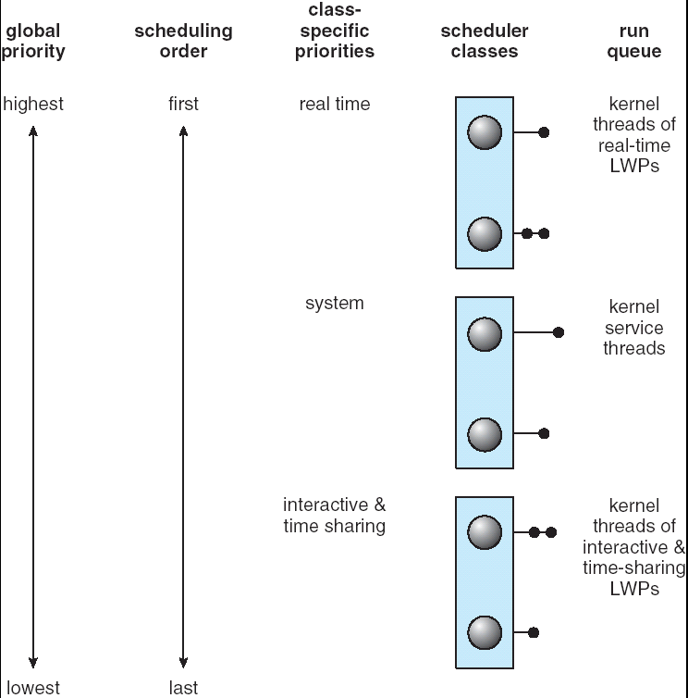
Solaris 2 Scheduling
Operating System
Page <number>

Slide 45

Solaris Dispatch Table
Operating System
Page <number>

Slide 46

Windows XP Priorities
Operating System
Page <number>
Notes:
横轴为主分类，纵轴为主分类内的分级

Slide 47
Linux Scheduling
Preemptive and priority-based
Two algorithms: time-sharing and real-time
Time-sharing
  Assign higher priority- tasks longer time quantum
  When a task exhausts its time quantum , will be moved from Active array to Expired array
Real-time
  Posix.1b compliant – two classes
    FCFS and RR
    Highest priority process always runs first
Operating System
Page <number>

Slide 48

The Relationship Between Priorities and Time-slice length
Operating System
Page <number>

Slide 49

List of Tasks Indexed According to Priorities
Operating System
Page <number>

Slide 50
Chapter 5: CPU Scheduling
Basic Concepts
Scheduling Criteria
Scheduling Algorithms
Multiple-Processor Scheduling
Thread Scheduling
Operating Systems Examples
Algorithm Evaluation
Operating System
Page <number>

Slide 51
Algorithm Evaluation
Deterministic modeling
Queueing models
Simulations
Implementation
Operating System
Page <number>

Slide 52
Assignment
5.3，5.4, 5.7, 5.11, 5.12
Operating System
Page <number>

Slide 53
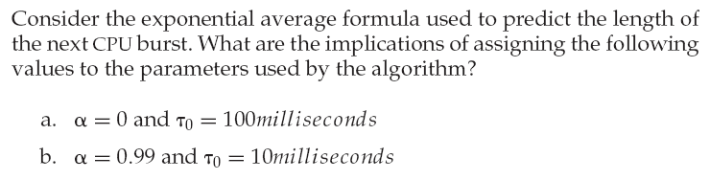
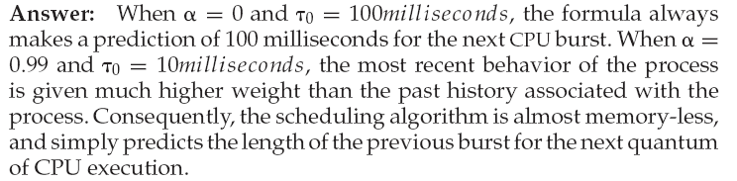
5.3
Operating System
Page <number>

Slide 54
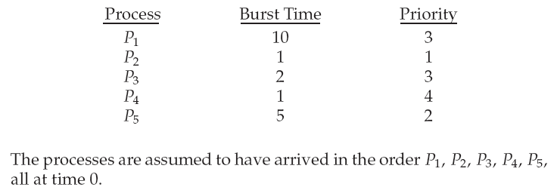
5.4
Operating System
Page <number>

Slide 55
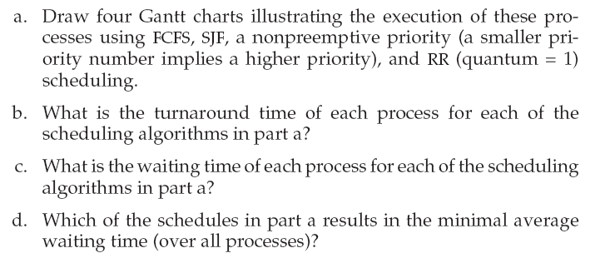
5.4
Operating System
Page <number>

Slide 56
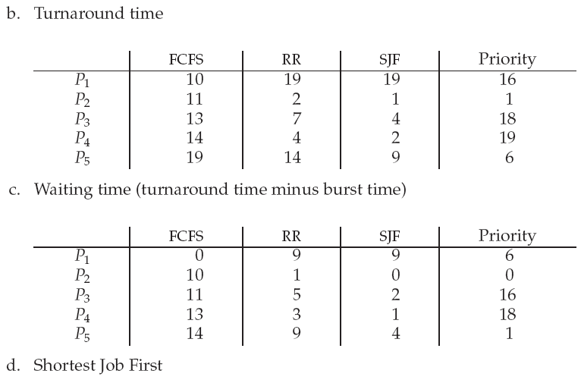
5.4答案
Operating System
Page <number>

Slide 57
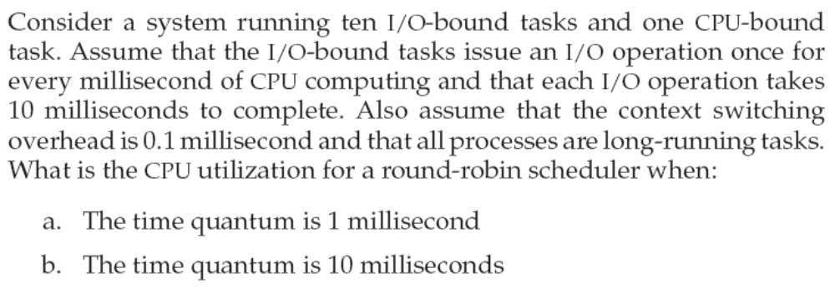
5.7
Operating System
Page <number>

Slide 58
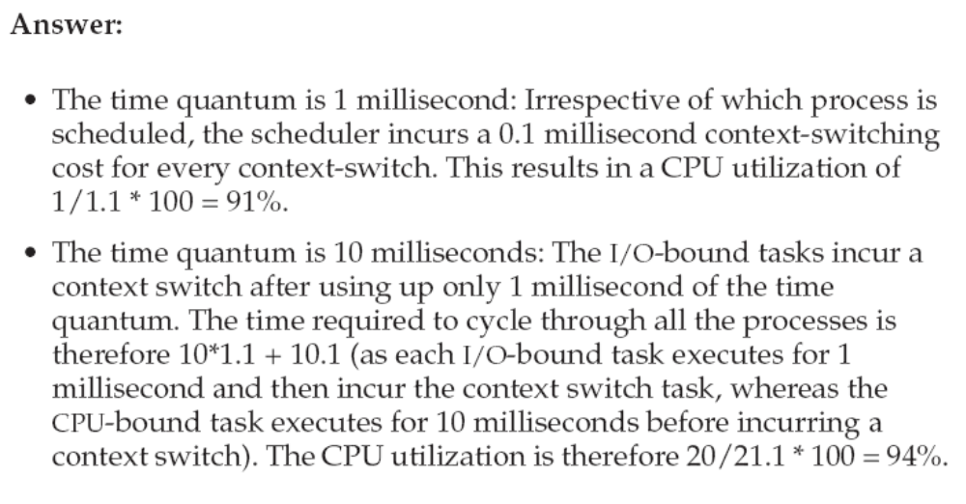
5.7答案
Operating System
Page <number>

Slide 59
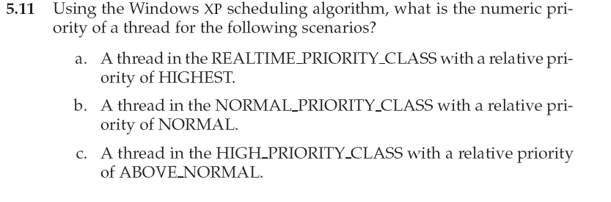
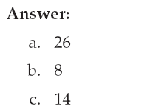
5.11
Operating System
Page <number>

Slide 60
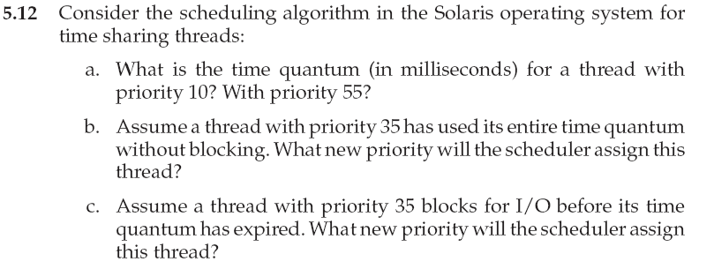
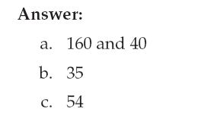
5.12
Operating System
Page <number>
Notes:
答案b 35应该为25

Slide 61
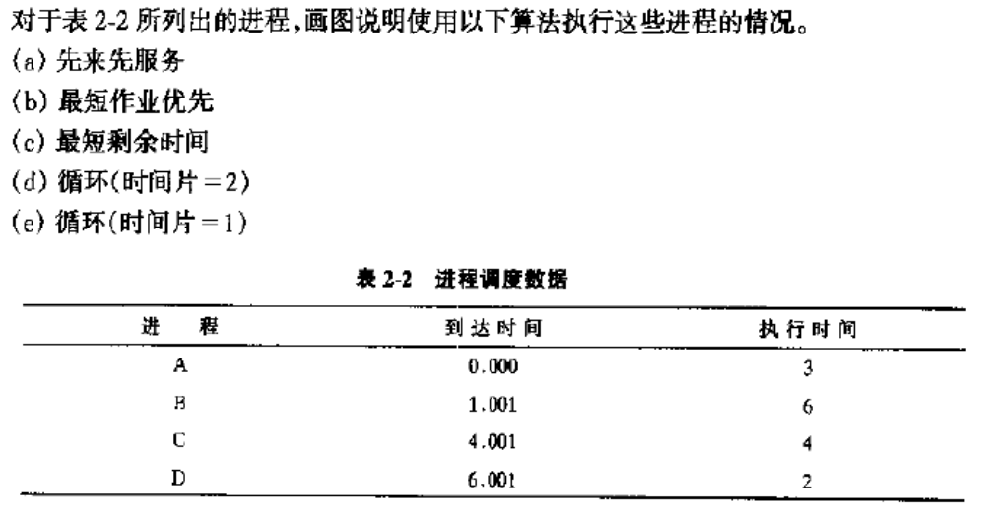
练习1
Operating System
Page <number>

Slide 62
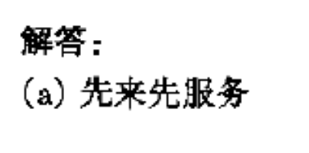
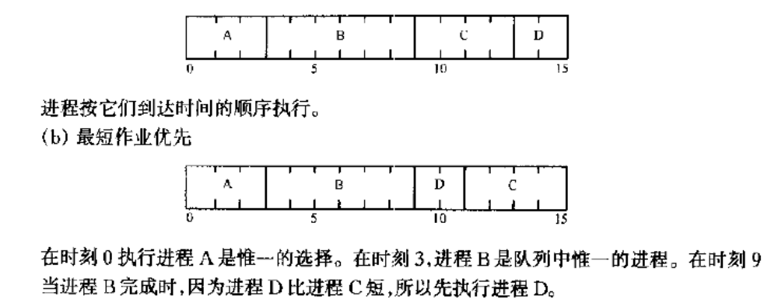
练习1答案
Operating System
Page <number>

Slide 63
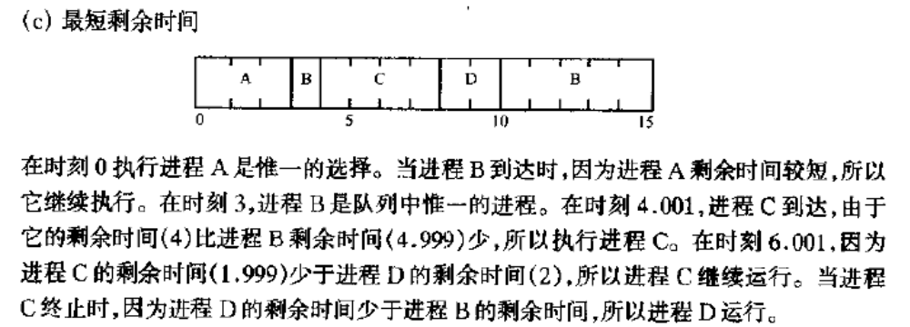
练习1答案
Operating System
Page <number>

Slide 64
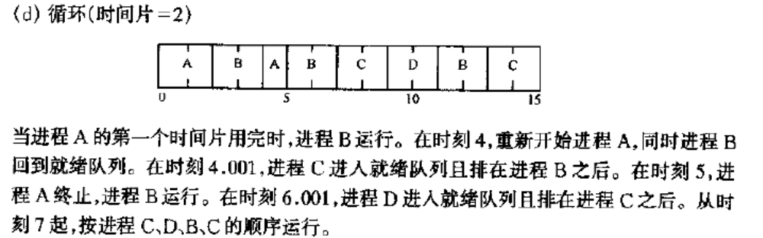
练习1答案
Operating System
Page <number>

Slide 65
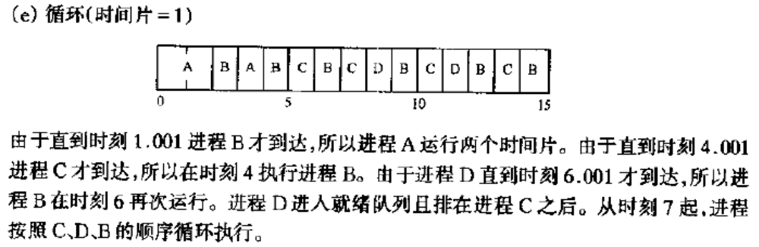
练习1答案
Operating System
Page <number>

Slide 66
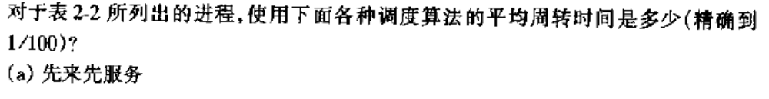
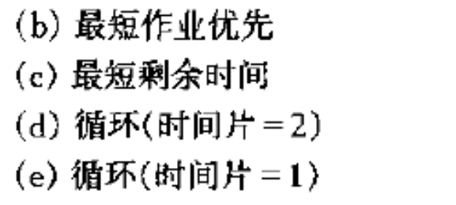
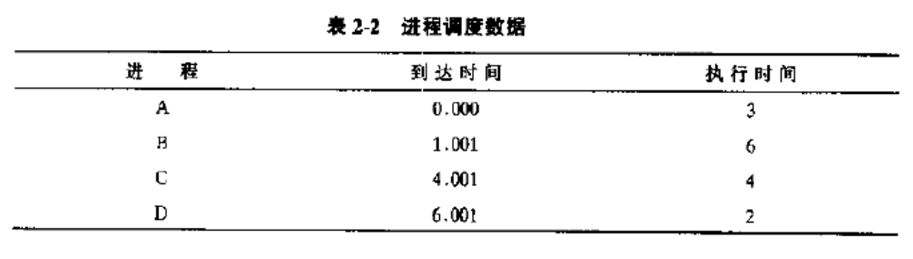
练习2
Operating System
Page <number>

Slide 67
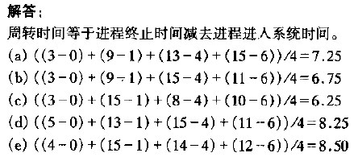
练习2 答案
Operating System
Page <number>

Slide 68
练习3
什么进程事件会引起CPU调度？哪些是抢占式调度？
  1. Switches from running to waiting state
  2. Switches from running to ready state
  3. Switches from waiting to ready
  4. Terminates
Scheduling under 1 and 4 is nonpreemptive
All other scheduling is preemptive
Operating System
Page <number>

Slide 69
End of Chapter 5

