Slide 1
Chapter 6: Process Synchronization

Slide 2
Objective
To introduce the critical-section problem, whose solution can be used to ensure the consistency of shared data
To present both software and hardware solution of the critical-section problem
To introduce the concept of atomic transaction and describe mechanisms to ensure atomicity
Operating System
Page <number>

Slide 3
Module 6: Process Synchronization
Background
The Critical-Section Problem
Peterson’s Solution
Synchronization Hardware
Semaphores
Classic Problems of Synchronization
Monitors
Synchronization Examples
Atomic Transactions
Operating System
Page <number>

Slide 4
Module 6: Process Synchronization
Background
The Critical-Section Problem
Peterson’s Solution
Synchronization Hardware
Semaphores
Classic Problems of Synchronization
Monitors
Synchronization Examples
Atomic Transactions
Operating System
Page <number>

Slide 5
Background
Concurrent access to shared data may result in data inconsistency
Maintaining data consistency requires mechanisms to ensure the orderly execution of cooperating processes
Suppose that we wanted to provide a solution to the consumer-producer problem that fills all the buffers.
  We can do so by having an integer count that keeps track of the number of full buffers.
  Initially, count is set to 0.
  It is incremented by the producer after it produces a new buffer and is decremented by the consumer after it consumes a buffer.
Operating System
Page <number>

Slide 6
Producer
while (true) {
/* produce an item and put in nextProduced */
while (count == BUFFER_SIZE)
; // do nothing
buffer [in] = nextProduced;
in = (in + 1) % BUFFER_SIZE;
count++;
}
Operating System
Page <number>

Slide 7
Consumer
while (true) {
while (count == 0)
; // do nothing
nextConsumed = buffer[out];
out = (out + 1) % BUFFER_SIZE;
count--;
/* consume the item in nextConsumed
}
Operating System
Page <number>

Slide 8
Inconsistency
count++ could be implemented as
register1 = count
register1 = register1 + 1
count = register1
count-- could be implemented as
register2 = count
register2 = register2 - 1
count = register2
Consider this execution interleaving with “count = 5” initially:
  S0: producer execute register1 = count {register1 = 5}
  S1: producer execute register1 = register1 + 1 {register1 = 6}
  S2: consumer execute register2 = count {register2 = 5}
  S3: consumer execute register2 = register2 - 1 {register2 = 4}
  S4: producer execute count = register1 {count = 6 }
  S5: consumer execute count = register2 {count = 4}
Operating System
Page <number>

Slide 9
The Problem
Increment and decrement are not atomic
  two or more operations are executed atomically if the result of their execution is equivalent to that of some serial order of execution
  operations which are always executed atomically are called atomic
    byte read; byte write;
    word read; word write
Operating System
Page <number>

Slide 10
The Problem
Reasons for non-atomic execution
  uniprocessors
    interrupts
    context-switches
  multiprocessors
    Execution on different processors
Operating System
Page <number>

Slide 11
Race Condition
Several process access and manipulate the same data concurrently and the outcome of the execution depends on the particular order in which the access takes place, is called a race condition
To guard against the race condition above, we need to ensure that only one process at a time can be manipulating the variable count
Operating System
Page <number>

Slide 12
The Solution
The producer and consumer processes need to synchronize，so that they do not access shared variables at the same time
  this is called mutual exclusion
    the shared and critical variables can be accessed by only one process at a time
  access must be serialized even if the processes attempt concurrent access
    in the previous example: counter increment and decrement operations
Operating System
Page <number>

Slide 13
The Solution
achieving this by: Critical Section
  The part of a program in which the shared object is accessed
Operating System
Page <number>

Slide 14
Module 6: Process Synchronization
Background
The Critical-Section Problem
Peterson’s Solution
Synchronization Hardware
Semaphores
Classic Problems of Synchronization
Monitors
Synchronization Examples
Atomic Transactions
Operating System
Page <number>

Slide 15
Critical-Section
Critical section: in which the process may be changing the shared data
  Feature: when one process is executing in its critical section, no other process is to be allowed to execute in its critical section
    ENTRY-SECTION
    CRITICAL-SECTION-CODE
    EXIT-SECTION
Operating System
Page <number>

Slide 16
Critical-Section
  the ENTRY-SECTION controls access to make sure that no more than one process P_{i} gets to access the critical section at any given time
  the EXIT-SECTION does bookkeeping to make sure that other processes that are waiting know that P_{i} has exited
Operating System
Page <number>

Slide 17
Solution to Critical-Section Problem
A solution to the critical-section problem must satisfy the following three requirements:
  1. Mutual Exclusion - If process P_{i} is executing in its critical section, then no other processes can be executing in their critical sections
Operating System
Page <number>

Slide 18
Solution to Critical-Section Problem
  2. Progress - If no process is executing in its critical section and there exist some processes that wish to enter their critical section, then the selection of the processes that will enter the critical section next can not be postponed indefinitely
  3. Bounded Waiting - A bound must exist on the number of times that other processes are allowed to enter their critical sections after a process has made a request to enter its critical section and before that request is granted
Operating System
Page <number>

Slide 19
Solution to Critical-Section Problem
How can we implement critical sections?
  turn off interrupts around critical operations
  build on top of atomic memory load/store operations
  provide higher-level primitives
Operating System
Page <number>

Slide 20
Module 6: Process Synchronization
Background
The Critical-Section Problem
Peterson’s Solution
Synchronization Hardware
Semaphores
Classic Problems of Synchronization
Monitors
Synchronization Examples
Atomic Transactions
Operating System
Page <number>

Slide 21
Peterson’s Solution
Two process solution
Assume that the LOAD and STORE instructions are atomic; that is, cannot be interrupted.
The two processes share two variables:
  int turn;
  Boolean flag[2]
The variable turn indicates whose turn it is to enter the critical section.
The flag array is used to indicate if a process is ready to enter the critical section. flag[i] = true implies that process P_{i} is ready!
Operating System
Page <number>

Slide 22
Algorithm for Process P_{i}
while (true) {
flag[i] = TRUE;
turn = j;
while ( flag[j] && turn == j)
; // do nothing
CRITICAL SECTION
flag[i] = FALSE;
REMAINDER SECTION
}
Operating System
Page <number>

Slide 23
Petersen’s Algorithm: Mutual Exclusion
        1: flag[i] := true
        2: turn := j
        3: while (flag[j] && (turn == j))； //wait-a-bit
        CRITICAL SECTION
        4: flag[i] := false
Suppose: P₀ is in its critical section, and P₁ is wanting to enter
This can happen only if either
  (case1) P₀ found flag[1] false, or
  (case2) P₀ found turn == 0
  in the first case: P₁ will set turn after P₀ did, and find turn == 0
  in the second case: P₁ has already set turn = 0
  in both cases: P₁ will wait till flag[0] == false
Operating System
Page <number>

Slide 24
Petersen’s Algorithm: Progress
        1: flag[i] := true
        2: turn := j
        3: while (flag[j] and (turn == j))
        {}； //wait-a-bit
        CRITICAL SECTION
        4: flag[i] := false
To prove progress:
  if P₁ is not ready to enter the critical section
    flag[1] will be false  P₀ can enter
Operating System
Page <number>

Slide 25
Petersen’s Algorithm: Bounded Waiting
        1: flag[i] := true
        2: turn := j
        3: while (flag[j] and (turn == j))
        {}； //wait-a-bit
        CRITICAL SECTION
        4: flag[i] := false
To prove bounded waiting:
  let P₀ be in the critical section and P₁ be waiting on instruction 3 above
  if P₀ exits and goes elsewhere,
    either P₁ will find flag[0] to be false
    if not, P₀ will attempt to reenter the critical section, setting turn := 1
    in either case, P₁ will find the condition for waiting in (3) to be false and will enter the critical section
Operating System
Page <number>

Slide 26
Module 6: Process Synchronization
Background
The Critical-Section Problem
Peterson’s Solution
Synchronization Hardware
Semaphores
Classic Problems of Synchronization
Monitors
Synchronization Examples
Atomic Transactions
Operating System
Page <number>

Slide 27
Synchronization Hardware
Many systems provide hardware support for critical section code
Uni-processors – could disable interrupts
  Currently running code would execute without preemption
  Generally too inefficient on multiprocessor systems
Modern machines provide special atomic hardware instructions
    Atomic = non-interruptable
  Either test memory word and set value
  Or swap contents of two memory words
Operating System
Page <number>

Slide 28
TestAndSet Instruction
Definition:
boolean TestAndSet (boolean *target)
{
boolean rv = *target;
*target = TRUE;
return rv:
}
Operating System
Page <number>

Slide 29
Solution using TestAndSet
Shared boolean variable lock, initialized to false.
Solution:
while (true) {
while ( TestAndSet (&lock ))
; /* do nothing
// critical section
lock = FALSE;
// remainder section
}
Operating System
Page <number>

Slide 30
Swap Instruction
Definition:
void Swap (boolean *a, boolean *b)
{
boolean temp = *a;
*a = *b;
*b = temp:
}
Operating System
Page <number>

Slide 31
Solution using Swap
Shared Boolean variable lock initialized to FALSE; Each process has a local Boolean variable key.
Solution:
while (true) {
key = TRUE;
while ( key == TRUE)
Swap (&lock, &key );
// critical section
lock = FALSE;
// remainder section
}
Operating System
Page <number>

Slide 32
The problem
The various hardware-based solution to the critical-section problem are complicated for application programmer to use
To overcome this difficulty, we can use a synchronization tool called a semaphore
Operating System
Page <number>

Slide 33
Module 6: Process Synchronization
Background
The Critical-Section Problem
Peterson’s Solution
Synchronization Hardware
Semaphores
Classic Problems of Synchronization
Monitors
Synchronization Examples
Atomic Transactions
Operating System
Page <number>

Slide 34
Semaphore
Semaphore S – integer variable
Two standard operations modify S: wait() and signal()
  Originally called P() and V()
Can only be accessed via two indivisible (atomic) operations
  wait (S) {
  while S <= 0
  ; // no-op
  S--;
  }
  signal (S) {
  S++;
  }
Operating System
Page <number>

Slide 35
Semaphore as General Synchronization Tool
Counting semaphore – integer value can range over an unrestricted domain
Binary semaphore – integer value can range only between 0
and 1
  Also known as mutex locks
  Can implement a counting semaphore S as a binary semaphore
  Provides mutual exclusion
    Semaphore S; // initialized to 1
    wait (S);
  Critical Section
  signal (S);
Operating System
Page <number>

Slide 36
Semaphore Implementation Problem
Could now have busy waiting in critical section implementation
  Little busy waiting if critical section rarely occupied
  Note that applications may spend lots of time in critical sections and therefore this is not a good solution.
Must guarantee that no two processes can execute wait () and signal () on the same semaphore at the same time
  Thus, implementation becomes the critical section problem where the wait and signal code are placed in the critical section.
Operating System
Page <number>

Slide 37
Semaphore Implementation with no Busy waiting
With each semaphore there is an associated waiting queue.
Two operations:
  block – place the process invoking the operation on the appropriate waiting queue.
  wakeup – remove one of processes in the waiting queue and place it in the ready queue.
Operating System
Page <number>

Slide 38
Semaphore Implementation with no Busy waiting (Cont.)
Implementation of wait:
wait (S){
value--;
if (value < 0) {
add this process to waiting queue
block();
}
}
Implementation of signal:
signal (S){
value++;
if (value <= 0) {
remove a process P from the waiting queue
wakeup(P);
}
}
Operating System
Page <number>

Slide 39
Implementing the Synchronization Primitives
Need support for atomic operations from the underlying hardware
  applicable only to a small number of instructions
    else, can implement critical sections this way
Two choices
  Selectively disable interrupts on uniprocessor
    so, no unanticipated context switches atomic execution
  Rely on special hardware synchronization instructions
Operating System
Page <number>

Slide 40
Implementation Choices (2): Hardware Support
Rationale: Hardware instructions enable simpler/efficient solutions to common synchronization problems
  disabling interrupts is a brute-force approach
  does not work on multiprocessors
    simultaneous disabling of all interrupts is not feasible
Two common primitives
  test-and-set
  swap
Operating System
Page <number>

Slide 41
Deadlock and Starvation
Deadlock – two or more processes are waiting indefinitely for an event that can be caused by only one of the waiting processes
Let S and Q be two semaphores initialized to 1
P₀ P₁
wait (S); wait (Q);
wait (Q); wait (S);
. .
. .
signal (S); signal (Q);
signal (Q); signal (S);
Starvation – indefinite blocking. A process may never be removed from the semaphore queue in which it is suspended.
Operating System
Page <number>

Slide 42
Module 6: Process Synchronization
Background
The Critical-Section Problem
Peterson’s Solution
Synchronization Hardware
Semaphores
Classic Problems of Synchronization
Monitors
Synchronization Examples
Atomic Transactions
Operating System
Page <number>

Slide 43
Classical Problems of Synchronization
Bounded-Buffer Problem
Readers and Writers Problem
Dining-Philosophers Problem
Operating System
Page <number>

Slide 44
Bounded-Buffer Problem
A classical problem in operating systems and networking
  Producer processes put data items into the buffer
  Consumer processes get the data items from the buffer
  Shared buffer with n slots to store at most n items
  Variable in points to the first empty slot in the buffer
  Variable out points to the first valid item in the buffer
Producer Process
repeat
  produce an item in nextp;
  entry synchronization;
    buffer[in] = nextp;
    in = in + 1 mod n;
  exit synchronization;
  remaining section;
until false
Consumer Process
repeat
  entry synchronization;
    nextc = buffer[out];
    out = out + 1 mod n;
  exit synchronization;
    consume the item nextc;
    remaining section;
until false
Operating System
Page <number>

Slide 45
Bounded-Buffer Problem
Synchronization Required
critical section for operations on shared buffer and its pointers
consumer should be blocked when buffer is empty
producer should be blocked when buffer is full
1. Critical Section
use a semaphore for the critical sections in both producer and consumer
Semaphore mutex = 1;
Operating System
Page <number>

Slide 46
Bounded-Buffer Problem
2. Emptiness Control
Producers reduce the emptiness
Consumers increase the emptiness
There are n empty slots initially
Use a semaphore to block producers when emptiness is reduced to zero
Semaphore empty = n;
3. Fullness Control
Producers increase the fullness
Consumers reduce the fullness
There are 0 full slots initially
Use a semaphore to block consumers when fullness is reduced to zero
Semaphore full = 0;
Operating System
Page <number>

Slide 47
Bounded Buffer Problem (Cont.)
The structure of the producer process
while (true) {
// produce an item
wait (empty);
wait (mutex);
// add the item to the buffer
signal (mutex);
signal (full);
}
Operating System
Page <number>

Slide 48
Bounded Buffer Problem (Cont.)
The structure of the consumer process
while (true) {
wait (full);
wait (mutex);
// remove an item from buffer
signal (mutex);
signal (empty);
// consume the removed item
}
Operating System
Page <number>

Slide 49
Readers-Writers Problem
A data set is shared among a number of concurrent processes
  Readers – only read the data set; they do not perform any updates
  Writers – can both read and write.
Problem – allow multiple readers to read at the same time; only one single writer can access the shared data at the same time.
Shared Data
  Data set
  Semaphore mutex initialized to 1.
  Semaphore wrt initialized to 1.
  Integer readcount initialized to 0.
Operating System
Page <number>

Slide 50
Readers-Writers Problem (Cont.)
The structure of a writer process
while (true) {
wait (wrt) ;
// writing is performed
signal (wrt) ;
}
Operating System
Page <number>

Slide 51
Readers-Writers Problem (Cont.)
The structure of a reader process
while (true) {
wait (mutex) ;
readcount ++ ;
if (readcount == 1) wait (wrt) ;
signal (mutex)
// reading is performed
wait (mutex) ;
readcount - - ;
if (readcount == 0) signal (wrt) ;
signal (mutex) ;
}
Operating System
Page <number>

Slide 52
Readers-Writers Problem (Cont.)
The structure of a reader process
while (true) {
wait (mutex) ;
readcount ++ ;
if (readcount == 1) wait (wrt) ;
signal (mutex)
// reading is performed
wait (mutex) ;
readcount - - ;
if (readcount == 0) signal (wrt) ;
signal (mutex) ;
}
Operating System
Page <number>

Slide 53
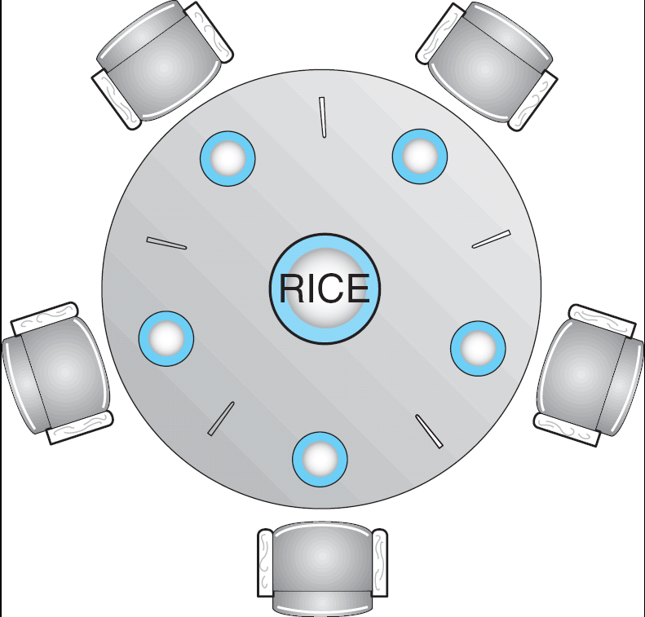
Dining-Philosophers Problem
Shared data
  Semaphore chopstick [5] initialized to 1
Operating System
Page <number>

Slide 54
Dining-Philosophers Problem (Cont.)
The structure of Philosopher i:
    While (true) {
    wait ( chopstick[i] );
    wait ( chopstick[ (i + 1) % 5] );
    // eat
    signal ( chopstick[i] );
    signal (chopstick[ (i + 1) % 5] );
    // think
    }
Operating System
Page <number>

Slide 55
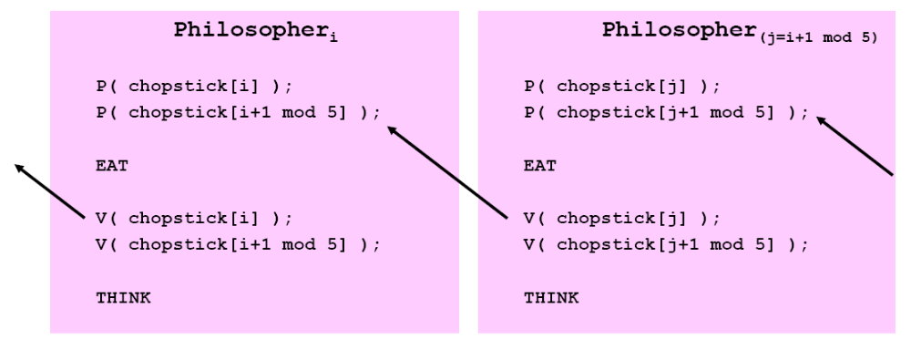
Dining-Philosophers Problem (Cont.)
Deadlock
a set of processes is in a deadlock state when every process in the set is waiting for an event that can be caused only by another process in the set
Operating System
Page <number>

Slide 56
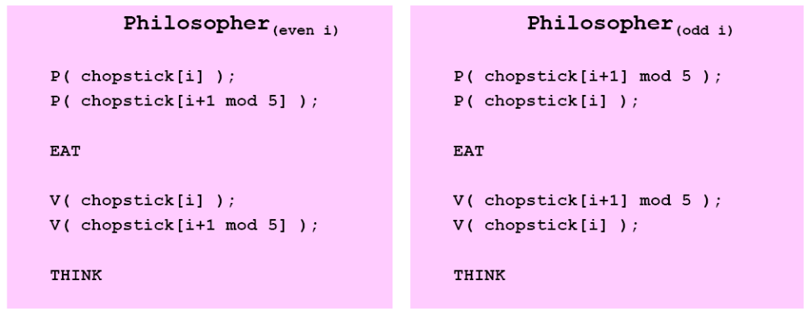
Dining-Philosophers Problem (Cont.)
Alternate solutions
  allow at most 4 philosophers to sit simultaneously at the table
  allow a philosopher to pick up chopsticks only if both are available
All of these solutions suffer from the possibility of starvation!
Operating System
Page <number>

Slide 57
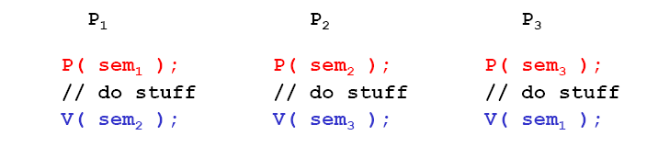
Problems with Semaphores
No abstraction and modularity
  a process that uses a semaphore has to know which other processes use the semaphore, and how these processes use the semaphore
  a process cannot be written in isolation
  Consider sequencing between three processes
    P1, P2, P3, P1, P2, P3, …
What happens if there are only two processes?
What happens if you want to use this solution for four processes?
Operating System
Page <number>

Slide 58
Problems with Semaphores
Very easy to write incorrect code
  changing the order of P and V
    can violate mutual exclusion requirements
      V( mutex); CODE; P( mutex); instead of
      P( mutex); CODE; V( mutex);
    can cause deadlock
      P( seq ); instead of V( seq );
  similar problems with omission
Extremely difficult to verify programs for correctness
Need for still higher-level synchronization abstractions!
Operating System
Page <number>

Slide 59
Module 6: Process Synchronization
Background
The Critical-Section Problem
Peterson’s Solution
Synchronization Hardware
Semaphores
Classic Problems of Synchronization
Monitors
Synchronization Examples
Atomic Transactions
Operating System
Page <number>

Slide 60
Monitors
A high-level abstraction that provides a convenient and effective mechanism for process synchronization
Only one process may be active within the monitor at a time
    monitor monitor-name
    {
    // shared variable declarations
    procedure P1 (…) { …. }
    …
    procedure Pn (…) {……}
    Initialization code ( ….) { … }
    …
    }
Operating System
Page <number>

Slide 61
Condition Variables
condition x, y;
Two operations on a condition variable:
  x.wait () – a process that invokes the operation is suspended.
  x.signal () –resumes one of processes (if any) that invoked x.wait ()
Operating System
Page <number>

Slide 62
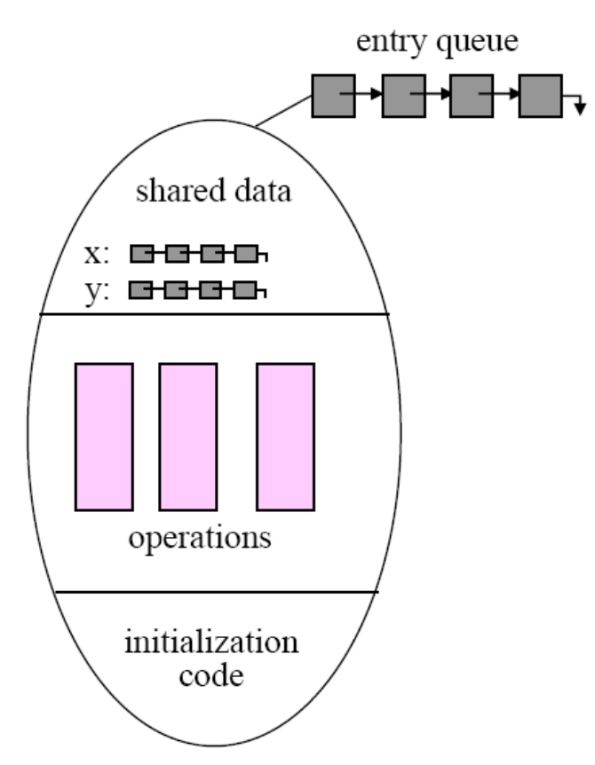
Monitor
An abstract data type
  private data
  public procedures
    only one procedure can be active in the monitor at one time
  condition variables
    queues of processes
    wait: block on a condition variable
    signal: unblock a waiting process
      no-op if no process is waiting
Processes can only invoke the public procedures
  raises the granularity of atomicity to a single user-defined procedure
Operating System
Page <number>

Slide 63
Waiting in the Monitor
Note that the semantics of executing a wait in the monitor is that several processes can be waiting “inside” the monitor at any given time but only one is executing
  wait queues are internal to the monitor
  there can be multiple wait queues
Operating System
Page <number>

Slide 64
Waiting in the Monitor（Cont.）
Who executes after a signal operation? (say P signals Q)
  (Hoare semantics) signallee Q continues
    logically natural since the condition that enabled Q might no longer be true when Q eventually executes
      P needs to wait for Q to exit the monitor
  (Mesa semantics) signaller P continues
    Q is enabled but gets its turn only after P either leaves or executes a wait
Operating System
Page <number>

Slide 65
Solution to Dining Philosophers
monitor DP
{
enum { THINKING; HUNGRY, EATING} state [5] ;
condition self [5];
void pickup (int i) {
state[i] = HUNGRY;
test(i);
if (state[i] != EATING)
self [i].wait;
}
void putdown (int i) {
state[i] = THINKING;
// test left and right neighbors
test((i + 4) % 5);
test((i + 1) % 5);
}
Operating System
Page <number>

Slide 66
Solution to Dining Philosophers (cont)
void test (int i) {
if ( (state[(i + 4) % 5] != EATING) &&
(state[i] == HUNGRY) &&
(state[(i + 1) % 5] != EATING) ) {
state[i] = EATING ;
self[i].signal () ;
}
}
initialization_code() {
for (int i = 0; i < 5; i++)
state[i] = THINKING;
}
}
Operating System
Page <number>

Slide 67
Solution to Dining Philosophers (cont)
Each philosopher I invokes the operations pickup() and putdown() in the following sequence:
dp.pickup (i)
EAT
dp.putdown (i)
Operating System
Page <number>

Slide 68
Monitor Implementation Using Semaphores
Variables
semaphore mutex; // (initially = 1)
semaphore next; // (initially = 0)
int next-count = 0;
Each procedure F will be replaced by
wait(mutex);
…
body of F;
…
if (next-count > 0)
signal(next)
else
signal(mutex);
Mutual exclusion within a monitor is ensured.
Operating System
Page <number>

Slide 69
Monitor Implementation
For each condition variable x, we have:
semaphore x-sem; // (initially = 0)
int x-count = 0;
The operation x.wait can be implemented as:
x-count++;
if (next-count > 0)
signal(next);
else
signal(mutex);
wait(x-sem);
x-count--;
Operating System
Page <number>

Slide 70
Monitor Implementation
The operation x.signal can be implemented as:
if (x-count > 0) {
next-count++;
signal(x-sem);
wait(next);
next-count--;
}
Operating System
Page <number>

Slide 71
习题1
睡觉的理发师问题
  一个理发店有为等待的顾客准备的n把椅子，一把理发师的椅子和一个理发师。如果顾客进入理发店，发现没有空椅子，该顾客将离开。如果顾客进入理发店，发现理发师正在睡觉，顾客唤醒理发师并理发。在其他的情况下，顾客进入理发店，坐下来等待。如果理发师给一个顾客理完发，并且还有等待的顾客，理发师给下一个顾客理发；否则理发师在自己的椅子上睡觉。使用信号量，写函数控制顾客和理发师的行为。
Operating System
Page <number>

Slide 72
习题1
Shared semaphore cutHair =0;
Shared semaphore waiting =0;
Shared semaphore countMutex =1;
Shared int count=0;
Void barber()
{
while(true)
{
P(cutHair);
GiveHaircut();
}
}
Operating System
Page <number>

Slide 73
习题1
Void customer()
{
P(countMutex);
If(count==n+1) //N chairs plus the barbers chair
Exit();
count=count+1;
If(count>1)
{
//-----------
//take a chair
//------------
V(countMutex);
P(waiting);
}
Else
V(countMutex);
//--------------------------------
V(cutHair);
ReceiveHaircut();
//----------------------------------
P(countMutex);
count=count-1;
If(count>0)
V(waiting);
V(countMutex);
}
Operating System
Page <number>

Slide 74
Module 6: Process Synchronization
Background
The Critical-Section Problem
Peterson’s Solution
Synchronization Hardware
Semaphores
Classic Problems of Synchronization
Monitors
Synchronization Examples
Atomic Transactions
Operating System
Page <number>

Slide 75
Synchronization Examples
Solaris
Windows XP
Linux
Operating System
Page <number>

Slide 76
Solaris Synchronization
Solaris 2: multi-CPU OS
  for brief accesses only
    Adaptive mutex
    starts off as a standard spinlock semaphore
      if lock is held by running thread （on another CPU）, continues to spin
        »valid only on a multi-CPU system
      otherwise blocks
  for long-held locks
    (process queue) semaphores
    condition variables
    reader-writer locks
      for frequent mostly read-only accesses
  turnstiles
    the queue structure on which threads block when waiting for a lock
    associated with threads rather than lock objects
Operating System
Page <number>

Slide 77
Windows XP Synchronization
Uses interrupt masks to protect access to global resources on uni-processor systems
Uses spinlocks on multiprocessor systems
Also provides dispatcher objects which may act as either mutexes or semaphores
Dispatcher objects may also provide events
  An event acts much like a condition variable
Operating System
Page <number>

Slide 78
Linux Synchronization
Used in the kernel only when a lock is held for a short duration
  SMP: spinlock
  Single-processor: Enable and disable kernel preemption
A lock must be held for a long period
  Semaphore
Operating System
Page <number>

Slide 79
Module 6: Process Synchronization
Background
The Critical-Section Problem
Peterson’s Solution
Synchronization Hardware
Semaphores
Classic Problems of Synchronization
Monitors
Synchronization Examples
Atomic Transactions
Operating System
Page <number>

Slide 80
Atomic Transactions
System Model
Log-based Recovery
Checkpoints
Concurrent Atomic Transactions
Operating System
Page <number>

Slide 81
System Model
Assure that operations happen as a single logical unit of work, in its entirety, or not at all
Related to field of database systems
Challenge is assuring atomicity despite computer system failures
Transaction - collection of instructions or operations that performs single logical function
  Here we are concerned with changes to stable storage – disk
  Transaction is series of read and write operations
  Terminated by commit (transaction successful) or abort (transaction failed) operation
  Aborted transaction must be rolled back to undo any changes it performed
Operating System
Page <number>

Slide 82
Types of Storage Media
Volatile storage – information stored here does not survive system crashes
  Example: main memory, cache
Nonvolatile storage – Information usually survives crashes
  Example: disk and tape
Stable storage – Information never lost
  Not actually possible, so approximated via replication or RAID to devices with independent failure modes
Goal is to assure transaction atomicity where failures cause loss of information on volatile storage
Operating System
Page <number>

Slide 83
Log-Based Recovery
Record to stable storage information about all modifications by a transaction
Most common is write-ahead logging
  Log on stable storage, each log record describes single transaction write operation, including
    Transaction name
    Data item name
    Old value
    New value
  <T_{i} starts> written to log when transaction T_{i} starts
  <T_{i} commits> written when T_{i} commits
Log entry must reach stable storage before operation on data occurs
Operating System
Page <number>

Slide 84
Log-Based Recovery Algorithm
Using the log, system can handle any volatile memory errors
  Undo(T_{i}) restores value of all data updated by T_{i}
  Redo(T_{i}) sets values of all data in transaction T_{i} to new values
Undo(T_{i}) and redo(T_{i}) must be idempotent
  Multiple executions must have the same result as one execution
If system fails, restore state of all updated data via log
  If log contains <T_{i} starts> without <T_{i} commits>, undo(T_{i})
  If log contains <T_{i} starts> and <T_{i} commits>, redo(T_{i})
Operating System
Page <number>

Slide 85
Checkpoints
Log could become long, and recovery could take long
Checkpoints shorten log and recovery time.
Checkpoint scheme:
  Output all log records currently in volatile storage to stable storage
  Output all modified data from volatile to stable storage
  Output a log record <checkpoint> to the log on stable storage
Now recovery only includes Ti, such that Ti started executing before the most recent checkpoint, and all transactions after Ti All other transactions already on stable storage
Operating System
Page <number>

Slide 86
Concurrent Transactions
Must be equivalent to serial execution – serializability
Could perform all transactions in critical section
  Inefficient, too restrictive
Concurrency-control algorithms provide serializability
Operating System
Page <number>

Slide 87
Serializability
Consider two data items A and B
Consider Transactions T₀ and T₁
Execute T₀, T₁ atomically
Execution sequence called schedule
Atomically executed transaction order called serial schedule
For N transactions, there are N! valid serial schedules
Operating System
Page <number>

Slide 88

Schedule 1: T₀ then T₁
Operating System
Page <number>

Slide 89
Nonserial Schedule
Nonserial schedule allows overlapped execute
  Resulting execution not necessarily incorrect
Consider schedule S, operations O_{i}, O_{j}
  Conflict if access same data item, with at least one write
If O_{i}, O_{j} consecutive operations of different transactions && O_{i} and O_{j} don’t conflict
  Then S’ with swapped order O_{j} O_{i} equivalent to S
If S can become serial schedule S’ via swapping nonconflicting operations
  S is conflict serializable
Operating System
Page <number>

Slide 90

Schedule 2: Concurrent Serializable Schedule
Operating System
Page <number>

Slide 91
Locking Protocol
Ensure serializability by associating lock with each data item
  Follow locking protocol for access control
Locks
  Shared – T_{i} has shared-mode lock (S) on item Q, T_{i} can read Q but not write Q
  Exclusive – T_{i} has exclusive-mode lock (X) on Q, T_{i} can read and write Q
Require every transaction on item Q acquire appropriate lock
If lock already held, new request may have to wait
  Similar to readers-writers algorithm
Operating System
Page <number>

Slide 92
Two-phase Locking Protocol
Each transaction issues lock and unlock requests in two phases
  Growing – obtaining locks
  Shrinking – releasing locks
Generally ensures conflict serializability
Does not prevent deadlock
Operating System
Page <number>

Slide 93
Timestamp-based Protocols
Select order among transactions in advance – timestamp-ordering
Transaction T_{i} associated with timestamp TS(T_{i}) before T_{i} starts
  TS(T_{i}) < TS(T_{j}) if Ti entered system before T_{j}
  TS can be generated from system clock or as logical counter incremented at each entry of transaction
Timestamps determine serializability order
  If TS(T_{i}) < TS(T_{j}), system must ensure produced schedule equivalent to serial schedule where T_{i} appears before T_{j}
Operating System
Page <number>

Slide 94
Timestamp-based Protocol Implementation
Data item Q gets two timestamps
  W-timestamp(Q) – largest timestamp of any transaction that executed write(Q) successfully
  R-timestamp(Q) – largest timestamp of successful read(Q)
  Updated whenever read(Q) or write(Q) executed
Timestamp-ordering protocol assures any conflicting read and write executed in timestamp order
Suppose Ti executes read(Q)
  If TS(T_{i}) < W-timestamp(Q), Ti needs to read value of Q that was already overwritten
    read operation rejected and T_{i} rolled back
  If TS(T_{i}) ≥ W-timestamp(Q)
    read executed, R-timestamp(Q) set to max(R-timestamp(Q), TS(T_{i}))
Operating System
Page <number>

Slide 95
Timestamp-ordering Protocol
Suppose Ti executes write(Q)
  If TS(T_{i}) < R-timestamp(Q), value Q produced by T_{i} was needed previously and T_{i} assumed it would never be produced
    Write operation rejected, T_{i} rolled back
  If TS(T_{i}) < W-timestamp(Q), T_{i} attempting to write obsolete value of Q
    Write operation rejected and T_{i} rolled back
  Otherwise, write executed
Any rolled back transaction T_{i} is assigned new timestamp and restarted
Algorithm ensures conflict serializability and freedom from deadlock
Operating System
Page <number>

Slide 96

Schedule Possible Under Timestamp Protocol
Operating System
Page <number>

Slide 97
Timestamp-ordering Protocol
Problem with timestamp-ordering protocol:
  Suppose T_{i} aborts, but T_{j} has read a data item written by T_{i}
  Then T_{j} must abort; if T_{j} had been allowed to commit earlier, the schedule is not recoverable.
  Further, any transaction that has read a data item written by T_{j} must abort
  This can lead to cascading rollback --- that is, a chain of rollbacks
Solution:
  A transaction is structured such that its writes are all performed at the end of its processing
  All writes of a transaction form an atomic action; no transaction may execute while a transaction is being written
  A transaction that aborts is restarted with a new timestamp
Operating System
Page <number>

Slide 98
Assignment
6.4, 6.5, 6.6, 6.13
Operating System
Page <number>

Slide 99
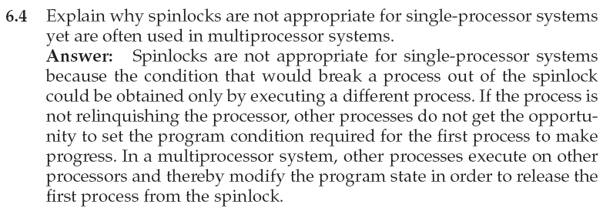
6.4
Operating System
Page <number>

Slide 100
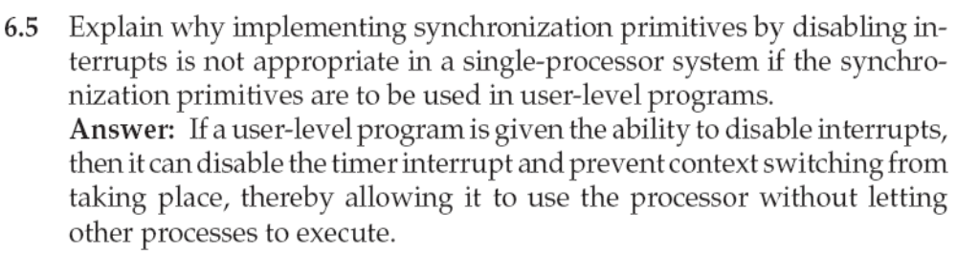
6.5
Operating System
Page <number>

Slide 101
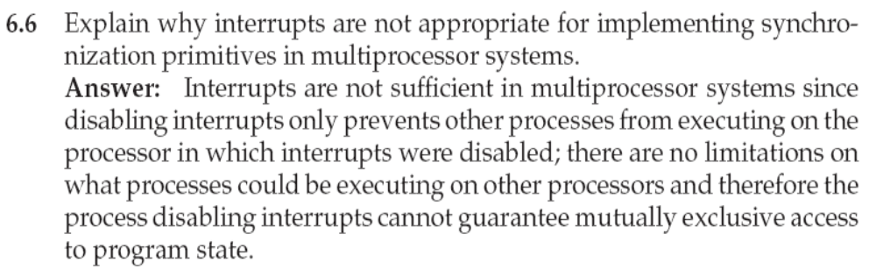
6.6
Operating System
Page <number>

Slide 102
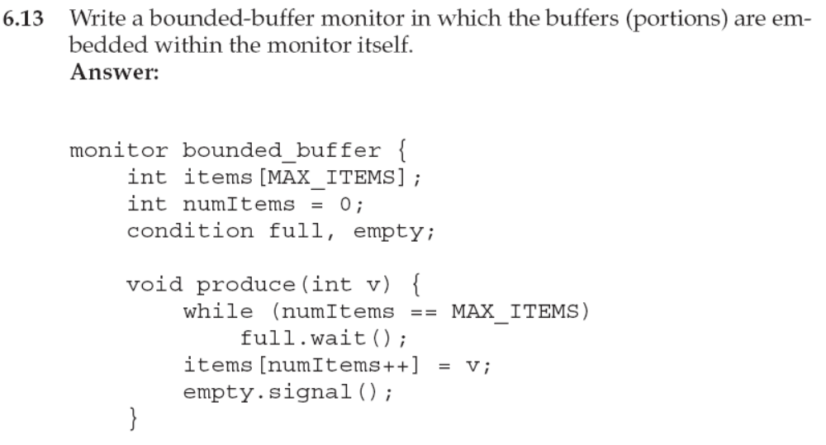
6.13
Operating System
Page <number>

Slide 103
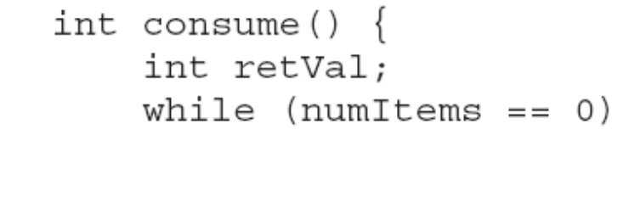
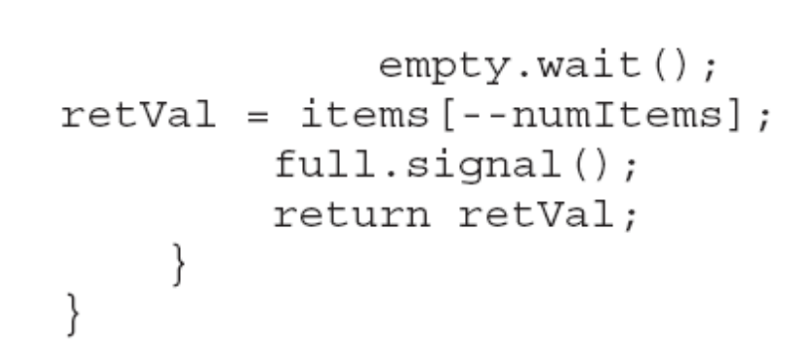
6.13
Operating System
Page <number>

Slide 104
End of Chapter 6

