Slide 1
Chapter 7: Deadlocks
April 12, 2010

Slide 2
Chapter Objectives
To develop a description of deadlocks, which prevent sets of concurrent processes from completing their tasks
To present a number of different methods for preventing or avoiding deadlocks in a computer system.
Wang Fengyu
Page <number>

Slide 3
Chapter 7: Deadlocks
The Deadlock Problem
System Model
Deadlock Characterization
Methods for Handling Deadlocks
Deadlock Prevention
Deadlock Avoidance
Deadlock Detection
Recovery from Deadlock
Wang Fengyu
Page <number>

Slide 4
Chapter 7: Deadlocks
The Deadlock Problem
System Model
Deadlock Characterization
Methods for Handling Deadlocks
Deadlock Prevention
Deadlock Avoidance
Deadlock Detection
Recovery from Deadlock
Wang Fengyu
Page <number>

Slide 5
The Deadlock Problem
A set of blocked processes each holding a resource and waiting to acquire a resource held by another process in the set.
Example
  System has 2 disk drives.
  P₁ and P₂ each hold one disk drive and each needs another one.
Example
  semaphores A and B, initialized to 1
        P₀ P₁
        wait (A); wait(B)
        wait (B); wait(A)
Wang Fengyu
Page <number>

Slide 6
Bridge Crossing Example
Traffic only in one direction.
Each section of a bridge can be viewed as a resource.
If a deadlock occurs, it can be resolved if one car backs up (preempt resources and rollback).
Several cars may have to be backed up if a deadlock occurs.
Starvation is possible.
Wang Fengyu
Page <number>

Slide 7
Deadlock versus Starvation
Deadlock: A process waits for a resource that is currently assigned to another process, which is in turn waiting for another resource …
Starvation: A process waits for a resource that continually becomes available but is never assigned to the waiting process
Two major differences between deadlock and starvation
  in starvation, it is not certain that a process will never get the requested resource (i.e., there is a chance it might), while a deadlocked process is permanently blocked
  in starvation, the resource under contention is continuously available, whereas this is not true in a deadlock
Starvation is typically easier to fix than deadlock
Wang Fengyu
Page <number>

Slide 8
Chapter 7: Deadlocks
The Deadlock Problem
System Model
Deadlock Characterization
Methods for Handling Deadlocks
Deadlock Prevention
Deadlock Avoidance
Deadlock Detection
Recovery from Deadlock
Wang Fengyu
Page <number>

Slide 9
System Model
Resource types R₁, R₂, . . ., R_{m}
    CPU cycles, memory space, I/O devices
Each resource type R_{i} has W_{i} instances.
Each process utilizes a resource as follows:
  request
  use
  release
Wang Fengyu
Page <number>

Slide 10
Chapter 7: Deadlocks
The Deadlock Problem
System Model
Deadlock Characterization
Methods for Handling Deadlocks
Deadlock Prevention
Deadlock Avoidance
Deadlock Detection
Recovery from Deadlock
Wang Fengyu
Page <number>

Slide 11
Deadlock Characterization
All of the following conditions must hold for deadlock to occur
  Mutual Exclusion
    at least one resource can only be used by one process at any one time
  Hold and Wait
    there must exist at least one process that is holding at least one resource, and is waiting to acquire additional resources currently held by other processes
Wang Fengyu
Page <number>

Slide 12
Deadlock Characterization
  No Preemption
    processes cannot be forced to give up resources
  Circular Wait
    there is a sequence of processes p₁, p₂, ..., p_{n}
    such that p_{i} is waiting for a resource held by p_{i+1,}，and p_{n} is waiting for p₁
Wang Fengyu
Page <number>

Slide 13
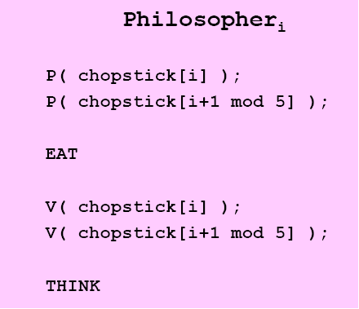
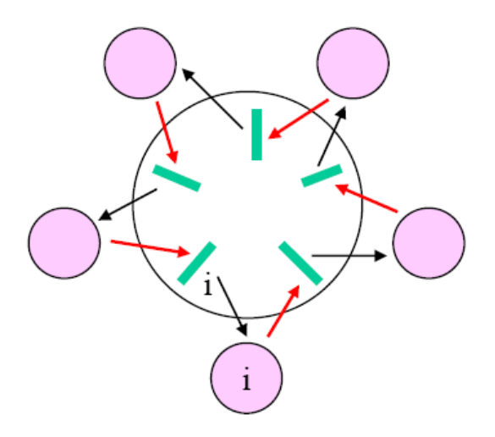
Conditions for Deadlock: Dining Philosophers
Conditions
  Mutual exclusion －each chopstick can only be used by one philosopher
  Hold and wait － philosophers hold on to a chopstick while requesting another
  No preemption － not possible to force a philosopher to give up a chopstick
  Circular wait － philosopher_{i} waits on philosopher_{i+1}…
Wang Fengyu
Page <number>

Slide 14
Resource-Allocation Graph (RAG)
A set of vertices V and a set of edges E.
V is partitioned into two types:
  P = {P₁, P₂, …, P_{n}}, the set consisting of all the processes in the system.
  R = {R₁, R₂, …, R_{m}}, the set consisting of all resource types in the system.
request edge – directed edge P₁ → R_{j}
assignment edge – directed edge R_{j} → P_{i}
Wang Fengyu
Page <number>

Slide 15
Resource-Allocation Graph (Cont.)
Process
Resource Type with 4 instances
P_{i} requests instance of R_{j}
P_{i} is holding an instance of R_{j}
P_{i}
R_{j}
P_{i}
R_{j}
Wang Fengyu
Page <number>

Slide 16

Example of a Resource Allocation Graph
Wang Fengyu
Page <number>

Slide 17

Resource Allocation Graph With A Deadlock
Wang Fengyu
Page <number>

Slide 18

Graph With A Cycle But No Deadlock
Wang Fengyu
Page <number>

Slide 19
Basic Facts
If graph contains no cycles ⇒ no deadlock.
If graph contains a cycle ⇒
  if only one instance per resource type, then deadlock.
  if several instances per resource type, possibility of deadlock.
Wang Fengyu
Page <number>

Slide 20
Chapter 7: Deadlocks
The Deadlock Problem
System Model
Deadlock Characterization
Methods for Handling Deadlocks
Deadlock Prevention
Deadlock Avoidance
Deadlock Detection
Recovery from Deadlock
Wang Fengyu
Page <number>

Slide 21
Methods for Handling Deadlocks
Three approaches with different cost-performance tradeoffs
Prevention
  deadlock cannot possibly occur
Avoidance
  deadlock can occur, but there are algorithms to avoid it
  relies on the OS having an advance model of possible resource requests from processes
Detection and Recovery
  deadlock may occur, but there are ways of detecting it and recovering
  this method is preferable when deadlocks happen rarely
Wang Fengyu
Page <number>

Slide 22
Chapter 7: Deadlocks
The Deadlock Problem
System Model
Deadlock Characterization
Methods for Handling Deadlocks
Deadlock Prevention
Deadlock Avoidance
Deadlock Detection
Recovery from Deadlock
Wang Fengyu
Page <number>

Slide 23
Deadlock Prevention
Approach: Ensure that the necessary conditions for deadlocks are never satisfied
Prevent one of the following from becoming true
  Mutual Exclusion
  Hold and Wait
  No Preemption
  Circular Wait
Wang Fengyu
Page <number>

Slide 24
Deadlock Prevention (1): Mutual Exclusion
Mutual exclusion is not a problem for sharable resources
  an example is a “read-only” file which is a resource that can be accessed simultaneously
Problem: Some resources are inherently not sharable
  so, denying the mutual exclusion condition cannot be enforced in general
Wang Fengyu
Page <number>
Notes:
打印机 不可共享访问

Slide 25
Deadlock Prevention (2): Hold-and-Wait
Approach: Guarantee that when a process requests a resource it does not hold any other resources
  Choice 1: A process requests and is allocated all of its resources before it begins execution
    require system calls requesting resources to precede all other system calls
  Choice 2: A process releases any resources it is holding before it requests for new ones
Wang Fengyu
Page <number>

Slide 26
Deadlock Prevention (2): Hold-and-Wait
Limitations
  lowered resource utilization
  starvation
Wang Fengyu
Page <number>

Slide 27
Deadlock Prevention (3): No Preemption
Approach: Take away resources from a process (preemption) and give them to another waiting process
  some resources are preemptible
    e.g., memory space, disk space
    these can be taken away from a process
  examples of non-preemptible resources?
Wang Fengyu
Page <number>
Notes:
不可抢占资源. 指不可能在不引起不良后果的情况下从拥有它的进程中直接抢走供其它进程使用的资源。如打印机等。

Slide 28
Deadlock Prevention (3): No Preemption
Choices
  protocol 1: if a process is holding some resources and requests other resources that cannot be granted to it, all of its resources are taken away
  protocol 2: when a process requests additional resources, see if these resources are being held by a process that is itself waiting for new resources. In this situation, preempt the second process
Limitation: Cost of preemption
  a process may get preempted even when there is no deadlock
Wang Fengyu
Page <number>

Slide 29
Deadlock Prevention (4): Circular Wait
Example:
  Processes need three resources: memory, disk, printer
  Consider two cases:
    Case 1: processes pick own order in which to ask for resources
    Case 2: each process asks first for memory, then disk, then the printer
  Which of these cases can result in deadlock?
P1
P2
P3
Case 2
mem
disk
print
Wang Fengyu
Page <number>

Slide 30
Deadlock Prevention: Circular Wait (cont’d)
Approach: Impose an order on resource acquisition
  all the N types of resources in the system are linearly ordered
    each is given a number, called rank, in the range 1, 2, ... , N
    the resources of the same type all have the same rank
    different types of resources get distinct ranks
  processes are required to sequence their resource requests in strictly increasing order of rank
    i.e., they ask for all the “smaller” rank resources first
In our example
  rank(memory) = 1, rank(disk) = 2, rank(printer) = 3
Why does this work?
Wang Fengyu
Page <number>

Slide 31
Deadlock Prevention: Circular Wait (cont’d)
Why it works
  suppose the circular wait consists of processes P1, P2, ..., Pn, P1
  suppose P(i) is waiting on a resource held by P(i+1) of rank R(j)
    P(i+1) must have been granted all resources it needs of rank R(j)
    it must therefore be waiting for a resource of rank R(j) + 1
  since a cycle of strictly increasing ranks cannot exist, there can exist no such cycle.
Two related points
  an equivalent strategy is one where a process, when it requests a resource of a particular rank, releases all those with a higher rank
  typical rank orders are based on natural usage
    e.g., since storage devices are used “before” printers, they get smaller ranks
Wang Fengyu
Page <number>

Slide 32
Chapter 7: Deadlocks
The Deadlock Problem
System Model
Deadlock Characterization
Methods for Handling Deadlocks
Deadlock Prevention
Deadlock Avoidance
Deadlock Detection
Recovery from Deadlock
Wang Fengyu
Page <number>

Slide 33
Deadlock Avoidance
Deadlock occurs because processes are waiting on each other to release resources
Main idea of deadlock avoidance:
  before allocating request, check if system will enter a deadlock state
  F( resources available, resources allocated, future requests/releases )
    if no: grant the request
    if yes: block the process
  request additional information about how resources are to be requested
How can we find out if a system will enter a deadlock state?
Wang Fengyu
Page <number>

Slide 34
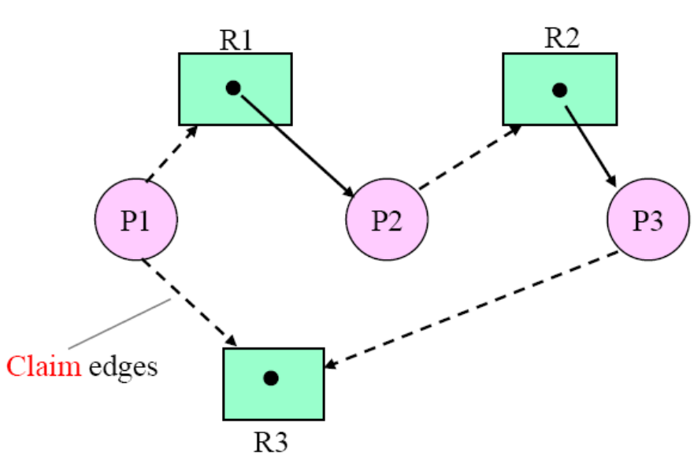
Deadlock Avoidance: Notion of a Safe State
A system is in a safe state if there exists a safe sequence
A sequence <P₁, P₂, …, P_{n}> is a safe sequence for the current allocation if, for each P_{i}, the resources that P_{i} can still request can be satisfied by the currently available resources plus resources held by all the P_{j}, for j<i
<P₃, P₂, P₁> is a safe sequence
P₃’s future request can be satisfied because R₃ is available
P₂’s future request can be satisfied by P₃ yielding R₂
P₁’s future requests can be satisfied by P₂ giving up R₁ and available R₃
Wang Fengyu
Page <number>

Slide 35
Properties of Safe States
A safe state is not a deadlock state
An unsafe state may lead to deadlock
It is possible to go from a safe state to an unsafe state
Example: A system with 12 units of a resource
  Three processes
    P1: max need = 10, current need = 5
    P2: max need = 4, current need = 2
    P3: max need = 9, current need = 2
  This is a safe state, since a safe sequence <P2, P1, P3> exists
  P3 requests an additional unit. Should this request be granted?
  No, because this would put the system in an unsafe state
    P1, P2, P3 will then hold 5, 2, and 3 resources (2 units are available)
    P2’s future needs can be satisfied, but no way to satisfy P1’s and P3’s needs
Avoidance algorithms prevent the system from entering an unsafe state
Wang Fengyu
Page <number>

Slide 36

Safe, Unsafe , Deadlock State
Wang Fengyu
Page <number>

Slide 37
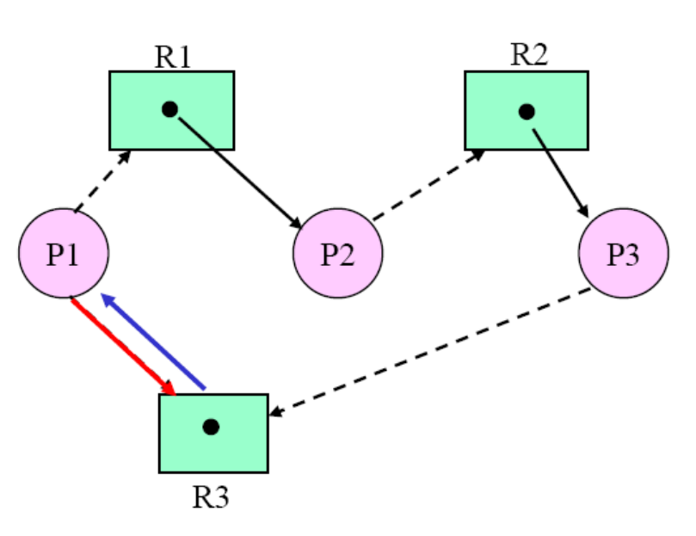
Deadlock Avoidance: Single Resource Instances
Deadlock= Cycle in the resource allocation graph
A request is granted if it does not result in a cycle
<P3, P2, P1> is a safe sequence
Say P1 requests R3:
should this be granted?
No, because an assignment edge from R3 to P1 would create a cycle in the RAG.
[ No safe sequence exists ]
Does this always imply a deadlock?
No, because P1 can release R3 before requesting R1
Wang Fengyu
Page <number>

Slide 38
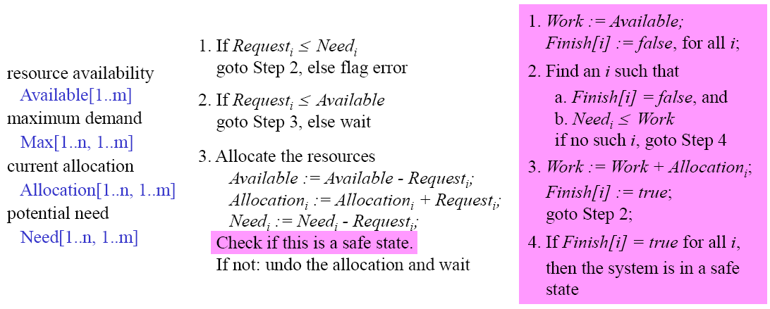
Deadlock Avoidance: Multiple Resource Instances
Banker’s Algorithm
  upon entering the system, a process declares the maximum number of instances of each resource type that it may need
  the algorithm decides, for each request, whether granting it would put the system in an unsafe state
Wang Fengyu
Page <number>

Slide 39
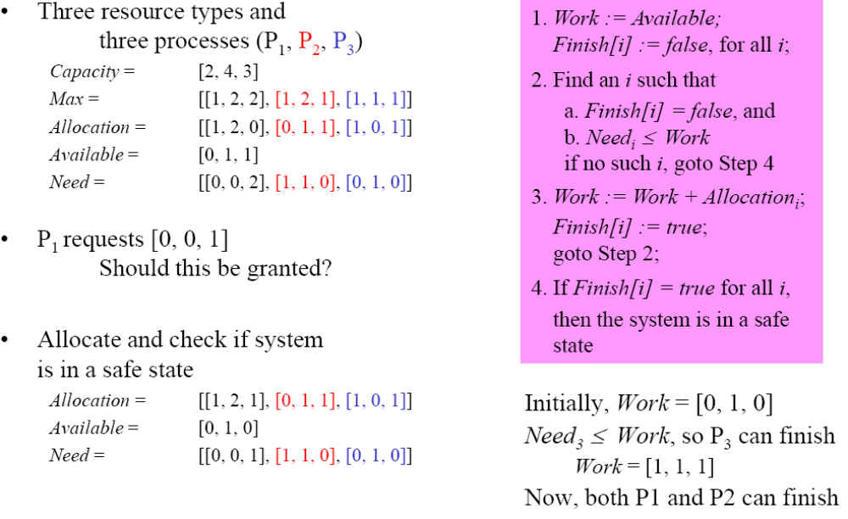
Banker’s Algorithm: Example
Wang Fengyu
Page <number>

Slide 40
Limitations of Deadlock Avoidance
However, avoidance schemes require specification of future needs
  not generally known for OS processes
More general solution: Deadlock detection and recovery
Wang Fengyu
Page <number>

Slide 41
Chapter 7: Deadlocks
The Deadlock Problem
System Model
Deadlock Characterization
Methods for Handling Deadlocks
Deadlock Prevention
Deadlock Avoidance
Deadlock Detection
Recovery from Deadlock
Wang Fengyu
Page <number>

Slide 42
Deadlock Detection
Allow system to enter deadlock state
Detection algorithm
Recovery scheme
Wang Fengyu
Page <number>

Slide 43
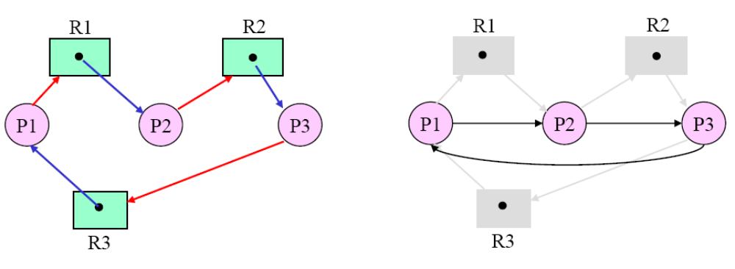
Deadlock Detection: Single Resource Instances
Go back to using a resource allocation graph in which only
  request and assignment edges are defined
  future (potential) requests are not relevant to “is there deadlock now?”
Deadlock =Cycle in the RAG
  need only look at the wait-for graph
    obtained by removing resource nodes and collapsing the appropriate edges
Wang Fengyu
Page <number>

Slide 44

Resource-Allocation Graph and Wait-for Graph
Resource-Allocation Graph
Corresponding wait-for graph
Wang Fengyu
Page <number>

Slide 45
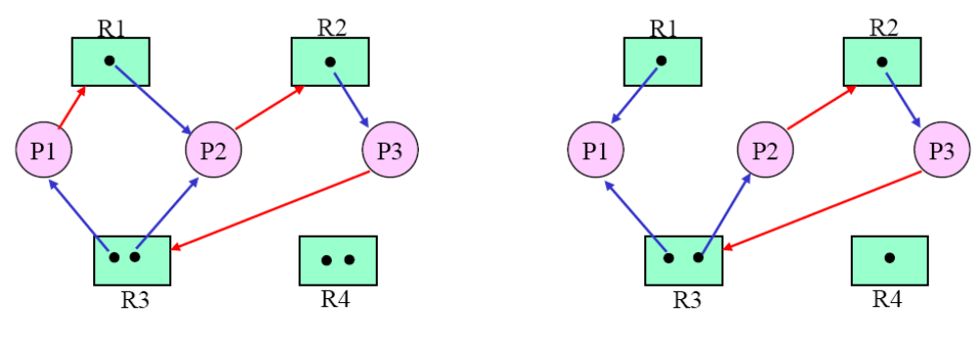
Deadlock Detection: Multiple Resource Instances
A cycle in the graph is a necessary but not sufficient condition for the existence of a deadlock
  if a cycle does not exist: no deadlock
  if a cycle exists: there may or may not be a deadlock
DEADLOCK
NO DEADLOCK
Wang Fengyu
Page <number>

Slide 46
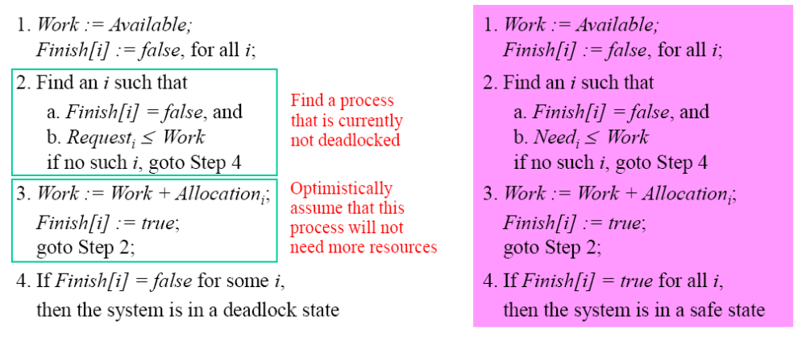
Detection: Multiple Resource Instances (cont’d)
A new use for the Bankers’ algorithm
  detect if the current set of requests are such that satisfying any of them will put the system in an unsafe state
Wang Fengyu
Page <number>

Slide 47
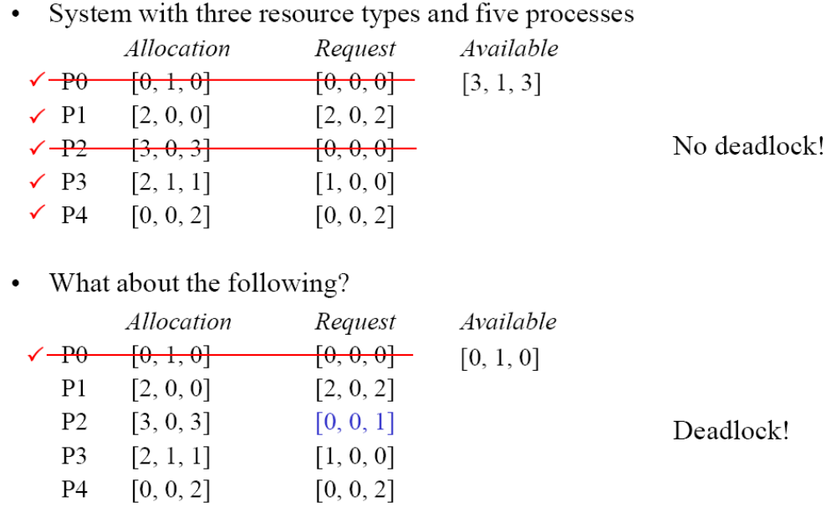
Detection: Multiple Resource Instances (Example)
Wang Fengyu
Page <number>

Slide 48
Example of Detection Algorithm
Five processes P₀ through P₄; three resource types
A (7 instances), B (2 instances), and C (6 instances).
Snapshot at time T₀:
Allocation Request Available
A B C A B C A B C
P₀ 0 1 0 0 0 0 0 0 0
P₁ 2 0 0 2 0 2
P₂ 3 0 3 0 0 0
P₃ 2 1 1 1 0 0
P₄ 0 0 2 0 0 2
Sequence <P₀, P₂, P₃, P₁, P₄> will result in Finish[i] = true for all i.
Wang Fengyu
Page <number>

Slide 49
Example (Cont.)
P₂ requests an additional instance of type C.
  Allocation Request Available
  A B C A B C A B C
  P₀ 0 1 0 0 0 0 0 0 0
  P₁ 2 0 0 2 0 2
  P₂ 3 0 3 0 0 1
  P₃ 2 1 1 1 0 0
  P₄ 0 0 2 0 0 2
State of system?
  Can reclaim resources held by process P₀, but insufficient resources to fulfill other processes; requests.
  Deadlock exists, consisting of processes P₁, P₂, P₃, and P₄.
Wang Fengyu
Page <number>

Slide 50
Chapter 7: Deadlocks
The Deadlock Problem
System Model
Deadlock Characterization
Methods for Handling Deadlocks
Deadlock Prevention
Deadlock Avoidance
Deadlock Detection
Recovery from Deadlock
Wang Fengyu
Page <number>

Slide 51
Recovery from Deadlock: Process Termination
Process Termination
  Abort all deadlocked processes.
  Abort one process at a time until the deadlock cycle is eliminated.
  In which order should we choose to abort?
    Priority of the process.
    How long process has computed, and how much longer to completion.
    Resources the process has used.
    Resources process needs to complete.
    How many processes will need to be terminated.
    Is process interactive or batch?
Wang Fengyu
Page <number>

Slide 52
Recovery from Deadlock: Resource Preemption
Resource Preemption
  Selecting a victim – minimize cost.
  Rollback – return to some safe state, restart process for that state.
  Starvation – same process may always be picked as victim
    include number of rollback in cost factor.
Wang Fengyu
Page <number>

Slide 53
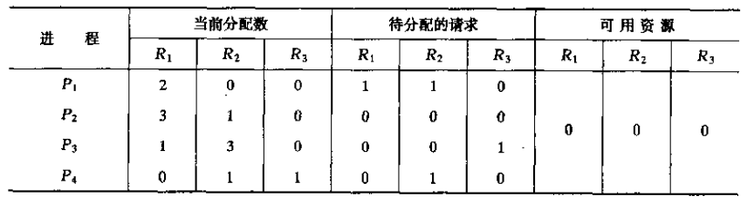
练习1
进程资源的使用情况和可用情况如上表所示，画出资源分配图
Wang Fengyu
Page <number>

Slide 54
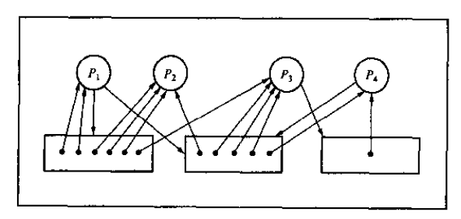
练习1答案
Wang Fengyu
Page <number>

Slide 55
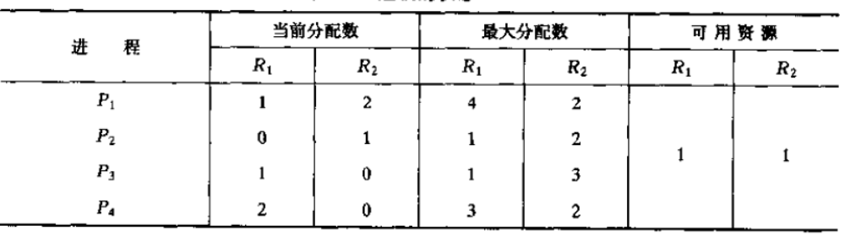
练习2
上面表描述的状态是安全的还是不安全的
Wang Fengyu
Page <number>

Slide 56
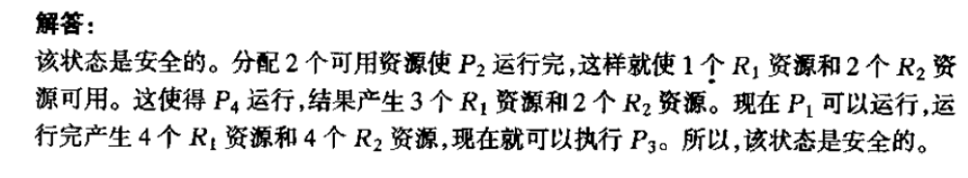
练习2答案
Wang Fengyu
Page <number>

Slide 57
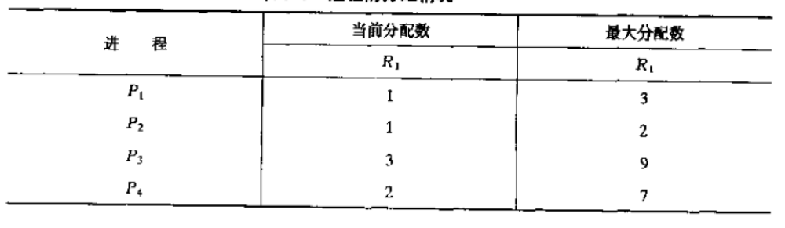
练习3
要使表中描述的状态安全，可用资源的最小数目应为多少
Wang Fengyu
Page <number>

Slide 58
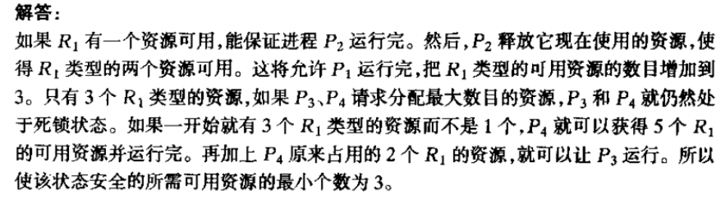
练习3答案
Wang Fengyu
Page <number>

Slide 59
Assignment
7.6， 7.11
Wang Fengyu
Page <number>

Slide 60
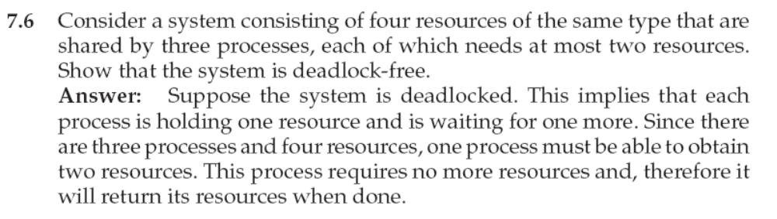
7.6 答案
Wang Fengyu
Page <number>

Slide 61
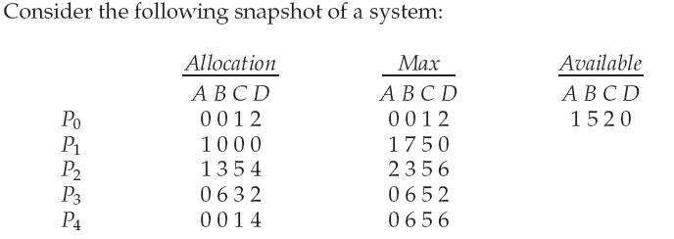
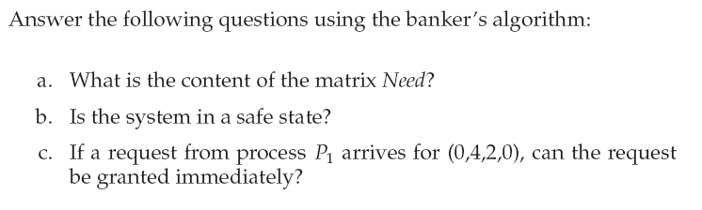
7.11
Wang Fengyu
Page <number>

Slide 62
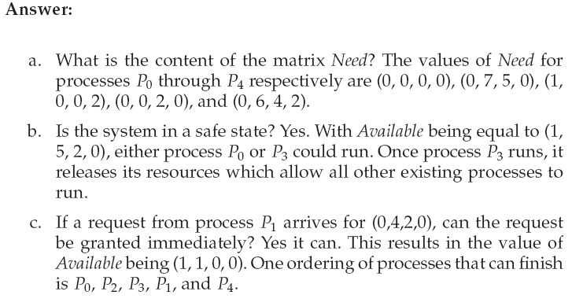
7.11
Wang Fengyu
Page <number>

Slide 63
End of Chapter 7
April 12, 2010

