Slide 1
Chapter 8: Main Memory
April 19, 2010

Slide 2
Objectives
To provide a detailed description of various ways of organizing memory hardware
To discuss various memory-management techniques, including paging and segmentation
To provide a detailed description of the Intel Pentium, which supports both pure segmentation and segmentation with paging
Wang Fengyu
Page <number>

Slide 3
Chapter 8: Memory Management
Background
Swapping
Contiguous Memory Allocation
Paging
Structure of the Page Table
Segmentation
Example: The Intel Pentium
Wang Fengyu
Page <number>

Slide 4
Chapter 8: Memory Management
Background
Swapping
Contiguous Memory Allocation
Paging
Structure of the Page Table
Segmentation
Example: The Intel Pentium
Wang Fengyu
Page <number>

Slide 5
Basic Hardware
Program must be brought (from disk) into memory and placed within a process for it to be run
Main memory and registers are only storage CPU can access directly
Register access in one CPU clock (or less)
Main memory can take many cycles
Cache sits between main memory and CPU registers
Wang Fengyu
Page <number>

Slide 6
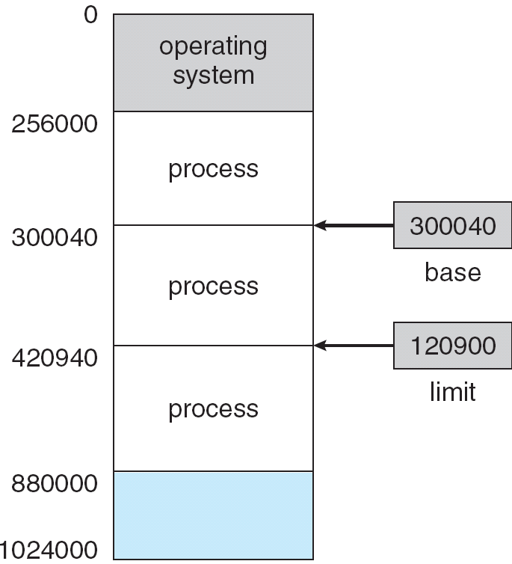
Base and Limit Registers
A pair of base and limit registers define the address space
Wang Fengyu
Page <number>

Slide 7
Address Binding
Address binding of instructions and data to memory addresses can happen at three different stages
  Compile time: If memory location known a priori, absolute code can be generated; must recompile code if starting location changes
  Load time: Must generate relocatable code if memory location is not known at compile time
  Execution time: Binding delayed until run time if the process can be moved during its execution from one memory segment to another. Need hardware support for address maps (e.g., base and limit registers)
Wang Fengyu
Page <number>

Slide 8

Multistep Processing of a User Program
Wang Fengyu
Page <number>

Slide 9
Logical vs. Physical Address Space
The concept of a logical address space that is bound to a separate physical address space is central to proper memory management
  Logical address – generated by the CPU; also referred to as virtual address
  Physical address – address seen by the memory unit
Logical and physical addresses are the same in compile-time and load-time address-binding schemes; logical (virtual) and physical addresses differ in execution-time address-binding scheme
Wang Fengyu
Page <number>

Slide 10
Memory-Management Unit (MMU)
Hardware device that maps virtual to physical address
In MMU scheme, the value in the relocation register is added to every address generated by a user process at the time it is sent to memory
The user program deals with logical addresses; it never sees the real physical addresses
Wang Fengyu
Page <number>

Slide 11

Dynamic relocation using a relocation register
Wang Fengyu
Page <number>

Slide 12
Dynamic Loading
Routine is not loaded until it is called
Better memory-space utilization; unused routine is never loaded
Useful when large amounts of code are needed to handle infrequently occurring cases
No special support from the operating system is required implemented through program design
Wang Fengyu
Page <number>

Slide 13
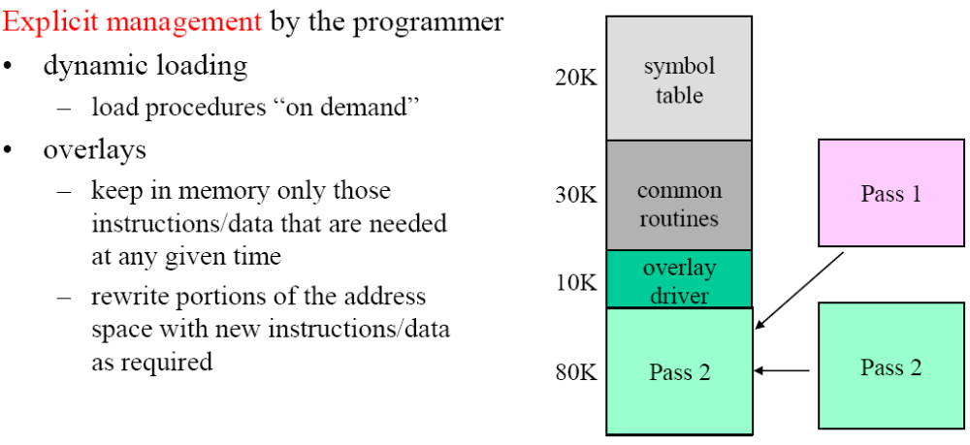
Dynamic Loading
Wang Fengyu
Page <number>

Slide 14
Dynamic Linking
Linking postponed until execution time
Small piece of code, stub, used to locate the appropriate memory-resident library routine
Stub replaces itself with the address of the routine, and executes the routine
Operating system needed to check if routine is in processes’ memory address
Dynamic linking is particularly useful for libraries
System also known as shared libraries
Wang Fengyu
Page <number>

Slide 15

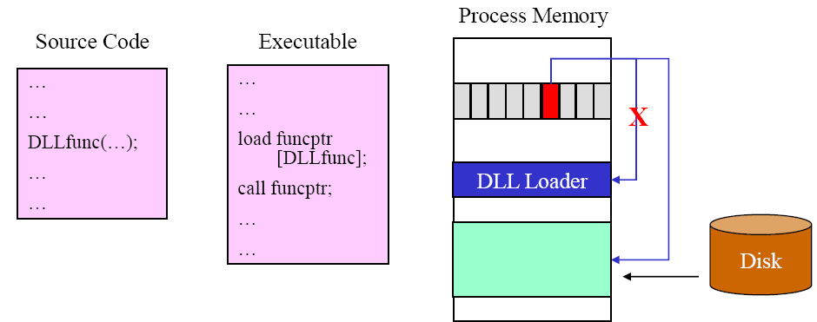
Dynamic Linking
Wang Fengyu
Page <number>

Slide 16
Chapter 8: Memory Management
Background
Swapping
Contiguous Memory Allocation
Paging
Structure of the Page Table
Segmentation
Example: The Intel Pentium
Wang Fengyu
Page <number>

Slide 17

Schematic View of Swapping
Wang Fengyu
Page <number>

Slide 18
Swapping: Issues
High context-switch times
  assume a user process of size 100 KB
  backing store is a standard hard disk with transfer rate of 5 MB/s
  actual transfer of 100 KB from and to memory takes
2 (100 KB / 5000 KB/s) = 2 (1/50 second)
= 2 (20 ms) = 40 ms+ disk time
Swapping out a process that is currently in the middle of I/O
  I/O completion might store values in memory, now occupied by a new process
  common solutions
    never swap out a process while in a wait state induced by I/O requests
    all I/O interactions are via a special set of buffers that are controlled by the OS and are part of its space; not swapped out
Wang Fengyu
Page <number>

Slide 19
Chapter 8: Memory Management
Background
Swapping
Contiguous Memory Allocation
Paging
Structure of the Page Table
Segmentation
Example: The Intel Pentium
Wang Fengyu
Page <number>

Slide 20
Contiguous Allocation
Main memory usually into two partitions:
  Resident operating system, usually held in low memory with interrupt vector
  User processes then held in high memory
Relocation registers used to protect user processes from each other, and from changing operating-system code and data
  Base register contains value of smallest physical address
  Limit register contains range of logical addresses – each logical address must be less than the limit register
  MMU maps logical address dynamically
Wang Fengyu
Page <number>

Slide 21
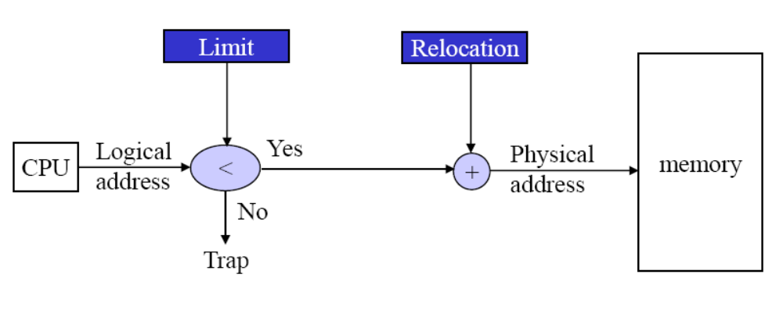
HW address protection with base and limit registers
Base
Wang Fengyu
Page <number>

Slide 22
Contiguous Allocation (Cont.)
Multiple-partition allocation
  Hole – block of available memory; holes of various size are scattered throughout memory
  When a process arrives, it is allocated memory from a hole large enough to accommodate it
  Operating system maintains information about:
  a) allocated partitions b) free partitions (hole)
OS
OS
OS
OS
process 5
process 5
process 5
process 5
process 9
process 9
process 8
process 10
process 2
process 2
process 2
process 2
Wang Fengyu
Page <number>

Slide 23
Dynamic Storage-Allocation Problem
How to satisfy a request of size n from a list of free holes？
First-fit: Allocate the first hole that is big enough
Best-fit: Allocate the smallest hole that is big enough; must search entire list, unless ordered by size
  Produces the smallest leftover hole
Worst-fit: Allocate the largest hole; must also search entire list
  Produces the largest leftover hole
First-fit and best-fit better than worst-fit in terms of speed and storage utilization
Wang Fengyu
Page <number>

Slide 24
Fragmentation
External Fragmentation – total memory space exists to satisfy a request, but it is not contiguous
Internal Fragmentation – allocated memory may be slightly larger than requested memory; this size difference is memory internal to a partition, but not being used
Reduce external fragmentation by compaction
  Shuffle memory contents to place all free memory together in one large block
  Compaction is possible only if relocation is dynamic, and is done at execution time
Wang Fengyu
Page <number>

Slide 25
Chapter 8: Memory Management
Background
Swapping
Contiguous Memory Allocation
Paging
Structure of the Page Table
Segmentation
Example: The Intel Pentium
Wang Fengyu
Page <number>

Slide 26
Paging
Physical address space of a process can be noncontiguous; process is allocated physical memory whenever the latter is available
Divide physical memory into fixed-sized blocks called frames (size is power of 2, between 512 bytes and 8,192 bytes)
Divide logical memory into blocks of same size called pages
Keep track of all free frames
To run a program of size n pages, need to find n free frames and load program
Set up a page table to translate logical to physical addresses
Internal fragmentation
Wang Fengyu
Page <number>

Slide 27
Address Translation Scheme
Address generated by CPU is divided into:
  Page number (p) – used as an index into a page table which contains base address of each page in physical memory
  Page offset (d) – combined with base address to define the physical memory address that is sent to the memory unit
  For given logical address space 2^{m} and page size 2^{n}
page number
page offset
p
d
m - n
n
Wang Fengyu
Page <number>

Slide 28

Paging Hardware
Wang Fengyu
Page <number>

Slide 29

Paging Model of Logical and Physical Memory
Wang Fengyu
Page <number>

Slide 30

Paging Example
32-byte memory and 4-byte pages
Wang Fengyu
Page <number>

Slide 31

Free Frames
Before allocation
After allocation
Wang Fengyu
Page <number>

Slide 32
Implementation of Page Table
Page table is kept in main memory
Page-table base register (PTBR) points to the page table
Page-table length register (PTLR) indicates size of the page table
In this scheme every data/instruction access requires two memory accesses. One for the page table and one for the data/instruction.
The two memory access problem can be solved by the use of a special fast-lookup hardware cache called associative memory or translation look-aside buffers (TLBs)
Some TLBs store address-space identifiers (ASIDs) in each TLB entry – uniquely identifies each process to provide address-space protection for that process
Wang Fengyu
Page <number>

Slide 33
Associative Memory
Associative memory – parallel search
Address translation (p, d)
  If p is in associative register, get frame # out
  Otherwise get frame # from page table in memory
Page #
Frame #
Wang Fengyu
Page <number>

Slide 34

Paging Hardware With TLB
Wang Fengyu
Page <number>

Slide 35
Effective Access Time
Associative Lookup = ε time unit
Assume memory cycle time is 1 microsecond
Hit ratio – percentage of times that a page number is found in the associative registers; ratio related to number of associative registers
Hit ratio = α
Effective Access Time (EAT)
EAT = (1 + ε) α + (2 + ε)(1 – α)
= 2 + ε – α
Wang Fengyu
Page <number>

Slide 36
Memory Protection
Memory protection implemented by associating protection bit with each frame
Valid-invalid bit attached to each entry in the page table:
  “valid” indicates that the associated page is in the process’ logical address space, and is thus a legal page
  “invalid” indicates that the page is not in the process’ logical address space
Wang Fengyu
Page <number>

Slide 37

Valid (v) or Invalid (i) Bit In A Page Table
Wang Fengyu
Page <number>

Slide 38
Shared Pages
Shared code
  One copy of read-only (reentrant) code shared among processes (i.e., text editors, compilers, window systems).
Wang Fengyu
Page <number>

Slide 39
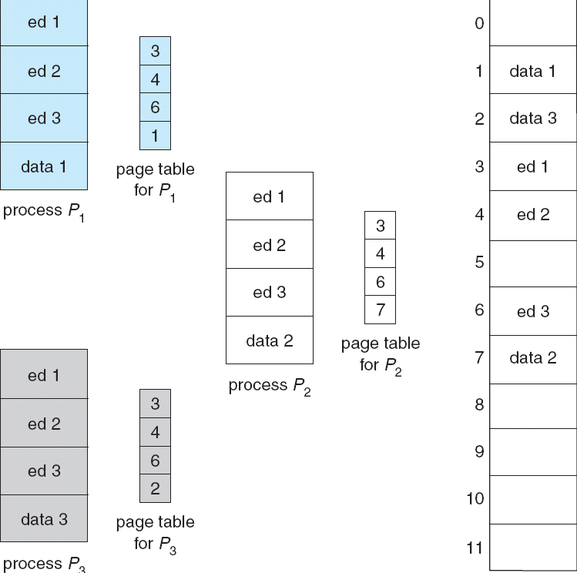
Shared Pages Example
Wang Fengyu
Page <number>

Slide 40
Chapter 8: Memory Management
Background
Swapping
Contiguous Memory Allocation
Paging
Structure of the Page Table
Segmentation
Example: The Intel Pentium
Wang Fengyu
Page <number>

Slide 41
Structure of the Page Table
Hierarchical Paging
Hashed Page Tables
Inverted Page Tables
Wang Fengyu
Page <number>

Slide 42
Hierarchical Page Tables
Break up the logical address space into multiple page tables
A simple technique is a two-level page table
Wang Fengyu
Page <number>

Slide 43

Two-Level Page-Table Scheme
Wang Fengyu
Page <number>

Slide 44
Two-Level Paging Example
A logical address (on 32-bit machine with 4K page size) is divided into:
  a page number consisting of 20 bits
  a page offset consisting of 12 bits
Since the page table is paged, the page number is further divided into:
  a 10-bit page number
  a 10-bit page offset
Thus, a logical address is as follows:
where p₁ is an index into the outer page table, and p₂ is the displacement within the page of the inner page table
page number
page offset
p₁
p₂
d
10
10
12
Wang Fengyu
Page <number>

Slide 45

Address-Translation Scheme
Wang Fengyu
Page <number>

Slide 46


Three-level Paging Scheme
Wang Fengyu
Page <number>

Slide 47
Hashed Page Tables
Common in address spaces > 32 bits
The virtual page number is hashed into a page table. This page table contains a chain of elements hashing to the same location.
Virtual page numbers are compared in this chain searching for a match. If a match is found, the corresponding physical frame is extracted.
Wang Fengyu
Page <number>

Slide 48

Hashed Page Table
Wang Fengyu
Page <number>

Slide 49
Inverted Page Table
One entry for each real page of memory
Entry consists of the virtual address of the page stored in that real memory location, with information about the process that owns that page
Decreases memory needed to store each page table, but increases time needed to search the table when a page reference occurs
Use hash table to limit the search to one — or at most a few — page-table entries
Wang Fengyu
Page <number>

Slide 50

Inverted Page Table Architecture
Wang Fengyu
Page <number>

Slide 51
Chapter 8: Memory Management
Background
Swapping
Contiguous Memory Allocation
Paging
Structure of the Page Table
Segmentation
Example: The Intel Pentium
Wang Fengyu
Page <number>

Slide 52
Segmentation
Memory-management scheme that supports user view of memory
A program is a collection of segments. A segment is a logical unit such as:
main program,
procedure,
function,
method,
object,
local variables, global variables,
common block,
stack,
symbol table, arrays
Wang Fengyu
Page <number>

Slide 53

User’s View of a Program
Wang Fengyu
Page <number>

Slide 54
Logical View of Segmentation
1
1
4
2
3
4
2
3
user space
physical memory space
Wang Fengyu
Page <number>

Slide 55
Segmentation Architecture
Logical address consists of a two tuple:
<segment-number, offset>,
Segment table – maps two-dimensional physical addresses; each table entry has:
  base – contains the starting physical address where the segments reside in memory
  limit – specifies the length of the segment
Segment-table base register (STBR) points to the segment table’s location in memory
Segment-table length register (STLR) indicates number of segments used by a program;
segment number s is legal if s < STLR
Wang Fengyu
Page <number>

Slide 56
Segmentation Architecture (Cont.)
Protection
  With each entry in segment table associate:
    validation bit = 0 ⇒ illegal segment
    read/write/execute privileges
  Protection bits associated with segments;
Since segments vary in length, memory allocation is a dynamic storage-allocation problem
Wang Fengyu
Page <number>

Slide 57

Segmentation Hardware
Wang Fengyu
Page <number>

Slide 58

Example of Segmentation
Wang Fengyu
Page <number>

Slide 59
Chapter 8: Memory Management
Background
Swapping
Contiguous Memory Allocation
Paging
Structure of the Page Table
Segmentation
Example: The Intel Pentium
Wang Fengyu
Page <number>

Slide 60
Example: The Intel Pentium
Supports both segmentation and segmentation with paging
CPU generates logical address
  Given to segmentation unit
    Which produces linear addresses
  Linear address given to paging unit
    Which generates physical address in main memory
    Paging units form equivalent of MMU
Wang Fengyu
Page <number>

Slide 61
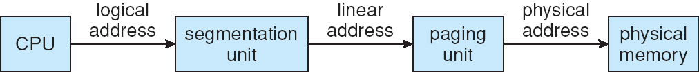
Logical to Physical Address Translation in Pentium
Wang Fengyu
Page <number>

Slide 62

Intel Pentium Segmentation
Wang Fengyu
Page <number>

Slide 63
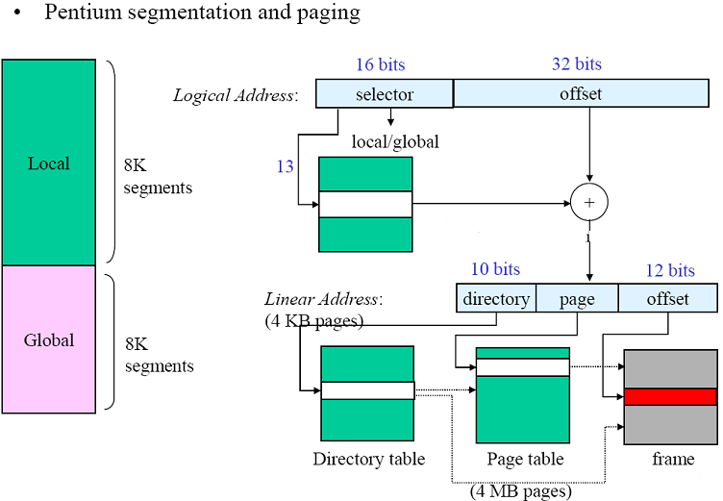
Example: The Intel Pentium
Wang Fengyu
Page <number>

Slide 64
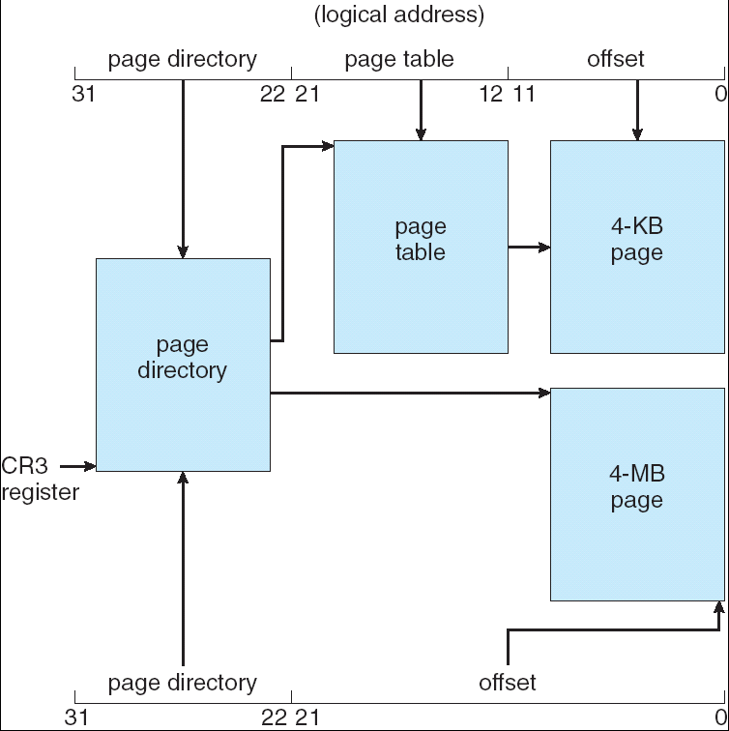
Pentium Paging Architecture
Wang Fengyu
Page <number>

Slide 65
Assignment
8.1， 8.3，8.5，8.7, 8.9, 8.12, 8.13
Wang Fengyu
Page <number>

Slide 66
8.1
Explain the difference between internal and external fragmentation.
Answer: Internal Fragmentation is the area in a region or a page that is not used by the job occupying that region or page. This space is unavailable for use by the system until that job is finished and the page or region is released.
Wang Fengyu
Page <number>

Slide 67
8.3
Given five memory partitions of 100 KB, 500 KB, 200 KB, 300 KB, and 600 KB (in order), how would each of the first-fit, best-fit, and worst-fit algorithms place processes of 212 KB, 417 KB, 112 KB, and 426 KB (in order)? Which algorithm makes the most efficient use of memory?
Wang Fengyu
Page <number>

Slide 68
8.3答案
Answer:
a. First-fit:
  b. 212K is put in 500K partition
  c. 417K is put in 600K partition
  d. 112K is put in 288K partition (new partition 288K = 500K - 212K)
  e. 426K must wait
f. Best-fit:
  g. 212K is put in 300K partition
  h. 417K is put in 500K partition
  i. 112K is put in 200K partition
  j. 426K is put in 600K partition
k. Worst-fit:
  l. 212K is put in 600K partition
  m. 417K is put in 500K partition
  n. 112K is put in 388K partition
  o. 426K must wait
In this example, Best-fit turns out to be the best.
Wang Fengyu
Page <number>

Slide 69
8.5
Compare the main memory organization schemes of contiguous-memory allocation, pure segmentation, and pure paging with respect to the following issues:
a. external fragmentation
b. internal fragmentation
c. ability to share code across processes
Wang Fengyu
Page <number>

Slide 70
8.5 答案
Answer: contiguous memory allocation scheme suffers from external fragmentation as address spaces are allocated contiguously and holes
develop as old processes dies and new processes are initiated. It also
does not allow processes to share code, since a process’s virtual memory
segment is not broken into non-contiguous finegrained segments. Pure
segmentation also suffers from external fragmentation as a segment of a
process is laid out contiguously in physical memory and fragmentation
would occur as segments of dead processes are replaced by segments of
new processes. Segmentation, however, enables processes to share code;
for instance, two different processes could share a code segment but have
distinct data segments. Pure paging does not suffer from external fragmentation,
but instead suffers from internal fragmentation. Processes are
allocated in page granularity and if a page is not completely utilized, it
results in internal fragmentation and a corresponding wastage of space.
Paging also enables processes to share code at the granularity of pages
Wang Fengyu
Page <number>

Slide 71
8.7
Compare paging with segmentation with respect to the amount of memory required by the address translation structures in order to convert virtual addresses to physical addresses.
Answer: Paging requires more memory overhead to maintain the translation structures. Segmentation requires just two registers per segment: one to maintain the base of the segment and the other to maintain the extent of the segment. Paging on the other hand requires one entry per page, and this entry provides the physical address in which the page is located.
Wang Fengyu
Page <number>

Slide 72
8.9
Consider a paging system with the page table stored in memory.
a. If a memory reference takes 200 nanoseconds, how long does a
paged memory reference take?
b. If we add associative registers, and 75 percent of all page-table
references are found in the associative registers, what is the effective memory reference time? (Assume that finding a page-table entry in the associative registers takes zero time, if the entry is there.)
Answer:
a. 400 nanoseconds; 200 nanoseconds to access the page table and
200 nanoseconds to access the word in memory.
b. Effective access time = 0.75 × (200 nanoseconds) + 0.25 × (400
nanoseconds) = 250 nanoseconds.
Wang Fengyu
Page <number>

Slide 73
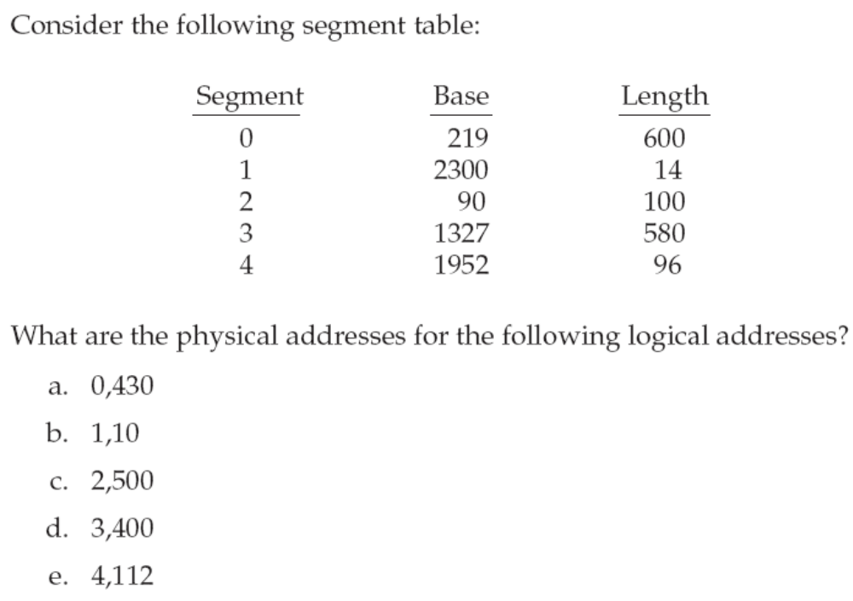
8.12
Wang Fengyu
Page <number>

Slide 74
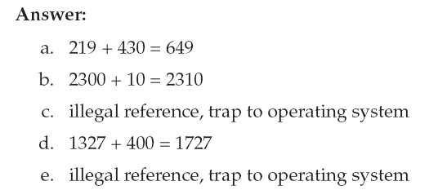
8.12 答案
Wang Fengyu
Page <number>

Slide 75
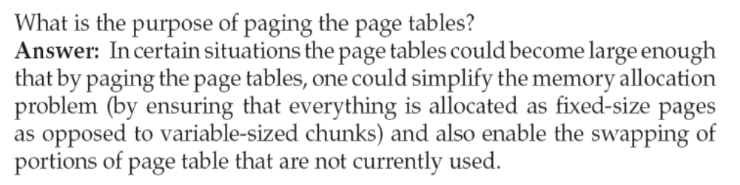
8.13
Wang Fengyu
Page <number>

Slide 76
End of Chapter 8
April 19, 2010

