Slide 1
Chapter 9: Virtual Memory

Slide 2
Objectives
To describe the benefits of a virtual memory system
To explain the concepts of demand paging, page-replacement algorithms, and allocation of page frames
To discuss the principle of the working-set model
Page <number>

Slide 3
Chapter 9: Virtual Memory
Background
Demand Paging
Copy-on-Write
Page Replacement
Allocation of Frames
Thrashing
Memory-Mapped Files
Allocating Kernel Memory
Other Considerations
Operating-System Examples
Page <number>

Slide 4
Chapter 9: Virtual Memory
Background
Demand Paging
Copy-on-Write
Page Replacement
Allocation of Frames
Thrashing
Memory-Mapped Files
Allocating Kernel Memory
Other Considerations
Operating-System Examples
Page <number>

Slide 5
Background-Virtual Memory Introduction
Key ideas
  Separation of logical and physical address spaces
  Automatic memory mapping mechanisms which support
    A large logical address space (bigger than physical memory)
    On-demand movement of program components between the disk and memory (performed transparently by the OS using hardware support)
  Demand paging + page replacement + frame allocation
Page <number>

Slide 6
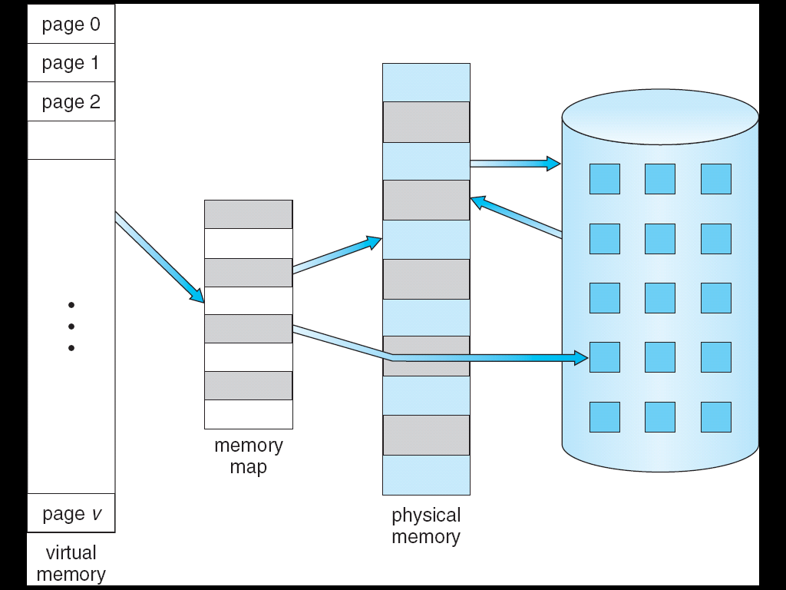
Virtual Memory That is Larger Than Physical Memory
⇒
Page <number>

Slide 7
Background-Virtual Memory Introduction
Potential advantages
  The programmer
    Is not constrained by limitations of actual physical memory
    Gets a clean abstraction of storage without having to worry about cumbersome attributes of the execution environment
      Overlays, dynamic loading, disk transfers, etc.
  The system
    Benefits from a higher degree of multiprogramming
      And hence utilization, throughput, …
Page <number>

Slide 8
Chapter 9: Virtual Memory
Background
Demand Paging
Copy-on-Write
Page Replacement
Allocation of Frames
Thrashing
Memory-Mapped Files
Allocating Kernel Memory
Other Considerations
Operating-System Examples
Page <number>

Slide 9
Demand Paging
Bring a page into memory only when it is needed
  Less I/O needed
  Less memory needed
  Faster response
  More users
Page is needed ⇒ reference to it
  invalid reference ⇒ abort
  not-in-memory ⇒ bring to memory
Lazy swapper – never swaps a page into memory unless page will be needed
  Swapper that deals with pages is a pager
Page <number>

Slide 10
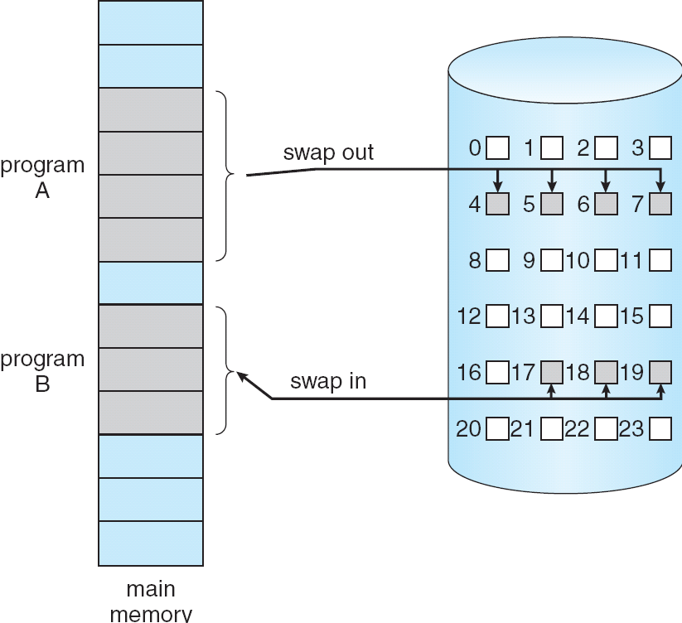
Transfer of a Paged Memory to Contiguous Disk Space
Page <number>

Slide 11
Valid-Invalid Bit
With each page table entry a valid–invalid bit is associated
(v ⇒ in-memory, i ⇒ not-in-memory)
Initially valid–invalid bit is set to i on all entries
Example of a page table snapshot:
During address translation, if valid–invalid bit in page table entry is i ⇒ page fault
Frame #
valid-invalid bit
v
v
v
v
i
…
i
i
page table
Page <number>

Slide 12
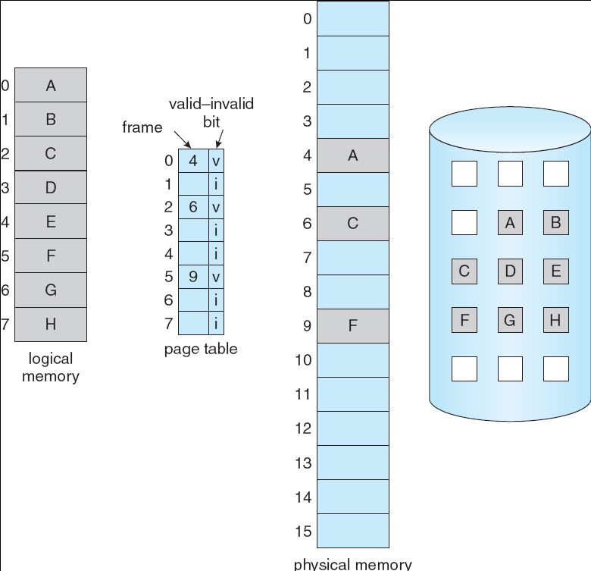
Page Table When Some Pages Are Not in Main Memory
Page <number>

Slide 13
Page Fault
If there is a reference to a page, first reference to that page will trap to operating system: page-fault trap
  Operating system looks at page table to decide:
    Invalid reference ⇒ abort
    Just not in memory
  Get empty frame
  Swap page into frame
  Reset tables
  Set validation bit = v
  Restart the instruction that caused the page fault
Page <number>

Slide 14

Steps in Handling a Page Fault
Page <number>

Slide 15
Page Fault (Cont.)
Restart instruction- problem
  block move（IBM360 MVC）
  solution：
  1. Attempt to access both ends of both blocks;
  2. Use temporary registers to hold the values of overwritten locations
Page <number>

Slide 16
Performance of Demand Paging
Page Fault Rate 0 ≤ p ≤ 1.0
  if p = 0 no page faults
  if p = 1, every reference is a fault
Effective Access Time (EAT)
EAT = (1 – p) × memory access
+ p ×(service page fault interrupt
+ read in page
+ restart the process
)
Page <number>

Slide 17
Demand Paging Example
Memory access time = 200 nanoseconds
Average page-fault service time = 8 milliseconds
EAT = (1 – p) × 200 + p (8 milliseconds)
= (1 – p) × 200 + p x 8,000,000
= 200 + p × 7,999,800
If one access out of 1,000 causes a page fault, then
EAT = 8.2 microseconds.
This is a slowdown by a factor of 40!!
Page <number>

Slide 18
Chapter 9: Virtual Memory
Background
Demand Paging
Copy-on-Write
Page Replacement
Allocation of Frames
Thrashing
Memory-Mapped Files
Allocating Kernel Memory
Other Considerations
Operating-System Examples
Page <number>

Slide 19
Process Creation
Virtual memory allows other benefits during process creation:
- Copy-on-Write
- Memory-Mapped Files (later)
Page <number>

Slide 20
Copy-on-Write
Copy-on-Write (COW) allows both parent and child processes to initially share the same pages in memory
  If either process modifies a shared page, only then is the page copied
COW allows more efficient process creation as only modified pages are copied
Free pages are allocated from a pool of zeroed-out pages
Page <number>

Slide 21
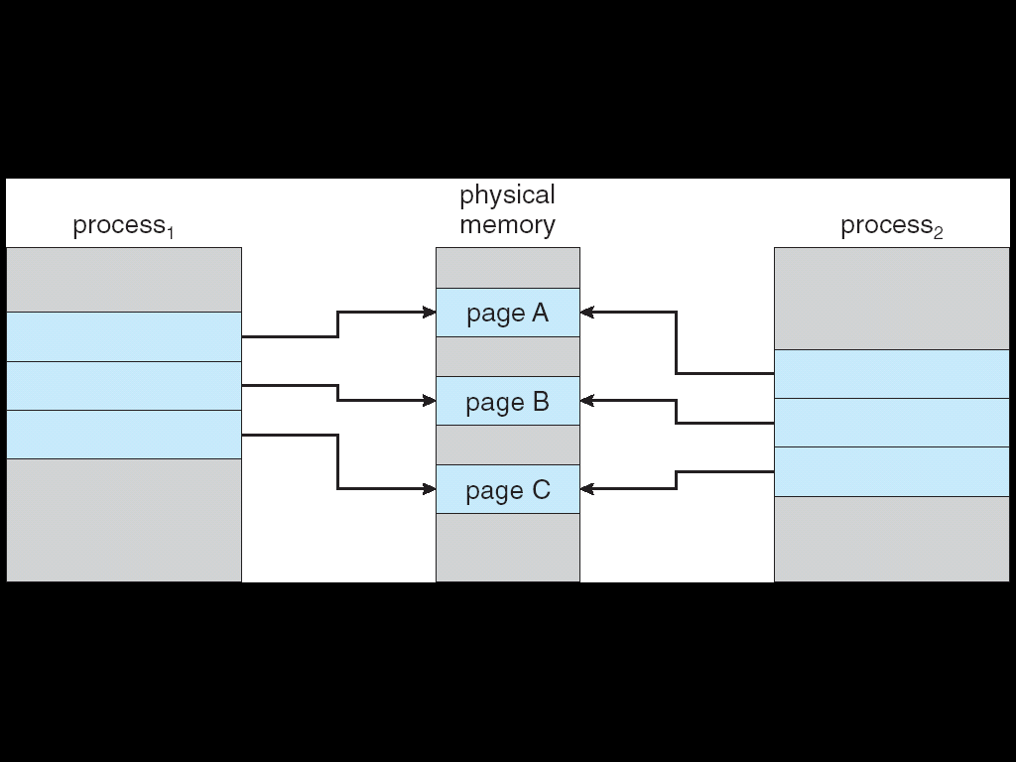
Before Process 1 Modifies Page C
Page <number>

Slide 22
After Process 1 Modifies Page C
Copy of page C
Page <number>

Slide 23
Chapter 9: Virtual Memory
Background
Demand Paging
Copy-on-Write
Page Replacement
Allocation of Frames
Thrashing
Memory-Mapped Files
Allocating Kernel Memory
Other Considerations
Operating-System Examples
Page <number>

Slide 24

Need For Page Replacement
Page <number>

Slide 25
What happens if there is no free frame?
Page replacement – find some page in memory, but not really in use, swap it out
  algorithm
  performance – want an algorithm which will result in minimum number of page faults
Same page may be brought into memory several times
Page <number>

Slide 26
Basic Page Replacement
Find the location of the desired page on disk
Find a free frame:
  If there is a free frame, use it
  If there is no free frame, use a page replacement algorithm to select a victim frame
Bring the desired page into the (newly) free frame; update the page and frame tables
Restart the process
Page <number>

Slide 27

Page Replacement
Page <number>

Slide 28
Page Replacement
Prevent over-allocation of memory by modifying page-fault service routine to include page replacement
Use modify (dirty) bit to reduce overhead of page transfers – only modified pages are written to disk
Page replacement completes separation between logical memory and physical memory – large virtual memory can be provided on a smaller physical memory
Page <number>

Slide 29
Page Replacement Algorithms
Want lowest page-fault rate
Evaluate algorithm by running it on a particular string of memory references (reference string) and computing the number of page faults on that string
In all our examples, the reference string is
1, 2, 3, 4, 1, 2, 5, 1, 2, 3, 4, 5
Page <number>

Slide 30

Graph of Page Faults Versus The Number of Frames
Page <number>

Slide 31
First-In-First-Out (FIFO) Algorithm
Reference string: 1, 2, 3, 4, 1, 2, 5, 1, 2, 3, 4, 5
3 frames (3 pages can be in memory at a time per process)
4 frames
Belady’s Anomaly: more frames ⇒ more page faults
1
1
4
5
2
2
1
3
9 page faults
3
3
2
4
1
1
5
4
2
2
1
5
10 page faults
3
3
2
4
4
3
Page <number>

Slide 32

FIFO Illustrating Belady’s Anomaly
Page <number>

Slide 33

FIFO Page Replacement
Page <number>

Slide 34
Optimal Algorithm
Replace page that will not be used for longest period of time
4 frames example
1, 2, 3, 4, 1, 2, 5, 1, 2, 3, 4, 5
How do you know this?
Used for measuring how well your algorithm performs
1
4
2
6 page faults
3
4
5
Page <number>

Slide 35

Optimal Page Replacement
Page <number>

Slide 36
Least Recently Used (LRU) Algorithm
Reference string: 1, 2, 3, 4, 1, 2, 5, 1, 2, 3, 4, 5
1
1
1
1
5
2
2
2
2
2
3
5
5
4
4
4
4
3
3
3
Page <number>

Slide 37

LRU Page Replacement
Page <number>

Slide 38
LRU Algorithm (Cont.)
Counter implementation
  Every page entry has a counter; every time page is referenced through this entry, copy the clock into the counter
  When a page needs to be changed, look at the counters to determine which are to change
Stack implementation – keep a stack of page numbers in a double link form:
  Page referenced:
    move it to the top
    requires 6 pointers to be changed
  No search for replacement
Page <number>

Slide 39

Use Of A Stack to Record The Most Recent Page References
Page <number>

Slide 40
LRU Approximation Algorithms
Reference bit
  With each page associate a bit, initially = 0
  When page is referenced bit set to 1
Second chance
  Need reference bit
  Clock replacement
  If page to be replaced (in clock order) has reference bit = 1 then:
    set reference bit 0
    leave page in memory
    replace next page (in clock order), subject to same rules
Page <number>

Slide 41

Second-Chance (clock) Page-Replacement Algorithm
Page <number>

Slide 42
Counting Algorithms
Keep a counter of the number of references that have been made to each page
LFU Algorithm: replaces page with smallest count
MFU Algorithm: based on the argument that the page with the smallest count was probably just brought in and has yet to be used
Page <number>

Slide 43
Chapter 9: Virtual Memory
Background
Demand Paging
Copy-on-Write
Page Replacement
Allocation of Frames
Thrashing
Memory-Mapped Files
Allocating Kernel Memory
Other Considerations
Operating-System Examples
Page <number>

Slide 44
Allocation of Frames
Each process needs minimum number of frames
Example: IBM 370 – 6 pages to handle MVC instruction:
  instruction is 6 bytes, might span 2 pages
  2 pages to handle from
  2 pages to handle to
Two major allocation schemes
  fixed allocation
  priority allocation
Page <number>

Slide 45


Fixed Allocation
Equal allocation – For example, if there are 100 frames and 5 processes, give each process 20 frames.
Proportional allocation – Allocate according to the size of process
Page <number>

Slide 46
Global vs. Local Allocation
Global replacement – process selects a replacement frame from the set of all frames; one process can take a frame from another
Local replacement – each process selects from only its own set of allocated frames
Page <number>

Slide 47
Chapter 9: Virtual Memory
Background
Demand Paging
Copy-on-Write
Page Replacement
Allocation of Frames
Thrashing
Memory-Mapped Files
Allocating Kernel Memory
Other Considerations
Operating-System Examples
Page <number>

Slide 48
Thrashing
If a process does not have “enough” pages, the page-fault rate is very high. This leads to:
  low CPU utilization
  operating system thinks that it needs to increase the degree of multiprogramming
  another process added to the system
Thrashing ≡ a process is busy swapping pages in and out
Page <number>

Slide 49

Thrashing (Cont.)
Page <number>

Slide 50
Demand Paging and Thrashing
Why does demand paging work?
Locality model
  Process migrates from one locality to another
  A locality is a set of pages that are actively used together
  A program is composed of several different localities
  Localities may overlap
Why does thrashing occur?
Σ size of locality > total memory size
Page <number>

Slide 51

Locality In A Memory-Reference Pattern
Page <number>

Slide 52
Working-Set Model
Δ ≡ working-set window ≡ a fixed number of page references
Example: 10,000 instruction
WSS_{i} (working set of Process P_{i}) =
total number of pages referenced in the most recent Δ (varies in time)
  if Δ too small will not encompass entire locality
  if Δ too large will encompass several localities
  if Δ = ∞ ⇒ will encompass entire program
D = Σ WSS_{i} ≡ total demand frames
if D > m ⇒ Thrashing
Policy: if D > m, then suspend one of the processes
Page <number>

Slide 53

Working-set model（ Δ =10）
Page <number>

Slide 54
Keeping Track of the Working Set
Approximate with interval timer + a reference bit
Example: Δ = 10,000
  Timer interrupts after every 5000 time units
  Keep in memory 2 bits for each page
  Whenever a timer interrupts copy and sets the values of all reference bits to 0
  If one of the bits in memory = 1 ⇒ page in working set
Why is this not completely accurate?
Improvement = 10 bits and interrupt every 1000 time units
Page <number>

Slide 55

Page-Fault Frequency Scheme
Establish “acceptable” page-fault rate
  If actual rate too low, process loses frame
  If actual rate too high, process gains frame
Page <number>

Slide 56
Chapter 9: Virtual Memory
Background
Demand Paging
Copy-on-Write
Page Replacement
Allocation of Frames
Thrashing
Memory-Mapped Files
Allocating Kernel Memory
Other Considerations
Operating-System Examples
Page <number>

Slide 57
Memory-Mapped Files
Memory-mapped file I/O allows file I/O to be treated as routine memory access by mapping a disk block to a page in memory
A file is initially read using demand paging. A page-sized portion of the file is read from the file system into a physical page. Subsequent reads/writes to/from the file are treated as ordinary memory accesses.
Simplifies file access by treating file I/O through memory rather than read() write() system calls
Also allows several processes to map the same file allowing the pages in memory to be shared
Page <number>

Slide 58

Memory Mapped Files
Page <number>

Slide 59
Chapter 9: Virtual Memory
Background
Demand Paging
Copy-on-Write
Page Replacement
Allocation of Frames
Thrashing
Memory-Mapped Files
Allocating Kernel Memory
Other Considerations
Operating-System Examples
Page <number>

Slide 60
Allocating Kernel Memory
Treated differently from user memory
Often allocated from a free-memory pool
  Kernel requests memory for structures of varying sizes，some of which are less than a page in size. As a result, the kernel must use memory conservatively and attempt to minimize waste due to fragmentation
  Certain hardware devices interact directly with physical memory----consequently may require memory to be contiguous
Page <number>

Slide 61
Buddy System
Allocates memory from fixed-size segment consisting of physically-contiguous pages
Memory allocated using power-of-2 allocator
  Satisfies requests in units sized as power of 2
  Request rounded up to next highest power of 2
  When smaller allocation needed than is available, current chunk split into two buddies of next-lower power of 2
    Continue until appropriate sized chunk available
Page <number>
Notes:
伙伴系统

Slide 62
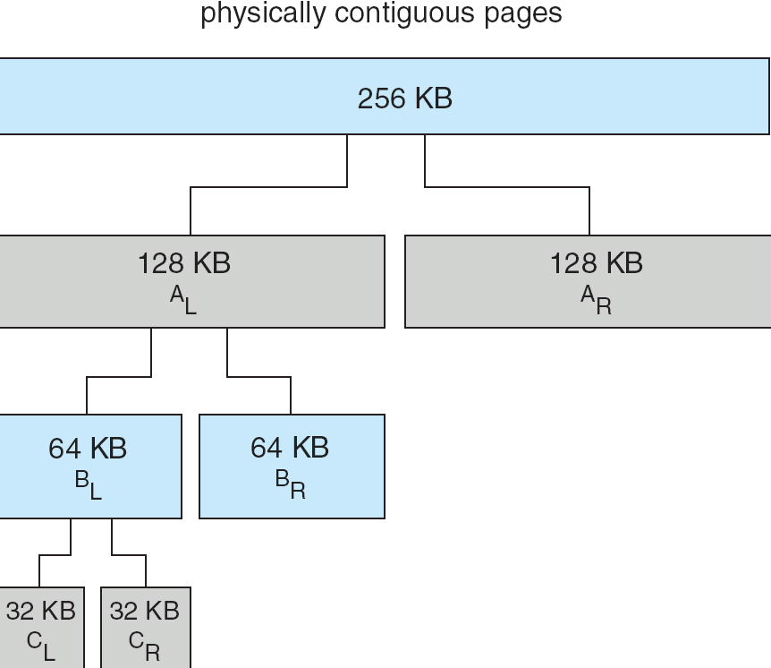
Buddy System Allocator
Page <number>

Slide 63
Slab Allocator
Alternate strategy
Slab is one or more physically contiguous pages
Cache consists of one or more slabs
Single cache for each unique kernel data structure
  Each cache filled with objects – instantiations of the data structure
When cache created, filled with objects marked as free
When structures stored, objects marked as used
If slab is full of used objects, next object allocated from empty slab
  If no empty slabs, new slab allocated
Benefits include no fragmentation, fast memory request satisfaction
Page <number>

Slide 64

Slab Allocation
Page <number>

Slide 65
Chapter 9: Virtual Memory
Background
Demand Paging
Copy-on-Write
Page Replacement
Allocation of Frames
Thrashing
Memory-Mapped Files
Allocating Kernel Memory
Other Considerations
Operating-System Examples
Page <number>

Slide 66
Other Issues -- Prepaging
Prepaging
  To reduce the large number of page faults that occurs at process startup
  Prepage all or some of the pages a process will need, before they are referenced
  But if prepaged pages are unused, I/O and memory was wasted
  Assume s pages are prepaged and α of the pages is used
    Is cost of s * α save pages faults > or < than the cost of prepaging
    s * (1- α) unnecessary pages?
    α near zero ⇒ prepaging loses
Page <number>

Slide 67
Other Issues – Page Size
Page size selection must take into consideration:
  Fragmentation（小页）
  table size （大页）
  I/O overhead (大页）
  Locality （小页）
  Page fault （大页）
  … … … …
Page <number>

Slide 68
Other Issues – TLB Reach
TLB Reach - The amount of memory accessible from the TLB
TLB Reach = (TLB Size) × (Page Size)
Ideally, the working set of each process is stored in the TLB
  Otherwise there is a high degree of page faults
Increase the Page Size
  This may lead to an increase in fragmentation as not all applications require a large page size
Provide Multiple Page Sizes
  This allows applications that require larger page sizes the opportunity to use them without an increase in fragmentation
Page <number>

Slide 69
Other Issues – Program Structure
Program structure
  Int[128,128] data;
  Each row is stored in one page
  Frame number<128
  Program 1
for (j = 0; j <128; j++)
for (i = 0; i < 128; i++)
data[i,j] = 0;
  128 x 128 = 16,384 page faults
  Program 2
  for (i = 0; i < 128; i++)
  for (j = 0; j < 128; j++)
  data[i,j] = 0;
  128 page faults
Page <number>

Slide 70
Other Issues – I/O interlock
I/O Interlock – Pages must sometimes be locked into memory
Consider I/O - Pages that are used for copying a file from a device must be locked from being selected for eviction by a page replacement algorithm
Page <number>

Slide 71

Reason Why Frames Used For I/O Must Be In Memory
Page <number>

Slide 72
Operating System Examples
Windows XP
Solaris
Page <number>

Slide 73
Windows XP
Uses demand paging with clustering. Clustering brings in pages following the faulting page.
Processes are assigned working set minimum and working set maximum
  Working set minimum is the minimum number of pages the process is guaranteed to have in memory
  A process may be assigned as many pages up to its working set maximum
When the amount of free memory in the system falls below a threshold, automatic working set trimming is performed to restore the amount of free memory
  Working set trimming removes pages from processes that have pages in excess of their working set minimum
Page <number>

Slide 74
Solaris
Maintains a list of free pages to assign faulting processes
Lotsfree – threshold parameter (amount of free memory) to begin paging
Desfree – threshold parameter to increasing paging
Minfree – threshold parameter to begin swapping
Paging is performed by pageout process
Pageout scans pages using modified clock algorithm
Scanrate is the rate at which pages are scanned. This ranges from slowscan to fastscan
Pageout is called more frequently depending upon the amount of free memory available
Page <number>

Slide 75

Solaris 2 Page Scanner
Page <number>

Slide 76
Assignment
9.4, 9.5, 9.10
Page <number>

Slide 77
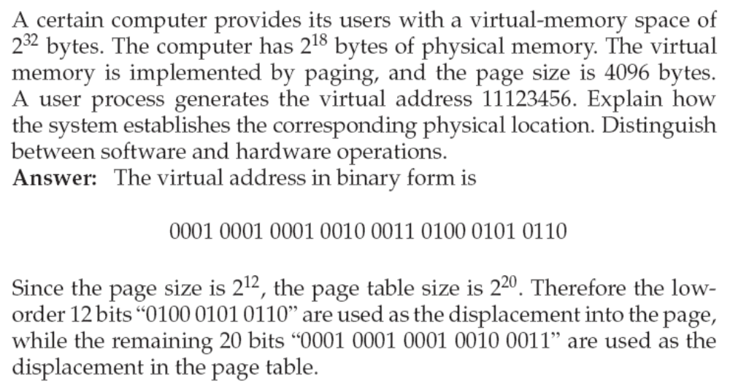
9.4
Page <number>

Slide 78
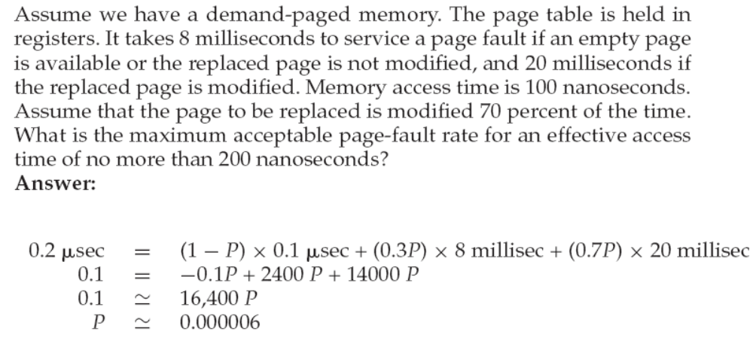
9.5
Page <number>

Slide 79
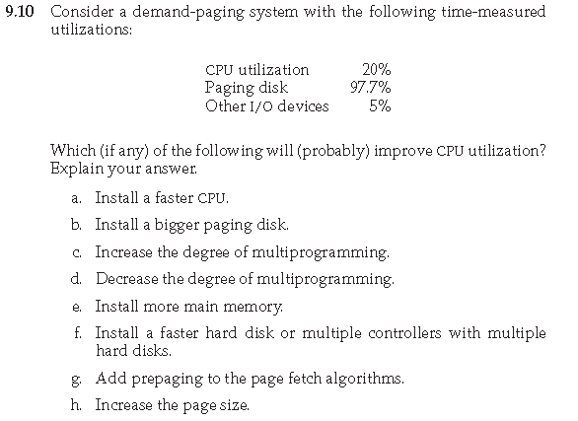
9.10
Page <number>

Slide 80
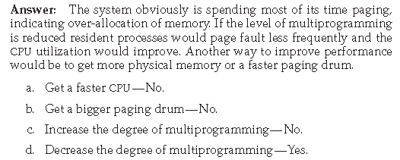
9.10
Page <number>

Slide 81
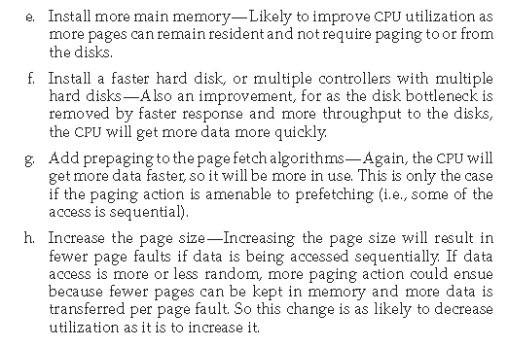
9.10
Page <number>

Slide 82
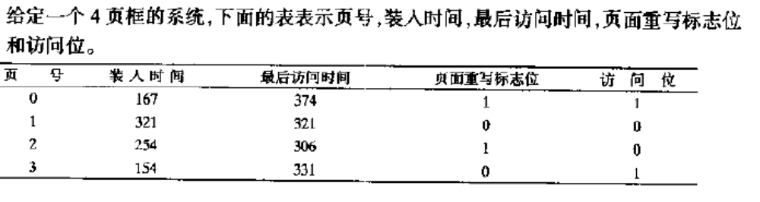
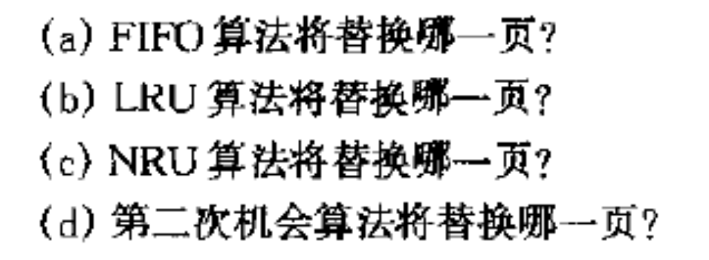
练习1
Page <number>

Slide 83
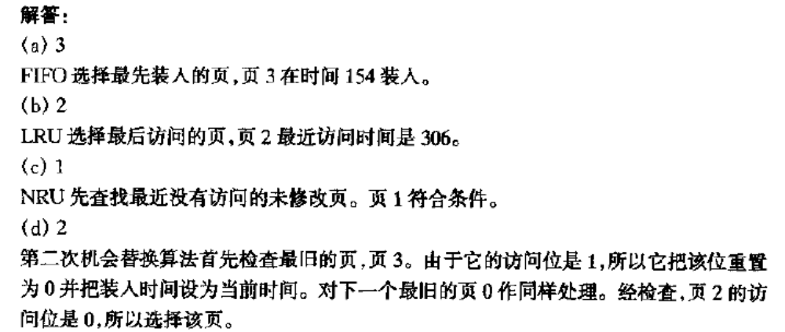
练习1答案
Page <number>

Slide 84
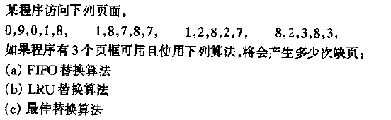
练习2
Page <number>

Slide 85
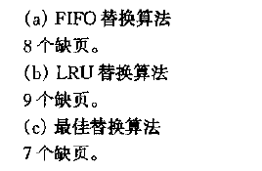
练习2答案
Page <number>

Slide 86
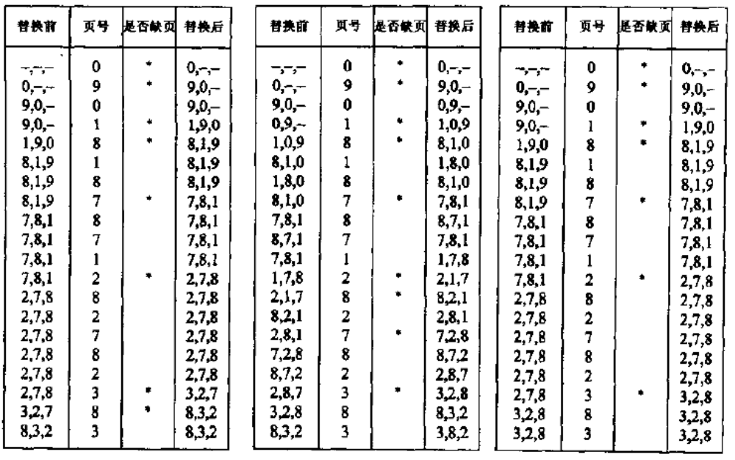
练习2答案
Page <number>

Slide 87
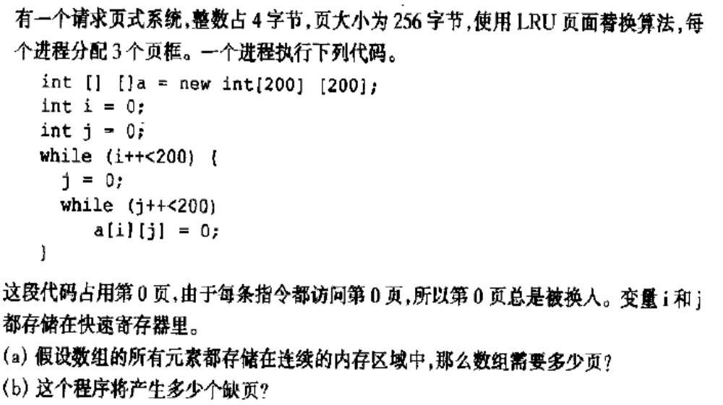
练习3
Page <number>

Slide 88
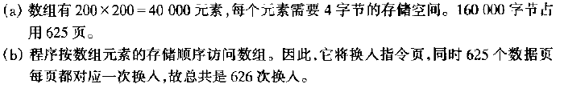
练习3答案
Page <number>

Slide 89
End of Chapter 9

