Slide 1
Chapter 10: File-System Interface

Slide 2
Objectives
To explain the function of file systems
To describe the interfaces to file systems
To discuss file-system design tradeoffs, including access methods, file sharing, file locking, and directory structures
To explore file-system protection
Wang Fengyu
Page <number>

Slide 3
Chapter 10: File-System Interface
File Concept
Access Methods
Directory Structure
File-System Mounting
Protection
Wang Fengyu
Page <number>

Slide 4
Chapter 10: File-System Interface
File Concept
Access Methods
Directory Structure
File-System Mounting
Protection
Wang Fengyu
Page <number>

Slide 5
File Concept
A named collection of related information that is recorded on secondary storage
For user, a file is the smallest allotment of logical secondary storage
Contiguous logical address space
Types:
  Data
    numeric
    character
    binary
  Program
Wang Fengyu
Page <number>

Slide 6
File Attributes
Name – only information kept in human-readable form
Identifier – unique tag (number) identifies file within file system
Type – needed for systems that support different types
Location – pointer to file location on device
Size – current file size
Protection – controls who can do reading, writing, executing
Time, date, and user identification – data for protection, security, and usage monitoring
Information about files are kept in the directory structure, which is maintained on the disk
Wang Fengyu
Page <number>

Slide 7
File Operations
Create
  Space in the file system must be found for the file
  An entry for the new file must be made in the directory
Write
  Make a system call specifying both the name of the file and the information to be written to the file
  System keep a write pointer to the location in the file where the next write is to take place
Read
  Make a system call that specifies the name of the file and where the next block of the file should be put
  System needs to keep a read pointer to the location in the file where the next read is to take place.
Wang Fengyu
Page <number>

Slide 8
File Operations (Cont.)
Reposition within file
  The current-file-position pointer is repositioned to a given value
  Need not involve any actual I/O
Delete
  Found the associated directory entry
  Release all file space and erase the directory entry
Truncate
  Allows all attributes to remain unchanged, but lets the file be reset to length zero and its file space released.
Wang Fengyu
Page <number>

Slide 9
File Operations (Cont.)
Open(F_{i})
  search the directory structure on disk for entry F_{i}, and move the content of entry to memory
Close (F_{i})
  move the content of entry F_{i} in memory to directory structure on disk
Wang Fengyu
Page <number>

Slide 10
Open Files
Several pieces of data are needed to manage open files:
  File pointer: pointer to last read/write location, per process that has the file open
  File-open count: counter of number of times a file is open – to allow removal of data from open-file table when last processes closes it
  Disk location of the file: cache of data access information
  Access rights: per-process access mode information
Wang Fengyu
Page <number>

Slide 11

File Types – Name, Extension
Wang Fengyu
Page <number>

Slide 12
File Structure
None - sequence of words, bytes
Simple record structure
  Lines
  Fixed length
  Variable length
Complex Structures
  Formatted document
  Relocatable load file
Who decides:
  Operating system
  Program
Wang Fengyu
Page <number>

Slide 13
Chapter 10: File-System Interface
File Concept
Access Methods
Directory Structure
File-System Mounting
Protection
Wang Fengyu
Page <number>

Slide 14
Access Methods
Sequential Access
read next
write next
reset
Direct Access
read n
write n
position to n
read next
write next
n = relative block number
Wang Fengyu
Page <number>

Slide 15

Sequential-access File
Wang Fengyu
Page <number>

Slide 16
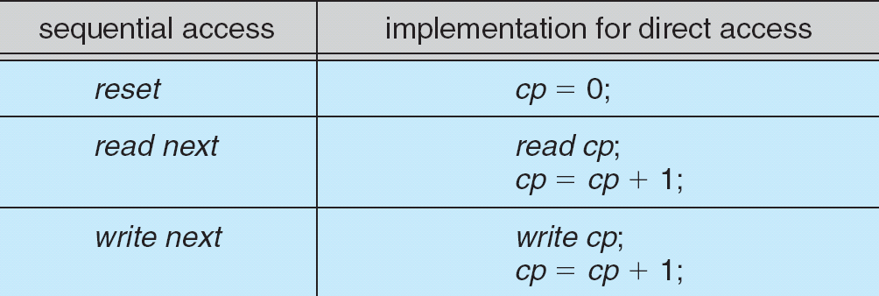
Simulation of Sequential Access on a Direct-access File
Wang Fengyu
Page <number>

Slide 17

Example of Index and Relative Files
Wang Fengyu
Page <number>

Slide 18
Chapter 10: File-System Interface
File Concept
Access Methods
Directory Structure
File-System Mounting
Protection
Wang Fengyu
Page <number>

Slide 19

A Typical File-system Organization
Wang Fengyu
Page <number>

Slide 20
Directory
Each volume that contains a file system must also contain information about the files in the system
This information is kept in entries in a directory
Directory records information for all files on that volume
  name, location, size, and type
Directory can be viewed as a symbol table that translate file names into their directory entries
Wang Fengyu
Page <number>

Slide 21
Directory Structure
A collection of nodes containing information about all files
Directory
Files
F 1
F 2
F 3
F 4
F n
Both the directory structure and the files reside on disk
Wang Fengyu
Page <number>

Slide 22
Operations Performed on Directory
Search for a file
Create a file
Delete a file
List a directory
Rename a file
Traverse the file system
Wang Fengyu
Page <number>

Slide 23
Organize the Directory (Logically) to Obtain
Efficiency – locating a file quickly
Naming – convenient to users
  Two users can have same name for different files
  The same file can have several different names
Grouping – logical grouping of files by properties, (e.g., all Java programs, all games, …)
Wang Fengyu
Page <number>

Slide 24

Single-Level Directory
A single directory for all users
Naming problem
Grouping problem
Wang Fengyu
Page <number>

Slide 25

Two-Level Directory
Separate directory for each user
Path name
Can have the same file name for different user
Efficient searching
No grouping capability
Wang Fengyu
Page <number>

Slide 26

Tree-Structured Directories
Wang Fengyu
Page <number>

Slide 27
Tree-Structured Directories (Cont)
Efficient searching
Grouping Capability
Current directory (working directory)
Wang Fengyu
Page <number>

Slide 28
Tree-Structured Directories (Cont)
Absolute or relative path name
Creating a new file is done in current directory
Delete a file
rm <file-name>
Creating a new subdirectory is done in current directory
  mkdir <dir-name>
Example: if in current directory /mail
mkdir count
mail
prog
copy
prt
exp
count
Deleting “mail” ⇒ deleting the entire subtree rooted by “mail”
Wang Fengyu
Page <number>

Slide 29

Acyclic-Graph Directories
Have shared subdirectories and files
Wang Fengyu
Page <number>

Slide 30

General Graph Directory
Wang Fengyu
Page <number>

Slide 31
General Graph Directory (Cont.)
How do we guarantee no cycles?
  Garbage collection
  Every time a new link is added use a cycle detection
  algorithm to determine whether it is OK
Wang Fengyu
Page <number>

Slide 32
Chapter 10: File-System Interface
File Concept
Access Methods
Directory Structure
File-System Mounting
File Sharing
Protection
Wang Fengyu
Page <number>

Slide 33
File System Mounting
A file system must be mounted before it can be accessed
A unmounted file system is mounted at a mount point
Wang Fengyu
Page <number>

Slide 34

(a) Existing. (b) Unmounted Partition
Wang Fengyu
Page <number>

Slide 35
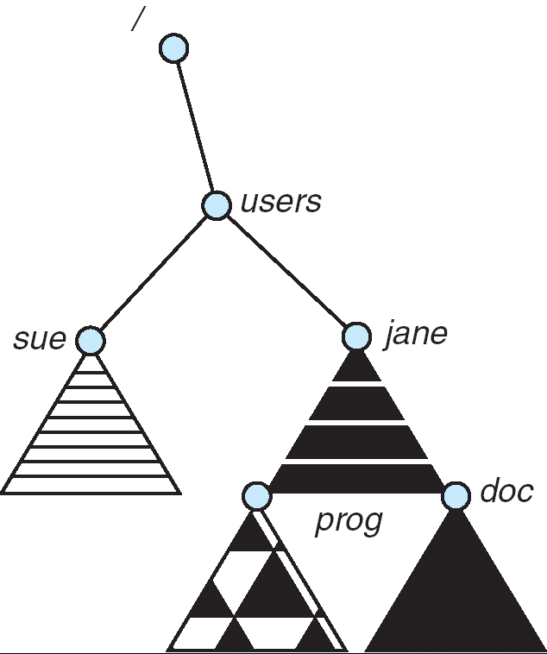
Mount Point
Wang Fengyu
Page <number>

Slide 36
Chapter 10: File-System Interface
File Concept
Access Methods
Directory Structure
File-System Mounting
Protection
Wang Fengyu
Page <number>

Slide 37
Protection
File owner/creator should be able to control:
  what can be done
  by whom
Types of access
  Read
  Write
  Execute
  Append
  Delete
  List
Wang Fengyu
Page <number>

Slide 38
Unix -Access Lists and Groups
Mode of access: read, write, execute
Three classes of users
RWX
a) owner access 7 ⇒ 1 1 1
RWX
b) group access 6 ⇒ 1 1 0
RWX
c) public access 1 ⇒ 0 0 1
Ask manager to create a group (unique name), say G, and add some users to the group.
For a particular file (say game) or subdirectory, define an appropriate access.
owner
group
public
chmod
761
game
Attach a group to a file
chgrp G game
Wang Fengyu
Page <number>

Slide 39

A Sample UNIX Directory Listing
Wang Fengyu
Page <number>

Slide 40

Windows XP Access-control List Management
Wang Fengyu
Page <number>

Slide 41
End of Chapter 10

