Slide 1
Chapter 11: File System Implementation

Slide 2
Objectives
To describe the details of implementing local file systems and directory structures
To describe the implementation of remote file systems
To discuss block allocation and free-block algorithms and trade-offs
Page <number>

Slide 3
Chapter 11: File System Implementation
File-System Structure
File-System Implementation
Directory Implementation
Allocation Methods
Free-Space Management
Efficiency and Performance
Recovery
Log-Structured File Systems
NFS
Example: WAFL File System
Page <number>

Slide 4
Chapter 11: File System Implementation
File-System Structure
File-System Implementation
Directory Implementation
Allocation Methods
Free-Space Management
Efficiency and Performance
Recovery
Log-Structured File Systems
NFS
Example: WAFL File System
Page <number>

Slide 5
File-System Structure
Disks provide the bulk of secondary storage
To provide efficient and convenient access to the disk, the operating system imposes file system to disk
I/O transfers between memory and disk are performed in units of blocks.
Each block has one or more sectors
Page <number>

Slide 6
File-System Structure
File system poses two design problems:
  How the file system should look to the user
    File and its attributes
    Operations allowed on a file
    The directory structure for organizing files
  Algorithms and data structures to map the logical file system onto the physical secondary-storage devices
Page <number>

Slide 7
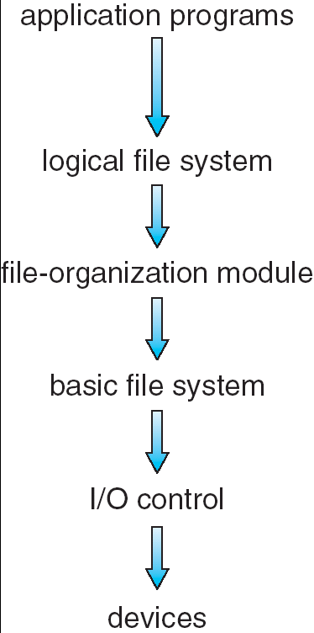
Layered File System
File system organized into layers
Page <number>

Slide 8
Layered File System- I/O control
I/O control consists of device drivers and interrupt handlers to transfer information between the main memory and the disk system
Its input consists of high-level commands and its output consists of low-level, hardware-specific instructions that are used by the hardware controller.
Page <number>

Slide 9
Layered File System- basic file system
Basic file system needs to issue generic commands to the appropriate device driver to read and write physical blocks on the disk
Each physical block is identified by its numeric disk address
Page <number>

Slide 10
Layered File System- file organization module
File-organization module knows about files and their logical blocks, as well as physical blocks
Can translate logical block address to physical block address
Logical blocks are numbered from 0 through N
Also includes the free-space manager, which tracks unallocated blocks and provides these blocks to the file-organization module when requested
Page <number>

Slide 11
Layered File System- logical file system
Logical file system manages metadata information
Metadata includes all of the file-system structure except the actual data
  Manages the directory structure to provide the file organization modal with the information the latter needs
  Maintains file structure via file-control blocks (FCB)
Page <number>

Slide 12
Chapter 11: File System Implementation
File-System Structure
File-System Implementation
Directory Implementation
Allocation Methods
Free-Space Management
Efficiency and Performance
Recovery
Log-Structured File Systems
NFS
Example: WAFL File System
Page <number>

Slide 13
Overview
Several on-disk and in-memory structures are used to implement a file system
On disk, the file system may contain :
  Boot Control Block
    How to boot an operating system stored there
    First block of a volume
  Volume Control Block
    Total number of blocks
    The number of free blocks
    Size of the blocks
    ….
  A directory structure per file system
  A per-file FCB
Page <number>

Slide 14
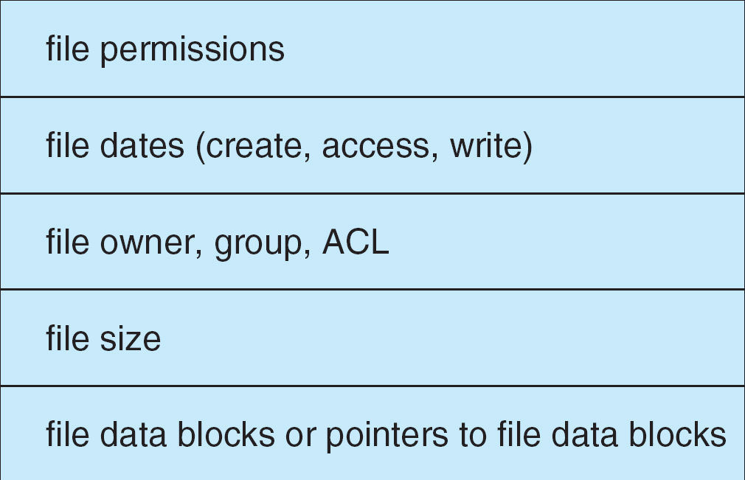
File control block
File control block – storage structure consisting of information about a file
Page <number>

Slide 15
Overview (Cont.)
The in-memory information is used for both file-system management and performance improvement via caching
  Mount table contains information about each mounted volume
  Directory-structure cache holds the directory information of recently accessed directories
  System-wide open-file table contains a copy of the FCB of each open file
  Per-process open-file table contains a pointer to the appropriate entry in the system-wide open-file table
Page <number>

Slide 16
In-Memory File System Structures
The following figure illustrates the necessary file system structures provided by the operating systems.
Figure 11-3(a) refers to opening a file.
Figure 11-3(b) refers to reading a file.
Page <number>

Slide 17

In-Memory File System Structures
Page <number>

Slide 18
Virtual File Systems
Modern operating systems must concurrently support multiple types of file systems
  Virtual File Systems (VFS) provide an object-oriented way of implementing file systems.
  VFS allows the same system call interface (the API) to be used for different types of file systems.
  The API is to the VFS interface, rather than any specific type of file system.
Page <number>

Slide 19

Schematic View of Virtual File System
Page <number>

Slide 20
VFS in Linux
Four main object types defined
  inode object - individual file
  file object - an open file
  superblock object - an entire file system
  dentry object - an individual directory entry
For each object types, the VFS defines a set of operations that must be implemented
Every object contains a pointer to a function table, which lists the addresses of the actual functions
Page <number>

Slide 21
Chapter 11: File System Implementation
File-System Structure
File-System Implementation
Directory Implementation
Allocation Methods
Free-Space Management
Efficiency and Performance
Recovery
Log-Structured File Systems
NFS
Example: WAFL File System
Page <number>

Slide 22
Directory Implementation
Linear list of file names with pointer to the data blocks.
  simple to program
  time-consuming to execute
Hash Table – linear list with hash data structure.
  decreases directory search time
  fixed size
    collisions – situations where two file names hash to the same location
    Chained-overflow hash table
Page <number>

Slide 23
Chapter 11: File System Implementation
File-System Structure
File-System Implementation
Directory Implementation
Allocation Methods
Free-Space Management
Efficiency and Performance
Recovery
Log-Structured File Systems
NFS
Example: WAFL File System
Page <number>

Slide 24
Allocation Methods
Many files are stored on the same disk, the main problem is how to allocate space to these files so that disk space is utilized effectively and files can be access quickly
An allocation method refers to how disk blocks are allocated for files
Three major methods are in wide use:
  Contiguous allocation
  Linked allocation
  Indexed allocation
Page <number>

Slide 25
Contiguous Allocation
Each file occupies a set of contiguous blocks on the disk
Advantage
  Simple
    only starting location (block #) and length (number of blocks) are required in directory entry
  Random access
Problems
  Wasteful of space (dynamic storage-allocation problem)
  Files cannot grow
Page <number>

Slide 26

Contiguous Allocation of Disk Space
Page <number>

Slide 27
Linked Allocation
Each file is a linked list of disk blocks
blocks may be scattered anywhere on the disk
The directory contains a pointer to the first and last blocks of the file
Each block contains a pointer to the next block
Page <number>

Slide 28

Linked Allocation
Page <number>

Slide 29
Linked Allocation (Cont.)
Advantage
  Simple – need only starting and ending pointers
  Free-space management system – no waste of space
  File can grow
Disadvantage
  No random access
  Pointers occupy storage space
    Pointer – 4bytes, block-512bytes 0.78%
  Reliability – a pointer were lost or damaged
File-allocation table (FAT) – disk-space allocation used by MS-DOS and OS/2.
Page <number>

Slide 30

File-Allocation Table
End of file
Page <number>

Slide 31
Indexed Allocation
In the absence of FAT, linked allocation cannot support efficient direct access, since the pointer to the blocks are scattered with the blocks themselves all over the disk
Indexed allocation brings all pointers together into the index block.
Each file has its own index block
The directory contains the address of the index block
Page <number>

Slide 32

Example of Indexed Allocation
Page <number>

Slide 33
Indexed Allocation (Cont.)
Need index table
Support direct access
Without suffering from external fragmentation
Suffer from wasted space
Page <number>

Slide 34
Indexed Allocation (Cont.)
How large the index block should be?
We want the index block to be as small as possible, however, it will not be able to hold enough pointers for a large file
A mechanism will have to be available to deal with this issue.
Page <number>

Slide 35
Linked Scheme
Page <number>

Slide 36
Multilevel Index

outer-index
index table
file
Page <number>

Slide 37

Combined Scheme: UNIX (4K bytes per block)
Page <number>

Slide 38
Chapter 11: File System Implementation
File-System Structure
File-System Implementation
Directory Implementation
Allocation Methods
Free-Space Management
Efficiency and Performance
Recovery
Log-Structured File Systems
NFS
Example: WAFL File System
Page <number>

Slide 39
Free-Space Management
Bit vector (n blocks)
0
1
2
n-1
…
1 ⇒ block[i] free
0 ⇒ block[i] occupied
bit[i] =

Block number calculation
(number of bits per word) *
(number of 0-value words) +
offset of first 1 bit
Page <number>

Slide 40
Free-Space Management (Cont.)
Bit map requires extra space
  Example:
block size = 2¹² bytes
disk size = 2³⁰ bytes (1 gigabyte)
n = 2³⁰/2¹² = 2¹⁸ bits (or 32K bytes)
Easy to get contiguous files
Page <number>

Slide 41

Linked Free Space List on Disk
Linked list (free list)
  Cannot get contiguous space easily
  No waste of space
Page <number>

Slide 42
Chapter 11: File System Implementation
File-System Structure
File-System Implementation
Directory Implementation
Allocation Methods
Free-Space Management
Efficiency and Performance
Recovery
Log-Structured File Systems
NFS
Example: WAFL File System
Page <number>

Slide 43
Efficiency and Performance
Efficiency dependent on:
  disk allocation and directory algorithms
  types of data kept in file’s directory entry
Performance
  disk cache – separate section of main memory for frequently used blocks
  free-behind and read-ahead – techniques to optimize sequential access
  improve PC performance by dedicating section of memory as virtual disk, or RAM disk
Page <number>

Slide 44
Page Cache
A page cache caches pages rather than disk blocks using virtual memory techniques
Memory-mapped I/O uses a page cache
Routine I/O through the file system uses the buffer (disk) cache
This leads to the following figure
Page <number>

Slide 45
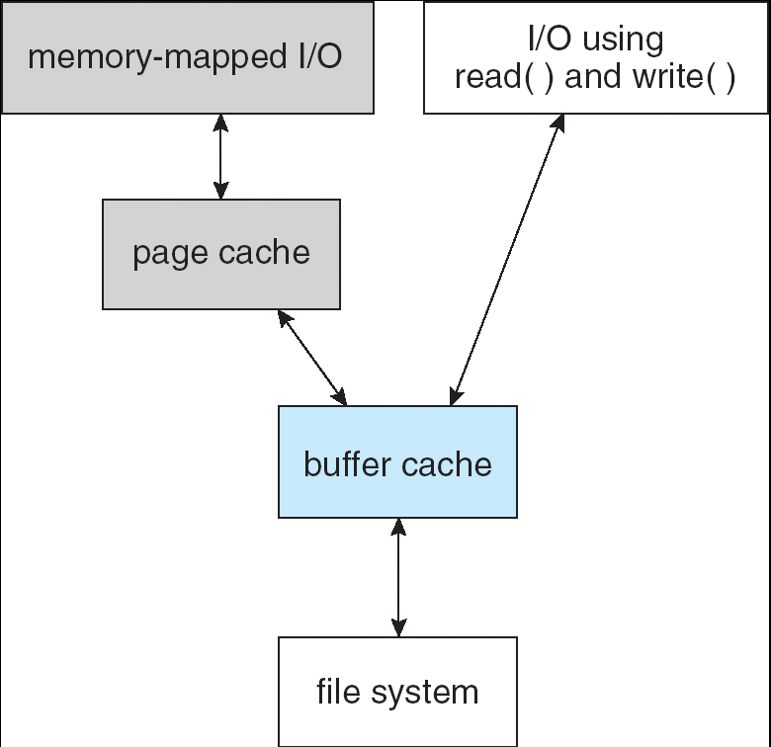
I/O Without a Unified Buffer Cache
Page <number>

Slide 46
Unified Buffer Cache
A unified buffer cache uses the same page cache to cache both memory-mapped pages and ordinary file system I/O
Page <number>

Slide 47
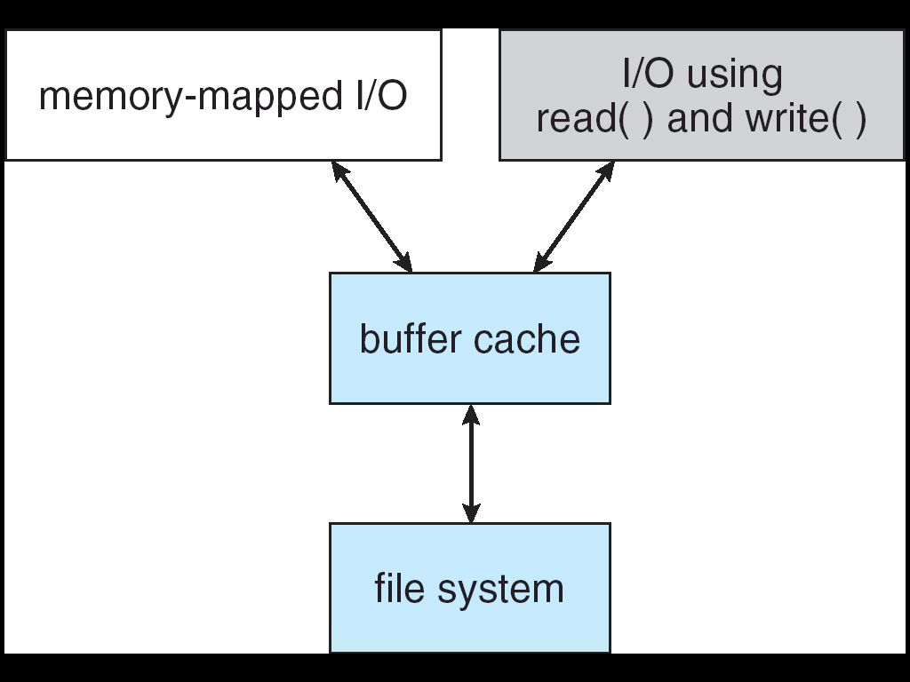
I/O Using a Unified Buffer Cache
Page <number>

Slide 48
Chapter 11: File System Implementation
File-System Structure
File-System Implementation
Directory Implementation
Allocation Methods
Free-Space Management
Efficiency and Performance
Recovery
Log-Structured File Systems
NFS
Example: WAFL File System
Page <number>

Slide 49
Recovery
Consistency checking – compares data in directory structure with data blocks on disk, and tries to fix inconsistencies
Use system programs to back up data from disk to another storage device (floppy disk, magnetic tape, other magnetic disk, optical)
Recover lost file or disk by restoring data from backup
Page <number>

Slide 50
Log Structured File Systems
Log structured (or journaling) file systems record each update to the file system as a transaction
All transactions are written to a log
  A transaction is considered committed once it is written to the log
  However, the file system may not yet be updated
The transactions in the log are asynchronously written to the file system
  When the file system is modified, the transaction is removed from the log
If the file system crashes, all remaining transactions in the log must still be performed
Page <number>

Slide 51
The Sun Network File System (NFS)
An implementation and a specification of a software system for accessing remote files across LANs (or WANs)
The implementation is part of the Solaris and SunOS operating systems running on Sun workstations using an unreliable datagram protocol (UDP/IP protocol and Ethernet)
Page <number>

Slide 52
NFS (Cont.)
Interconnected workstations viewed as a set of independent machines with independent file systems, which allows sharing among these file systems in a transparent manner
  A remote directory is mounted over a local file system directory
    The mounted directory looks like an integral subtree of the local file system, replacing the subtree descending from the local directory
  Specification of the remote directory for the mount operation is nontransparent; the host name of the remote directory has to be provided
    Files in the remote directory can then be accessed in a transparent manner
  Subject to access-rights accreditation, potentially any file system (or directory within a file system), can be mounted remotely on top of any local directory
Page <number>

Slide 53
NFS (Cont.)
NFS is designed to operate in a heterogeneous environment of different machines, operating systems, and network architectures; the NFS specifications independent of these media
This independence is achieved through the use of RPC primitives built on top of an External Data Representation (XDR) protocol used between two implementation-independent interfaces
The NFS specification distinguishes between the services provided by a mount mechanism and the actual remote-file-access services
Page <number>

Slide 54

Three Independent File Systems
Page <number>

Slide 55
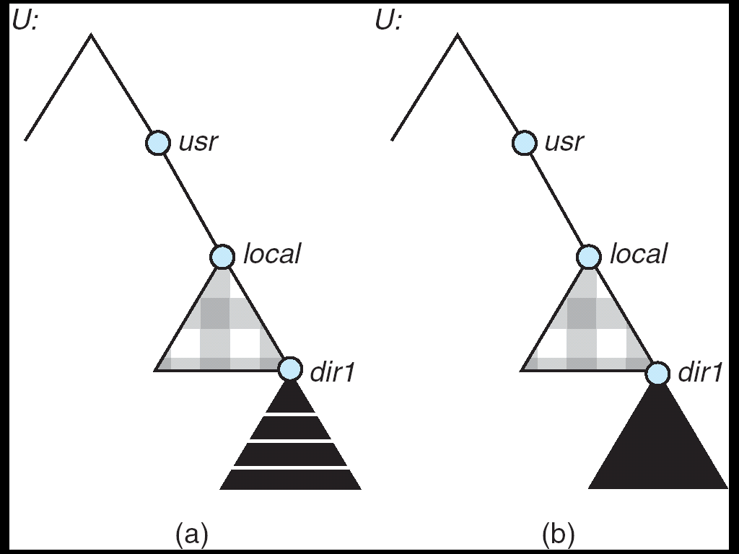
Mounting in NFS
Mounts
Cascading mounts
Page <number>

Slide 56
NFS Mount Protocol
Establishes initial logical connection between server and client
Mount operation includes name of remote directory to be mounted and name of server machine storing it
  Mount request is mapped to corresponding RPC and forwarded to mount server running on server machine
  Export list – specifies local file systems that server exports for mounting, along with names of machines that are permitted to mount them
Following a mount request that conforms to its export list, the server returns a file handle—a key for further accesses
File handle – a file-system identifier, and an inode number to identify the mounted directory within the exported file system
The mount operation changes only the user’s view and does not affect the server side
Page <number>

Slide 57
NFS Protocol
Provides a set of remote procedure calls for remote file operations. The procedures support the following operations:
  searching for a file within a directory
  reading a set of directory entries
  manipulating links and directories
  accessing file attributes
  reading and writing files
NFS servers are stateless; each request has to provide a full set of arguments
(NFS V4 is just coming available – very different, stateful)
Modified data must be committed to the server’s disk before results are returned to the client (lose advantages of caching)
The NFS protocol does not provide concurrency-control mechanisms
Page <number>

Slide 58
Three Major Layers of NFS Architecture
UNIX file-system interface (based on the open, read, write, and close calls, and file descriptors)
Virtual File System (VFS) layer – distinguishes local files from remote ones, and local files are further distinguished according to their file-system types
  The VFS activates file-system-specific operations to handle local requests according to their file-system types
  Calls the NFS protocol procedures for remote requests
NFS service layer – bottom layer of the architecture
  Implements the NFS protocol
Page <number>

Slide 59
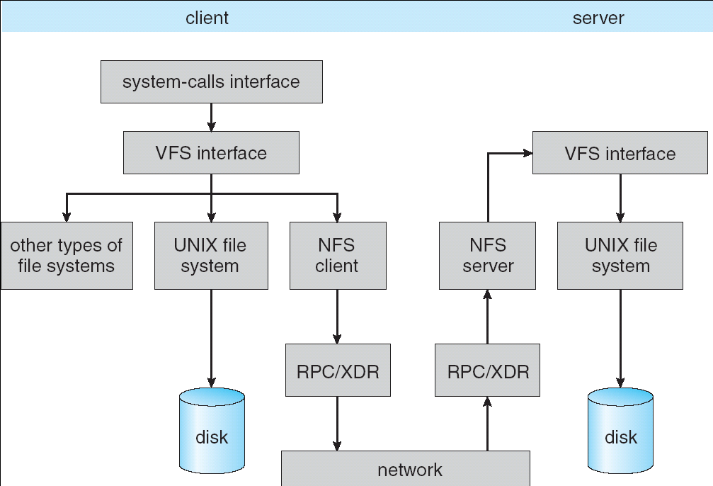
Schematic View of NFS Architecture
Page <number>

Slide 60
NFS Path-Name Translation
Performed by breaking the path into component names and performing a separate NFS lookup call for every pair of component name and directory vnode
To make lookup faster, a directory name lookup cache on the client’s side holds the vnodes for remote directory names
Page <number>

Slide 61
NFS Remote Operations
Nearly one-to-one correspondence between regular UNIX system calls and the NFS protocol RPCs (except opening and closing files)
NFS adheres to the remote-service paradigm, but employs buffering and caching techniques for the sake of performance
File-blocks cache – when a file is opened, the kernel checks with the remote server whether to fetch or revalidate the cached attributes
  Cached file blocks are used only if the corresponding cached attributes are up to date
File-attribute cache – the attribute cache is updated whenever new attributes arrive from the server
Clients do not free delayed-write blocks until the server confirms that the data have been written to disk
Page <number>

Slide 62
Example: WAFL File System
Used on Network Appliance “Filers” – distributed file system appliances
“Write-anywhere file layout”
Serves up NFS, CIFS, http, ftp
Random I/O optimized, write optimized
  NVRAM for write caching
Similar to Berkeley Fast File System, with extensive modifications
Page <number>

Slide 63
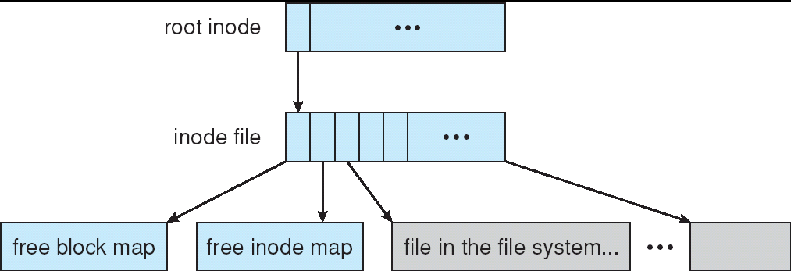
The WAFL File Layout
Page <number>

Slide 64
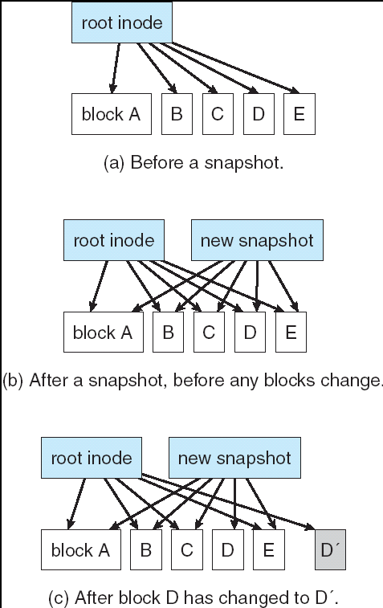
Snapshots in WAFL
Page <number>

Slide 65
Assignment
11.2, 11.3，11.6
Page <number>

Slide 66
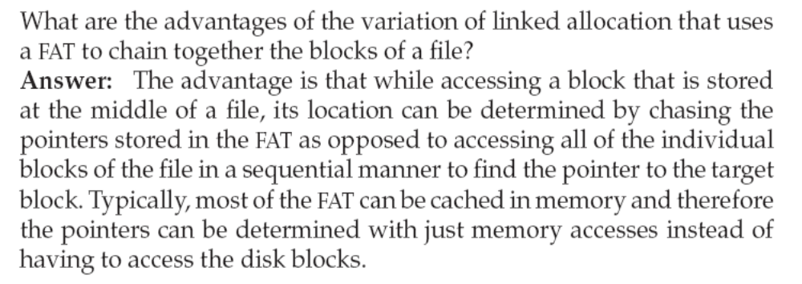
11.2
Page <number>

Slide 67
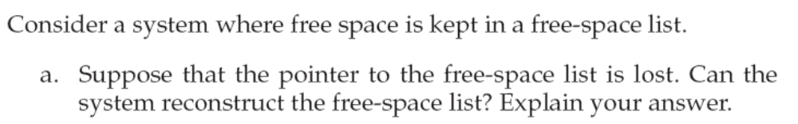
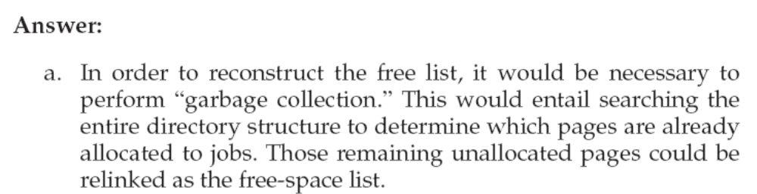
11.3
Page <number>

Slide 68
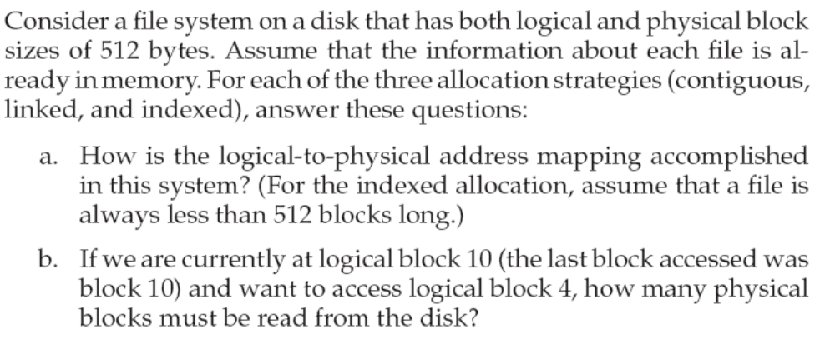
11.6
Page <number>

Slide 69
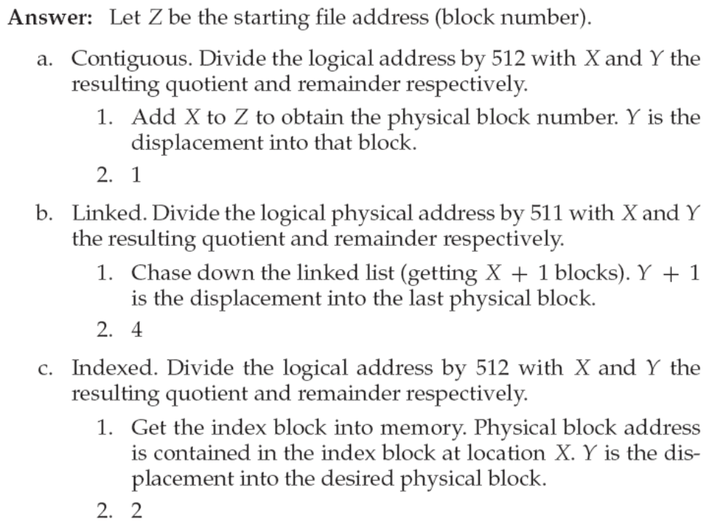
11.6 答案
Page <number>

Slide 70
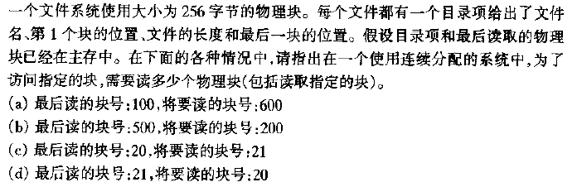
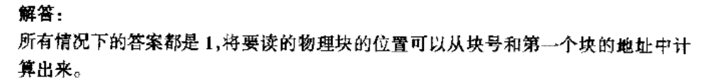
练习1
Page <number>

Slide 71
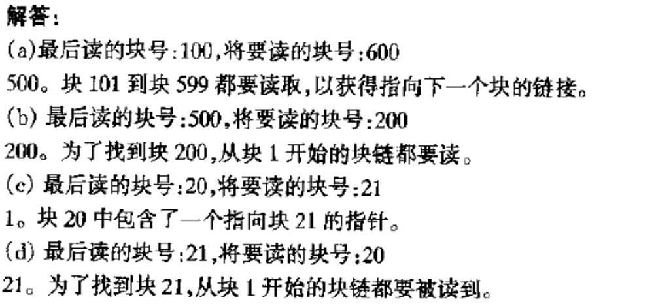
练习2
Page <number>

Slide 72

练习3
Page <number>

Slide 73
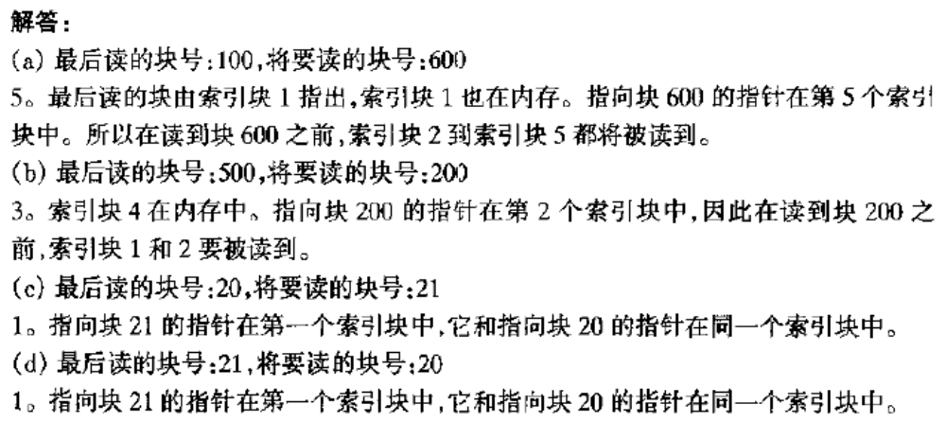
练习3答案
Page <number>

Slide 74

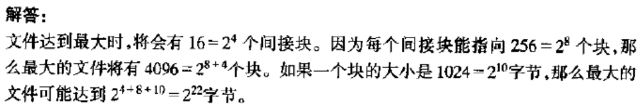
练习4
Page <number>

Slide 75
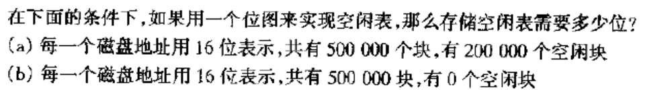
练习5
Page <number>

Slide 76
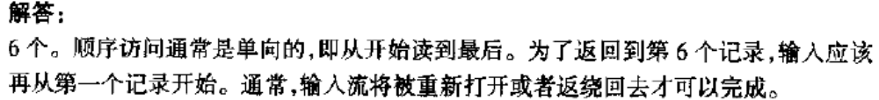
练习6
Page <number>

Slide 77
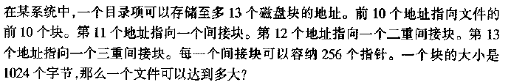
练习7
2¹⁰*（10+2⁸+2¹⁶+2²⁴）=17247250432字节
Page <number>

Slide 78
End of Chapter 11

